Slide 1
ECAR National study of students and information technology in higher education, 2011
Eden Dahlstrom, Peter Grunwald,
Tom de Boor, Martha Vockley
October 2011
Notes:
The ECAR study of undergraduate students and information technology sheds light on how IT affects the college experience. ECAR has conducted this annual study since 2004, and though students’ ownership and utilization of technology changes from year to year, students consistently rely upon their instructors and institutions to meet their technology expectations and needs. The 2011 study differs from past studies in that the questionnaire was re-engineered and responses were gathered from a nationally representative sample of 3,000 students at 1,179 colleges and universities. The sample was stratified by region, institution type, and key demographics, and results were weighted to match statistics from the National Center for Education Statistics. Despite methodological differences in the 2011 study, the student voice about information technology is heard resoundingly in the study results.

Slide 2
contents
Study Overview
Key Findings
  Technology Ownership (slides 9–13)
  Technology Use and Value (slides 14–31)
  Institutional and Instructional Technology Competencies (slides 32–40)
  Technology for Connecting and Relationships (slides 41–44)
  Online Learning (slides 45–47)
ECAR Recommendations
Source: Dahlstrom, Eden, Tom de Boor, Peter Grunwald, and Martha Vockley, with a Foreword by Diana Oblinger. The ECAR National Study of Undergraduate Students and Information Technology, 2011 (Research Report). Boulder, CO: EDUCAUSE Center for Applied Research, October 2011, available from http://www.educause.edu/ecar

Slide 3
Study overview

Slide 4
ECAR Student study, 2011
Research objectives
Assess students’ technology ownership and use
Explore how effectively instructors and institutions are using technology
Understand students’ technology skill level
Gauge students’ technology perceptions, attitudes, and preferences

Slide 5
ECAR Student study, 2011 sample
Responses from 3,000 students at 1,179 colleges and universities provided a nationally representative sample of students
Data are weighted to match statistics from the National Center of Education Statistics for the composition of college students in the United States on the following variables:
      Year (freshman, sophomore, junior, senior)
      Gender
      Age
      Region
      Major of study
      Institution type (public, private, for-profit)
      Institution size
      Institution type (4-year vs. 2-year)
      Ethnicity

Slide 6
ECAR Student study, 2011
Sample composition
Year | Percentage | N
Freshman | 21% | 640
Sophomore | 31% | 918
Junior | 25% | 760
Senior | 23% | 682
Gender
Male | 43% | 1,283
Female | 57% | 1,717
Age
18–24 | 60% | 1,802
25–34 | 23% | 709
35–44 | 9% | 259
45+ | 8% | 230
Region
Northeast | 21% | 630
South | 25% | 750
Midwest | 33% | 990
West | 21% | 630
Ethnicity
White | 66% | 1,975
Black/African American | 13% | 398
Hispanic | 11% | 344
American Indian or Alaskan native | 1% | 30
Asian/Pacific Islander | 7% | 201
Other | 1% | 37
Prefer not to answer | 2% | 65
Major | Percentage | N
Biological/life sciences | 14% | 408
Business, management, marketing | 21% | 642
Education, including physical education | 7% | 198
Engineering, including computer science | 7% | 213
Liberal arts and sciences/general studies | 11% | 342
Physical sciences, including math | 2% | 72
Social sciences | 17% | 498
Fine arts | 6% | 168
Other | 13% | 402
Undecided | 2% | 57
Institution Type
Public | 73% | 2,190
Private | 23% | 691
For-profit | 4% | 118
Enrollment
Less than 500 | 1% | 30
500 to 999 | 3% | 90
1,000–4,999 | 19% | 570
5,000–9,999 | 18% | 540
10,000–19,999 | 24% | 720
20,000 or more | 35% | 1,049
Type
A two-year or community college | 37% | 1,110
A four-year college or university | 63% | 1,890
Student Enrollment Status
Full-time | 82% | 2,459
Part-time | 18% | 541

Slide 7
Key findings

Slide 8
ECAR Student study, 2011 key findings
Students are drawn to hot technologies but rely on more traditional devices.
Students recognize major academic benefits of technology.
Students report uneven perceptions of institutions and instructors on technology.
Facebook-generation students juggle personal and academic interactions.
Students prefer, and say they learn more in, classes with online components.

Slide 9
Key finding 1 – students are drawn to hot technologies but rely on traditional devices

Slide 10
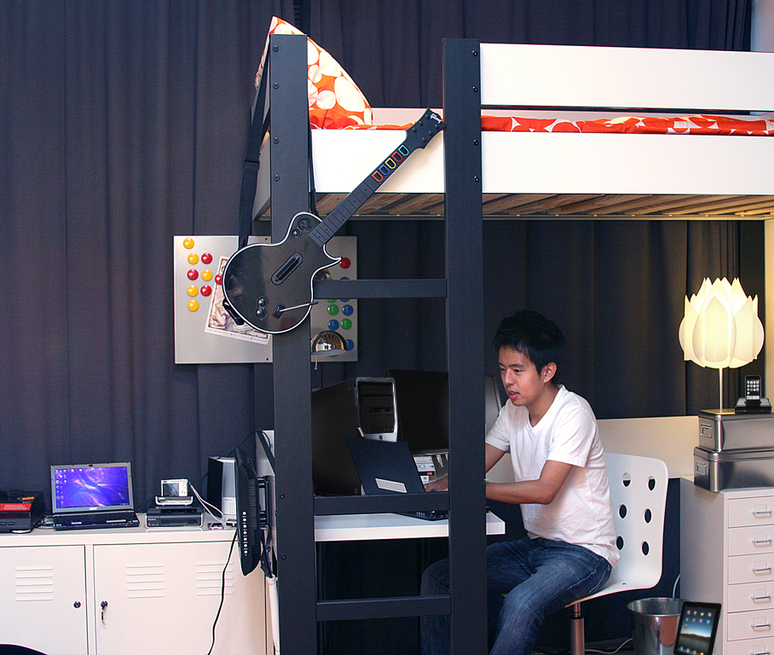

Drawn to Hot Technologies… prefer small, mobile devices
Technology Ownership
Technology | Students Own
Laptop | 87%
Printer | 81%
DVD Player | 75%
USB Thumbdrive | 70%
Wi-Fi* | 67%
Stationary gaming device | 66%
Ipod | 62%
HDTV | 56%
Smartphone | 55%
Digital Camera | 55%
Webcam | 55%
Desktop Computer | 53%
Handheld Gaming Device | 38%
Netbook | 11%
iPad | 8%
1
6
2
3
4
5
6
7
8
9
5
10
7
12
11
12
11
13
14
10
14
1
2
4
15
3
*Likely interpreted by the respondent as having access to Wi-Fi
8
9
13
Traditional age college students (18-24) and those from households of $100K+ own more technology than their counterparts.
Q1. Which of the following items do you own?
©2011 EDUCAUSE. CC by-nc-nd
15
10
Notes:
Students are still attached to “standard issue” technology. A majority of students own a printer (81%), a DVD player (75%), a stationary gaming device (66%), an HDTV (56%), and a desktop computer (53%).
Graphic depicts 15 of the 34 devices that students were asked about owning.

Slide 11
Drawn to Hot Technologies… reliant on traditional devices
Students Own
Q1. Which of the following items do you own?
Notes:
Students own many different kinds of technology devices—and their clear preference is for small, mobile devices that fit in a pocket or backpack and go with them everywhere. A majority of students own a laptop (87%), a USB thumb drive (70%), an iPod (62%), a smartphone (55%), a digital camera (55%), and a webcam (55%).
Graphic depicts all devices that students were asked about owning, with smartphone ownership aggregated into one data point.

Slide 12
Drawn to hot technologies… opinions on platform preference
Institution Preference
Student Preference
Q4b. Does your college or university officially prefer you use one computing platform over another?
Q4c. And, what is your preference? Do you prefer to use one platform over another?
Notes:
Students have a stronger platform preference (65% prefer Windows PCs) than they say their institutions do (67% say their institutions are open to any platform). Age makes a difference in undergraduates’ platform preferences. Thirty-one percent of younger students (under 25 years old) prefer Apple computers, compared to 13% of students who are 25 or older. Still, a clear majority of even younger undergraduates (58%) prefers Windows platforms.
In addition, the preference for Windows platforms is significantly higher among students attending associate’s colleges or other two-year programs than it is among those attending other institutions. Seventy-four percent of students at associate’s colleges prefer Windows PCs, compared to 59% of all other students.

Slide 13
Drawn to hot technologies…
Carnegie class differences
Students at community colleges are more likely to own stationary technologies (e.g., desktop computers and stationary gaming and video devices), particularly in comparison to students at research institutions
Students at institutions that award master’s and doctorate degrees are more likely to own portable technologies (e.g., laptops, iPods, webcams, thumb drives, and Wi-Fi devices)
Still, there are both mobile devices (e.g., iPads) and stationary technologies (e.g., HDTVs) for which no significant differences exist among students at institutions of different Carnegie Classifications.

Slide 14
Key finding 2 – students recognize major academic benefits of technology

Slide 15
Academic benefits… devices used for academics
Technology use for academics
Technology
Laptop | 85%
Printer | 79%
Desktop Computer | 63%
Wi-Fi | 60%
USB Thumbdrive | 59%
Smartphone | 37%
DVD Player | 30%
iPod | 23%
Digital Camera | 21%
HDTV | 18%
Webcam | 17%
Stationary gaming device | 12%
iPad | 12%
Netbook | 11%
Handheld Gaming Device | 7%
Students Use For Academics
Total
(Owners)
1
(92%)
12
2
(84%)
3
(78%)
4
(75%)
5
(74%)
6
(60%)
7
(33%)
8
(22%)
9
(32%)
4
10
(26%)
8
(24%)
3
11
12
(15%)
11
13
(67%)
14
9
14
(70%)
1
2
5
15
(13%)
7
( ) = use among owners
10
6
15
Traditional age college students (18-24) and those from households of $100K+ use more technology than their counterparts
Q1. Which of the following items do you own?
©2011 EDUCAUSE. CC by-nc-nd
13
15
Q2a. Regardless of whether you own it, which of the following have you used for at least one course or academic activity in the past year?
Notes:
Small, mobile devices (laptops, smartphones, iPads, thumbdrives, and netbooks) as well as traditional devices (printers, desktops, Wi-Fi access) are used for academic work.

Slide 16
Academic benefits…
Core software is central to success
Frequency of Use for School or Personal Purposes
Q5b. Thinking about the most recent school year, how often did you do the following, whether it was for school or personal purposes?
Notes:
Other than core communication tools (e-mail, text messaging, and Facebook), word processing, presentation, and spreadsheet software are the most frequently used applications for academic or personal purposes, along with the institutional library website and course or learning management system. But this core academic software is not necessarily coming out of a box; students could be using newer productivity software accessed “in the cloud” that offers more collaborative and participatory experiences (e.g., Google Docs).

Slide 17
academic benefits… students value software basics
Value of Technology to Academic Success
Percent Responding “Extremely Valuable”
Q7. How valuable are each of the following when it comes to your academic success? Please consider only your academic success when rating these technologies, not the other aspects of your life.
Notes:
Students value software/program basics for academics. Longitudinal data will provide insight into which of the these technologies are waxing and which are waning in terms of value to students.

Slide 18
Academic benefits… accessing resources and efficiency
Agreement with Statements about Academic Success
Percent Responding “Agreeing or Strongly Agreeing”
Gives me access to a wide range of resources
Makes it easy to track my academic progress
Simplifies administrative-related activities such as registering for classes, paying tuition, etc.
Helps me know how I am doing in a course
Extends learning beyond the classroom
Helps me do my work faster
Is an efficient way to store examples of my work
Allows me to produce higher quality work
Makes it easier to get help when I need it
Allows me to take control of my own learning
Makes college easier
Makes learning more creative
Better prepares me for entering the workforce
Makes learning more fun
Makes me feel more connected to what’s going on at the college/university
Makes coursework/lectures more engaging
Enables me to reach my true academic potential
Elevates the level of teaching
Gives me access to experts in my field
Makes me feel connected to professors and other college/university staff
Makes me feel connected to other students
Makes my academic experience more individualized/personalizes curriculum
Makes classes more relevant to real life
Better prepares me for getting into graduate school
Helps me think out of the box
Q12. To what extent do you agree with each of the following statements regarding technology when it comes to your academic experience?
Notes:
The major academic benefits of technology, in decreasing magnitude of students’ experience, encompass four areas.
Above all else, technology makes it easier to access a wide range of resources, track academic progress, dispense with administrative tasks, and work faster.

Slide 19








Academic benefits… four factors for academic success
Avg. Agreement with Statements
Gives Students Access to Resources and Progress Reports
Easy to track my academic progress
Helps me know how I am doing
Simplifies administrative-related activities
Gives me access to resources
Easier to get help when I need it
Makes Students More Efficient
Helps me do my work faster
Allows me to produce higher-quality work
Efficient way to store examples of work
Makes college easier
Facilitates Connecting with Others
Feel connected to other students
Feel connected to professors/staff
Feel connected to what's going on
Gives me access to experts in my field
Makes Learning More Engaging and Relevant
Learning more creative
Learning more fun
Think out of the box
Individualized/personalized
More relevant to real life
More engaging
Elevates teaching
Reach academic potential
Take control of own learning
Extends learning beyond classroom
Prepares me for the workforce
Prepares me for graduate school
Notes:
Explaining how factor analysis was used to identify benefits of technology in academic success:
A statistical technique used to reduce a large number of attributes into a smaller set of “factors” based on response patterns.
A factor consists of a number of attributes that are rated in a similar way.
Factor analysis is extremely useful when dealing with a very large number of attributes that would be cumbersome to analyze individually.
The names of the factors are subjective and are intended to describe the common theme shared by all of the attributes within that factor.

Slide 20























Academic benefits…Relationships between technologies and benefits
Access to Resources & Progress Reports
Laptop computer
Wi-Fi
Printer
Document camera
USB drive
Projector
Efficiency
Laptop
Wi-Fi
Printer
Connecting With Others
Smartphone
Internet device that attaches to TV
Digital video camera
eReader
iPad
Digital point and shoot camera
Scanner
Student clickers/
student response systems
Engagement and Relevance
Digital video
camera
Internet device that attaches to TV
Interactive
whiteboard
Digital cameras
Student clickers/
student response
systems
iPhone/
smartphone
Document
camera
Scanner
iPad
Mp3 player
DVD player
DVR
Webcam
Desktop computer
Notes:
Continuing with the factor analysis, there are relationships between selected technologies and certain benefits.

Slide 21
Academic benefits… communication tools - mass adoption
Frequency of Use for School or Personal Purposes
Q5a. Thinking about the most recent school year, how often did you do the following, whether it was for school or personal purposes?
Notes:
Overall, the average student spends at least some time engaging in about 21 different kinds of software applications and activities out of 40 they were asked about. Students use a variety of communication tools, but the most common ones have reached mass adoption.

Slide 22
Academic benefits…
A blizzard of messages
Frequent e-mail users (75% of students) send or receive an average of 25 e-mails a day.
Frequent texters (74% of students) send or receive an average of 84 text messages a day.
Frequent Facebook users (58% of students) log into and/or check Facebook 13 times a day.
Frequent Twitter users (11% of students) read or post 112 tweets a day.

Slide 23
Academic benefits…Smartphones—not just for communication
Ways Smartphones Are Used for Academic Work
(Among Users) n= 1,122
Opportunities exist for universities and students to take greater advantage of smartphone technology when it comes to administrative activities, such as ordering transcripts, purchasing textbooks, accessing financial aid information, and registering for courses.
Q11. You said you own an iPhone or smartphone. Which of the following are ways you use your iPhone or smartphone for your academic work?
Notes:
Smartphones have a variety of academic uses, not just communication.
More than one in three students (37%) have used an iPhone or another smartphone in one or more courses or academic activities in the past year. Forty-five percent of smartphone users have used these devices to look up information on the Internet in class.

Slide 24
Academic benefits…
Top Apps for Mobiles
Types of Apps Used Most For Coursework and other University-Related Activities
(Among smartphone and tablet users) n= 1,230
Q10b. Which of the following types of mobile or tablet apps do you use for coursework or other college/university-related activities? Please do not include any apps that you only use for personal, non-academic purposes.
Notes:
Top applications for mobile devices: math, language and search tools. Among smartphone and tablet users, the three types of applications used most for coursework and other institution-related activities are calculators or mathematical equations (selected by 52%), dictionaries or thesauruses (49%), and search tools (43%). One in five students (20%) use these devices for foreign language or translation apps.

Slide 25







Academic benefits…The one website students can’t live without
36%
3%
2%
2%
2%
11%
8%
An additional 88 websites/online resources were mentioned by less than 2% of the sample.
Q15. When it comes to your success as an undergraduate, what is one website or online resource you couldn’t live without?
Notes:
The one website students can’t live without when it comes to academic success.

Slide 26
Academic benefits…
Value Anytime, anywhere access
Value of Technology for Academic Success
Percent Responding “Extremely Valuable”
(Among users and those whose instructors use)
N = bases vary
Wi-Fi access is instrumental to student success, and students want access from everywhere
on campus.
Q4a. And, how valuable are each of the following when it comes to your academic success, (whether it’s your own personal device, or something your instructor or university uses as a part of your academic experience)? Please consider only your academic success when rating these technologies, not the other aspects of your life.
Notes:
Laptops and Wi-Fi connectivity are the most valued technologies to students, along with other computing devices (desktops and netbooks) and accessories (printers, USB thumbdrives or portable hard drives, and projectors).

Slide 27
Academic benefits…Technologies valued align with instructors’ use
Instructors’ Use
There is a wide range of technologies with potential educational benefits that aren’t being used yet.
Q2b. You’ve told us about all the different kinds of technological devices you own and use for academic work. Now tell us, which of the following your instructors used to teach, mentor and communicate with you in the past year?
Notes:
There is a strong correlation between the technologies students value most and the technologies their instructors use—and use effectively—to teach, mentor, and communicate. For academic purposes, students tend to most highly value the technologies that they see their instructors using—and using “extremely effectively,” including laptops, Wi-Fi, printers, USB thumb drives or portable hard drives, and desktop computers.
The three devices most used by instructors in the classroom are projectors, laptops, and desktop computers, with 69%, 67%, and 65% of students reporting their instructors use these technologies, respectively. These three technologies, along with Wi-Fi (which 44% of students report their instructors use) and printers (which 42% of students report their instructors use), top students’ perceptions in terms of those that their instructors use most effectively as well.

Slide 28
Academic benefits…
Many lack confidence in their skills
Student Technology Skill Level
Percentage Responding 4 or 5 “My skill level meets my needs” (out of 5)
Q6. How comfortable do you feel with your ability to use each of the following?
Notes:
A surprising number of students say they are not fully confident that they have the technology skills to meet their needs. This applies to core as well as more specialized applications. Nearly one-third of students (32%) say their skills using a course or learning management system, which is intended to facilitate academic life for students and instructors, aren’t where they believe they should be.
At the same time, there apparently is substantial interest in relatively sophisticated uses of technology, including programming languages, audio-creation software, e-portfolios, geotagging and geotagged environments, and video-creation software.

Slide 29
Academic benefits…
E-Mail hits the top of wish list
Wish Instructor Used More Often
Why Students Say
they Want “More”
(From open-end responses)
E-mail
Course or learning management system
E-books or e-textbooks
Presentation software
Online forums or bulletin boards
Online chats, chat events, webinars
College/university library website
Web-based videos
Freely available course content
Video-sharing websites
Word processors
Podcasts and webcasts
Text message
Spreadsheets
Facebook
Tagging/bookmarking/liking
Simulations or educational games
Blogs
Wikis
Web-based citation/bibliography tools
Social studying sites
Instant message
Telephone-like communication over the Internet
Graphics software
Video-creation software
Online multi-user computer games
Programming languages
E-portfolios
Web-based music
"I wish instructors e-mailed more so that students and teachers could communicate easier, faster, and more efficiently."
"Blackboard makes viewing things in your class easier and more convenient."
"E-books are cheaper than regular hardbound textbooks, easier to carry around, and more accessible all the time."
"I find PowerPoint presentations easy to follow & understand."
*Only items mentioned by at least 5% of students are shown
Q8A. Which things do you wish your instructors used more?
Notes:
E-mail hits the top of students’ wish list for what instructors should use more.

Slide 30
Academic benefits…Carnegie differences in technology value
Students in community colleges are generally less likely to engage in many technology applications and activities than students at institutions of other Carnegie Classifications.
Students in community colleges tend to find non-core technologies more valuable than do students in doctoral-granting institutions. These technologies include multi-user games, educational simulations and games, speech recognition software, and, to a lesser extent, virtual worlds, geotagging, and graphics software.
Notes:
Still, neither group (community college students and students at doctoral institutions) feels strongly about these applications, with fewer than a third saying that any of them are academically valuable.

Slide 31
Academic benefits…Carnegie Differences in technology value
Across a broad range of technologies, students at institutions that award doctorate degrees are more comfortable with their skills than students at community colleges and, in many cases, students in institutions that award bachelor’s and master’s degrees.
Students at institutions that award doctorate degrees tend to find a number of core communication, course, and social networking tools more valuable than their counterparts in community colleges.
Notes:
These core tools in DRs include e-mail, LinkedIn, wikis, learning or course management systems, presentation software, word processors, and bibliographic tools.
Still, neither group feels strongly about these applications, with fewer than a third saying that any of them are academically valuable.

Slide 32
Key finding 3 – students report uneven perceptions of institutions and instructors on technology

Slide 33
uneven perceptions of technology… Effective, frequent, and seamless use
The strongest predictors of how students rate their institution in its use of technology
  their instructors’ effective use of technology
  their instructors’ use of technology frequently enough
  the seamless integration of technology into their courses
These three predictors alone accounted for approximately 54% of the variance in students’ perceptions of their institution’s effectiveness in using technology.
Notes:
How well are institutions and instructors doing on these predictors of students’ perceptions? Fifty-five percent of students agree that their instructors use technology effectively (and 22% strongly agree), compared to 12% who disagree. Fifty-seven percent of students agree that their instructors use technology frequently enough (and 20% strongly agree), compared to 11% who disagree. Forty-six percent agree that technology is seamlessly integrated into their courses (and 19% strongly agree), compared to 15% who disagree.

Slide 34
Uneven perceptions of technology…
No magic bullets
Students at institutions rated as highly effective in the use of technology say they engage in about as many software activities as their peers and that their instructors use about the same number of devices in their coursework.
There are no significant differences between students’ frequency of use of most software applications at institutions rated effective and less effective in their use of technology.
Virtually no high or even moderate correlations exist between individual technologies and any of the major academic benefits of technology described earlier.
Differentiating technologies, where they exist, often are mundane (e.g., printers, spreadsheets, even USB thumb drives).
Notes:
Differentiating technologies, where they exist, often are mundane (e.g., printers, spreadsheets, even USB thumb drives) and tend to fall into these categories: portable/mobile devices; devices designed for classroom use; core academic and productivity software; and basic social networking and communications software and services.
Students at institutions rated as highly effective in the use of technology say they engage in about as many software activities as their peers and that their instructors use about the same number of devices in their coursework.
There are no significant differences between students’ frequency of use of most software applications at institutions rated effective and less effective in their use of technology.
Virtually no high or even moderate correlations exist between individual technologies and any of the major academic benefits of technology described earlier.
Differentiating technologies, where they exist, often are mundane (e.g., printers, spreadsheets, even USB thumb drives).

Slide 35
Uneven perceptions of technology…
Delivery of basic online services
Institutional Performance in Online Delivery of Services
Percentage rating 4 or 5 (out of 5)
Service Not Offered | Service Not Used
1% | 2%
-- | 1%
1% | 6%
4% | 7%
1% | 7%
6% | 11%
Q16. How would you rate your college/university with regards to the following online services?
Notes:
Students in associate’s colleges and other two-year programs are more likely to rate their institutions highly than other students in providing online textbook sales and some basic technology services, including online course registration and access to grades.
On the other hand, students at doctoral institutions are more likely than students at associate’s colleges to generally agree that their institutions do a good job in these areas: offering library resources online, providing online transcripts, and providing financial aid information online.
When only the perceptions of students who have actually used these services in their institutions are considered, these results are even more favorable. The percentages of these students who rate their institutions as excellent or good on providing basic services are as follows: 88% for online registration, 82% for online grades, 80% for online library resources, 79% for online transcripts, 76% for online financial aid information, and 64% for online textbooks sales.

Slide 36
Uneven Perceptions of technology… value vs. effective use
Used Most Effectively
by Instructors
Technology valued most and used most effectively by professors
Projector
average
Document camera/
digital overhead projector
Wi-Fi
Desktop computer
Laptop computer
Printer
Interactive whiteboard
USB drive
Internet-ready TV
Digital SLR camera
Netbook
Valued Least for Academic Success
Valued Most for Academic Success
mp3 player
HDTV
Windows phone
average
DVD player
Internet device that attaches to TV
Flip video camera
Other tablet
Clickers/response systems
Smartpen
Scanner
Webcam
Blackberry
eReader
Digital Point and Shoot
Digital video camera
Android
iPod
Other Smart Phone
iPhone
iPad
Other Mobile / Cell Phone
Used Least Effectively
by Instructors
Items with Ns below 45 are not included on this chart.
Q3. How effectively did your instructors use these technologies to teach, mentor and communicate with you in the past year?
Q4a. And, how valuable are each of the following when it comes to your academic success?
Notes:
Students who rate their instructors as highly effective in their use of technology are significantly more likely to agree that technology delivers substantial benefits to their academic experience. These benefits include basic access to resources and information, simpler administrative activities, and increased productivity. These benefits extend to more transformative learning experiences, such as extended learning beyond the classroom; better preparation for the workforce; more creative, engaging and fun experiences; and the capacity to reach their true academic potential.
Not surprisingly, students at doctoral institutions believe that they are experiencing more of technology’s benefits.

Slide 37
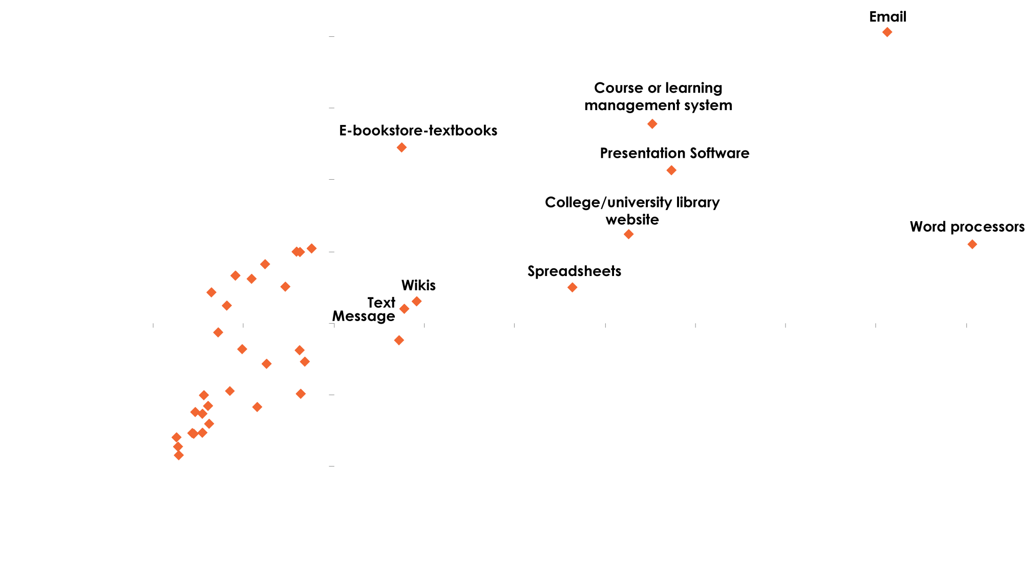
Uneven Perceptions of technology…
Software value vs. wished used more
Most Wish Instructor Used More
1ST priority
Highly valued technologies students wish instructors used more
average
Web-based videos
Video-sharing websites
Online chats, events,
webinars
Online forums or bulletin boards
Podcasts and webcasts
Freely available course content
Simulations or
educational games
Facebook
VALUE LEAST
Tagging/bookmarking/liking
Blogs
Graphics
Software
Web-based
citation/bibliography tools
average
VALUE MOST
Social studying sites
Telephone – like communication over internet
Instant Message
Online multi-user computer
Programming languages
E-Portfolios
Web-based music
Twitter
Photo-sharing websites
Audio-creation software
Online virtual worlds
Linked In
Geo-Tagging
Internet content via TV
Other social
networking websites
Speech recognition software
Note: Students may value creative technologies less in an academic context because their instructors don’t model their use.
Least Wish Instructor Used More
Items with Ns below 45 are not included on this chart.
Q7. How valuable are each of the following when it comes to your academic success?
Q8A. Which things do you wish your instructors used more?

Slide 38
Uneven perceptions of technology… instructors use “typical” technology
Instructors’ Effective Use of Technology
Percentage responding “extremely effectively”
(Among those whose instructors use), n=base sizes vary
Q3. How effectively did your instructors use these technologies to teach, mentor and communicate with you in the past year?
Notes:
Overall, students say their instructors use presentation devices effectively, but devices that inspire interactivity and participation, not so much.
Students report that projectors, Wi-Fi, laptops, desktops, and document cameras or digital overhead projectors are devices that instructors use “extremely effectively” to teach, mentor, or communicate—and these are generally the technologies that students also value highly. More personal technologies, such as e-readers, iPads, smartphones, and student response systems (clickers) are not used as effectively, students say. That students do not consider student response systems as more effectively used is notable, given that this technology is designed specifically for instructional support, as opposed to other, general-purpose devices.
Successful teaching with technology is like a coin, with obverse and reverse sides together constituting the whole. Successful instructors combine technology (obverse) with targeted pedagogical activities (reverse). Managing diverse technologies and weaving them all into a coordinated pedagogy is a challenging business requiring diverse expertise. As demonstrated by students’ lackluster response to student response systems (clickers), there are opportunities to inspire student participation and interactivity with existing technology, but the technology by itself isn't sufficient and doesn't guarantee successful learning outcomes.
Instructors at associate’s colleges and other two-year programs are significantly less likely to use a wide variety of technologies in class, students say. Devices that instructors at two or more other institutional types are significantly more likely to use than associate’s college instructors include laptops, projectors, Wi-Fi, student response systems, document cameras, USB thumb drives, interactive whiteboards, smartphones, webcams, iPads, and digital and Flip video cameras.
Notably, however, for the technologies that associate’s college instructors do use, students say those instructors often use those technologies more effectively. These include desktop computers, laptop computers, webcams, scanners, printers, projectors, and interactive whiteboards. In fact, instructors at other institution types do not use any devices more effectively than associate’s college instructors do, according to students.

Slide 39
Uneven perceptions of technology… opportunities for improvement
Agreement with Statements about Technology
Strongly Agree
Strongly Disagree
My institution uses the technology it has effectively
I know more about how to use technology than my professors
My instructors use technology frequently enough
Technology makes professors better at their job
My institution needs more technology
Technology is integrated seamlessly into my courses
My instructors use technology effectively
My instructor requires help to get technology up and running
Instructors don’t know how to use technology that is available
Q13. And how much do you agree with each of the following statements about technology, as it relates to your college experience?
Notes:
Students in associate’s colleges are significantly less likely to feel they know more about technology than their professors, that their instructors don’t know how to use the technology that is available, or that their instructors need help from others to get technology up and running.

Slide 40

Uneven perception of technology…
Technology assistance opportunities
Professors should be able to actually use the technology that is available to them. Many of my professors must enlist the help of students to get the technology up and running which wastes valuable class time.
I hate that when you actually need the technology to work at our school, it never does.
The campus needs a more reliable Wi-Fi connection, available everywhere. It's gone out repeatedly and there always seems to be new bugs every month!
I'd like them to use Blackboard to give us more resources outside the classroom, to post grades, and to have discussions outside the classroom. The tools are all there, but they're not used.
Professors can utilize emails a lot more to inform the class of important announcements.
I would like if my college had more up-to-date technology.
Videoconferencing and webcams could and should be more widely used. The technology is widely available and is easy to use, and can help bring these online classes to life and give the teacher more influence over their material.
Make the technology more integrated to the learning environment and use more than just PowerPoint.
Finding some way to make eBooks more widely available to students would be amazing.
Q14. Please describe in as much detail as you can how your college/university or professors could use technology better when it comes to providing you with the best possible college and learning experience. Please mention any additional technology that you think would be beneficial to your education, or ways to make current technology use more effective.

Slide 41
Key finding 4 – facebook-generation students juggle personal and academic interactions

Slide 42
Juggle interactions… social network use—not universal
Social Networking Activities Students Do At Least Once a Month
Q19. Do you do any of the following activities on a regular basis (by “regular” we mean at least once a month)?
Notes:
The vast majority of students use social network sites (including 58% who report using Facebook several times a day). Students at associate’s institutions use Facebook less frequently than other students, but nearly half (49%) still use it multiple times a day. In contrast, only 32% of students participate in online forums or bulletin boards at least once a month, while 24% say they participate in online chats, chat events, and webinars that often.
Associate’s college students are generally more inclined to keep their academic and social lives separate and are less comfortable using Facebook to talk about coursework, although nearly half (49%) are comfortable with this. This may be a function of the demographics of these institutions: older, part-time, and lower-income students are all less comfortable using Facebook to talk about coursework than associate’s college students in general.

Slide 43
Juggle interactions… use facebook to communicate
Agreement with Statements about Social Networking
Students are comfortable communicating with other students on Facebook about academics; however, they prefer their communication with instructors to be more formal (using email for this
purpose instead).
Q20. How much do you agree with the following statements about the use of social networking sites such as Facebook in conjunction with your learning?
Notes:
Twelve percent of students say Facebook is “extremely valuable” to their academic success—and one in four students (25%) consider it “valuable” or “extremely valuable.”
A majority of students (58%) say they are comfortable using Facebook as a way to communicate and connect with other students about coursework. Some students draw a line between their academic and social lives, with 30% saying they “strongly agree” that they like to keep them separate.

Slide 44
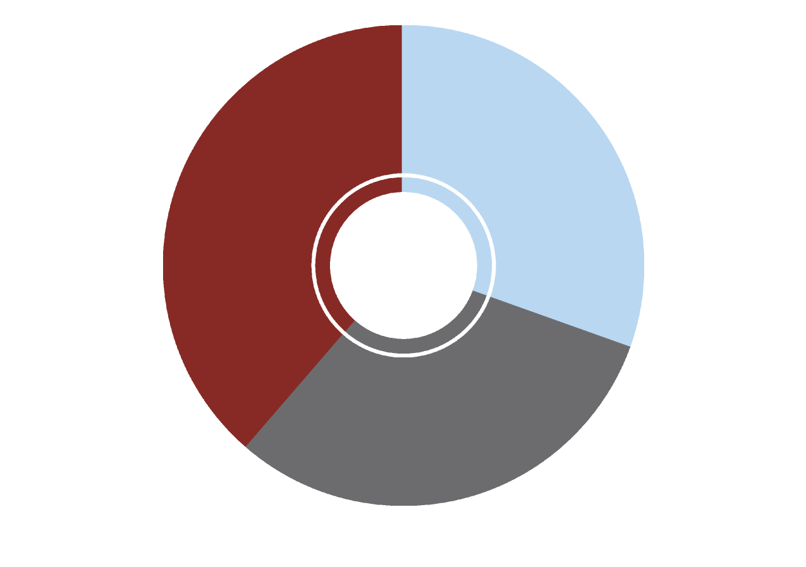
Juggle interactions…
“friending” by an instructor?
Appropriateness of Teacher or Professor “Friending” You for Academic Purposes
Not Appropriate
39%
Appropriate
31%
Neutral
30%
Q21. Let’s say a teacher or professor wanted to “Friend” you for academic purposes. Is that appropriate?
Notes:
At the same time, while students were not asked about the appropriateness of Facebook interactions with instructors if the students initiated the “friending,” 15% say they wish their instructors used Facebook more often.

Slide 45
Key finding 5 – students prefer, and say they learn more, in classes with online components

Slide 46
Students prefer online components… blend traditional and online
Preferred Learning Environment
Q17. What type of learning environment do you generally prefer?
Notes:
Over half (52%) of students report preferring some form of blended learning, with another 22% reporting they want flexibility for as much or as little online components they need. One in seven reported wanting no online components in their academic coursework, and one in ten students prefer coursers offered completely online.

Slide 47
Students prefer online components… Mixed signals about online-only
Does an online course have the same educational value as an in-person course?
Does your institution offer exclusively online courses?
Have you taken a course entirely online?
(Among those whose institutions
offer online courses)
n=2,395
Online courses provide equal value
Age
<25 23%
25+ 40%
Live
on-campus 18%
off-campus 33%
Taken an online course
Yes 45%
No 12%
Q18b. Generally speaking, do you believe a course taken only online provides an equal educational value compared with a course taken in person in a classroom, or not?
Q18c. Does your institution offer any courses for which the instruction takes place exclusively in an online environment, or not?
Q18d. Have you ever taken a course entirely online?
Notes:
Face-to-face (F2F) context is still very powerful and meaningful for students. Online learning environments are evolving, for the better, to accommodate students as social beings. For example, there is an emergence of more effective presentation of material and of better ways to facilitate discussion and collaborative work. Institutions are even developing ways to conduct science labs in online environments. These instructional techniques are being optimized in online educational venues. Also under development are techniques for intelligent tutoring and the deployment of learning analytics that will provide additional tools to monitor student progress and success in the near future. The online learning environment is starting to come into its own, and this will influence student perception of taking courses online in the future. Rather than obviating F2F learning, the improvements in the online learning environment will be of great benefit as they are incorporated into blended learning models.

Slide 48
Ecar recommendations

Slide 49
Recommendations
Investigate your students’ technology needs and preferences, and create an action plan to better integrate technology into courses and help students access institutional and academic information from their many and diverse devices and platforms.
Provide professional development opportunities and incentives so that instructors can make better use of the technology they have and feel more comfortable with the technologies students find more engaging and relevant.

Slide 50
Recommendations, cont.
Expand or enhance students’ involvement in technology planning and decision making.
Nail the basics. Help faculty and administrators excel at supporting students’ use of core productivity software and applications for academic use, including, e-mail, word processing, spreadsheets, content or learning management systems, library sites, and bibliography tools.

Slide 51
Recommendations, cont.
Meet students’ expectations for anytime, everywhere, Wi-Fi access on the devices they prefer to use.
Make more and better use of technologies that students value—and those that are easily integrated into learning experiences in the shared environments in higher education (e.g., tablets, smartphones, student response systems or clickers). In many cases, these are the technologies that distinguish highly rated from less highly rated institutions on the effective use of technology today.

Slide 52
Recommendations, cont.
Meet students’ expectations for joining the consumer migration to e-content.
Establish/refine social media policies utilizing information about how your students use social media to enhance their educational experience.
Use technology in more transformative ways, such as participatory and collaborative interactions and for higher-level teaching and learning that is engaging and relevant to students’ lives and future plans. Use technology more to extend learning beyond the classroom.

Slide 53
Recommendations, cont.
Give students different options for interacting with the institution and with instructors, including “standard” and more forward-leaning options. Leverage the value that students find in instructional relationships, using face-to-face, online, and blended strategies.
Move strategically toward blended/hybrid learning environments to meet students’ preferred styles of learning. Offer many different ways for students to engage in learning using technology and meet differentiated needs (e.g., for different student populations and preferences, academic disciplines, and coursework).

Slide 54
For more information
ECAR National Study of Students and Information Technology in Higher Education, 2011
http://www.educause.edu/library/ERS1103
Eden Dahlstrom
ECAR Senior Research Analyst
edahlstrom@educause.edu

