Slide 1
ACTI Data Management Working Group – Status Report
January 10, 2012
Judy Caruso, Mike Fary, Jina Choi Wakimoto

Slide 2
Overview of DM Group
Members
Vijay Agarwala, Penn State
Phillip Berres, Univ of Southern California
Judy Caruso UW-Madison
Tom Dopirak, Carnegie Mellon
Mike Fary, Univ of Chicago
Curtis Hillegas, Princeton
Courtney Jones, Kennesaw State
William Labate, UCLA
Clifford Lynch, CNI
Mairead Martin, Penn State
Donald McMullen, Univ of Kansas
Kim Owen, North Dakota State
Jina Choi Wakimoto, Univ of Colorado
Steve Wilcox, UW-Madison

Slide 3
Team Started in late Fall 2011
Focusing on emerging challenges to how institutions manage large online data collections, be they the product of research or the product of administrative processes. There are technological challenges stemming from the interactions among cloud options broadening access requirements, and the sheer size of datasets, and policy challenges stemming largely from agency requirements and privacy concerns. The group identifies issues in this area and seeks to provide solutions to problems through the development of white papers, best practices, case studies, presentations and other means.

Slide 4
Team Agenda
Generated list of issues/areas
Just getting started – everything up for discussion

Slide 5
2012 Agenda
Decided on 4 areas for 2012:
Research Data Management Plans: Prelim planning done by Mike Fary and Kim Owen
Implementation of Research Data Management – Institutional Infrastructure: Prelim planning done by Judy Caruso and Jina Choi Wakimoto
Data storage – on hold
Emerging technologies – on hold

Slide 6
Data Management Plans

Slide 7
"Science is becoming data-intensive and collaborative…Researchers from numerous disciplines need to work together to attack complex problems; openly sharing data will pave the way for researchers to communicate and collaborate more effectively.”
Ed Seidel
Acting Assistant Director
NSF Mathematical and Physical Sciences Directorate

Slide 8
"Twenty-first century scientific inquiry will depend in large part on data exploration. It is imperative that data be made not only as widely available as possible but also accessible to the broad scientific communities.”
José Muñoz
Acting Director
Office of Cyberinfrastructure

Slide 9
Federal Funding Agency Requirements
The Office of Management and Budget (OMB)Circular A-110 provides the federal administrative requirements for grants and agreements with institutions of higher education, hospitals and other non-profit organizations.
In 1999 Circular A-110 was revised to provide public access under some circumstances to research data through the Freedom of Information Act (FOIA).

Slide 10
NSF DMP Requirements (Mandatory ~ effective date January 18, 2011)
For example…
“Proposals must include a supplementary document of no more than two pages labeled ‘Data Management Plan.’ This supplement should describe how the proposal will conform to NSF policy on the dissemination and sharing of research results…”
Fastlane will not permit submission of a proposal that is missing a DMP

Slide 11
DMP Elements as suggested by NSF
Type of data
Standards to be applied for format, metadata content, etc.
Project storage: provisions for archiving and preservation
Access policies and provision for re-use of data
Long-term plans for transition or termination of data
Specific requirements may apply for individual Directorates.

Slide 12
Data Storage
Shared | Archive
Private
Inter-Institutional
Intra-institutional

Slide 13
Data Lifecycle & Associated Services
Data Services &
Resources
HPC & Visualization
Rights & Restrictions
Data Storage
Data Curation & Preservation
Grant Writing & Planning
Identifying Partners
Data Management Planning
Data Collection
Data Sharing
Data Analysis
Publication
Data Processing

Slide 14
Data Management Planning Service
Data Services &
Resources
HPC & Visualization
Rights & Restrictions
Data Storage
Data Curation & Preservation
Grant Writing & Planning
Identifying Partners
Data Management Planning
Data Collection
Data Sharing
Data Analysis
Publication
Data Processing

Slide 15
Data Management Planning Service
Consultations
Policies
Training
DMP Tool: Tool for creating data management plans; developed by California Digital Library

Slide 16
Components of the Program
Outreach/awareness campaign
Consulting with research community, IT, and Library
Ongoing education and new developments
Development of protocols and policies
Metrics

Slide 17
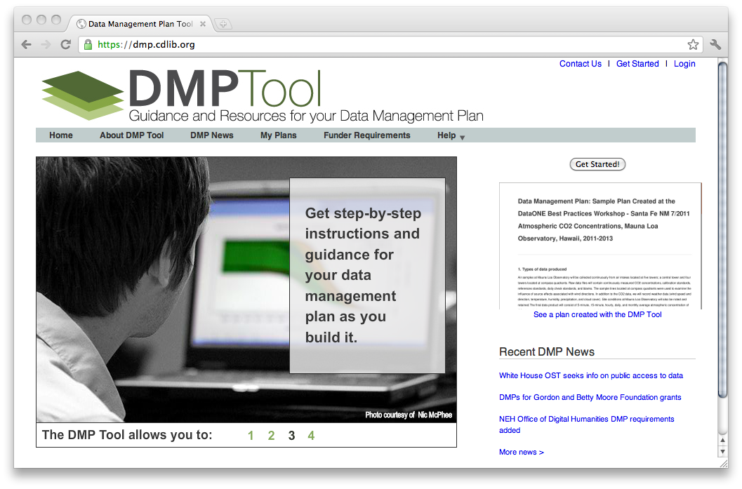
https://dmp.cdlib.org/

Slide 18
Next Steps
Create consulting group
Process for ingestion of requests for help
DMP tool vs. In house templates
Submission of DMP with proposal
Special skills for different disciplines
Identify funding/resources for the service

Slide 19
Implementation of Research Data Management – Institutional Infrastructure
Focus on institution’s internal operations
5 areas:
Infrastructure planning, governance and policy
Data definition, access and securing data
Technological services
Campus collaboration
Researcher support
Notes:
A sound technological and organizational infrastructure for research data is essential for ensuring successful implementation of research data plans at the institution. Research data is multiplying rapidly not only with “big” data but with “small science” data. Institutional policies need to be developed and data management service areas and the responsible parties for those areas need to be identified. Successful stewardship of research data will depend on collaboration among experts across the institution.
There is no “one-size fits all” business model for all institutions – these are 5 areas that Judy and I thought of as common issues to start the conversations.

Slide 20
Infrastructure Planning, Governance and Policy
Includes
Definition of research data
Governance of funding, IT infrastructure, architecture, strategies and initiatives
Creation and/or extension of policies
Strategic planning
Data stewardship
And more…
Notes:
Definition of research data (i.e., what is covered in the policy, e.g., types, formats etc.)
Governance of funding, IT infrastructure architecture, strategies, and initiatives
Creation and/or extension of policies such as audit policy, storage, sensitive data handling, data sharing, authorization and authentication, legal compliance and ethical standards, and intellectual property
Policies re: Retention and archiving of research data
strategic planning for developing a framework for research data stewardship
Shared services issues: funding, organization, administration, governance, support, policies and processes
Establishing priorities and funding models (resource allocation for infrastructure, not only IT architecture and but also for data services)
Data stewardship responsibilities and data standards (e.g., PI responsibilities and institution responsibilities)

Slide 21
Data definition, access, and securing data
Defining the data lifecycle for research data
Identify/classifying: are there sensitive data?
Authentication/authorization
Metadata management and development of best practices
Discipline specific metadata standards
Identifying data volume and expected growth
Big data issues – storage, processing, archive
And more….
Notes:
Data lifecycle – defining the data lifecycle for research data, as mentioned earlier
Identifying/classifying research data – is there sensitive data?
Authentication/authorization for access to research data
Current data management models and how to migrate to the future
Metadata management and development of best practices to facilitate sharing of data across discipline
As well as Considering Discipline specific metadata standards
Identifying data volume and expected growth
Big data issues – a major concern
Data reuse for additional research, i.e., making it searchable and accessible for reproducibility

Slide 22
Technological services
Data storage services – institution provides centrally? Provided locally?
Data backup and recovery services
Discipline specific repositories
Establishing metrics and measuring service delivery
Data analysis services
And more….
Notes:
Data storage services – what services can the institution provide centrally? What needs to be provided by the PI?
Data backup and recovery services – what services can the institution provide centrally? What needs to be provided by the PI?
Data analysis services – what services can the institution provide centrally?
What services does the institution provide for Discipline-specific repositories, if any?
What services are provided through Institutional repository (technologies/tools, e.g., Data Conservancy, etc.)
Establishing metrics and measuring service delivery
Data sharing services
Long-term data preservation (file formats for long-term access)

Slide 23
Campus Collaboration
Engaging all stakeholders – researchers, grant admin, records mgmt, archives, libraries, IRB, legal, etc.
Determining responsible parties
And more…
Notes:
Engaging all the stakeholders including researchers, grant administration, records management, archives, legal, IRB, library, IT, Research computing, etc.
Stakeholders – primary and secondary – primary being responsible parties, secondary being parties to consult with.
Campus collaboration with data curation throughout the data lifecycle
Big data issues – storage, processing, archive

Slide 24
Researcher support
Technical and analytical support
Training for PIs/researchers
Direct support of PI research (virtualization, data mining, statistic analysis)
Notes:
Technical and analytical support
Training for PIs and researchers
Direct support of PI research (virtualization data mining, statistic analysis)
Report “Digital Research Data Sharing and Management” published recently by The National Science Board’s Committee on Strategy and Budget Task Force on Data Policies

Slide 25
Overall questions/issues
What are the overlaps with other ACTI groups?
What are the issues re. local vs. national discipline repositories?
What are the issues re. HPC vs. archival storage?
Are there legal aspects of where data resides?
How does cloud storage play?

