Slide 1
ACTI-OCI working group
Optimizing Computing Infrastructure
Working Group Status Report
Robin Ying
Jan 10, 2012

Slide 2
ACTI-OCI working group
The ACTI-OCI group was created in recognition of the increasing demand for centralized efficiency and economy in higher education, and the growing consolidation of IT infrastructure and services as a means of achieving that goal.

Slide 3
ACTI-OCI working group
The group will look to develop methodologies, recommendations, best practices, and other materials intended to guide campuses looking to consolidate their IT infrastructure.

Slide 4
ACTI-OCI working group
Formed in October, 2011, the OCI Work Group had 5 conference calls:
10/5/2011
11/3/2011
11/17/2011
12/1/2011
12/15/2011
Notes:
Summarizing about 5 hours or work …

Slide 5
ACTI-OCI working group
As a starting point, ACTI-OCI will be focusing on optimization by integration (e.g., through the centralization of IT services), including how that plays out both with various parties on campus as well as when dealing with external vendors.

Slide 6
ACTI-OCI working group
Mission & Scope:
The OCI Working Group will look at the consolidation of IT infrastructure on campuses for both research and administrative computing. New technology has created new opportunities for centralized efficiency and economy, while retaining departmental control/autonomy. By looking at specific issues inherent in consolidation, the group will develop methodologies, recommendations, best practices, and other materials intended to guide campuses looking to consolidate their IT infrastructure.

Slide 7
ACTI-OCI working group
Focusing on:
Defining “optimization”
Addressing differences between administrative, academic (teaching/learning), and research computing
Working with entities internally versus externally
Collecting use cases
Welcoming more members to join the group
Notes:
Administrative/Academic/Research Computing:
What are the main areas of computing?
What do these areas have in common?
What are the special needs for each area?
What issues need to be considered (e.g. governance) when dealing with computing divisions on a campus? (an LMS might cross over various areas)
Internal/External:
What different strategies and practices to employ?
Contractual obligations?

Slide 8
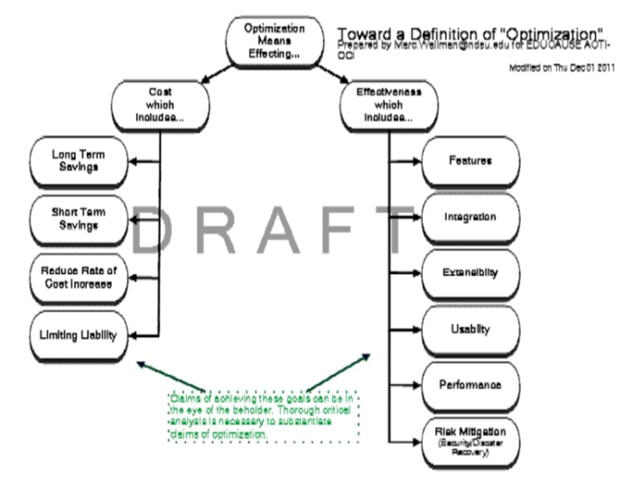
ACTI-OCI working group
Notes:
Marc Wallman of North Dakota State U.

Slide 9
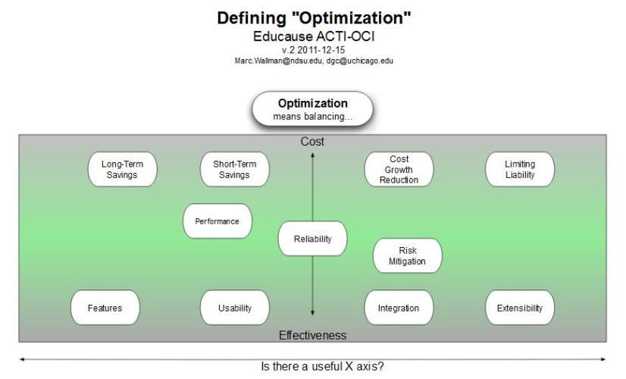
ACTI-OCI working group
Notes:
Marc Wallman (North Dakota State U.) and David Champion (U. of Chicago)

Slide 10

ACTI-OCI working group
Notes:
Marc Wallman (North Dakota State U.) and David Champion (U. of Chicago)

