Slide 1
The Enterprise Application Market in Higher Education
Susan Grajek, Vice President, EDUCAUSE
October 2012

Slide 2
Questions
Which applications are dominated by a handful of solution providers?
Which have an almost bewildering range of choice?
When is open source a common choice?
Which are the most frequently outsourced applications
Which applications are most likely to be managed by system offices?
What types of applications are more – and less – widespread in higher education?

Slide 3
The Data

Slide 4
The Data
2011 EDUCAUSE Core Data survey
635 colleges and universities
16 application areas
Financial
Student information
HR/payroll
Alumni/advancement/development
Library
Course/learning management (LMS)
Grants management (pre-award)
Grants management (post-award)
Facilities management
Portal
Administrative data warehouse/business intelligence
Web content management (CMS)
Faculty/staff e-mail
Student e-mail
IT service/help desk trouble ticket
Customer relationship management (CRM)

Slide 5
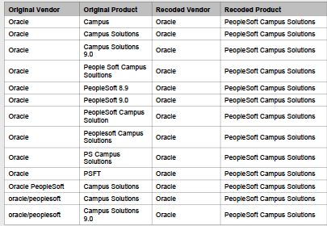
Limitations
Limited to higher education market overall.
No trends yet. This is the first year for most of these data.
Data irregularities.
Ongoing changes among vendors.
Application categories need refinement (e.g., email).

Slide 6
Trends Across Application Areas

Slide 7
Installed Based For Applications

Slide 8
Solution Diversity
Two inputs
% of market for top five solution providers
Total number of solution providers
Most homogeneous
LMS
Student information
Faculty/staff e-mail
Alumni/advancement
Most diverse
CMS
IT help desk
Facilities

Slide 9
Solution Diversity: The Long Tail

Slide 10
Open Source
Open source is most widespread in LMS and CMS
Moodle and Sakai among top 5 LMS
Drupal #2 CMS
Other open source leaders
COEUS/Kuali in grants pre-award and post-award
JASIG uPortal in Portal
RT in IT help desk

Slide 11
Homegrown
Most common for grants management (pre- and post-)
Portal
Data warehouse

Slide 12
Application Management
In-House is the most common
Across the 16 applications, median 71% of institutions manage the application in-house (ranging from 44% to 91%, depending on application type)
System office management next most common
Median 21%, ranging from 3% to 33%
Outsourced management least common
Median 7%, ranging from 2% to 43%

Slide 13
Market Shares

Slide 14
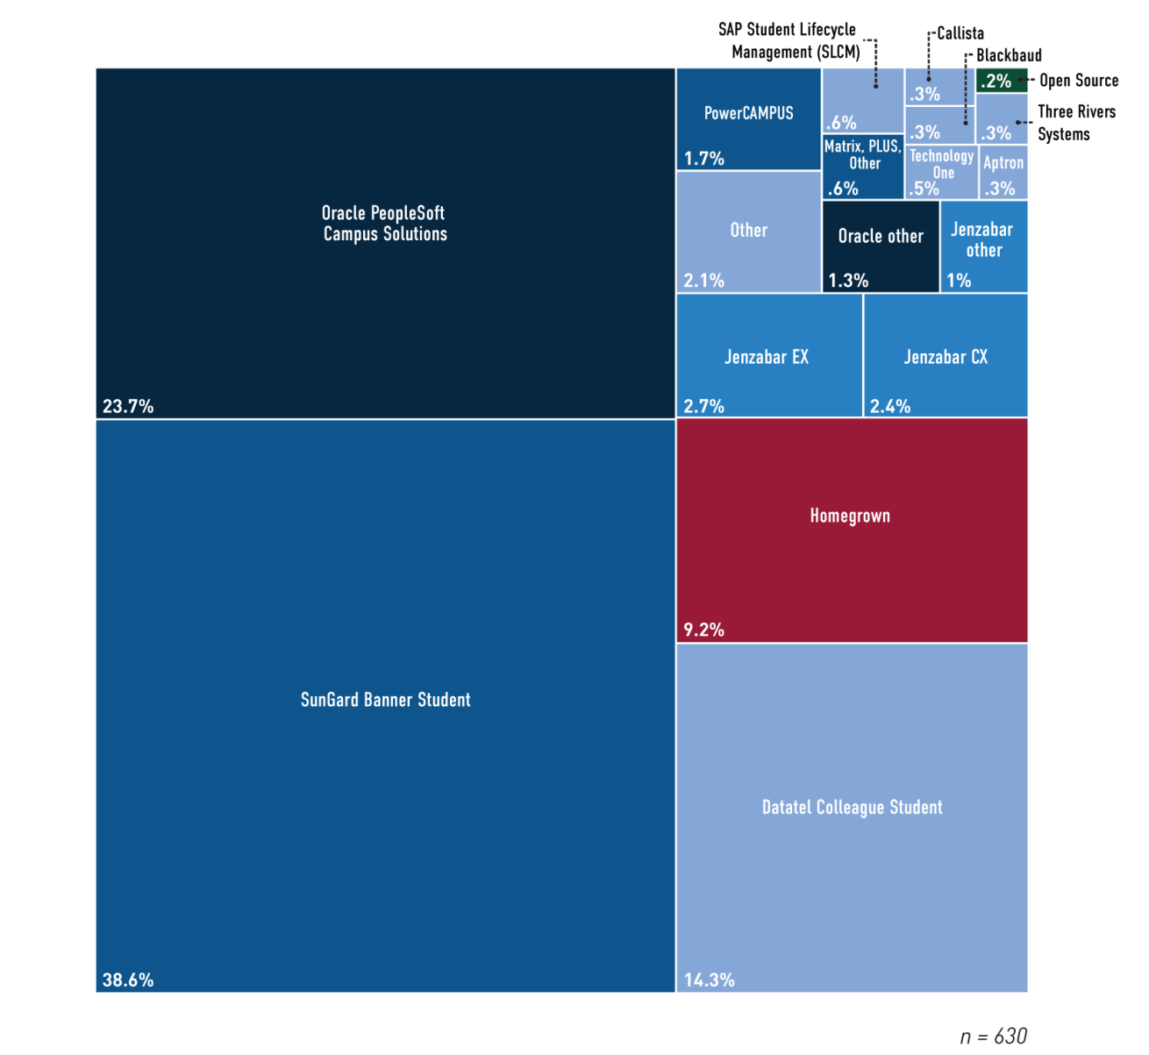
Student Information Systems
% of institutions using | 99%
% outsourced | 2%
% managed by system office | 28%
% of market owned by top 5 providers | 87%

Slide 15
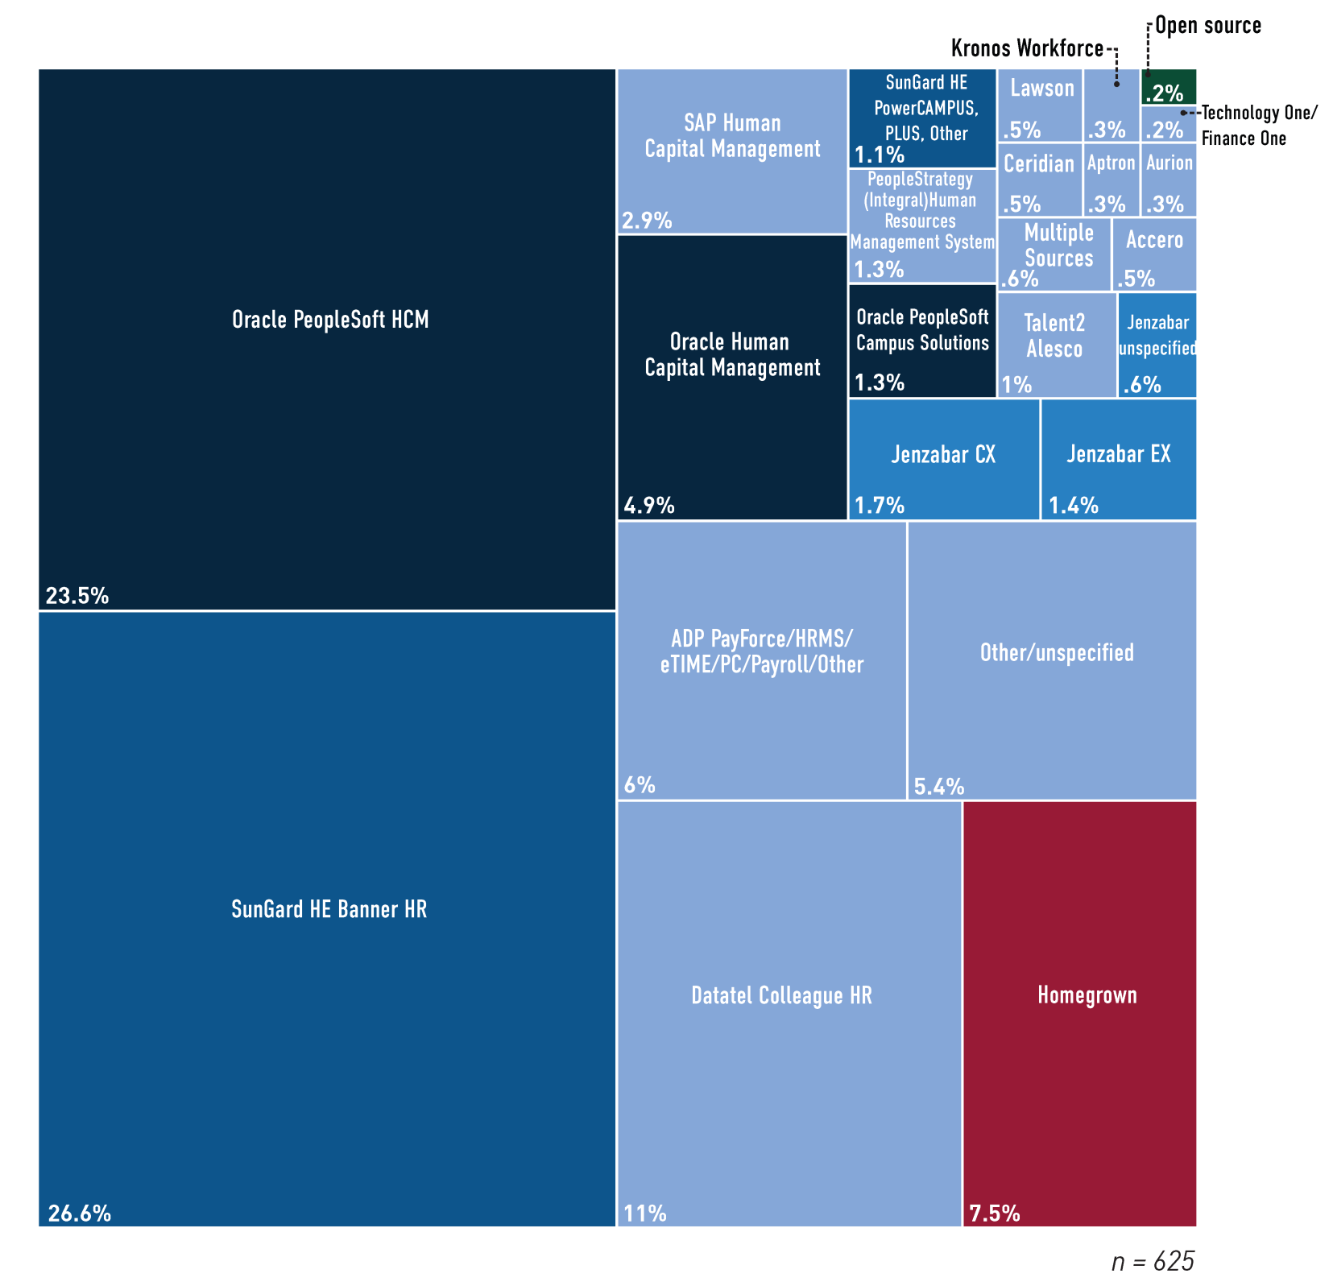
HR/Payroll
% of institutions using | 98%
% outsourced | 8%
% managed by system office | 31%
% of market owned by top 5 providers | 79%

Slide 16
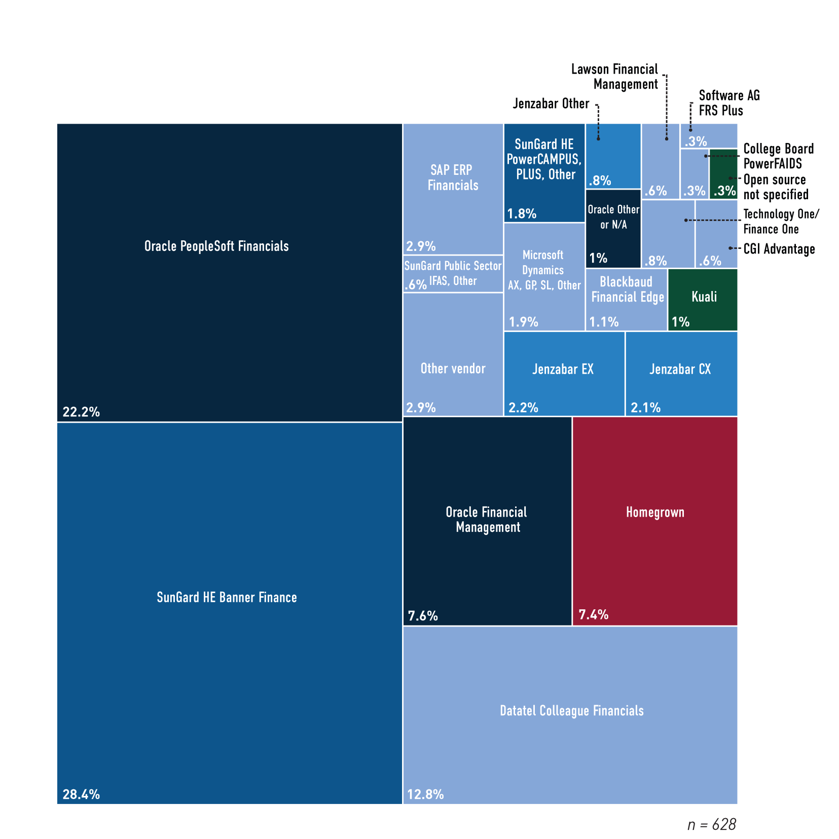
Financial
% of institutions using | 99%
% outsourced | 2%
% managed by system office | 33%
% of market owned by top 5 providers | 82%

Slide 17
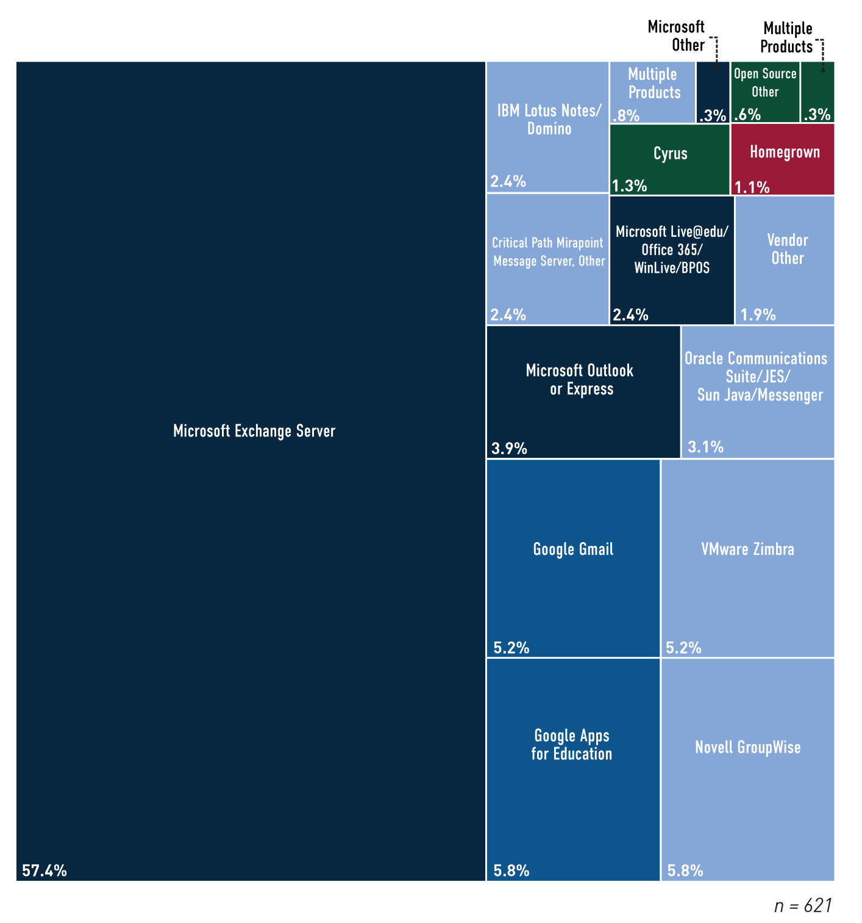
Faculty/Staff E-Mail
% of institutions using | 98%
% outsourced | 8%
% managed by system office | 8%
% of market owned by top 5 providers | 89%

Slide 18
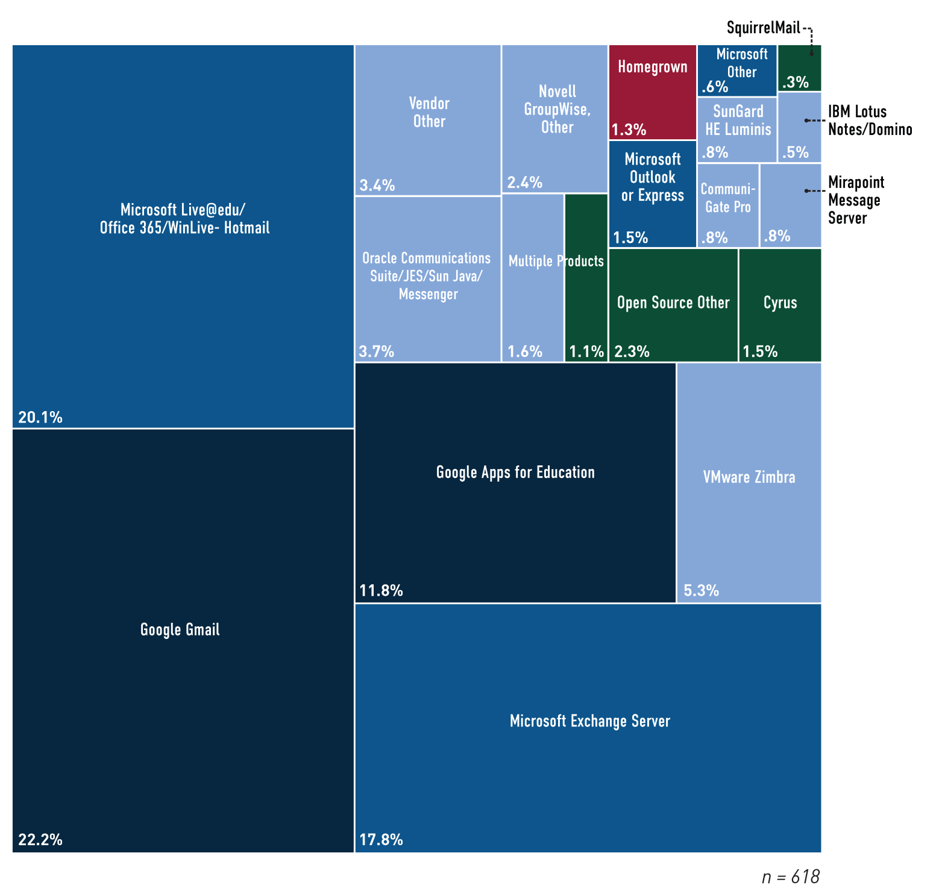
Student E-Mail
% of institutions using | 97%
% outsourced | 43%
% managed by system office | 13%
% of market owned by top 5 providers | 85%

Slide 19
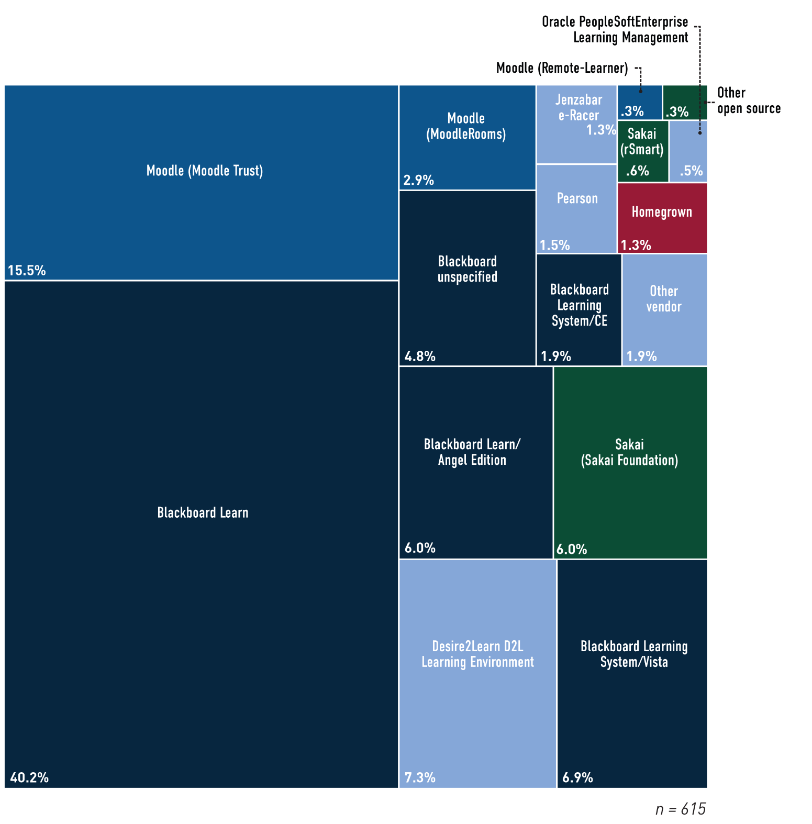
Course/Learning Management Systems
% of institutions using | 97%
% outsourced | 19%
% managed by system office | 22%
% of market owned by top 5 providers | 94%

Slide 20
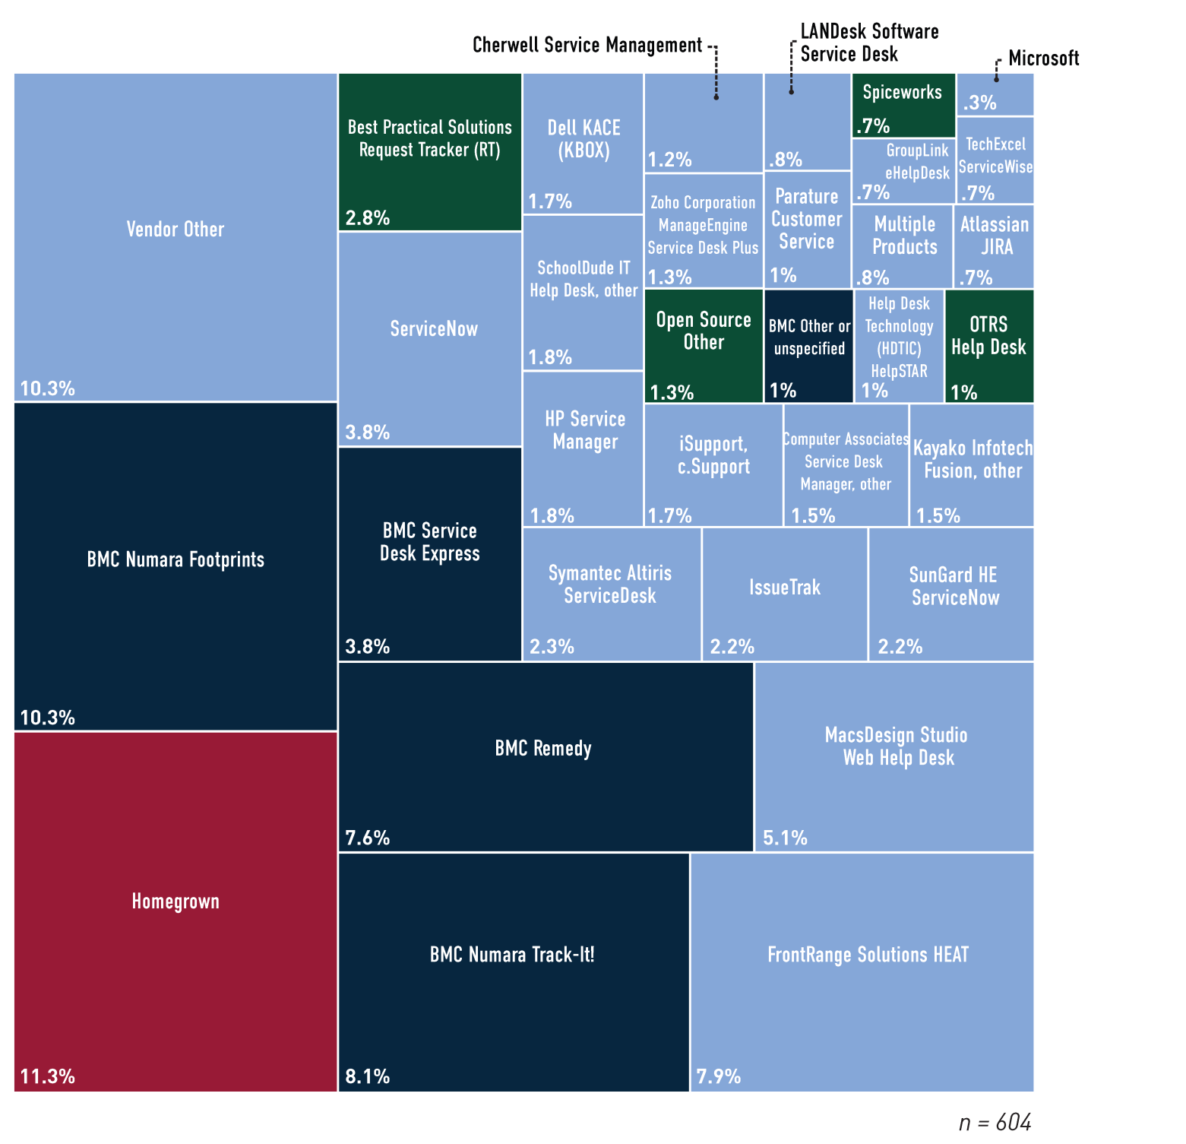
IT Service/Help Desk Trouble Ticketing
% of institutions using | 95%
% outsourced | 9%
% managed by system office | 11%
% of market owned by top 5 providers | 50%

Slide 21
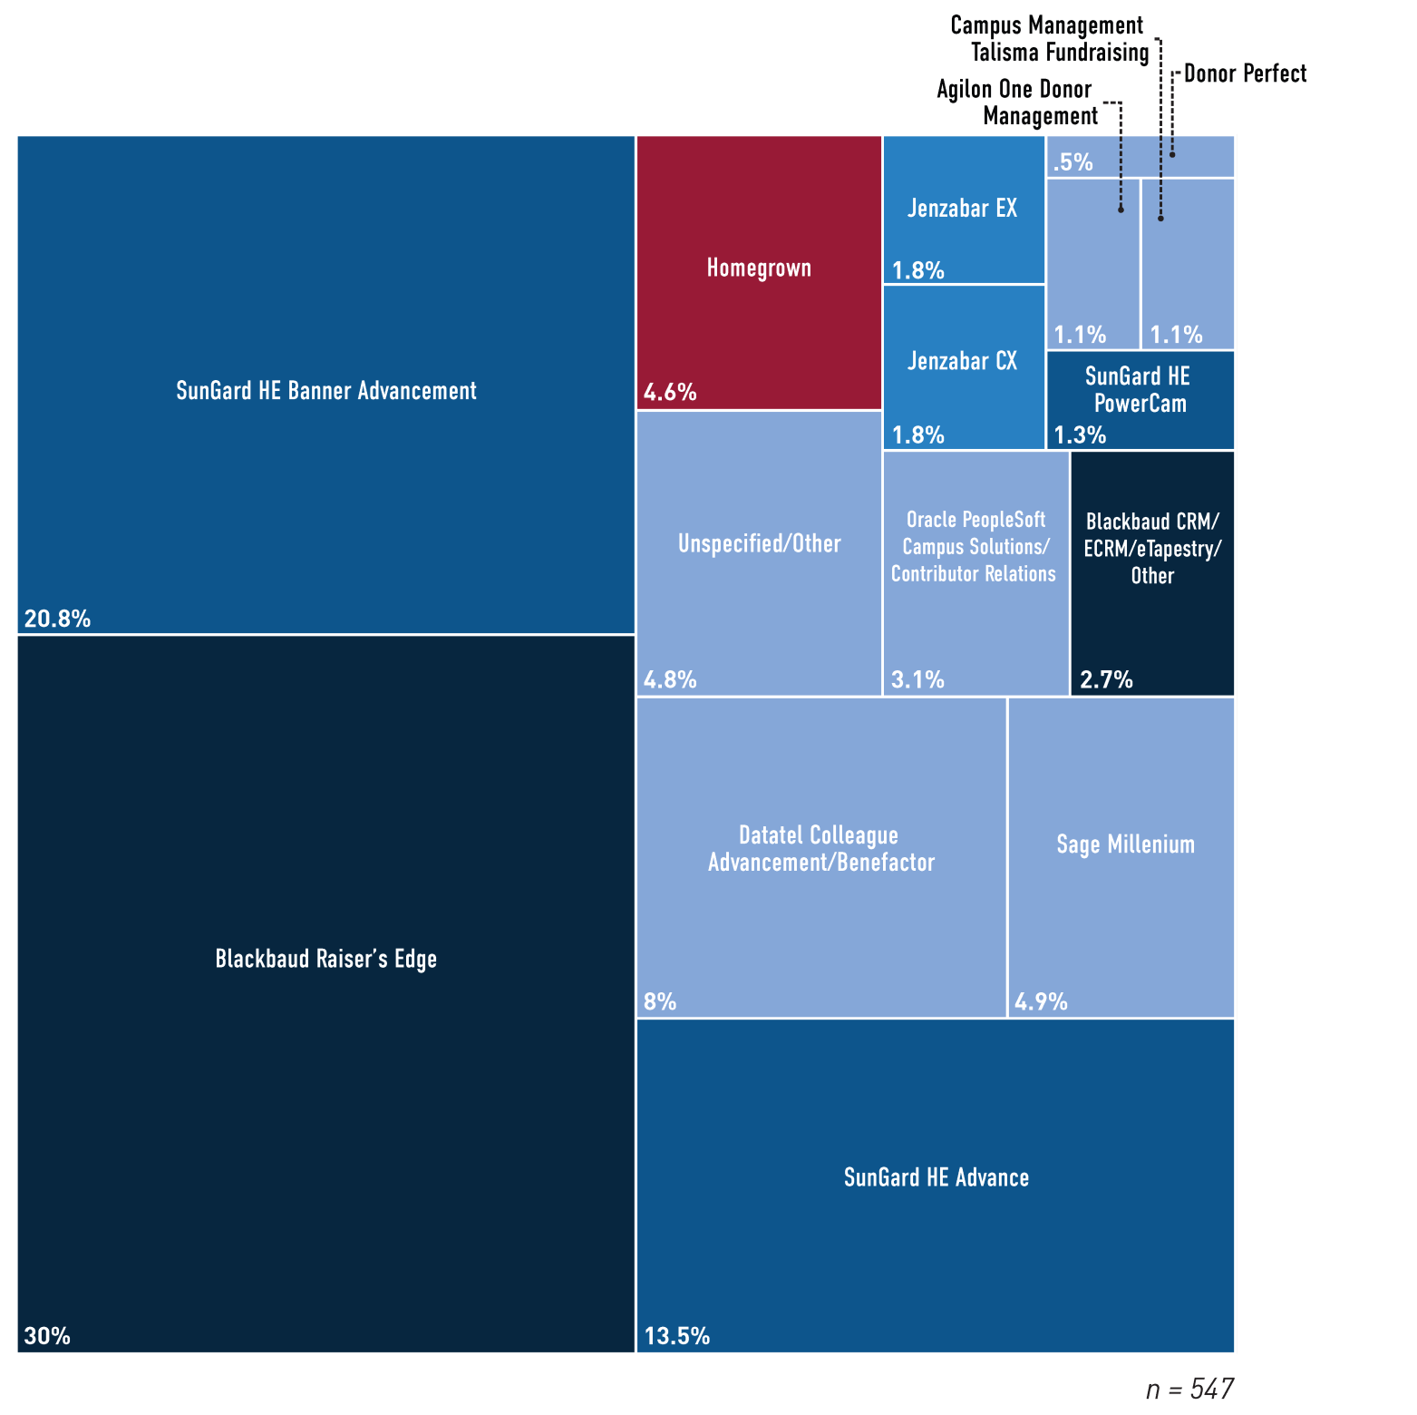
Alumni/Advancement/Development
% of institutions using | 86%
% outsourced | 5%
% managed by system office | 6%
% of market owned by top 5 providers | 85%

Slide 22
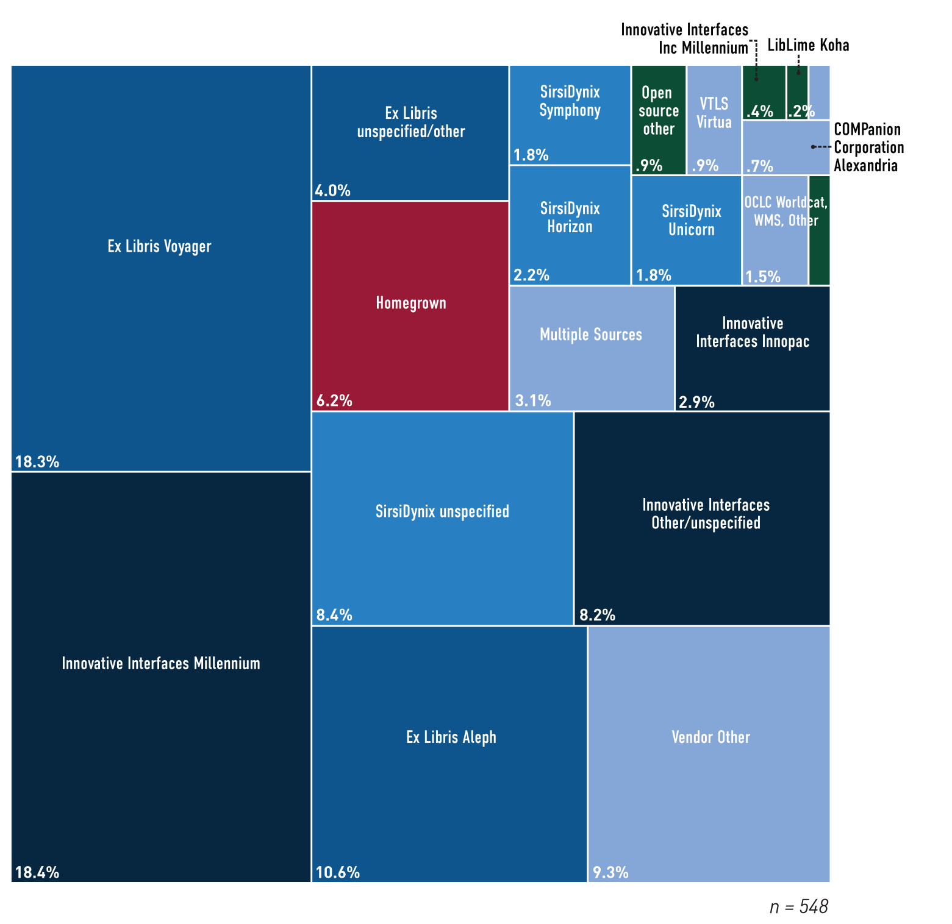
Library
% of institutions using | 86%
% outsourced | 18%
% managed by system office | 32%
% of market owned by top 5 providers | 79%

Slide 23
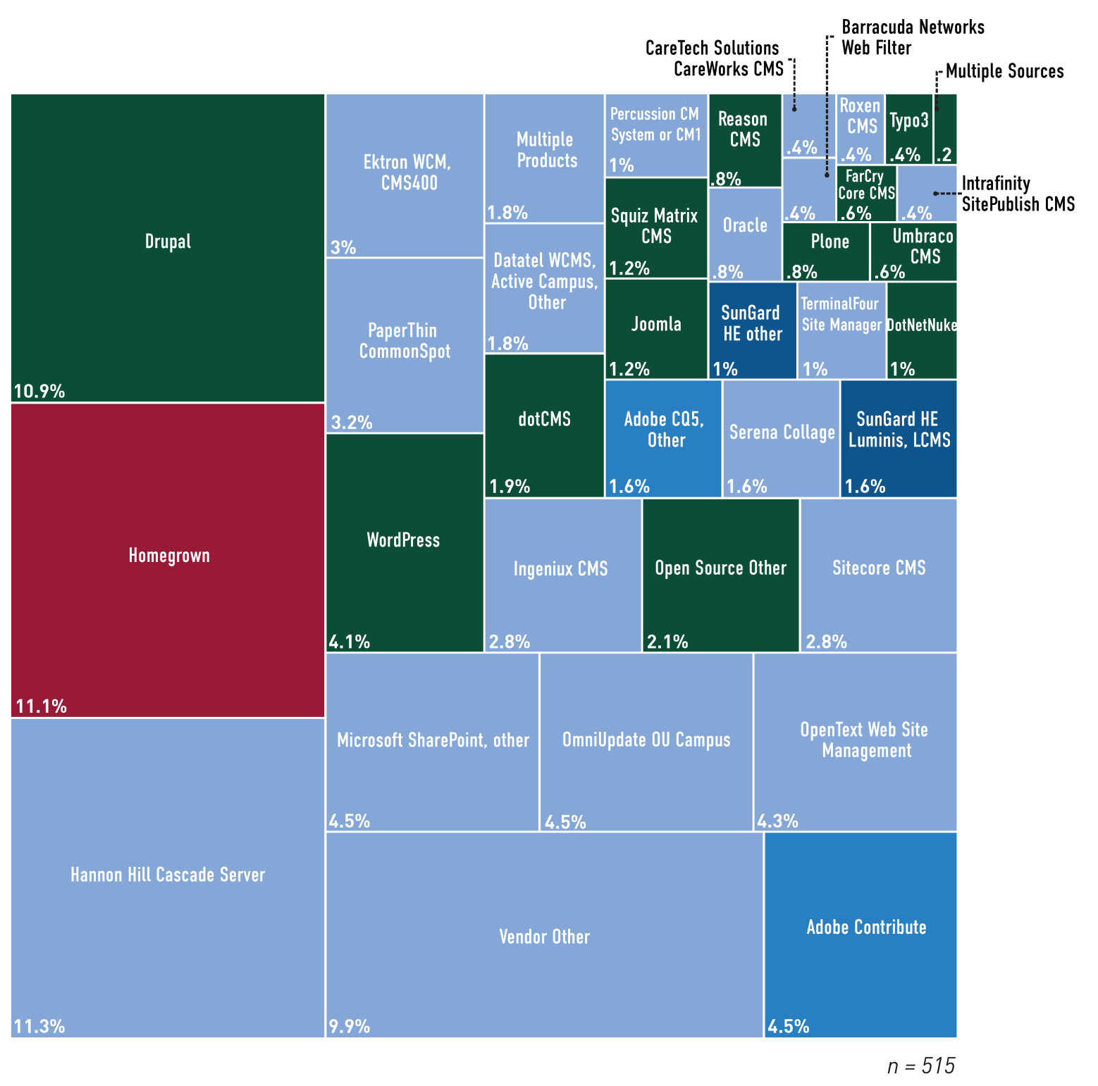
Web Content Management
% of institutions using | 81%
% outsourced | 7%
% managed by system office | 3%
% of market owned by top 5 providers | 37%

Slide 24
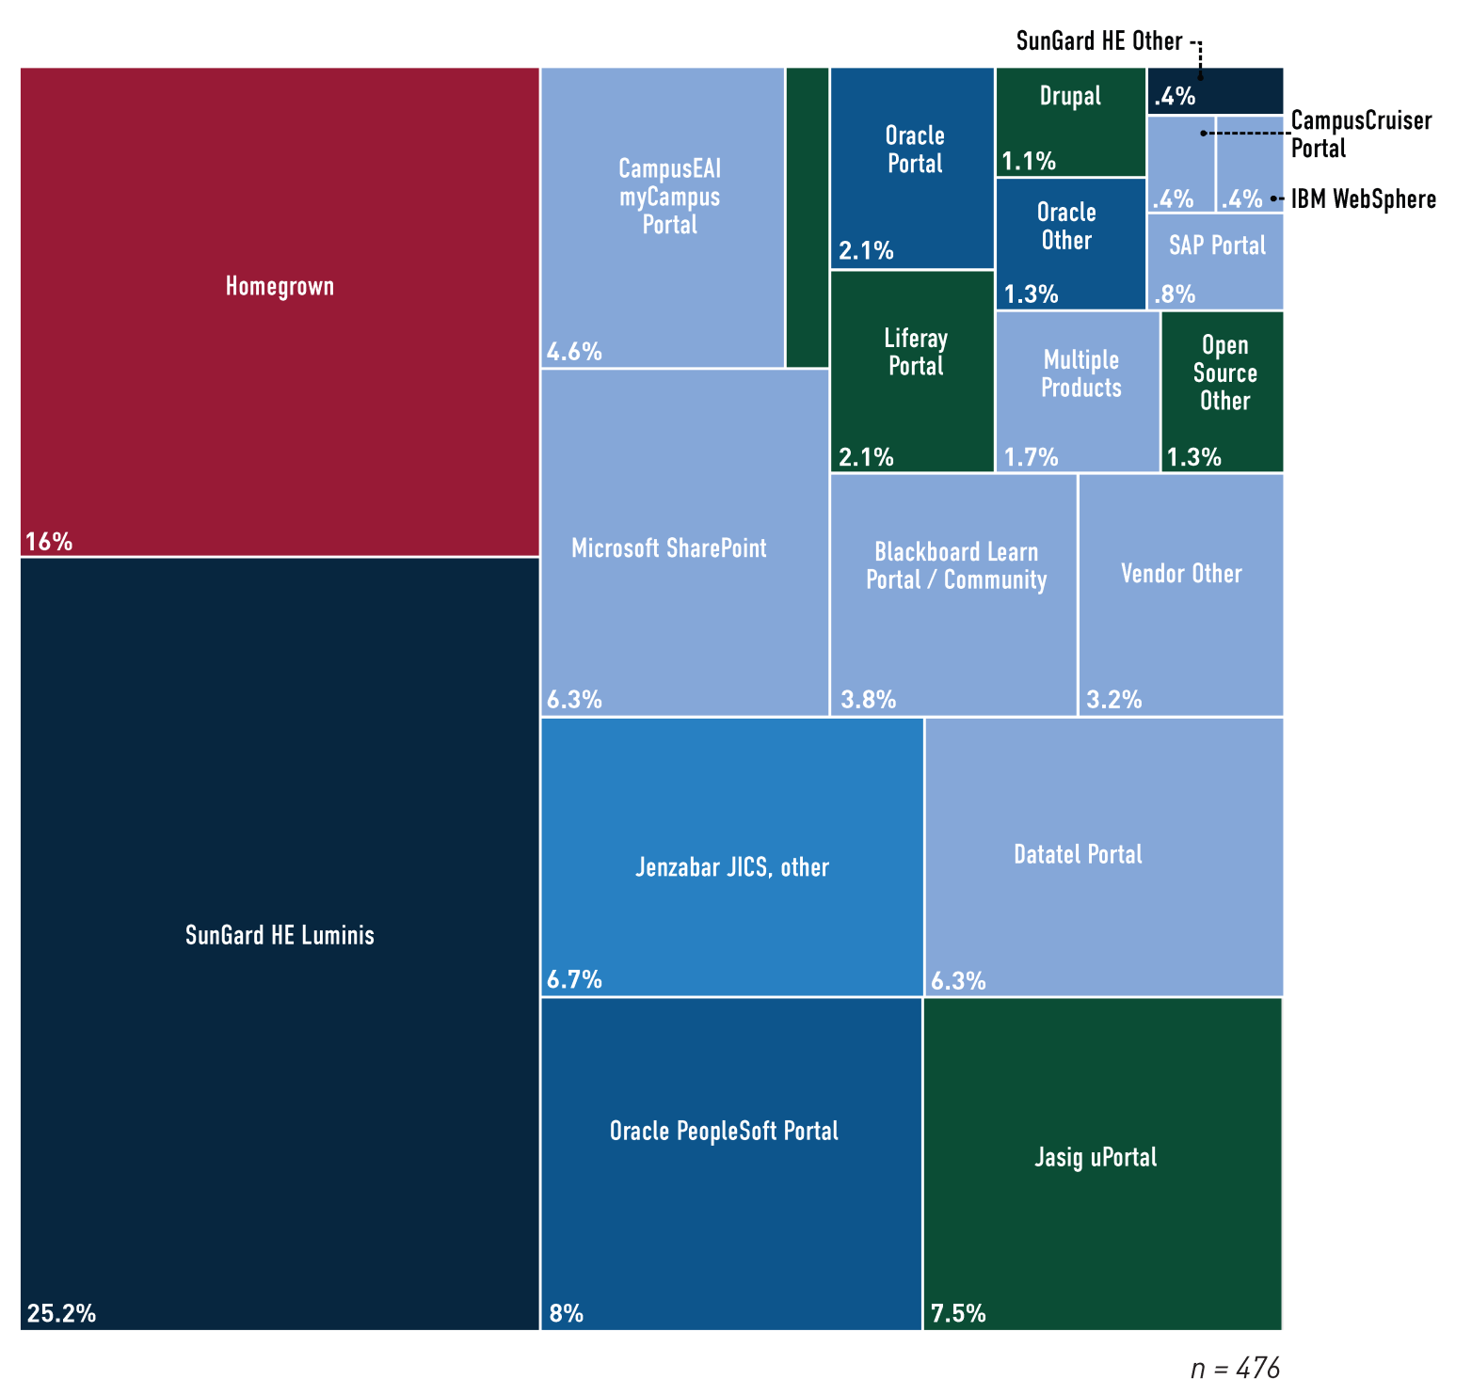
Portal
% of institutions using | 75%
% outsourced | 4%
% managed by system office | 11%
% of market owned by top 5 providers | 58%

Slide 25
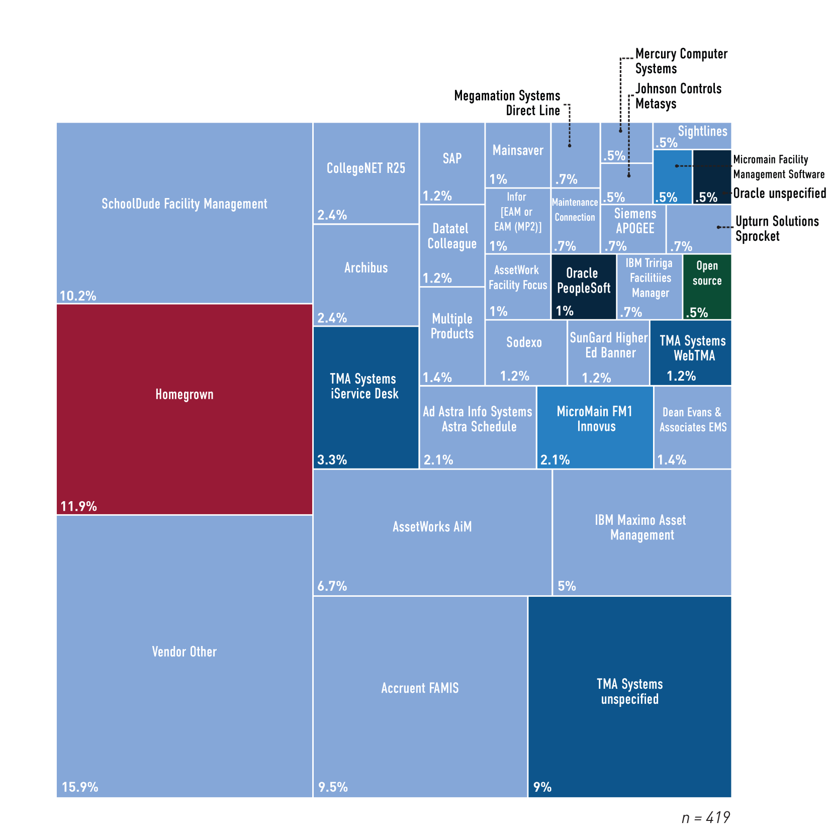
Facilities Management
% of institutions using | 66%
% outsourced | 16%
% managed by system office | 19%
% of market owned by top 5 providers | 47%

Slide 26
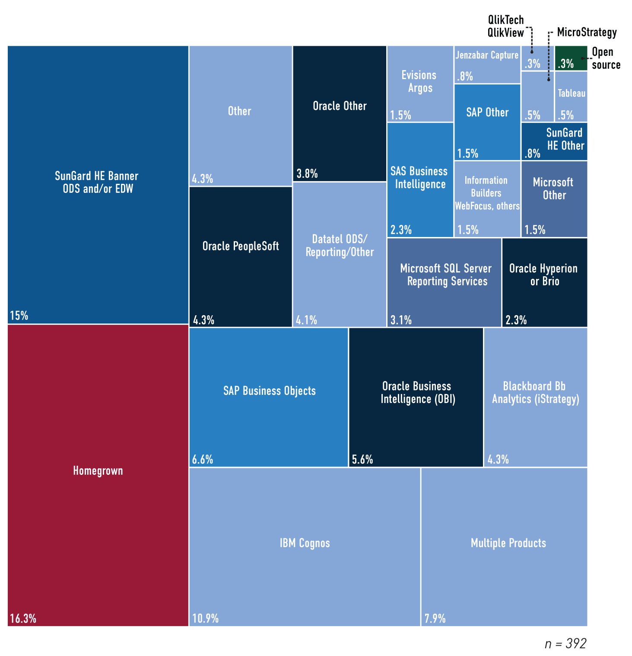
Administrative Data Warehouse/Business Intelligence
% of institutions using | 62%
% outsourced | 2%
% managed by system office | 24%
% of market owned by top 5 providers | 56%

Slide 27
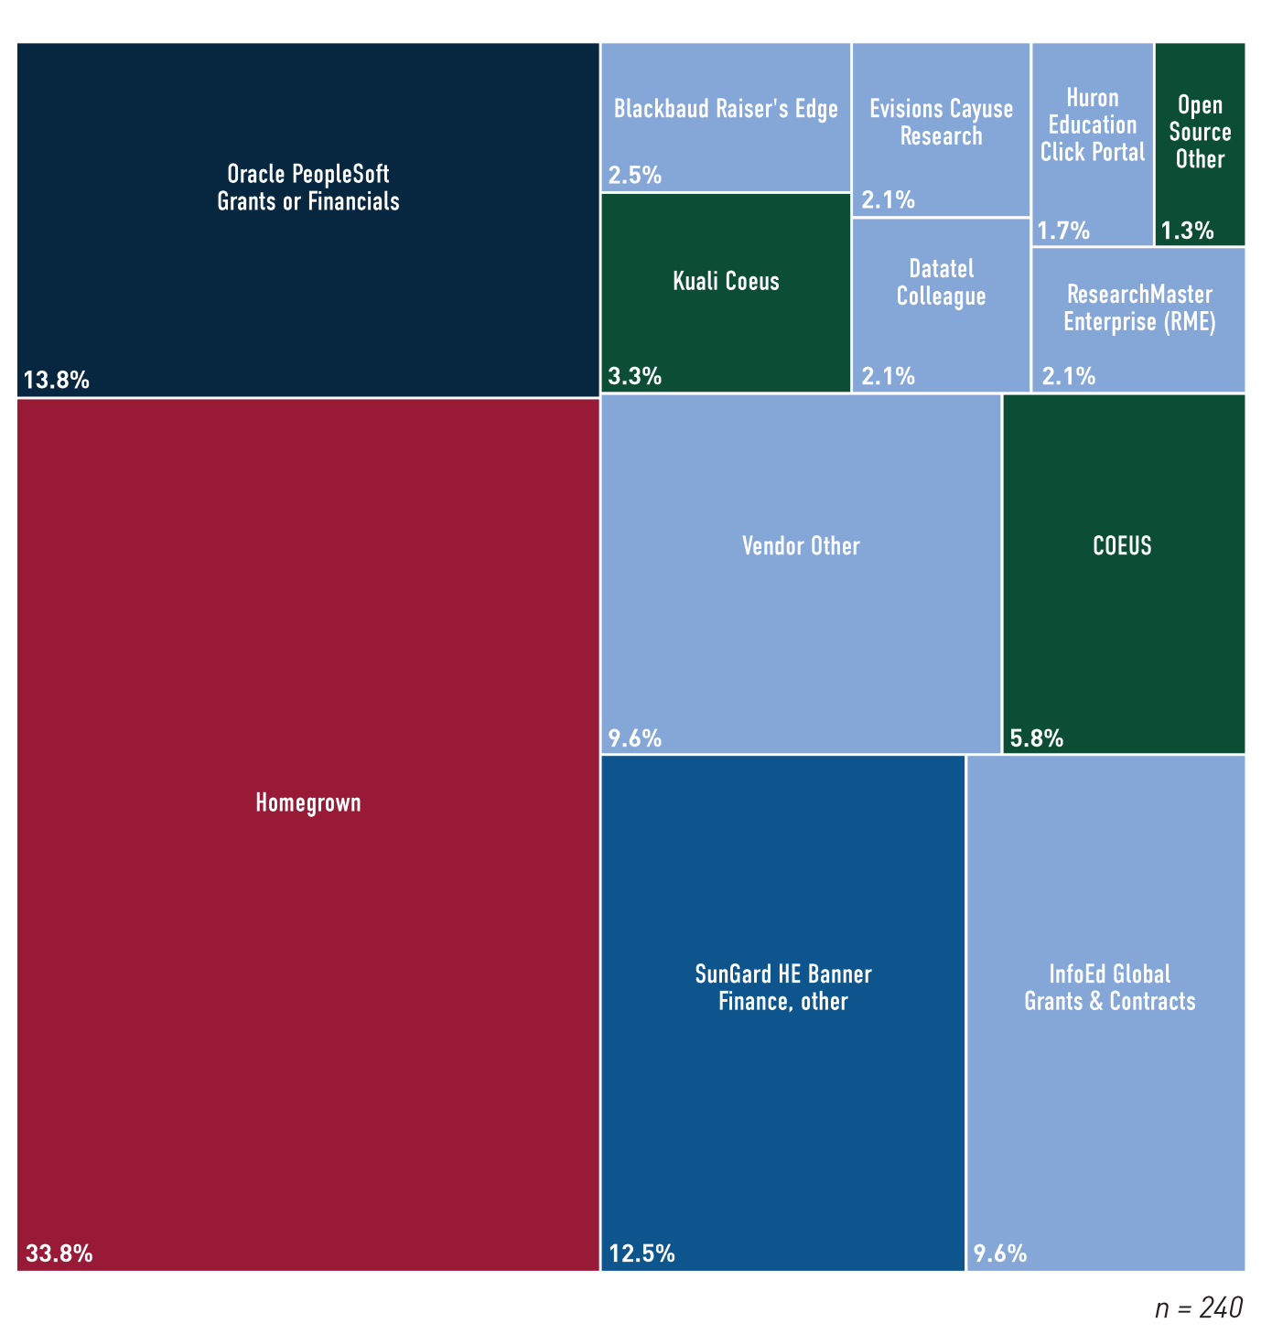
Grants Management: Pre-Award
% of institutions using | 38%
% outsourced | 4%
% managed by system office | 22%
% of market owned by top 5 providers | 45%

Slide 28
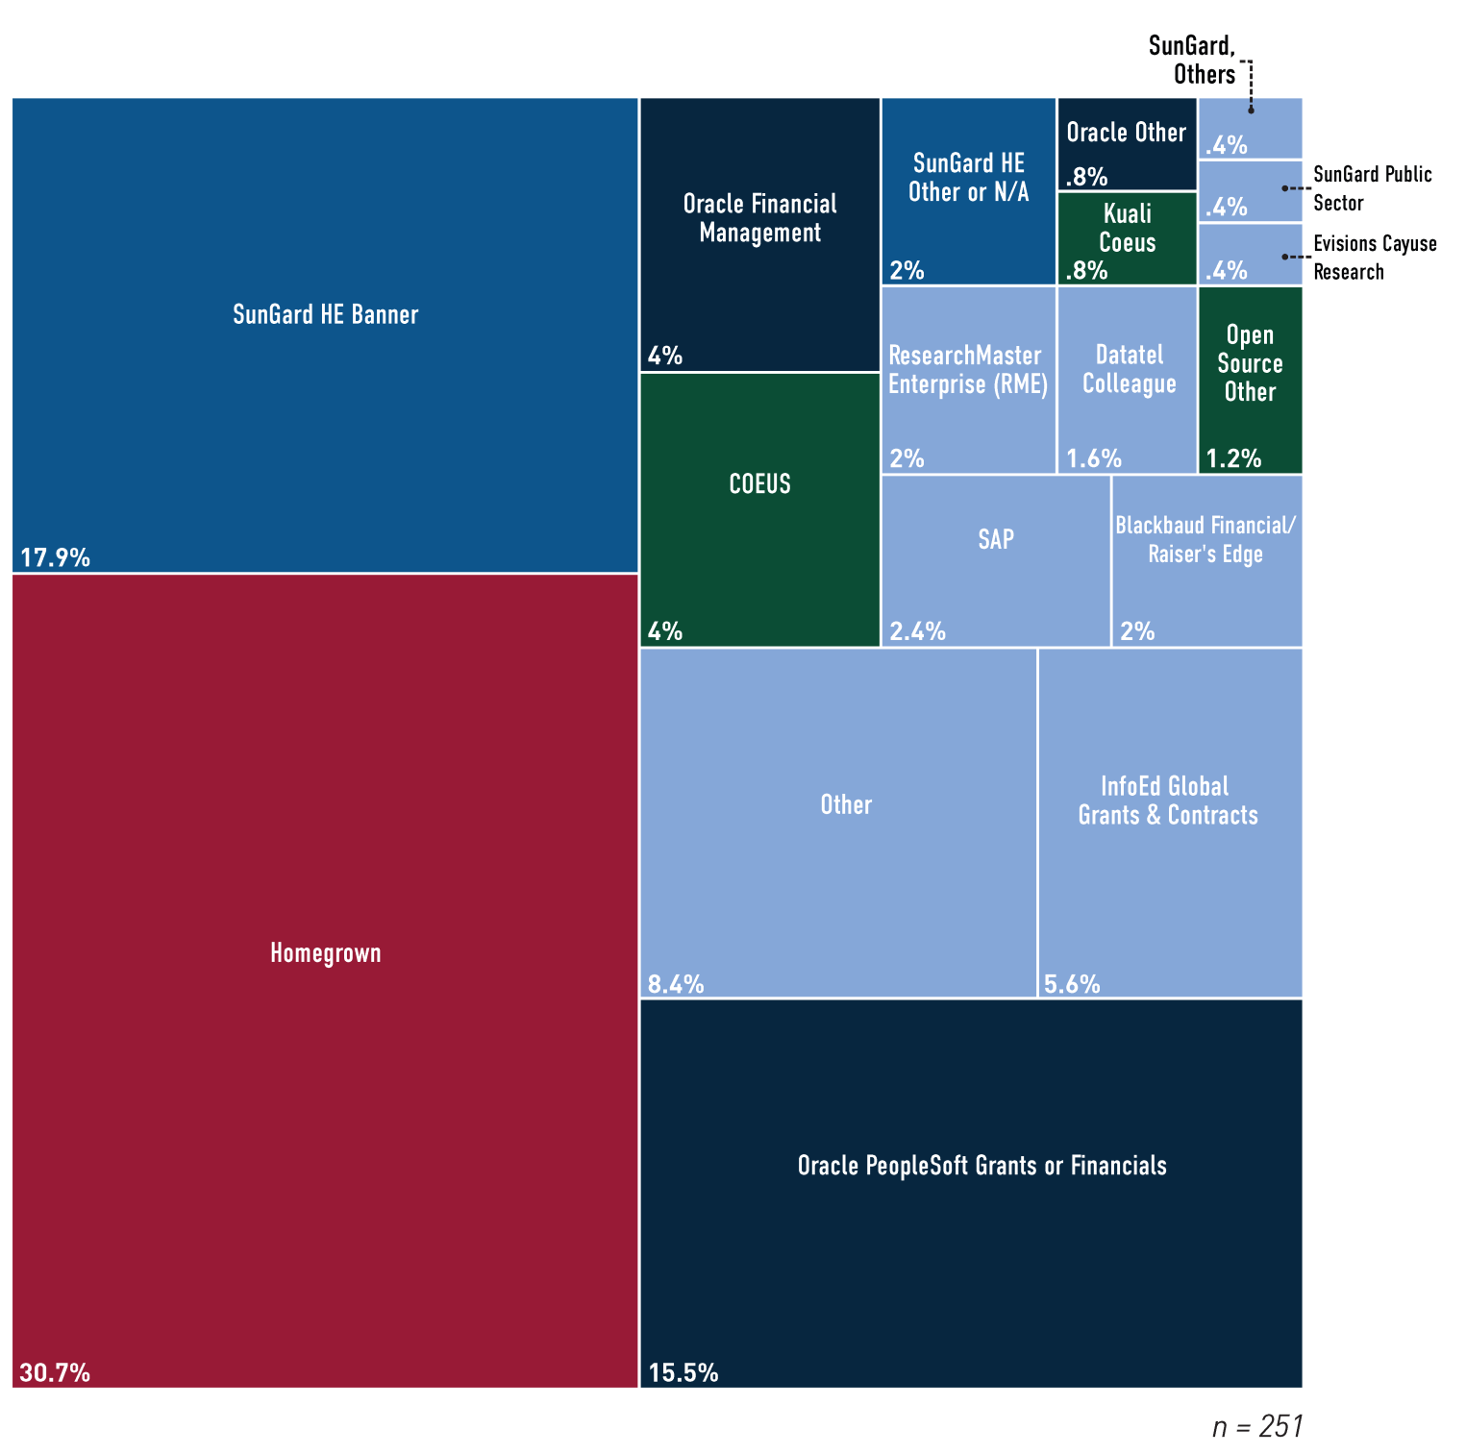
Grants Management: Post-Award
% of institutions using | 40%
% outsourced | 5%
% managed by system office | 23%
% of market owned by top 5 providers | 52%

Slide 29
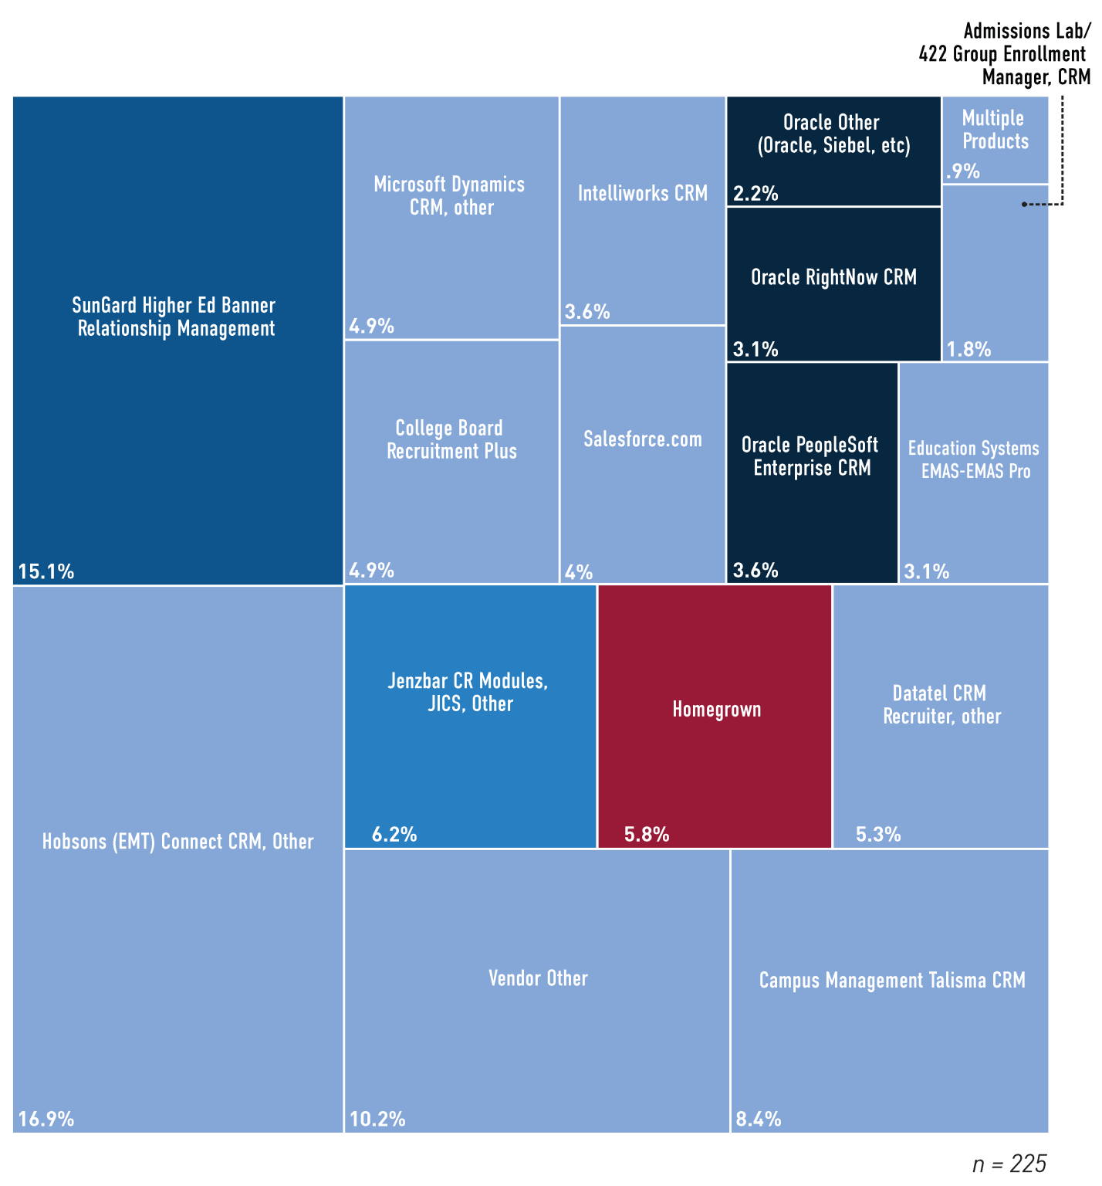
Customer Relationship Management
% of institutions using | 35%
% outsourced | 18%
% managed by system office | 15%
% of market owned by top 5 providers | 56%

Slide 30
EDUCAUSE CENTER FOR APPLIED RESEARCH

Slide 31
ECAR Research
About 30 reports annually
Original research
Member research
Third-party research from Gartner and CHECS
Research is restricted to subscribers
Reports initially restricted
Other materials permanently restricted

Slide 32
2012 Research
Analytics
Measuring User Satisfaction
Community College IT
Students’ Use Of Technology
Enterprise Application Marketplace
ERP Cost Drivers
Research Computing

Slide 33
2013 Research Under Consideration
Consumerization of IT
Student Technology Use
Higher Education IT Workforce
Measuring the Cost of IT
E-Learning
Update on Mobile IT

Slide 34
Thank You!
Susan Grajek

