Slide 1

WiMAX Technology Overview
Dirk Grunwald
Department of Computer Science
University of Colorado at Boulder

Slide 2
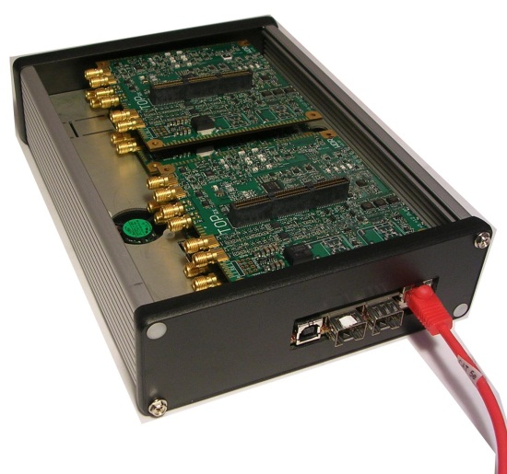
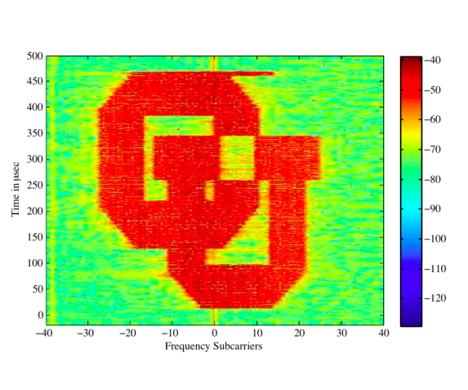
Testbed Experience
Design and Build GENI Cognitive Radio wideband radio (≥ 100MHz) network testbed
Current radio by Peter Wolniansky
  100Mhz-7500Mhz / 40Mhz select
  Switched filter bank
  Superheterodyne radio with a sharp IF filter, allowing measurements as close as 5-10 MHz from strong interferers.
  Soise floor is -101dBm for a 8MHz channel
Bonded to a commodity (Avnet) FPGA board, working on support for multi-FPGA systems
Up to 4 radios on one FPGA

Slide 3
Campus Local Wireless Networks
Most campuses using 802.11 WiFi
  WLAN: Short range due to limited power, design
  Limited spectrum choices (2.4Ghz & 5Ghz), but a lot of spectrum (esp. in 5Ghz band)
  High performance for limited ranges - 30-100meter range, 1-200mb/s
  Limited quality of service (voice, video)
Limitations based on technology and regulation

Slide 4
WiMAX & LTE: WRAN
WiMAX & LTE designed for wide area mobile wireless networks
Better network integration
Better device and user authentication, better security, fast handover
Covers 1km-30km
Goal is coverage, not capacity
Throughput depends on bandwidth (Hz) and signal quality
10Mhz - ~25MHz down, 6MHz up
Notes:
LTE is telecom
WiMAX is network

Slide 5
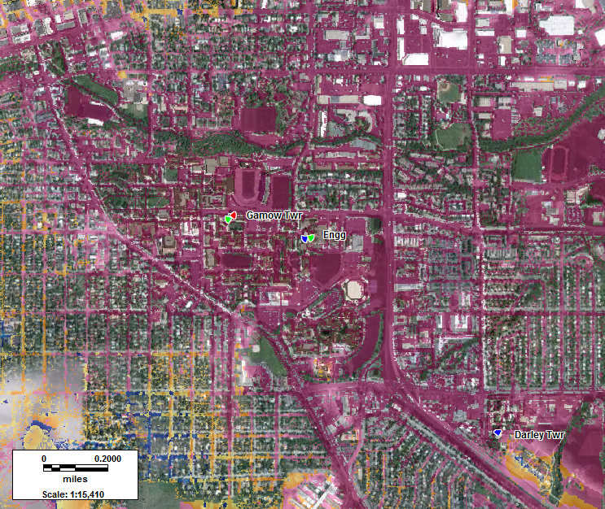
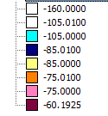
WiMAX & LTE: Deployment Challenges
Wider coverage means fewer AP’s, but each AP is more important
Most LTE / WiMAX spectrum is “line of sight” – buildings get in the way
Spectrum planning tools, follow-up measurement more important
Spectrum planning tools use frequency, height & “clutter”

Slide 6
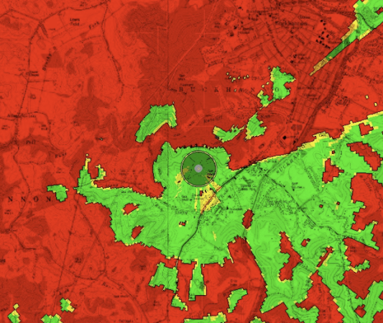
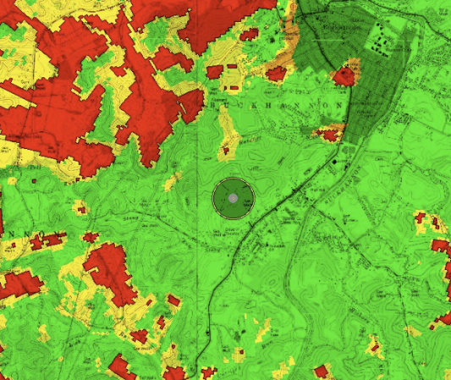
Wide Area Network Planning
3500 MHz
700 MHz
Lower frequencies have wider coverage at the same power
  good for coverage, but less available spectrum
  More coverage usually means more interference
Technologies (LTE/WiMAX) are design for specific frequencies - future wireless network standard will use “TV White Spaces”

Slide 7
Take away:
LTE is “telecom”, WiMax is “data” – moving from one to the other is more about the “backend network” than the AP’s
Much of your (CIO) planning for wide-area wireless is largely independentw of underlying technology
At higher frequencies, spectrum planning is very important, but the accuracy of such spectrum planning is variable

