Slide 1

Privacy Officers Around the Virtual Water Cooler
Data Privacy Month 2013
#dataprivacy
#dpd13
Wednesday, January 30
1:00-2:00 p.m. ET
(UTC-5; 12:00 p.m. CT, 11:00 a.m. MT, 10:00 a.m. PT)
Notes:
Speakers:
Merri Beth Lavagnino, CPO & Compliance Coordinator, Indiana University
Jane Rosenthal, Director, Privacy Office, University of Kansas
Kent Wada, CPO & Director, Strategic IT Policy, UCLA

Slide 2
Social Media
Data Privacy Month 2013 – www.educause.edu/dpm
Notes:
Topic 1: Social Media

Slide 3
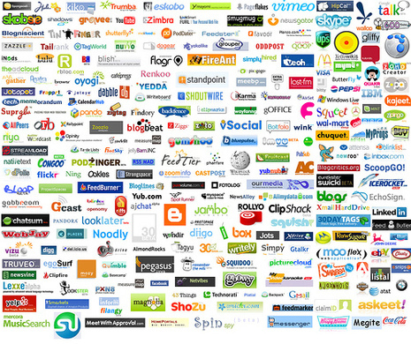
Social Media
Facebook logo
Show IM screen from iPhone
Gmail login screen
Twitter feed
Notes:
Social Media

Slide 4
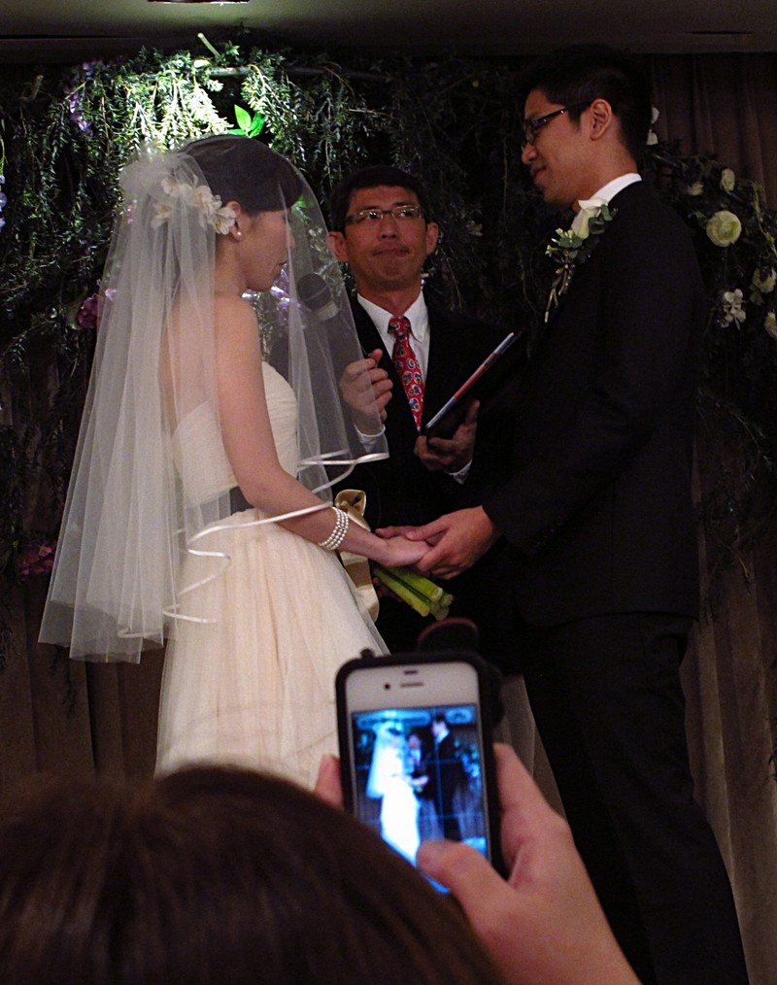
300 million pictures are uploaded to Facebook every day via Instagram
http://www.mediabistro.com/alltwitter/files/2013/01/100-social-media-stats.png
http://frank.itlab.us/photo_essays/wrapper.php?feb_18_2012_minjie_wanzhi.html
Notes:
http://frank.itlab.us/photo_essays/wrapper.php?feb_18_2012_minjie_wanzhi.html
http://www.mediabistro.com/alltwitter/files/2013/01/100-social-media-stats.png

Slide 5
Facebook status updates [are] about one and a half times more memorable than sentences from books and almost two and a half times more memorable than faces.
http://ucsdnews.ucsd.edu/pressrelease/facebook_beats_books_and_faces_in_memory_test
Notes:
http://ucsdnews.ucsd.edu/pressrelease/facebook_beats_books_and_faces_in_memory_test

Slide 6
Mobility
Data Privacy Month 2013 – www.educause.edu/dpm
Notes:
Topic 2: Mobility

Slide 7
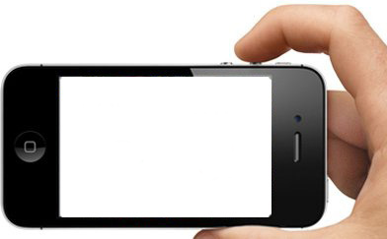
It is predicted that by 2013 mobile phones will overtake desktop computers as the most common web access devices worldwide.
www.educause.edu/library/resources/developing-institutional-research-data-management-plan-service
Notes:
http://farm8.staticflickr.com/7240/7325280358_257b915320.jpg
http://www.flickr.com/photos/charlesfettinger/7325280358/
www.educause.edu/library/resources/developing-institutional-research-data-management-plan-service

Slide 8
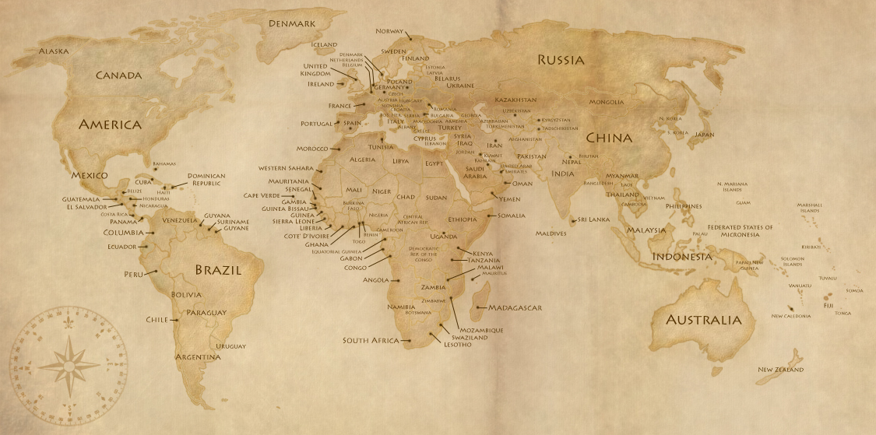
Notes:
Travel & Privacy

Slide 9
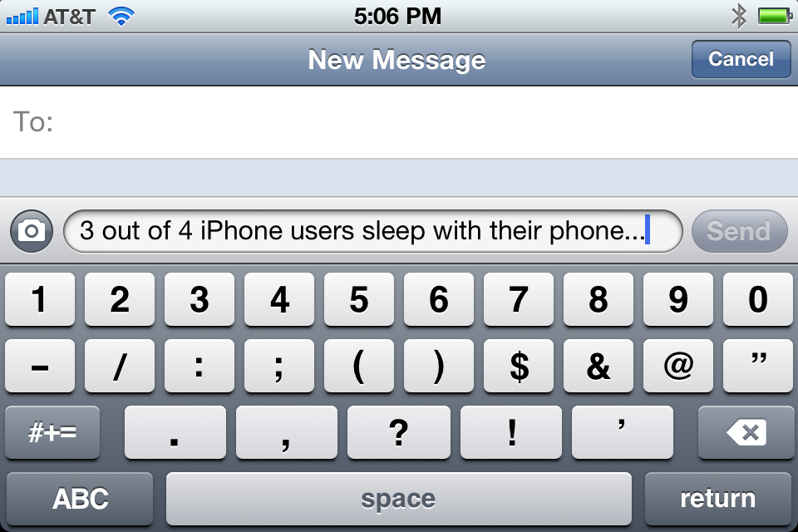
http://www.msnbc.msn.com/id/35768107/
Notes:
http://www.msnbc.msn.com/id/35768107/

Slide 10
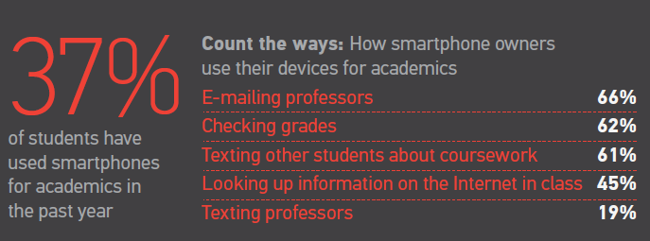
http://net.educause.edu/ir/library/pdf/ERS1103/EIG1103.pdf
Notes:
http://net.educause.edu/ir/library/pdf/ERS1103/EIG1103.pdf

Slide 11
Working with Technical Staff
Data Privacy Month 2013 – www.educause.edu/dpm
Notes:
Topic 3: Working with Technical Staff

Slide 12
SECURE
Notes:
Secure…
Apps
Software Design
Admin Controls
Websites

Slide 13
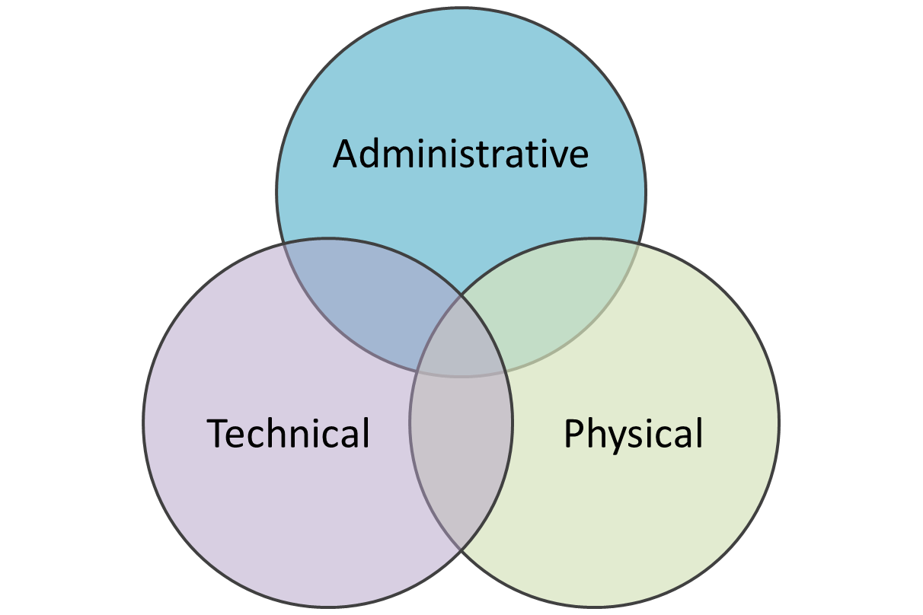
Controls
Notes:
Controls: Administrative, Technical, and Physical

Slide 14
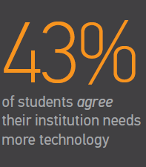
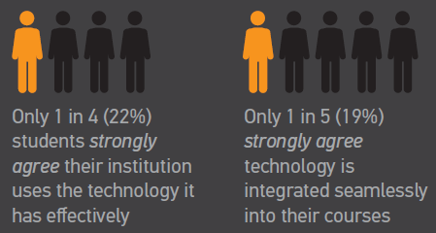
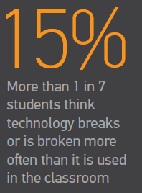
http://net.educause.edu/ir/library/pdf/ERS1103/EIG1103.pdf
Notes:
http://net.educause.edu/ir/library/pdf/ERS1103/EIG1103.pdf

Slide 15
Instruction and Faculty
Data Privacy Month 2013 – www.educause.edu/dpm
Notes:
Topic 4: Instruction and Faculty

Slide 16
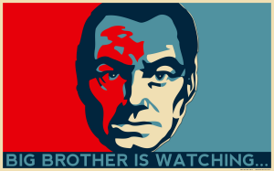
http://nighted.deviantart.com/art/Big-Brother-Is-Watching-YOU-119409480
Notes:
http://nighted.deviantart.com/art/Big-Brother-Is-Watching-YOU-119409480

Slide 17
Instruction and Faculty
Autonomy
Transparency
Surveillance
Cloud Tools
Academic Freedom
New Models of Instruction
Notes:
Instruction and Faculty – Topics to Consider

Slide 18
Monitoring & Surveillance
Down the hall in the billing department, a clerk uses a lunch break to scan the Web for information on abuse victims. The information retrieved also flashes onto a screen in the boss's office, revealing a secret the employee never told anyone.
http://www.pcworld.com/article/14557/article.html
Notes:
Monitoring & Surveillance
http://www.pcworld.com/article/14557/article.html

Slide 19

http://tanjerahn.deviantart.com/art/Sitting-Clouds-179687622
Notes:
Cloud and privacy
http://tanjerahn.deviantart.com/art/Sitting-Clouds-179687622

Slide 20
It is the university’s responsibility both to comply with state law and to protect our community’s right to explore freely and freely express their points of view.
http://www.news.wisc.edu/19163
Notes:
Academic Freedom
http://www.news.wisc.edu/19163

Slide 21
Day in the Life of a CPO
Data Privacy Month 2013 – www.educause.edu/dpm
Notes:
Topic 5: Day in the Life of a CPO

Slide 22

http://www.sxc.hu/photo/1040693
Notes:
http://www.sxc.hu/photo/1040693

Slide 23
Day in the Life of a CPO
Financial Aid
Student Affairs
CFO/Treasury
HR
Contracts
Risk Officer
Audit (Internal)
Legal Counsel
Institutional Research
IRB
Office of Budget & Planning
Office of Sponsored Projects
Faculty Council
Academic Senate
Data Stewards
Administrative Staff
Privacy Advisory Board
Compliance Office
Identity Management
Information Security
IT Help Desk
E-mail Admin
Campus Police
Facilities (e.g., recycling center; new or renovated buildings)
Affirmative Action Office
Medical School, Campus Hospital, or Health Center
Career Services
Library
Notes:
Departments on campus that a Chief Privacy Officer may engage.
Privacy is pervasive at an institution.

Slide 24
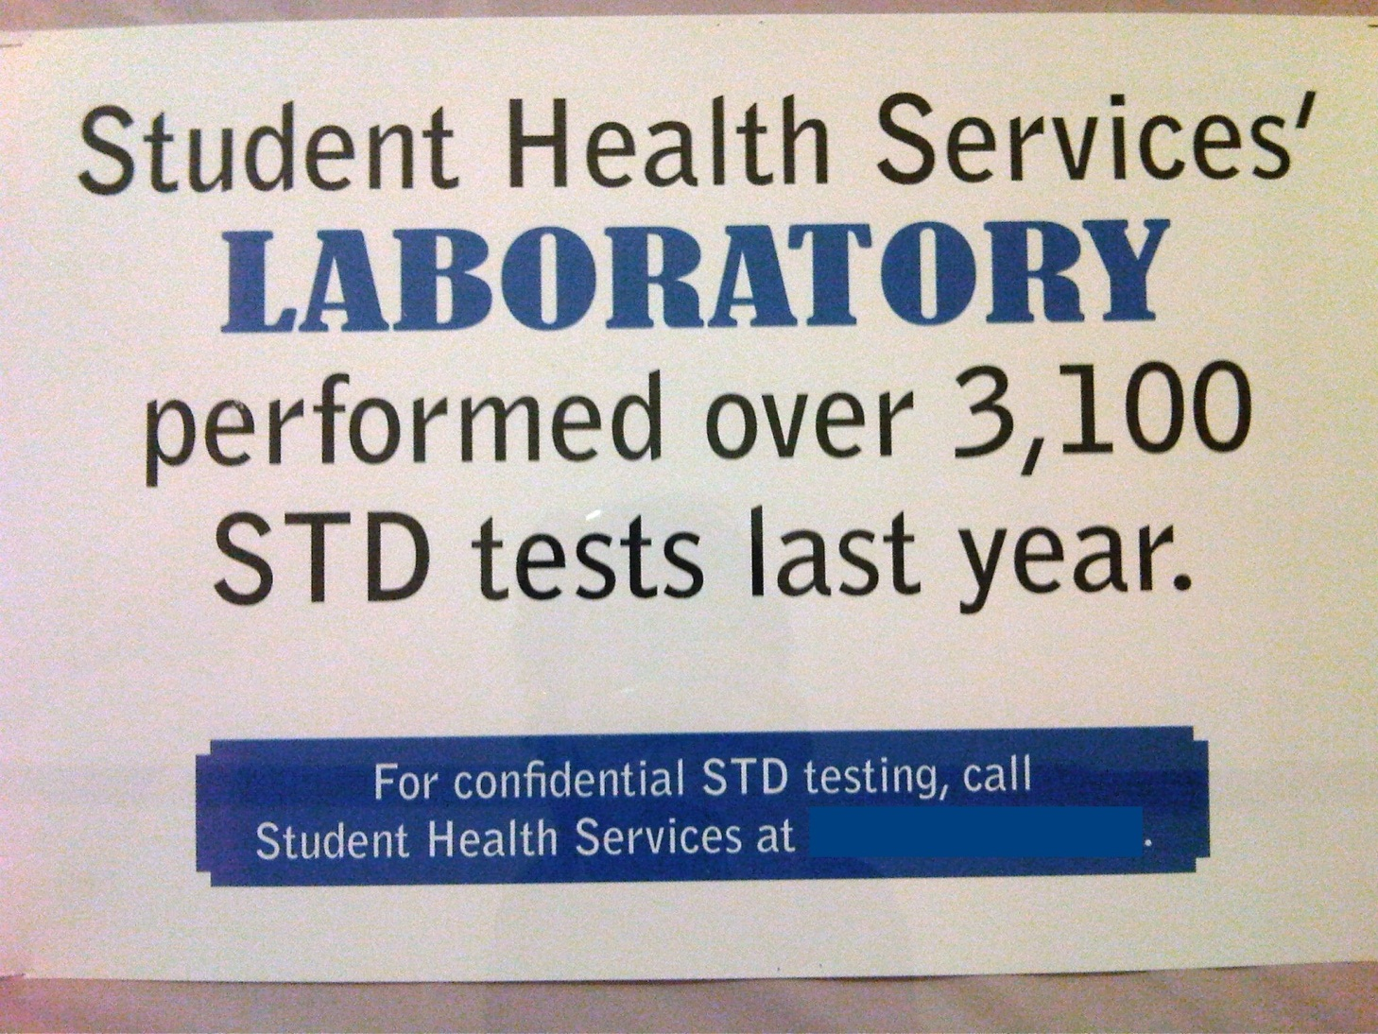
Notes:
Student Privacy

Slide 25
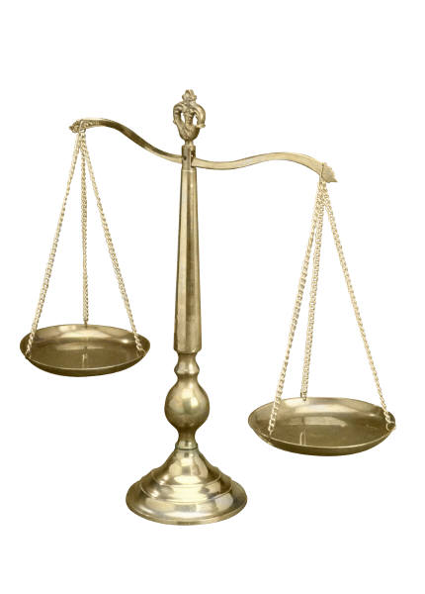
Balancing Privacy & Institutional Needs
Notes:
Balancing Privacy & Legitimate Interests of an Institution

Slide 26
Q&A
Data Privacy Month 2013 – www.educause.edu/dpm
Notes:
Final Q&A

