Slide 1
Where Students Compute
Micheal M Malsed
Asst. Director for Student Technology Services
Information Technology Services
Claremont McKenna College

Slide 2
CMC Background
Established in 1946 (Claremont Men’s College)
Went Co-Ed in 1976 (Claremont McKenna College)
  Named after founding trustee
1200 undergraduates – ~1100 resident
  Rest either study abroad, Washington D.C. program, etc.
Highly ranked liberal arts college
  Focus on Economics and Government
Claremont McKenna College motto:
  "Crescit cum commercio civitas”
  (Civilization prospers with commerce)

Slide 3
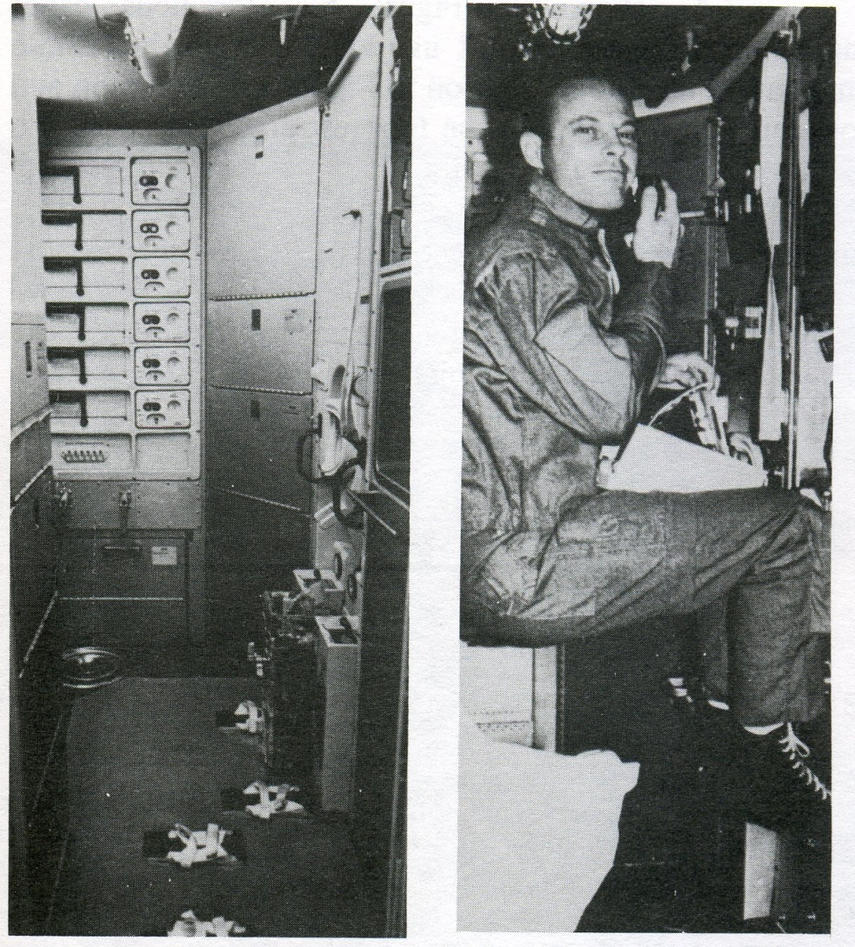
Story Time
Human Factors in the Design of Spacecraft
  Prof. Harvey Wichman
Notes:
Toe-loop example – astronauts wedged themselves (or their toes) instead of using the ingenious little foot-loops provide for them.
We tend to try to force faculty and students into our own conceptions of the proper pedagogical paradigm rather than observe, establish needs, and fit model to observed behavior and needs.

Slide 4
Premise
No model fits!
  Observation first
  Determine needs next
  Create model to needs and observations
Some Models and Surveys
  http://rescomp.stanford.edu/info/survey/
  http://www.bath.ac.uk/bucs/surveys/2005/studentques.cfm
  Computers on the Campus (Winifred Asprey)
  National Survey of Student Engagement (NSSE)
  EDUCAUSE Core Data Service
Notes:
Models presented don’t seem to fit CMC. Even models presented by other colleges similar to CMC don’t fit our circumstances.
Especially the large conglomerated surveys – I see the results of those and wonder what planet they’re on or we’re on!
For instance, we’ve had 95%+ computer ownership since 2003 – yet the 2006 CDS survey shows a mean of 85.5% and a median of 95%, much lower even than our 2003 statistic. We’re now at 99%+.
In addition, most of these surveys don’t really address the things we need to see – where computing is taking place, where the “computORS” are living and moving around. . .Traffic patterns are very important.
Use an empiric methodology. Observe, determine needs, build model to fit.

Slide 5
CMC Observations
Snapshot Survey
  Extensive response rate (62+%) means that our sample gives excellent statistical results
    2003 – 598 responses (57%)
    2004 – 696 responses (66%)
    2005 – 637 responses (61%)
    2006 – 650 responses (62%)
Notes:
How we do the snapshot
Limitations
How we get the response rates

Slide 6
CMC Observations
Snapshot Survey
  Extensive response rate
  Covers computing practices
    99% own their own computer in their own room
      Yet 95% still use the labs
    40% own their own printer (trend is downward)
    90% have a laptop
      85 with laptop only
      5% with both desktop and laptop
    Wireless practices
      Even though we have 100% coverage, most still prefer to come to the labs – many now bring their laptop and use both!
Notes:
Why do people still use the labs?
responses?

Slide 7
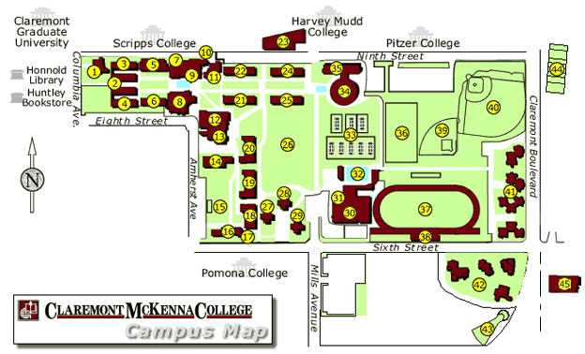
CMC Observations
North Quad
Mid Quad
Locations of
established labs
South Quad
Apartments
Notes:
Apartments are the farthest

Slide 8
CMC Observations
Snapshot Survey
  Extensive response rate
  Covers computing practices
  We get dorm and room information
    We’re able to track where users are coming from
      Apartment Dwellers – 95% use the labs; 20% fairly heavily
      North Quad – 94% use the labs; 15% fairly heavily
      Mid Quad – 85% use the labs; 15% fairly heavily
      South Quad – 89% use the labs; 10% fairly heavily
              Fairly heavily = > 5 hours per week
Notes:
Apartments are the farthest

Slide 9
CMC Observations
Snapshot Survey
  Extensive response rate (65+%) means that our sample gives excellent statistical results
  Covers computing practices
  We get dorm and room information
  SurveyMonkey.com

Slide 10
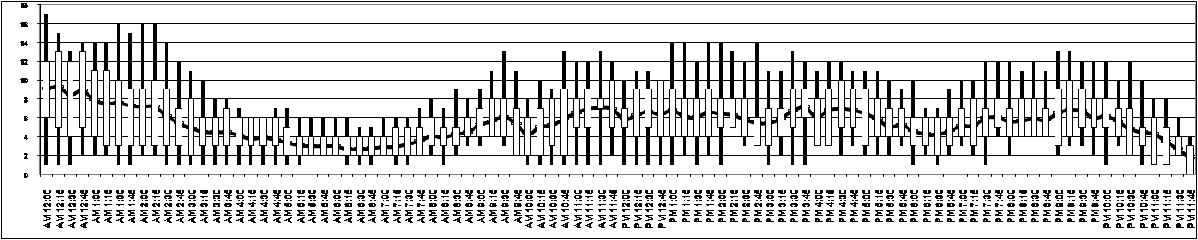
CMC Observations
Snapshot Survey
    Using Snapshot
    Using lab tracking
      Sub LabTrack()
        'change action to logon, logout, startup, shutdown
        sEcho = "http://134.173.170.135/LabTracking?action="& "login" & "&station=" & sComp & "&username=" & sSamAC
        Set oShell = WScript.CreateObject("WScript.Shell")
        oCommand = "Curl.exe "
        oShell.Run(oCommand & sEcho)
      End Sub
Notes:
Lab Tracking tracks logons and logoffs and aggregates them at 15 minute intervals.
Then we calculate the mean, the 25% and 75% and upper and lower outliers.
We have data for each day of the week.
We use this to determine when we set our staffed hours – creating rules such as we don’t staff if the 75% and mean are below quarter capacity, and we double-staff if the 25% and mean are above half capacity.

Slide 11
CMC Initial Conclusions
Distributed
  Nearly 100% of students own their own computers
  (91% wireless)
    Maybe we don’t NEED a lab…
  90% of students spend some significant amount of time in the labs
    Maybe we need a BIG computing center…
  2 of the 4 most important issues to students are lab related
Access to Internet | 4.92
Speed of Internet Access | 4.79
Free Printing | 4.74
Wireless in Public areas | 4.47
Computer Labs always available | 4.44
Notes:
While many places are beginning to think that wireless = no lab, we’re finding the opposite!
More and more people are beginning to bring their laptop to the lab and using it alongside the lab computer – multi-tasking, using the lab computer for the software and power and reliability, and their laptop for generic word processing, IM, and “normal” apps.

Slide 12
CMC Initial Conclusions
South and Mid-Quads are high traffic, but low impact – i.e. less dorm damage.
  Based upon Dean of Students and Campus Services
Much of student computing is group based, even when it’s individual work, i.e. lab use is community work.
  Based on Snapshot Survey and observations
Notes:
We know something of the “what we need”?
We need to figure out “where”
Desires – obviously we want a place that is safe, no alcohol, no damage, etc. Some areas (like the party quads, - we all have them!!!) aren’t good. . .

Slide 13
CMC Needs
Capacity – we were running at full capacity
  According to our Lab Tracking, our main lab (Poppa Lab) was at 75% capacity nearly 50% of the time, with waiting lists several hours per day.
  Our expansion lab (a classroom) was heavily used but only available during off-peak hours.

Slide 14
CMC Needs
Capacity
Residential computing space
  Obviously our lab was
  far from everyone:
  Might be nice to have a
  lab near STUDENTS. . .
  Also methodology –
    Each dorm gets 2 comps
    and a printer?
    Mid-sized lab in central
    area?
Notes:
We had a choice of how to do this – fully distributed (2 computers and a printer per dorm) or residential center (small to mid-sized lab)
Three main areas where considered – South/Mid quad; Apartments; North Quad.

Slide 15
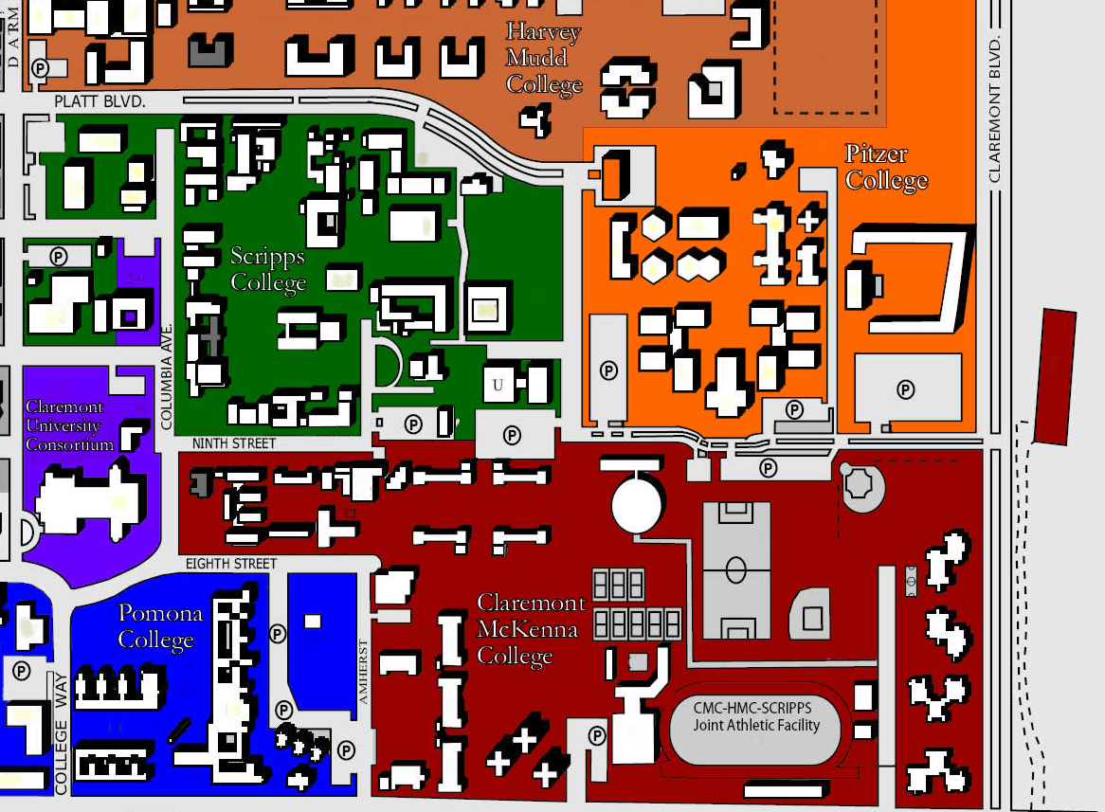
CMC Needs
Capacity
Residential computing space
Small amount of available space
  CMC is undergoing a
  growth phase so every
  room is in use!
  Fenced in by the other
  colleges, residential areas
  and the county line.
Notes:
In fact, in many dorms the lounges are in use as dorm rooms while we build additional dorms!

Slide 16
CMC Needs
Capacity
Residential computing space
Small amount of available space
No funds – must use existing area with little to no development or furnishings
Notes:
We had some money from a grant, but not much, and no regularized funds – so this had to be done on next to nothing.

Slide 17
CMC Needs
Capacity
Residential computing space –
Small amount of available space
No funds – must use existing area with little to no development or furnishings
Small staff – cannot support widely distributed system.
Notes:
One person for ResTech, Lab Support, Classroom support – all of Student Technology.
Distributing computing into each dorm would over-tax staff and student workers.

Slide 18
CMC Solution
Dean of Students found a very lightly used lounge
  Central location – high concentration of dorms
    Within ~100ft of 6 dorms
    Within ~200ft of 8
  Central to over ½
  the student body
  (~560 residents)
  Will be central to 2/3
  of the student body
  when new dorm is built

Slide 19
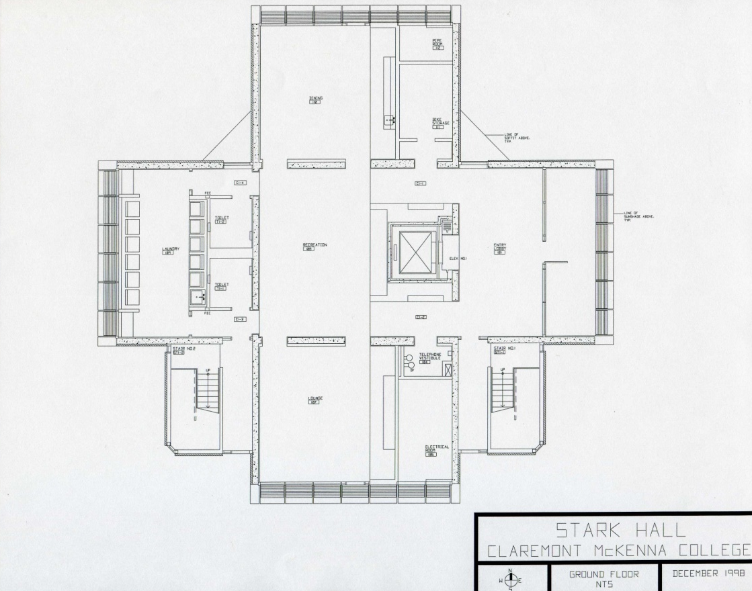
CMC Solution
Dean of Students found a very lightly used lounge

Slide 20
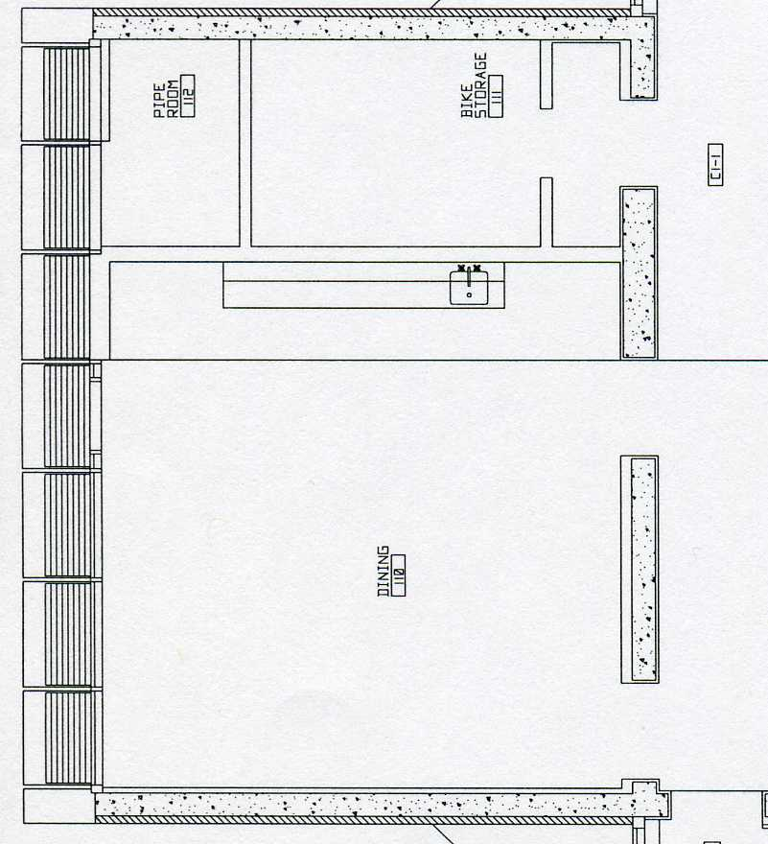
CMC Solution
Dean of Students found a very lightly used lounge
Added a door and a small
wall to cover 2 interior exits
  Issue with HVAC
  Issue with sound from the rest
  of the dorm lounge area

Slide 21
CMC Solution
Dean of Students found a very lightly used lounge
Added a door and a small
wall to cover 2 interior exits
Added card readers and
surveillance cameras
Furniture came from
retired classroom

Slide 22
CMC Solution
Extended rotation from 3 to 4 years for labs
  Main classroom gets brand new computers
  Those computers go to main lab for 2 years
  Afterward, they proceed to South Lab.
  Have sufficient spares “just in case”

Slide 23
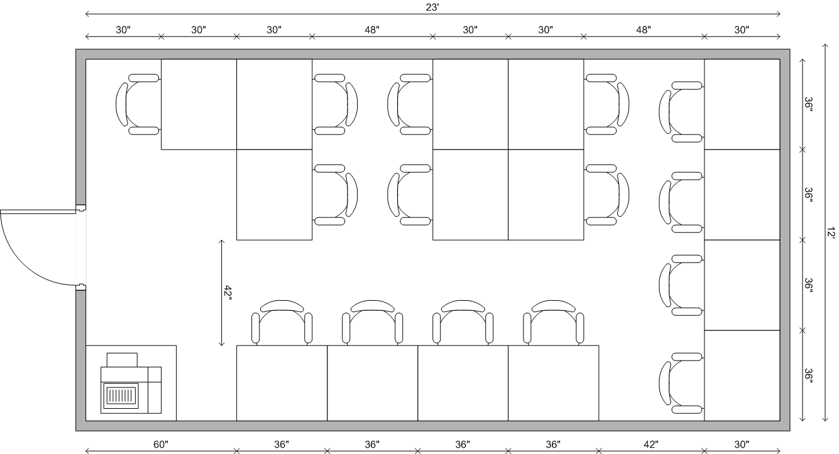
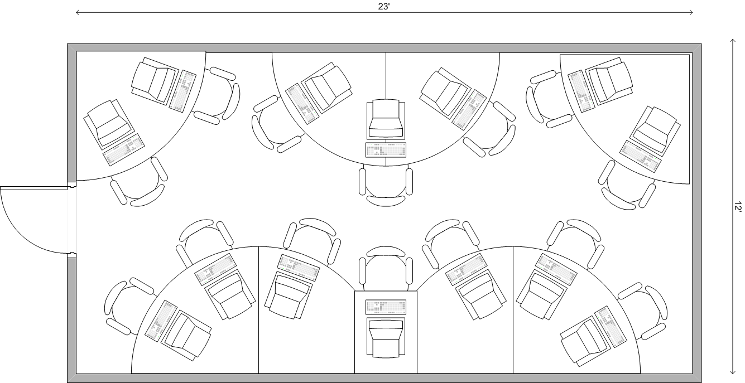
Other design ideas

Slide 24
CMC Solution
Extended rotation from 3 to 4 years for labs
Lab Tech Assts “check” lab only – no staffing.
  Student assistants (LTAs) check paper, toner, supplies every 2 hours (average) based on lab traffic statistics
  Students don’t want staffing
    – “Leave Me Alone and Let Me Work”

Slide 25
Results
SouthLab has higher usage percentage
than other labs

Slide 26
Results
SouthLab has higher usage percentage
than other labs
Few complaints
  Ping Pong. . .
  HVAC control and ventilation
  Outside door issues

Slide 27
Results
SouthLab has higher usage percentage
than other labs
Few complaints
Relieved some strain from Poppa Lab (main)
  Only kept up with demand

Slide 28
Final Thoughts
This fits CMC – may not fit your campus

Slide 29
Final Thoughts
This fits CMC – may not fit your campus
Empirical method for determining
what approach to use
Notes:
We observed, we measured, and adjusted to that.

Slide 30
Final Thoughts
This fits CMC – may not fit your campus
Empirical method for determining
what approach to use
Future Plans
  We’re putting in a new dorm and a new academic building
    What kind of lab/classroom will we use?
    Talking with faculty and students and looking at data. . .

