Slide 1
Born Digital - and Accessible
Larry Goldberg and Madeleine Rothberg
WGBH National Center for Accessible Media
January 28, 2013
Notes:
Required – Title Slide

Slide 2
Introduction
Notes:
Optional – Agenda Slide – Option 2
Instead of using the agenda template on the previous slide, you also have the option to use this section break template to place sub titles or section breaks within your presentation.

Slide 3
Digitization of Online Learning
Digital media
And textbooks
And electronic publishing
Notes:
Required - Main Body Slide

Slide 4
Digitization of Online Learning
Great opportunities
Unique challenges
Anywhere, anytime learning
Malleable and flexible digital formats
Timely and equal access
Old models of retrofitting materials
  No longer work
  Can be vastly expensive
Notes:
Required - Main Body Slide

Slide 5
Into the Future . . .
Notes:
Optional – Agenda Slide – Option 2
Instead of using the agenda template on the previous slide, you also have the option to use this section break template to place sub titles or section breaks within your presentation.

Slide 6
How Do People with Print Disabilities Read?
Notes:
Required - Main Body Slide

Slide 7



How Do People with Print Disabilities Read?
    Standards
Notes:
Required - Main Body Slide

Slide 8
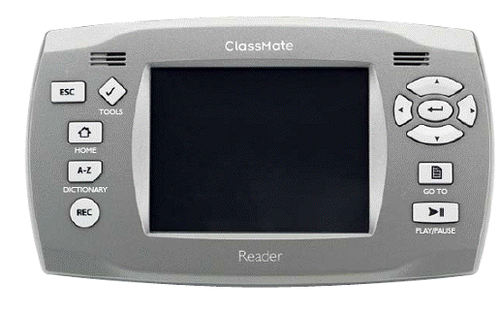
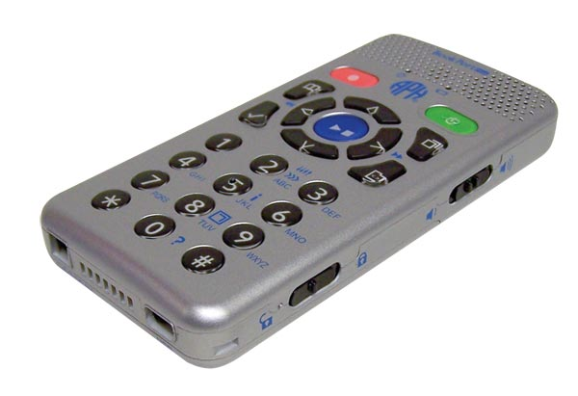
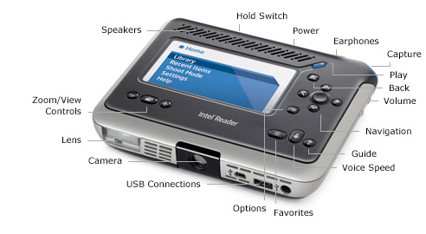
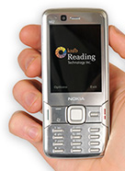
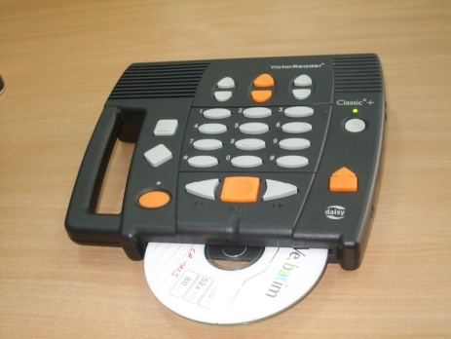
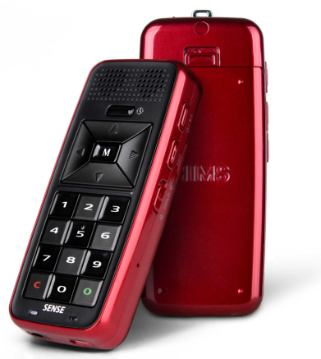
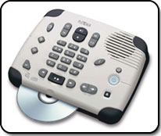
How Do People with Print Disabilities Read?
Hardware – specialized

Slide 9

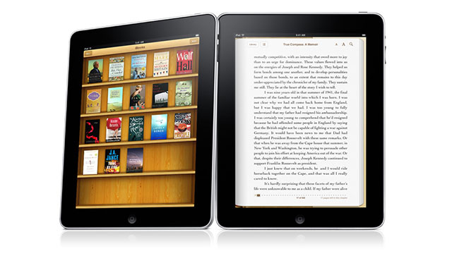
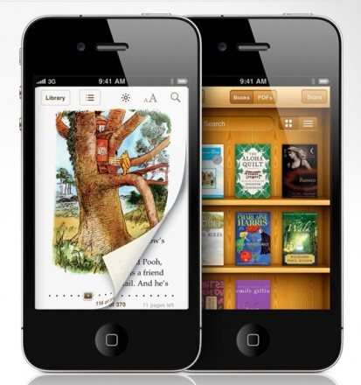
How Do People with Print Disabilities Read?
Hardware – mainstream

Slide 10








How Do People with Print Disabilities Read?
Software

Slide 11
A New Approach
Born Digital : Born Accessible

Slide 12
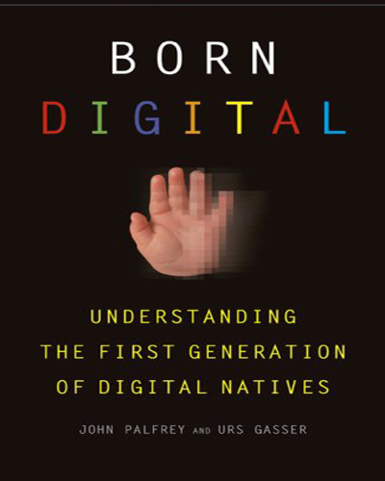

Slide 13
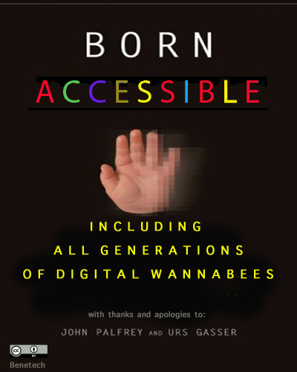

Slide 14
Born Digital: Building Infrastructure
  New publishing practices and tools
    Publishers are moving toward digital standards that support accessibility enhancements., i.e. DAISY, ePub3, AccessforAll, longdesc
    Publishers are training their authors and editors to create accessible images
    Poet and other tools for annotating, tagging, adding metadata
    DIAGRAM Content Model for specialized access and mainstreaming eventually

Slide 15
Born Digital: Building Enhancements
  Enhancements can be built into content and delivery when e-books contain multimedia:
    Closed captioning
    Audio description

Slide 16
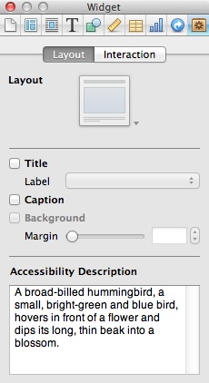

Born Digital: From Conception
Direct, on-demand access for all
  GPII
  APIP (an example from K-12)
  Adobe tools
  Apple tools (iBook Author2)

Slide 17
How will we do it?
Federally funded research and development projects
Bookshare (Dept. of Education)
Digital Image and Graphic Resources for Accessible Materials (DIAGRAM – Dept. of Ed.)
CAST’s Universal Design for Learning
Mathematics eText Research Center (MeTRC – Dept. of Ed.)
Personalized Access to NSDL (NSF)
Preferences for Global Access (Dept. of Ed.)

Slide 18
How will we do it?
Commercial enterprises large and small
ETS, Pearson, O’Reilly (DAISY), MacMillan
Teachers’ Domain <demo>
PBS Learning Media
OER Commons
gh, NCAM, Touch Graphics, Design Science

Slide 19
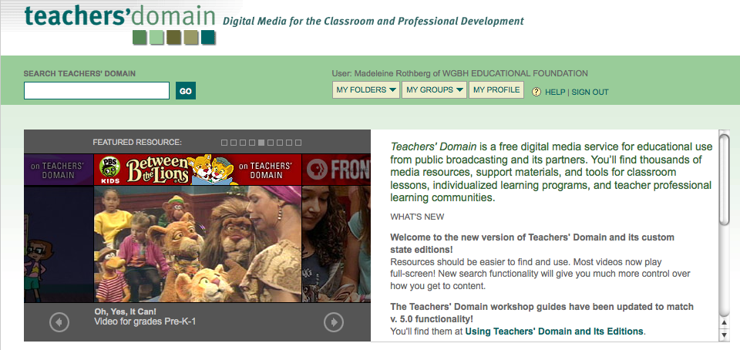
Teachers’ Domain
http://www.teachersdomain.org/

Slide 20
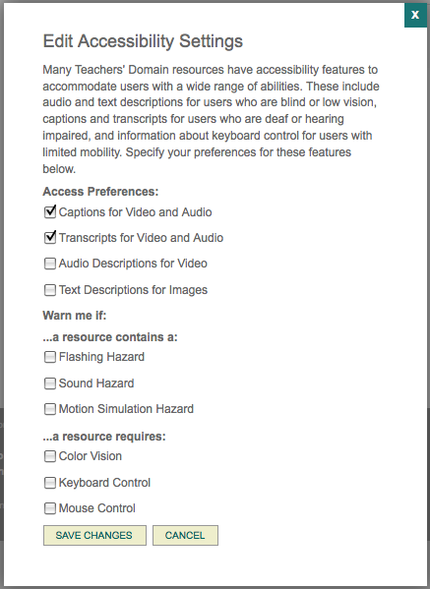
Teachers’ Domain
Accessibility Settings

Slide 21
Teachers’ Domain

Slide 22

Teachers’ Domain
The resource page lists all accessibility features and shows the match with your preferences

Slide 23
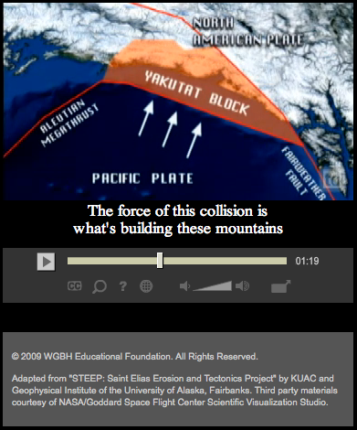
Teachers’ Domain
Captions appear automatically when indicated in your preferences
Or turn them on from the video interface

Slide 24
How will we do it?
Cloud-based services with distributed labor
dotSub
Amara
YouTube automated CC
GPII
YouDescribe.org (VDRDC crowdsourcing tool)

Slide 25
How will we do it?
Hardware and software manufacturers
  iPad
  Kindle
  Nook (we hear an accessible version is coming)
  Android

Slide 26
How will we do it?
Advocacy organizations
American Foundation for the Blind
National Federation of the Blind
American Council of the Blind
Association on Higher Education and Disability

Slide 27
Questions?
Larry_Goldberg@wgbh.org
Madeleine_Rothberg@wgbh.org
Notes:
Required – End Slide

