Slide 1
Analytics in Higher EDUCATION:
Progress and Promise
Susan Grajek, PhD
Vice President, EDUCAUSE
July 2012

Slide 2
OBJECTIVES
Assess the current state of analytics in higher education
Outline the challenges and barriers to using analytics
Assess progress in analytics

Slide 3
Methodology
Two surveys
Seven focus groups
  IT and IR professionals from around the country
  EDUCAUSE members (N=214, 21% response rate)
  AIR members (N=125, 25% response rate)

Slide 4
The Current state of analytics

Slide 5
Analytics is a major priority
Analytics is a major institutional priority at 24% of higher education institutions
8–10% of AA, BA, and BA LA are not interested or not aware
Only true of 3–4% of MA and DR
“What priority does your institution place on analytics?” N = 255 (excluded “other”), EDU + AIR

Slide 6
Analytics is a major priority
Publics are leading, but are privates catching up?
“What priority does your institution place on analytics?” N = 275, EDU + AIR

Slide 7
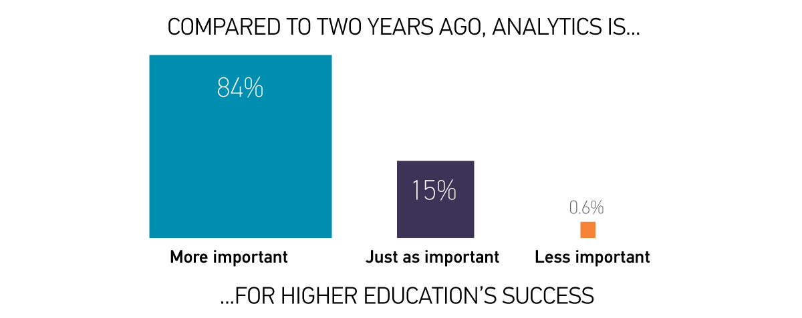
Analytics is a major priority
INSERT TYSON CHART 9
N = 339, EDU + AIR

Slide 8
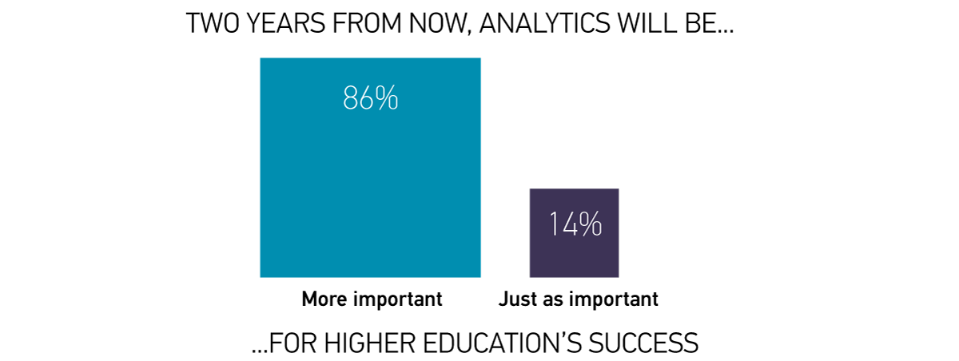
Analytics is a major priority
N = 339, EDU + AIR

Slide 9
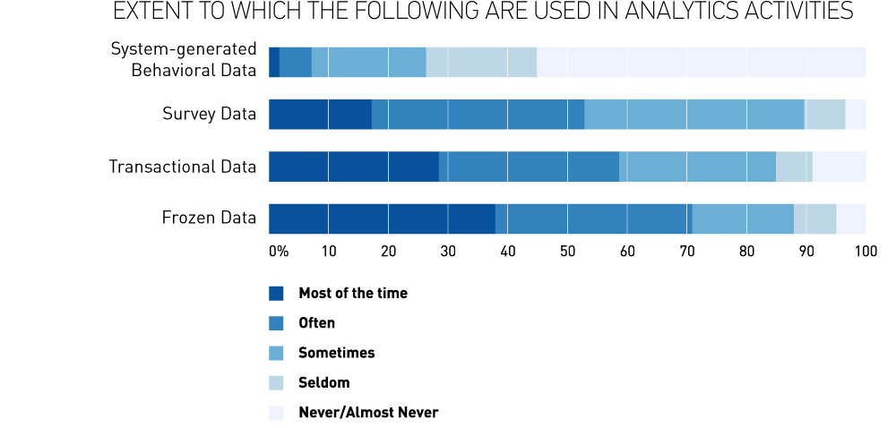
DATA USED FOR ANALYTICS
INSERT TYSON CHART 3
“To what extent are the following types of data used in analytics activities?” N = 180, EDU ONLY

Slide 10
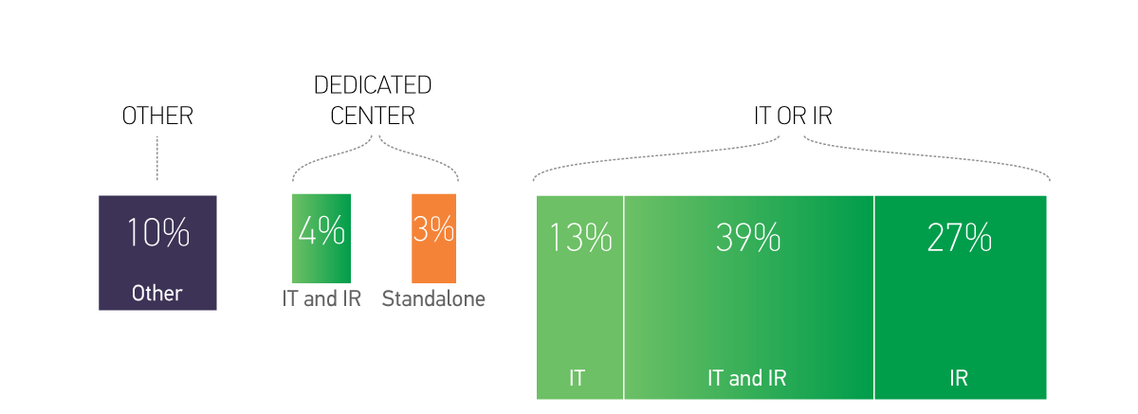
analytics services and activities:
IR and IT Most often Share responsibility
“How are analytics services and activities delivered at your institution?”, N = 180, EDU ONLY

Slide 11
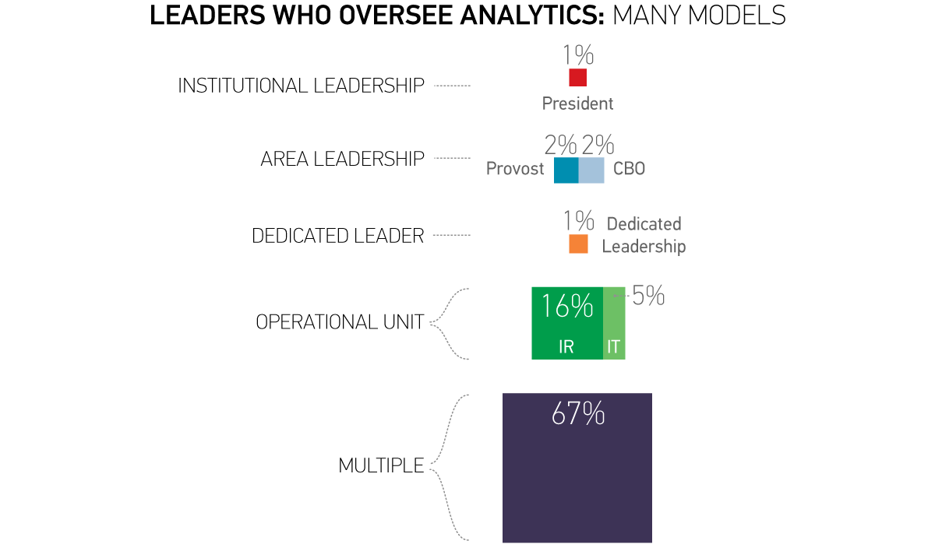
Leaders who oversee analytics: Many Models
INSERT TYSON CHART 1
“Which leaders or areas oversee analytics at your institution?” N = 180,EDU ONLY

Slide 12
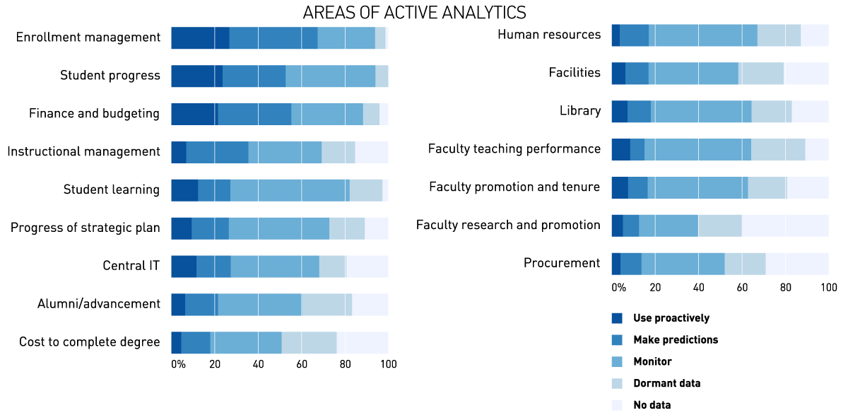
MOST ACTIVITY IN STUDENT and FINANCE AREAS, LEAST IN FACULTY
INSERT TYSON CHART 4
“Provide your best estimate of how data are being used at your institution”.; N = 339, EDU + AIR
Notes:
More than 50% of institutions are using data to make predictions or to be proactive.

Slide 13
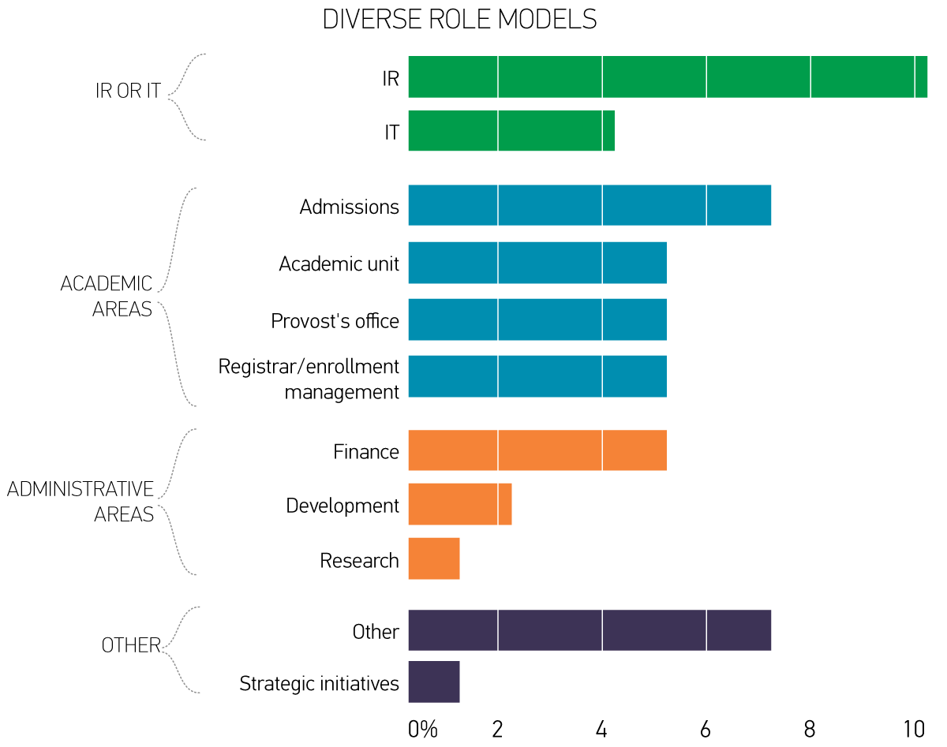
Diverse role models
“Specify the departments, units, or programs that are role models for analytics”; EDU members only.

Slide 14
Opportunities, Challenges, and barriers

Slide 15
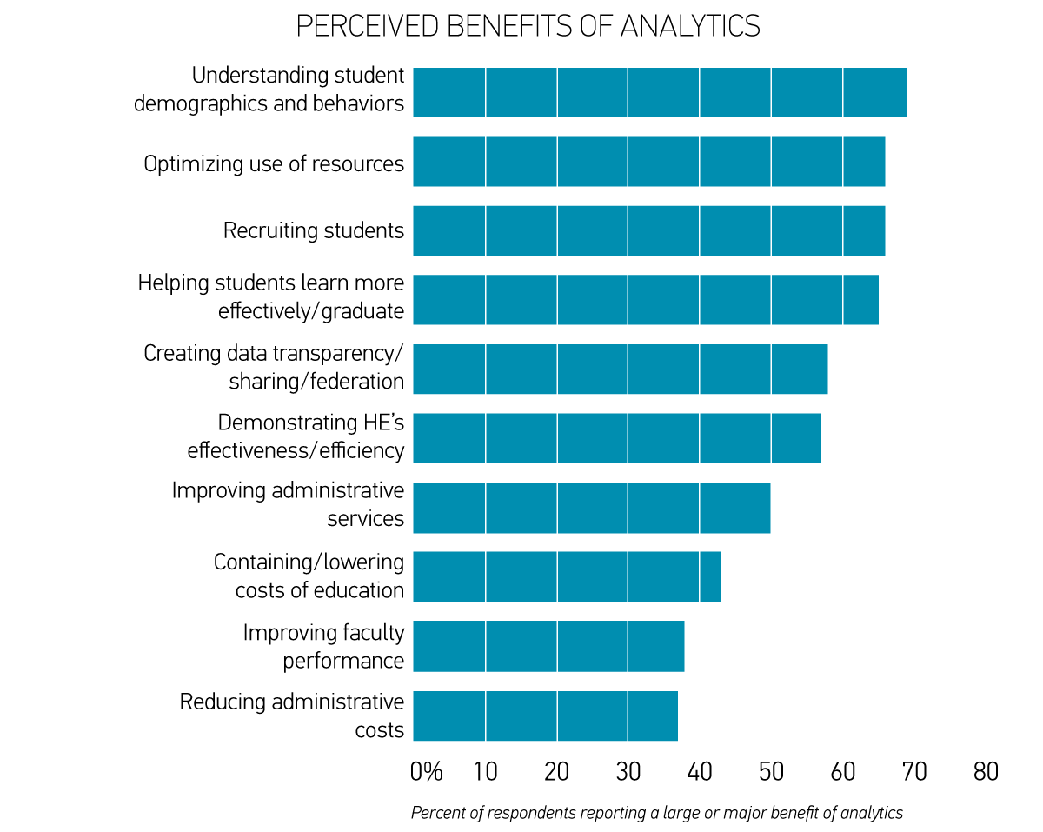
MORE Potential seen for STUDENT AREAS THAN COST OR FACULTY
“What are the potential benefits of analytics in addressing the following challenges?” N = 339, EDU + AIR

Slide 16
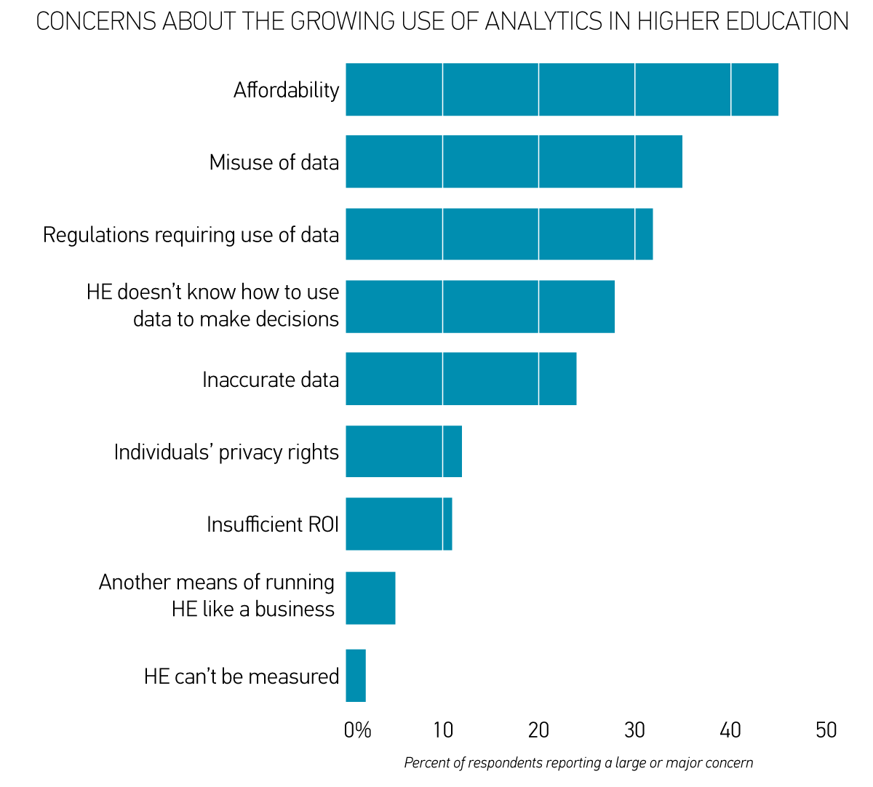
DATA AND AFFORDABILITY ARE THE BIGGEST CONCERNS
“What are your concerns about the growing use of analytics in higher education?”; N = 339, EDU + AIR

Slide 17
Progress in analytics
What are the components of analytics, and how capable is higher education today?

Slide 18
ANALYTICS maturity in higher education has five components
CULTURE/PROCESS
  Committed leadership; the use of data to make decisions in embedded in the culture
DATA, REPORTING & TOOLS
  Clean, standardized data and reports; right tools and software
INVESTMENT
  Funding and staffing for analytics
  Derived from factor analysis of 21 items asking
  “To what extent are the following in place to enable your institution to make progress with analytics?”
N = 339, EDU + AIR

Slide 19
Five components of higher Education analytics maturity
EXPERTISE
  IR and/or business professionals with analytics training
GOVERNANCE INFRASTRUCTURE
  Storage capacity; IT professionals supporting analytics; policies regarding security and rights to data
WHERE DO WE STAND?

Slide 20
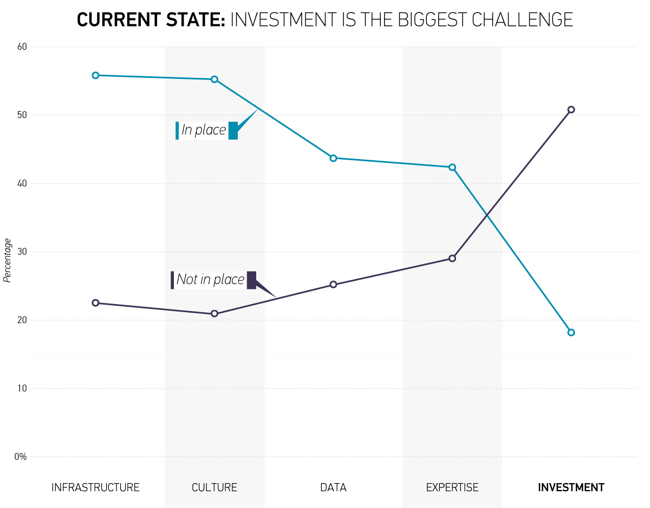
CURRENT STATE: INVESTMENT IS THE BIGGEST CHALLENGE

Slide 21
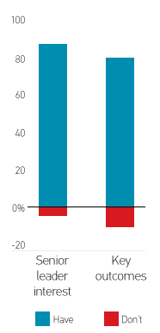
DETAILS: What are the strengths?
More than 80% reporting having:
Senior leaders interested in/committed to using data to make decisions
Identified the key outcomes (e.g., student retention, cost reductions, etc.) to target

Slide 22
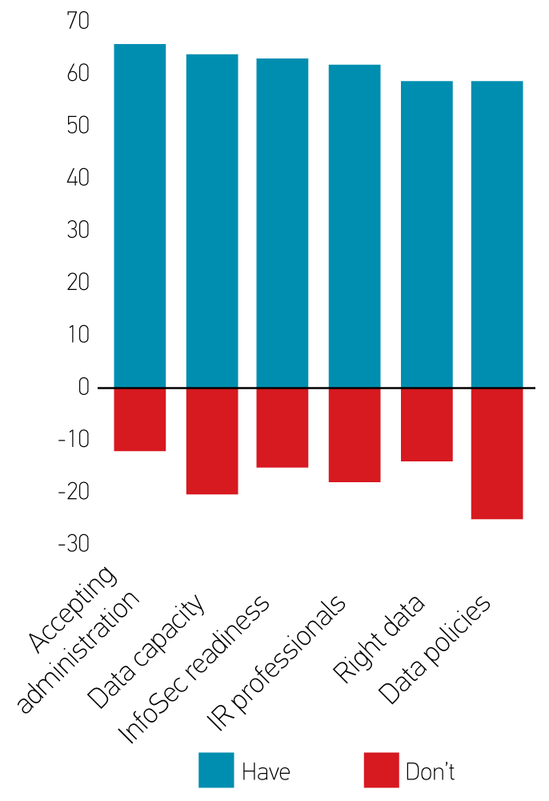
DETAILS: WHERE ARE WE MAKING PROGRESS?
Between 55% and 70% report:
Administration accepts analytics
Sufficient capacity to store and analyze data
Robust information security policies and practices
IR professionals with needed expertise
The right kind of data
Data policies that specify access rights and privileges

Slide 23
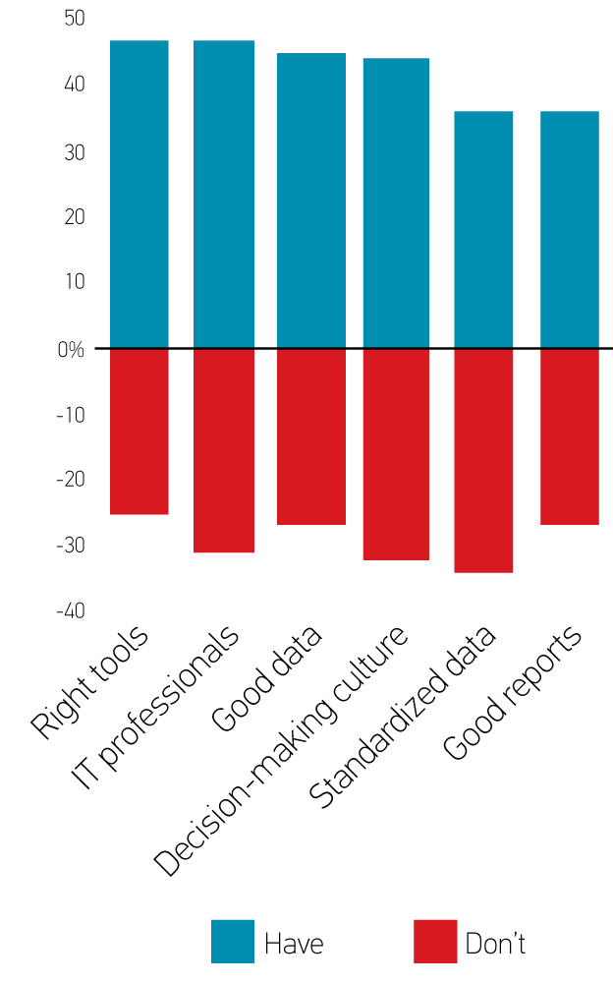
DETAILS: MANY GAPS
Between 30% and 50% report having:
The right tools
IT professionals with needed expertise
“Good” data
A culture that accepts the use
of data to make decisions
Standardized data
“Good” reports

Slide 24
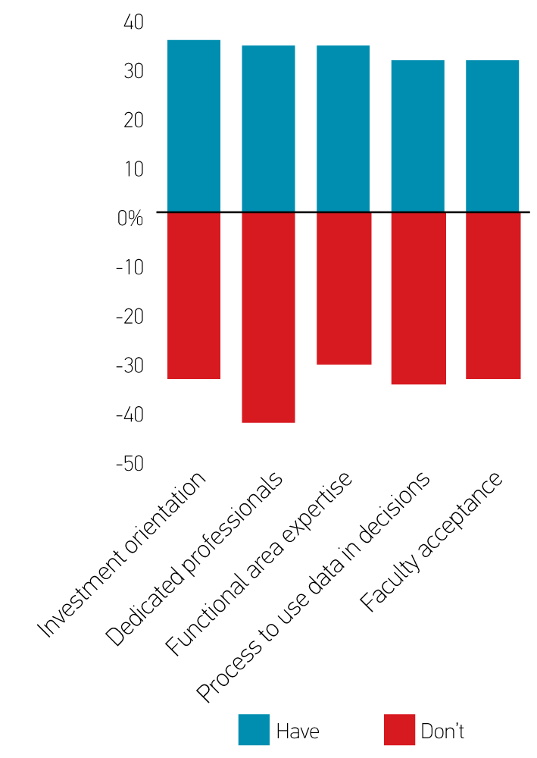
DETAILS: MANY GAPS (continued)
Between 30% and 50% report having:
Analytics funding viewed as an investment
Dedicated analytics professionals*
Functional owners who know how to apply analytics
A process for using data to make decisions*
Faculty who accept the use of analytics*
* More institutions reporting not having this than report having it.

Slide 25
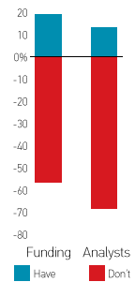
DETAILS: investment is the biggest gap
Fewer than 20% report having
and
More than 50% report not having:
An appropriate amount of funding
An appropriate number of analysts
Institutions that view analytics as an investment rather than an expense are more likely to have appropriate funding in place.

Slide 26
Once again, leadership is the magic ingredient
Senior leaders need to make analytics a priority
Institutions that place a higher priority on analytics are further ahead with
  Culture
  Investment
  Expertise
  Infrastructure
  …but not Data

Slide 27
SUMMARY and final points
Analytics is widely viewed as important
IR and IT are both critical partners
  IT is more optimistic than IR regarding the potential of analytics
  IT rates maturity higher on Culture and Infrastructure
  IR rates maturity higher on Expertise
  Focus group analysis suggests that great analytics programs have good communication between IR and IT

Slide 28
Summary and final points
Analytics activities are occurring throughout institutions, but student and financial areas are the most active
Least optimism that analytics can be used to lower HE costs…but promise is seen in optimizing resource usage
The big challenge: How can higher education afford analytics? (Hint: Think investment)

