Slide 1
Welcome to the Analytics 3-Day Sprint

Slide 2
Funding provided by The
Bill and Melinda Gates Foundation

Slide 3
Sprint Sponsor and Silver Partner
Visit IBM Analytics for Education

Slide 4
Day 1: What Does Analytics Mean for Higher Education?

Slide 5
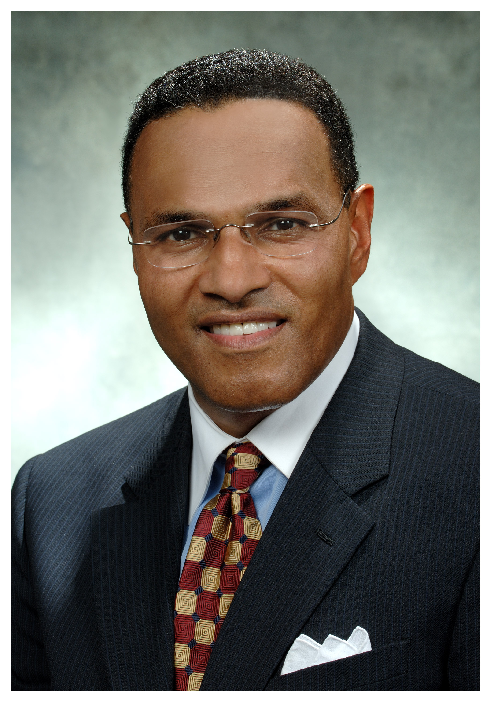
Speakers
 | Dr. Freeman Hrabowski President, University of Maryland, Baltimore Campus (UMBC) Bio: http://www.umbc.edu/aboutumbc/president/index.php

Slide 6
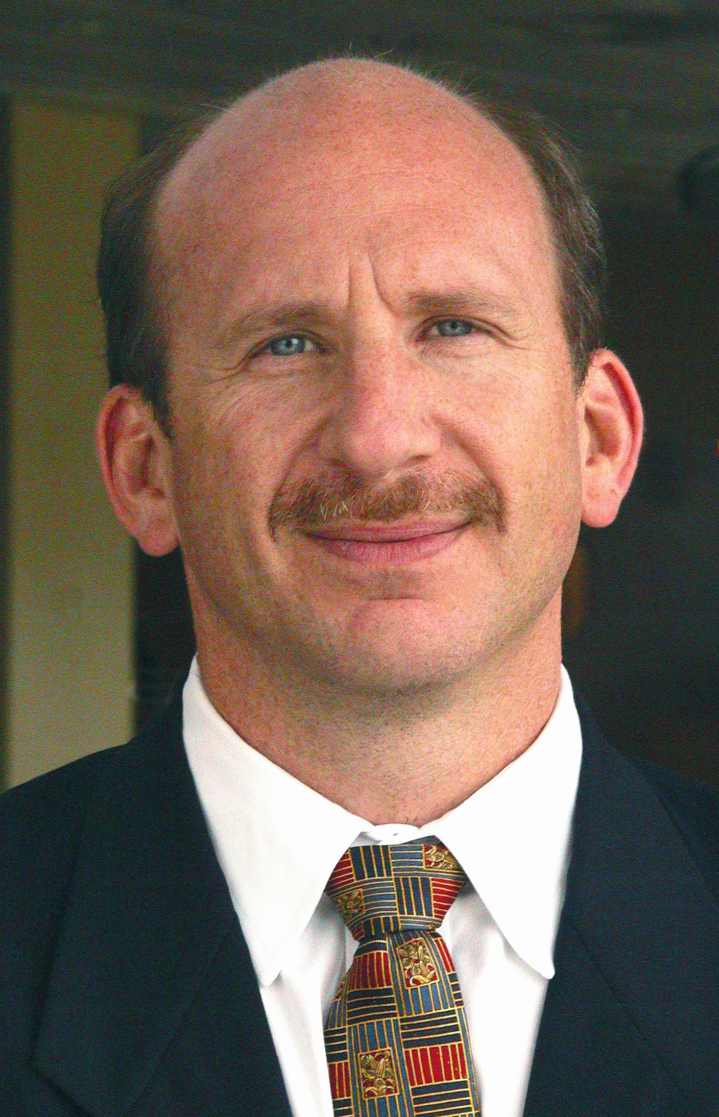
Speakers
 | Mr. Jack Suess VP of IT & CIO UMBC Bio: http://www.educause.edu/members/john-j-suess http://doit.umbc.edu/about-doit/vp-cio/

Slide 7
Speakers
 | Dr. Michael Dillon Director, Office of Institutional Research UMBC Bio: http://www.educause.edu/members/michael-dillon
Notes:
Need michaels photo.

Slide 8
Institutional Transformation
Good Questions
Being Honest
Using Data
Innovative Strategies
Execution
Culture
Notes:
Freeman will discuss this in his remarks to diana’s question
DIANA: In your article, Assessment and Analytics in Institutional Transformation, you postulated that : Assessment and analytics, supported by information technology, can change institutional culture and drive the transformation in student retention, graduation, and success. Can you elaborate on that?

Slide 9
Why Analytics is Important
Analytics, combined with leadership, is one way to break through an institutional culture that often resists change?
Leaders do this by asking questions that force the institution to be honest with itself, gather evidence, and regularly reflect on how they can do better.
Notes:
Slide displays when Freeman is answering diana on this question
DIANA: Freeman, you mentioned Analytics, what role does analytics play and is it important?

Slide 10
Resources for Institutional Transformation
 | David Brooks, The Social Animal: The Hidden Sources of Love, Character, and Achievement Larry Bossidy, Execution – The Discipline of Getting Things Done Hrabowski, Suess, Fritz – Assessment and Analytics in Institutional Transformation, EDUCUASE Review, September 2011 http://www.educause.edu/ero/article/assessment-and-analytics-institutional-transformation Hrabowski, Rous, Suess, Fritz – Podcast on Lessons Learned in Institutional Transformation, http://www.umbc.edu/ER2011.
Notes:
Slide displays when Freeman is answering diana on this question
DIANA: Freeman, you mentioned Analytics, what role does analytics play and is it important?

Slide 11
UMBC Activities on Student Learning
Chemistry Discovery Center http://www.umbc.edu/window/discovery_center.html
CASTLE – Active Science Teaching and Learning Environment http://www.umbc.edu/cnms/CASTLE
Blackboard reports http://umbc.edu/oit/newmedia/blackboard/stats/
Office of Institutional Research Studies http://www.umbc.edu/oir
Notes:
Slide displays when Freeman is answering diana on this question
DIANA: Freeman, you mentioned Analytics, what role does analytics play and is it important?

Slide 12
Notes:
Slide in response to diana’s question
DIANA: How have the trustees engaged institutional analytics initiatives?

Slide 13
USM Dashboard
http://www.usmd.edu/usm/adminfinance/IR/reports/DBI_2011_final_for_web.pdf
Notes:
Slide in response to diana’s question
DIANA: How have the trustees engaged institutional analytics initiatives?

Slide 14
Notes:
Slide in response to diana’s question
DIANA: How have the trustees engaged institutional analytics initiatives?

Slide 15
Notes:
Slide in response to diana’s question
DIANA: How have the trustees engaged institutional analytics initiatives?

Slide 16
Blackboard Reporting
Notes:
Slide in response to diana’s question – when jack starts to speak.
DIANA: How have the trustees engaged institutional analytics initiatives?

Slide 17
Using Analytics in Telling the Story
Notes:
Slide in response to diana’s question
Where have you seen the most value accrue from UMBC analytics initiatives? What has surprised you - either positively or negatively?

Slide 18
2011 Campus Retreat Poster Session on Analytics
We asked -- What if you knew?
Who your students are? Where they come from?
How well they are doing? Overall and in specific classes?
If they were persisting beyond the first year? Second year?
Who are your students that are most at risk? How long it takes your students to graduate?
What courses your students are taking? In your program and outside your program?
More about the students taking your courses?
If you were meeting course demand and supporting progress toward degree completion?
Notes:
Where have you seen the most value accrue from UMBC analytics initiatives? What has surprised you - either positively or negatively?
Slides displays when michael starts to talk

Slide 19
Making the Case For Analytics
By Using Analytics – Then You Could…
Target marketing and recruitment efforts
Enhance advising practices
Increase opportunities for faculty and peer engagement
Strengthen school, community and alumni relationships
Identify opportunities for cross department collaboration
Develop student engagement experiences
Maximize use of limited resources
Notes:
Where have you seen the most value accrue from UMBC analytics initiatives? What has surprised you - either positively or negatively?
Slides displays when michael starts to talk

Slide 20
http://www.youtube.com/watch?v=PjbYm-FUjws
Notes:
DIANA: That brings up a question, how did you pay for the analytics initiative and how do you sustain it? Freeman, did you get any criticism for allocating scarce resources. Jack how do you handle governance?
Jack Will note that this is part of our IT as a Game Changer article and that we have a 20 minute discussion between four leaders
Yvette mozie-ross, associate provost, enrollment manageent
Michael Dillon, Director of OIR
Kevin Joseph, Asst. Director, Business Intelligence
Jack Suess, VP of IT

Slide 21
REX Data Includes
Student Administration Admissions Financial Aid Enrollment/Registration Student Performance Retention/Graduation | Other Data Trouble ticket data LMS Learning Analytics Project Tracking data Financial Data (State accts) Coming later in AY 2012-13 Grant Data (planned for early 2013) Faculty productivity data
Notes:
This slide goes up in response to the question
DIANA: That brings up a question, how did you pay for the analytics initiative and how do you sustain it? Freeman, did you get any criticism for allocating scarce resources. Jack how do you handle governance?

Slide 22
Data Management Committee Meets twice a year to review progress made by various teams and solicit feedback on specific issues and prioritizations.
VPs & Deans
Campus Systems
Executive Committee
(Twice Monthly)
Chairs: CIO & AVP EM
IT Steering Committee (Monthly)
Chair: Vice Provost
Deans’ Representation
Data Warehouse Team (Weekly)
Assigns REX tickets, manages changes to warehouse & reporting envir.
Chair: IR
Rep: IR, IT, EM, Cont. Ed
REX User Group
(2X Monthly)
Chair: IT
Rep: IR, IT ,EM, Stud Affairs, Cont. Ed, Dean Offices
Informal meeting to discuss users needs and specific reports. Could be used to discuss training options.
Data Quality Team (ad hoc)
Chair: IR
Rep: IR, IT, EM, Cont. Ed, Bud&Fin, HR, Res Life
Comprised of data managers from various functional offices to develop and monitor data integrity processes
Data Access & Security Team (ad hoc)
Chair: IT
Rep: IR, IT, EM, Cont. Ed, Bud&Fin, HR, Res Life
Manages access to and security levels in PS and REX, including confidentiality issues
Setup Tables Team (ad hoc)
Chair: EM
Rep: IR, IT, EM, Bud&Fin, HR, Res Life
Manages changes to plans and subjects as well as the rollups to orgs, colleges, etc.
Training Team (ad hoc)
Chair: IT
Rep: IR, IT, EM, Cont. Ed, Bud&Fin, HR, Res Life
Manages training material for both SA and REX
Notes:
DIANA: That brings up a question
Diana: Jack and Michael, how does this fit into the broader IT goverance.
Nu

Slide 23
Notes:
Michael will explain the report and how we are trying ot use graphics to leverage more visual information

Slide 24
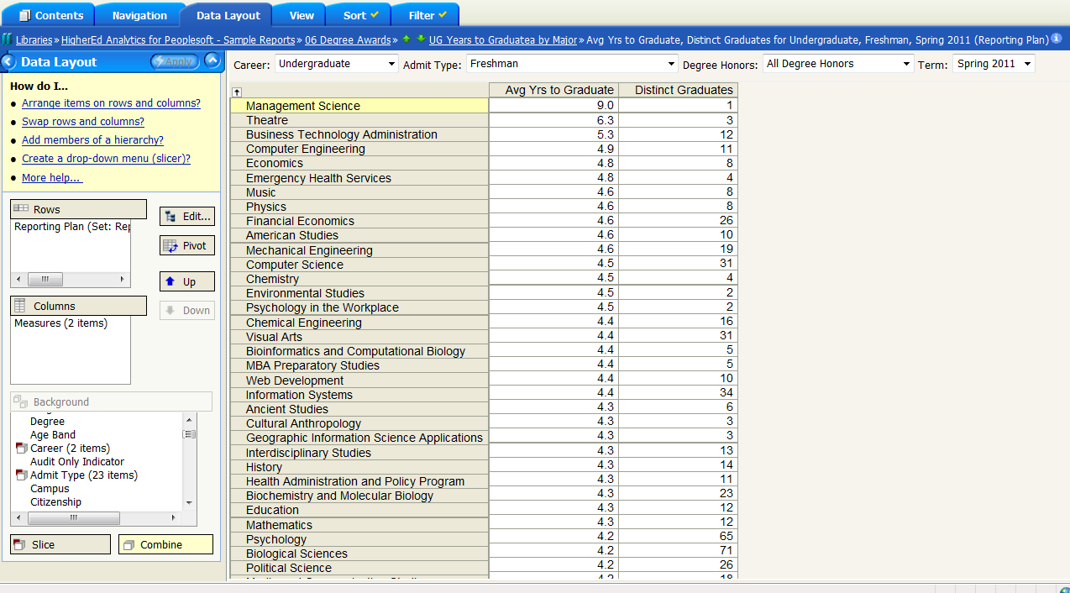
Student Demographic Report

Slide 25
Time to Degree by Major

Slide 26
Questions?

