Slide 1

Big Data Meets Learning Analytics
Ellen Wagner
Partner and Sr. Analyst , Sage Road Solutions, LLC
Executive Director, WICHE Cooperative for Educational Technologies (WCET)

Slide 2





Data Optimize Online Experience
The digital “breadcrumbs” that online technology users leave behind about viewing, engagement and behaviors, interests and preferences provide massive amounts of information that can be mined to better optimize online experiences.

Slide 3
Data In Daily Life:
Lots Of “Big Data”, All The Time
search
shopping
FRIENDING
Check-ins
Progress Tracking
Location based services
Dashboards
Gamification
Ratings
Personalization

Slide 4
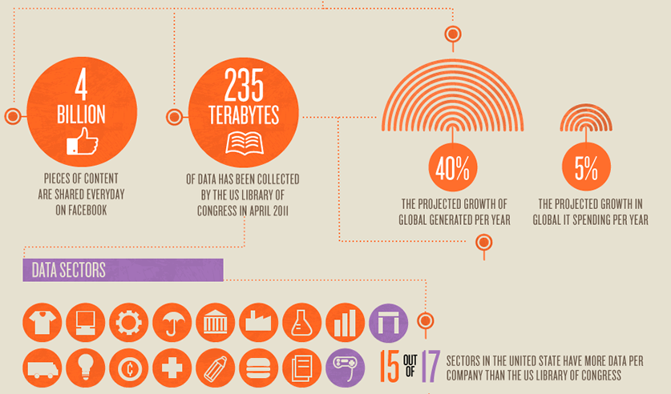
Just How Big is “Big Data”?
http://blog.getsatisfaction.com/2011/07/13/big-data/?view=socialstudies

Slide 5
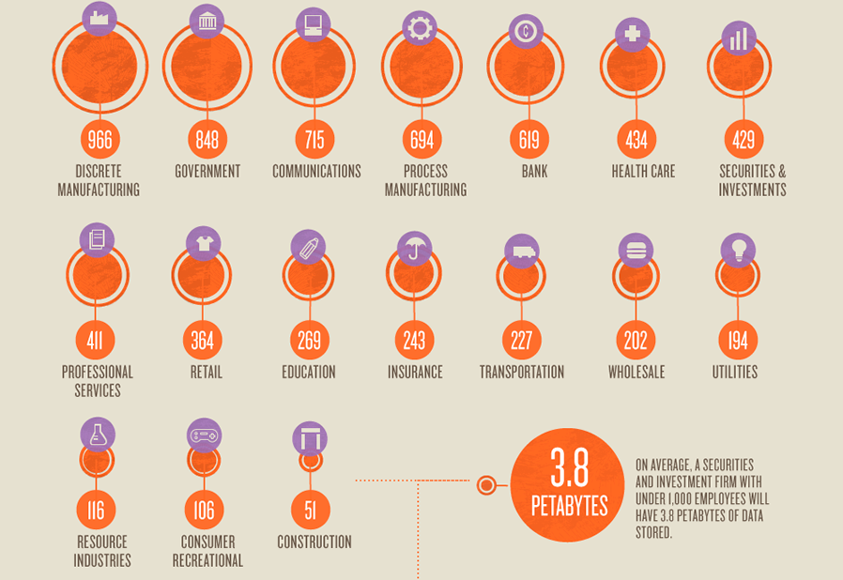
Big Data in Industry Sectors
http://blog.getsatisfaction.com/2011/07/13/big-data/?view=socialstudies

Slide 6
Major Trends at Play
Data Warehouses and “the Cloud” make it possible to collect, manage and maintain massive numbers of records.
Sophisticated technology platforms provide computing power necessary to grind through calculations and turn the mass of numbers into meaningful patterns.
Data mining uses descriptive and inferential statistics —moving averages, correlations, regressions, graph analysis, market basket analysis, and tokenization – to look inside patterns for actionable information.
Predictive techniques, such as neural networks and decision trees, help anticipate behavior and events.

Slide 7
Gartner Pattern Based Strategy, 2010:
From reacting to events that had major effects on business strategy to proactively seeking patterns that might indicate an impending event.
The interest in Pattern-Based Strategy is likely to grow as we understand the technologies that are emerging to seek patterns
  from both traditional (financial information, customer order data, inventory, etc.)
  nontraditional sources of information (social media, news, blogs).
Gartner Research, Inc. 3 August 2010
ID Number: G00205744. p.4

Slide 8
Emergence of Business Intelligence
Research typically reports empirical evidence to prove the tenability of ideas concepts and constructs.
Business Intelligence uses analytical techniques to mine data to make decisions and create action plans.
Techniques for analyses include many of the same tools, but the focus on structuring the research question is very different.

Slide 9

Learning Organizations and Data Analytics
Analytics have ramped up everyone’s expectations for accountability, transparency and quality.
Learning organizations simply cannot live outside the enterprise focus on measurable, tangible results driving IT, operations, finance and other mission critical applications.

Slide 10
The Case for Learning Analytics
The digital “breadcrumbs” that learners leave behind about their engagement behaviors and interests provide massive amounts of data that can be mined to improve and personalize educational experiences
This is making learning professionals very uncomfortable

Slide 11
Will Data REALLY Optimize
Educational Experience?
Completion
ROI
engagement
retention
sustainability
Progression
Learning
Outcomes
Recruiting
competitiveness
Notes:
Why anaylitcs comes up in every conversation
Google-like analytics
Commercial sector experiences driving HED expectations
“EASY button” solutions
Education not keeping up with consumer-like

Slide 12

Lessons from Moneyball
Moneyball: The Art of Winning an Unfair Game (ISBN 0-393-05765-8) Michael Lewis, 2003

Slide 13

The Predictive Analytics
Reporting Framework – Fast Facts
A ‘Big Data” project using predictive statistical analyses to identify factors affecting retention, progress and completion
6 institutional partners
  2 for profit (APUS, U. of Phoenix)
  2 4 year schools (U. of HI system, U of Illinois, Springfield)
  2 community colleges (CCC Online, Rio Salado)
3,100,000 course level records
640,000 student level records

Slide 14
PAR Framework Objectives
Identify common variables influencing student retention and progression;
Establish factors closely associated with online students’ proclivity to remain actively enrolled within the institution;
Determine if measures and definitions of retention, progression, and completion differ materially among various types of postsecondary institutions; and
Discover advantages and/or disadvantages to particular statistical and methodological approaches pertaining to identifying profiles of students considered to be “at-risk.”

Slide 15
PAR Framework Process
Examine variables common across institutions
Federate records of online students
Aggregate all data into a single pool
Apply exploratory statistical tests
Interpret Outcomes
Normalize Variables
Document to accelerate next round

Slide 16
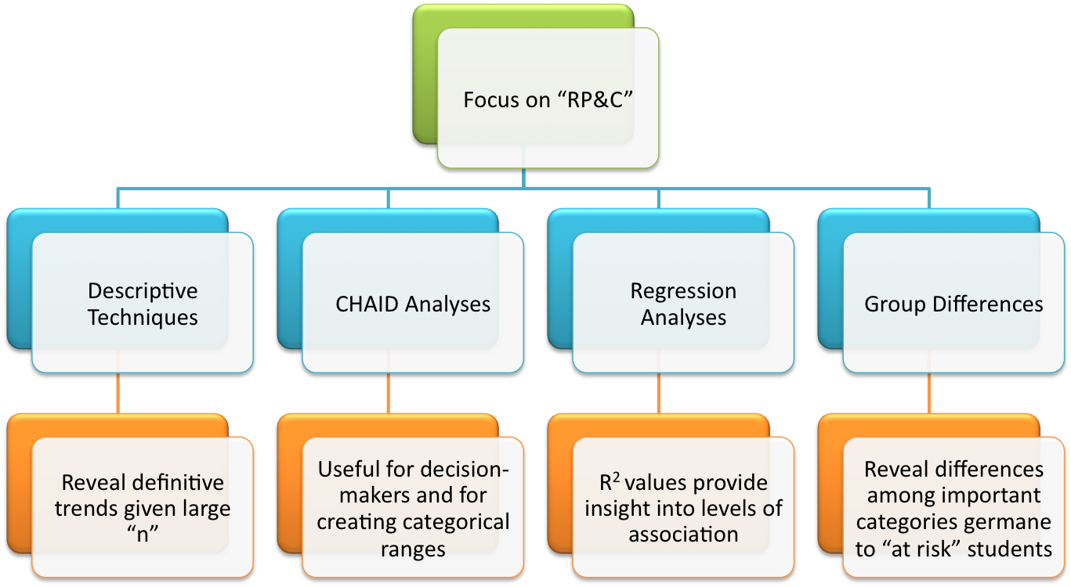
Analysis Protocols

Slide 17
Some Preliminary PAR Findings
For students at-risk, disenrollment was influenced by the number of concurrent courses in which that student was enrolled, with taking more than one course, in the early stages of their college career, being highly correlated with an increased risk of disenrollment..
No apparent relationships existed between age, gender, or ethnicity as a function of the student’s risk profile.
For students not at-risk of disenrollment, institution-specific factors predicted student success.

Slide 18
Lesson Learned – So Far

Slide 19

(1) Analytics are here today, and they are here to stay. Get on board or get left behind!

Slide 20
(2) It’s what we do with the analytical findings that really matter.

Slide 21
(3) Doing research on analytics is fundamentally different than applying analytics results to help learners succeed.

Slide 22
(4) We already have more data than we can handle. That means we need to find better ways to handle it.

Slide 23
(5) Even more interesting data collecting opportunities await.

Slide 24
(6) We need to be prepared to live under the “sword of data.”

Slide 25
(7) There's no such thing as “sort of” transparent.

Slide 26
(8) We have just started to understand the true power that analytics bring to the learning enterprise.

Slide 27


THANKS for your interest
Ellen Wagner
edwsonoma@gmail.com
http://wcet.wiche.edu
http://twitter.com/edwsonoma
+ 415.613.2690 mobile

