Slide 1
Security From The Ground Up
David Seidl
Information Security Program Manager
University of Notre Dame

Slide 2
Copyright
Copyright David Seidl, 2009. Portions of this presentation copyright Michael J. Chapple, 2008. This work is the intellectual property of the author. Permission is granted for this material to be shared for non-commercial, educational purposes, provided that this copyright statement appears on the reproduced materials and notice is given that the copying is by permission of the author. To disseminate otherwise or to republish requires written permission from the author.

Slide 3
Background
The Office of Information Technology (OIT) is the central IT organization for Notre Dame.
Departmental IT organizations exist independently in some departments.
The Information Security department is part of the OIT, but bears central responsibility for campus information security.

Slide 4
Background: 2006
The Information Security department was founded in 2002 and grew to a total of five staff members by 2006.
Up until 2006, Information Security was a combination of implementing internal controls and external consulting
This was seen to not be sufficient due to regulatory and risk based assessments.

Slide 5
Background: 2006
Initial credit card compliance discussions were being held due to PCI requirements and a credit card network inventory was completed.
70 merchant accounts and 15 distinct applications were found.
Credit card compliance efforts were begun and then…

Slide 6
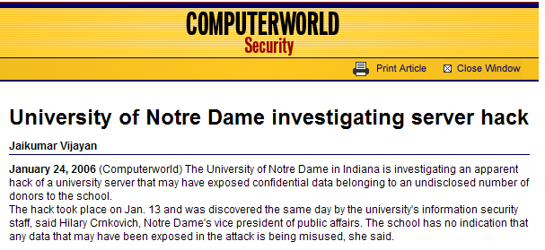
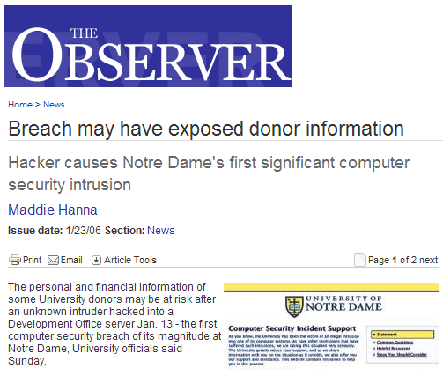
Game Changers

Slide 7
Result:
The CCSP and CITRA
Credit Card Security Program – PCI compliance
  Additional detail is available in slides available on the EDUCAUSE site as “The Data Center Within A Datacenter” and “Navigating The Regulatory Maze”
University Leadership requested a campus wide IT risk assessment, which came to be called CITRA, or the Campus IT Risk Assessment

Slide 8
Parallel Efforts
Incident Response
Incident
CITRA
Initial PCI DSS
Discussions
Credit Card
Network Inventory
Consultant
Assessment
CCSP
Planning

Slide 9
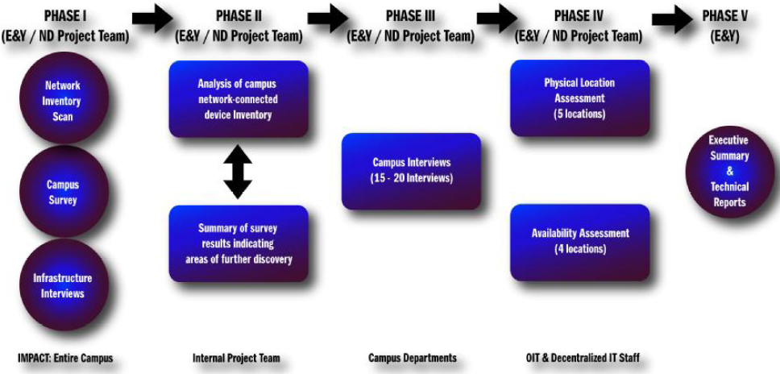
Assessment Process

Slide 10
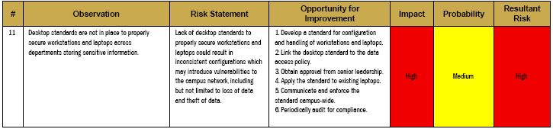
CITRA Findings
End result was 68 findings covering 10 key areas:
For example…
Information Security Framework | Data Classification and Handling
Access Control | Encryption Strategy
Configuration Standards | Physical Security
Technical Security Architecture | Disaster Recovery
Compliance | Information Security Awareness

Slide 11
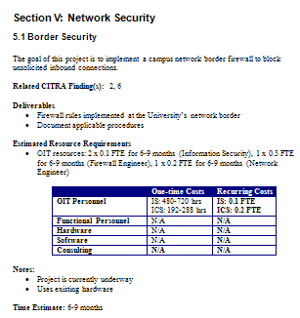
Planning Workshop
Analyzed CITRA results and created project specifications for all medium/high risk findings
Produced comprehensive project plan with resource estimates and sequencing
Each project ranked on costs (financial and staff), importance and urgency

Slide 12
Resource Planning
Discussed project objectives with resource managers
Simple approach to resource estimation for both staffing and cost:
  Determine “best case” and “worst case” time and cost estimates
  Average those endpoints
  Surprisingly accurate!

Slide 13
Outcome
Projects sequenced to prioritize high-risk findings and balance resource consumption
Overall costs: $4.6M one-time, $630K recurring. Since then, we have returned $1M to central control.
Presented to University leadership and funded IN FULL!

Slide 14
Security Program Mission
Identify confidentiality, integrity and availability risks to sensitive University information, and mitigate those risks to acceptable levels.

Slide 15
Objectives
The objectives of the program are to:
Evaluate risks to the confidentiality, integrity and availability of sensitive information
Establish and implement controls to fill critical gaps, as determined by institutional risk tolerance
Create awareness of information security and proper data handling practices
Establish and communicate security-related policies, procedures and standards

Slide 16
Program Elements
Policy
Awareness, Training and Education
Credit Card Support Program
Security Infrastructure
Network Security
Workstation Security
Server Security
Incident Handling
Sustaining Activities

Slide 17
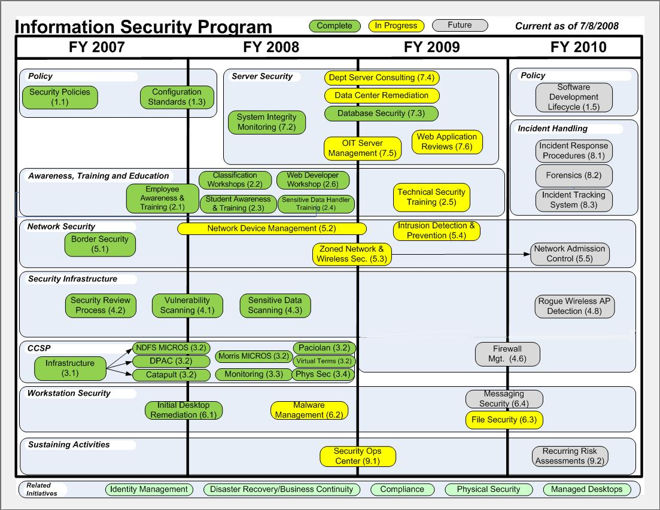
Putting it all together

Slide 18
Policy
Policy was required as a foundation for other projects.
Security Policies and Standards (FY 2007)
Establish University-wide Information Security policies and handling standards based on ISO 17799
Configuration Standards (FY 2007)
Develop configuration standards for applications and mobile systems
Software Development Lifecycle (FY 2010)
Select and implement a SDLC model for use with OIT systems

Slide 19
Awareness, Training and Education
Employee Awareness (FY 2007-2008)
Provide security awareness, communication and training for faculty & staff
Student Awareness (FY 2008)
Provide security awareness, communication and training for students
Classification Workshops (FY 2008)
Conduct workshops to aid Data Stewards in classifying their data
Sensitive Data Handler Training (FY 2008)
Provide specialized training for those who work with sensitive University Data
Technical Security Training (FY 2009)
Provide specialized technical security training for IT Professionals

Slide 20
Workstation Security
Initial Desktop Remediation (FY 2007)
Apply a basic set of security controls to University workstations
Malware Management (FY 2008)
Provide a solution for management and monitoring of antivirus and anti-spyware software on University systems
File Security (FY 2009)
Conduct a vulnerability assessment and apply security controls to NetFile
Messaging Security (FY 2009-2010)
Apply security controls to electronic mail and instant messaging

Slide 21
Server Security
Data Center Architecture Enhancements (FY 2008)
Enhance security controls on the OIT Data Center front end
Server Integrity Monitoring (FY 2008)
Formalize OIT server integrity monitoring infrastructure and processes
Database Security (FY 2008)
Conduct a vulnerability assessment of University databases and implement appropriate controls
Departmental Server Consulting (FY 2008-2009)
Conduct a security assessment of each departmental server and provide recommendations on alternative technologies and/or appropriate controls.
OIT Server Management (FY 2008-2009)
Implement security management practices for OIT servers with
separation of duties and data segregation, where appropriate

Slide 22
Network Security
Border Security (FY 2007)
Implement campus network border firewall to block unsolicited inbound connections
Network Device Management (FY 2007-2008)
Implement security standards on campus network devices
Zoned Network and Wireless Security (FY 2008-2009)
Design and implement a zoned network architecture with appropriate security controls on the wired and wireless networks
Intrusion Prevention (FY 2009)
Replace the University’s existing intrusion detection system with a comprehensive intrusion prevention system
Network Admission Control (FY 2010)
Implement controls to ensure that network-
connected systems meet security standards

Slide 23
Security Infrastructure
Vulnerability Scanning (FY 2007)
Create a scanning facility to proactively detect technical vulnerabilities in University systems
Security Review Process (FY 2007)
Create a process for consistently conducting information security reviews
Sensitive Data Scanning (FY 2008)
Create a scanning facility to proactively detect CC/SSNs stored in institutional file systems

Slide 24
Security Infrastructure (cont’d)
Application Logging, Network Logging, and Security Log Analysis projects (FY 2009)
Intended to capture enterprise application events as well as records of off-campus connections involving University systems in the OIT central log repository, and to create security analysis capabilities for the data that is available via these logging processes. These were all rolled into the SOC project.
Firewall Management (FY 2009)
Audit existing firewall rulebase and implement standard management practices
Rogue Wireless AP Detection (FY 2010)
Provide the ability to identify unauthorized wireless access points on the University network

Slide 25
Credit Card Security
CCSP Infrastructure (FY 2007)
Create the infrastructure required to migrate card processing applications to the OIT data center
CCSP Application Migration (FY 2007-2008)
Move card processing servers to the payment card environment located in the OIT data center
CCSP Monitoring (FY 2008)
Implement ongoing technical monitoring of the payment card environment
CCSP Physical Security (FY 2008-2009)
Upgrade data center physical security to meet PCI DSS requirements

Slide 26
Incident Handling
Incident Response Procedures (FY 2010)
Create technical procedures for responding to information security incidents to supplement the existing Incident Response Plan
Forensics (FY 2010)
Identify forensic resources for use in information security incident response.
Incident Tracking System (FY 2010)
Provide an information security incident tracking system

Slide 27
Sustaining Activities
Security Operations Center (FY 2008-2009)
Create an operations center to monitor and provide initial response to security events
Recurring Risk Assessments (FY 2010)
Establish a process for recurring, periodic risk assessments to measure risk to University data assets
Program Monitoring (FY 2010)
Assess the ongoing effectiveness of the information security program

Slide 28
Where are we now?
Security Operations
Technology and Procedures
Policy and Regulatory Requirements
Awareness
Current Efforts
Ongoing

Slide 29
Program Highlights
For the most part, on-time completion under budget
Some “in-flight” changes to the plan to:
  Combine projects (SOC)
  Reprioritize project sequencing
  Deal with staffing and priority changes
  Address new risks (e.g. Web application security)
  Balance resource utilization with other initiatives

Slide 30
Successes
CCSP fully implemented and online
More than 50% of the program’s projects are successfully completed.
High success rate for awareness program - >85% two-touch response rate.
Vulnerability scanning resulted in very significant decrease in reported vulnerabilities.

Slide 31
Lessons Learned
Maintenance of business activities were originally not designed to increase as projects came online.
  This led to delayed maintenance and issues with sustaining activities
  Meeting ongoing operational security needs proved difficult.
Added a process to review maintenance activities after project go-live.

Slide 32
More Lessons Learned
Staffing changes
  Program Manager left for another campus organization.
  Backfilling InfoSec position took 6 months.
  Worked to solve this by spreading work over longer time periods and by using more project management time to conserve technical resources.

Slide 33
More Lessons Learned
Priorities
  Priorities driven by non-program projects require additional staff time from InfoSec
  This time was not allocated in the program design, and leads to delays in programs projects
  Still working to deal with this:
    Increase maintenance of business time
    Create a pool of available hours
    Project planning phase involvement for new projects and strong partnership with project management

Slide 34

Questions?

