Slide 1
Coordinated Autonomy:
Centralized ERP in the Decentralized Institution
EDUCAUSE Live! Webinar
August 21, 2012
1:00 – 2:00 pm
Coordinated Autonomy: Centralized ERP in the Decentralized Institution
by Jason Shaffner & Geoffrey Corb is licensed under a Creative Commons Attribution-NonCommercial-ShareAlike 3.0 Unported License.

Slide 2


Speakers
Jason Shaffner | @jasonshaffner | jason_shaffner@harvard.edu
  Director of Financial Systems Solutions, Harvard University
  Responsible for applications strategy, business analysis, and project management for Harvard’s centrally managed financial applications
  12+ years leading transformative information technology programs in higher education, including ERP (Financials, HRMS, Procurement), Planning and Budgeting, and Student Information Systems
  Harvard graduate
Geof Corb | @geofdotedu | geof@jhu.edu
  Senior Director, Enterprise Applications, Johns Hopkins University and Johns Hopkins Health System
  Responsible for enterprise business systems, business intelligence, student information systems, academic & classroom technologies
  8+ years leading transformative information technology programs in higher education , including ERP (Financials, HRMS, Procurement), Student Information Systems, Business Intelligence, and Academic Technologies
  Hopkins graduate

Slide 3
Objectives
Review Harvard and Johns Hopkins context
  Organization Structure
  Enterprise Systems Landscape and History
  Key Challenges and Constraints
Analyze recent enterprise projects at both institutions, including obstacles and solutions
Discuss lessons learned at Harvard and Johns Hopkins
NOTE: For the purposes of this presentation, “ERP” refers to all enterprise-scale applications

Slide 4
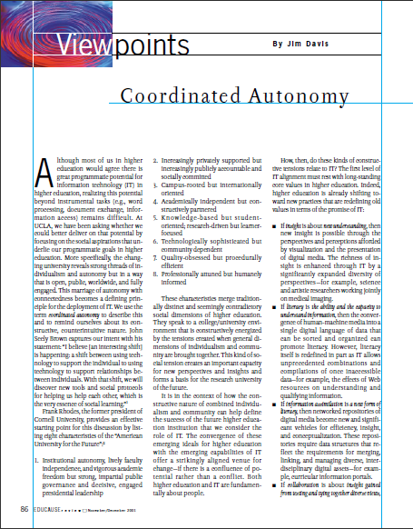
Coordinated Autonomy
Attributed to UCLA’s Jim Davis in EDUCAUSE Review (Nov/Dec 2001):
  The term coordinated autonomy indicates, first, that IT should be deployed to actively preserve and support individual and institutional autonomy.
We extend this definition to other intra-institutional entities besides individuals:
  Respecting the unique business requirements of each organization, but encouraging alignment around shared principles and best practices.

Slide 5
About harvard

Slide 6
Harvard University at a Glance
Research and Teaching
Finances
12 primary academic units
~ 21,000 degree candidates
~2,100 faculty members and 10,000 academic appointments in affiliated teaching hospitals
More than 70 libraries and 17 million volumes
FY11 Operating revenue: $3.8 billion
FY11 Operating expenses: $3.9 billion
6/30/11 Endowment value: $32.0 billion
FY11 Capital expenditures: ~$314 million
Employment
Physical Plant
Among the largest employers in Massachusetts with approximately 18,000 employees (15,000 full time equivalents)
More than 600 buildings
25.8 million gross square feet
Over 5,000 acres
Harvard in Context
Not-for-profit
Decentralized organizational structure (“ETOB”)
Intense public and community scrutiny
Increasingly global
AAA/Aaa credit ratings

Slide 7
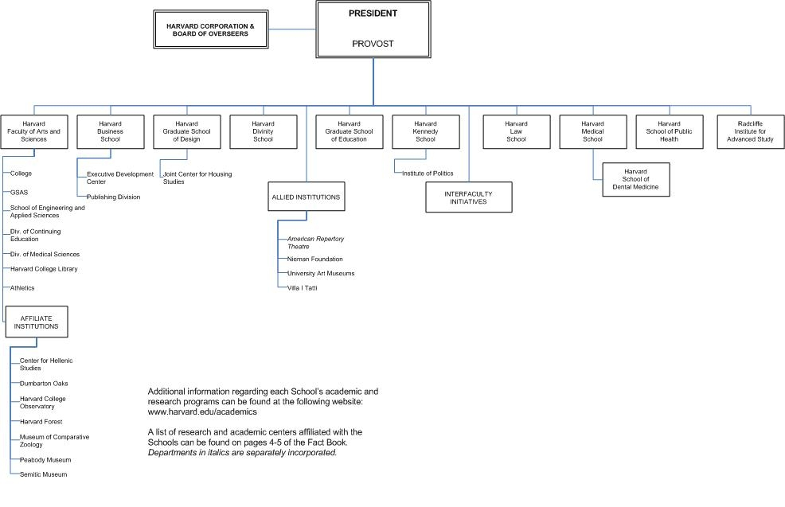
Harvard Organization Chart - Academic
Key Takeaway: By and large, each box on this chart functions as a semi-autonomous entity, responsible for its revenue and expenses, paying “taxes” to support central administration shared services and common activities (including ERP).
Most schools have a local CIO and IT organization responsible for pedagogical, research, student, and faculty needs.
Notes:
Talking Points:
One of the key concepts behind Harvard’s decentralization is “Every Tub on its Own Bottom” or ETOB. You may call this Responsibility Center Management (RCM) or any of a number of other terms. Within this structure, the schools are largely responsibility for their own financial well being. They “own” their endowments, revenues, and debts. Schools have robust internal organization structures on both the academic and adminstrative side; at the head of each school is a Dean – there is typically a COO, CFO, CIO at each school. As shown on this chart, the Deans report to the President and Provost. In addition to the schools, there are numerous allied institutions, affiliates, and imbedded centers that also function as semi-autonomous organizations.

Slide 8
Core Business Model Variations Across Harvard Schools
($ in millions)
$3,099 |  | $23 |  | $30 |  | $1,017 |  | $38 |  | $171 |  | $88 |  | $144 |  | $630 |  | $37 |  | $91 |  | $496 |  | $333
Note: Proportions may slightly differ from those reported in the University Financial Report (e.g., Financial Report does not adjust for tuition discount transfers, object 6432; SEAS’ proportions in the Financial Report exclude tuition discount). Percentages may not always add to 100% due to rounding.
*Other Income includes publications, rental and parking fees, royalties, sales and services income.
*
Notes:
The point of this slide – which is in the University financial statements – is to illustrate the fact that the schools are extremely varied businesses, with huge variations in the source of revenue as well as overall scale. One of the clear challenges for my group is to design solutions that meet the needs across a spectrum of organizations from the $28M Radcliffe Institute to the $1.1B Faculty of Arts and Sciences. The nature of the business at each school varies widely, with some schools heavily dependent on grants/contracts and others relying almost exclusively on endowment distributions. As you might imagine, this can foster varied perspectives on business application investment choices.

Slide 9
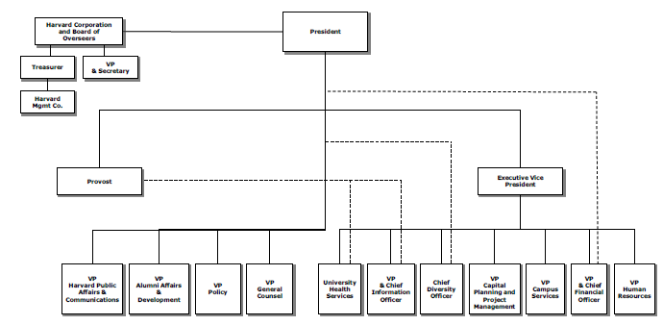
Harvard Central Administration
ERP Apps
Dev / DBA
ERP Product Management
Key Takeaway: Central Administration provides a host of administrative and shared services, including Enterprise IT and Administrative Systems. However, “CADM” is a large, complex, and decentralized organization (and larger than many of the schools!)

Slide 10
ERP Architecture at Harvard University
Oracle E-Business Suite 11i
  GL, AP, AR, CM, iProcurement
  Implemented in 1999 (10.7); upgrade to 11i in 2003
  R12 Go-live: November 2012
PeopleSoft Enterprise 9.1
  HR, Benefits, Pension, Payroll, Time & Labor, Absence Mgmt
Oracle Hyperion Planning 11.1.2
  Used primarily for annual budget process
  Now expanding to focus on interim financial reporting, multi-year planning, tuition and enrollment planning, etc.
Grants Management Application Suite (GMAS)
  Custom application suite; implemented 2004
  Includes comprehensive pre- and post-award functionality, integrated with other ERPs
Harvard Data Warehouse
  Custom data warehouse and web interface; Oracle Reports and Interactive Reporting for information delivery
  Planning to implement Oracle Business Intelligence (OBIEE) in several phases over the next two years
Notes:
You’ll note the absence of Student Information Systems here… My group plays a small role in maintaining the centralized student “term billing” system based on SIS+ (SunGard / SCT) and various custom and third-party bolt-on applications. At this time, each school maintains its own student information systems. There is an active planning phase – I just reviewed proposed staffing models last week – for an enterprise SIS.

Slide 11
Challenges of Harvard Enterprise Applications Environment
Differentiated Requirements
Schools and service units have vastly different business models, which are not easily satisfied by commercial off-the-shelf software packages or within a single install
Rocky Implementation History
ERP projects in 1990s were difficult and often divisive; several organizations built shadow systems to compensate for perceived or real gaps
Local Autonomy and Resources
Every Tub on its Own Bottom (ETOB) establishes schools and units as semi-autonomous entities
Consensus Decision-Making
Limited ability for central administration to mandate conformance even when majority of schools agree; critical to obtain buy-in at all levels of the institution
Availability of local funds and resources can be a disincentive to accepting sub-optimal central ERP

Slide 12
Harvard case studIES

Slide 13
Harvard University Case Studies - Background
Harvard University Budgeting System (HUBS) (Oracle Hyperion Planning) | Harvard Crimson Online Marketplace (HCOM) (Oracle iProcurement & SciQuest)
Objective: Implement common University-wide system to replace Excel as primary method of budget development and analysis | Objective: Achieve internal control, operational efficiency, and cost savings goals through online requisition and PO system.
Key Challenges: Multiple business process owners 20 different approaches to budgeting Varying levels of end user sophistication | Key Challenges: Resistance to pre-commitment controls Uneven benefits across business units Confusion about project objectives
Critical Success Factors Multiple Deployment “Waves” Center / School Engagement Model Transparency of Decisions/Priorities Focus on Points of Agreement | Critical Success Factors Pilot Followed by Staged Deployment Center / School Engagement Model Robust governance model Build buy-in across all org levels

Slide 14
Harvard University Case Study – Budgeting System
Harvard University Budgeting System (HUBS) (Oracle Hyperion Planning)
Timeline: Project Start: April 2008 Wave 0 – Prototype Demo: July 2008 Wave 1 Go-Live (4 Schools): Oct 2008 Wave 2 Go-Live (Reporting for All Schools): June 2009 Wave 3 Go-Live (All Others): Oct 2009
Project Metrics: Delivered on-time and under-budget 18 Planning Applications 50+ budget analysis reports 1,000 users; 600+ active
More Info (Membership Required) HEUG Alliance 2008, 2009, 2010, 2011 OAUG Collaborate 2011
We defined a pilot group that represented a cross-section of the University’s potential requirements – large school, small school, professional school.
We also engaged the entire stakeholder community in monthly presentations from day one. Through this we were able to develop 90% “baseline” solution and limit customizations.

Slide 15
Harvard University Case Study - iProcurement
Harvard Crimson Online Marketplace (HCOM) (Oracle iProcurement & SciQuest)
Timeline: Pilot: Fall 2006 - Summer 2008 Extended Pilot (aka “Fiscal Crisis”): Aug 2008 - May 2010 Implementation Re-Launch: May 2010 First Wave Live: August 2010 E-Invoicing Go-Live: October 2010 Final Wave Live: December 2011
Project Metrics: Completed on-time and on-budget On-boarded 5,000+ users in ~12 mos 170+ Hosted Catalogs; 20+ Punchout From ~1% to >25% invoices received electronically from suppliers
More Info Oracle Open World 2011
Pilot group focused on sciences, but extended pilot allowed us to slowly develop full feature set while implementation on hold due to fiscal crisis.
Implementation consisted of many discrete three-month engagements, with departments going live on a rolling basis. Departments scheduled into “cohorts” based on similar business needs and resource availability.

Slide 16
The Harvard iProcurement “Hockey Stick”
Deployment Take 2
Gradual Adoption / 2008 Fiscal Crisis
Pilot Go-Live

Slide 17
Tools and Techniques
Rather than dive into the details of these implementation projects, I will focus on just a few techniques we have used to build a successful implementation practice.
  Local Implementation Managers
  Business Relationship Management
  Uniform Governance
  Transparency and Engagement

Slide 18
The “Local Implementation Manager”
Starting with the implementation of Oracle Financials in 1999, Harvard adopted a concept known as the “Local Implementation Manager” or LIM
The LIM’s primary responsibilities included:
  Provide local business and process expertise
  Serve as the primary point of contact for their unit’s end users
  Manage the Tub’s implementation project plan in conjunction with support from the central project team
  Manage communications to/from the project team and execute local unit communications strategy
  Coordinate the design of Tub-specific configuration, training, etc.
The LIM model, for all its challenges (see next page), has proven the most effective mechanism for managing local complexities.

Slide 19
Failures of the LIM Model
Unclear communication pathways
Coordination by accident
“Us vs. Them”
Universal Frustration

Slide 20
Business Relationship Management
Created a new role called “Design & Implementation Manager” (DIM) to act as the face of the project and serve as advocates for each of their assigned schools / units.
DIM responsibilities included:
  Serve as the primary point of contact for a portfolio of department(s)
  Define the department implementation project plans and coordinate work efforts with the corresponding LIMs
  Work with LIMs to develop school-specific procedures, configuration spreadsheets, communications, etc.
  Coordinate training activities in support of end users
  Capture requests for enhancements and document requirements as needed
The “DIM” portfolio management model proved highly successful in both the budgeting and e-procurement projects.
Notes:
As we are moving forward with ITSM/ITIL at Harvard, I was excited to realize that in large part we were implementing Business Relationship Management best practices in grassroots style. I can’t emphasize enough what a difference this model made in terms of customer satisfaction, reduction in issue escalation, etc.

Slide 21
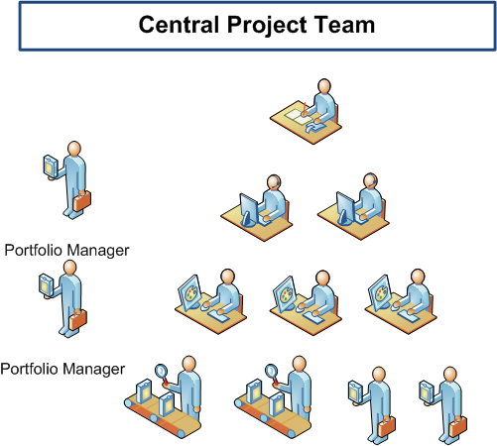
Reinventing the LIM Model with “BRM” Portfolio Managers
More 1:1 attention to local needs
Deeper knowledge of school requirements
Enhanced customer service
Better performance against estimates
Notes:
Talking points:
We sourced team of skilled “design and implementation managers” from both internal Harvard staff and consulting firms to drive the project.
A DIM’s responsibilities included:
Serve as the primary point of contact for their assigned department(s)
Define the Tub’s implementation project plan and coordinate work efforts with each of their LIMs
Work with LIMs to design the approval hierarchies and associated transaction thresholds
Coordinate training activities in support of end users
Capture requests for enhancements and document requirements as needed

Slide 22
Governance Challenges
“They wondered about what went on behind closed doors at that gathering. ‘They imagined we were dressing up in robes and chanting…’”
Herminia Ibarra and Morten T. Hansen, “Are You a Collaborative Leader”, Harvard Business Review, July 2011
Some organizations felt excluded from the decision-making process, not only for strategic elements but for tactical issues such as prioritizing enhancements
Due to very large number of stakeholders, universal representation is untenable, yet under-representation puts project success in grave danger
Critical to ensure projects driven by broad institutional business needs rather than Central Admin or IT objectives as some had perceived in previous projects

Slide 23
Success Factor: Uniform Project Governance Model
Executive Committee
Priorities
Steering Committee
Solutions
Local Implementation Manager (LIM) Working Group
Requirements
End Users
Subject Matter Experts
Peers
Opportunities
Guiding Principle: If you agree with the process, you cannot* challenge the outcome! *At least in theory…
23
Notes:
Broad school representation
Affinity / interest representation “by proxy”
Full stakeholder community engaged via user group meetings, newsletters, and portfolio manager site visits
Transparent and collaborative decision-making
Schools integrated into vendor selection

Slide 24
Success Factor: Engagement at All Levels
Multiple target audiences
  Grassroots – If the project has a real, positive impact on end-users, find ways to get them excited; peer relationships at this level a huge success factor
  Executives – Generating excitement at the bottom is not an alternative to engaging senior leaders; you need support from both to succeed
  Middle Management – Often forgotten, the critical membrane between strategy and execution
Know the needs of your audience
  Different messages resonate with each audience; e.g., tougher to sell controls than efficiency to end users
  Consider tone, media, name on the “from” line
  Know whether to count on messages passing up and down the hierarchy or if direct communication is required
School X
School Y

Slide 25
About johns hopkins

Slide 26
Johns Hopkins University
Mr. Johns (his maternal great-grandmother’s last name) Hopkins endowed both a university and a hospital in 1873
The University was founded on the European model of research and scholarship
Many undergraduate students, as well as graduate students, work with faculty in research
Today there are seven campuses in Baltimore; three more in Maryland, one in the District of Columbia and one each in Bologna, Italy and Nanjing, China

Slide 27
Johns Hopkins University – By the Numbers
11 academic divisions
26,000+ employees
  Together with the Johns Hopkins Health System, a separate legal entity, Johns Hopkins is the largest private employer in Maryland (50,000+)
21,000+ students, split nearly 1/3 UGrad, 1/3 FT Grad, 1/3 PT Grad
2,600+ full-time professorial faculty
236 buildings totaling over 16M sq ft
$2.6B endowment (ranked 25th in 2011)
Ranks first among U.S. universities in receipt of federal research and development funds

Slide 28
Culture and Character of Johns Hopkins University
Decentralized operations in eleven academic divisions
  Every Tub on its Own Bottom
Revenues captured at the lower levels of the organization; funds coming to the President are less than ½ of 1% of total University revenues
The budgetary allocation function does not reside with the President, the Provost, or Senior Vice President for Finance & Administration
Financial management rests not only on central finance and human resources but also on divisional deans and directors and their financial officers
A 20-year model of a rolling five-year financial plan provides the basis for monitoring and control
Results
  High level of entrepreneurship and autonomy
  Attract and retain people who like personal challenges
  Able to try new ventures

Slide 29
JHU Budgeted Revenues by Division (FY12), $M
University Total = $4.4 Billion

Slide 30


Johns Hopkins Health System
3 academic hospitals
  Johns Hopkins Hospital (Baltimore)
  Johns Hopkins Bayview Medical Center (Baltimore)
  All Children’s Hospital (St. Petersburg, FL)
3 community hospitals
  Howard County General Hospital (Howard County, MD)
  Sibley Memorial Hospital (Northwest Washington D.C.)
  Suburban Hospital (Bethesda, MD)
Johns Hopkins HealthCare = managed care plans
Johns Hopkins Community Physicians = physician practices
Johns Hopkins Home Care Group = full-service home care provider

Slide 31

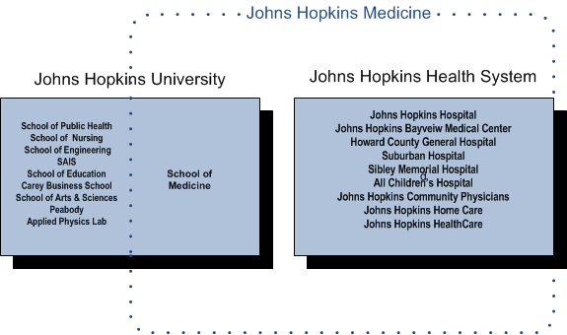
Johns Hopkins Medicine
Non-legal entity comprised of The Johns Hopkins Health System and The Johns Hopkins University School of Medicine
Together, Johns Hopkins is a $9.1B enterprise.

Slide 32
ERP Architecture at Johns Hopkins
The last decade was one of near consolidation
Student Information System = Matrix Student Suite (Ellucian?)
  Admissions, Financial Aid, Student Billing, Records & Registration
  Phased go-lives starting in March 2003, running through July 2007
  Subsequent implementations for other programs
  Now implementing a student data warehouse, loosely based on iStrategy (now Blackboard Analytics) product
Enterprise Resource Planning = SAP
  Financials, Human Resources, Supply Chain
  SAP Business Warehouse (BW) as data warehouse and reporting solution
  “Big bang” go-live for all of JHU and JHHS on January 1, 2007

Slide 33
Near Consolidation - Examples
Matrix Student Suite
SAP
Financial Aid: all schools! ☺
Student Billing: all schools, except for third-party sponsored billing
Records & Registration: all schools, except the School of Medicine
Admissions: all schools, except the School of Medicine… and others slowly backed out over time
Billing: all, except students and patients
All of the Johns Hopkins University, except the Applied Physics Lab (APL)
All of the Johns Hopkins Health System, except Howard County General Hospital… and hospitals acquired since SAP implementation

Slide 34
Challenges of Harvard Enterprise Applications Environment
Johns Hopkins
Differentiated Requirements
Schools and service units have vastly different business models, which are not easily satisfied by commercial off-the-shelf software packages or within a single install
Rocky Implementation History
ERP projects in 1990s were difficult and often divisive; several organizations built shadow systems to compensate for perceived or real gaps
Local Autonomy and Resources
Every Tub on its Own Bottom (ETOB) establishes schools and units as semi-autonomous entities
Consensus Decision-Making
Limited ability for central administration to mandate conformance even when majority of schools agree; critical to obtain buy-in at all levels of the institution
Availability of local funds and resources can be a disincentive to accepting sub-optimal central ERP

Slide 35
Johns Hopkins case studies

Slide 36
Origins
SAP
ISIS
Top-down mandate with top-down directives
Grassroots effort, with demand originating in the divisions and ultimately supported by central and divisional administration

Slide 37

At Both Ends of the Spectrum
significant divisional latitude
very little divisional latitude

Slide 38
Johns Hopkins Case Study – ISIS
ISIS = Integrated Student Information System
  The first university-wide, fully-integrated student information system
Matrix was determined to be the ideal product for JHU
  Benefit of a single, centralized database of persons and the ability to dramatically differentiate configuration based on “zones” and “data domains” allowing for relative freedom in divisions
Matrix was in development at the time we purchased it
  JHU was a development partner, along with U. Arizona and U. Chicago
SunGard discontinued the Matrix product in 2006; support ends in 2014
  JHU is well-positioned to support and maintain the system and has effectively been doing so since 2006… but we really don’t want to support financial aid on our own

Slide 39
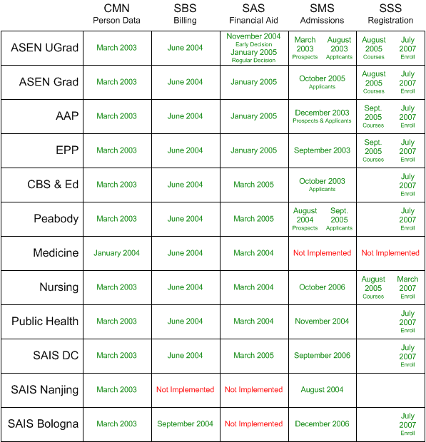
ISIS: Nearly 30 Implementations

Slide 40
ISIS Lessons Learned
It’s never too late to rethinking governance if it’s not working
  Executive Committee of enrollment management leaders merged with Finance Committee of divisional business officers ⇨ more efficient decision making
“Just enough” data governance
  Ground rules are an imperative
Built an implementation and support model that mirrors our decentralized structure
  Divisions employ their own technical analysts who performed division-specific functions (e.g. configuration, reporting) and provided first line of support to their users
  Central IT manages the overall system and related technical processes and provided project management for the implementation
Transparency and no surprises
  Extensive use of a wiki for all documentation and collaboration between all stakeholders

Slide 41
The Future of ISIS at Johns Hopkins
ISIS is slowly becoming disintegrated
  Admissions offices have been working outside the system for years (e.g. ApplyYourself) and loading in applicant data
  Moving to College Board’s PowerFAIDS for financial aid this summer
Migration to an Integrated Student Information Platform
  A collection of tightly integrated systems, with ISIS as the hub
The [multi-] million dollar question:
Would we ever implement another fully-integrated SIS?

Slide 42

Johns Hopkins Case Study – SAP
Why?
  Antiquated, expensive systems
  Business process redesign
  Greater integration of services between JHU and JHHS
  Support Johns Hopkins Medicine
Anticipated benefits:
  Integrate the business processes of an organization into a single informational platform
  Reduce the duplication of information (and errors) characteristic of stand-alone un-integrated systems
  Optimize the approach to completing work (through business process redesign) to achieve significant gains in operating performance and service quality

Slide 43
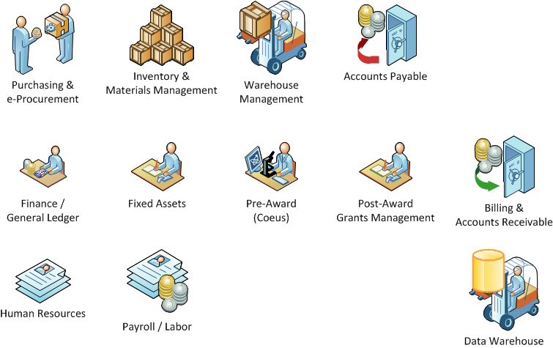
SAP Implementation Scope

Slide 44

Framework for ERP Benefits at JHU
A fundamental requirement of the ERP initiative is that, overall, “changes” implemented must enhance management reporting capabilities, compliance, productivity and/or service delivery.
Reduced duplication
Reduced transaction input time
Reduced cycle times
Increased flexibility
Ease of decision making
Ease of navigation
Interactive
Stakeholder satisfaction
Service
Inventory management
Increased leverage with vendors/contract management
Improved billing and collecting processes
Decreased payroll processing and recruiting costs
Controls enhanced by automating manual processes
Compliance risks reduced by incorporating workflows/
approvals
ERP
Compliance
Productivity

Slide 45
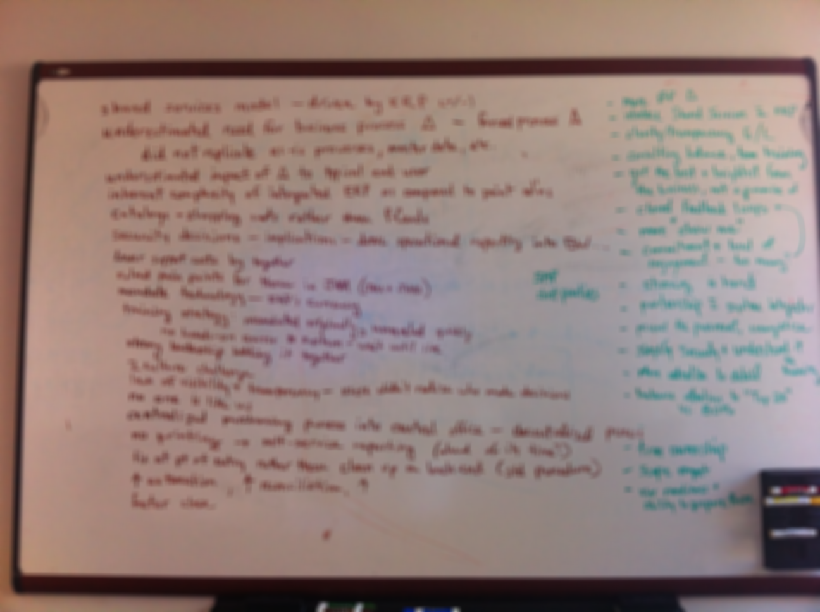
If You Could Do It Over…

Slide 46
SAP Lessons Learned
Never underestimate change management and the need for business process change
  Change is always greater than expected… especially when implementing a tightly integrated (i.e. complex) system like an ERP
Transparency is tricky
  Damned if you do, damned if you don’t
You only have one chance to make a first impression
Seriously think, and then seriously rethink, the security strategy
Top-down mandate is counter-culture for JHU (as expected)
Balance between the “Top 20” and the 80%

Slide 47
Q & A

Slide 48
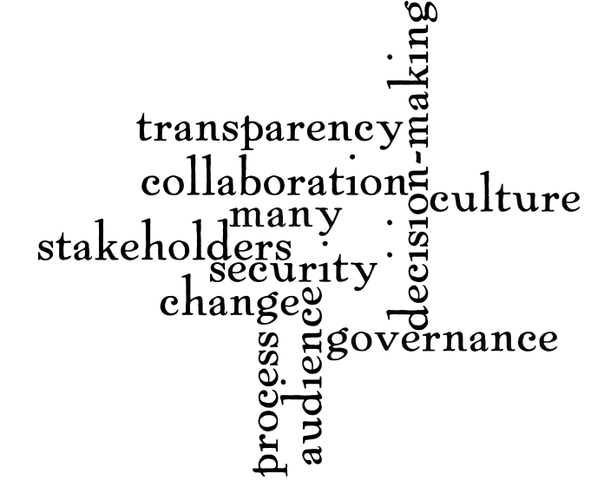
Discussion and Q & A
Jason Shaffner
Director of Financial Systems Solutions, Harvard University
@jasonshaffner
jason_shaffner@harvard.edu
Geof Corb
Senior Director, Enterprise Applications, Johns Hopkins University and Johns Hopkins Health System
@geofdotedu
geof@jhu.edu

