Slide 1


From insight
action
to
Translating Student Voice for
Education Transformation
September 12, 2012

Slide 2
“Children are the consumers of education. They know what’s good and bad about the design of their schools. So we need to listen to them and listen hard. Then, we stand a chance of designing better schools for the future.”
- John Sorrell, Sorrell Foundation

Slide 3
What if we
Took this
Seriously?

Slide 4
Business Innovation Factory

Slide 5
We believe that tackling complex social issues, like education and health care, require new possibilities.

Slide 6
We believe we can find these possibilities by understanding the experience of people within these systems (students, teachers, patients, doctors).

Slide 7
We seek to understand their needs, behaviors, motivations, and factors…

Slide 8
From these observations and interactions, we develop rich insights about what might be possible…

Slide 9
And then we experiment like mad.

Slide 10
Our approach is not new.

Slide 11
We model our approach on
design
thinking
Notes:
There are a host of good reasons to think like a designer

Slide 12
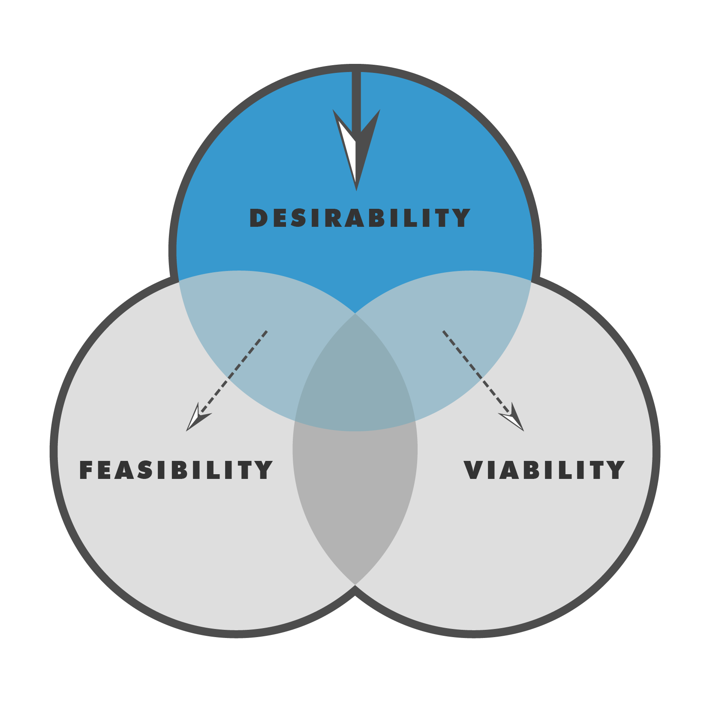
1. We want to understand how people experience things.
© IDEO
Notes:
There are plenty of reasons we rely on design thinking.

Slide 13

2. We want to learn by doing.

Slide 14
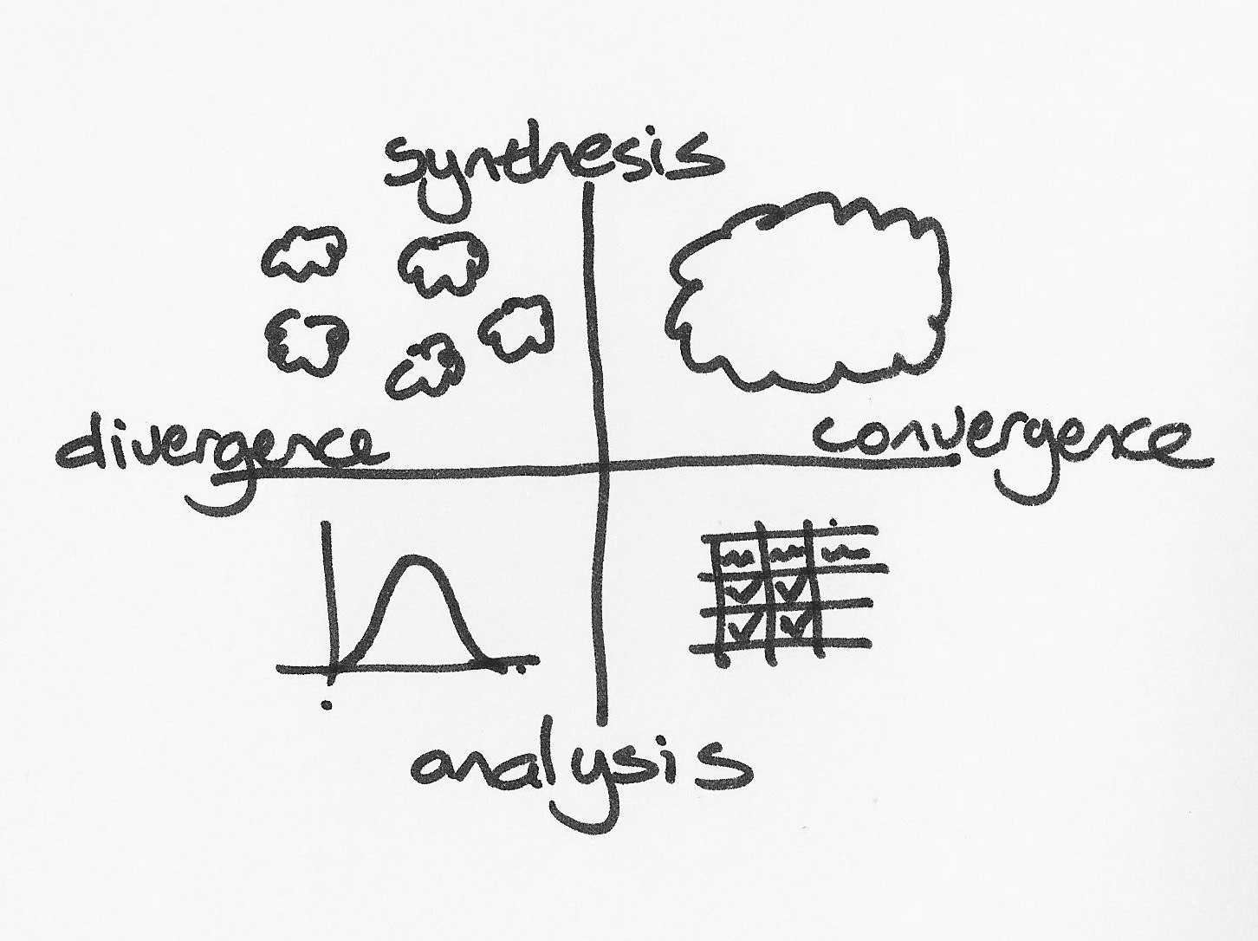
3. We want rigorous methods that repeatedly yield results.
© Tim Brown

Slide 15

4. We want to challenge the current meaning of existing models and systems.
© The Cramer Institute

Slide 16
BIF brings Design Thinking to solve social problems through 5 capabilities

Slide 17
HUMAN CENTERED:
voice of and experience of the end user
MAKING SYSTEMS LEVEL THINKING SEXY:
stakeholder mapping and engagement
STORIES CAN CHANGE THE WORLD:
story studio, push vs. pull
CO-CREATING THE FUTURE:
participative design and testing
EXPERIMENT ALL THE TIME:
living labs for ongoing exploration

Slide 18
Why we’re here
Demonstration of the contribution and ongoing role student voice can have in education reform and innovation.

Slide 19
AND…
Gain fresh perspective about the ‘why,’
‘what’ and ‘how’ of the student experience.

Slide 20
RHETORIC

Slide 21
MOMENT OF PAUSE
Questions?
Poll: Do you have formal processes in place for engaging students in reform efforts?
Chat: How do you define student voice?

Slide 22
A 3-Part Tale
why Ι what Ι how
Notes:
W

Slide 23
{An (almost) approach for designing student experiences}
WHAT
how
Models, environment, resources, support structures, curricula, programs, policies, etc. needed to deliver the best experience
An appropriate,
smart, delightful way to put the ‘what’ into action

Slide 24
{An approach for designing winning student experiences}
WHy
WHAT
how
Needs, emotions, meaning involved in the activity
Models, environment, resources, support structures, curricula, programs, policies, etc. needed to deliver the best experience
An appropriate,
smart, delightful way to put the ‘what’ into action

Slide 25
Part I:
Listening for Insight
why Ι what Ι how
Notes:
W

Slide 26
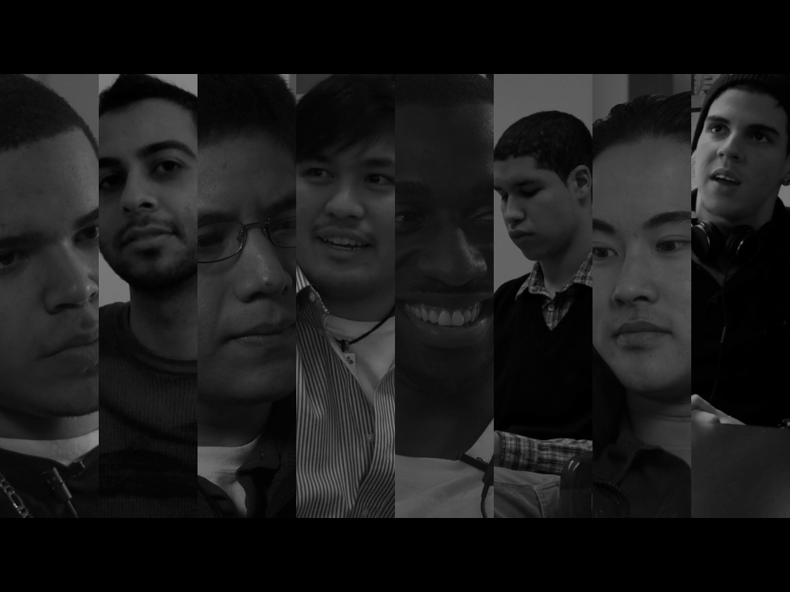
Capturing the Educational Experiences of Young Men of Color
Notes:
Let’s talk about the Why: In 2011 we

Slide 27

Play Video 1
Young Men of Color - Final

Slide 28
INSIGHT noun
1. An instance of apprehending the true nature of something, especially through intuitive understanding

Slide 29
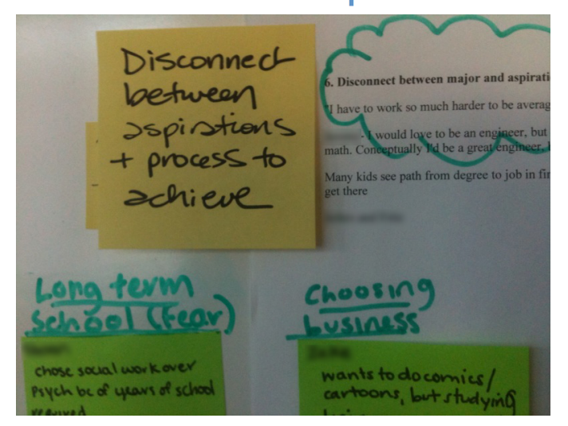
Notes:
Settling for less
Some students make educational choices that sideline or dismiss their goals or aspirations.
“I thought being a doctor was totally out of my league, so I thought maybe I could do dental assisting.”
-Andy, Hispanic/Latino, 27, middle, 4-year public school, West
Many students are predisposed to make safe choices or to feel that certain options are not obtainable because of pre-college experiences where they’re expected to succeed.
Others choose majors that will serve their family or community over personal interests.
Some students have no one to encourage them along a more challenging path or to help them overcome feelings of inadequacy.

Slide 30
Insights allow us to see big, important
Aspects of the experience in a new light. They are:
Actionable
Something that can be translated into concrete, sensory,
direct experience
meaningful
Deeply linked to the research data
inspirational
Help focus creativity on the challenge

Slide 31
MOMENT OF PAUSE
Questions?
Poll: On a scale of 1-5, how would you rate your overall awareness and understanding of the design-thinking process?
Chat: What are the key issues hindering student voice application and integration in your organization?

Slide 32
Part II:
Translating Insight into Opportunity
why Ι what Ι how
Notes:
Models, environment, resources, support structures, curricula, programs, policies, etc. needed to deliver the best experience

Slide 33
CHALLENGE noun
something that by its nature or character serves as a call to battle, contest, solve, special effort, etc.
a demand to explain or justify.

Slide 34
WHAT DID YOU DISCOVER
THAT YOU DIDN’T CONSIDER BEFORE?
HOW MIGHT WE evolve
the ways we currently create, capture, and deliver value?
What opportunities
for improving or innovating the experience?

Slide 35
Play Video 2
Design Challenge - Final

Slide 36
MOMENT OF PAUSE
Questions?
Chat: What changes or innovations are you inspired to discuss with your organization after today’s webinar?

Slide 37
Part III:
A Radical Approach for Change
why Ι what Ι how
Notes:
An appropriate,
smart, delightful way to put the ‘what’ into action

Slide 38
DESIGN CHALLENGE
What changes must be made to allow for a coherent and goal-focused educational experience for students?

Slide 39
Play Video 3
USU Design Class Overview

Slide 40
IMPACT OF PARTICIPATORY DESIGN
By building young people’s capacity, skills and competencies and, strengthening their ownership of the results within the lab, we are creating the right kind of environment for ongoing experimentation, culture change and radical student engagement.
We view this as a missing link to systemic change.

Slide 41

Questions?
Notes:
W

