Slide 1
Current/Future State of Higher Education
George Siemens, Andy Calkins, Malcolm Brown
November 2012

Slide 2

Background for CFHE12
Notes:
Optional – Agenda Slide – Option 2
Instead of using the agenda template on the previous slide, you also have the option to use this section break template to place sub titles or section breaks within your presentation.

Slide 3
Partners
EDUCAUSE
AASCU
Desire2Learn
TEKRI (Athabasca U)
University of British Columbia
U of Hawaii
Georgia Tech
AACE
University of Prince Edward Island
SoLAR
NRC
CEIT (Queensland)
Chronicle of Higher Education
Bill & Melinda Gates Foundation
Notes:
Optional – Two column, text and image

Slide 4
Why?
Model innovative networked learning
Topical
Extend on strategies/software developed in CCK08/09/11/12, LAK11/12, PLENK, Critical Literacies, Change11, Oped12
Involve faculty & higher education leaders in a distributed MOOC

Slide 5





Notes:
Required - Main Body Slide

Slide 6
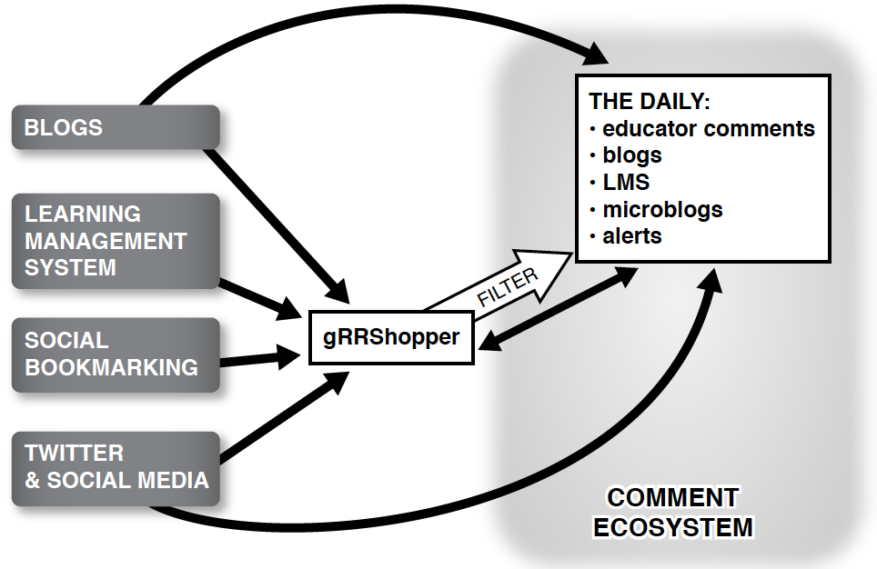

Slide 7
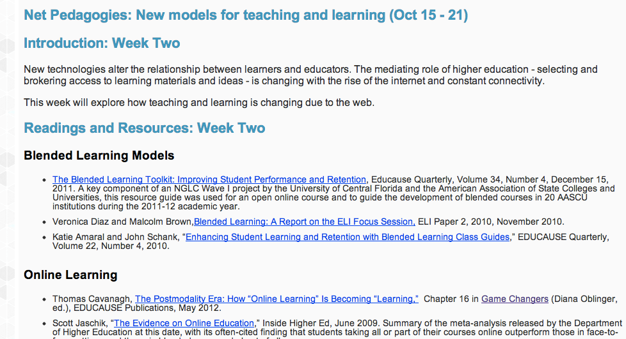

Slide 8
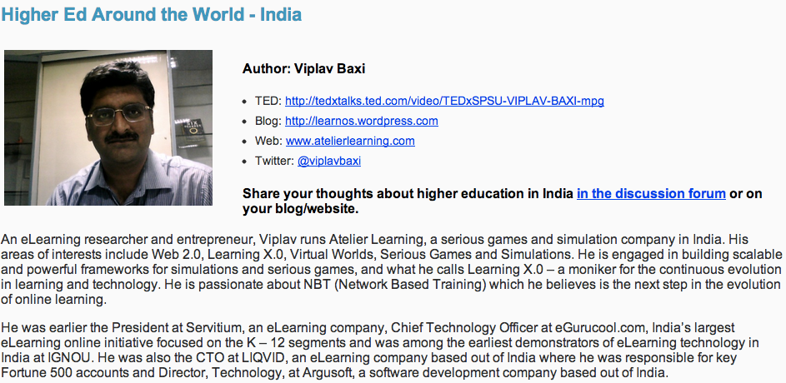

Slide 9
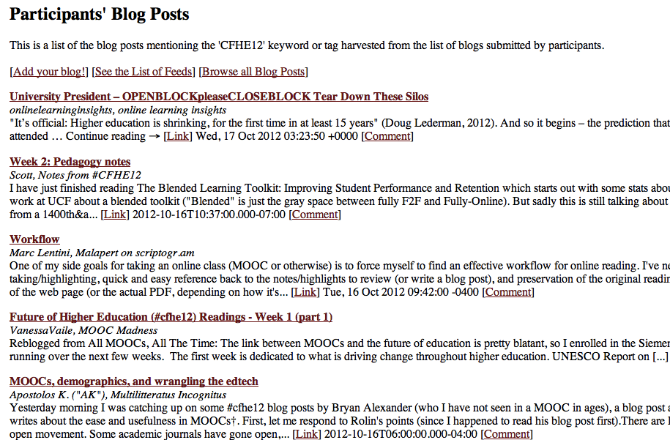

Slide 10
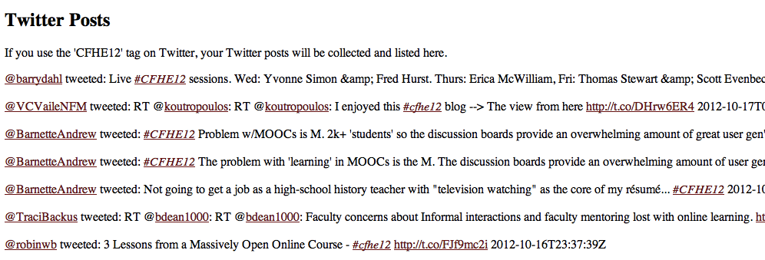

Slide 11
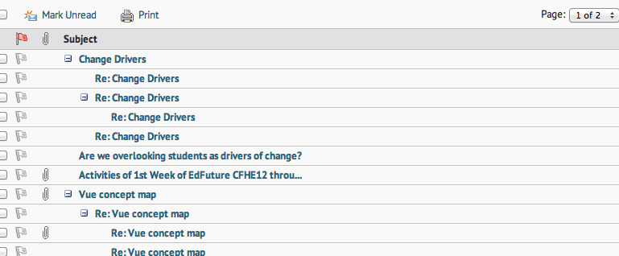

Slide 12
Week 1: Change Drivers
Notes:
Optional – Agenda Slide – Option 2
Instead of using the agenda template on the previous slide, you also have the option to use this section break template to place sub titles or section breaks within your presentation.

Slide 13
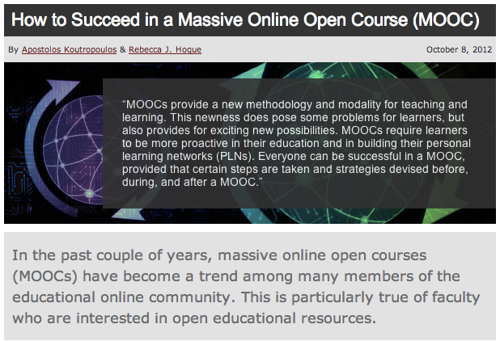
http://www.learningsolutionsmag.com/articles/1023/how-to-succeed-in-a-massive-online-open-course-mooc

Slide 14
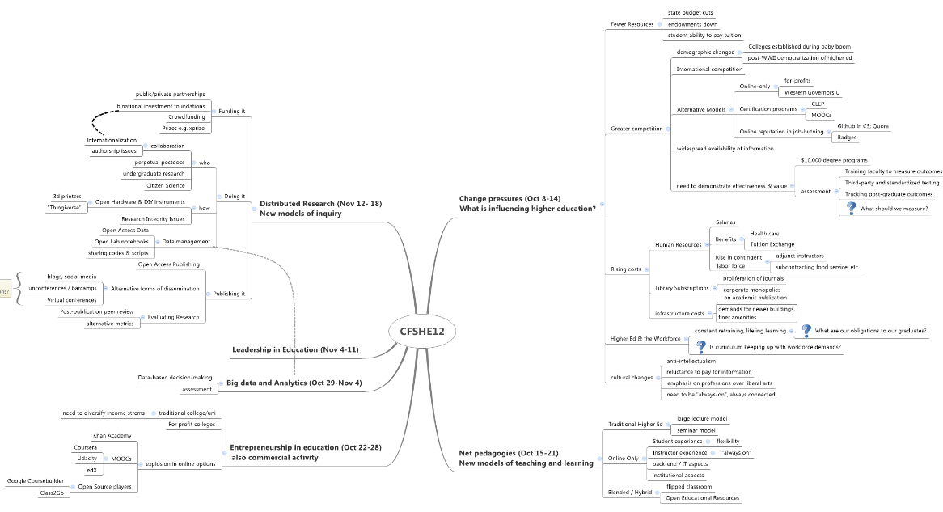
http://claudiascholz.wordpress.com/2012/10/07/cfshe12_3/

Slide 15
Change drivers
Globalization
Commercial/Entrepreneurial activity
Funding cuts
Online learning
Unbundling of education systems
Technology advancement (mobiles)
Employment-oriented education
Big data and analytics

Slide 16
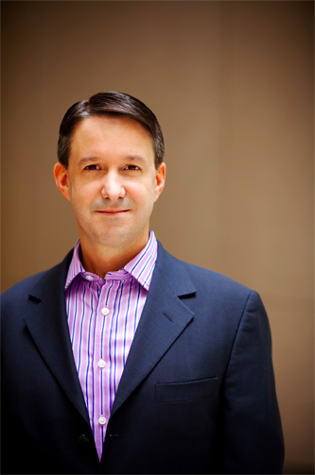
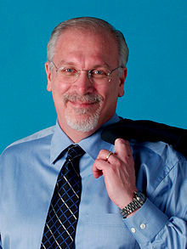
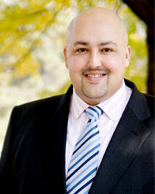
Speakers
Jeff Selingo
Richard DeMillo
Siva Vaidhyanathan

Slide 17
Week 2: Net Pedagogies
New Models for Teaching and Learning
Notes:
Optional – Agenda Slide – Option 2
Instead of using the agenda template on the previous slide, you also have the option to use this section break template to place sub titles or section breaks within your presentation.

Slide 18
Themes from the Week
New pedagogies are emerging not simply, or mainly, as a response to the presence of new technologies. They reflect a proactive response to two trends that were discussed (in different ways) by all of the week’s speakers:
  Concerns about how well institutions are meeting their mission, on behalf of the students they serve
  Pressures resulting from feeling constrained within the “Iron Triangle” of costs, access, and quality
Notes:
Required - Main Body Slide

Slide 19
Themes from the Week
New model designers and builders are grappling with a complex set of challenges that include:
  How to balance personalization with competency-based pathways (Meaning: does self-paced progression mean personalized learning? Or does personalized learning extend to the nature of the learning and design of the pathways as well?)
  How to build community among students who are most frequently geographically distant and may be proceeding at different rates
Notes:
Required - Main Body Slide

Slide 20
Themes from the Week
Interesting areas of commonality emerged from the presentations and discussions:
  $2500 per year seems to be a popular (aggressive) price point, in a “subscription” kind of context
  Some of this is about reaching backwards to older forms of education (coffee houses) and original mission statements in order to redesign learning and business models for the 21st century
  Questions from participants reflected concern about the key bread-and-butter issues:
    “Tell us more about the business model”
    “Tell us more about the learning model”
    “Tell us more about what you can show in terms of student outcomes”
Notes:
Required - Main Body Slide

Slide 21
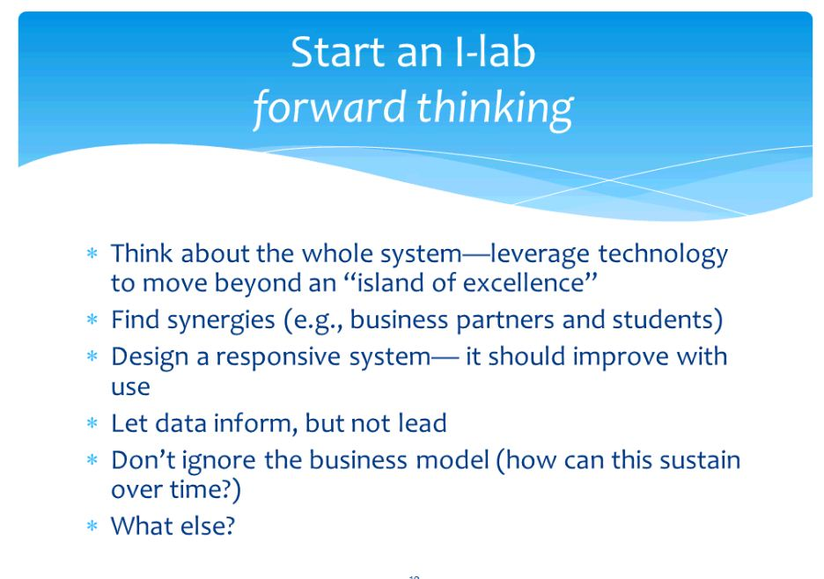
Southern New Hampshire University
Notes:
Optional – Two column, text and image

Slide 22
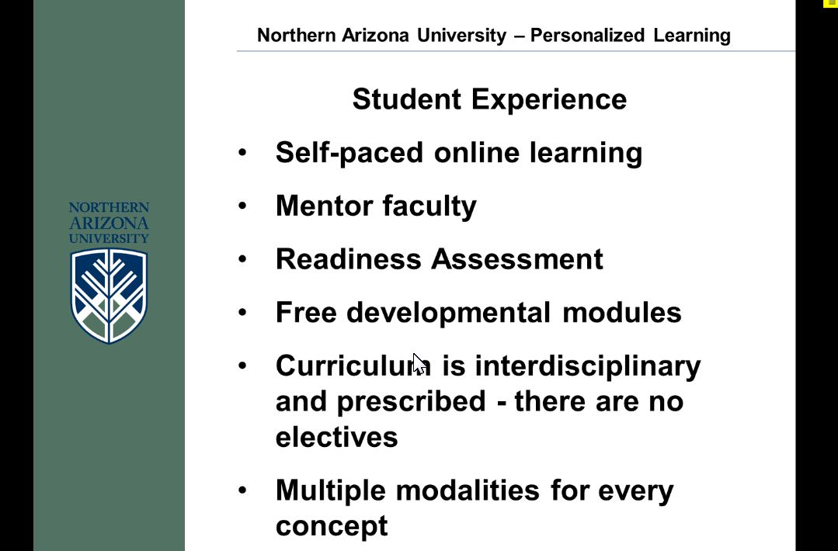
Northern Arizona University
Notes:
Optional – Two column, text and image

Slide 23
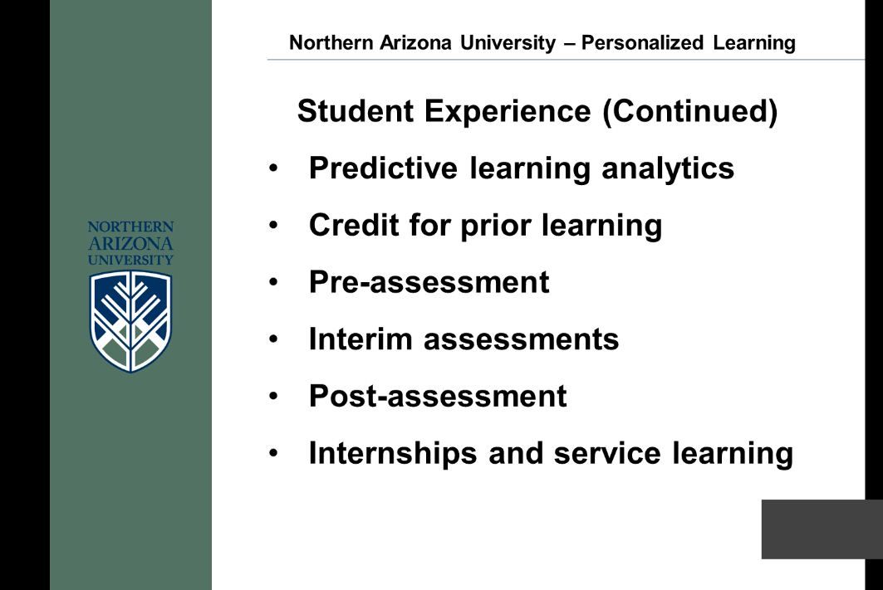
Northern Arizona University (2)
Notes:
Optional – Two column, text and image

Slide 24
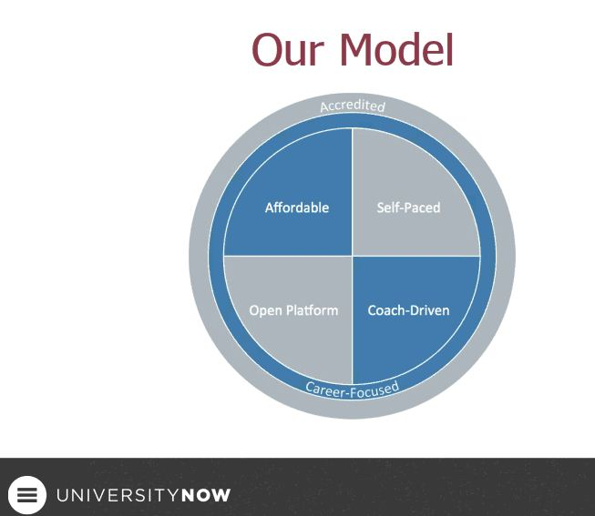
University NOW
Notes:
Optional – Two column, text and image

Slide 25
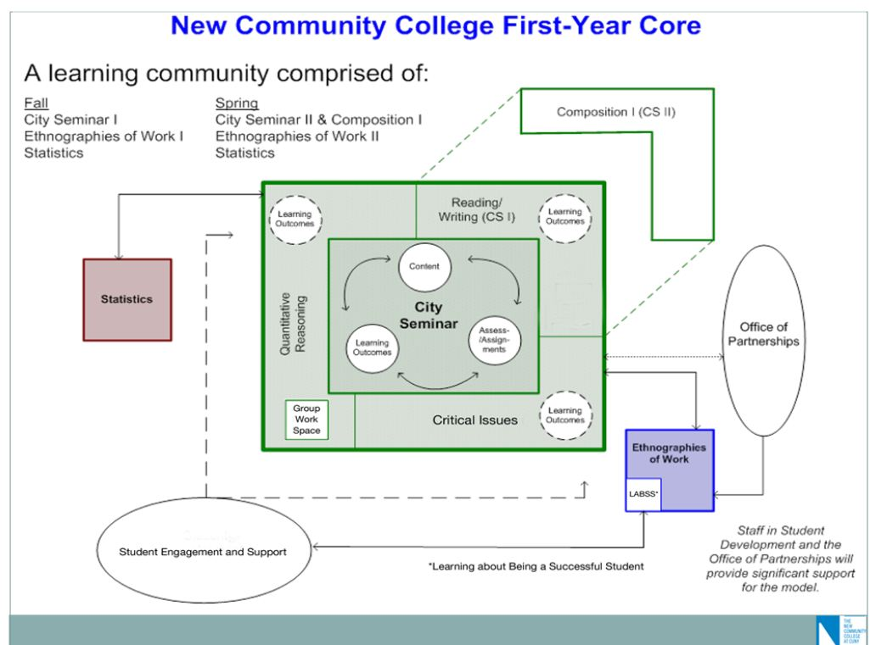
New CUNY
Notes:
Optional – Two column, text and image

Slide 26
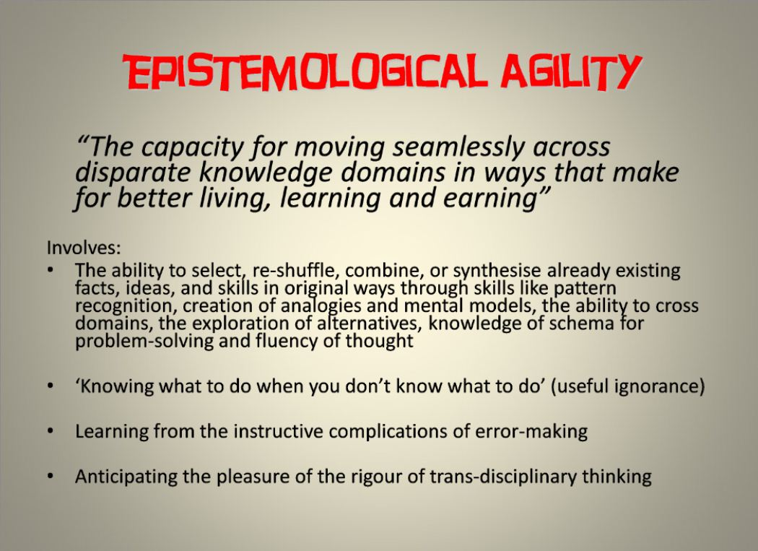
Erica McWilliam
Notes:
Optional – Two column, text and image

Slide 27


Slide 28
Week 3: Entrepreneurship
Entrepreneurship and commercial activity in education

Slide 29
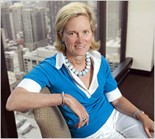
Deborah Quazzo
Founder and Managing Partner
GSV Advisors

Slide 30
Velocity of change
e-books up 30% in Q1 2012
200K education apps
Collapse of the digital divide (98% of students own)
Coursera: 33 partners; 1.7M students
Students: 13% attend for-profits
Degrees 2011-2020: US 30M; China 83M; India 54M

Slide 31

image source: Deborah Quazzo

Slide 32
The “bear” story
Readiness
Completion
Cost
Career

Slide 33
Venture capital in HE
1999:
31
2011:
75
1999:
$449M
2012:
$616M

Slide 34
What is driving investment: confluence (aka perfect storm)
Funding
Accountability
Technology
Consumer choice

Slide 35
Waves of HE innovation

Slide 36

source: Deborah Quazzo

Slide 37
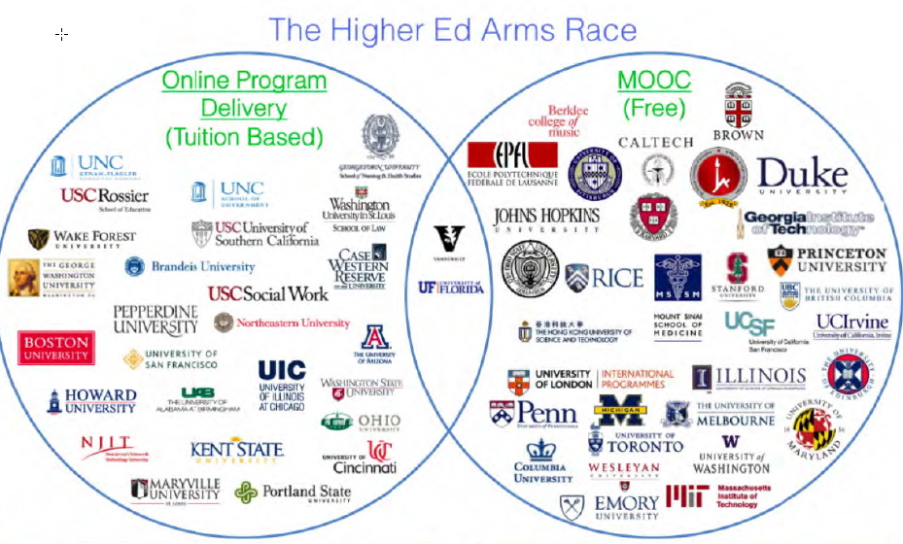
source: Deborah Quazzo

Slide 38
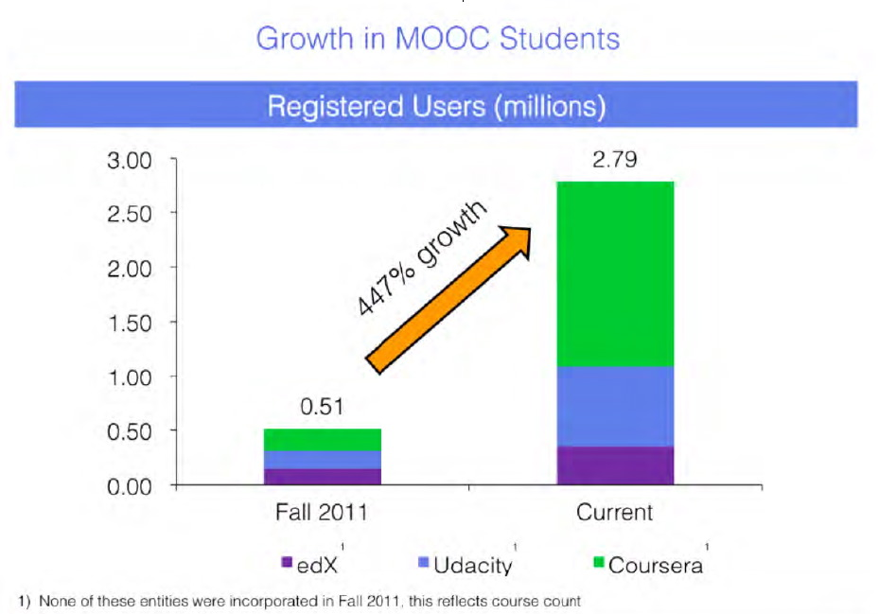
source: Deborah Quazzo

Slide 39
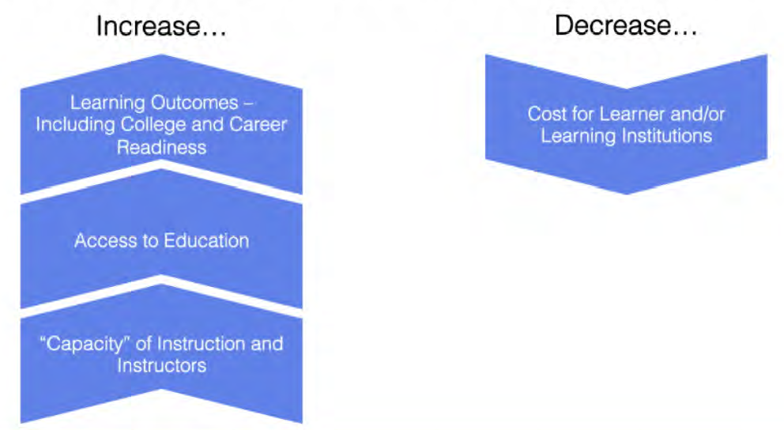
Key: ROE
source: Deborah Quazzo

Slide 40
Week 4: Big Data & Analytics
Notes:
Optional – Agenda Slide – Option 2
Instead of using the agenda template on the previous slide, you also have the option to use this section break template to place sub titles or section breaks within your presentation.

Slide 41
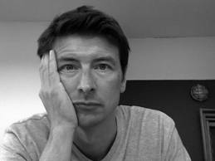
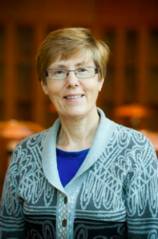
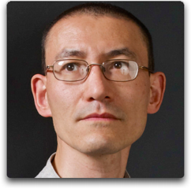
Speakers
Erik Duval
Caroline Haythornthwaite
Simon Buckingham Shum
Notes:
Optional – Main body slide without the header background graphic

Slide 42
State of Learning Analytics
Open analytics
Standards (data, methods)
Methods and metrics
Impact on learner success
Early risk detection
Common language
Institutional use of analytics
Planning and deployment of LA
Move from concept to application

Slide 43
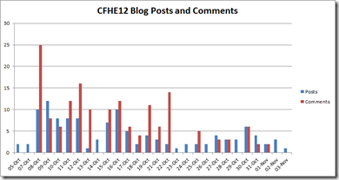
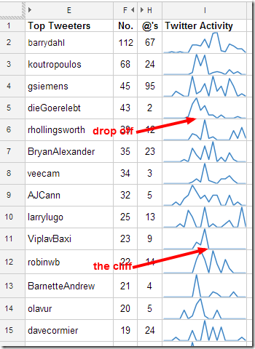
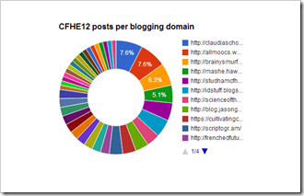
http://mashe.hawksey.info/

Slide 44
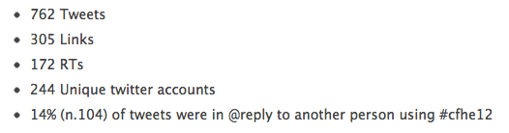
http://mashe.hawksey.info/

Slide 45
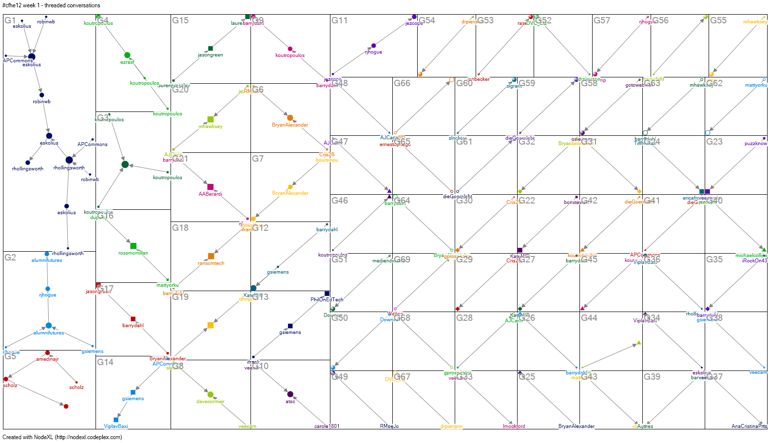
http://mashe.hawksey.info/

Slide 46


Slide 47
Week 5: Leadership
Leadership in Education
Notes:
Optional – Agenda Slide – Option 2
Instead of using the agenda template on the previous slide, you also have the option to use this section break template to place sub titles or section breaks within your presentation.

Slide 48
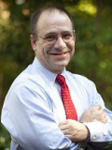
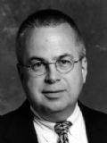
James Hilton
Vice President and CIO
University of Virginia
George Mehaffy
Vice President of Academic Leadership and Change
AASCU

Slide 49
Characterizing change
Linear change
“Emergent” change
A
A
B

Slide 50
Working with emergent change
Unknown end point
Discipline of adjusting as you go
Adjust fundamental conditions

Slide 51
Two fundamental forces
1: commoditization
2: unbundling

Slide 52
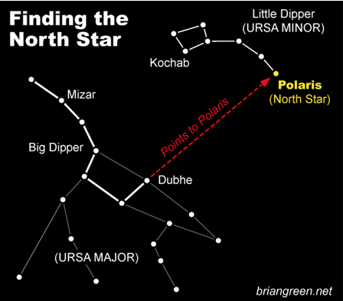

Slide 53
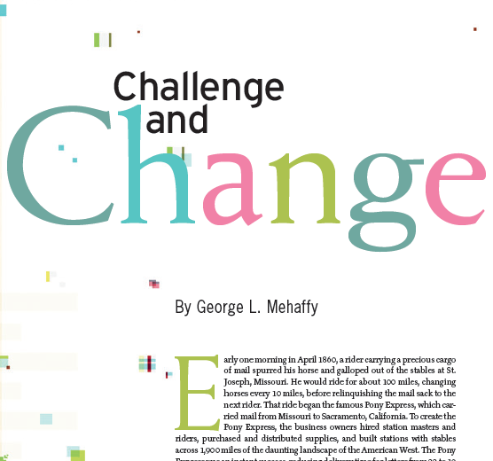
EDUCAUSE Review, Sept/Oct 2012

Slide 54
“We are confronting a period of massive change and great uncertainty.”
“Technology changes everything.”

Slide 55
Existential crisis
“… the choice for higher education during this critical juncture is ‘reinvention or extinction.’ ”
E. Gordon Gee, Ohio State

Slide 56
Shifting power
Traditional institutions’ loss of control
Students’ abilities to interact and learn without mediating agents
Ability of ‘outsiders’ to become players

Slide 57
What is changing?
Venture capital
Models of college
Course models
Data analytics
Cost discrepancies
Measuring success
Loss of credentialing monopoly

Slide 58
Leadership vacuum
Tenure process increases adversity to risk
No leadership training
No leadership continuity
Curricular change ponderous
Too much fund raising
Structural conflict between the administration and the faculty

Slide 59
Key take-aways
Change is rapid, profound, emergent
Rethinking of HE leadership model
Rethinking of HE in many fundamental dimensions
Now is the time for bold, imaginative, entrepreneurial leadership

Slide 60
Week 6: Distributed Research
New Models of Inquiry
Notes:
Optional – Agenda Slide – Option 2
Instead of using the agenda template on the previous slide, you also have the option to use this section break template to place sub titles or section breaks within your presentation.

Slide 61
Themes from the Week
Traditional methods of sharing research, still largely the norm today, were established centuries ago within the parameters, constraints, goals, and technologies of those times. We are now living at a moment of unprecedented opportunity to reimagine those methods and generate higher, faster, better outcomes from research.
Sound familiar?
Notes:
Required - Main Body Slide

Slide 62
Themes from the Week
Challenges researchers grapple with:
  Pace
  Limitations on amount of research disseminated
  Outmoded measurement of impact
  Corrupting incentives that undercut collaboration
Notes:
Required - Main Body Slide

Slide 63
Themes from the Week
Opportunities:
  Immediacy of distribution and response
  Openness in terms of what’s posted
  New, richer measurement tools and indicators
  Opportunities for unprecedented progress through collaboration
Notes:
Required - Main Body Slide

Slide 64
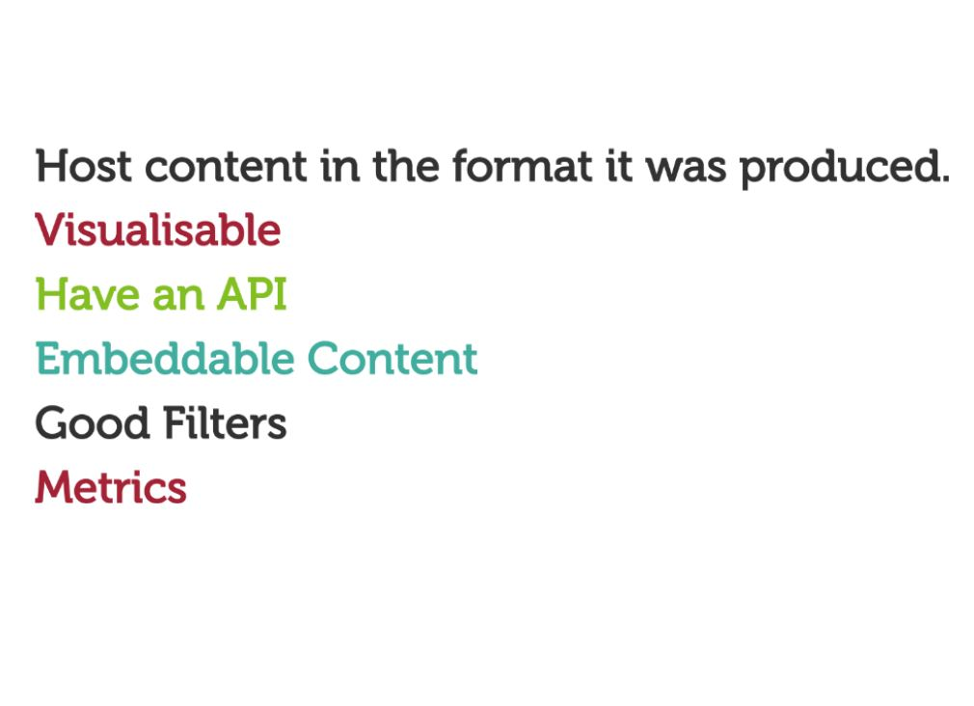
Mark Hahnel: new distribution
Notes:
Optional – Two column, text and image

Slide 65

Mark Hahnel: new distribution
www.figshare.org
Notes:
Optional – Two column, text and image

Slide 66
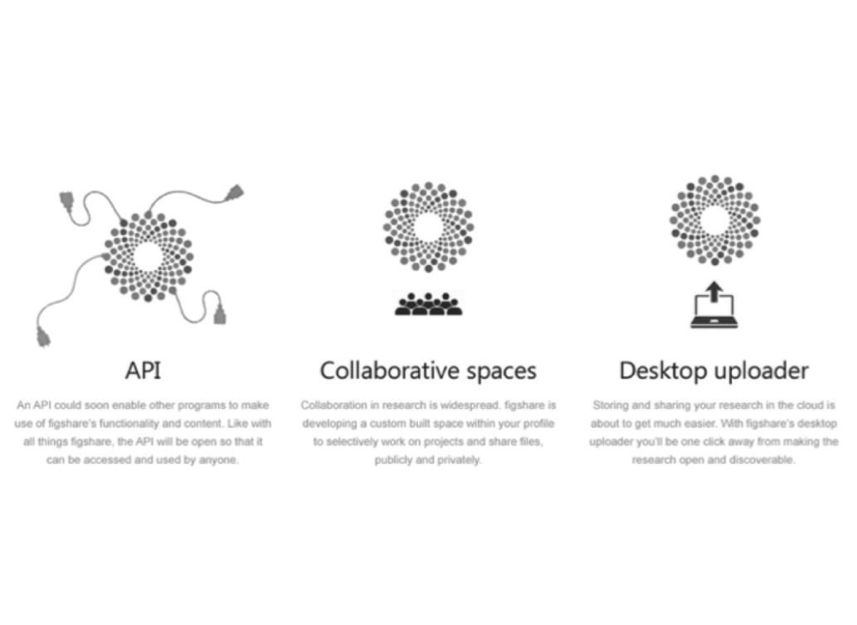
Mark Hahnel: new distribution
www.figshare.org
Notes:
Optional – Two column, text and image

Slide 67
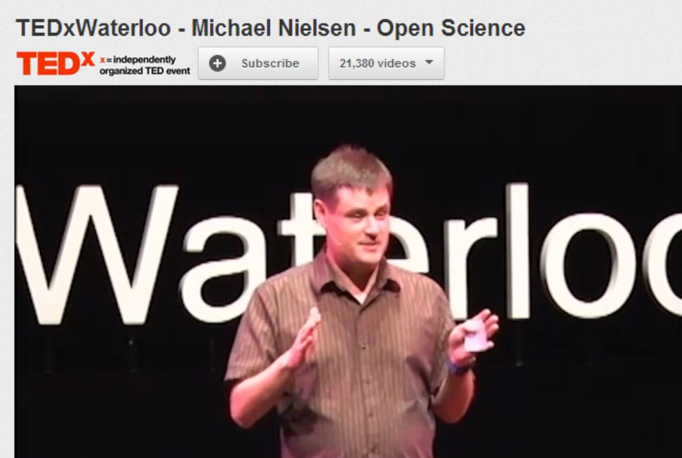
Michael Nielson: collaboration
Human Genome Project
PolyMath Project
http://www.youtube.com/watch?feature=player_embedded&v=DnWocYKqvhw
Notes:
Optional – Two column, text and image

Slide 68
All publicly funded research projects should be open science.”
– Michael Nielson
Notes:
Optional – Quote Template

Slide 69
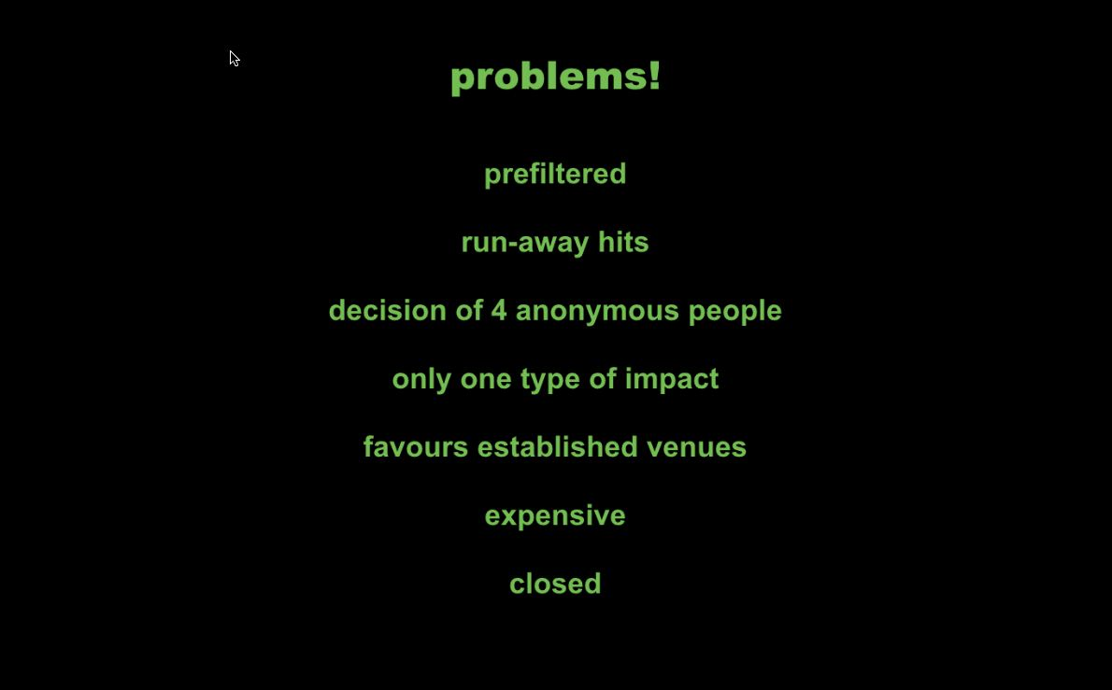
Heather Piwowar: new metrics
Notes:
Optional – Two column, text and image

Slide 70
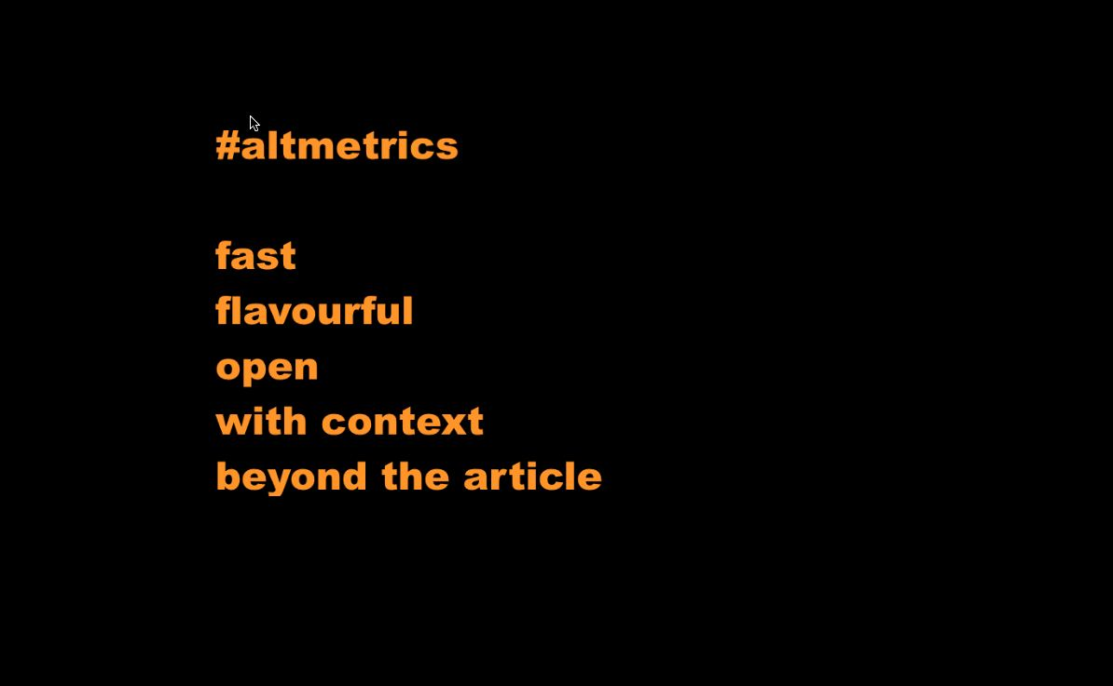
Heather Piwowar: new metrics
www.altmetrics.org
Notes:
Optional – Two column, text and image

Slide 71
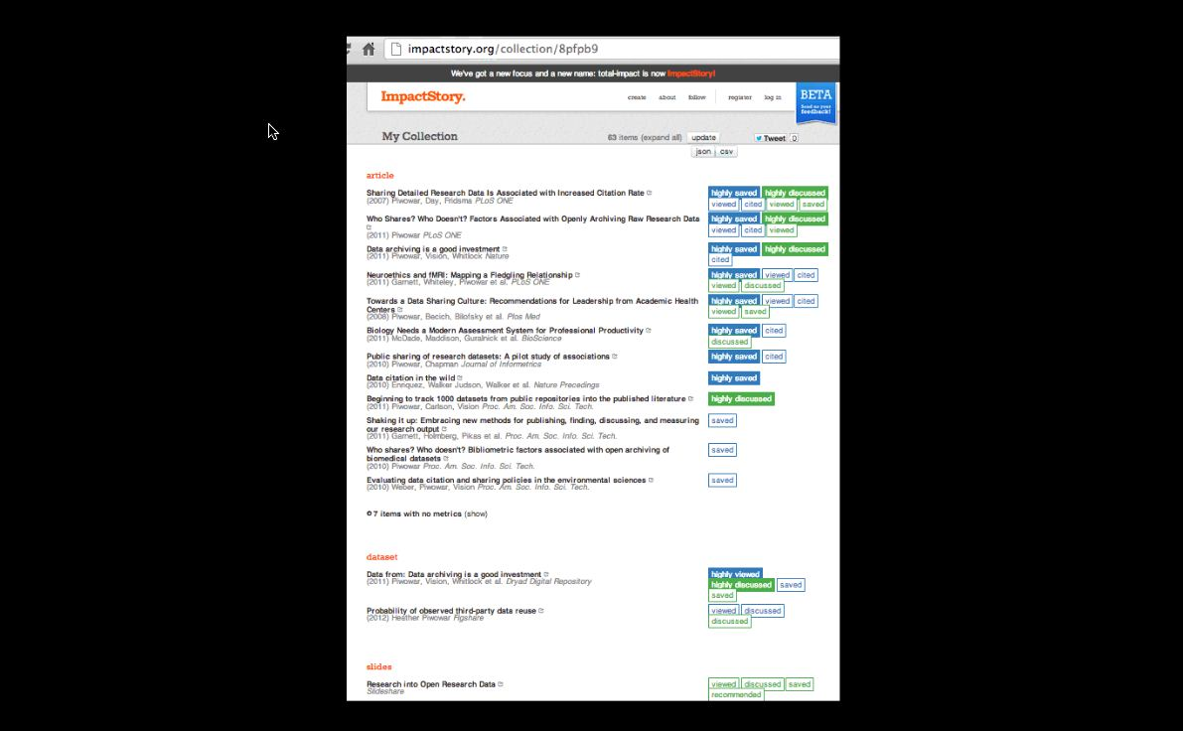
Heather Piwowar: new metrics
www.impactstory.org
Notes:
Optional – Two column, text and image

Slide 72
(a paraphrase)
Why do we have to keep re-learning the value of collaboration and open sharing? How can we build that understanding into policy, incentives, and the whole infrastructure of research?
Notes:
Optional – Quote Template

Slide 73
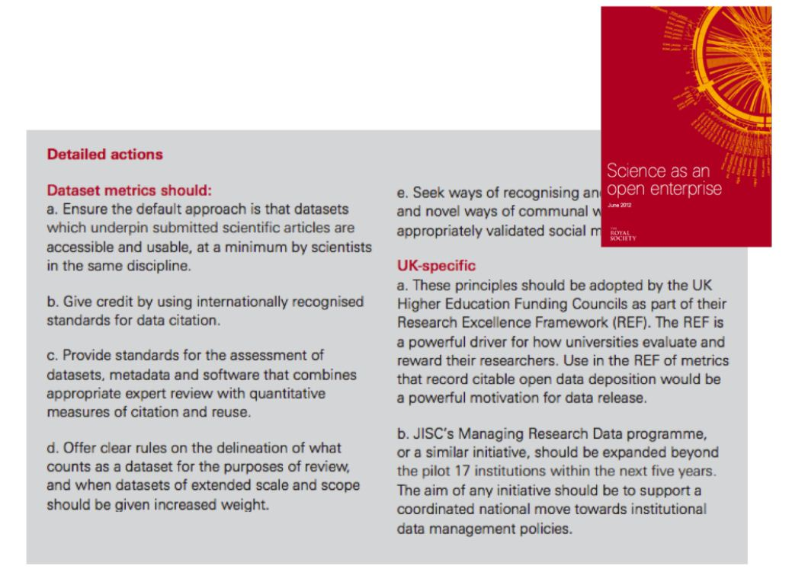
Mark Hahnel: glimmers of response
Notes:
Optional – Two column, text and image

Slide 74
Closing Observation from a participant
“This week I started to watch (via Apple TV) Oprah’s 2009 online course on Echart Tolle’s “A New Earth”. So far, I’ve watched the first three weeks of the ten-week course. It didn’t take me long to realize this was a massive open online course.
“The thing about Oprah’s course is that it’s the best format I’ve ever seen for a MOOC…HD video with multiple camera angles, an expert panel, a textbook, a workbook, hundreds of participants from around the world, Skype and email for synchronous Q and A. And I could watch the whole thing (all 10+ hours) five years later, if that’s when I “needed” the education. The comments and discussion board are ongoing.
“So ask me what an integrated system of education might look like...the winner is going to be able to pass as entertainment.”
Notes:
Required - Main Body Slide

Slide 75
Closing Observation from a participant
“…And what if Echart and Oprah wanted to provide ‘credentials’ to New Earth prophets? I’m thinking they may not go through Prometric Test Centers. I would hope that I would be able to submit, via email or video, my application for ‘certification’. If I passed the ‘pre-screening’ I could opt to either submit a thesis of my own on the subject of mindfulness and spiritual awakening or I could meet with a regional examination panel (for lack of a better term) and present my ideas and let them test my understanding.
“What if all education was offered online like this (k-12, secondary, post-secondary) and the schools and universities became the vehicles of assessment?
“Maybe universities are focusing on the wrong role. Are they going to be able to compete with private industry when it comes to making edutainment? Isn’t it really the credentialing they want to retain control of?”
Notes:
Required - Main Body Slide

Slide 76
Discussion
Notes:
Optional – Agenda Slide – Option 2
Instead of using the agenda template on the previous slide, you also have the option to use this section break template to place sub titles or section breaks within your presentation.

