Slide 1
EDUCAUSE Live! –
The Annual ECAR Student and IT Study
Eden Dahlstrom, EDUCAUSE
December 18, 2012

Slide 2
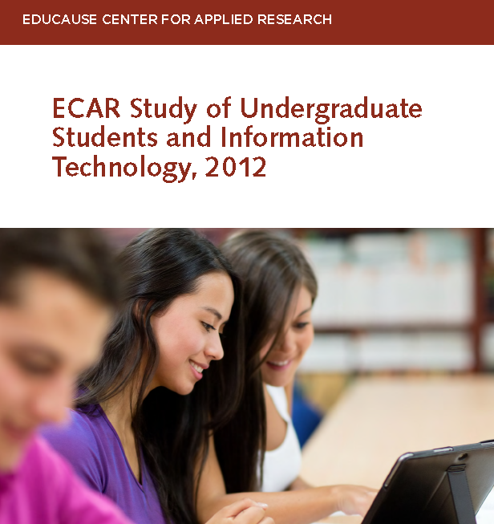
Notes:
For 2012:
Eden Dahlstrom, Principal Investigator EDUCAUSE
Charles Dziuban, University of Central Florida
JD Walker, University of Minnesota
And new for 2013:
Glenda Morgan, University of Illinois at Urbana-Champaign
Kate Hellweg, Research Associate EDUAUSE

Slide 3
Poll Question 1:
Has your institution EVER participated in the ECAR Student Study?
No, not yet
Yes
Don’t know

Slide 4
Student Study Project Overview

Slide 5
What Is It?
ECAR
  Conceptualizes
  Operationalizes
  Invites
  Facilitates
  Returns
  Analyzes
  Reports
Institutions
  Volunteer
  Implement
  Remind
  Utilize
F R E E
An annual ECAR study undergraduate student technology

Slide 6
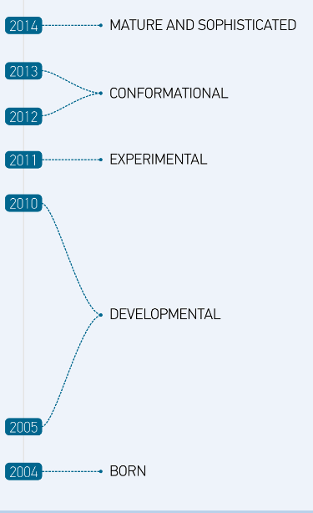
Past, Present, and Future
Notes:
Mention 2 data collection cycles in 2011.
Mention continuous improvement, experimental, and strategic innovation

Slide 7
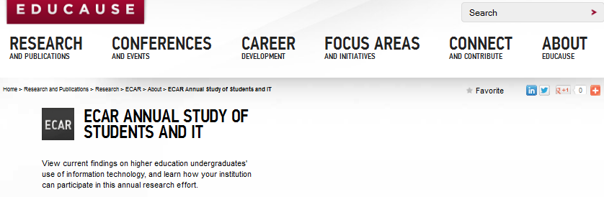
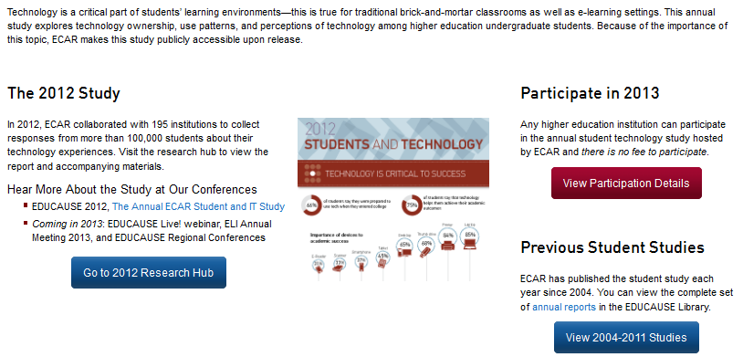
Resource Hub: www.educause.edu/student-study

Slide 8
Methodology
Voluntary survey, opportunistic sample
195 institutions; 106,575 student responses
$50 and $100 survey incentives (1 in 2,500 chance of “winning”)
Sample of 10,000 U.S.-based respondents
  Stratified, random sample to proportionality match undergraduate demographics per IPEDS
  5% ME
All non-U.S.-based responses included in report where noted

Slide 9
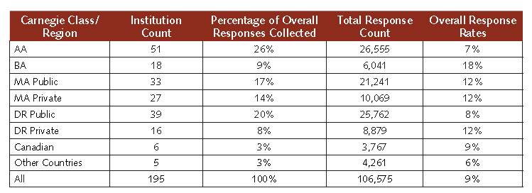
Methodology – Response Counts

Slide 10
Why Is This Work Important?
Monitors ongoing evolution of undergrads’ relationship with technology
Provides baseline and trending metrics
  Longitudinal trends
  Peer benchmarks
Amplifies the student voice in shaping the learning environment in higher education
  Preferences for technology and motivation to use technology
Notes:
Also:
Undergraduate student behaviors and opinions of today can inform the technology needs of tomorrow
Knowing what devices and technology resources students prefer and find useful helps focus attention and concentration on the technologies that matter most
Looking at the results and considering them in context of the big picture of cultural relevance of technology helps flesh out explanatory material that goes beyond what students do or say, revealing why they do it or say it and how institutions and instructors can better serve students’ technology needs and expectations.

Slide 11
Questions?

Slide 12
Key Findings

Slide 13
Broad Thematic Messages
Blending modalities and using technology to engage learners is a winning combination.
Students continue to bring their own tech, and the tech is prolific and diverse.
Students have strong and positive perceptions about how technology is being used and how it benefits them.
Students are selective about the communication modes and how best to connect with different audiences.

Slide 14
Student engagement…
…through blending learning environments and infusing technology
Notes:
Section preface:
Technology is important to students in terms of how they access course materials and how instructors use technology to engage them in the learning process. Students prefer courses with some online components and they expect their instructors to seamlessly integrate technology in their pedagogical practices. It is important to students that their instructors know how to use technology to facilitate and support learning, and the majority of students said that their instructors use technology effectively. Students shared the types of technology they want instructors to use more of, such as open educational resources and game-based learning. Given the resources needed for instructors to change their curriculum and pedagogy, listening to what students say about new or different technologies to integrate into the learning environment could be a wise investment.

Slide 15
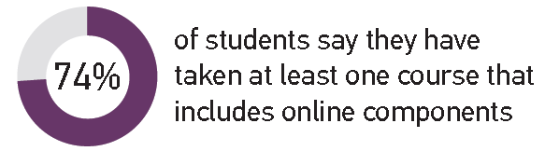
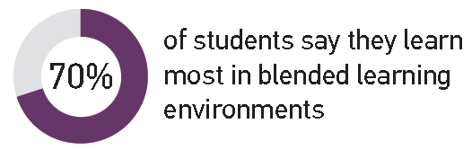
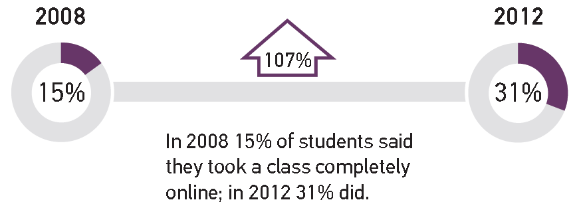
Blended Learning Environments Are the Norm
And Online-
Only Course Experiences Are Up
Notes:
Figure 1 –
Learn Most:
Blended learning environment preference is universal across C-classes.
Non North-American countries have the highest rate (82%) for preferring blended learning environments
AA institution students have highest rate (12%) for preferring completely online courses
Online Components:
82% of students at DR Public institutions tell us they take blended courses; the highest for any C-class.
-
Online Only:
Highest for AA-institution students (39%); lowest for DR Priv (8%
Can = 22%; non-North Am = 12%

Slide 16
Poll Question 2:
What percentage of students say they skip classes when course materials are made available online?
76%
36%
16%

Slide 17
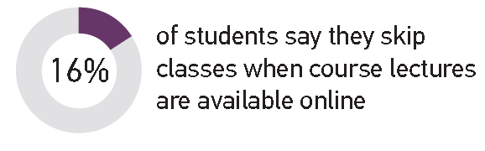
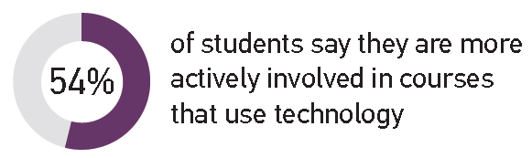
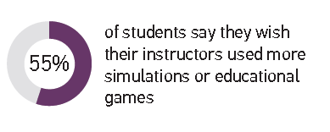
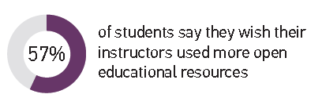
Technology Engages Students
Engagement Winners
Notes:
Re: engagement
67% say technology helps them feel connected to what’s going on at the institution
Undergrads have a comfort level with technology
But more technology doesn’t translate to more connectedness – the same percentage of students reported tech makes them feel connected to other inn 2012 as in 2011 yet there has been continued proliferation of mobile devices which are today’s tools for “connectedness”
Re: Engagement Winners
OER –
57% of students wishing their instructors used freely available course content MORE is up from 2011 when only 19% said so
The emergence of freely available content is part of the way open solutions are changing the game of higher ed
GBL
NMC Horizon report of 2012 pegs GBL as a mid-term horizon (2-3 yrs out) before seeing widespread adoption. SS findings support this
Caution: educational games can require tech skills of instructors and students beyond those typically epxected for general perp for a course

Slide 18
BYO technology…
…is prolific and diverse
Notes:
Section Preface:
The ownership rates of technological devices among students continues to proliferate. Nearly all students own a laptop, and more students in 2012 than in previous years own handheld mobile devices such as tablets, smartphones, and e-readers. There is diversity in brands and operating systems among these devices, and consequently there is growing need for device neutrality of apps designed for these mobile technologies. Striking a balance between device-neutral apps and apps that are optimized for specific mobile platforms is tricky but critical in the bring-your-own-device era.

Slide 19
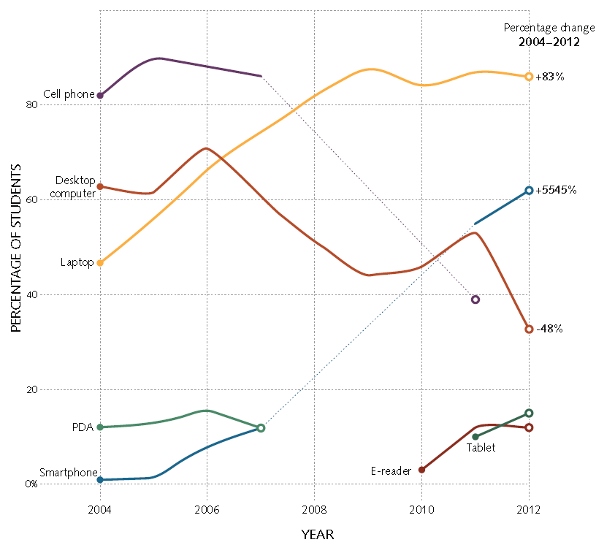
Trend Toward Mobility
Trend Toward Mobility
Smartphones replaced feature phones
WOW!
teehee

Slide 20

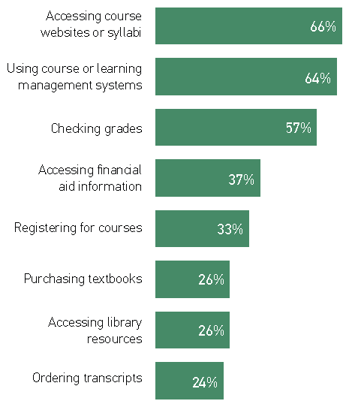
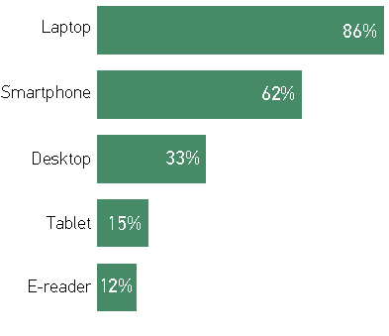
Extreme Mobility Still Supplemental
Important to do from
a mobile device
Own device
Use device for academic purposes
Notes:
Time will tell if mobile devices are additive or will replace another technology. Tablets are notably good consumption tools but still somewhat awkward tools for production.
Use Device for Academics
e-reader 6%, Tablet 12%, Desktop Computer 56%, Smartphone 42%, Laptop 91%
Own Device e-reader 12%, Tablet 15%, Desktop Computer 33%, Smartphone 62%, Laptop 86%
No surprises this year for device ownership.
86% own a laptop
Highest among younger students and students attending four-year colleges/universities
62% own smartphones
Up from 55% in 2011
Nearly twice as many in 2012 than in 2011 said they use these for academic purposes (67% and 37%, respectively)
Pew says 46% of adults own a smartphone, and it is on the rise
15% own tablets…12% own e-readers…according to Pew 19% of adults own these items
Greatest in non-north American countries
Chasm between desktop ownership (33%) and percent who say they use one (56%) – suggesting institutionally-provisioned desktops are still popular. Why?
Fast/reliable internet connection?
Designated workspace/?
Specialty hardware/software access?
Access free/low cost printing??

Slide 21
Prolific and Diverse BYO Technology
Notes:
Laptops (86%)–
Mac market share higher at 4-yr institutions, especially doctoral institutions
More Macs at Canadian institutions
Smartphones (62%)
Not stat sig diffs
Tablets/E-readers (15%/12%) –
No stat sig diffs by age, gender, class standing, or C-class
Message:
@ most institutions, enough students use both to warrant supporting both platforms for academics.

Slide 22
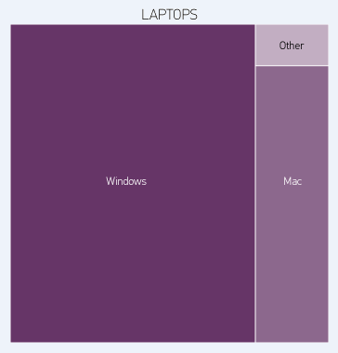
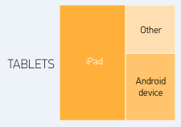
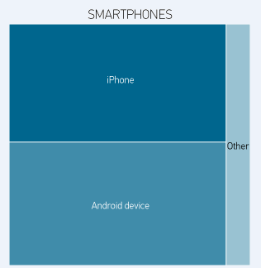
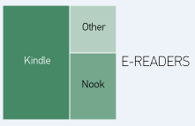
Prolific and Diverse BYO Technology
Notes:
Laptops (86%)–
Mac market share higher at 4-yr institutions, especially doctoral institutions
More Macs at Canadian institutions
Smartphones (62%)
Not stat sig diffs
Tablets/E-readers (15%/12%) –
No stat sig diffs by age, gender, class standing, or C-class
Message:
@ most institutions, enough students use both to warrant supporting both platforms for academics.

Slide 23
Questions?

Slide 24
Using technology…
…to evoke strong, positive responses from students
Notes:
Section Preface:
Students value technology in the academic environment, and the vast majority say that technology helps them achieve their academic outcomes and prepares them for the future. Technologies such as laptops, printers, and USB thumb drives top the list for the most important devices, and technology infrastructure such as the library website and course or learning management systems are among the institutions’ technology resources that students use the most. In terms of student use, the three types of resources that grew the most over the last year were e-portfolios, web-based citation tools, and e-books.
Despite the availability of new technology and integration of existing technology into “the classroom,” students’ interest in having more technology skills or training by far exceeds their interest in having new, more, or “better” technology. Using technology for academics for most undergraduates is more about using existing technologies better and less about adopting innovative technologies.

Slide 25
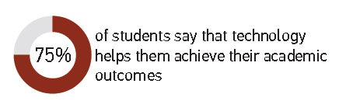

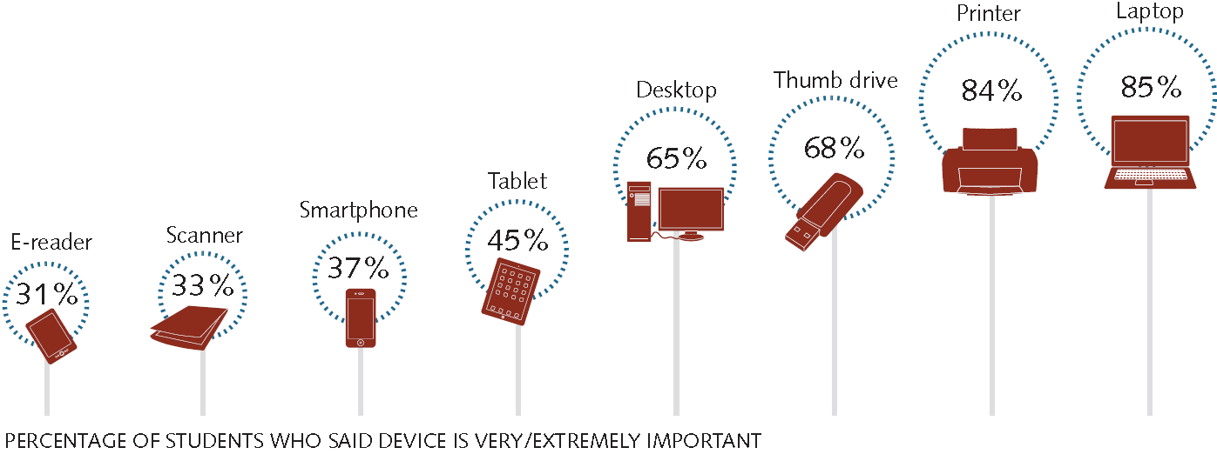
Technology Commendations
Importance of various devices to academic success
Notes:
Tech has a democratizing effect
By providing access to info on demand
The effect can be harnessed when “access to info” is streamlined THEORETICALLY creating a scenario where students have more time to “use the info”
75% say tech helps them achieve their ac outcomes, 75% say it preps them for future ed plans, 63% say it prepares them for the workforce
Winning tech trifecta:
Laptops – to produce
Printers – review and submit
Thumb drives – to transport and share

Slide 26
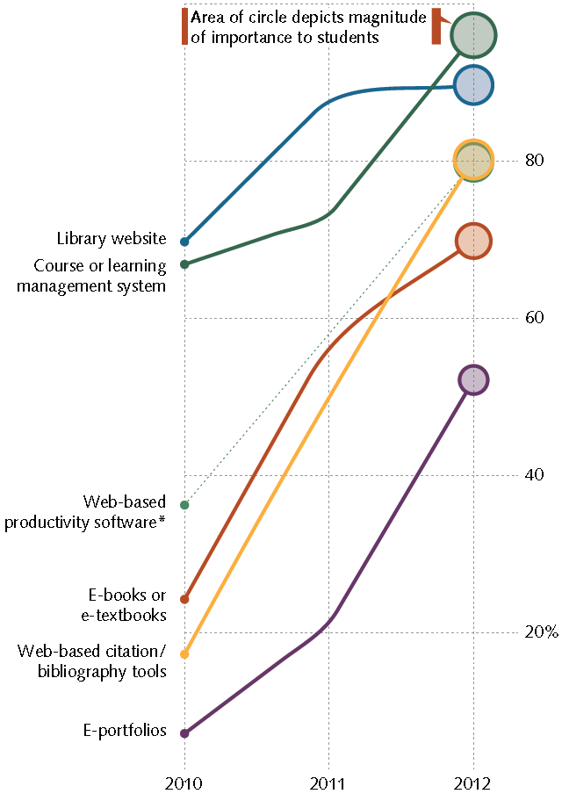
Beyond Devices
Comparing 2012 to 2010
7 times as many students used e-portfolios
Percentage of students who use the resource
5 times as many students used web-based citation/bib tools
3 times as many students used e-books or e-textbooks
Notes:
Basic technologies still have the greatest impact on student success.
Like textbooks and chalkboards, an institutions library website and CMS/LMS are the baseline resources students expect to encounter in most of their courses
Re: EBOOKS and Texts: the 2011 Horizon report predicted widespread adoption in 1-year or less. Trends here support this.
However, interestingly: the three emerging items (e-portfolios, web-based citation, and e-books) are at the bottom of the importance list. Could be a latent effect – with exposure/use will come the value/importance increase

Slide 27
Tech Literacy Isn’t Innate
Percentage saying they agree/strongly agree that they are prepared to use technology upon entering college/university
Percentage saying it is very/extremely important to be better skilled or trained at using technology
Percentage saying most/all instructors provide adequate technology training
Notes:
Figure 9. Importance to Academic Success (% very or extremely important) – for all, not just among owners

Slide 28
Listening to students…
…about how best to connect with them
Notes:
Section Preface:
Social networks are more about socializing with friends than succeeding academically, and students prefer it this way. Most students prefer to keep their academic and social lives separate. E-mail is the preferred method of communication with instructors while on-demand interactive communication methods (i.e., texting, instant messaging, online chatting) are commonly used among students to interact with one another. These on-demand communication methods increased the most from 2011 to 2012 in terms of what students wished their instructors used more often.

Slide 29
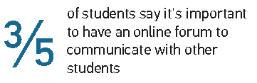
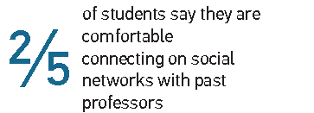
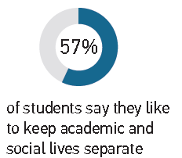
Communication Mode Selectivity
Social networking
with other students?
Social
networking
with current instructors?
Notes:
The separation of academics and social lives appears to be specific to students’ disinterest in connecting with instructors on social networks.
Friending current and former instructors is still taboo
Big take-away: even though students use a technology regularly as part of their everyday life, it does not necessarily mean they want that same technology integrated into their academic lives

Slide 30
Poll Question 3:
What form of communication topped students’ “wish list” for what instructors should use more?
E-mail
Face-to-face interaction
Instant messaging/online chatting

Slide 31
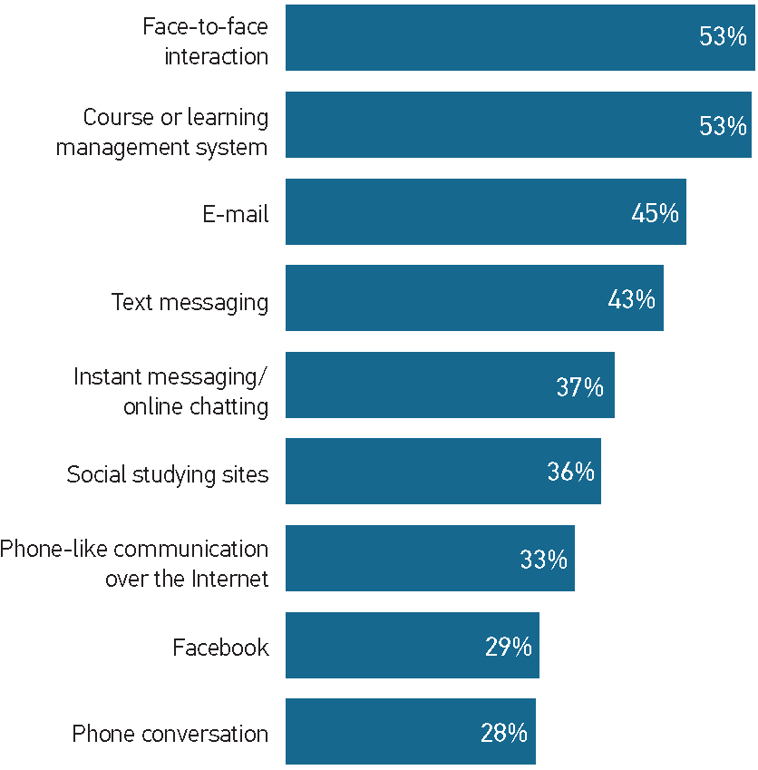
Students Say: Use These More
21% •
27% •
Percentage
change
from
2011
to
2012
28% •
20% •
24% •
Notes:
Students want to interact with instructors using direct forms of interaction (f2f, email) and the cms/LMS
Even students for who have taken online courses 8 out of 10 say F2F interaction is very/extremely important
Don’t know if they consider f2f as physically f2f or f2f 1:1 interaction remotely
Email provides a passive, but highly documentable way to connect with instructors
Email topped this list in 2011…didn’t ask about F2F

Slide 32
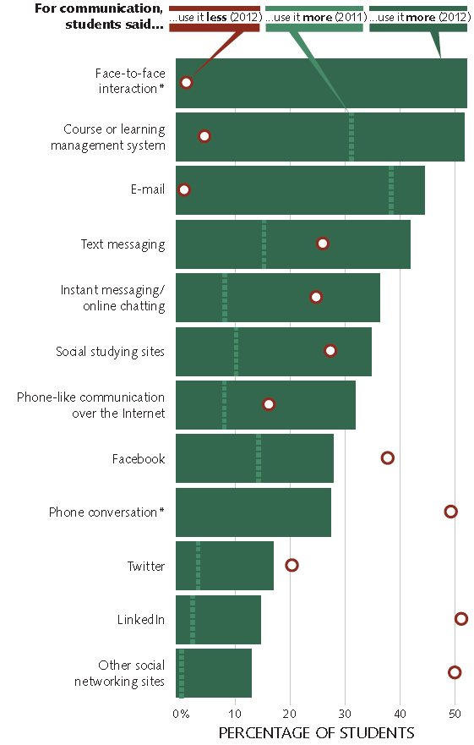
Students Also
Say…
…Use Some of These Less
Notes:
Use this as a communication mode MORE in 2012 SS
Use this as a communication mode MORE in 2011 SS
Use this as a communication mode LESS in 2012 SS

Slide 33
Questions?

Slide 34
New Content for the 2013 Study

Slide 35
We are investigating:
The fascination with desktop computers
Specific interests in technology training, learning analytics, and early alert opps
MOOC experiences and digital badge perceptions
How mobile devices are used (or can be used) as academic tools – and beyond
Details about OER, GBL, EBs and EPs
Insight about BYOD growth + potential
Notes:
The (morbid?) fascination with desktop computers
Despite nearly all students owning laptops, institutionally-provisioned desktops are still widely used – WHY?
Specific interests in technology training, learning analytics, and early alert opps
Training: More students than were expected said they didn’t feel prepared to use tech for academics when the entered college
Analytics/Alert: what do students think about using their information to offer Amazon.com or Netflix-like “you may also like” types of suggestions
MOOC experiences and digital badge perceptions
What is the pervasiveness of MOOCs for undergrads enrolled in traditional HE institutions? What is the value of a badge vs. a degree or cert?
How mobile devices are used (or can be used) as academic tools – and beyond
In what way are they used, or do students want to use their mobile devices?
Worked with NASPA to add answer options that went beyond academics and we’ll try to get at mobile device functionality for general engagement activities
Details about OER, GBL, EBs and Eps
OER, GBL, E-books, and E-portfolios were the tools/resources that saw the greatest growth from 2011 to 2012 – what is it that students want from these?
Insight about BYOD growth + potential
What can we learn about student’s tech behaviors that can inform policy and practice around IT issues like infrastructure and security. Where should we put resources if we want to leverage these devices in the T&L environment?

Slide 36
How to Get Involved

Slide 37
What Can YOU Do?
Develop a plan to learn about your students’ technology profile, experiences and interests.
Notes:
Develop a plan to learn about your students’ technology profile, experiences and interests. Use the information you learn from students to take action to improve their experiences with technology at your institution.

Slide 38
Participate in the Student Study
Do recon on the Student Study Website: www.educause.edu/student-study
Complete the online “intent to participate” form
Submit IRB/approval documentation
Submit a sampling plan
Finalize local survey logistics
Administer the survey to your students
Use your local results to inform decisions

Slide 39
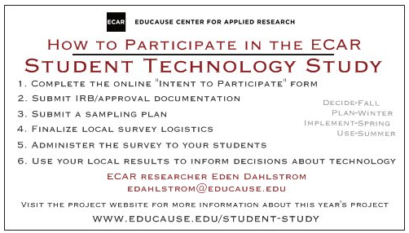
Participate in the Student Study
Do recon on the Student Study Website: www.educause.edu/student-study
Complete the online “intent to participate” form
Submit IRB/approval documentation
Submit a sampling plan
Finalize local survey logistics
Administer the survey to your students
Use your local results to inform decisions

Slide 40
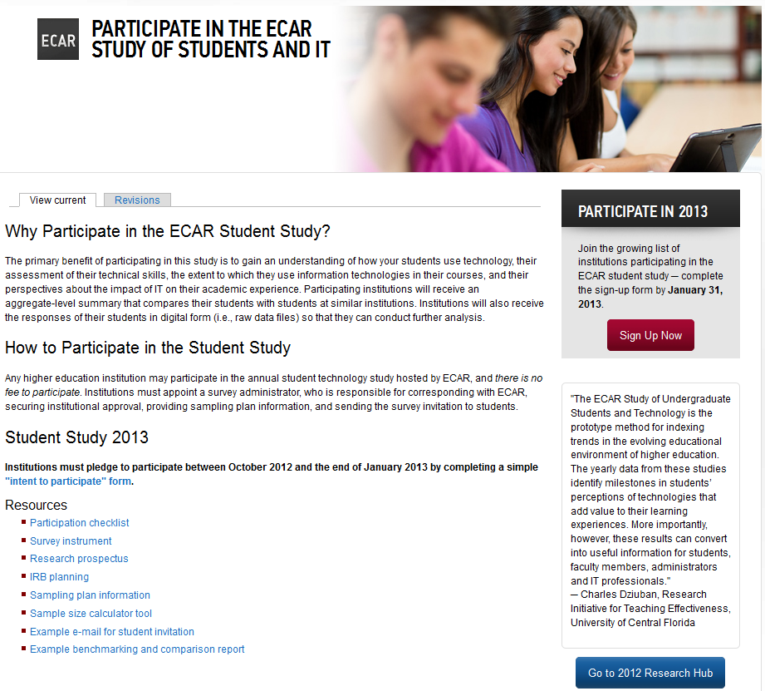

Slide 41
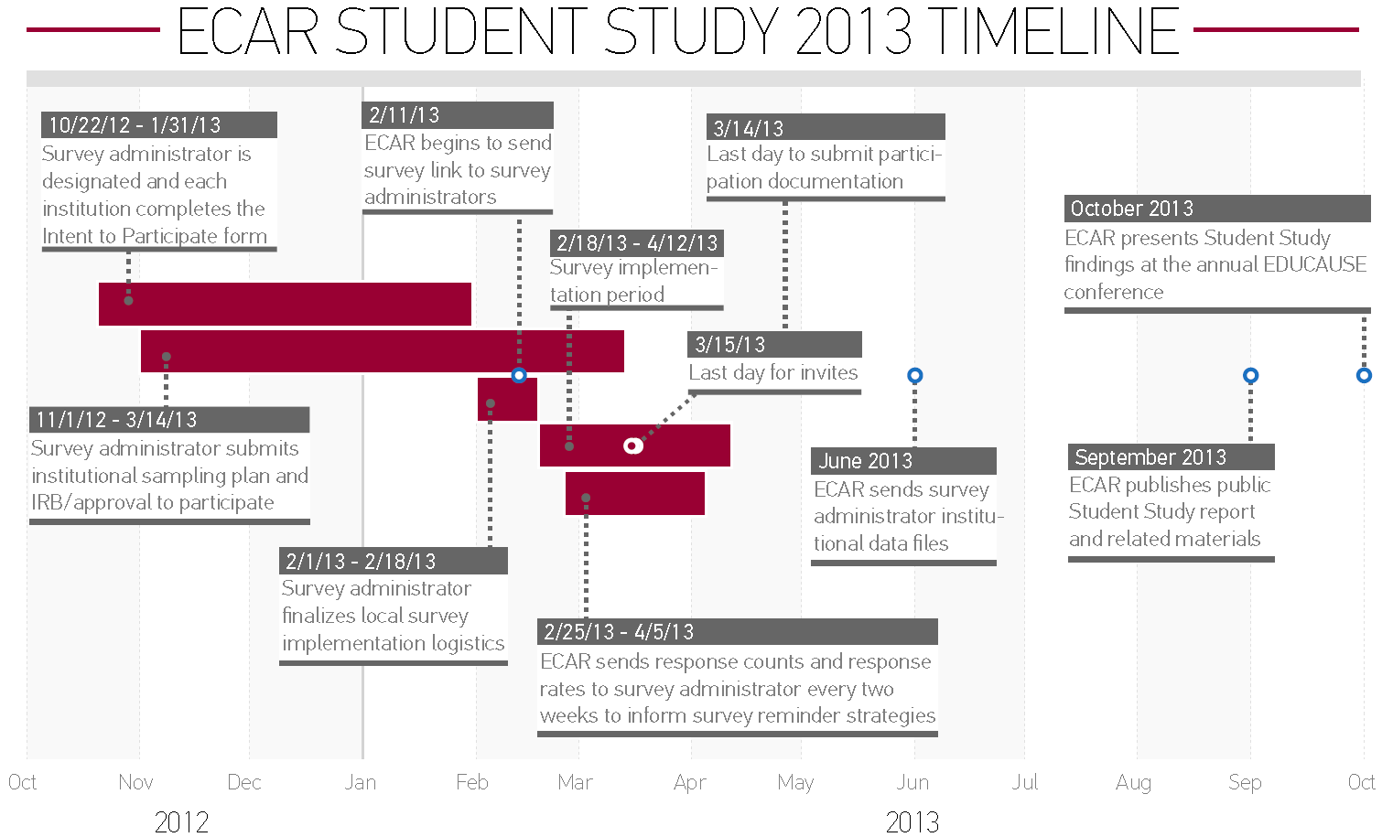
Participate in the Student Study
You Are Here

Slide 42

Contact the 2013 SS Research Team: ecarstudy@educause.edu
Eden Dahlstrom, Principal Investigator EDUCAUSE
Kate Hellweg, Research Associate EDUAUSE

Slide 43
Questions?

Slide 44
Recommendations

Slide 45
THEME 1: Blended Modalities and Engaging Students
Continue to support blended-learning environments and reward innovation of scalable (successful) blended-learning practices.
Notes:
Continue to support blended-learning environments and reward innovation of scalable (successful) blended-learning practices. Students say they learn most in courses that have online components, and this practice supports their interest in anytime, anywhere learning opportunities

Slide 46
THEME 1: Blended Modalities and Engaging Students
Don’t underestimate the importance of technology to students, and consider their ratings of the effective use of technology by their instructors as a key indicator for their general experience with technology at the institution.
Notes:
Don’t underestimate the importance of technology to students, and consider their ratings of the effective use of technology by their instructors as a key indicator for their general experience with technology at the institution. Instructors have the most frequent direct contact with students, and as the institutions’ de facto technology ambassadors to students, faculty should have professional development opportunities and support for their use of technology “in the classroom”

Slide 47
THEME 1: Blended Modalities and Engaging Students
Look to emerging or established leaders (other institutions, other countries, other industries) for strategies to deliver institutional and curricular content to tablets and smartphones.
Notes:
Look to emerging or established leaders (other institutions, other countries, other industries) for strategies to deliver institutional and curricular content to tablets and smartphones. Learn from their exemplary strategies for IT support and security with student devices as well as planning, funding, deploying, and managing instructional technologies, services, and support.

Slide 48
THEME 1: Blended Modalities and Engaging Students
Develop a plan to learn about your students’ technology profile, experiences, and interests.
Notes:
Develop a plan to learn about your students’ technology profile, experiences and interests. Use the information you learn from students to take action to improve their experiences with technology at your institution.

Slide 49
THEME 1: Blended Modalities and Engaging Students
Work with faculty to experiment with open educational resources and game-based learning.
Notes:
Work with faculty to experiment with open educational resources and game-based learning opportunities; these are among the technologies that students wish their instructors used more.

Slide 50
THEME 2: Moving Beyond Individual Devices and Platforms
Develop mobile IT strategies that allow for cross-platform compatibility.
Notes:
Diversity of technology among students is as high as it has ever been, and it is impossible to support all brands, products, and platforms. Develop mobile IT strategies that allow for cross-platform compatibility, such as generic mobile apps and hybrid apps.

Slide 51
THEME 2: Moving Beyond Individual Devices and Platforms
Prioritize the development or improvement of mobile-friendly resources and activities that students say are important.
Notes:
Prioritize the development or improvement off mobile-friendly resources and activities that students say are important: course websites and syllabi, course and learning management systems, and academic progress reports (i.e., grades).

Slide 52
THEME 2: Moving Beyond Individual Devices and Platforms
Identify what additional value or resource desktops provide beyond the user-owned laptop, and consider alternative and perhaps more affordable options to meet this need.
Notes:
For institutions that provide desktop computer stations on a physical campus, investigate how these are being used by students. Identify what additional value or resource desktops provide beyond the user-owned laptop, and consider alternative and perhaps more affordable options to meet this need.

Slide 53
THEME 3: Tech Is Critical to Success and Future Accomplishments
Consider multiple communication channels between the institution and students and between instructors and students; students say they want options.
Notes:
Even though technology helps students feel more connected, don’t discount the importance of face-to-face interaction. Consider multiple communication channels between the institution and students and between instructors and students; students say they want options.

Slide 54
THEME 3: Tech Is Critical to Success and Future Accomplishments
Bridge the gap between the technologies that have seen the greatest growth (e-portfolios, e-books/
e-textbooks, and web-based citation/bibliographic tools) and students’ attitudes about their importance.
Notes:
Bridge the gap between the technologies that have seen the greatest growth (e-portfolios, e-books/e-textbooks, and web-based citation/bibliographic tools) and students’ attitudes about their importance. Focus training/skill-building opportunities for students, professional development opportunities for faculty, and support service opportunities on these “emerging technologies.”

Slide 55
THEME 3: Tech Is Critical to Success and Future Accomplishments
Don’t assume all students know how to use the technology they own and use as academic tools.
  Instructors should reconcile the technical literacy of their students and the technology they use/ask students to use.
  Institutions should consider assessing the technical literacy of their students upon entry and offer opportunities for technical training or on-demand skills building.
Notes:
Don’t assume all students know how to use the technology they own and use as academic tools.
Instructors should reconcile the technical literacy of their students and the technology they use/ask students to use. Providing on-demand opportunities or resources to gain requisite technical skills will contribute to student performance assessments being true to their knowledge of the subject matter rather than to their technical skills in completing assignments.
Institutions should consider assessing the technical literacy of their students upon entry and offer opportunities for technical training or on-demand skills building. Training is more important to students than more or “better” technology and is essential for their success in a world where these skills are expected.

Slide 56
THEME 4: Communication Options
Provide students with networking opportunities and support their academic work but that are one step removed from faculty oversight or involvement.
Notes:
Students want to connect with one another through social networks but are cautious of mixing academic and social lives. Provide students with networking opportunities and support their academic work but that are one step removed from faculty oversight or involvement.

Slide 57
THEME 4: Communication Options
Use e-mail and the course and learning management system for formal communication with students.
Notes:
Use e-mail and the course and learning management system for formal communication with students. Experiment with text messaging and instant messaging/online chatting, and don’t focus efforts on using social networks and telephone conversations to interact with students.

