Slide 1
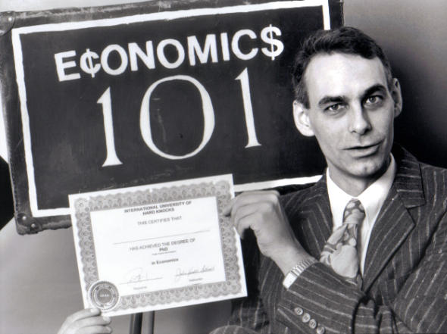

Revenge of
Burck Smith
Notes:
Goes by other names such as “disruption”
Caveats – ACICS is unique, and I will talk about college generally, particularly regionals
Must talk about StraighterLine because I’ve built it according to the trends in higher ed that I will talk about.

Slide 2
Recent Studies
1/3 of all students transfer.
1/3 of all students took at least one online course.
2/3 of colleges offered online courses.
93% of colleges charge the same or more for online.
Credit is fungible.
Credit for online is widespread
Many providers
High profit margins

Slide 3
P = MC
Online courses should be much cheaper than f2f courses
You no longer need to be a college to offer a college course
Notes:
Hearkens back to your days as a freshman.
In a competitive market, eventually price = marginal cost. So, If I’m the first one to build a new widget and I price it much higher than what it costs me to make because nobody has one yet, I can generate profit. Eventually, someone else produces the widget and charges less than me. Eventually someone does the same thing to the second person utnil the price of a widget falls to its cost of delivery.
Historically, we’ve never been able to say what it cost to produce a college degree because there was only one way to do “college.” However, online “college” can be disaggregated and pieces can be done much more cheaply. This is threatening to some and an opportunity to others. But this is the dynamic of higher ed today.

Slide 4
How Big Is The Bubble?
Institution/Course | Cost Per Course | Non-Resident Tuition and Fees
Frostburg State University/Intro. Psych | $25 | $1,688
University of Alabama/Intermediate Math | $82 | $2,680
Average NCAT Institutions/Gen Ed Course | $111 | $1,854
Typical Adjunct Taught ($3K/30 students) | $100 | $1,000 - $2,000
Notes:
The equivalent would be the USPS charging first class rates for email exchange.

Slide 5
Annual Higher Education Subsidies
$190 Billion
(in $b) | Direct | Indirect
Student | $52 | $35
College | $73 | $20+
Notes:
Subsidy – conservatively estimated at $7,750 per student per year. Doesn’t include federal tax exemption and more.
Preferred market position that’s very difficult to penetrate.
The result is “profiteering” by colleges.
Huge subsidies to face to face programs from online programs – ASU and SNHU.
Why for-profit colleges are so profitable.
Growth in platform companies with revenue sharing arrangements

Slide 6
Accreditation Keeps Competition Out
Subsidy
State allocation
Non-profit tax status
Accredited Colleges
Only degrees can be accredited, not courses
Accreditation measures inputs, not outcomes
Competitive Barriers
Colleges cannot easily be “disaggregated”
Federal student grants/subsidized loans
Colleges set own, subjective articulation policies
Colleges must look similar to each other
Standards set and enforced by those that would be undermined by changes
Accrediting agencies are staffed and financed by colleges
Tax preferred plans
Competitive advantages
Notes:
Subsidy – conservatively estimated at $7,750 per student per year. Doesn’t include federal tax exemption and more.
Preferred market position that’s very difficult to penetrate.
The result is “profiteering” by colleges.
Huge subsidies to face to face programs from online programs – ASU and SNHU.
Why for-profit colleges are so profitable.
Growth in platform companies with revenue sharing arrangements

Slide 7

Can I repay the debt?
Tuition
What am I learning?
Student Funding Sources
Can I get a job?
Out-of-Pocket Spending
Different Buying Behavior
Exponentially More Choices
Focus on Course Transferability
Students are Shoppers!
Notes:
Mention VC reaction.

Slide 8
StraighterLine
Provides affordable, well-supported, flexible online general education college courses.
$99 per month + $49 per course started. Almost 90% sign up for the subscription.
Expect to serve 12,000 – 14,000 students this fiscal year.
At WGU, 90% of SL students are still enrolled after twelve months.
Student enrolls
Student successfully completes a series of rigorous assessments and receives a final grade
Students choose and are admitted to partner college or use ACE Credit
Student Advisor forwards student records to partner college
Partner college awards credits for the coursework
Notes:
2008 Controversial. Now, not so much. MOOC with a business model.

Slide 9
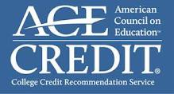










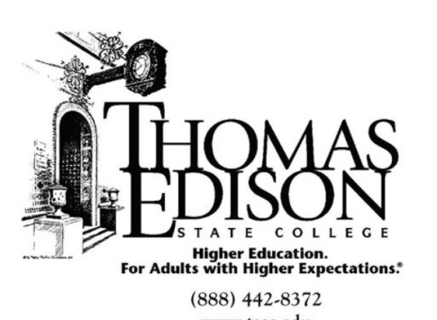






















Slide 10
Value to a College
More Students
After StraighterLine a student will need to complete the majority of his or her degree.
More Valuable Students
These students are very likely to persist
Referral Partner
Colleges refer students that they cannot serve to StraighterLine
They will likely be out-of-state and using distance education
Students can receive discount or the college can receive a fee.
Notes:
2008 Controversial. Now, not so much. MOOC with a business model.

Slide 11

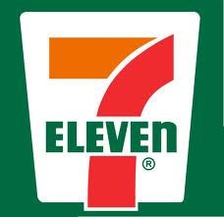
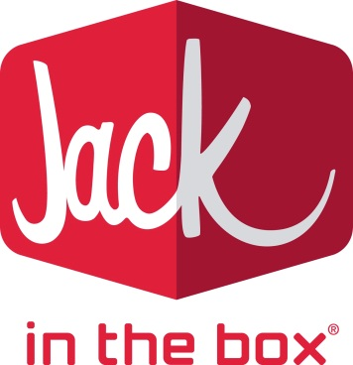







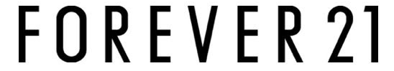









Slide 12
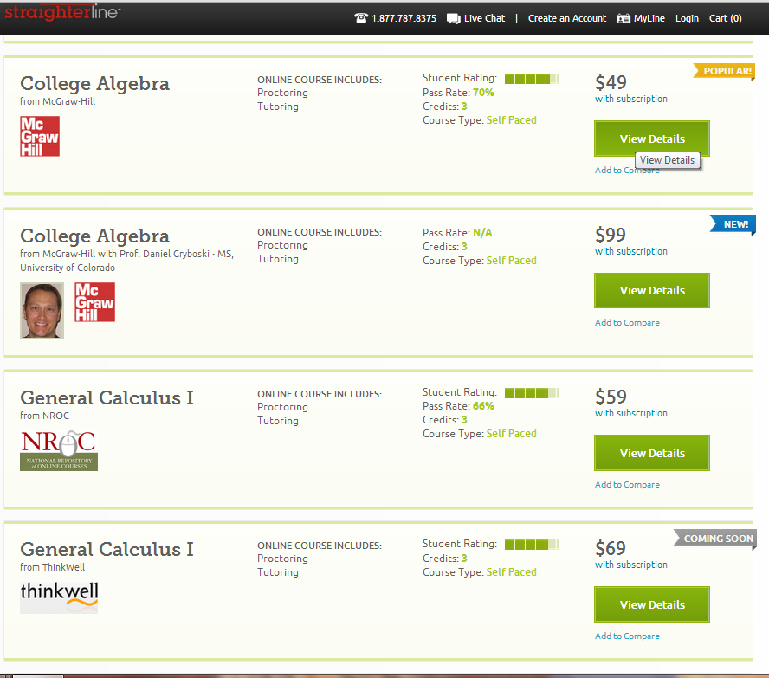

Slide 13
Institutional Issues
Selective, high-priced colleges will be unaffected.
Non-selective colleges will loosen transfer restrictions.
Erosion of most profitable courses.
Colleges should think carefully about online delivery.
Residential will cost a lot more than online courses.
Term-based vs. credit-based pricing is significant.
New marketing opportunities for the most creative.
The rising cost of college will become a non-issue.
New emphasis on academic credibility and integrity.
Notes:
Selective v. non-selective
Transfer restrictions – already loosening. Converse is also true – selective will increase transfer restrictions – article about Williams and Tufts accepting fewer AP credits.
Course prices will vary by the cost of the course – subscription models make a lot more sense for students. On a separate note, I think subscription pricing has tremendous potential to reduce the cost of high-failure rate courses for students and for state governments.
College marketing strategies – buy-one-get-one-free, refer-a-friend, frequent learner cards… Read a story recently about college tuition vouchers given to teachers showing up on eBay.
Institutional participation in PD – removed from constructs of the college and allowed to transfer back in/Agency model.
Rising cost of college – Not that it won’t cost more, but that people will know what they’re getting. The rising cost of cars isn’t an issue, thought here are expensive cars. People pick what meets their needs.

Slide 14
Questions?
Burck Smith
bsmith@straighterline.com
Twitter: @burck
Blog: http://www.straighterline.com/ceo-corner
Notes:
If you really want to wonk out…

