Slide 1
MOOCs and More The Coming Revolution
Transforming Higher Education
Arrived
Brian D. Voss
Vice President and CIO, University of Maryland

Slide 2

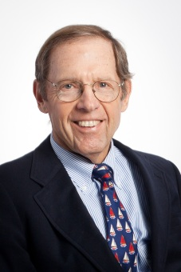

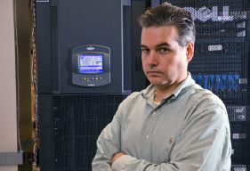
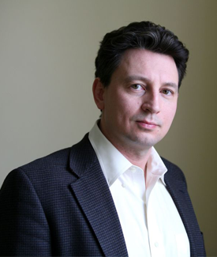

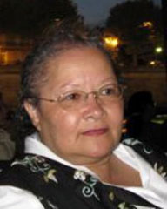

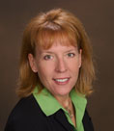
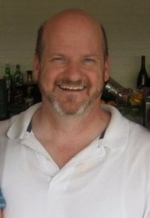
It’s not about IT …
Fundamental Idea #1
The ‘Stars’ ON Stage
Who are MOST important!
The ‘Techs’ Backstage
Who ARE Important!
It IS about
teaching and learning

Slide 3
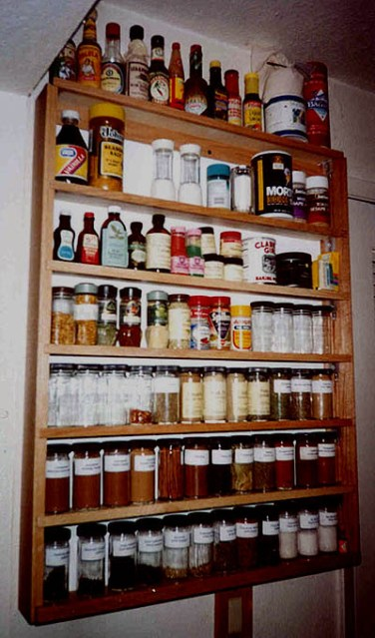
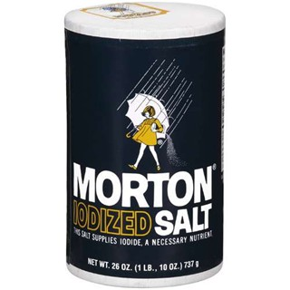
There is no one solution
Fundamental Idea #2
Not this ….
Think SPICE RACK
THIS!

Slide 4
Spices in the Rack
MOOCs – Massive Open Online Courses
E.g.: Coursera, edX, Udacity, Udemy
Online Learning Providers (University-in-a-Box)
Embanet+Compass, 2Tor/2U
Blended Learning
Traditional classroom augmented with online components
Learning Management Systems
Commercial and open & community source
All of these things impacting the “online” space at our institutions

Slide 5

Is This Time Different?

Slide 6
This time … for real?
Committee on Institutional Cooperation (CIC) CIOs answer the question: Is This Time Different? with a big YES!
The effect on residential universities relative to previous experiences and events in this arena will be profound and long-term
The Education Advisory Board report: State of the Union – Higher Education: Competitive Challenges to the Traditional Higher Education Model supports (actually spurred) this viewpoint from the CIC CIOs

Slide 7
Recommended Near-Term Actions
Engage purposefully in trials of MOOCs, adaptive learning systems, and emerging technologies to develop institutional understanding while formulating long-term strategy for ‘badges,’ professional development, MOOCs, courses for credit and full degree programs.
Carefully model and analyze emerging business models for revenue-generating, free, and partnered courses that also incorporate costs for campus services and systems
Ramp up institutional capacities for online course production to support instructional design, media development, assessment, and analytics
Develop IT system readiness to integrate with a range of education software that may need to link to campus information systems for rosters, identity and services in a legal, secure, and policy-complaint way

Slide 8
Questions for Discussion
What kinds of online experiences are needed?
As substitutes for current models?
As complements for current models?
How – and why – does scale matter?
Massive versus not
Whole programs versus courses
For credit (and fee) versus non-credit (for free)
What is lacking at the institution to achieve online objectives?
What kinds of partners are needed and why?

Slide 9
Questions for Discussion
What is the degree of urgency?
Things we should address sooner? Later?
Is there value in a centralized approach and a identified (by title) leader coordinating this (Vice Provost, etc.)?
Or is a holistic, campus-based strategy implemented in a
decentralized/distributed fashion appropriate?
What are the ramifications for a more central IT environment?
Is it time to centralize more pedestrian things so that distributed IT staff can focus on more advanced needs, especially supporting faculty development?

Slide 10
Opinions/Editorials/Perspectives
The views expressed subsequently are not necessarily those of the University of Maryland, EDUCAUSE, the CIC, or anyone, anywhere, in any state of mind – except my own.

Slide 11
Kevin Carey’s The Washington Monthly Magazine Article
Suggests two models Venture Capital Investors are following:
Traditional: Technology is a winner-takes-all world, so the trick is to identify the smartest people with the best teams in their quest to back a winner.
New Wave: The world is too complicated and chaotic to accurately predict which company will have the exact combination of talent, luck and timing to be victorious – therefore, the smart strategy is to invest in the entire ‘scrum’ – to bet on categories, not people.

Slide 12
Carey postulates that before this decade is out ….
The ‘parallel universe’ of an online-age education will reach a point of sophistication and credibility where the degrees – or whatever new word is invented to mean “evidence of your skills and knowledge” – granted will be accepted and taken seriously by employers.
American colleges and universities will start to feel real pain.
Political pressure will continue to grow for credits earned in low-cost MOOCs to be transferable to traditional colleges.
Profit margins that colleges have traditionally enjoyed in providing more traditional education will be cut into.
Colleges with strong brand names and other sources of revenue will emerge stronger than ever, but everyone else will scramble to survive as vestigial players.

Slide 13
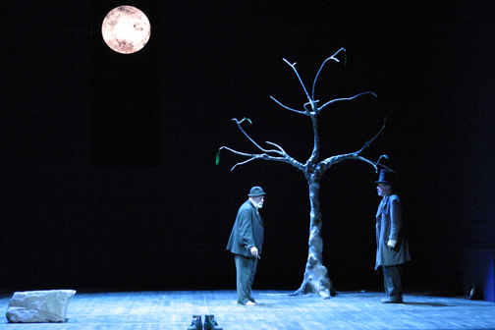
Op-Ed
If you’re waiting for someone to invent a perfect device/platform that overnight transitions faculty from the ‘old way’ to the ‘new way’ …. you’re waiting for Godot.
This will be a task requiring people – course designers, multi-media specialists, support for faculty
This will take a significant investment in this humanware over the rest of this decade to transform the way teaching is delivered – blended, totally online, and all points in between
Whether this is managed centrally or distributed – and how it is facilitated – is a matter of institutional culture

Slide 14
Op-Ed
This effort must be led out of the academy – provosts, deans, chairs, and faculty must embrace the change and lead the charge
In most instances … IT can play the role of collaborators or supporters of the process of change (as well as instigating it), but if this is viewed as “an IT thing” along with all the other IT things facing many campuses – this will not succeed

Slide 15
Op-Ed
There will be a lot of discussion and debate about whether MOOCs and other forms of online teaching & learning offerings actually improve learning outcomes
Whether it does or not … is academic (sorry for the pun)
And not necessarily relevant …Remember the music industry and the debate about ‘sound quality’ vis-à-vis CDs versus MP3s (Clay Shirky’s story at EDUCAUSE ‘12 in Denver’): CDs were ‘higher fidelity’ … but MP3s were not much less so, and were vastly more ‘flexible’

Slide 16
Be Aware That Tensions Exist
Presidents and their administrations are being pressed to act
Governing Boards are insisting , Students (and their parents) are demanding more online options and more use of “modern technology” (better or perceived better … no matter)
Faculty are across a spectrum of interest and opinion as to approach; and even as more and more are pushing to move toward blended, ‘flipped,’ and online capabilities, there remains concern and caution
This is resource and time intensive (Godot is not coming …)
Coursera suggests one full-time course designer per course!
UMD experience developing – but Coursera’s estimate may be close
Many institutions ‘cut back’ on support staff during this recent downturn
This challenge is raising many other IT-centric questions (centralization versus not, etc.); some not so comfortably

Slide 17

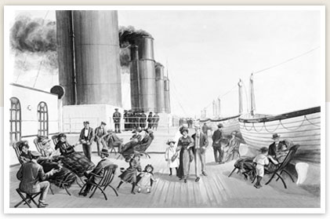
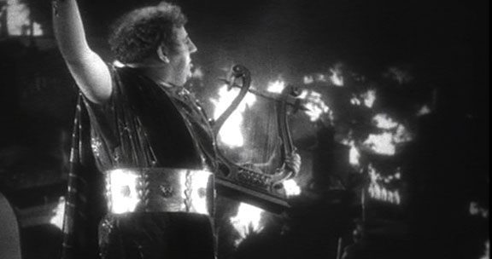
Some Colorful Metaphors

Slide 18
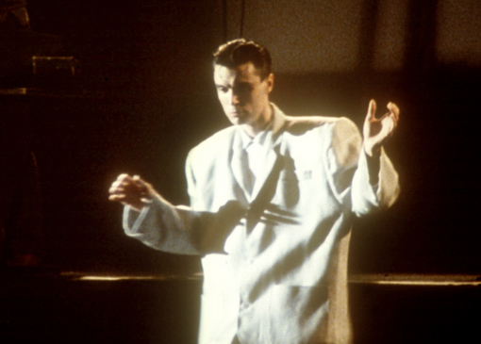
In the immortal words of David Byrne
This ain’t no party …
This ain’t no disco …
This ain’t no foolin’ around.

Slide 19
Q&A
Brian D. Voss
bdvoss@umd.edu
University of Maryland

