Slide 1
Changing the culture of an
IT organization
Whirlwind Style
Jane Livingston and Karen Polhemus
For Educause Live! April 2013

Slide 2
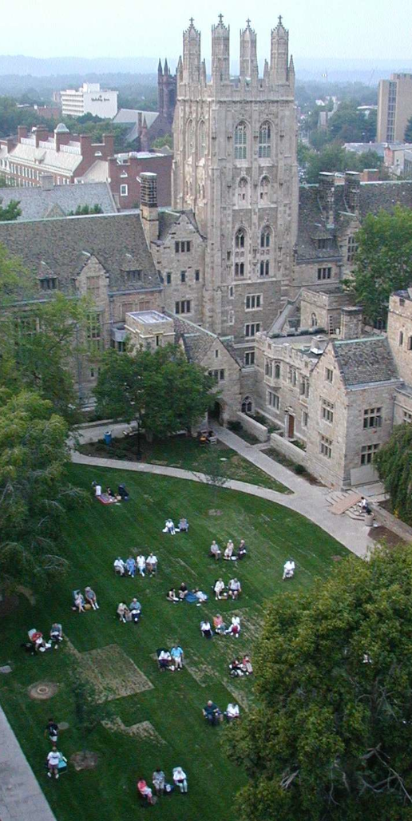
Yale Facts
Total Headcount
  Undergrad & Grads 11,906
  Faculty 4,000
  Staff 9,000
  FTEs in central ITS 420
  FTEs in distributed IT 300 ±

Slide 3
POLL ALERT
What is your role?
What is the name of your school?
How many employees in central IT?

Slide 4
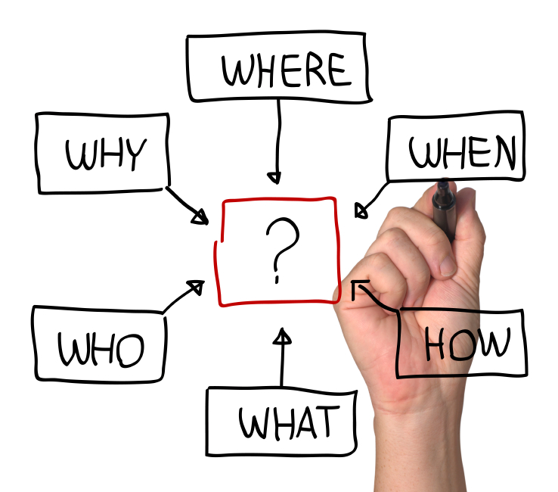
Session Overview
Brief overview of changes
Specific approaches we’ve used
Lessons learned
Keys to success
Notes:
As we describe our organization and culture has been changing over past two years.
Like you to think about
When we get to the lessons learned, we’d like to open it up to you to talk about what lessons youv’e learned too

Slide 5

Organizational Priorities
Staff Development
Rock Solid Services
Community Satisfaction
Technological Leadership
Fiscal Management
Global Recognition
Notes:
New CIO in May 2011
Early on, new CIO Len Peters established a vision and set forth key organizational priorities….
He spent the first 10 months slowly --- no org changes immediately.
He did put together some PIT crews, which Karen will say more about later, but we kicked off the

Slide 6
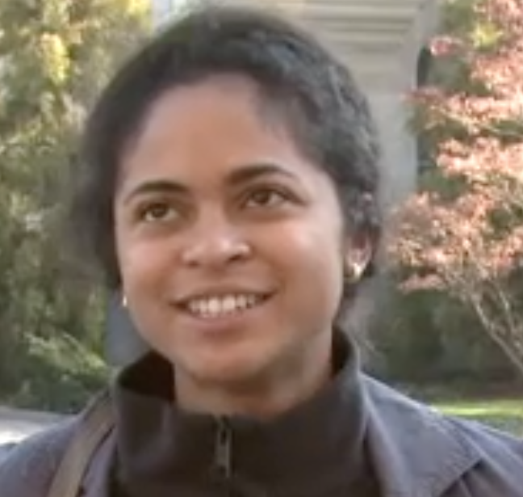
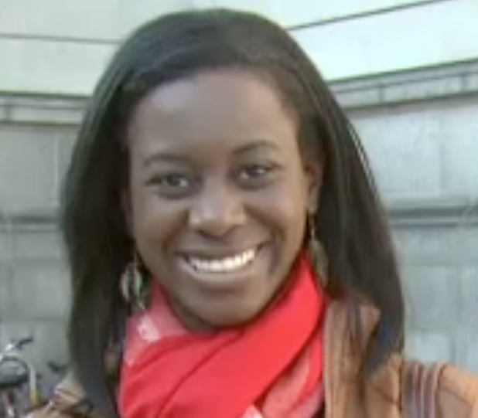
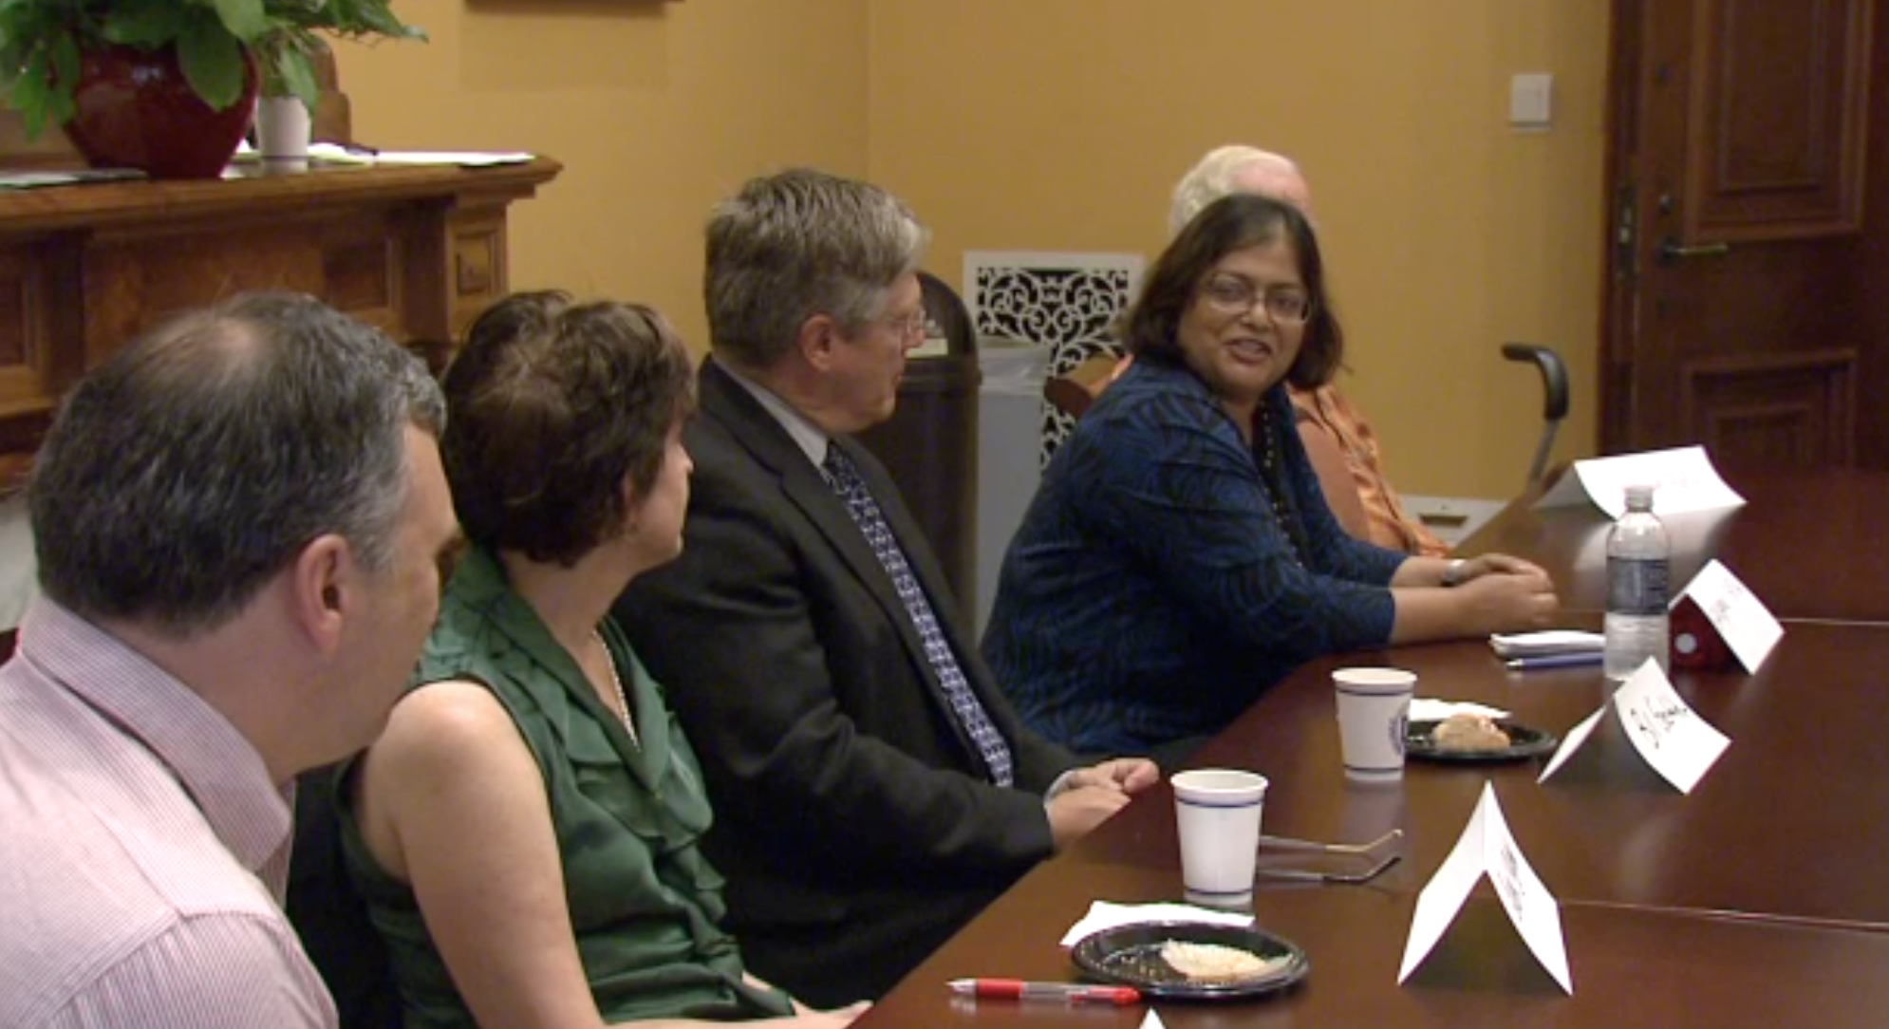
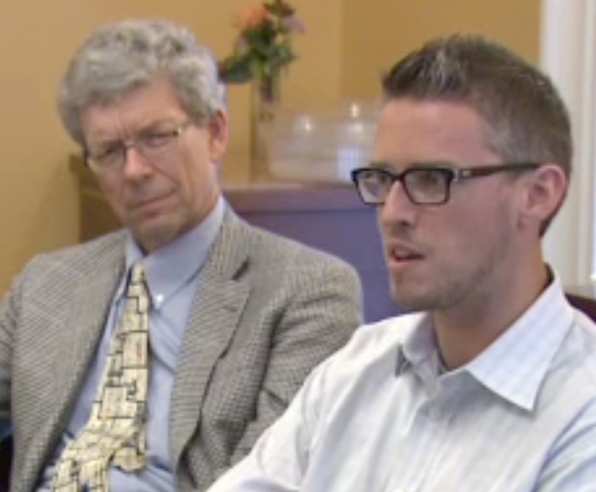
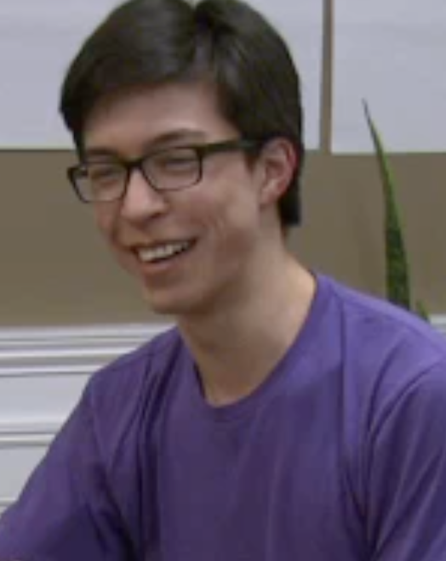
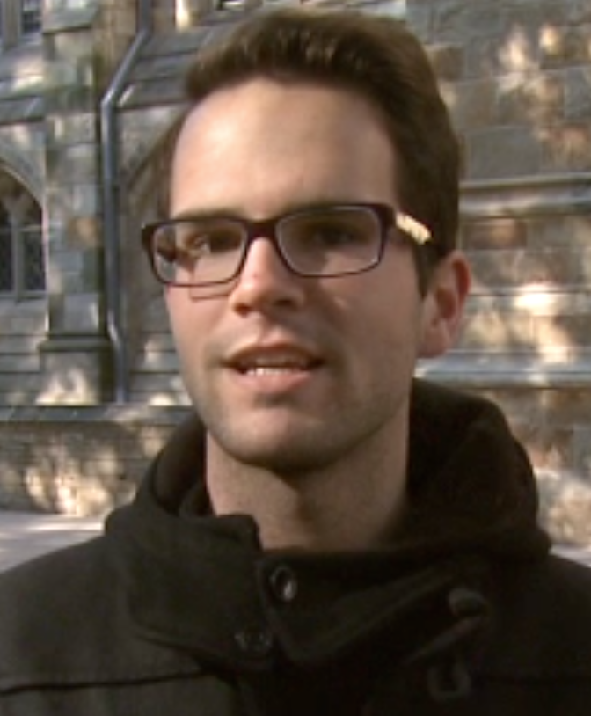
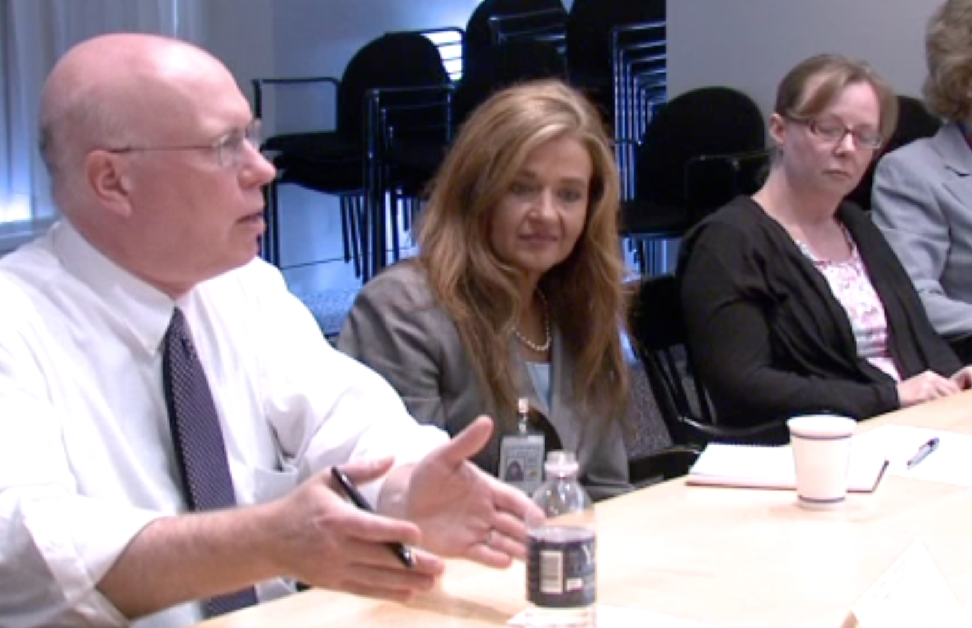
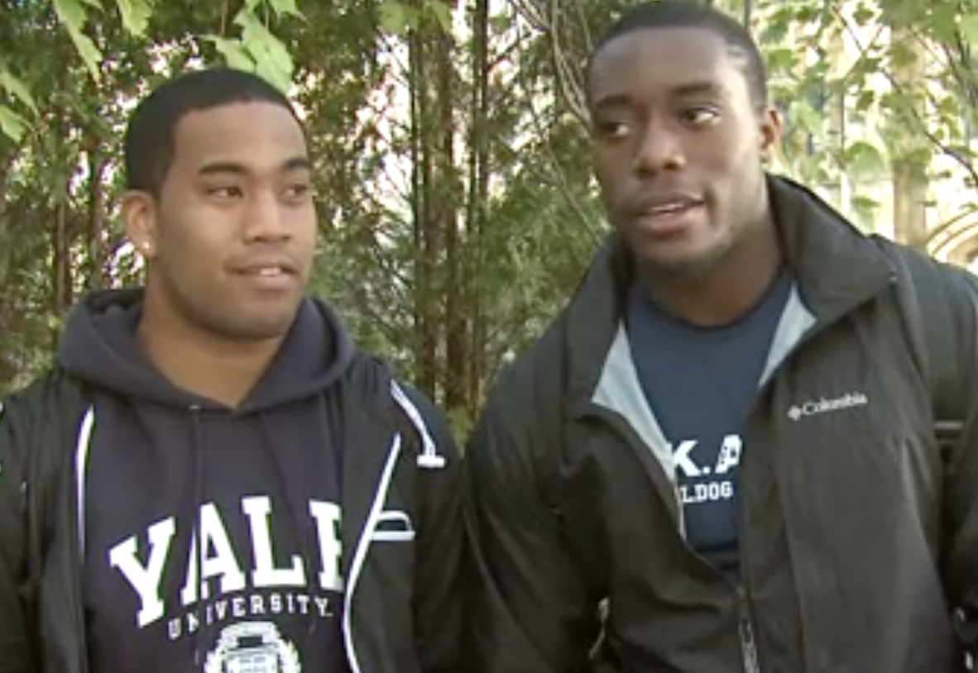
The Way We Were . . . Perceived
Voice of the Community
Notes:
Analysis of community satisfaction a campus wide survey and 19 focus groups for faculty, staff and on the street interviews with students
We found that the results of the survey were consistent with the messages we heard in the focus groups
Top 5 issues in our survey were:
Email and calendaring
Timely resolution
University Systems are easy/helpful
Network reliability
Knowledgeable support staff

Slide 7
Overview of Our Changes
Organizational Change
One major re-organization last year (Feb 2012)
CIO
OSS
Operations & Infrastructure
Network Services
Conferencing Services
Campus Technology Services
Conferencing Services
New Org
Old Org
Notes:
Rebalance the team to better focus on the mission
Flattened the organization dramatically: Number of staff within two management levels of CIO
Old: 35 (5 avg reports)
New: 60 (7 avg reports)

Slide 8
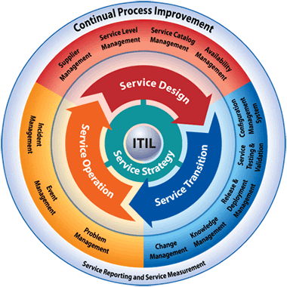
Overview of Our Changes
ITIL – IT Service Management
Trained 400 IT employees (95% of the organization)
Implemented governance:
Change Advisory Board, Service Board
Implemented ServiceNow
  Incident
  Problem
  Change
  Request
  Knowledge
Notes:
IT support personnel from outside of ITS were also trained and started using ServiceNow with the initial ITS rollout

Slide 9
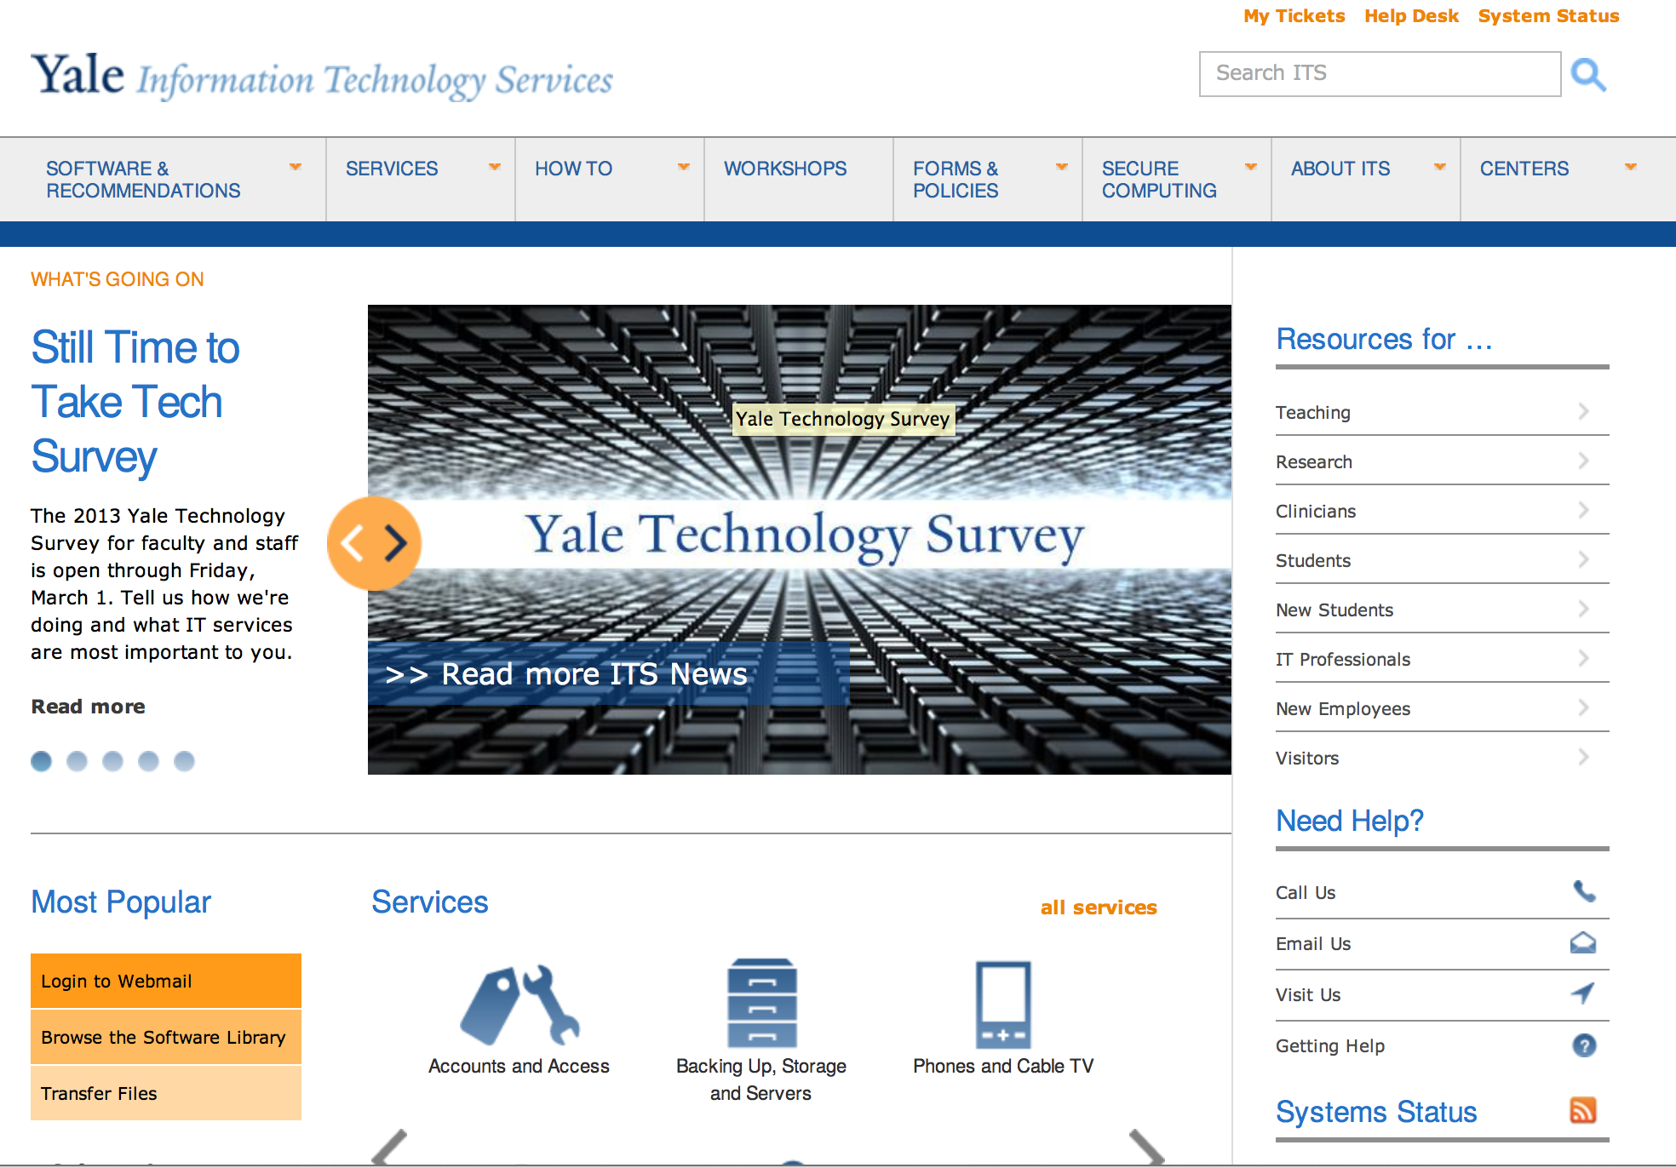
Overview of Our Changes
Notes:
Surveys & benchmarking
New website
Outreach to partners
Regular communication

Slide 10

Overview of Our Changes
Governance and Collaboration
Formed Project and portfolio governance boards
Created Strategic Interest committees
  Teaching & Learning
  Research
  Clinical
  Administrative Systems
Strategy
Design
Transition
Operation
governance
Notes:
Institute a clear framework that enables IT collaboration across Yale
Transparency in
Decision rights
Prioritization
Accountability
Continuously improve IT decision-making through client feedback and metrics
Make decisions in a transparent fashion and communicate them effectively
Framework to enable collaboration and communication
Well defined and understood roles and responsibilities

Slide 11
POLL ALERT
What causes change in your IT Department?
New Technology
New processes
New org structure
Solving a problem
Budgets
Or add your own
Notes:
Institute a clear framework that enables IT collaboration across Yale
Transparency in
Decision rights
Prioritization
Accountability
Continuously improve IT decision-making through client feedback and metrics
Make decisions in a transparent fashion and communicate them effectively
Framework to enable collaboration and communication
Well defined and understood roles and responsibilities

Slide 12
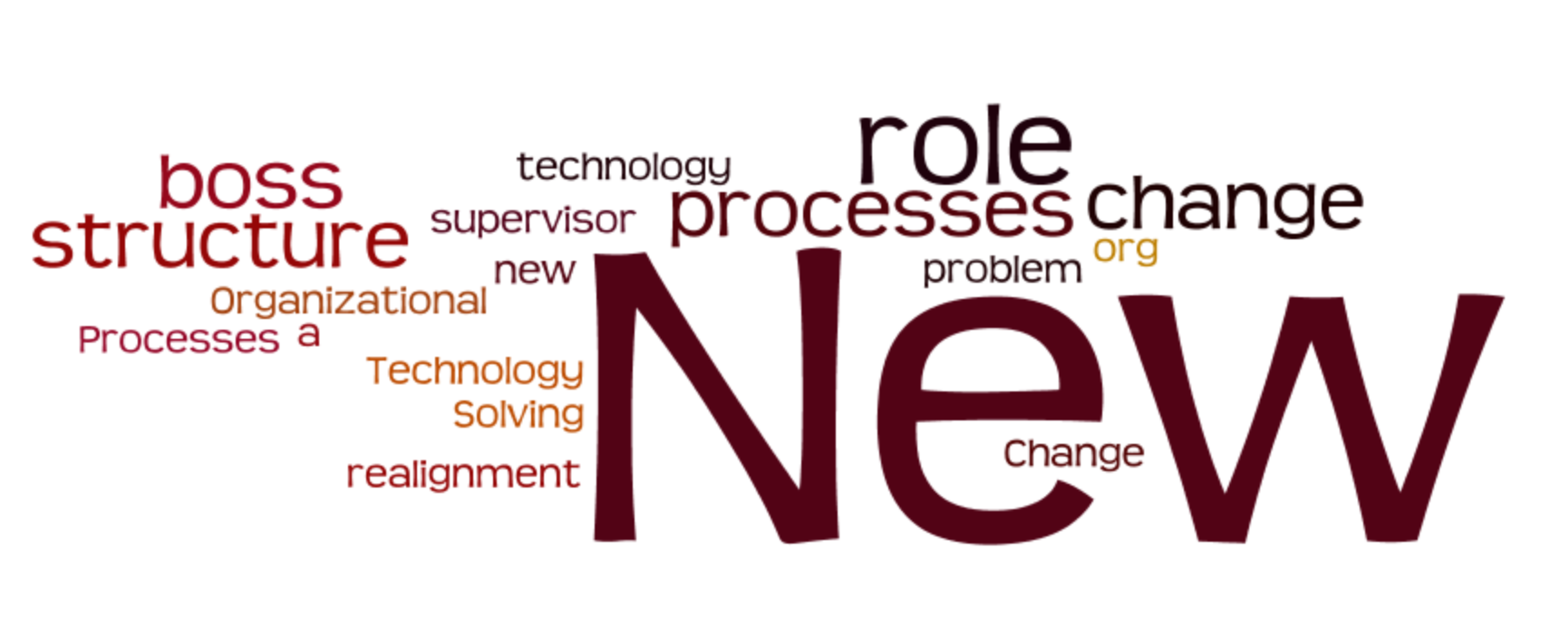
What Causes Change in University IT?
New Technology
New processes
New org structure
New roles, new bosses
Solving a problem
Notes:
Change is about people. While you can make changes quickly, cultural change is ongoing and lasts much longer than the initial change
To support change, we needed some goals
Build relationships
Change behaviors and attitudes
Reinforce change
Create shared experience
Other ideas
Budget

Slide 13

Communication Cascades
✔
Awareness
Desire
Knowledge
Ability
Reinforcement
Celebration
✔
Individuals
  Current / New Manager
Teams
  Current / New Manager
Departments
Notes:
In order to ensure everyone being impacted by the change is aware before broad communications are disseminated, individual and team meetings are held and then departmental meetings prior to broad communications.

Slide 14
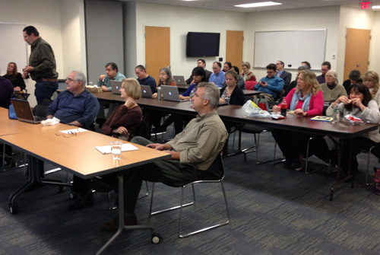
Formal Training
ITIL Certification
ServiceNow
Apple HW/SW Certification
Windows 8 Configuration
Ruby-on-Rails
Knowledge Management
  Editor/Author
New IT Employee
  Orientation
IT Professionals Forum
✔
Awareness
Desire
Knowledge
Ability
Reinforcement
Celebration
✔
✔

Slide 15
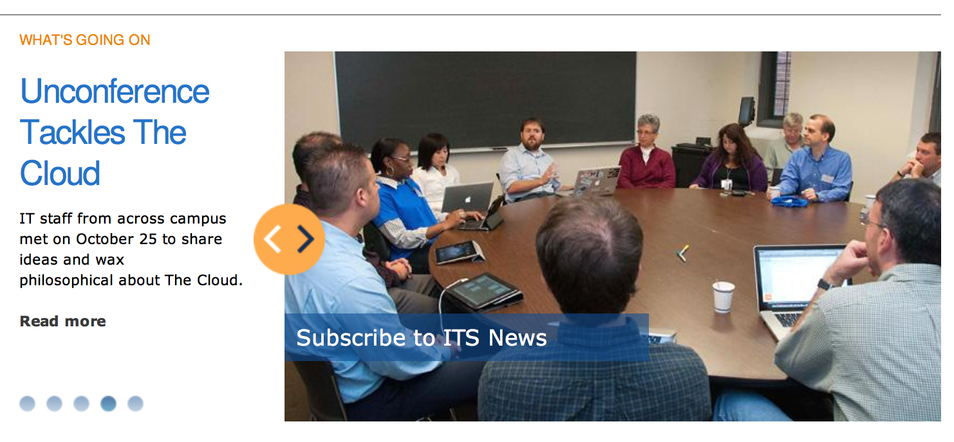

Monday Morning News
Weekly newsletter
1,400 recipients
IT and non-IT staff
Increased traffic 800% in past year
✔
Awareness
Desire
Knowledge
Ability
Reinforcement
Celebration
✔
✔
✔
✔

Slide 16

Lunch & Learn Seminars
Change Management / CAB
Technology Solutions at Yale
Knowledge Management
ITSM – Request Process Build-out
IPv6 Implementation
✔
Awareness
Desire
Knowledge
Ability
Reinforcement
Celebration
✔
✔
✔
... a training event scheduled during the lunch hour. Employees bring their lunches and eat them during the training session. Training is less formally structured. Topics are presented by employees from all levels of the organization.

Slide 17
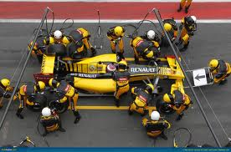
PIT Crews
Performance Improvement
Teams
  … a group of experts assigned to investigate and/or solve technical or systemic problems
  Voice of the Community
  Research Technologies
  Internal satisfaction (ITS) and
  cross-team collaboration
  External communication
  Staff Development
  Innovation
  PMO Practices
  Collaboration tools
✔
Awareness
Desire
Knowledge
Ability
Reinforcement
Celebration
✔
✔

Slide 18
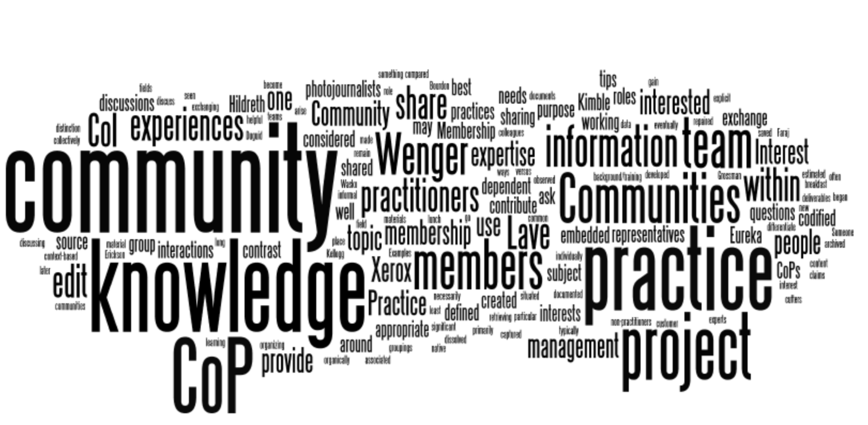
Communities of Practice
Project Management
Business Analysis
Change Management
Software Developers
✔
Awareness
Desire
Knowledge
Ability
Reinforcement
Celebration
✔
✔
✔
… process of sharing information and experiences with the group that the members learn from each other, and have an opportunity to develop themselves personally and professionally.
(Lave & Wenger 1991)
✔

Slide 19
Individual Development Plans
competence
C
Awareness
Desire
Knowledge
Ability
Reinforcement
Celebration
✔
O
P
✔
organizational need
passion
✔
If you focus on …
Competence
Passion/Goals
Organizational Need
you will …
Grow your abilities and effectiveness
Sustain commitment and motivation
Keep adding value to the organization
over time

Slide 20
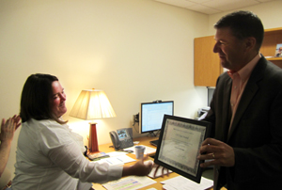
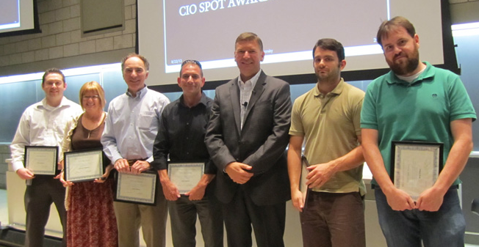
CIO Spot Awards
Recognize world-class service
Formal award presentation
  to individuals and teams
Presented by the CIO
  “on the spot”
✔
Awareness
Desire
Knowledge
Ability
Reinforcement
Celebration
✔
✔
✔
✔

Slide 21
POLL ALERT
What lessons have you learned implementing change?
Notes:
ITIL implementation/SN
Organization change
ITS Website
IDPs

Slide 22
Lessons learned
  Change (itself) is easier to implement fast and big bang.
Focus on people and process, and the technology
will follow.
Notes:
ITIL implementation/SN
Organization change
ITS Website
IDPs

Slide 23
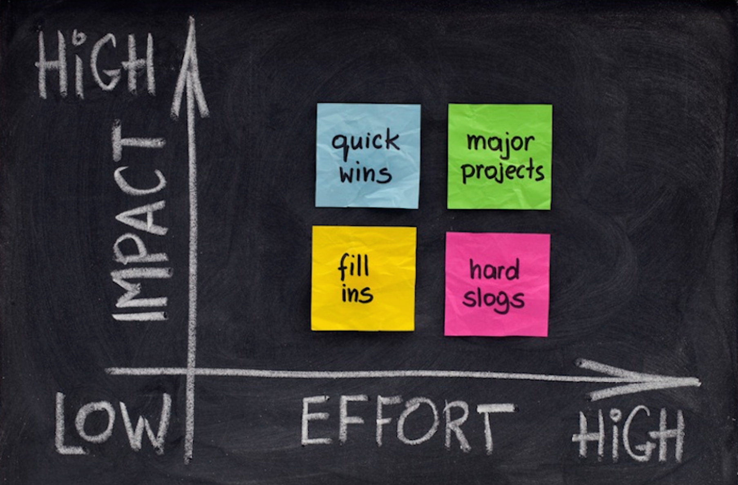
Culture change is HARD
Notes:
Changing culture is hard and takes time
Successful change takes at least 3 years to take root
maturity

Slide 24
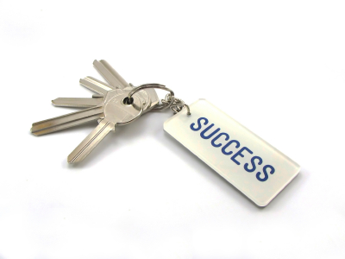
Keys to success
Buy-in at the top
Define values that you want to see and model them
Find early wins
Recruit influencers
Role models act differently / behavior is rewarded
Reinforcement

Slide 25
Thank you
Jane Livingston
jane.livingston@yale.edu
Karen Polhemus
karen.polhemus@yale.edu

