Slide 1
Higher Education in the Ultra-Connected Age
Susan Metros
University of Southern California
Justin Sipher
St. Lawrence University

Slide 2
Agenda
Why Connect?
Connectedness in Context
The “Ultra-Connected” Society
Connected Learning Principles
Learning Connections Examples
Digital Natives and Learning
Questions and Contacts

Slide 3
Poll
  Why Connect?
  Because connection underpins basic communication
  Because we are curious beings
  Because it allows us to expand boundaries
  Because technology affords us the ability to connect
  All of the above
  Other reasons to connect?
Notes:
First, we need to ask ourselves- WHY CONNECT?
ALL of the ABOVE
Because connection underpins communication
---Most species have ways to connect with each other- simplest organisms to the most sophisticated human transactions-
-- from procreation to telepathy
Because we are curious beings
--- Are humans- are curious about each other- and reach out to learn more – positive and negative consequences
Because it allows us to expand boundaries
--- Both physically and remotely
Because technology affords us the ability to connect
--- It untethers us from physical space
-- Allows us to create networks of like minded associations
-- Makes connecting easy, convenient, and ever- present- pervasive and ubiquitous

Slide 4
Connectedness
Notes:
-- Planet- earthlings
-- Species- human, gender, generations, age
-- Nationality- country, culture, region, race, language, ethnicity
-- Religion- formal – organized- and informal
-- Profession- job, union, talent
-- Sports affiliation- type of sport Soccer or baseball, Particular Team- Vikings, fantasy leagues
-- Recreation preferences- runners, bikers, surfers, golfers
-- Hobbies- quilters, gardeners, knitters
-- Product preferences- Mac or PC?, Pepsi or Coke?, dark meat or light meat?
-- Taste in art, music- classical or pop, wine, foodie
-- Pet preferences- cats or dogs
-- Political party and causes
-- School and university affiliations
-- Clubs- fraternities and sororities, civic organizations, gangs
-- Social status – blue bloods, red necks
-- Social movements-
-- Community- neighborhood, block, building
-- Groups- support groups, affinity groups
-- Social networks- Facebook, Likedin, Classmates,
-- Family- far flung distant relatives to immediate family parents, sibling, children
-- Individual traits- name (Bobs), physical characteristics (curly hair site), illness, habits, style…

Slide 5
“Ultra-Connected” Society
What does this mean and is it here?
Notes:
Connections today are more persistent than ever.
Reunions – past: “What’s new in your life?”
Reunions – present: “I see you took up skydiving last week…”

Slide 6
Poll
How many hours a day are you digitally connected?
  0-6
  6-12
  12-18
  18-24
Notes:
On-line is a tough thing to calculate, so I thought digitally connected might make more sense with the audience.
Why the question – how “ultra-connected” is the audience?
Should we ask same question – but what they assume a typical undergrad student would say?

Slide 7
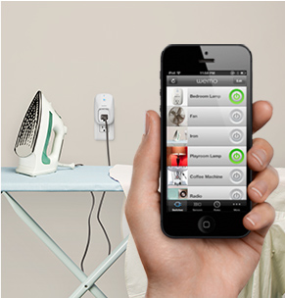
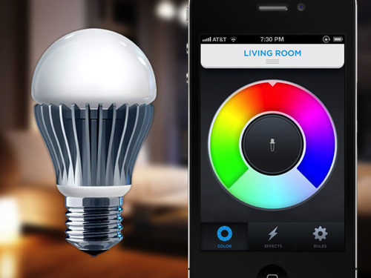
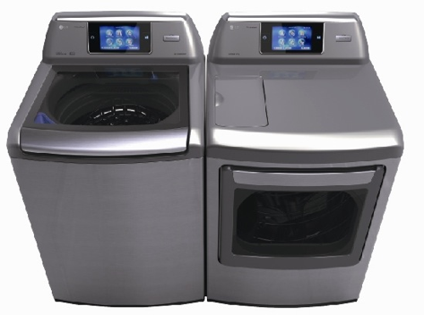
“Always on” Devices
Previous – devices when used by people
Current – devices in preparation of being used by people
Future – userless device connections
Notes:
We’ve gone from networks that are in use when we use them (aka at computer) to while they can see a network (handhelds/tablets downloading email while we are not even “using” the device), to devices that will need/use the network even if we are not around.
LG washer/drive
Belkin power adapter
LifeX Bulb

Slide 8
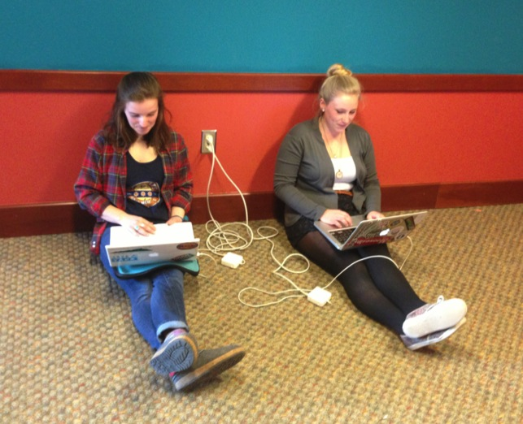
Infrastructure for “Ultra-Connected”
Network
  Bandwidth Consumption
  Device Density
Compatibility
Power (AC)
Notes:
Reminder of our next-generation infrastructure needs are.

Slide 9
Service Delivery Evolution
New IT expectations and responsibilities
  Mobile friendly and mobile compatible
  Agility for landscape changes
  Champion privacy and security
  IT as architect and not contractor

Slide 10
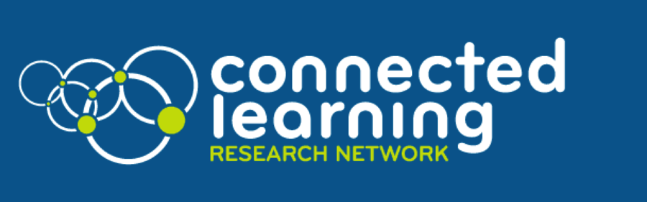
Connected Learning Framework
Values
Learning Principles
Design Principles
ConnectedLearning.tv
Ito et al, 2013
Notes:
Ito, Mizuko, Kris Gutiérrez, Sonia Livingstone, Bill Penuel, Jean Rhodes, Katie Salen, Juliet Schor, Julian Sefton-Green, S. Craig Watkins. 2013. "Connected Learning: An Agenda for Research and Design." Irvine, CA: Digital Media and Learning Research Hub. http://dmlhub.net/sites/default/files/ConnectedLearning_report.pdf
Not a lot of research on connected learning.
-- Most relevant research comes out of the The Digital Media & Learning Research Hub, a non-profit research organization based at UC Irvine and supported by the MacArthur Foundation
-- Work of Mimi Ito and Howard Rheingold
Published their findings and case studies on “Connected Learning Website
Connected draws from social, ubiquitous, blended and personalized learning, delivered by new media, to help us remodel our educational system in tune with today’s economic and political realities.

Slide 11
Connected Learning Values
Equity
Full participation
Social Connection
Ito et al, 2013
Notes:
At the core of connected learning are three values:
Equity -- when educational opportunity is available and accessible to all young people, it elevates the world we all live in.
Full Participation -- learning environments, communities, and civic life thrive when all members actively engage and contribute.
Social connection -- learning is meaningful when it is part of valued social relationships and shared practice, culture, and identity.

Slide 12
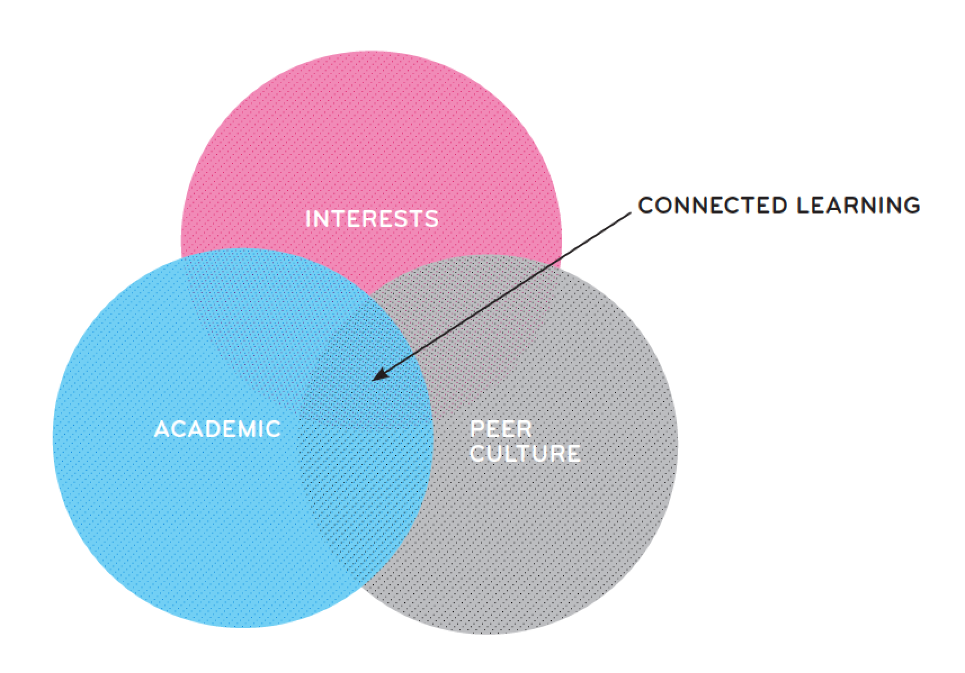
Connected Learning Principles
Interest-powered
Peer-supported
Academically oriented
Ito et al, 2013
Notes:
Connected learning inspired by an initial set of three educational values, three learning principles, and three design principles.
Principles
Connected learning knits together three crucial contexts for learning:
Interest-powered
-- When a subject is personally interesting and relevant, learners achieve much higher-order learning outcomes
2. Peer-supported
--In their everyday exchanges with peers and friends, young people are contributing, sharing and giving feedback in inclusive social
experiences that are fluid and highly engaging
3. Academically oriented
-Learners flourish and realize their potential when they can connect their interests and social engagement to academic studies, civic engagement, and career opportunity.

Slide 13
Connected Learning Design Principles
Shared purpose
Production-centered
Openly networked
Ito et al, 2013
Notes:
CL Design principles
Core properties of connected learning experiences include:
Shared purpose
-- Social media and web-based communities provide unprecedented opportunities for cross-generational and cross-cultural learning and connection to unfold and thrive around common goals and interests
2 Production-centered
-- Digital tools provide opportunities for producing and creating a wide variety of media, knowledge, and cultural content in experimental and active ways
3. Openly networked
-Online platforms and digital tools can make learning resources abundant, accessible, and visible across all learner settings

Slide 14
Learning Connections Examples
Reality Ends Here: USC School of Cinematic Arts Card Game
Traditional vs. Online Learning Environments

Slide 15
Reality Ends Here
USC School of Cinematic Arts Card Game
http://reality.usc.edu
#EDULIVE

Slide 16
Reality Ends Here
USC School of Cinematic Arts Card Game
http://reality.usc.edu
#EDULIVE

Slide 17
Reality Ends Here
USC School of Cinematic Arts Card Game
http://reality.usc.edu
http://reality.usc.edu
#EDULIVE

Slide 18
Reality Ends Here
USC School of Cinematic Arts Card Game
http://reality.usc.edu
#EDULIVE

Slide 19
Reality Ends Here
USC School of Cinematic Arts Card Game
http://reality.usc.edu
#EDULIVE

Slide 20
Reality Ends Here
USC School of Cinematic Arts Card Game
http://reality.usc.edu
#EDULIVE

Slide 21
Traditional Learning Environment
Teacher
Students

Slide 22
Online Learning Environment
Instructional Designer
Teacher
Teacher
(SME)
Students
Recruiter
Notes:
Classroom
Online
Partner
Content
Cohorts

Slide 23
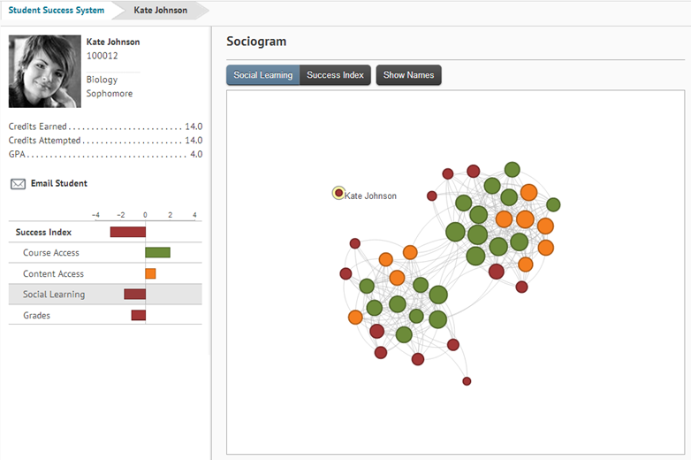
Online Learning Environment
Desire2Learn

Slide 24
Text Poll
How is “ultra-connectedness” impacting teaching and learning at your Institute?

Slide 25
Assumptions
Digitally savvy
E-learning savvy
Grown-up digital
Notes:
Changing gears from infrastructure to JDS belief of misassumptions of digital natives. For me this is why we should be exposing all students to e-learning.

Slide 26
Assumptions
Digitally savvy
E-learning savvy
Grown-up digital
Notes:
Changing gears from infrastructure to JDS belief of misassumptions of digital natives. For me this is why we should be exposing all students to e-learning.

Slide 27
Assumptions
Digitally savvy
E-learning savvy
Grown-up digital
Notes:
Changing gears from infrastructure to JDS belief of misassumptions of digital natives. For me this is why we should be exposing all students to e-learning.

Slide 28
Digital Natives and Learning
Digital native ≠ Digitally savvy ≠ E-learning savvy.
Our students will be exposed to and depend on some form of e-learning in their life.
We should expose them to and not shelter them from this learning environment.
Should we think about one’s learning adaptability?
Notes:
Follow-up on previous slide.

Slide 29
Questions and Contacts
Susan Metros
smetros@usc.edu
University of Southern California
Justin Sipher
jsipher@stlawu.edu
St. Lawrence University

