Slide 1
EDUCAUSE Live! Leading Large IT Projects the Small-College Way
Maria Piret, Director Information Systems, Lynn University
Wednesday, May 8, 2013
1:00-2:00 p.m. ET (UTC-4; 12 p.m. CT, 11 a.m. MT, 10 a.m. PT)

Slide 2
COLLABORATION
Please contribute with your comments to the Google document
http://tinyurl.com/crzwdru
Notes:
Ideas welcome!

Slide 3
Session Agenda
About Lynn University
Leading Large Projects
Challenges & Opportunities
EDUCAUSE TOP 10 Issues 2012
Top 3 Issues
IT Skills and Roles
Consumerization / BYOD
Cloud

Slide 4
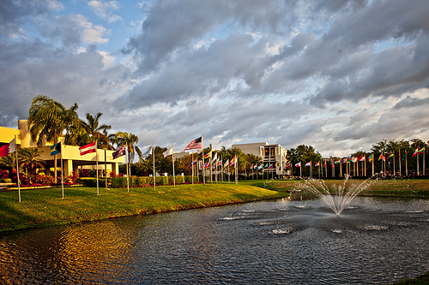
About Lynn University
Located in Boca Raton, FL
Independent, nonprofit, coeducational
Enrollment: 2,109, from 44 states and 78 nations
Student to Faculty Ratio 16:1
27 bachelor's degrees (daytime, eve & online)
8 master's degrees (evening & online)
Ed.D. for scholar practitioners
No tenure track for faculty

Slide 5
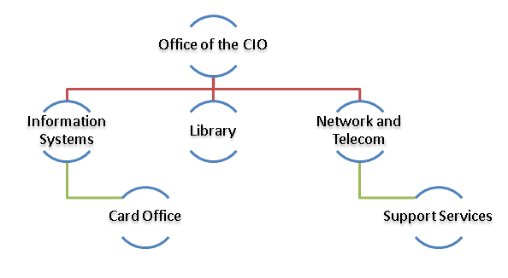
About Lynn University IT department
Centralized Department
Information Systems,
Networking, Telco, Helpdesk
Library
30 staff
CIO reports to President
Manage institution technology budget

Slide 6
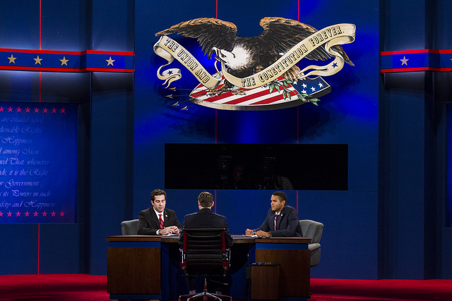

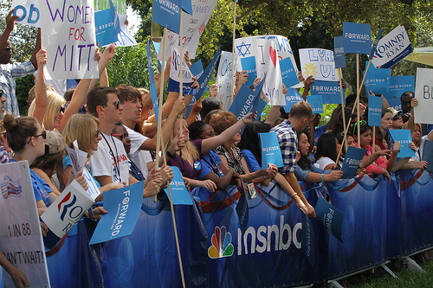
Major Initiative 2012 3rd Presidential Debate
Setup Presidential Debate
Viewing Parties & Events
Fall 2012 UG courses
K-12 Debate Curriculum for Palm Beach School District
Tours K-12
Library exhibit
Lectures & Seminars
Carry on with business as usual!
Notes:
More than just a Presidential debate, linked to the teaching and learning mission and citizenship

Slide 7
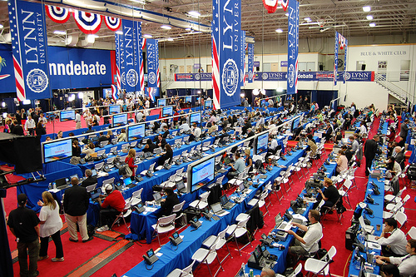
Major Initiative 2012 3rd Presidential Debate
IT Related Projects
Wireless
VoIP
Network
Co-Location
Cabling
Debate Area
Debate Hall
Modular
Broadcast Platforms
Network Production Trucks
CCTV/CATV Support
Ticketing/Credential
Rate Card
Outside Debate Area
Secret Service
Over $2 million IT investment!
Notes:
Over $2 million in IT infrastructure. Donations from Corning, Lenovo, Cisco, Tegile, Liebert, MSNBC

Slide 8

Major Initiative 2013 iPad initiative
iPad mini Freshman 2013 (+500)
iPads to 100 faculty
iPads to 50 mentors
Faculty Professional Development
Revamp Core Curriculum courses
Policies, acceptable usage
Design & Implement business processes
Sean MacEntee Flick.com http://www.flickr.com/photos/smemon/7118776943/sizes/m/in/photostream/

Slide 9

Question to Audience
How does your institution define “large” projects?
Money $$$$
Resources
Impact
Combination
No exact definition, most seem large projects.
Notes:
Open question

Slide 10
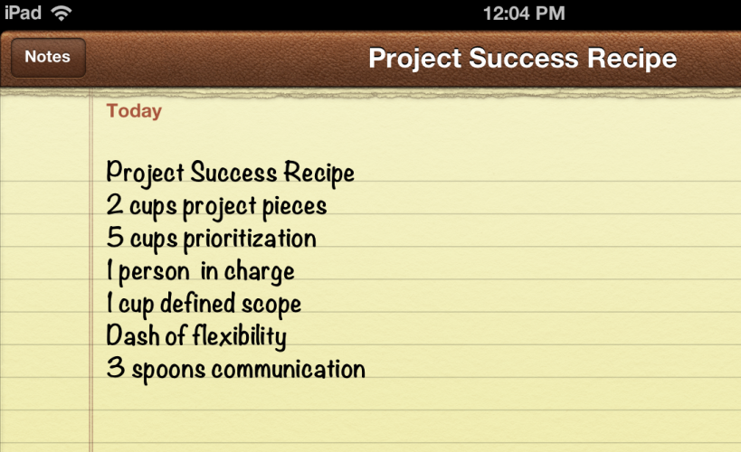
Leading Large Projects
Break into smaller pieces
Prioritization
Manage scope
Have people with skin in the game
Flexible
Manage change
Manage vendors
Communicate, often
Notes:
Good Enough, 80/20

Slide 11
Every project looks ugly in the middle. You must keep your eyes in the prize.
Notes:
To rephrase Rosabeth Moss Kanter “Change Is Hardest in the Middle”
Be the cheerleader!

Slide 12
Leading Large Projects
Top Down
Top Down
Change
Bottom Up
Bottom Up
Notes:
When top down and bottom up approach meets in the middle, momentum for change happens.
Talk their language: Operational, Management, Education

Slide 13
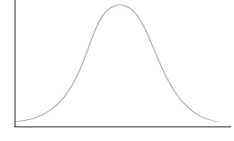

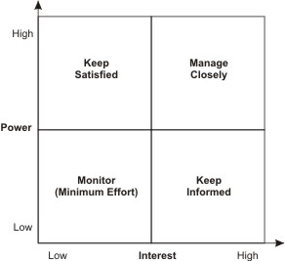
Leading Large Projects
Attitude Bell Curve
Consider stakeholders
Operational Staff
Management
Parents
Vendors
Faculty
Students
Stakeholder Matrix
Mindtools, Stakeholder Analysis at http://www.mindtools.com/pages/article/newPPM_07.htm
Notes:
Michael Kubit Director of Run, Information Technology Services
Case Western Reserve University
Leading Sustained, Desired Change
Power may have little with org charts

Slide 14
Challenges & Opportunities
Org Charts
Limited Resources
Centralized IT
Staff wears different hats
Silo mentality, IT as core business
More agile
Private vs Public
No economies of scale
Location
Notes:
Considerations on small colleges and universities what may be a challenge in one project, may be an opportunity in another project.
No economies of scale but size may allow us to do projects large universities may not be able to do

Slide 15

Educause Top-Ten IT Issues, 2012
Institution size does not affect the issues, it affects how we manage and respond to those issues!
IT skills and roles
IT consumerization / BYOD
Cloud Strategy
Institutional efficiency
Institutional decision-making
Analytics
Funding
Using IT transformatively
Supporting research
Governance
EDUCAUSE Review Volume 46, Number 3, May/June 2011
Notes:
Question, do you agree these are your top 10 IT issues?
Institution size does not affect the issues we face, it affects how we respond or are impacted by the issues.

Slide 16
Question to Audience
Do you agree with EDUCAUSE Top 10 IT issues?
YES?
NO?
Notes:
Question: Select between yes, no

Slide 17
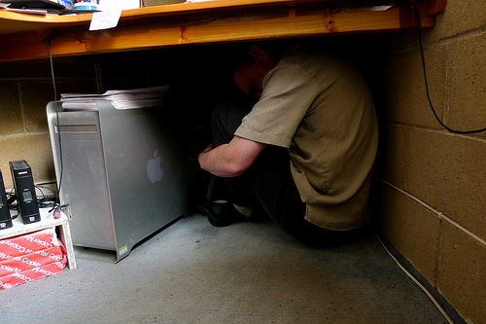
IT Staff and Skills
Harry Harris Flick.com http://www.flickr.com/photos/harryharris/3582799666/sizes/m/in/photostream/
Non technical skills
Consulting and vendors
Foster SME, power users
Diversity
Fit
Work close with HR
Documentation & Coverage
Know the business:
Education!

Slide 18

CONSUMERIZATION / BYOD
People bringing technology faster than our adoption rates
Expectation
Standards
Infrastructure
Scope
Gap analysis
Faculty support
Trendmatcher Flick.com http://www.flickr.com/photos/webber/6812400649/sizes/m/in/photostream/

Slide 19
“Technology is the campfire around which we tell our stories.”
Laurie Anderson
Notes:
It is not about the device or technology,
It is about teaching and learning

Slide 20


Cloud
Services >5yrs
Implementation time
May not have alternative
Contract Management
Cash flows, budget
Authentication, SSO
Data Integration
Data Conversion
Flat Files
Hierarchical DB
Vendor change management (should you trust?)
$
Yrs
Notes:
Internet 2 contract management cloud services

Slide 21
Question to audience
To MOOC or not to MOOC?
Yes: we are working/considering MOOC projects, (Please explain in the chat space)
No: we are not considering MOOC projects at the moment, (Please explain in the chat space)
Notes:
Open Question

Slide 22
Continue the conversation!
Consider telling your story!
EDUCASE Constituent Groups
Small Colleges (SMALLCOL), Chief Information Officers (CIO), IT Strategic Planning (STRATPLAN), Administrative Systems Management (ASM), Project Management (PROJECT)
Project Management Course and Resources
EDUCAUSE Project Management
Project Management Institute (PMI)
Professional Development
Conferences, EDUCAUSE Institute
Other Organizations
Society for Information Management (SIM) http://www.simnet.org/
CIO Executive Council http://council.cio.com/
Notes:
Resources for small colleges

Slide 23
Questions?

Slide 24
Thank You!
Maria Piret
mpiret@lynn.edu
G+ Maria Piret
LinkedIn: Maria Piret
http://tinyurl.com/crzwdru

