Slide 1


Slide 2
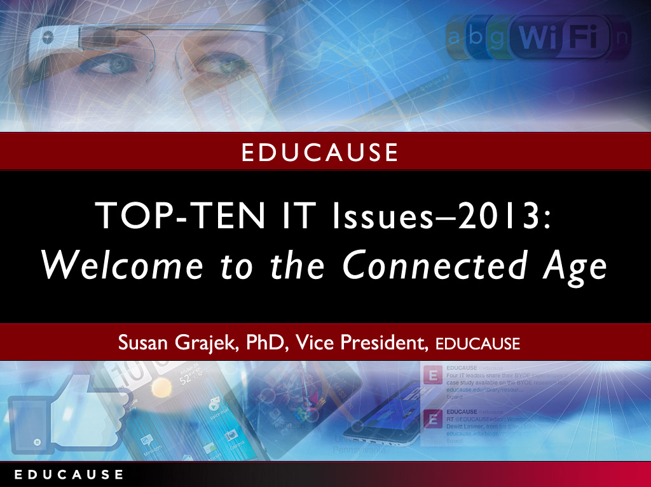

Slide 3
Today’s Speakers
Diane Dagefoerde, CIO, Arts and Sciences, The Ohio State University
Butch Juelg, Associate Vice Chancellor, Technology Services, Lone Star College System
Joseph Vaughan, CIO and Vice President for Computing and Information Services, Harvey Mudd College
Susan Grajek, Vice President of Data, Research and Analytics, EDUCAUSE
Notes:
The EDUCAUSE annual publication of top IT issues has long resonated as a yearly snapshot of the most pressing issues for IT leaders in higher education. In 2000, EDUCAUSE changed the method by which the issues were selected and ranked, instituting a member survey. For twelve years, members were asked to select the five most-important IT issues out of a selection of about thirty in each of four areas: (1) issues that are critical for strategic success; (2) issues that are expected to increase in significance; (3) issues that demand the greatest amount of the campus IT leader’s time; and (4) issues that require the largest expenditures of human and fiscal resources.
To echo the 2000 article that inaugurated the new survey methodology, this year we “put a new spin on this tradition”—in response to perceptions that the top issues were at risk of becoming a stale recycling of the same fifteen or so issues (many of the thirty choices never made the cut). In 2011, EDUCAUSE appointed a research panel of IT leaders from nineteen representative member institutions to both identify and prioritize the top IT issues facing their institutions. In two focus group sessions in September and October 2011, the panel members were asked the question: “What is the single-biggest IT-related issue currently facing your institution?” In an online survey in December 2011, panel members were asked to select the top IT issues for 2012 from the results of those focus groups and were invited to provide additional suggestions. Finally, the IT Issues Panel met in January 2012 to review the survey results and write-ins before voting on the final set of issues.
The EDUCAUSE IT Issues Panel (http://www.educause.edu/ITIssues) includes individuals from EDUCAUSE member institutions to provide quick feedback to EDUCAUSE on current issues, problems, and proposals across higher education information technology. Panel members, who are recruited from a randomly drawn and statistically valid sample to represent the EDUCAUSE membership, serve for one year, with staggered terms. Panel members meet quarterly for 90 minutes via webinar or in person. The meetings, facilitated by EDUCAUSE Vice President Susan Grajek, are designed to stimulate an ongoing dialogue to flesh out and refine an array of open-ended technology questions about the IT organization, the institution, and cross-institution boundaries. The members discuss, refine, and vote on the most relevant underlying issues or options. Grajek explains: “There is a richness behind the process that is a little different from giving people a list of topics to vote on. We introduce open-ended questions and let the members bat ideas back and forth. Sometimes there is debate, and then it transitions to refining and defining the issue and what it really means. As facilitators, we summarize what we heard and reflect it back to the panel members. We often get it right, but sometimes we don’t: panel members correct us until we arrive at a final list of issues for the panel to vote on. Our process enables the panel to move from a very open-ended question to a set of bulleted answers, adding some depth in quite a short period of time.”

Slide 4


Slide 5


Slide 6
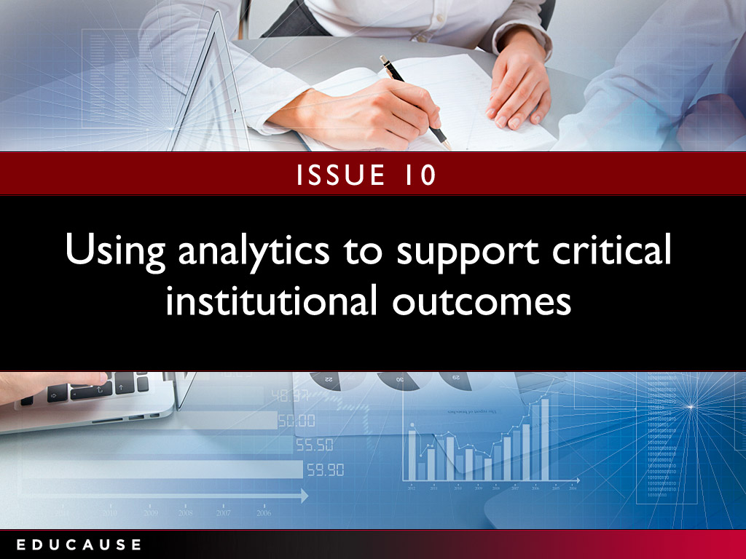

Slide 7
Use analytics to support critical institutional outcomes
Strategic questions to ask:
Do you have a culture of data-driven decision-making?
Does your institution view analytics as a strategic investment or as a new cost?
Do current data flows, definitions, and architectures need to be restructured and redefined to support institution-wide analytics?
Have you inventoried the skills and resources that could support analytics?
“The strength of data and analytics helps us understand our past and our current state and provides a glimpse of scenarios of the future based on that past and current state. ‘If you don’t know where you’re going, how will you know when you get there?”
-- CIO and Vice President
Notes:
Are the institution’s IT governance principles and structure widely understood?
Is the institution’s IT governance deemed effective? If not, how can IT leaders improve it?
What is the IT governance’s institutional realm of influence?
How does the institution’s IT governance structure adapt to new circumstances and issues such as the decentralization of information technology, new technologies, outsourcing, and cloud-based services?

Slide 8
Analytics: What we know
Source: ECAR Analytics Maturity Index, 2012
Notes:
Not readable. You may need multiple slides to focus on specific areas that are readable.

Slide 9


Slide 10
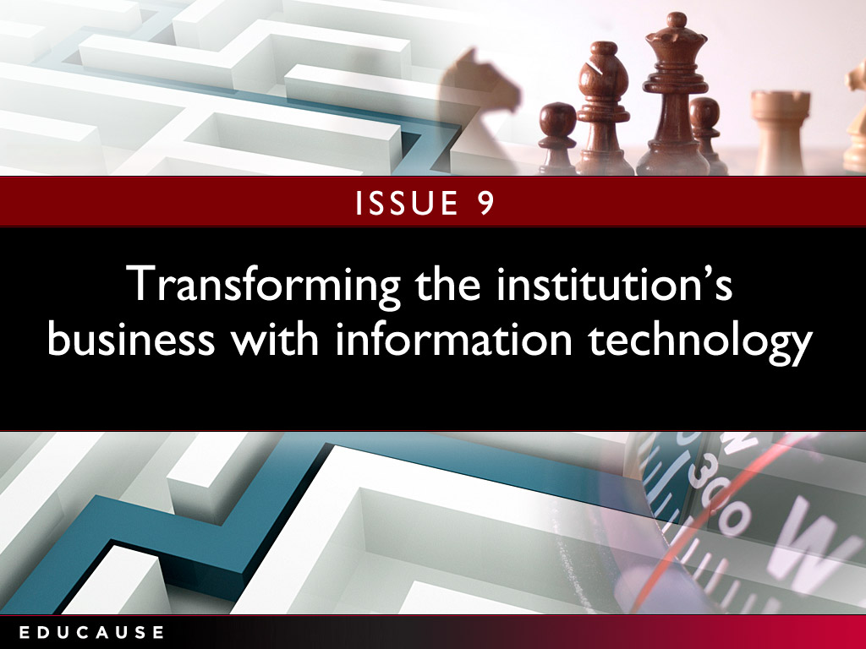

Slide 11
Transforming the institution's business with information technology
Strategic questions to ask:
How can innovation be encouraged in both the institution and the IT organization?
Is the organization willing to change business process or practice to garner effective and efficient use of its information technology?
Does the institutional funding model incentivize or undermine achieving the full benefits of business transformation?
“Higher education IT will need to change its mindset; it can’t provide everything in-house any more. We need to move from 'service provider' to 'solutions architect.' It’s an opportunity and a key challenge.”
— CIO
Notes:
What is the institution’s strategy for funding IT research infrastructure?
What is the balance between the central IT organization and decentralized IT support for the institution’s research mission?
What are the infrastructure, application, support, and staffing (levels and specialized roles) implications for central IT in supporting research?
What are the opportunities for cross-institutional collaborations? How do IT leaders evaluate the worth and risks of such collaborations? How do they foster participation and buy-in?

Slide 12
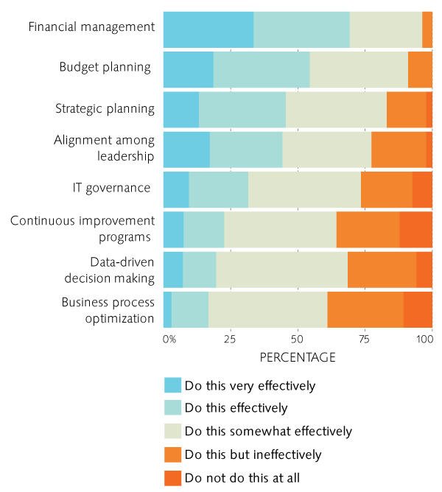
Transforming the institution's business with information technology: What we know
Need to develop stronger capabilities to support transformation
Financial capabilities are strongest; process transformation the weakest
Source: Assessing Your Fiscal Bandwidth: Current Practices for Measuring IT Costs in Higher Education, ECAR, May 2013
Notes:
Research computing: What we know

Slide 13
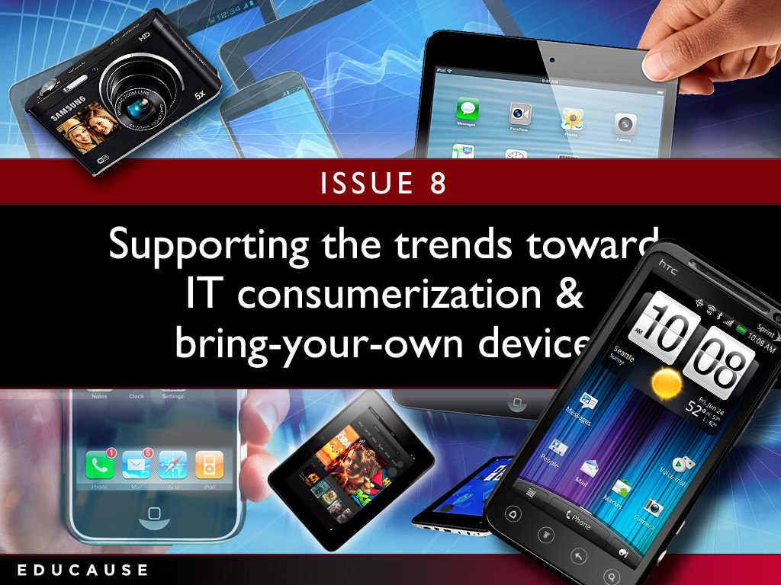

Slide 14


Slide 15

CIO Reflections
Butch Juelg
Associate Vice Chancellor,
Technology Services Lone Star College System
Notes:
Does the institution’s strategic plan include transformative objectives?
Is the IT organization viewed as a trusted partner in institutional transformation?
How can the institution support experimentation with technology to transform teaching and learning without unduly risking students’ learning outcomes?
Are the process reengineering and continuous improvement capabilities in place to enable transformative information technology?

Slide 16


Slide 17
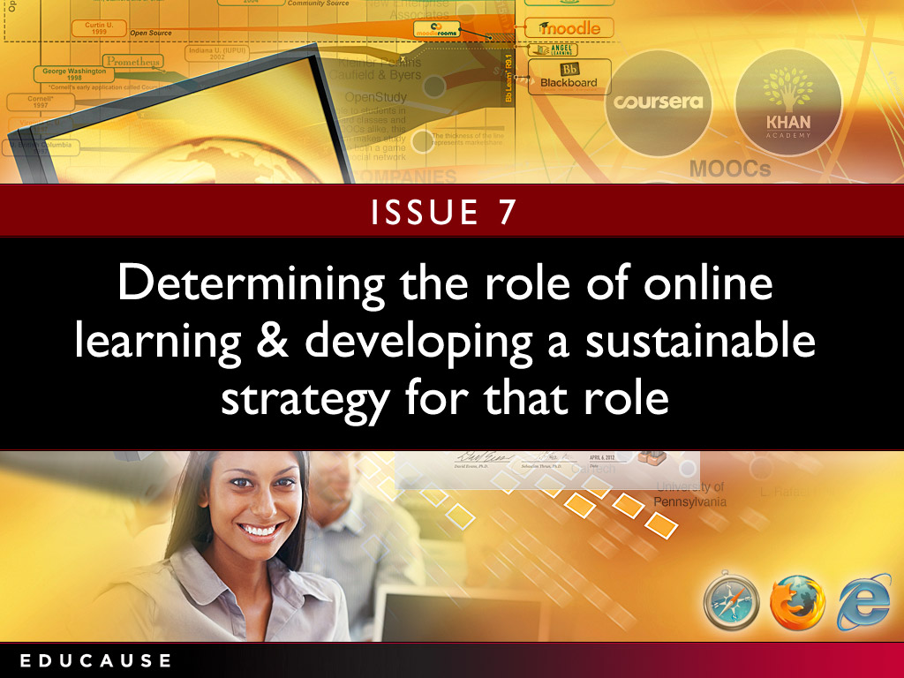

Slide 18

CIO Reflections
Diane Dagefoerde CIO, Arts and Sciences
Notes:
How can IT leaders verify they are doing the very best with available IT resources?
How can IT leaders create an institution-wide view of IT funding and expenditures? What relationships and partnerships will they need to cultivate? What business processes might need to be changed?
How can IT leaders interweave an IT funding component into broader, institutional initiatives to ensure IT is appropriately funded to deliver what is needed?

Slide 19


Slide 20
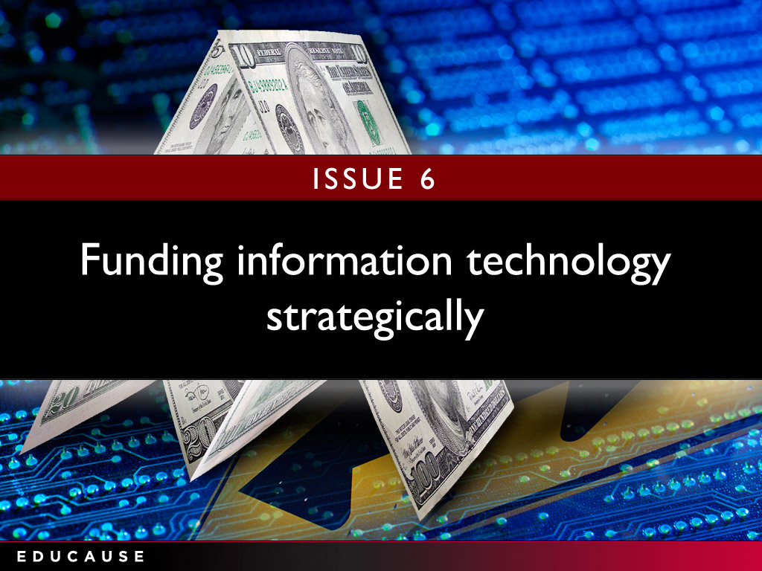

Slide 21
CIO Reflections
Diane Dagefoerde CIO, Arts and Sciences
Notes:
How can IT leaders verify they are doing the very best with available IT resources?
How can IT leaders create an institution-wide view of IT funding and expenditures? What relationships and partnerships will they need to cultivate? What business processes might need to be changed?
How can IT leaders interweave an IT funding component into broader, institutional initiatives to ensure IT is appropriately funded to deliver what is needed?

Slide 22


Slide 23
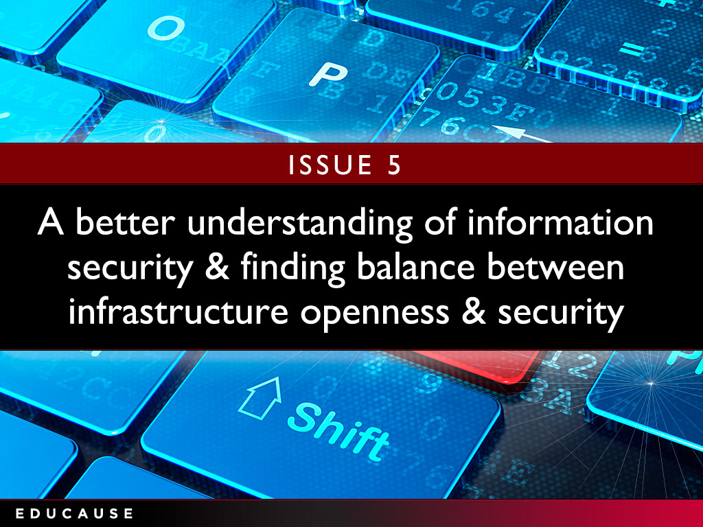

Slide 24
Facilitating a better understanding of information security and finding appropriate balance between infrastructure openness and security
“The now-pervasive nature of technology the use of social media compounds security issues. Maintaining the balance as perceived by those who are responsible for protecting institutional data and resources and those who use them often differs a great deal .”
— CIO
Strategic questions to ask:
Do you have a formal risk management process to identify and prioritize risks?
Do you have a dedicated ISO?
How to create a community of well-informed, vigilant users?
Notes:
Do the goals of the IT organization align with the institution’s strategic goals?
How can CIOs transform sidebar discussions about “technology” into a discussion about the tools, capabilities, and services the institution needs to be successful?
Do IT leaders possess the communications, strategic thinking, and negotiation skills to interact effectively with executive leadership?
Does the entire IT organization understand the nature of the many “businesses” at the institution well enough?

Slide 25
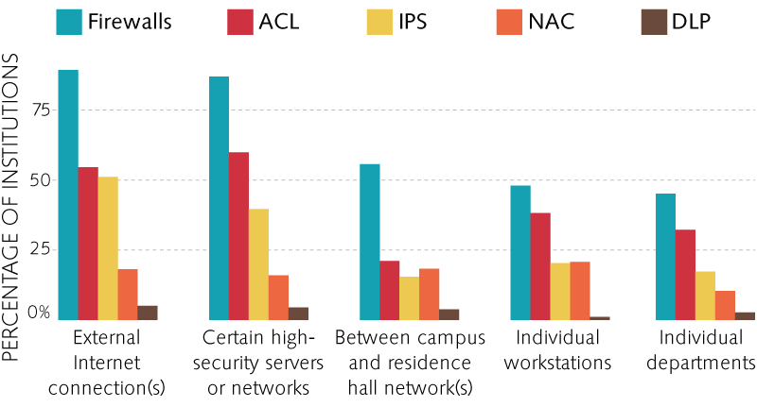
Information security: What we know
Access Control Lists
Intrusion Protection Systems
Network Access Control
Data Loss Prevention
Firewalls
Source: 2012 EDUCAUSE Core Data Survey
Notes:
Themes:
The future will not be as busy as the present
Move from tactics and technology to strategy
Multidimensional nature of the IT leadership role
Emergent role of innovation

Slide 26
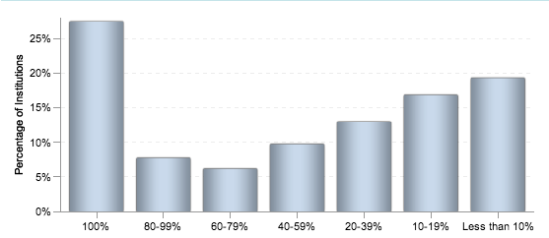
Information security: What we know
Only 27% of institutions have a dedicated ISO
Percent FTE of Information Security Officer
Source: 2012 EDUCAUSE Core Data Survey
Notes:
Themes:
The future will not be as busy as the present
Move from tactics and technology to strategy
Multidimensional nature of the IT leadership role
Emergent role of innovation

Slide 27
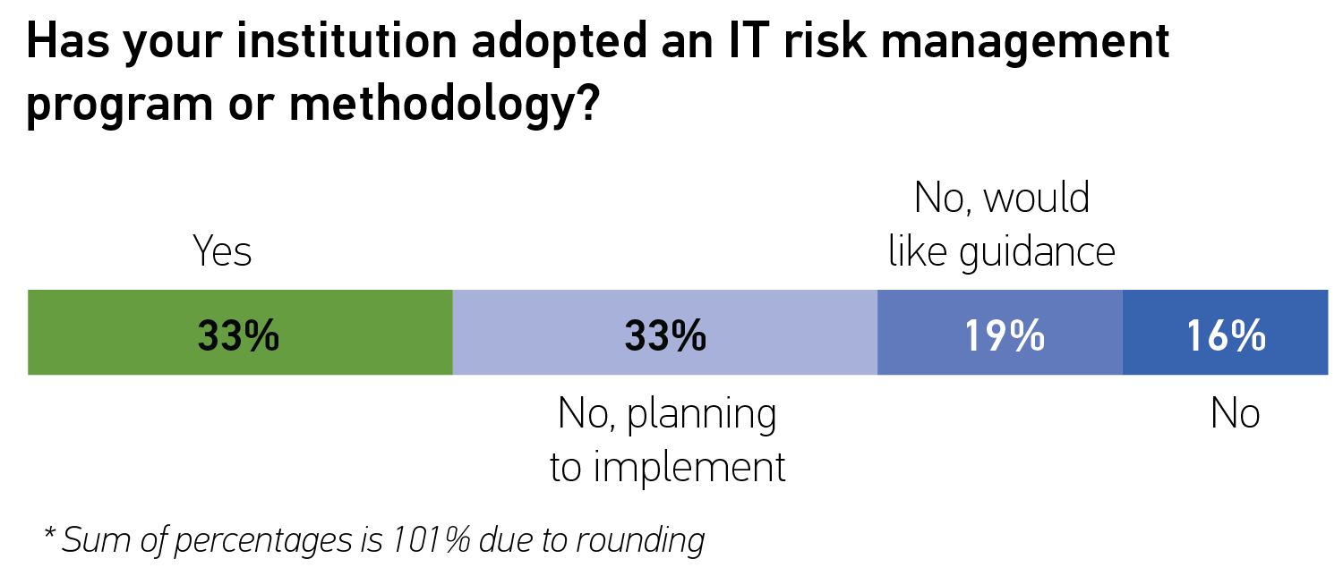
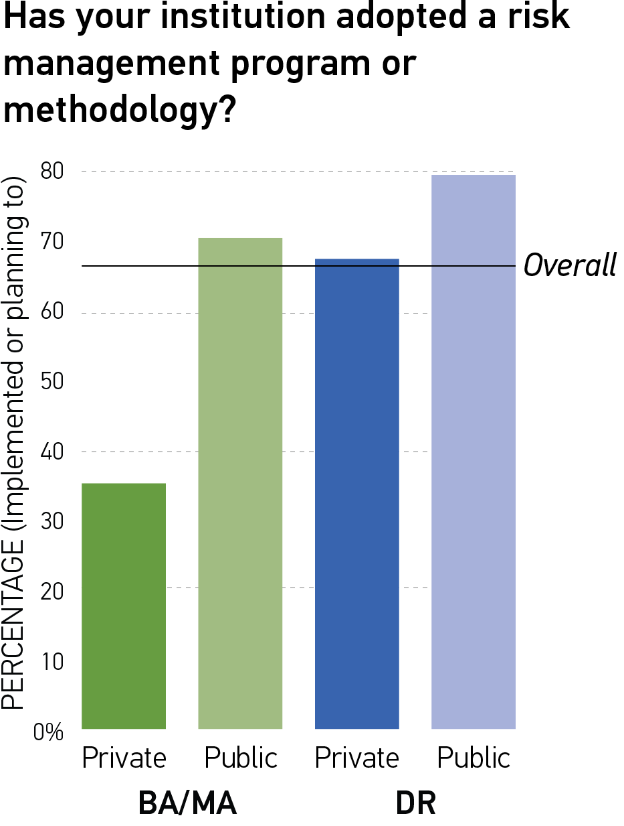
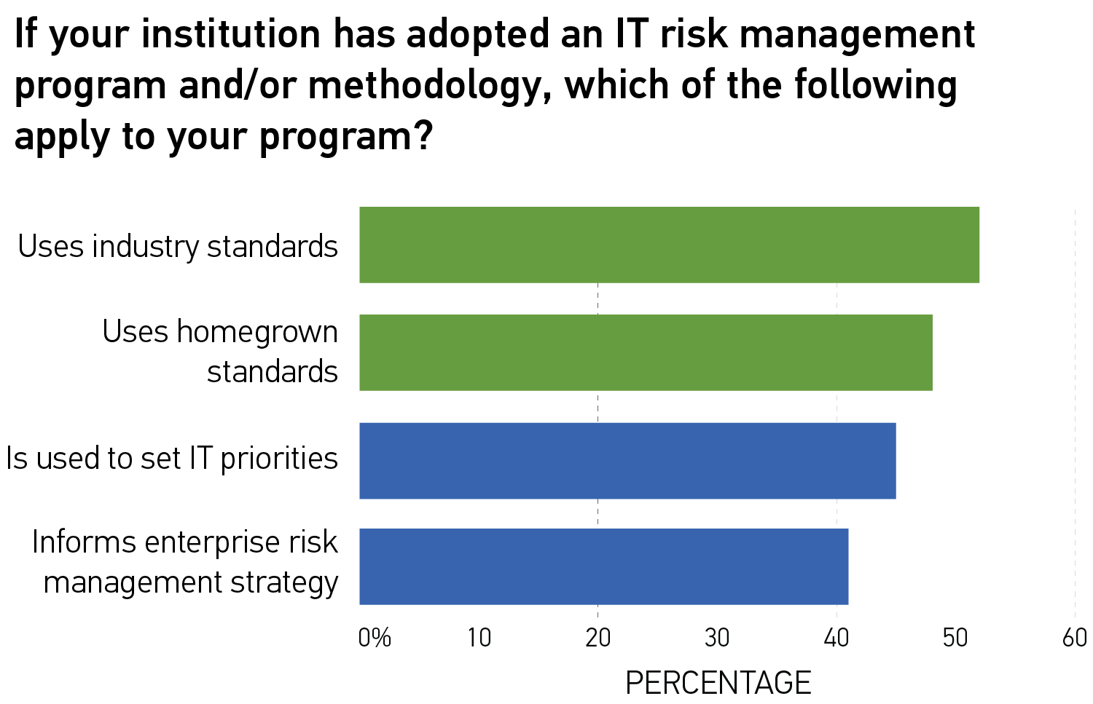
Information security: What we know
Source: ECAR Risk Management Research Bulletin, Paul Jeffries and Nadine Sterns, forthcoming 2013
Notes:
Themes:
The future will not be as busy as the present
Move from tactics and technology to strategy
Multidimensional nature of the IT leadership role
Emergent role of innovation

Slide 28


Slide 29
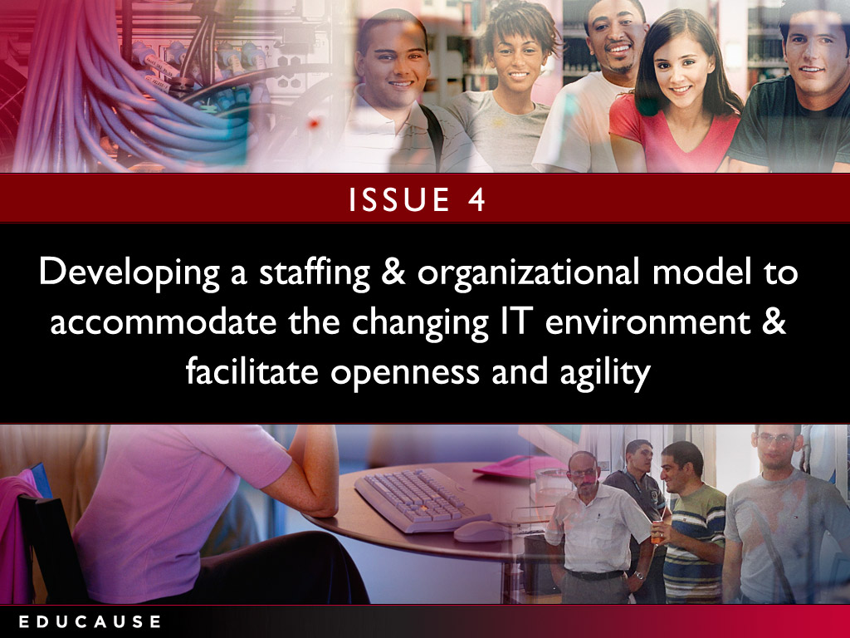

Slide 30

CIO Reflections
Joseph Vaughan CIO
Vice President for Computing and Information Services
Notes:
What business processes could most benefit from greater operational efficiencies using IT?
Does the IT organization have strong-enough institutional partners and partnerships to define new processes and to champion and implement change?
What needed technology pieces (e.g., workflow, electronic forms, and digital signing) are in place now?
What are the institutional strategies, policies, and governance models to map out and redefine business processes?

Slide 31


Slide 32
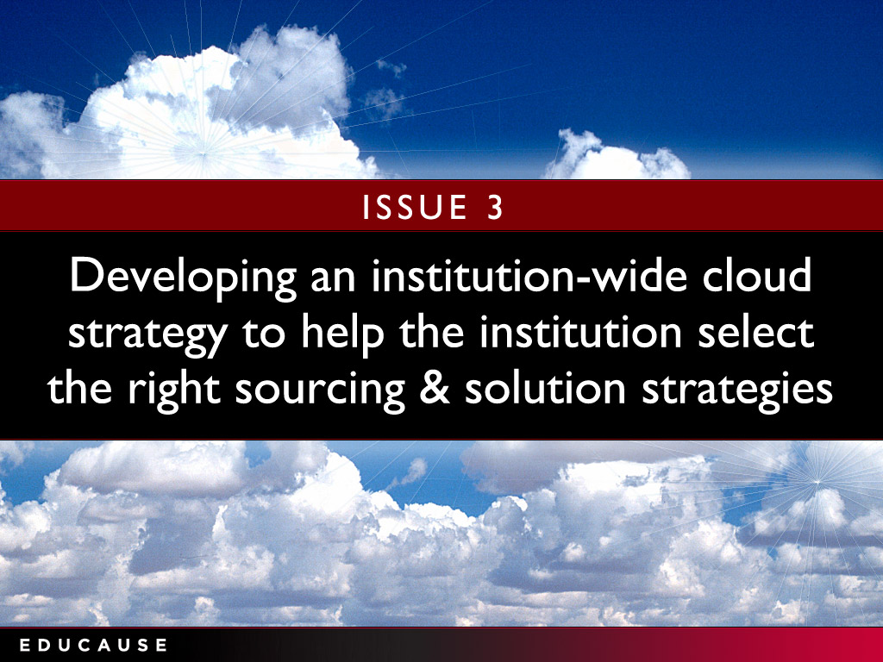

Slide 33
CIO Reflections
Joseph Vaughan CIO
Vice President for Computing and Information Services
Notes:
What business processes could most benefit from greater operational efficiencies using IT?
Does the IT organization have strong-enough institutional partners and partnerships to define new processes and to champion and implement change?
What needed technology pieces (e.g., workflow, electronic forms, and digital signing) are in place now?
What are the institutional strategies, policies, and governance models to map out and redefine business processes?

Slide 34


Slide 35
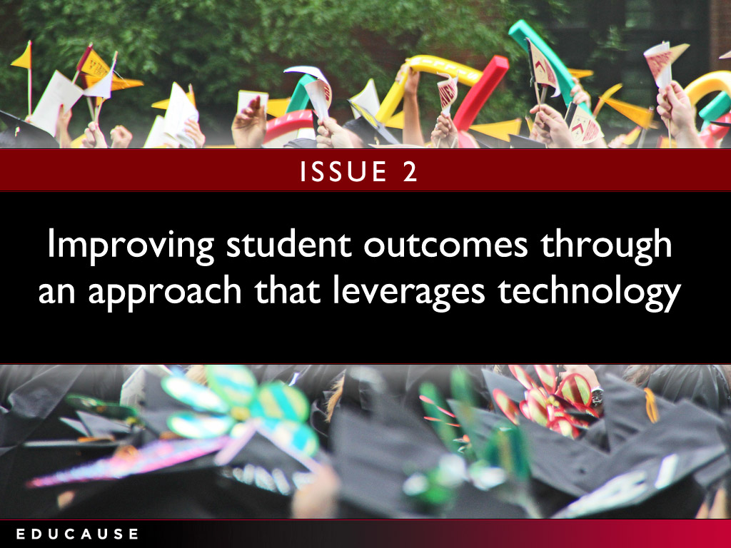

Slide 36
Improving student outcomes through an approach that leverages technology
Strategic questions to ask:
Do you use tools embedded in the LMS to track student learning?
Do faculty reward systems encourage or impede their use of instructional technology?
Does you provide adequate and timely instructional design assistance and services for students and faculty?
“It’s not enough to identify students at risk. To be successful, we need to ensure follow-through, so that students are provided the support they need in order to remediate problems and connect with the resources they need to succeed.”
— President
Notes:
What devices, operating systems, applications, and services fall under this umbrella?
What are the infrastructure implications, such as bandwidth and connectivity?
How does BYOD affect the IT organization’s support strategy?
What are the security implications?

Slide 37
Using technology to improve student outcomes: What we know
Most progress in past year with
E-textbooks
Mobile apps
Source: 2012 EDUCAUSE Core Data Survey
Notes:
Source:
Building a Flexible BYOD Program
To succeed at BYOD, organizations must have the flexibility to respond quickly as technologies evolve.
MITCH DAVIS
posted August 13, 2012 | Appears in the Summer 2012 issue of EdTech Magazine.
Know what's important to your users. A BYOD program can succeed only if users are happy, so find out what they want. In doing outreach with students, we found that printing from a tablet was at the top of the list. We then moved printers to spaces where students congregate. Now that we've put printers in more convenient locations, there's less need for students to run back to their dorms or apartments to print.
Support as many devices as possible. What's unique about mobility today is that everyone has access to a device, and they all want to join the conversation and share information. Don't stand in the way by restricting people to specific devices. Be there to educate, support and deliver service. Also be prepared to support all the main platforms, and deliver exceptional service to the ones that work best. Today, we have people across the IT organization doing research on the many different flavors of mobile devices.
Make the technology available to everyone. For a BYOD program to evolve, your stakeholders on campus need access to mobility tools, and not everyone can afford to buy them. That's why we offer free access to equipment through a loaner pool. In the past, users could obtain technology only through their department. Now, everyone has access to every type of mobile device, from tablets and MP3 players to projectors and portable video equipment. Having a loaner program also gives people an opportunity to try new technology before they buy it.
Be proactive, not reactive, when building a robust network. Start by creating a specific plan for delivering adequate wired and wireless bandwidth, including adding switches and access points where necessary. Effective BYOD requires a highly available network that never goes down. With the proper infrastructure and a financial model for funding upgrades in place, it's easier to more flexibly support new technologies as they evolve.
For example, the need for high-performance computing in classes has greatly expanded over the past three to five years. Students and faculty from the sociology, history and geology departments are now asking for access to major systems that store massive amounts of data — and they want access to that information on all of their devices. The IT staff must build a network that's robust and flexible enough so that when technology changes and users are ready to deploy new devices, the network is ready for them.
Keep IT staff engaged and well trained. Create a culture in which continuous learning among IT staff is encouraged and properly funded. It costs time and money to send people to classes, but without the proper training, the IT department will continue to implement old solutions, resist change and be unprepared for a fast-approaching future. The organizational disruption and technology failure that results will hinder everything, from academic research to fundraising.
Bottom-line financial managers may have a hard time understanding that IT skills and technology are a strategic advantage. The time-lost multiplier makes it easy to justify having an informed technology staff. Technology changes every three months. When the staff has limited skills, the group's ability to support innovative programs such as BYOD is diminished

Slide 38
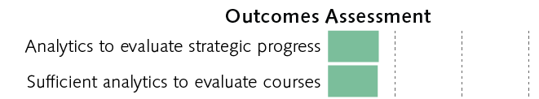
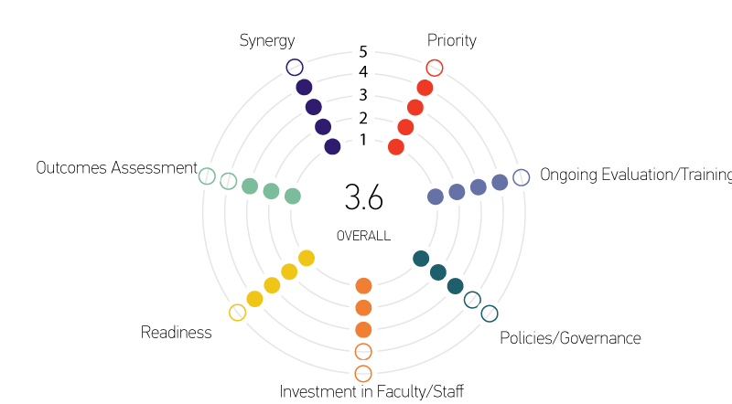
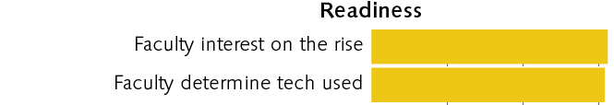
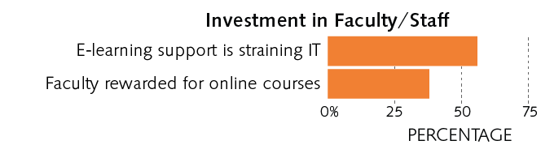
Online learning: What we know
E-Learning Maturity Index
Source: The State of E-Learning in Higher Education: An Eye Toward Growth and Increased Access, ECAR, June 2013
Notes:
Distributed vs central IT. Varies greatly from instituiton to institution, range is about 50-50 to 100 (all central)
Run—optimize the execution of activities and processes already in place. Seek organizational growth through offering products and services faster and cheaper than the competition.
Grow—increase market reach, product and service offerings, expand market share, and so on. Seek organizational growth by taking market share from the competition (i.e., get a bigger piece of the pie).
Transform—innovate business processes and/or products and services in a completely new way, move into seemingly different markets, and so on. Seek organizational growth through new and different means.
As you can see, the RGT framework is similar in many ways to both Porter’s three generic strategies and a top-line versus bottom-line approach as follows:
Run overall cost leadership bottom line
Grow focus and differentiation top line
Transform (new) differentiation top line (when the focus is innovation)
Gartner
Run the business: This is an indicator of how much of the IT resource is consumed and focused on the continuing operation of the business. It includes all nondiscretionary expenses as part of the run-the-business cost. Examples include capital expenses for replacement of laptops at the end of their useful life, operating expenses for software maintenance contracts, operating expenses help desk outsourcing, infrastructure utility computing for human resources applications and software maintenance for regulatory software.
Grow the business: This is an indicator of how much of the IT resource is consumed and focused on developing and enhancing IT systems in support of business growth (typically organic growth). Discretionary investments are more likely to be included in the grow-the-business or transform-the-business cost. Examples include ERP upgrade project capital expenses to expand the capacity to include organic growth in software users, bandwidth capacity expansion project capital expenses to accommodate an organic forecast increase in customers using existing Internet applications, or software license upgrade for engineering software.
Transform the business: This is an indicator of how much of the IT resource is consumed and focused on implementing technology systems that enable the enterprise to enact new business models. This is very much a venture category, and would be represented by activities such as a brick-and-mortar retailer moving to online shopping, a traditional bank offering online banking (or moving into offering insurance services) or a commercial airline offering new freight services.

Slide 39


Slide 40
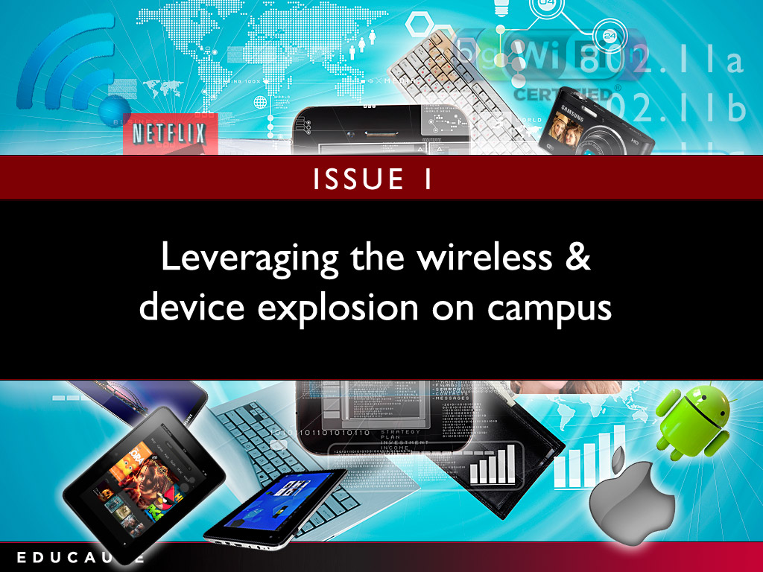

Slide 41
CIO Reflections
Butch Juelg
Associate Vice Chancellor,
Technology Services Lone Star College System
Notes:
Does the institution’s strategic plan include transformative objectives?
Is the IT organization viewed as a trusted partner in institutional transformation?
How can the institution support experimentation with technology to transform teaching and learning without unduly risking students’ learning outcomes?
Are the process reengineering and continuous improvement capabilities in place to enable transformative information technology?

Slide 43
Top 10 IT Issues 2013
Leveraging the wireless and device explosion on campus
Improving student outcomes through an approach that leverages technology
Developing an institution-wide cloud strategy to help the institution select the right sourcing and solution strategies*
Developing a staffing and organizational model to accommodate the changing IT environment and facilitate openness and agility
Facilitating a better understanding of information security and finding appropriate balance between infrastructure openness and security
Funding information technology strategically*
Determining the role of online learning and developing a sustainable strategy for that role
Supporting the trends toward IT consumerization and bring-your-own device*
Transforming the institution's business with information technology*
Using analytics to support critical institutional outcomes*
*Also on 2012 list

Slide 44
Poll Question
How do you plan to make use of this report?

