Slide 1
The Unified Organization: Fighting the Silo Tendency
EDUCAUSE LIVE! Webinar
June 20, 2013
Notes:
David will introduce the panel, the presentation, moving on to the agenda slide

Slide 2
Bio
Director of Outreach, Brandeis Library & Technology Services
Chair, NERCOMP Board of Trustees
Co-dean, Learning Organization Academy
Administrator, Boston Digital Humanities Consortium
Certified Immunity to Change Coach
Blog wedaman.wordpress.com
Poems fixedformpoetry.blogspot.com
Twitter @wedaman

Slide 3
Agenda
1. Theory
Cooperation and Collaboration
2. Practice
A. Granite State College
B. University at Albany, SUNY
C. Brandeis University
D. Learning Organization Academy
3. Q & A Q & Q

Slide 4
Today’s talk is excerpted from a NERCOMP 2013 presentation.
Thank you to:
Marty Chang, Granite State College Lisa Trubitt, University at Albany, SUNY Nick Ragusa, Brandeis University
Thanks!

Slide 5
Part one:
1
Theory

Slide 6
Proposition
You can apply ideas from learning environments to the workplace with good effect.

Slide 7
Example
Cooperation and Collaboration
Two kinds of group learning workplace operating systems.

Slide 8
Sources
L. Shulman, “Communities of learners and Communities of teachers.”
T. Paulus, “Collaboration or Cooperation? Analyzing Small Group Interactions in Educational Environments.”
S. Ford, “A Synthesis of Research on Organizational Collaboration.”

Slide 9
Cooperation
We know where we’re going, how to get there, and we know our roles.
“tasks are divided up and completed individually”
Notes:
it's what we do MOST of the time. It's TRANSACTIONAL. Predictable. I do my thing and you do your thing. My group does its thing, yours does yours. LOW FEEDBACK & LOW COMMUNICATION. Very comforting. Quote is from Henri & Rigault 1996.

Slide 10
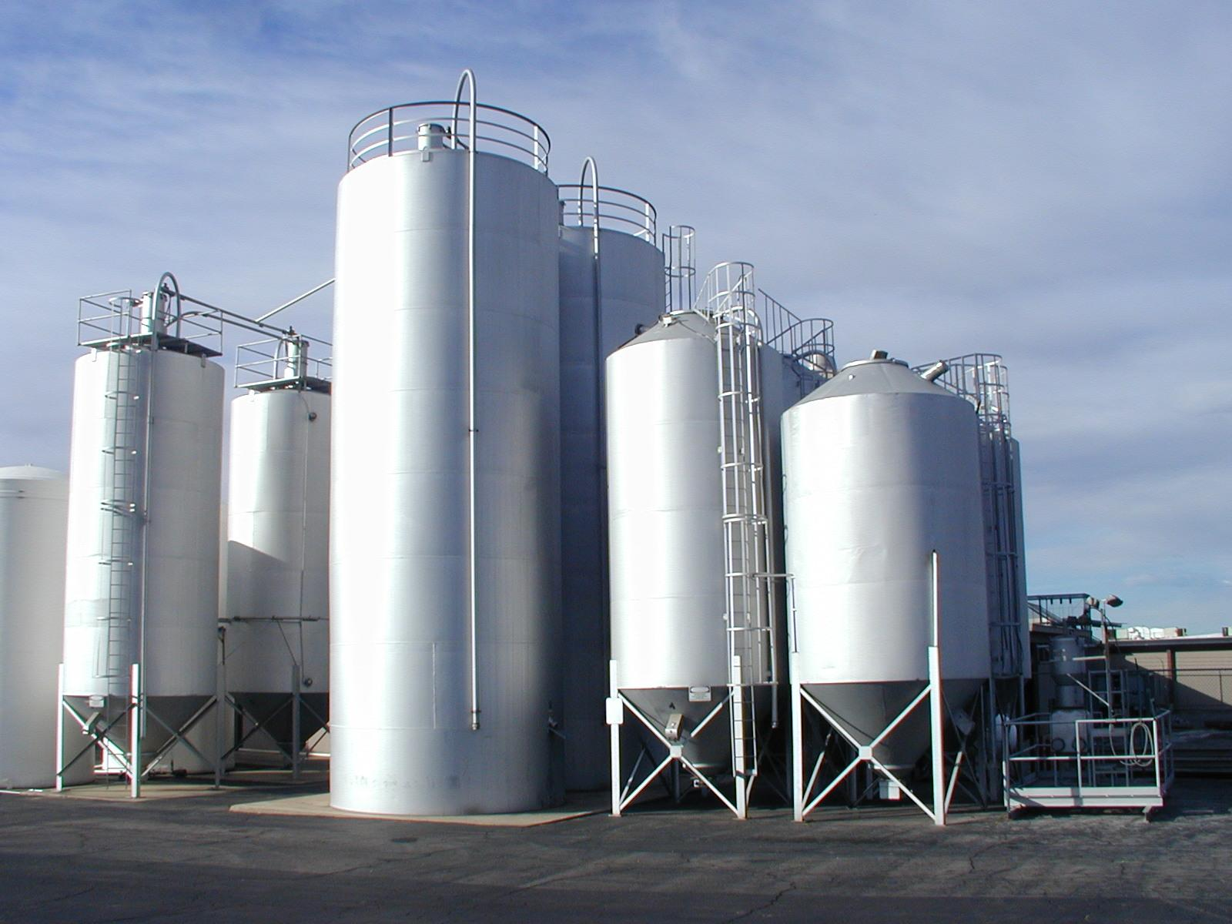

Slide 11
Feedback: low
Communication: low
Risk: low
Relationship: low
Anxiety: low
Trust: low
Learning: low
Introduction of novelty
to the world: low
Cooperation
Notes:
it's what we do MOST of the time. It's TRANSACTIONAL. Predictable. I do my thing and you do your thing. My group does its thing, yours does yours. We can be replaced. LOW FEEDBACK & LOW COMMUNICATION.

Slide 12
Collaboration
We don’t know where we’re going, how we’ll get there, what our roles are.
A "marriage of insufficiencies.”
Notes:
It's what we do when we do something we’ve not done before. Innovation, for instance. We both figure out as we're doing it, what IT is, and what our roles are. It includes an INVENTORY feeling. It's brief, it's INTENSE. Heavy communication.
““improves learning because it creates awareness of one’s own thinking processes as multiple perspectives are shared”

Slide 13
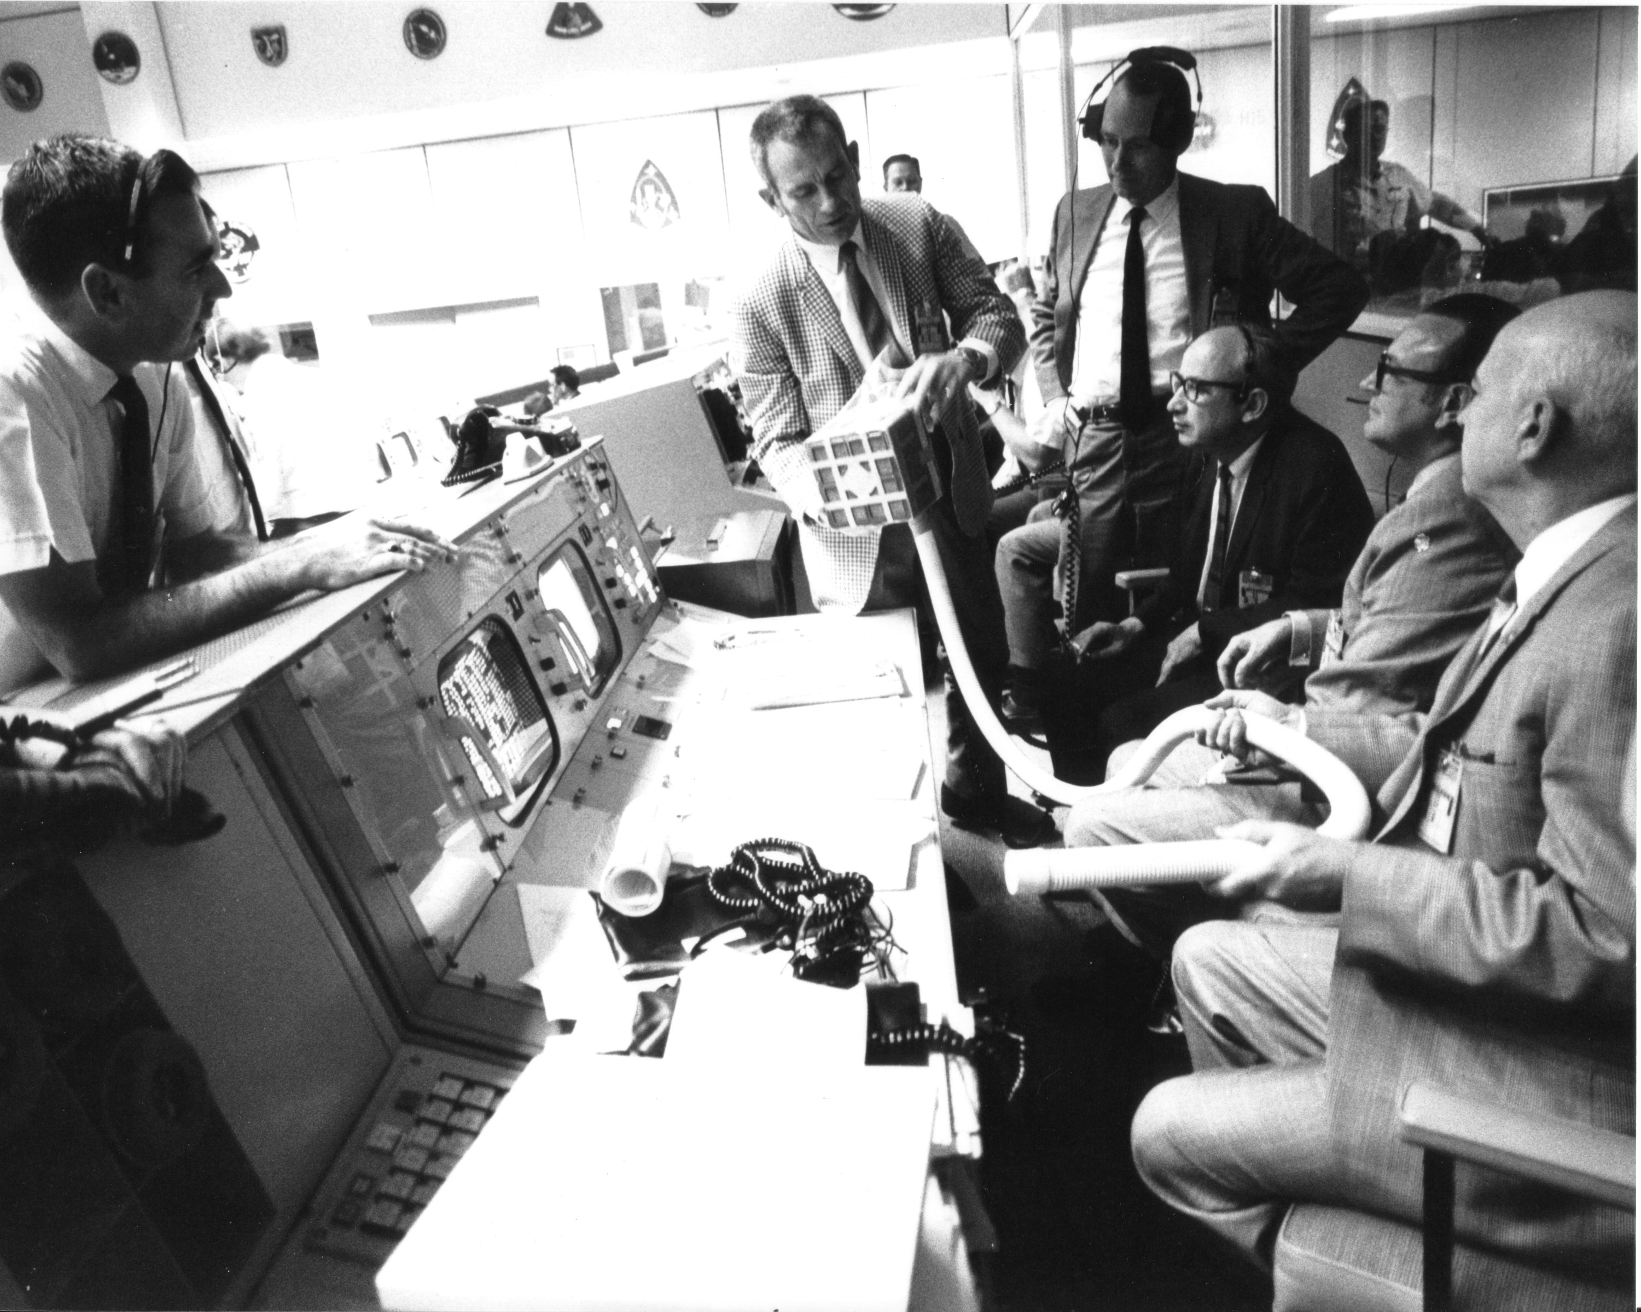
Notes:
APOLLO 13 moment. Roles go out the window, Inventory of stuff, inventory of people.

Slide 14
Feedback: high
Communication: high
Risk: high
Relationship: high
Anxiety: high
Trust: high
Learning: high
Introduction of novelty
to the world: high
Collaboration

Slide 15
Planned outcomes
Stable
Routine
Structured
Predictable
Comforting
Reliable
Extrinsic motivation
Workplace = factory
Us vs. them
Unpredictable
Uncomfortable
Faith required
Intrinsic motivation
Perspective taking
Hard to describe
Experiential Builds relationships
Workplace = life Us
Cooperation
Collaboration

Slide 16
Judging vs. Perceiving
Evaluation vs. Ideation
Closing vs. Opening
Transactions vs. virtuous circles
Linear Process vs. dynamic system
Department vs. Institution
Fixed mindset vs. Growth mindset
Red ocean vs. Blue ocean
Stable state vs. Learning organization
IQ test vs. Zone of Proximal Development
Intellect vs. Intuition (Bergson)
Representation vs. Resemblance (Foucault)
Hierarchy vs. Rhizome (Deleuze)
Related Pairs
Notes:
skip over this really

Slide 17
Cooperation (silos):
Good in static contexts.
Reinforces group identity.
Too much limits growth.
Collaboration (anti-silos):
Key in times of change. Required for organization adaptation.
Too much hinders mastery.
Hypotheses

Slide 18
Which do you prefer?
?

Slide 19
What do you have in your workplace?
?

Slide 20
Can you collaborate all the time?
?

Slide 21
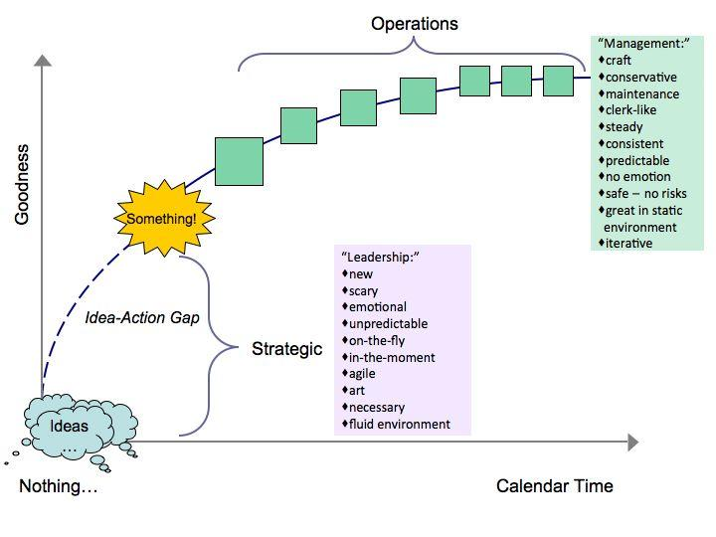
Notes:
Co-authored by Sarah Walkowiak, Wentworth Institute of Technology

Slide 22
Bergsonian
Cooperation
Collaboration
Collaboration
Cooperation
Evolution
Cooperation
Evolution
Time

Slide 23
stable model
Help Desk
Admin Computing
Research Support
Systems
Project Management
Notes:
Stable as in muck out one stall at a time

Slide 24

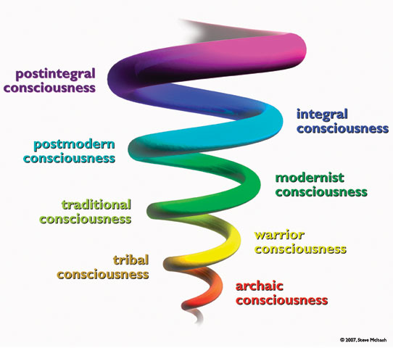
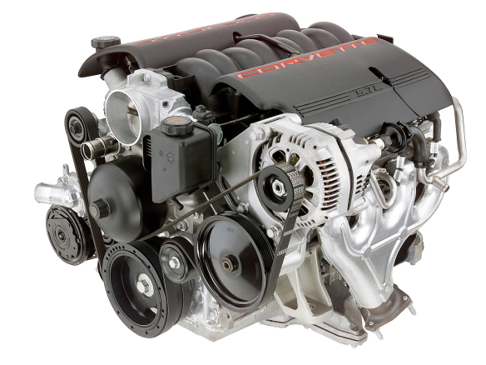
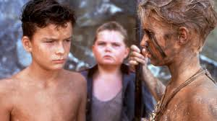
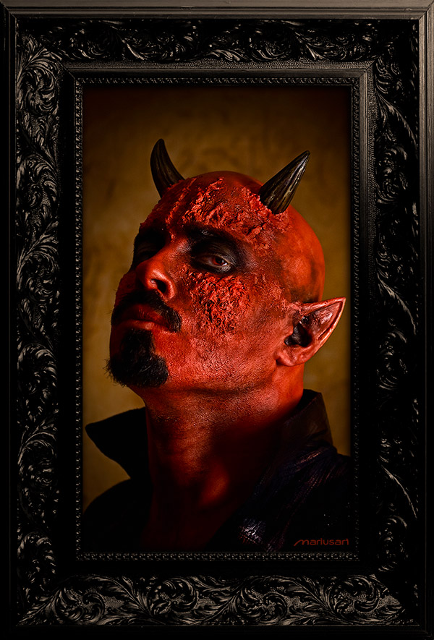
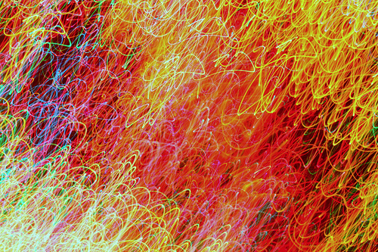
hierarchy
GOOD Collaboration
GOOD Cooperation
BAD Cooperation
BAD Collaboration

Slide 25
People orient to one or the other.
Confusion about which is the current paradigm freaks people out.
Collaboration and cooperation build on each other.
Having neither is bad.
Carry both in your managerial quiver.
Notate bene

Slide 26
Part two:
Practice
2

Slide 27
Granite State
College
A

Slide 28
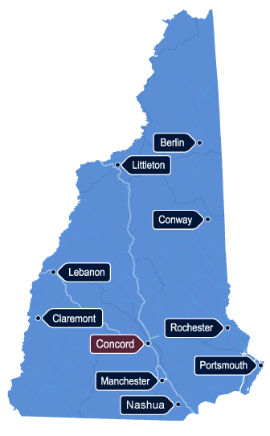
Office of Undergraduate Studies School of Education Office of Graduate Studies Enrollment Management Registrar Finance and Administration Human Resources Institutional Research
10 campuses and 9 departments
facts

Slide 29
symptoms
"us" vs. "them"
Inconsistent customer experience
Resistance to change in processes, technology-related or otherwise
Low employee morale
Notes:
Something changes on the academic calendar by Academic Affairs, but Campus Ops doesn't know about it. Mass communications go out, and front-line staff don't know.
Students going from one campus to the next have to restart conversations
Projects are done within a department have cross-functional impacts that aren't fully considered, creating resistance to change
People just aren't happy

Slide 30
Sales Force CRM to manage service
Basecamp to manage projects
Chatter to encourage communication
Google docs to write a shared “Technology Playbook” and other ides
actions

Slide 31
contact
Marty Chang
Chief Technology Officer
Granite State College
Marty.Chang@granite.edu

Slide 32
University
at Albany,
B
SUNY

Slide 33
1 of 4 University Centers in the SUNY system
18,000 students
5500 faculty/staff
Central IT: 115 staff, 6 different groups Staff in multiple locations on different campuses
facts

Slide 34
We don't all know each other
At all-staff events, people tend to stick with their own group
Differences in information shared—or not—create knowledge gaps across the organization
Information is most often shared within groups, rather than across the entire organization
ITS culture expects one-way organizational communication
symptoms

Slide 35
Created clear expectations: Give everyone the same information Make sharing information a high priority
Increased co-location of staff
Took every opportunity to facilitate staff interaction
Added “Tech Talks,” “Inside ITS” newsletter, ITS-wide initiatives
Feedback, feedback, feedback
actions
Notes:
Tech talks are brown bag things; other ITS-wide initiatives: work environment changes; standing desks; shared project management

Slide 36
contact
Lisa Trubitt
Assistant CIO
University at Albany, SUNY
ltrubitt@albany.edu

Slide 37
C
Brandeis University

Slide 38
&
facts
symptoms
Network and Systems Group
14 FTEs in three teams: DBAs, systems engineers, network engineers
Were solving problems as individuals; communication and documentation not emphasized

Slide 39
Use HIPCHAT for group problem troubleshooting
Use all-in Google Docs document sharing protocols; documents are easily findable
Made the budget process transparent
actions
Notes:
4 rooms; 4200 in 30 days in general category. People invite all team members to a doc by default. Budget transparency results in much better decision-making: “we paid THAT for that consultant?!”

Slide 40
contact
Nick Ragusa
Associate Director for Networks and Systems
Brandeis University
nragusa@brandeis.edu

Slide 41
Learning Organization Academy
D
July 8 - 10, Wellesley College
3 days of "perspectives on learning at work"
Mindfulness, Immunity to Change, Creative Problem Solving, Communities of Practice, Intrinsic Motivation, Reflection, music
Conch - piano - voice ensemble and trombone duet

Slide 42
Q & Q
?
?
?
3

Slide 43
Thank you!
wedaman@brandeis.edu 781-736-4548 wedaman.wordpress.com @wedaman

Slide 44
Image sources
Picture of Satan: http://mariusart.deviantart.com/
Precious Moments angel: http://sahrahussain.com/2012/12/24/christmas-is-a-time-to-love/0902_artd/
Grain elevator: http://www.forbes.com/sites/johnkotter/2011/05/03/breaking-down-silos/
Campuses of Granite State College: from Marty Chang
Apollo 13 image: http://commons.wikimedia.org/wiki/File:Apollo_13_Mailbox_at_Mission_Control.jpg
Engine: http://automotiveengineparts.wordpress.com/2012/09/03/lion-peugeot-modern-3-cylinder-automotive-engines-review/
Lord of the Flies image: http://www.listal.com/viewimage/725816h
Spiral of consciousness: http://www.sunnyguy.com/?p=292
Chaos: http://www.flickr.com/photos/pagedooley/3199296759/sizes/m/in/photostream/

Slide 45
Idea sources
Shulman, Lee S. Communities of Learners & Communities of Teachers. Monographs from the Mandel Foundation. Jerusalem: Mandel Foundation, 1997.
Hord, Shirley M. “A Synthesis of Research on Organizational Collaboration.” Educational Leadership 43, no. 5 (February 1986): 22.
Paulus, Trena M. ““Collaboration or Cooperation? Analyzing Small Group Interactions in Educational Environments.” In Roberts, Tim S. Computer-Supported Collaborative Learning in Higher Education. Idea Group Inc (IGI), 2005.

