Slide 1
Copyright Jill M. Forrester and Jim Cunningham 2008. This work is the intellectual property of the author. Permission is granted for this material to be shared for non-commercial, educational purposes, provided that this copyright statement appears on the reproduced materials and notice is given that the copying is by permission of the authors. To disseminate otherwise or to republish requires written permission from the author.

Slide 2


365 Days to a Campus-Wide Portal
Educause 2008 Mid-Atlantic Regional Conference
Jill M. Forrester
Director, Institutional Systems
Dickinson College
Jim Cunningham
Vice President for Information Technology
Pennsylvania College of Technology

Slide 3
Overview
Dickinson College’s Sungard Luminis Implementation Experience
Pennsylvania College of Technology’s Sharepoint Implementation Experience
Questions

Slide 4
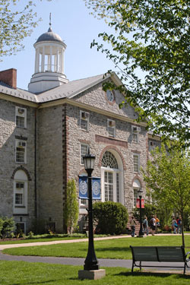
About Dickinson College
4-year, private liberal arts college
Students: 2,400
Faculty: 230
Employees: 524 full-time
89 part-time
Banner client since 2005

Slide 5
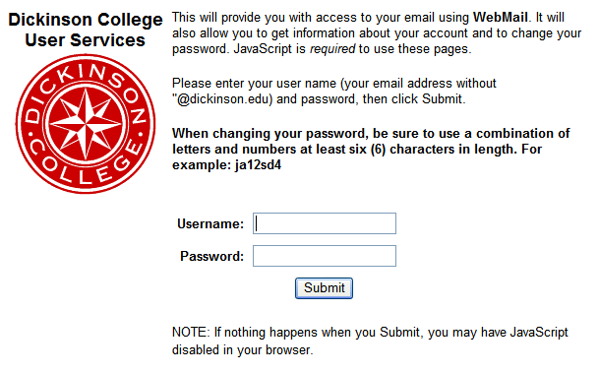
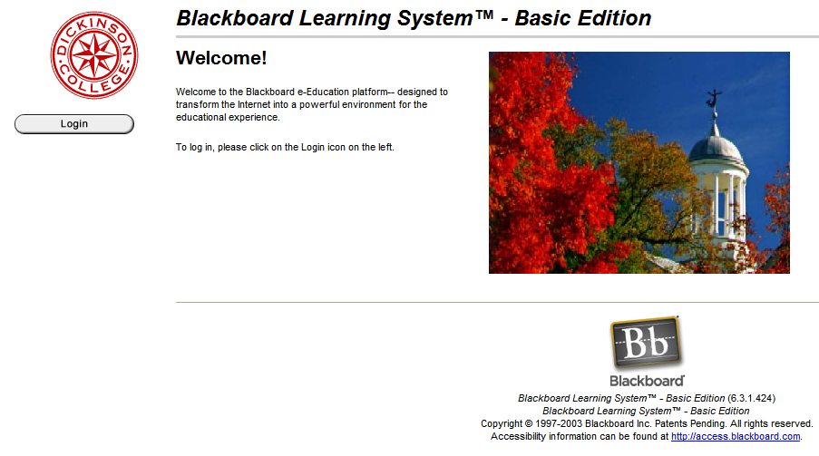
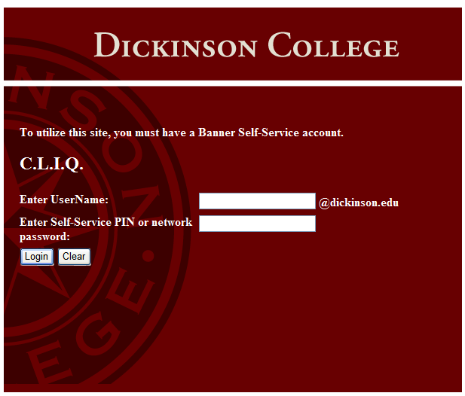
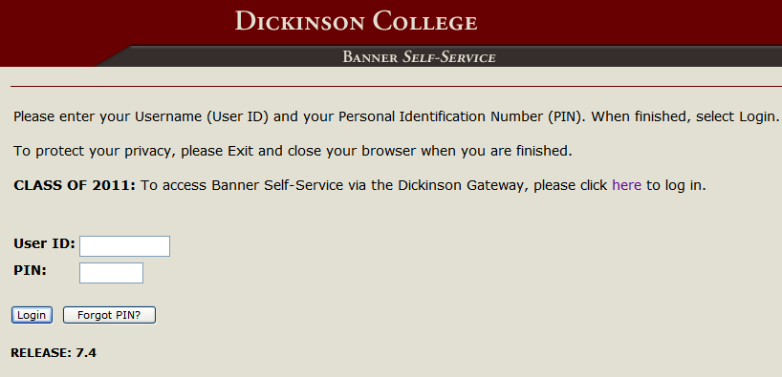
Our Goal
To provide students and employees with a web-based solution that would integrate with Banner and provide single sign-on (SSO) access to a core suite of heavily used applications.

Slide 6

Our Solution
Implement the Luminis portal solution
Utilize the Luminis framework to provide users with SSO access to all campus web-based applications.

Slide 7
Our Challenges
No portal administrator
No staff with experience with Luminis or portal management
< 365 days to launch (very short timeline)
High expectations and an infinite number of ideas!

Slide 8
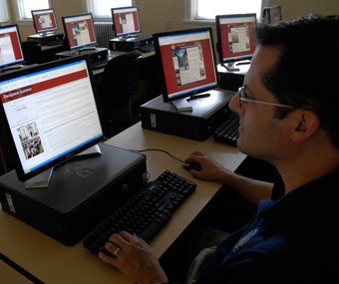
Our Approach
Utilize existing web content and applications
Limited and focused community involvement
Focus on building the technology foundation to provide future enhancements and capabilities

Slide 9
Our Approach
Benefits
  Deliver a solution very quickly
  Provide immediate benefit to community with SSO to existing web applications
  Provide better organization of existing web content
  Availability of standard Luminis features: Announcements, Calendar, Groups
Risks
  Short timeline
  Limited community involvement and feedback
  No new content or web applications at launch

Slide 10

Our Plan – The Technology
Find a portal administrator
Establish a technical support team
Train the administrator and support team
Install and configure the software
Identify the core suite of SSO-enabled web-based applications
Develop and test the external authentication framework (SSO)

Slide 11


Our Plan – The Technology
Core applications made available using Luminis tabs and toolbar icons
Core Applications
Email – Microsoft Exchange and WebMail
Blackboard
Network File Access
Banner Self-Service
Cognos Reporting
CLIQ

Slide 12
Our Plan – The People
Establish portal roles and target launch dates for each role
Identify content owners and members of the content support teams
Portal Role | Content Owner and Support Teams | Launch Date
First-Year Students | Orientation Office | May 2007
Employees | Human Resources and Academic Affairs | July 2007
Returning Students | Student Life, Academic Affairs, Financial Aid, Student Accounts, Global Education | August 2007

Slide 13
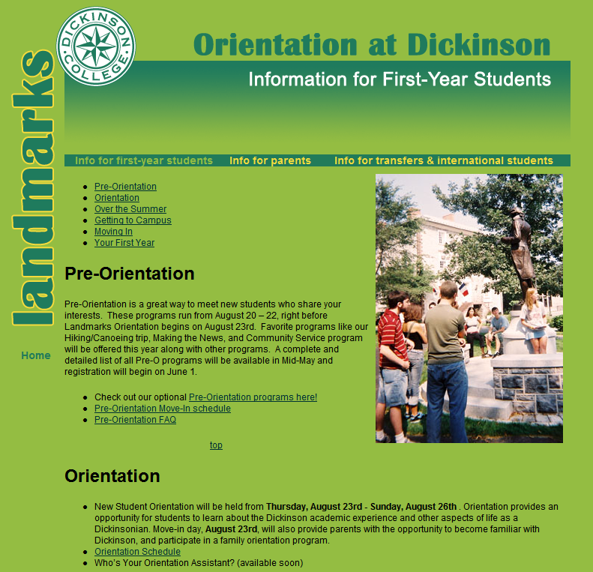
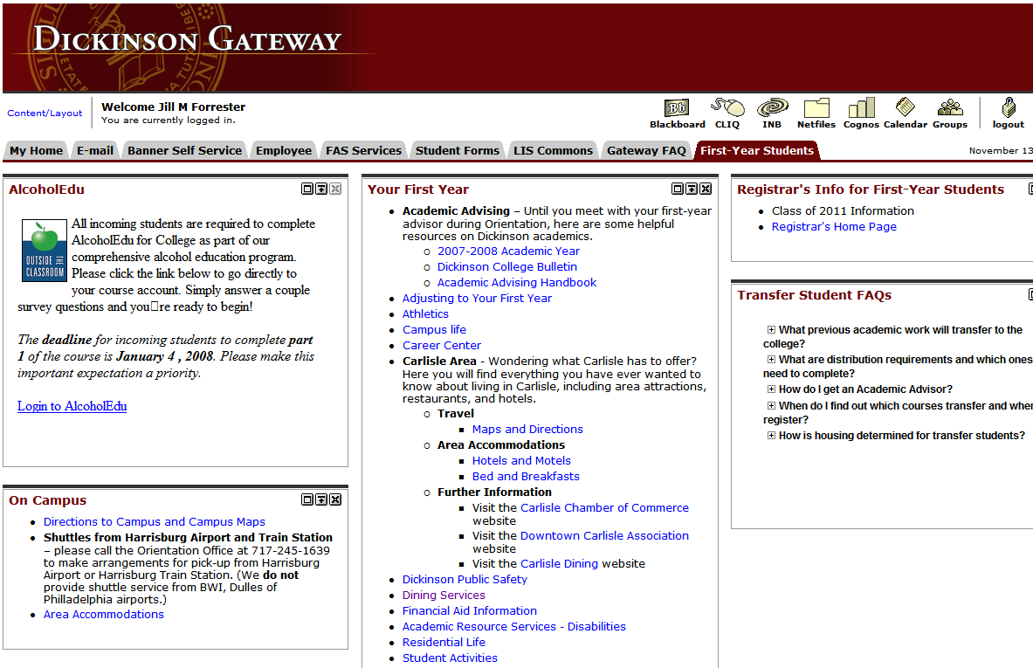
Our Plan – The Content
Utilized existing web content
Focused on identifying and
organizing relevant information
Used the tab and channel
structure to organize
information

Slide 14
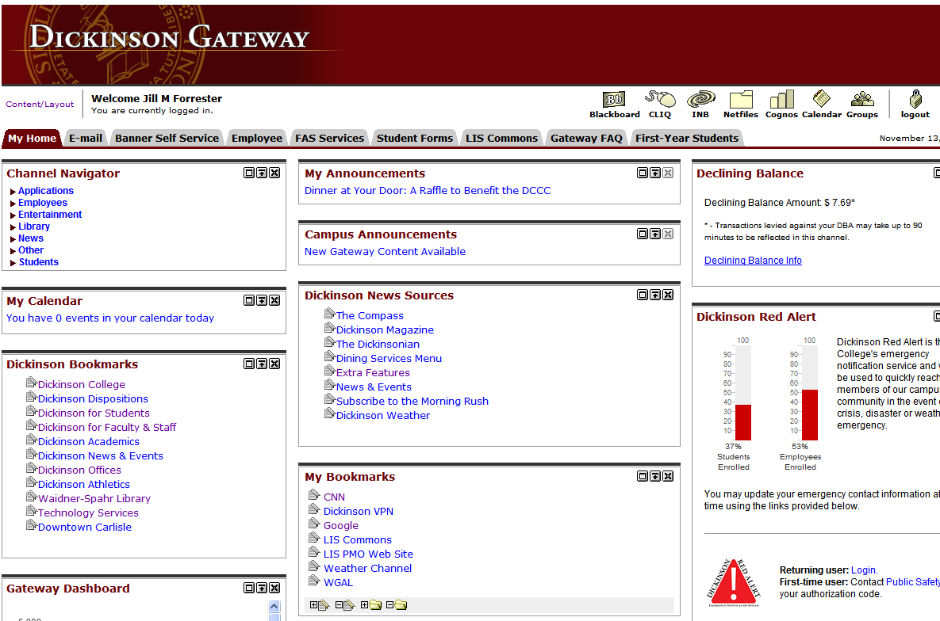
Our Results

Slide 15
Our Results
All target launch dates were met!
First User: May 10, 2007 at 12:35 PM
Student and employee usage continues to increase
Students
Class | Percentage
2011 | 100%
2010 | 72%
2009 | 61%
2008 | 76%
All Students | 78%
Employees
Type | Percentage
Faculty | 51%
Administrators | 64%
Staff | 47%
All Employees | 53%

Slide 16
Our Results
Reduction in the number of first-year computer access problems during orientation
Students and employees are very pleased with the SSO access to the core application suite:
  Thanks for making the Gateway happen, it is so much easier to use. Thanks again. -Alex (Faculty member)
  Gateway ROCKS!!!! -Nancy (Staff member)

Slide 17
Lessons Learned
Give examples of secure passwords – instructions are not enough
Consolidate systems before launching
Organizing content takes time – the more people involved the longer it will take
Keep content and technical support teams focused

Slide 18
Since we launched…
New Content
  October 31: 28 new channels
    Library Channel Suite (18 channels)
    Campus Services Channel Suite (5 channels)
    Gateway Support Channel Suite (5 channels)
  December 5: 11 new channels
    LIS Support Channel Suite (3 channels)
    News and Events Channel Suite (5 channels)
    Campus Services Channel Suite (3 additional channels)

Slide 19
What’s Next
Luminis IV Upgrade
Alumni Portal Launch
Parent Portal Launch
Applicant Portal Launch
Prospective Student Portal Launch

Slide 20
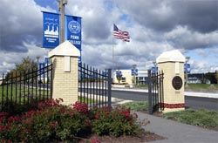
About Penn College
2-year/4-year, public college specializing in applied technology education
Special mission affiliate of the Penn State University system
Students: 6,213
Faculty: 304 full-time, 207 part-time
Employees: 595 full-time, 510 part-time
Homegrown ERP
Notes:
Acknowledge that I’m the last thing between the audience and the SUN reception
Advertising Art to Welding and everything in between

Slide 21
Our Goals
Eliminate employee internal-only content from www.pct.edu and to some extent PCToday (campus electronic newspaper)
“One stop shopping” for employee information needs
    Department specific employee information, W:\public\docs
    Policy and Procedure, W:\Policy and W:\Procedure
    Broadcast employee e-mail “announcements”
    Web-browser based Employee Information System (EIS)
Improve ability to find information (search and logical organization)
Notes:
Spring 2006 www.pct.edu redesign
Lots of www employee content
Secondary
Improve workgroup collaboration (calendars, tasks, documents, discussions)
Provide MySpace-like workplace social networking
Improve communication (presence, blogs, wikis)
Personalization of information, alerts, tasks

Slide 22
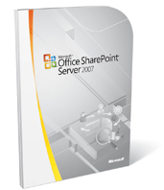
Our Solution
Microsoft Office Sharepoint Server 2007

Slide 23
Our Challenges
No staff with experience with Sharepoint or web design/portal content management
Content owners had no web experience
< 365 days to launch (very short timeline)
Capabilities of portal software created potential for significant “feature creep”
Concurrent with campus migration from Novell to Microsoft infrastructure conversion

Slide 24
Our Approach
Identified clear Phase I goals (department, policy and procedure content)
Partnered w/Academic Affairs to access their technical writer
Designed the overall information architecture
Built a prototype, test, refined design, built working model
Brought in a consultant for advanced training and review of prototype
Freeze development and start migrating content
Notes:
Note, the Phase I goals did not include the original employee www content

Slide 25
Our Approach
Benefits
  Deliver a portal solution relatively quickly
  Provide immediate benefit to employees with improved access to content
  Availability of standard Sharepoint collaboration features: Announcements, Calendar, Document Libraries, Links, “Presence” for workgroup adoption

Slide 26
Our Approach
Risks
  Short timeline
  Limited community involvement and feedback
  No new content or applications at launch
  Limited ITS staff resources due to Novell-Microsoft conversion

Slide 27
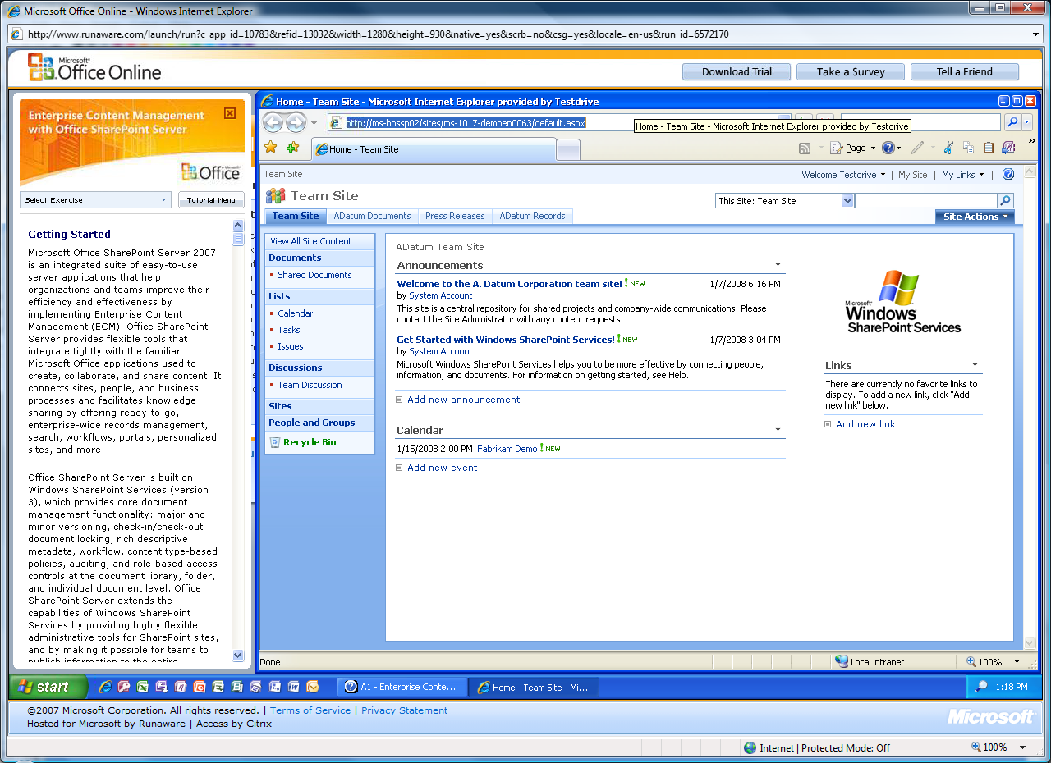
Our Plan – The Technology
Utilized Sharepoint portal 100% out-of-the box, no custom graphics, no branding

Slide 28
Our Plan – The People
Project Director: project management
Director of Network Services and Server Administrator: Sharepoint Portal server farm and software deployment
Technical Support Staff (3): testers and department content trainers and technical support
Technical Writer: overall design and information architecture
Department content contacts: transition existing documents and update basic department information

Slide 29
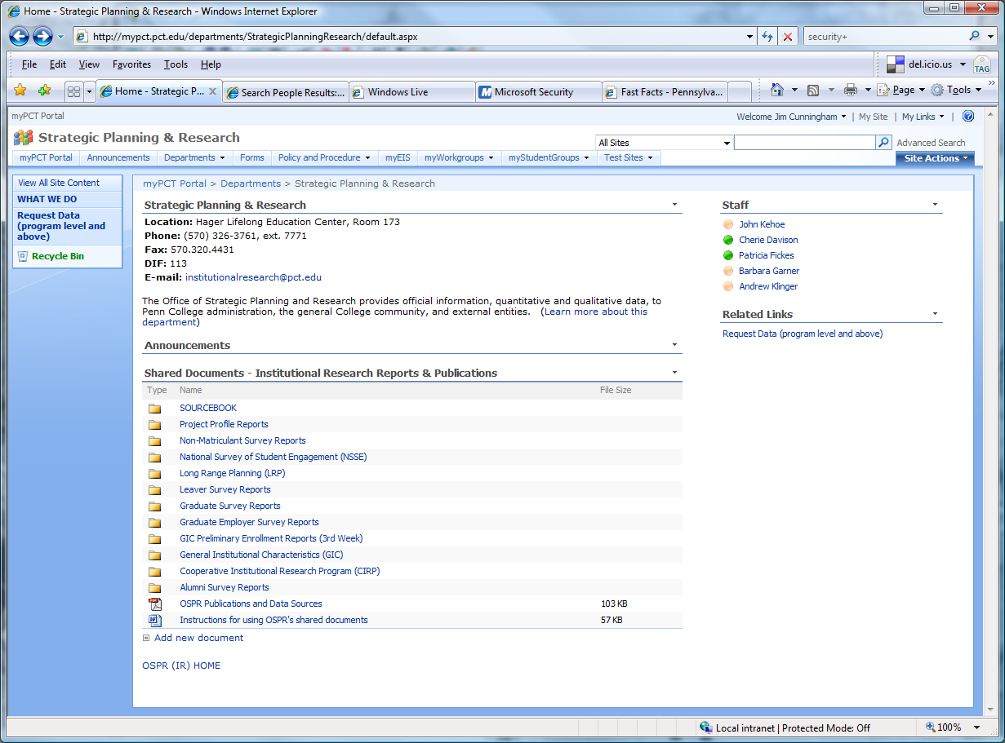
Our Plan – The Content
Template for presentation of department content

Slide 30
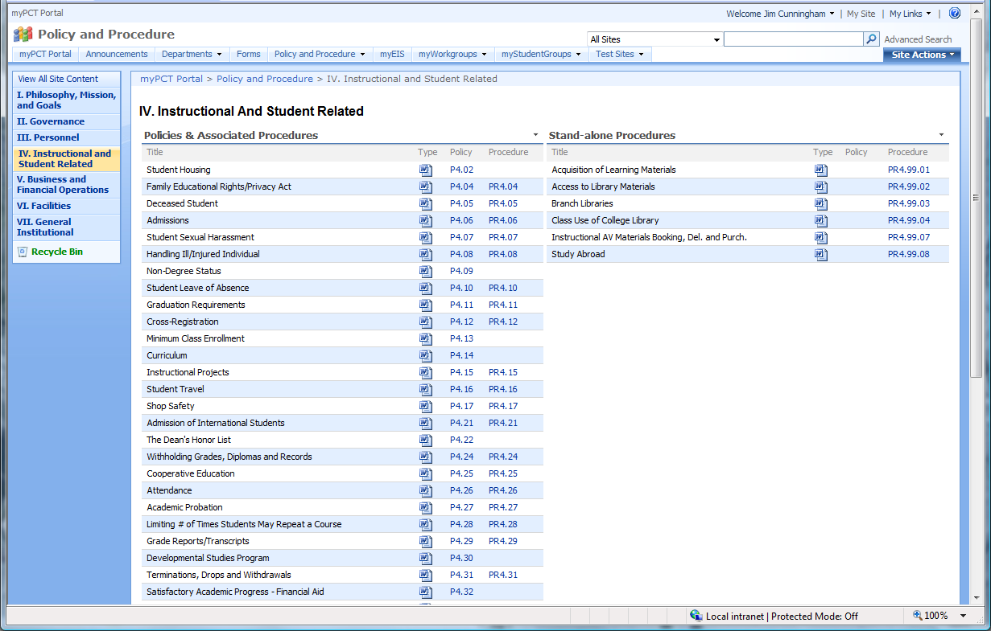
Our Plan – The Content
Policy and Procedure

Slide 31
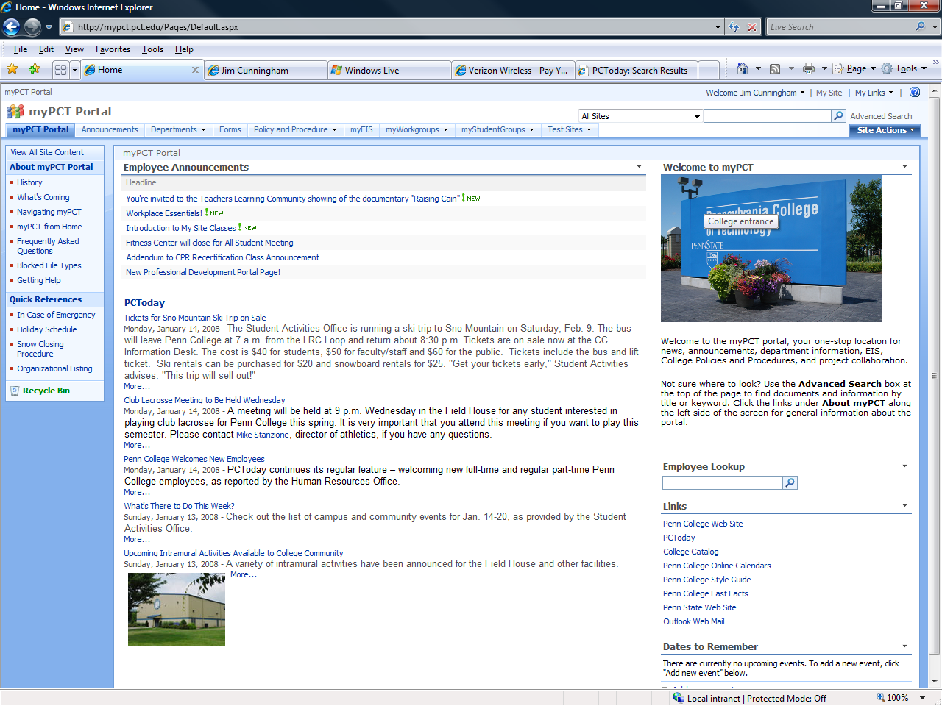
Our Results

Slide 32
Lessons Learned
Sometimes simple concepts are hard to explain and harder to understand, a picture is worth a thousand words
Organizing content takes time – the more people involved the longer it will take
Keep content and project teams focused
Notes:
The prototype helped us sell the concept

Slide 33
Since we launched…
50 myWorkgroup sites
460 announcements
1 www.pct.edu site migrated, Information Technology Services
Many staff and faculty have updated their My Site social networking information
Notes:
Explain the workgroup concept
Explain the my site concept

Slide 34
What’s Next
Migrate department specific employee-only web content
Continue to add Workgroups, train Workgroup owners on advanced collaboration tools
Expand use of portal tools; survey, project management, blogs, wikis
Integrate Student content and access
Integrate ERP, Angel, Sirsi, R25 Event Management
Promote My Site social networking

Slide 35
Open to the Floor
Questions
Comments
For more information contact
  Jill Forrester (forrestj@dickinson.edu)
  Jim Cunningham (jcunning@pct.edu)

