Slide 1
How To Make Support Easier Through Effective Training
EDUCAUSE
Mid-Atlantic Regional Conference 08
Christine Mencer
Director of Information Technology
The Pennsylvania State University, Hazleton Campus

Slide 2
Copyright Statement
Copyright Christine Mencer 2008. This work is the intellectual property of the author. Permission is granted for this material to be shared for non-commercial, educational purposes, provided that this copyright statement appears on the reproduced materials and notice is given that the copying is by permission of the author. To disseminate otherwise or to republish requires written permission from the author.

Slide 3
Where IT Support Began
Finding the elusive first IT support person may be difficult, but it is well understood, that as long as we have had a mechanism to move information from one place to another, we have had someone who provided support. However, as the need grew to operate personal computers, and network these devices, events occurred to change our ways of supporting what we now call the End User. Consider the timeline.

Slide 4
Timeline
1982 - Elk Cloner, widely credited with being the first virus to appear "in the wild" (outside a lab), infects Apple II machines.
1984 - IBM announces the PC Cluster system, allowing up to 64 IBM PCs to be connected.
1986 - AT&T produces a 32-bit CISC processor
1986 – The percent of US homes with personal computers: 16.6%
1993 – the web browser MOSAIC was developed.
1994 - The first test versions of the 100 MHz PowerPC 604 processor are created by IBM and Motorola
2006 - Unit sales of personal computers worldwide: Dell 39.1 million, Hewlett-Packard 38.8 million, Lenovo 16.6 million
2007 - To date, Microsoft has sold over 60 million licenses to Windows Vista

Slide 5
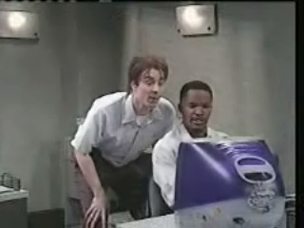
Then Came The IT Professional
Geeky
Not approachable
Speaks that crazy Language
Changes things just to drive us crazy
If nothing else this perception needed to change

Slide 6
The Rationale Behind Our Research and Implementation of Training Programs
Due to the ever changing and emerging technologies, the desire to integrate technology into the learning experience, and Net Generation of learners, we believe it would be better to have informed End Users who were more able to make decisions about their own information technology needs.

Slide 7
Research and Data Collected
Research
Literature Reviewed
Others Best Practices
Data Collected
Information collected from Footprints
Information collected from University wide satisfaction surveys
Information collected from local campus surveys and feedback

Slide 8
Research
Literature Reviewed
Technology Strategic Planning, The Search for IT Governance In Higher Education. Common Solutions Group – January 4, 2006
Faculty Development for the Net Generation ; Anne H. Moore, John F. Moore, and Shelli B. Fowler Virginia Polytechnic Institute and State University
Best Practices Reviewed
Syracuse University Information Technology and Services: Campus Connections, Accomplishments and New Horizons(2005)
Best Practices: A Triangulated Support Approach in Transitioning Faculty to Online Teaching; Online Journal of Distance Learning Administration, Volume VIII, Number I, Spring 2005 State University of West Georgia, Distance Education Center

Slide 9
Data Collected
Student Surveys
  2002 Penn State Student Satisfaction Survey
  2004 Penn State Student Satisfaction Survey
Faculty responses to local questionnaires and committees.
  Email correspondences (emails requesting feedback)
  Educational Technology Committee
  Campus Council
  Faculty Senate
  Direct feedback (direct conversation with faculty)
Staff responses to local questionnaires and committees.
  Email correspondences (emails requesting feedback)
  Educational Technology Committee
  Campus Council
  Direct feedback (direct conversation with staff)
Data collected from local helpdesk response tracking.

Slide 10
What We Found
In comparing the information we gathered, we also noticed many of the request for IT assistance were directly related to areas of weakness which are mention in the table to the right. It became clear, that if we redirected our training efforts, we could enable our end users to more fluently use the technology resources provided to them. While also, effectively creating an environment that allowed IT staff to better utilize their time on more campus critical technology infrastructure.
Students | Faculty | Staff
Although are tech savvy, were not comfortable using many of the technologies needed in their classes. Were not using the resources available to them. Were not prepared with the necessary skills to protect themselves on a large network. | Perceived using technology as being to time consuming. Perceived students to be tech savvy and assumed students were able to use the technology without instruction. Were not aware of resources available to them. Were misusing the technology or lacked the skills to use it to their benefit. | Lacked skills in newer technologies. Were not aware of, or were not using job related technology resources. Lacked important computer skills, for example, file management.

Slide 11
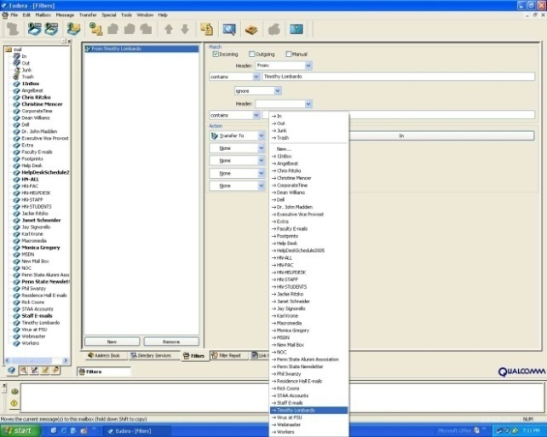
Help for Everyone
Faculty, staff and students can find help online with our online tutorials…

Slide 12
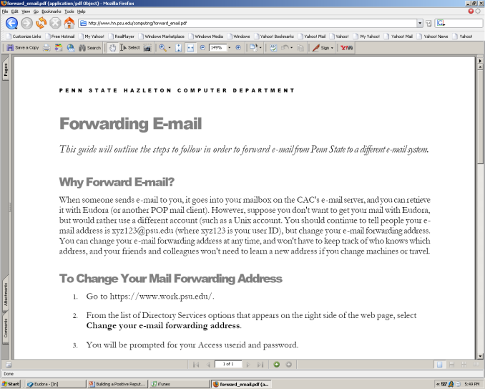
Help for Everyone
…or with our online documentation….

Slide 13
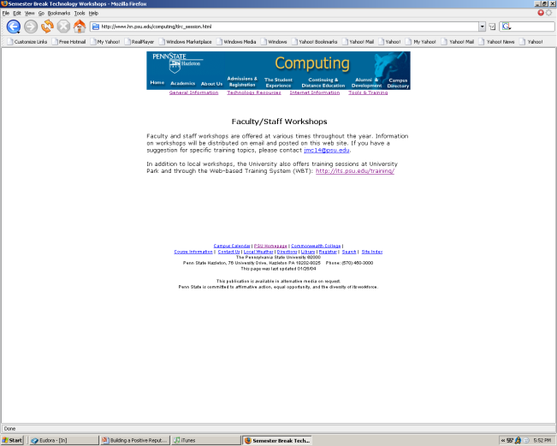
Help for Everyone
…also, our IDS and IT Director work hard to provide convenient times for many valuable trainings…

Slide 14
Help for Everyone
…and they can request one-on-one training or, faculty can request someone come into their class, by contacting the helpdesk.
Computer Helpdesk
(570) 450-3456
hn-helpdesk@lists.psu.edu

Slide 15
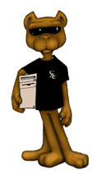
Programs for Students
http://www2.hn.psu.edu/hn/makingtheconnection.pdf
Penn State Hazleton
Orientation 2007
Making the Connection
“Making the Connection”, is tied directly to the students FYS class.

Slide 16
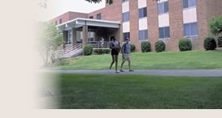
Programs for Students
Our campus offers Residence Halls. These are wired for student use. We provide security training for these students. The program is provided a few weeks after move-in. However, students are provided with information on how to prepare their computers before they move into the dorms.

Slide 17

Students Resources
In addition to making these sites available, our IT staff and Instructional Design Specialist, will provide training sessions.
http://eportfolio.psu.edu/
http://its.psu.edu/students/

Slide 18
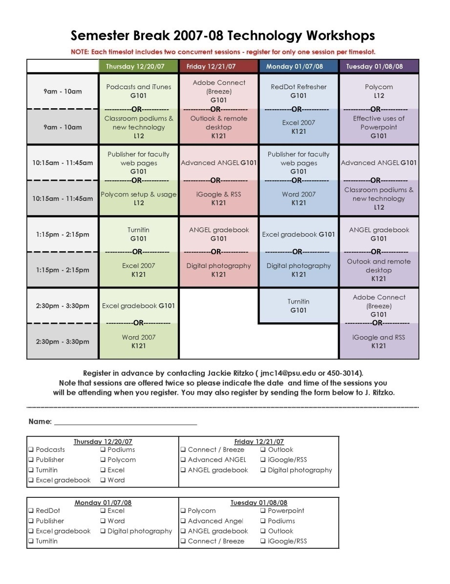
Programs for Faculty and Staff

Slide 19
Resources for Faculty and Staff
http://www2.hn.psu.edu/staff/jritzko/
http://its.psu.edu/training/resources/index.html
http://its.psu.edu/training/resources/handouts/index.html

Slide 20
Keeping the Support Persons Trained
With the rapid pace of the development of new technologies and with newer versions of products often engaging our End Users more directly with Internet architecture, IT professionals need to find avenues to keep up.
Server Management
Web Servers
SQL
Email Servers
File Management
And
File Share Servers
Network Systems Specialist
Firewall
Routers
Switches
Security
Computer Support Specialist
Podcasting
Video Conferencing
Web Design
New Classroom Technology

Slide 21
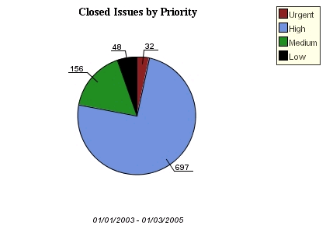
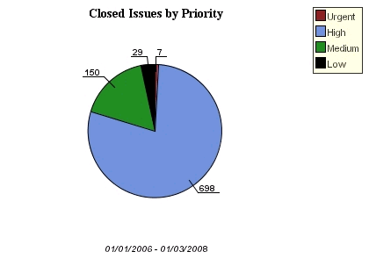
Progress
Before Redirecting Our Efforts
After Redirecting Our Efforts
The two most significant areas in which we have been able to decrease support were Urgent and Low priority requests. These were target areas of highest concern.

Slide 22

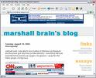




Where do we go from here?

Slide 23


Slide 24
Christine Mencer
Director of Information Technology
The Pennsylvania State University
Hazleton Campus
clm18@psu.edu

