Slide 1
Inexpensive IPTV for educational and entertainment video programming
Ethan J Sommer
Dan Oachs (in absentia)
Gustavus Adolphus College

Slide 2
Outline
What is IPTV?
How does IPTV work?
Why would I want to use IPTV?
What Gustavus currently offers
What unexpected benefits did Gustavus get from IPTV?
How can IPTV be used for education?
How can we use IPTV on our campus?

Slide 3
What IPTV isn’t
Analog Cable Television (the problem)
  Plug in Coax cable to jack in the wall
  Easy to use with a TV but difficult/uncommon to use with a computer
  Requires esoteric knowledge about muxers,amps, slopes, interference, etc which was our staff did not possess.
  Requires its own wiring infrastructure, which adds to the cost of new construction and making video services more widely available on campus.
  Prohibitively expensive to transmit to other colleges.
  Limited (college level) educational material due to E.

Slide 4
What is IPTV
IPTV (the solution)
Watch it easily from a computer
Easy to use with a Computer and possible to use with a TV with use of a Set Top Box (STB.)
Requires knowledge of computers and streaming video which is more within our realm of knowledge as IT professionals.
Makes use of existing Ethernet wiring.
Can make use of multicast (see next slide) to minimize bandwidth usage.
Can originate a stream from anywhere on the network. (More about this later.)

Slide 5
Broadcast
NBC
Science Building
4mb
Lab A
4mb
Lab B
4mb
Dorm
4mb
Jane Student
4mb
Campus Center
4mb
Joe Student
4mb
Cafeteria
4mb
Student Lounge
4mb

Slide 6
Multicast
NBC
Science Building
4mb
Lab A
4mb
Lab B
Dorm
4mb
Jane Student
Campus Center
Joe Student
4mb
Cafeteria
Student Lounge

Slide 7
Informal Poll
Raise your hand if your campus offers students video services
  Analog coax
  IPTV
Are there areas of your campus that aren’t covered?

Slide 8
Why use IPTV
We don't (currently) have the expertise to run an analog coax cable system.
After two 5 year contracts with our current cable provider¹ which required them to “fix” the infrastructure to give a clear signal, students are still frustrated with the quality.
IPTV gives us the option to give students a choice – get limited IPTV service or pay for analog cable.
IPTV requires less specialized equipment. You can “broadcast” a show using a Macbook Pro and a DV camera.
¹ Who presumably know more about analog cable than we do.

Slide 9
What Gustavus Currently Offers
We offer the twin cities over the air channels by taking the Digital TV signals (which are already MPEG2 encoded) and streaming them using HDHomeRuns ($160/two tuners)
  NBC, NBC Weather Plus
  ABC, Local News reruns
  CBS
  Fox
  CW
  PBS
  Fourty5
About half of our students use “GusTV” occasionally.
About 200 (of 2000 residential students) use it each week.

Slide 10
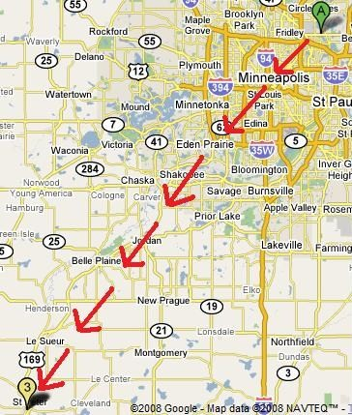
How does it get there

Slide 11
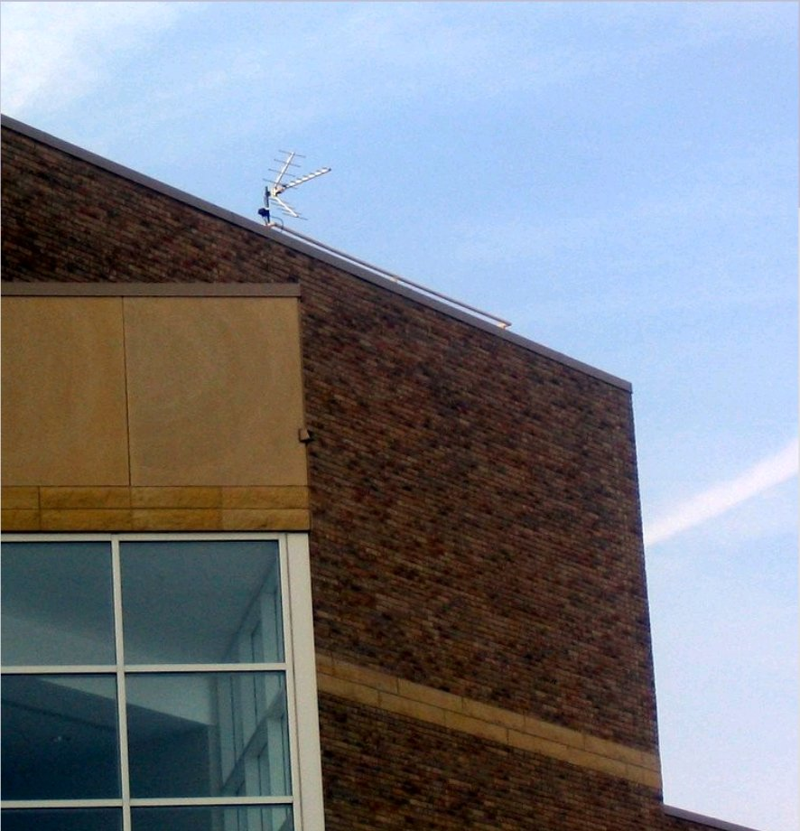
How does it get there

Slide 12
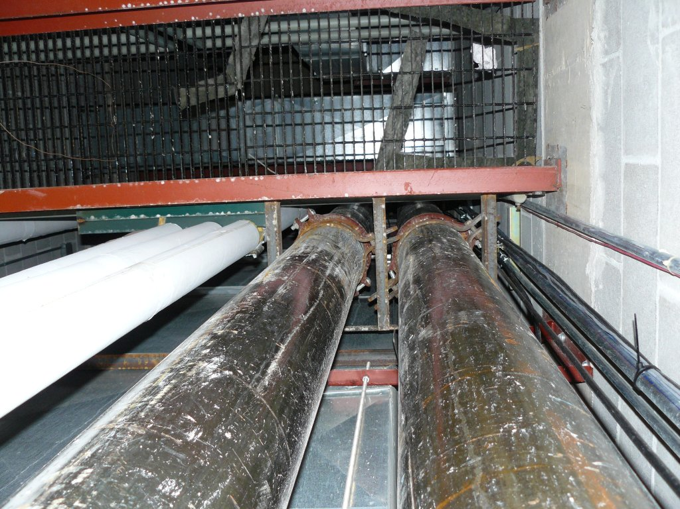
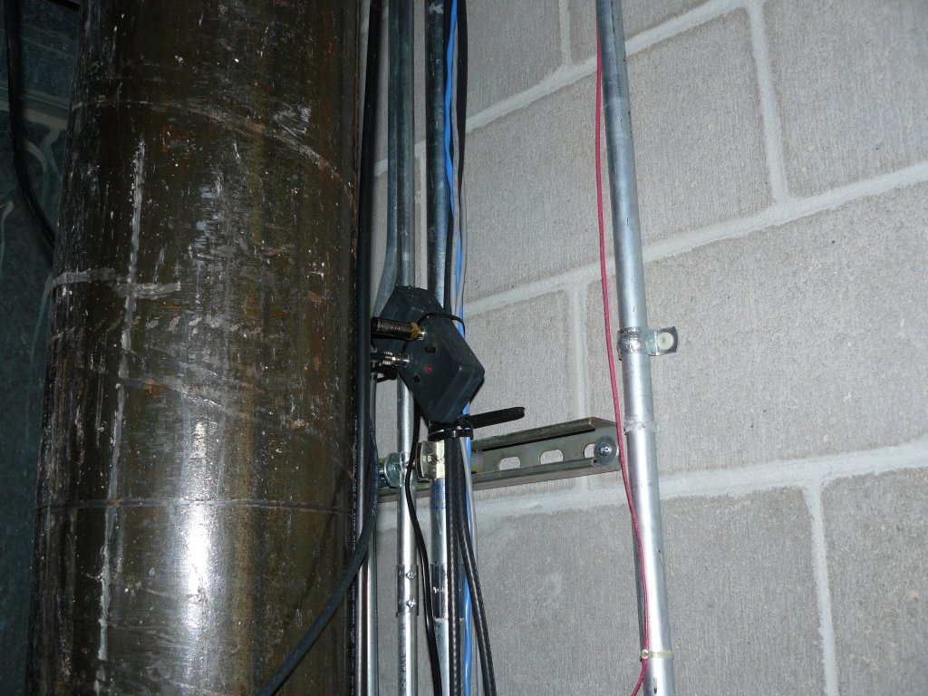
How does it get there

Slide 13
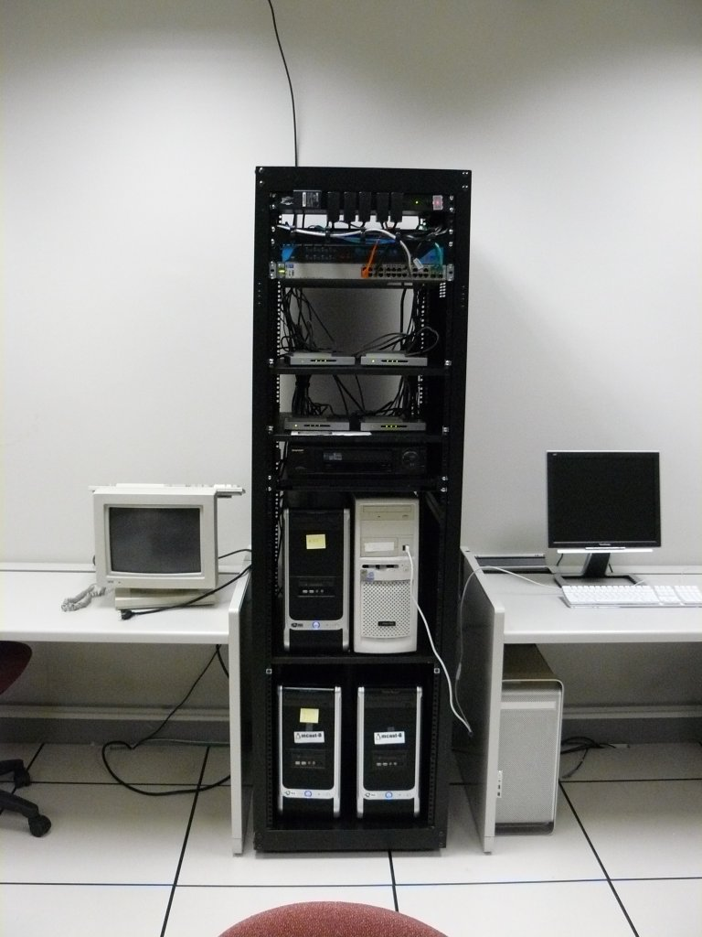
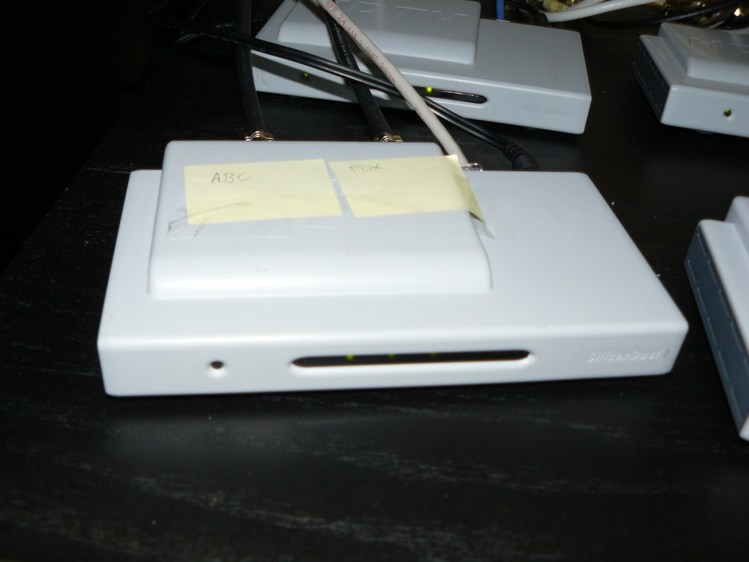
How does it get there

Slide 14
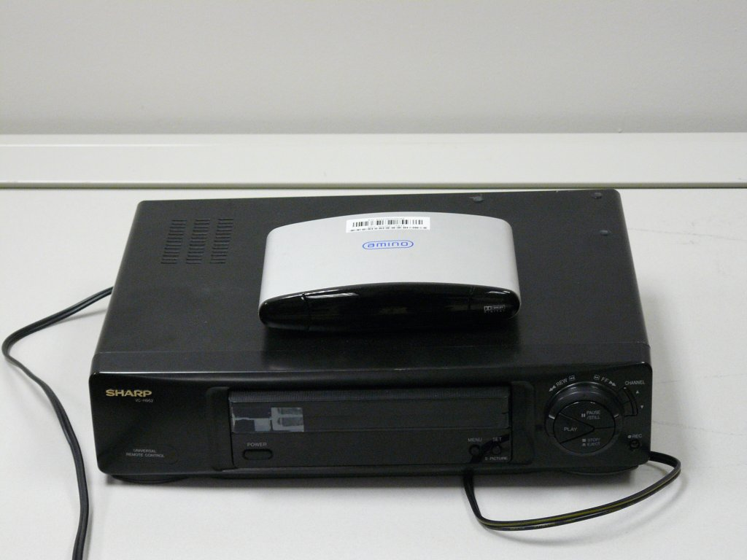
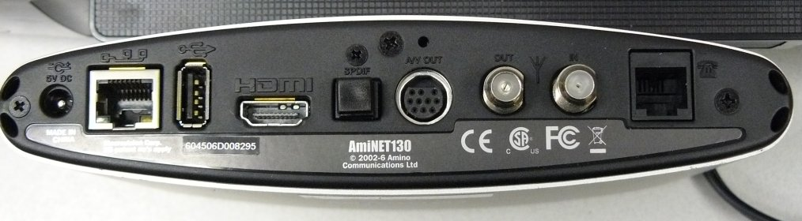
How does it get there

Slide 15
What Gustavus Currently Offers
We also provide a guide to some programming available from Internet2
  CSPAN and CSPAN2
  Research Channel (Academic research talks 24/7)
  UWTV (Washington University Research TV)
  UMich TV (channel dedicated to lifelong learning)
  mtvU (Music TV targeted at undergrads)
  Immersion Channel (Underwater video)
  Phoenix (German Public Television)
  The Irish Parlement
  Some French language channels

Slide 16
What unexpected benefits did Gustavus get from IPTV?
Easily transmit video across campus from anywhere with network access.
  Nobel Conference available to Professors
  Easily set up overflow space for popular talks
  Broadcast football games
Use same technology for IP Security Cameras from AXIS.
  We used the AXIS cameras to broadcast “Perry” the gigantic flower last spring.
When other Campuses multicast their events, our campus benefits.
Administrators can watch TV from desk with computer.
  Safety and Security can watch for weather/news alerts.

Slide 17
How can IPTV be used for education
Students can be exposed to content otherwise unavailable to them
  Colloquium such as those on Research Channel
  Programming on foreign language channels over I2
  You can supplement your cable company’s offerings with video you get from elsewhere (satellite, etc) to add foreign languages, Science Channel, History Channel
  Speakers at peer institutions
  MythTV can be used for recording
    10 days for classroom use, 45 days to “evaluate” whether to seek further rights, except PBS may be different, and research channel might be different, and stuff from other countries…

Slide 18
How can IPTV be used for education
Broadcast Popular Classes – (maybe you can’t let everyone into that class that always fills up, but why can’t they watch?)
Record lectures and make them available for students to review at the end of the term
Broadcast a video for a class
Student run TV Station
Broadcast video students created for classes
Faculty can create “TV Stations” like IDEA Channel

Slide 19
How can we use IPTV on our campus?
Enable IPTV on campus
  Turn on IGMP on all switches
  Turn on PIM-SM on all routers
  (optional) Buy HDHomeRuns and set up antenna and start offering local channels
  (optional) Set up Linux machine(s) with PVR150 or PVR500 to broadcast cable channels you already have rights to OR as portable broadcast stations.
  (optional) Set up Macbook Pro with Wirecast and DV camera or HDDV camera as portable broadcast station with mixing capabilities
  (optional) Set up a web page to help students find options
  (optional) Purchase commercial system like Video Furnace

Slide 20
How can we use IPTV on our campus?
Enable IPTV from I2
  Get MSDP working with your upstream provider. (Easy if you have Cisco or Juniper edge router. If not, linux running XORP works, kinda.)
  (optional) Provide web page to guide students to reliable worthwhile channels.
  (optional) Filter out junk SAP announcements.

Slide 21
Screenshots
Now for some screenshots…

Slide 22
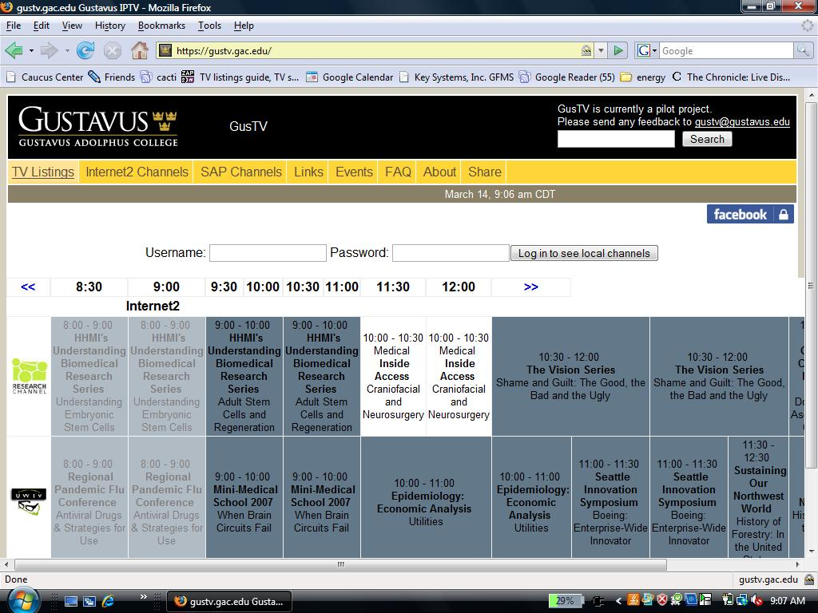
http://gustv.gac.edu

Slide 23
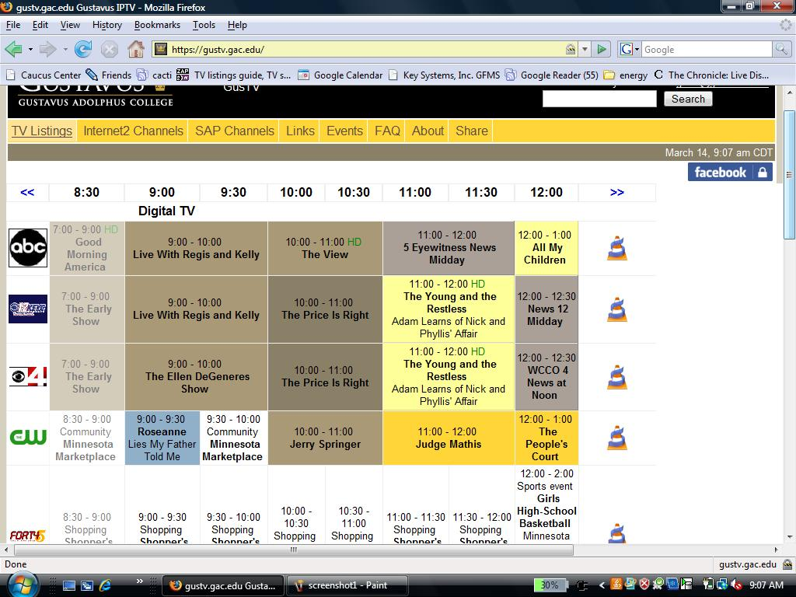
After you log in

Slide 24
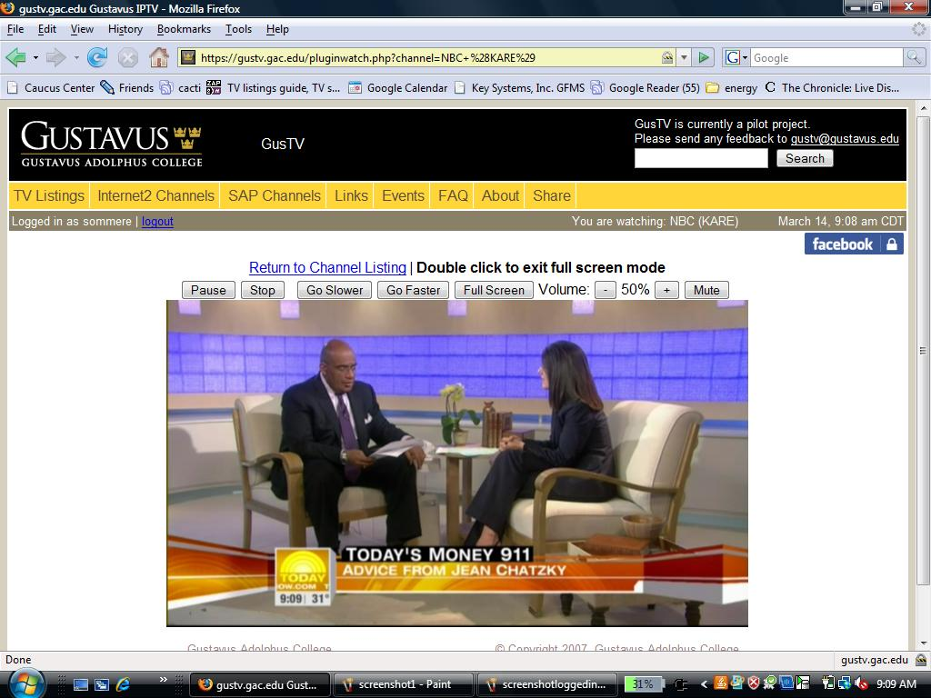
Watching Today

Slide 25
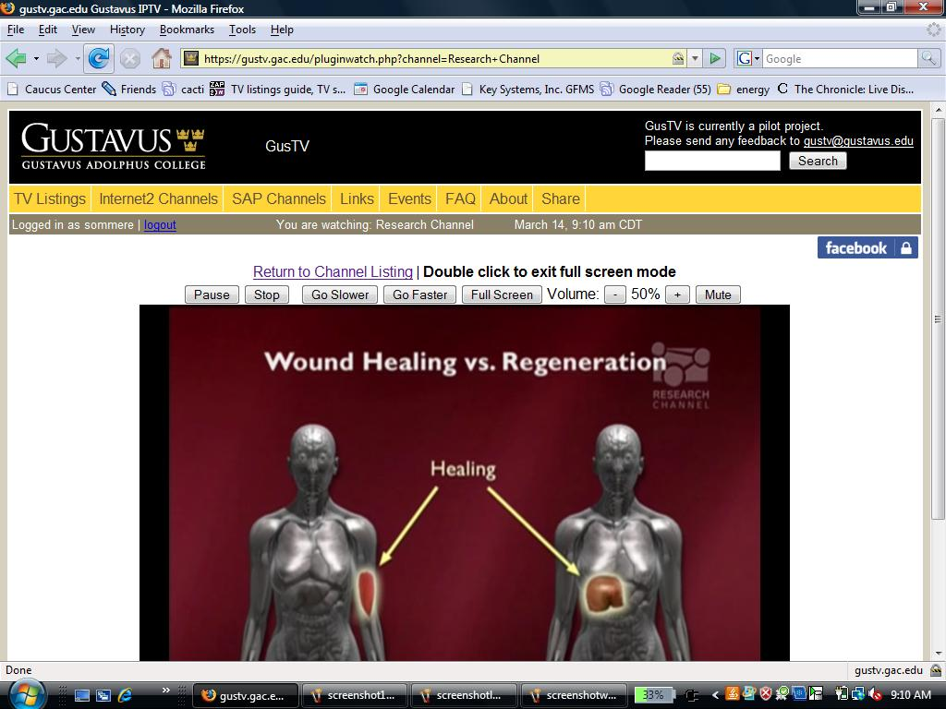
More Substance?
Research Channel

Slide 26
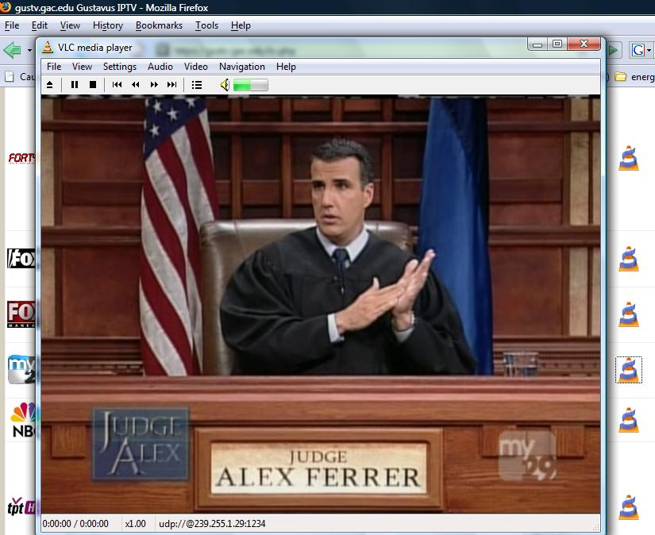
Less Substance?
Judge Alex in Divorce Court

Slide 27
Common Comments
Students want more channels (ESPN, Comedy Central, etc.)
  Through DirecTV, we could get Basic Cable (except ESPN) for about $2.50/room/month (so about $2500/month)
  We could get ESPN for $2.70/room/month.
Students want set top boxes
Based on informal surveys, we think that about 80% of students would like us to add cable to room rates, 10% would still want to purchase cable from MediaCom and 10% would be VERY VERY upset if we spent their money on TV.

Slide 28
Questions?
Resources
  http://gustv.gac.edu
  Code is up at https://gustv.gac.edu/about.php
  UWisc DATN – http://datn.wisc.edu
  AminoCom – http://www.aminocom.com
  VideolanClient – http://videolan.org

