Slide 1
General Information & Copyright Notice
This document contains material presented during the formal presentation of EDUCAUSE Midwest Regional Conference 2008.
Copyright Chris A. McCoy, 2008. This work is the intellectual property of the author. Permission is granted for this material to be shared for non-commercial, educational purposes, provided that this copyright statement appears on the reproduced materials and notice is given that the copying is by permission of the author. To disseminate otherwise or to republish requires written permission from the author.
The reader assumes all liability for making his/her workplace a better place of work and impacting the lives of others.

Slide 2
Contact Information
Chris McCoy
Director of Engineering Computing
College of Engineering
2240 Hoover Hall
Iowa State University
Ames, IA 50011-2300
Email: mccoy@iastate.edu
Phone: 515-294-7337

Slide 3
Abstract
Culture clash between centralized and decentralized IT is common on campuses today. Understanding what motivates one team to pursue risky solutions and another to pursue reserved solutions helps us work together and appreciate our differences. Using S-curves, this presentation will illustrate why cultures are different among various campus populations.

Slide 4
A Place for Everyone: Understanding IT Culture Using S-Curves
Chris A. McCoy
Director of Engineering Computing
Email: mccoy@iastate.edu

Slide 5
Introduction
This all began a couple of years ago at one of the annual retreats I hold for my staff – just the IT staff that report to me. The purpose of that retreat was very specific.
We were beginning to buckle under the weight of our own success and we needed to find some way to relieve that pressure. Over the years preceding this retreat we had launched so many successful services that we were beginning to feel the stress. So, our goal was to identify those services that were “right” for us to keep – our priority services – and to identify those services would go. We didn’t know where or how, but we just knew that we couldn’t do it all.
What we ended up with was something totally unexpected. You see we entered into this meeting with tremendous animosity for our “friends” providing central computing services, but we left just a few short hours later with a newfound understanding and respect for them.
What we came to realize at this meeting changed our perspective in a very profound way. Many of the staff described it as an epiphany. I’m here this morning to share that story.

Slide 6
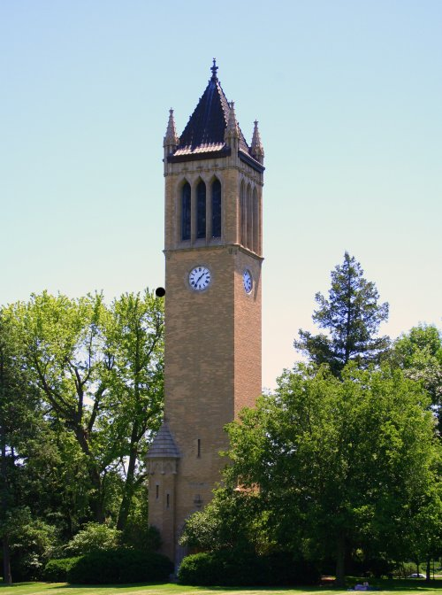
Iowa State University
1st land-grant university in the US
26,000 students (120 countries)
1,751 faculty
7 colleges:
  Agriculture
  Business
  Design
  Engineering
  Human Science
  Liberal Arts & Sciences
  Veterinary Medicine
Ames Laboratory

Slide 7
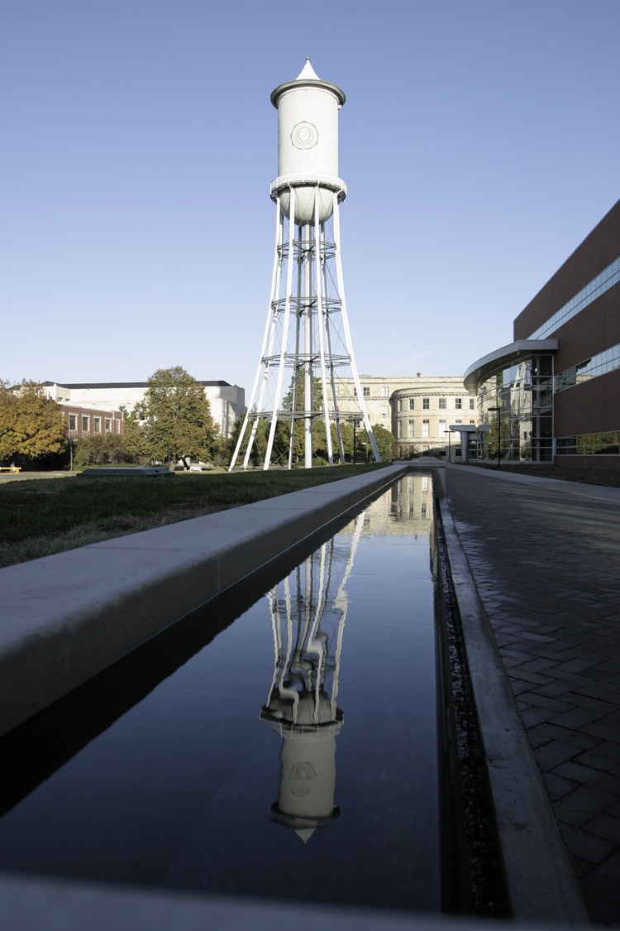
College of Engineering
7th largest in the US
8 departments
Computing:
  7000 active users
  3000 desktops
  300 servers
  75+TB storage
  Wide services
  Team of <20 FTE’s

Slide 8
“Culture
is a fact of the forces and pressures
upon us.”

Slide 9
Realization #1: Services Have Different Life Stages
Stabilization
Growth
Birth
Maturity

Slide 10
Characteristics of the IT Service Lifecycle
Birth
  Internal users & “techies”
  Pilot projects
  Development, R&D
  Feature churn
Growth
  Release to early adopters
  ID valuable features
  Rapid deployment, tuning
  Experiment w/ processes
Stabilization
  General population
  Institutionalization
  Slowing feature changes
  Reduction in deployment
Maturity
  Maximum saturation
  Organizationally adopted
  Managed expectations
  Consistency, stability

Slide 11
IT Service Lifecycle Modeled Using S-Curve

Slide 12
Realization #2: Consumer Interest Changes Over Time

Slide 13
Realization #3: Infrastructure Requirements Vary Widely

Slide 14
Differences in Investment
Mature Services
    Redundant and enterprise equipment and systems
    Highly qualified and specialized staff
    Redundant and dedicated staff
    24x7x365 response
    High-performance data backup systems
    Traceable, manageable systems of security
Emergent Services
    Off-the-shelf leftovers and existing systems -- whatever we find
    No redundancy or low-grade backups
    Growing and multi-tasking staff
    10x5 response
    Low-level security schemes (who uses it anyway at this level??)

Slide 15
Realization #4: My Team is Best at Emerging Services

Slide 16
Realization #5: Central is Best at Maturing Services

Slide 17
Notice a potential problem?

Slide 18
Realization #6: Transition is a Bottleneck

Slide 19
Realization #7: Services Die Hard

Slide 20
The IT Service Lifecycle Model

Slide 21
Conclusion
I’m not sure we discovered anything new, anything mystical, or anything of such great intellectual value. But, what we did discover and came to accept – not just “know”, but really comprehend and shift our paradigm – was that there are some pretty big differences between our team and other teams on campus – and I’m not referring to just central services.
If we can figure out a way to explain who they are – and I mean really explain what forces and pressures help create their cultures, we can probably find a means to appreciate those differences, and just maybe work together a little.
Now, I’m a realist, too. I’m not going to sell you some snake oil that the Engineering IT team works perfectly with the campus IT team, but I can tell you that we’ve done some pretty amazing things in working together. One of those, of which I’m particularly proud – a project in Engineering called the “Seamless IT Initiative” – could NOT have succeeded without the cooperation and collaboration of our colleagues in central IT.
As we finish here this morning, I leave you with a challenge. Find a way to explain and understand your differences and then use that understanding to make a difference.

Slide 22
Questions and Comments?
Chris McCoy
Director of Engineering Computing
College of Engineering
Iowa State University
Email: mccoy@iastate.edu
Phone: 515-294-7337

