Slide 1
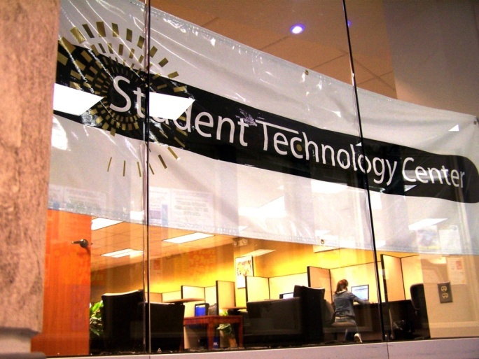
Oakland University
Student Technology Center

Slide 2
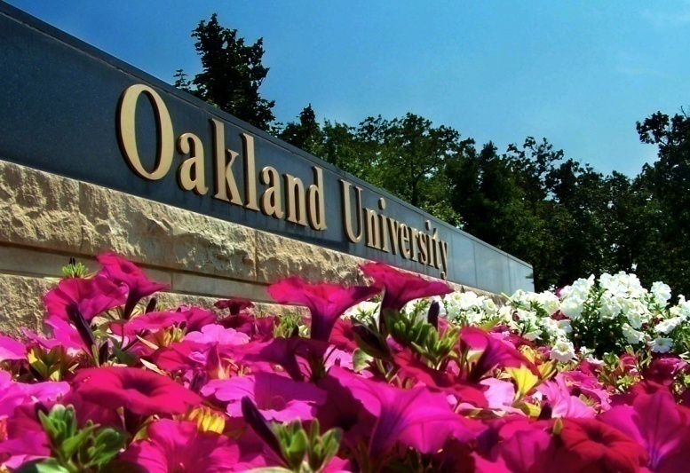
Oakland University
Located in Rochester, MI
Doctoral Research-Intensive University
Current population – 18,000+ students
90% commuter, 10 % residential
Plans to grow to 25,000 students by 2010
Medical school
Division I athletics - 1998

Slide 3
Video

Slide 4
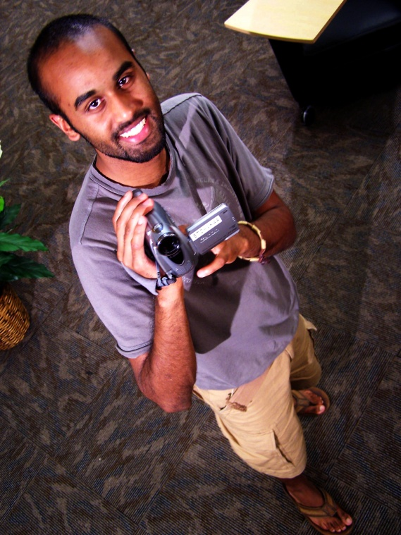
Why a Student Technology Center??
Division of Student Affairs – A support service for everything, right???
Students were proficient with Facebook, but
were they proficient in technology?
How could we help students gain the
skills for classes & the workforce?

Slide 5

Vision for a Student Technology Center??
Technology Academic Skills Center
BGSU presentation at Educause
BGSU collaboration

Slide 6
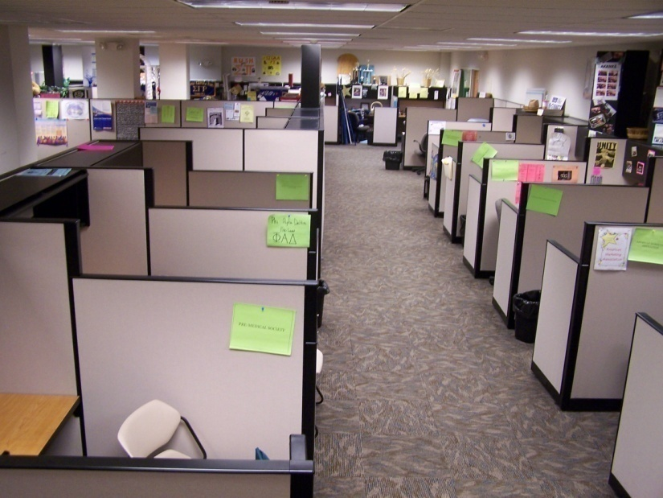
Opening the STC
Started the planning after Educause – March 2005
The Big Three:
#1 Space
#2 Funding – Michigan Economy
#3 If we build it, will they come??
Proposal co-written with Asst. VP
of Student Affairs

Slide 7
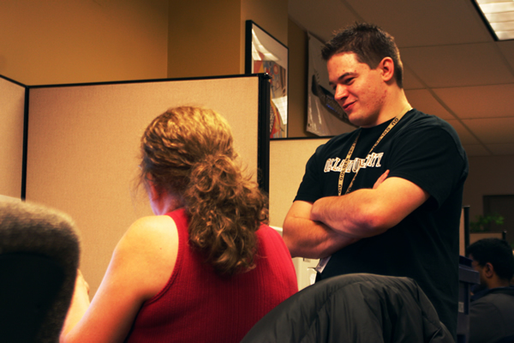
Services Provided at the STC
Mentoring
Walk-in
One-on-one/Groups
By appointment
Notes:
Next I am going to talk to you about the three major services that the student technology center provides:
Mentoring
You can think of us as an academic skills center for technology. our mentoring staff is cross trained on a multitude of programs as well as customer service and leadership skills.
We provide 2 levels of mentoring, One on One and Walk in:
Walk-in: students can stop by at their convenience for help on their technology related work
One on One Mentoring: for a more in-depth learning experience, students can schedule a one hour appointment with a mentor that goes at a pace that works best for their individual needs.
Equipment loans
Our equipment loan program allows students to borrow equipment free of charge as long as they are currently registered for classes.
Digital Cameras: Students may borrow a digital camera at no charge for 48 hours. Students can go out take pictures then bring them in and get help editing the photographs in programs such as Photoshop and adding the pictures to their projects.
Digital Camcorders: Students may borrow a digital video cameras at no charge for 48 hours. Students can shoot video, then come in and get help editing the video, burning it to a DVD and posting it to websites such as youtube.com
Tablet PCs: Students may borrow our Tablet PC’s for one a one week period, Tablet PC's are equipped with a sensitive screen designed to interact with a pen that allows for freestyle writing on the screen. Tablet PC’s have proven to be very useful for taking notes in courses where a lot of formulas and graphs are used.
Workshops
We conduct a wide variety of workshops on many different subjects
Emerging Technologies: our Emerging technologies workshops focus on rising technologies relevant to our students. Some recent examples include a youtube, Wikis and podcasting workshops.
Faculty Workshops: we have conducted numerous workshops tailors to the needs of a particular professor and his class. Recent examples include a Macromedia Flash course for the ATIB program, PowerPoint workshop for a German class and a digital video editing course for a Political Science course
Departmental Collaborations: New university technology initiatives are highlighted in these workshops some recent examples include electronic portfolios and XXX?
Beg/Inter/Advanced: Finally we provide Beginning intermediate and advanced workshops on many of the software title that we support, such as Macromedia Flash,

Slide 8
General Statistics
Notes:
In this slide we can see that the original projection called for an estimated 1,000 mentoring sessions, for the last academic year we had 3,200 and this year’s estimated numbers are 22% higher than the previous year.

Slide 9
General Statistics
Notes:
Thank you Brandon, Next I would like to talk about some General Statistics for the student technology center
As you can see, our original projection for students visits was 4,500, last year we exceeded that number by more than 11 times with 53,000 visits.
the current projected number of visits for this academic year is 71,000 which is over 34% higher than last year’s numbers.

Slide 10
Services Provided at the STC
Equipment Loans
Digital Cameras
Digital Camcorders
Tablet PC’s
Notes:
Next I am going to talk to you about the three major services that the student technology center provides:
Mentoring
You can think of us as an academic skills center for technology. our mentoring staff is cross trained on a multitude of programs as well as customer service and leadership skills.
We provide 2 levels of mentoring, One on One and Walk in:
Walk-in: students can stop by at their convenience for help on their technology related work
One on One Mentoring: for a more in-depth learning experience, students can schedule a one hour appointment with a mentor that goes at a pace that works best for their individual needs.
Equipment loans
Our equipment loan program allows students to borrow equipment free of charge as long as they are currently registered for classes.
Digital Cameras: Students may borrow a digital camera at no charge for 48 hours. Students can go out take pictures then bring them in and get help editing the photographs in programs such as Photoshop and adding the pictures to their projects.
Digital Camcorders: Students may borrow a digital video cameras at no charge for 48 hours. Students can shoot video, then come in and get help editing the video, burning it to a DVD and posting it to websites such as youtube.com
Tablet PCs: Students may borrow our Tablet PC’s for one a one week period, Tablet PC's are equipped with a sensitive screen designed to interact with a pen that allows for freestyle writing on the screen. Tablet PC’s have proven to be very useful for taking notes in courses where a lot of formulas and graphs are used.
Workshops
We conduct a wide variety of workshops on many different subjects
Emerging Technologies: our Emerging technologies workshops focus on rising technologies relevant to our students. Some recent examples include a youtube, Wikis and podcasting workshops.
Faculty Workshops: we have conducted numerous workshops tailors to the needs of a particular professor and his class. Recent examples include a Macromedia Flash course for the ATIB program, PowerPoint workshop for a German class and a digital video editing course for a Political Science course
Departmental Collaborations: New university technology initiatives are highlighted in these workshops some recent examples include electronic portfolios and XXX?
Beg/Inter/Advanced: Finally we provide Beginning intermediate and advanced workshops on many of the software title that we support, such as Macromedia Flash,

Slide 11
General Statistics
Notes:
Finally in this slide we can see that we have more than tripled our original projections for equipment loans in the past few years

Slide 12
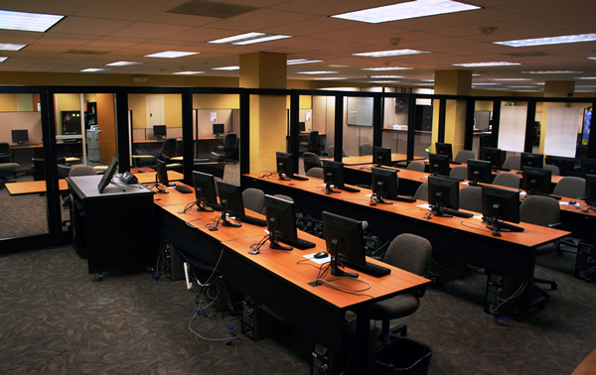
Services Provided at the STC
Emerging Technologies
Faculty collaborations
Departmental collaborations
Beg/Inter/Advanced Workshops
Workshops
Notes:
Next I am going to talk to you about the three major services that the student technology center provides:
Mentoring
You can think of us as an academic skills center for technology. our mentoring staff is cross trained on a multitude of programs as well as customer service and leadership skills.
We provide 2 levels of mentoring, One on One and Walk in:
Walk-in: students can stop by at their convenience for help on their technology related work
One on One Mentoring: for a more in-depth learning experience, students can schedule a one hour appointment with a mentor that goes at a pace that works best for their individual needs.
Equipment loans
Our equipment loan program allows students to borrow equipment free of charge as long as they are currently registered for classes.
Digital Cameras: Students may borrow a digital camera at no charge for 48 hours. Students can go out take pictures then bring them in and get help editing the photographs in programs such as Photoshop and adding the pictures to their projects.
Digital Camcorders: Students may borrow a digital video cameras at no charge for 48 hours. Students can shoot video, then come in and get help editing the video, burning it to a DVD and posting it to websites such as youtube.com
Tablet PCs: Students may borrow our Tablet PC’s for one a one week period, Tablet PC's are equipped with a sensitive screen designed to interact with a pen that allows for freestyle writing on the screen. Tablet PC’s have proven to be very useful for taking notes in courses where a lot of formulas and graphs are used.
Workshops
We conduct a wide variety of workshops on many different subjects
Emerging Technologies: our Emerging technologies workshops focus on rising technologies relevant to our students. Some recent examples include a youtube, Wikis and podcasting workshops.
Faculty Workshops: we have conducted numerous workshops tailors to the needs of a particular professor and his class. Recent examples include a Macromedia Flash course for the ATIB program, PowerPoint workshop for a German class and a digital video editing course for a Political Science course
Departmental Collaborations: New university technology initiatives are highlighted in these workshops some recent examples include electronic portfolios and XXX?
Beg/Inter/Advanced: Finally we provide Beginning intermediate and advanced workshops on many of the software title that we support, such as Macromedia Flash,

Slide 13
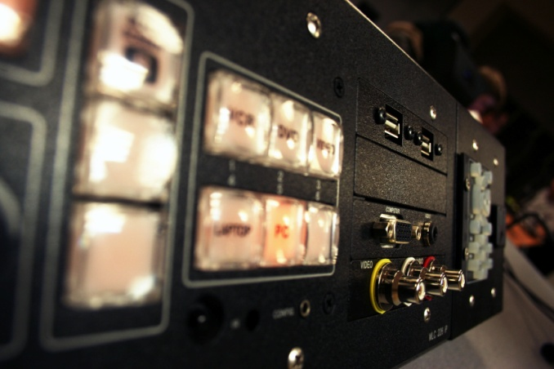
Available Equipment
Available Equipment:
32 PC’s
8 iMacs
20+ software titles
Color Laser Printers, Scanners
and 3 Plasma TV’s
Separate room with a classroom
management system
Notes:
32 powerful PC’s
8 recent iMacs
Over 20 software titles
The separate room is used to conduct workshops and training sessions.

Slide 14
Supported Software
PC - Supported Software
Apple - Supported Software
Microsoft Office 2007
Dreamweaver CS3
Windows XP
Fireworks CS3
Flash CS3
Photoshop Elements
Premier Elements
Mac OS X Tiger
iMovie
Garage Band
iDVD
iWeb
iPhoto
Internet Apps / Web 2.0
OU Websites
Google Docs
Second Life
iGoogle
Wiki's
Picassa
YouTube
ePortfolio
SAIL
Moodle
OU Personal Web Space
OU Portal
OakShare
Notes:
Here are some examples of the more than 30 software programs and websites supported by the student technology center
We have
web development programs such as: Dreamweaver, Flash and Fireworks
Video editing programs such as: Adobe Premier and Apple iMovie
Image editing programs like: Photoshop Elements and iPhoto
In addition we support popular web applications such as: Google Docs, iGoogle, wiki’s and youtube
Finally we also provide support for our University websites and technologies

Slide 15
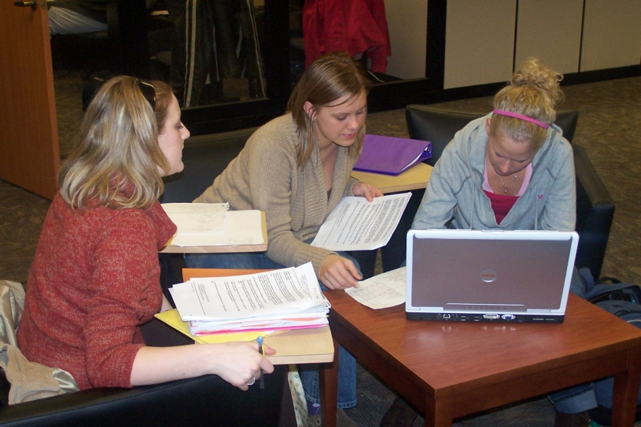
Student Engagement
Keeping students on campus
Student collaborations
Group Projects
Student Organizations
Notes:
We have found that many times students who would have gone home to work on their homework are instead staying on campus and completing their assignments in the student technology center taking advantage of our mentors if they ever need help.
Students with group projects as well as student organizations often come in groups and work with our mentors

Slide 16
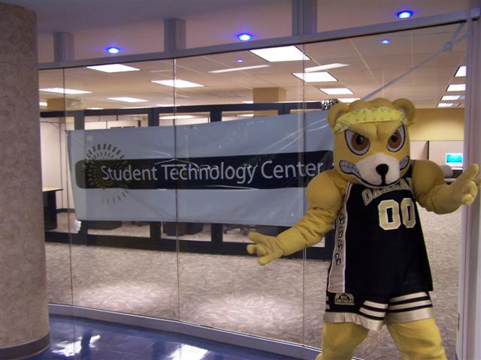
Marketing the STC
Students
MBA group developed strategic marketing plan
Online marketing
Social networking
Email Campaigns
Surveys
Faculty
Personalized letter
Syllabus insert
Brochures/Flyers
Email Campaigns
Notes:
Back in 2005 a group of a Chrysler Managers from the MBA program developed a strategic marketing plan which we still use today
email campaigns include follow-up emails to students who rented out equipment

Slide 17
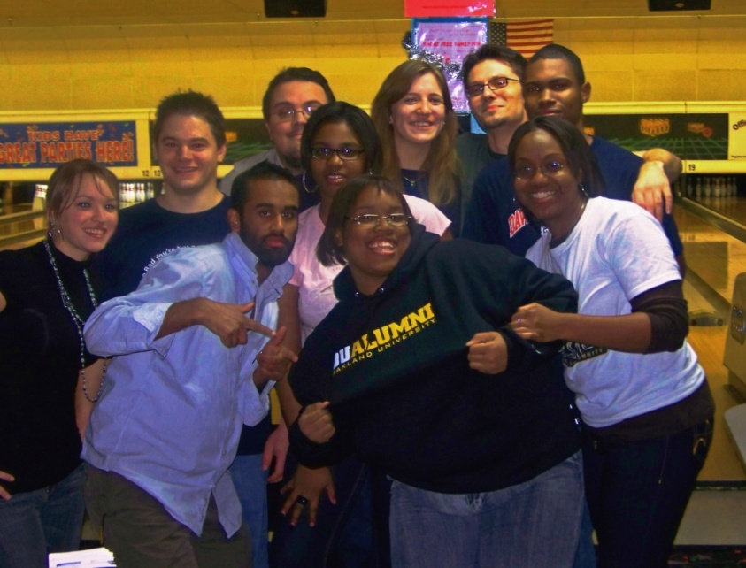
Staffing the STC
Started with Director & 6 student employees
Has grown to Director, 10 student employees & 2 co-op professionals
Training
What majors we hire
Hiring philosophy

Slide 18
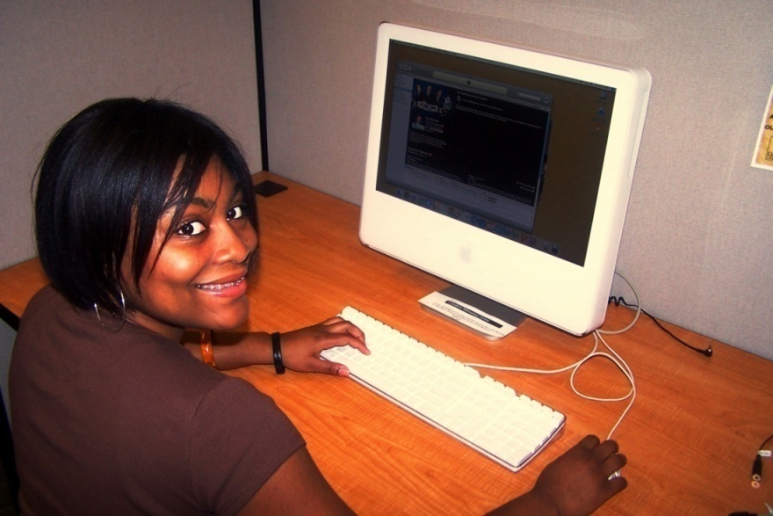
Staff at the STC
Real World Experience
How do we keep students until graduation?

Slide 19
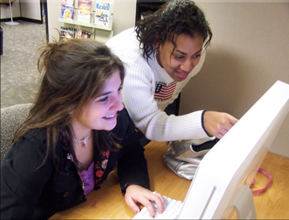
Financial Implications
Initial Funding
Annual Funding
Operational
Hardware/Software

Slide 20
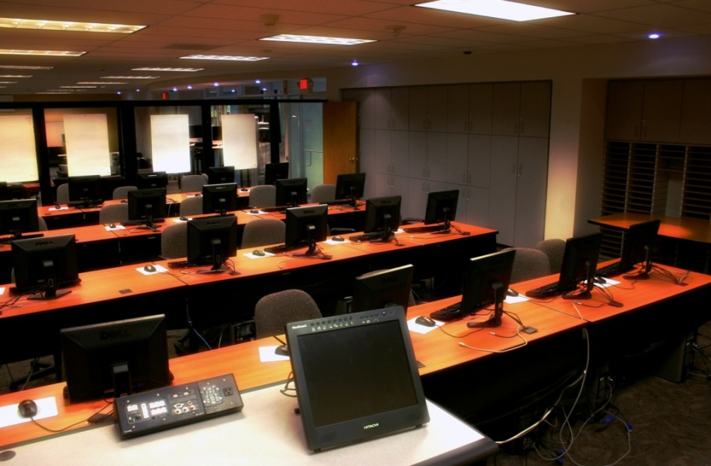
Future of the STC
Return on Investment (ROI) project
Sustainable funding source
Technology & Leadership
Grants
Growth

Slide 21
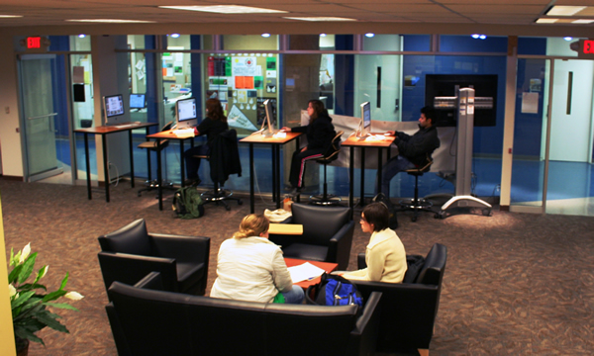
Questions?
www.oakland.edu/stc

