Slide 1
Securing the High Ground – Strategies & Technologies for a Comprehensive Assessment Program
Copyright Rod Henshaw & Teri Koch, 2008. This work is the intellectual property of the authors. Permission is granted for this material to be shared for non-commercial, educational purposes, provided that this copyright statement appears on the reproduced materials and notice is given that the copying is by permission of the authors. To disseminate otherwise or to republish requires written permission from the authors.

Slide 2
Securing the High Ground – Strategies & Technologies for a Comprehensive Assessment Program
Presented by:
Rod Henshaw & Teri Koch
Drake University
Educause Midwest Regional Conference, March 18, 2008, Chicago

Slide 3
Assessment – the Key Questions
What factors compel an organization to undertake assessment?
How can an organization structure itself to
integrate assessment into the organizational culture?
What role does technology play in assessment?
What are the benefits of assessment to an organization?

Slide 4
Definitions
“Assessment is a set of measurements, linked to specific pre-defined outcomes”
Assessment is embedded in a culture of evidence, which is “the outcome of a deliberate strategy to make decisions through the analysis of data” (Tracey)

Slide 5
Discussion Questions
Do you have a positive, effective assessment experience that you can share?
Do you have an assessment experience that did not go so well that you can share?
Are there issues or topics that we can expand on in the discussion?

Slide 6
Defining Assessment!
“To most faculty Assessment is a FOUR letter word” (source protected)

Slide 7
Drake – Institutional Context
Focused on validating the mission
Highly participative
Academic and non-academic units
Data and evidence driven
Drive change
Build a sustainable model (HLC Academy, training, positions)

Slide 8
Cowles Library - Assessment
How do we make it real?
Data Repository!

Slide 9
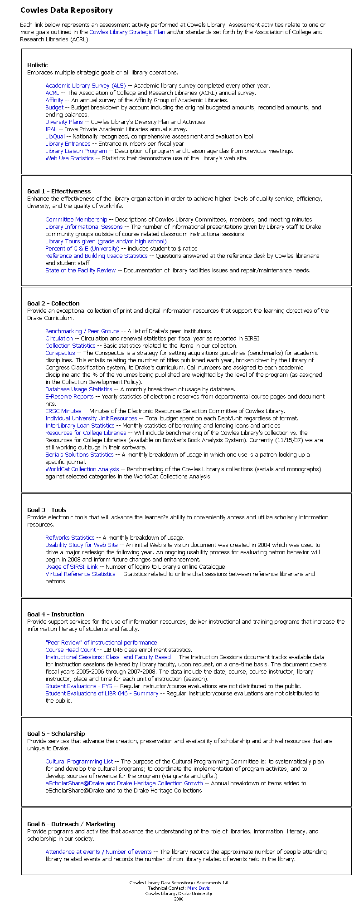

Slide 10
So, Why Assess and Plan?
Because you HAVE to!
Drake Self-Study Experience
Four year process
Criterion Committees (Criterion 3: Student Learning & Effective Teaching)
Library “Futures” Committee
Library hosted HLC – NCA visit
Drake accredited “without qualification”

Slide 11
So, Why else Assess and Plan?
It IS a lot of work!
The number of projects and collaborations we can take on is infinite; we are not.
Thus, “working with the future:”
  Inoculates us against irrelevance
  Puts us in step with the campus mission
  Identifies internal priorities
  Provides evidence of accountability

Slide 12
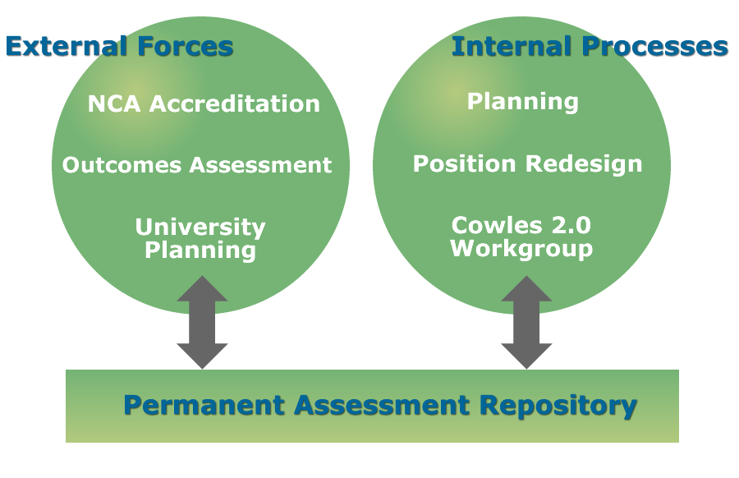
What compelled Cowles Library to undertake formal assessment?

Slide 13
Where are we (libraries, that is?)
We need to go beyond “books and bricks” in telling our story
There are dozens of other things that libraries are today…
Many of which are vital to the growth & vitality of our institutions
Libraries need to speak “their language”
What we must be most: A force for change with a systematic approach

Slide 14
ARL Survey on Assessment - 2007
“Big Picture” on Assessment in Academic Libraries
Survey distributed to 123 ARL (Association of Research Libraries) in May 2007. Response rate = 60% (73 libraries). Of these, 63% were in public academic institutions, 22% were private academic libraries, 12% were Canadian academic institutions, and 3% were public libraries.

Slide 15
ARL Survey on Assessment (cont):
Question: Why Assess?
Impetus was service driven and user centered and came from within the library itself rather than from an outside source. Top impetus (91%) was the desire to know more about their customers.
The first assessment activity (over 50%) was a user survey.

Slide 16
ARL Survey on Assessment (cont):
Question: What are the Most assessed Library functions?
Library Web site, Electronic Resources, Collections (quantifiable)
Question: What are the Least assessed Library functions?
Qualitative functions (Administration, Marketing, HR)

Slide 17
ARL Survey on Assessment (cont):
Question: What are the Top three outcomes that were attributable to assessment activities:
(1) Changes to web sites and facilities
(2) Collections, hours, and staff
(3) Customer service, journals, access services, online catalog interface, instruction & outreach, and reference services.

Slide 18
ARL Survey on Assessment (cont):
Final Observation:
Between 68% and 79% of the respondents agreed or strongly agreed with statements related to the commitment of their library administrations to assessment.
Only 50% (or fewer) of respondents agreed with statements that had to do with staff support for, or ability to carry out, assessment activities.

Slide 19
How Can an Organization Structure itself to Undertake Meaningful Assessment Activities?
Ingredients (components)
Structure
Process

Slide 20
Making it Real – Ingredients
Mission
Strategic Planning
Measurements
Performance (individual)
Training and Development

Slide 21
Making it Real – Ingredients
Technology
Collaboration
Service goals
Budget/Resource Allocation

Slide 22
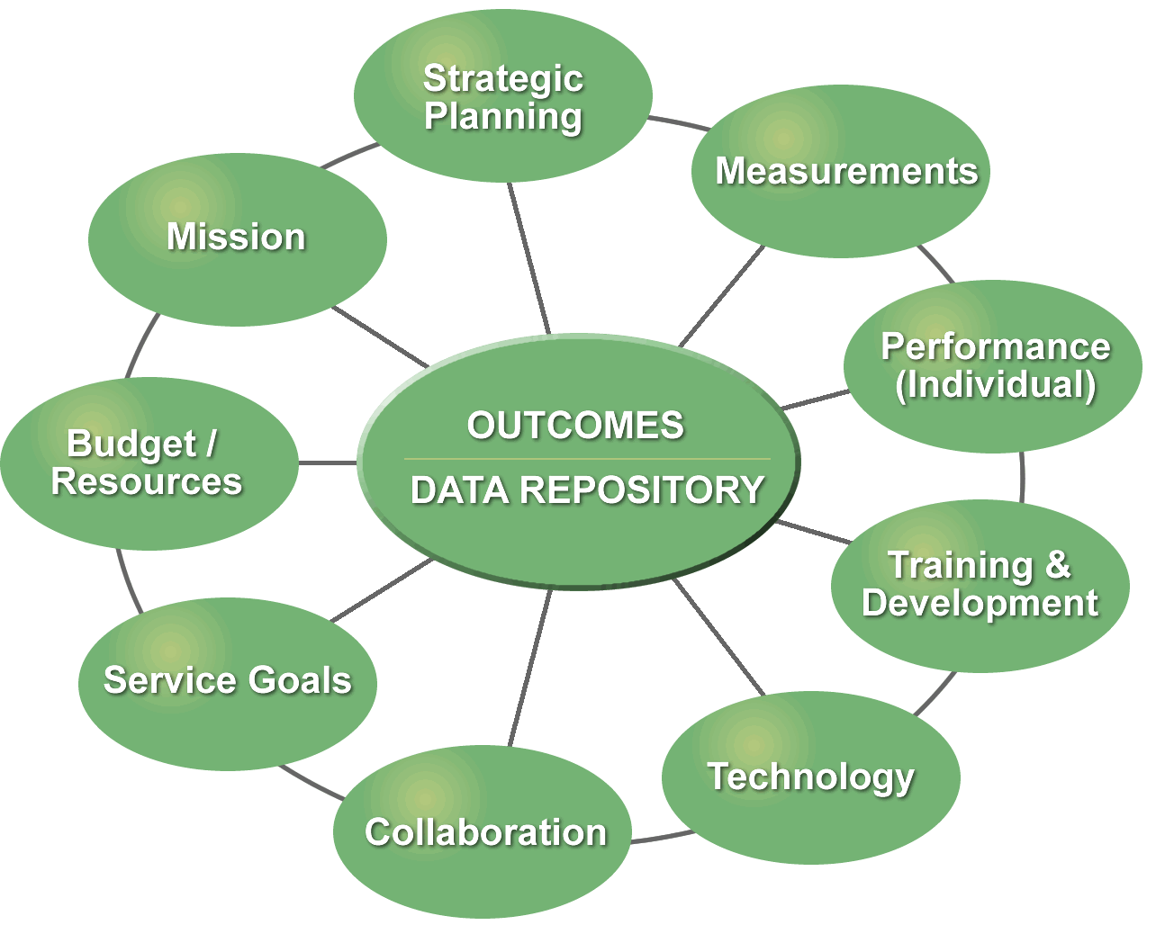
Making it Real – Ingredients

Slide 23
Making it Real – Structure
Commitment from Leadership
Management has the lead role for overall coordination
Everyone in the organization has some role
Tech group provides support
Data repository is the central “vessel”
Training and Development Officer provides oversight for maintaining the data repository

Slide 24
Making it Real - Process
Planning cycles
Goals linked to outcomes (organizational and individual)
Data is contributed to repository
Data is public
Incentives – compensation, development

Slide 25
Top Outcomes from Assessment at Cowles:
LibQUAL User Survey 2005 & 2007
Concern: Student Workers
Solution: Redesigned organization to create new position: Service & Training Coordinator.

Slide 26
Top Outcomes from Assessment at Cowles:
Concern: Out-of-date technology.
Solution: Redesigned Reference area to create an Information Commons with dozens of new computer workstations, including support (combined with computing lab)

Slide 27
Top Outcomes from Assessment at Cowles (cont):
Concern: Resources in Pharmacy & Sciences were deficient.
Solution: Used these comments to leverage library’s request for increased $ from IT fee; greatly increased electronic resources in these areas

Slide 28
Top Outcomes from Assessment at Cowles (cont):
Just-completed 2007 LibQUAL User Survey
Top concerns: Building, hours, more technology, more resources

Slide 29
Technology utilized in Assessment at Cowles Library
Technology/Tools used & developed:
http://www.lib.drake.edu/site/aboutCowles/mission.php

Slide 30
Free and Open Source Tools
Linux (operating system)
Apache (web server)
MySQL (database)
PHP (web pages)
D-Space (institutional Repository)
Google Analytics (web statistics)

Slide 31
Free and Open Source Tools
Cowles Library Web Developer’s e-mail address:
Scott Phillips: scott.phillips@drake.edu

Slide 32
Summary
Important for library to have a seat at University-level committees (curriculum, self-study, budget, etc.)
Process messy and library’s role often undefined
Reiterate importance of using data to “close the loop”. Show what you want to do, do it, measure it, evaluate it, improve it.

Slide 33
Assessment – Program Checklist
Use it to drive change
Link to your institution
Get everyone involved
Give structure and process
Get training
Use technology
Use the results
Go public
Provide Incentives
Review, refine, refocus

