Slide 1

A Strategic Approach to Implementing Clickers
University of Nebraska at Omaha
Ted Turgeon, Instructional Designer
Jay Killion, Assistant Director of Academic Computing
Copyright Jay Killion and Ted Turgeon 2008. This work is the intellectual property of the author. Permission is granted for this material to be shared for non-commercial, educational purposes, provided that this copyright statement appears on the reproduced materials and notice is given that the copying is by permission of the author. To disseminate otherwise or to republish requires written permission from the author.

Slide 2

University of Nebraska at Omaha
Four-year public institution founded in 1908
Metropolitan university
15,000 undergraduate and graduate students
900+ full and part-time faculty
200+ programs of study

Slide 3
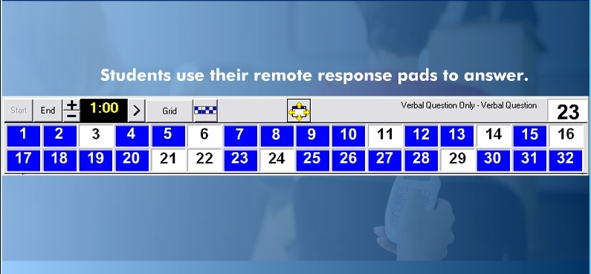
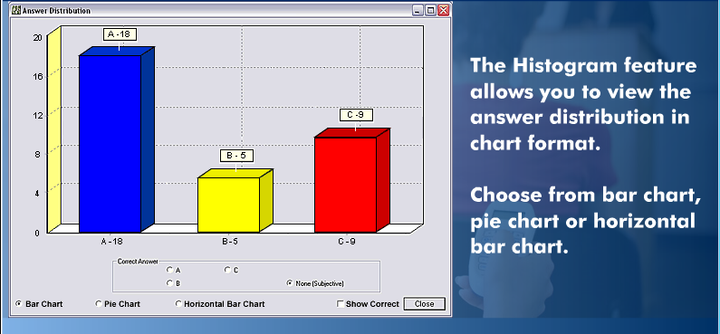

Slide 4
Clicker Timeline
User Group
Fall 05
Pilot
AY 06-07
Promotion
Spring 07
Go Live
Fall 07
Support
Fall 07 >

Slide 5
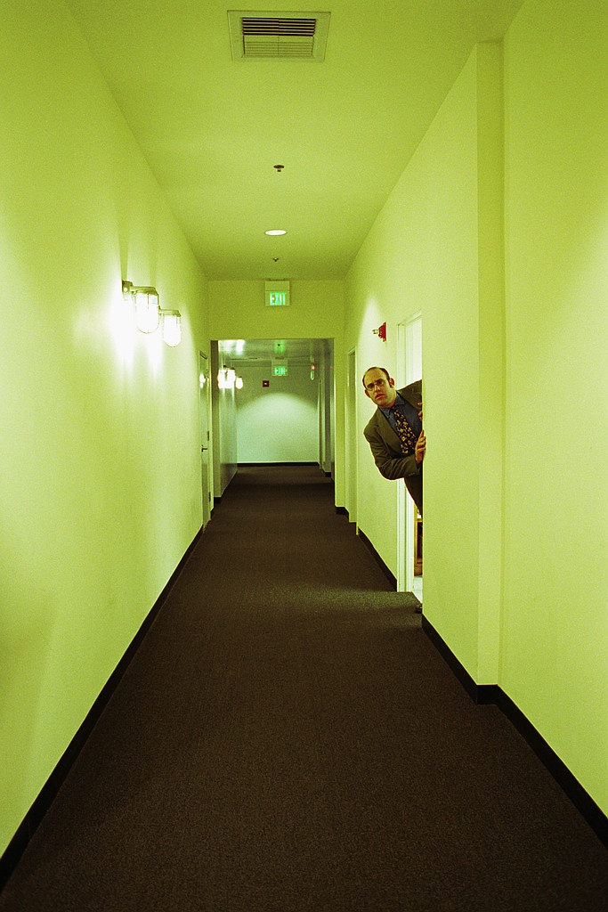

Slide 6
Innovation-Decision Process
Knowledge
Persuasion
Relative Advantage
Decision
Continued Adoption
Implementation
Confirmation
Compatibility
Complexity
Trialability
Observability
Adoption
Rejection
Later Adoption
Discontinuance
Continued Rejection
Adopted from Everett M. Rogers’ Diffusion of Innovations

Slide 7
Workflow Analysis
Vendor
Distribute instructor kit
Bookstore
Answer questions
Instructor
Checkout set
Student
Tech
Fulfill orders
Provide support
Provide training
Upgrade software
Fix bugs
Order clickers
Prepare clickers for sale
Return clickers
Request kit
Order clickers
Install software
Register course
Register test clicker
Develop content
Classroom setup
Conduct course
Request support
Purchase clicker
Register clicker
Request support
Sell clicker
Image classrooms
Support hardware
Support instructor
Support student
Escalate issues
Drop class

Slide 8
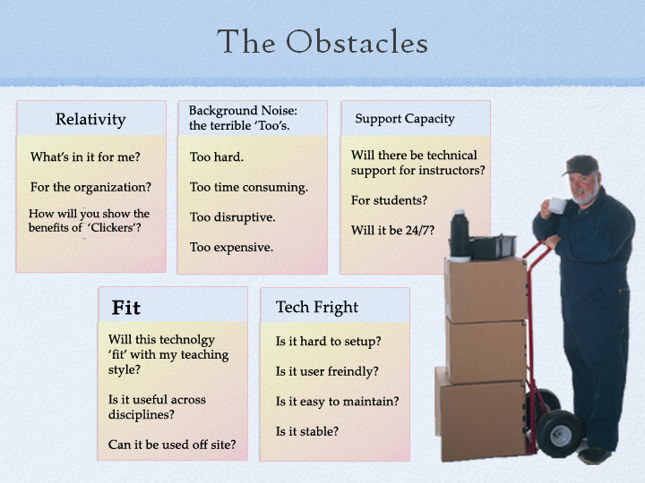

Slide 9
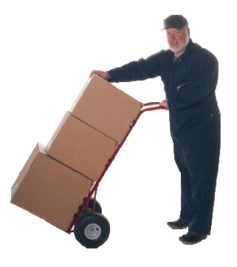

Obstacle Removal
Methodology to show relevancy: Vendor, API staff, and Faculty Demonstrations and hands-on classes.
Developed ‘Best Practices’ (BB) luncheons and Teaching circles where Faculty mentor and coach one another on CPS issues.
First person access, coaches, Helpdesk, and on-line tutorials.
Integrated with campus technology and culture
Loaners and try before you buy.

Slide 10
Obstacle Removal: Relevancy
Engagement
All Students
participate
Engagement/
Reflection
Data displayed
on screen
provides instant
feedback to
instructor
Formative
Assessment
Student’s can
see all class
responses
Reflection
Students get
immediate
feedback
Summative
Assessment
Recorded
responses
form record sets
for comparison

Slide 11

Communities of Practice

Slide 12
Performance Indicators
 | Fall 07 | Spring 08
Instructors | 20 | 19
Students | 2,572 | 1,450
Sections | 43 | 34
Support Calls | 50 | 3
Onsite Support | 20 hrs wk – 6 wks | 4 hrs

Slide 13
‘Success+tament’
Okay, so I had an ultimate clicker experience last Thursday. My class had taken an exam and hadn't done well on it--partly their fault, and probably partly my fault as I lectured sick one day and am not sure I actually made sense.
So I decided to let them retake the top ten most missed questions from the exam to have an opportunity to earn back half their value (10 points). I made them bunch up in groups and had them put everything away except their clickers. I put the questions up in Powerpoint one at a time and gave them two minutes to discuss (no books, no notes) in their groups before weighing in with an answer.
So everything sounds okay, so far right? Well let me tell you that it went over like gangbusters. They had good discussions and they earned points and had the best time. On three of the questions the entire class came to consensus with the right answer. Everytime the answer was flashed they cheered. It got a little Thunderdomey (new word) when many of them would enter their answer and then put the clicker down with a thump. By the end of the ten questions, they were banging the clickers in time to the seconds counting down--and then giving a roaring cheer.
I have never been through anything like it.
For the rest of class, they were attentive during lecture, more people offered opinions, and six people came up after class to say how much they enjoyed it.
Apparently, clickers work. Of course, we'll see what happens today......

Slide 14

Lessons Learned
Just-in-time support
Diverse technical environments
Student workflows
Realistic expectations
Academic calendar

Slide 15
Next Steps
Advanced training
New audiences – small classes, staff, community
Better assessments
Testing

Slide 16


Q & A

Slide 17
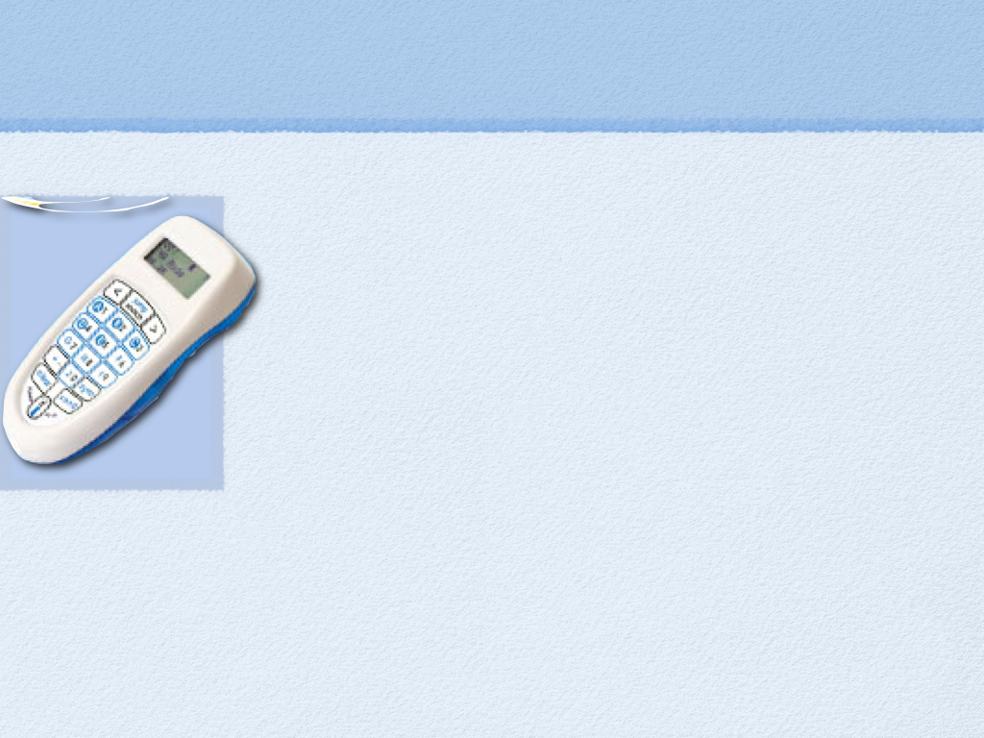
Contact
Ted Turgeon
Instructional Designer
(402) 554-3115
tturgeon@unomaha.edu
Jay Killion
Assistant Director of Academic Computing
(402) 554-3758
jaykillion@unomaha.edu

Slide 18
Resources
Clicker Support and Adoption Page: http://api.unomaha.edu/instructionaltech/clickers.php
Student Support Page: http://its.unomaha.edu/clickers.php
Tutorials: http://api.unomaha.edu/cps_tutorials/
API: http://api.unomaha.edu/

