Slide 1

Deploying 802.11n Pilot
Tammy Closs
Bob Johnson
Kevin Miller

Slide 2
Introducing Duke
Research & teaching
  Medicine, nursing, basic sciences, genomics, clinical trials
  Engineering
  Social science, divinity
  Environmental science
  Law, Business, Public Policy
Hospitals, clinics
Student life: athletics, residential life
Auxiliaries

Slide 3

Metrics
5,500 undergraduate
6,500 graduate
8,000 faculty
22,000 staff (incl. medicine)
8,600 acres – 1,200 developed
48,000 wired ports (excl. medicine)
7TB+/day to/from Internet

Slide 4
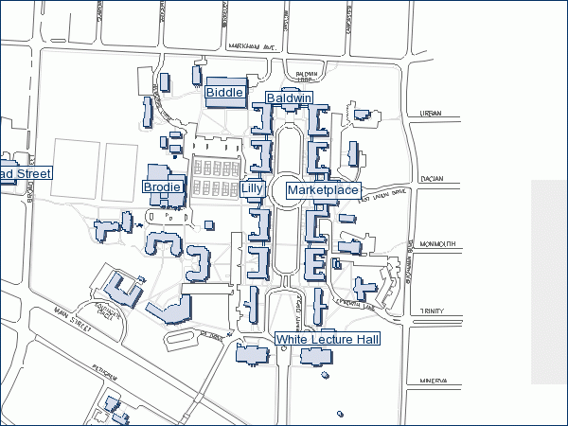
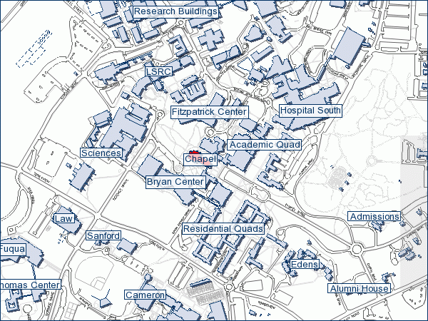
Campus Maps

Slide 5

Backdrop for 802.11n
Duke Digital Initiative
  Inspired new uses for technology in academics
Strategic Plan: Making a Difference
  $1.3B over 5-8 yrs (2nd yr)
Teaching & Learning Center
  Classes as performances
  Primary access: wireless or wired?

Slide 6
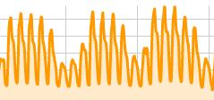
Business Drivers
Increase in wireless connectivity
Decrease in wired use
  Public wired ports (library) completely unused
Increased need for mobility

Slide 7
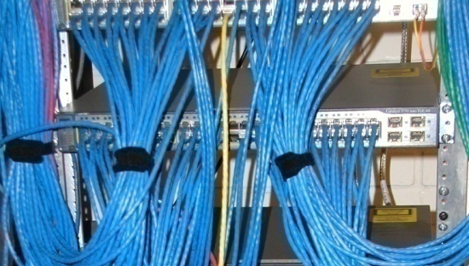
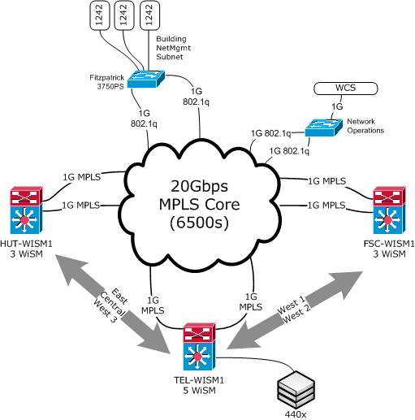
Current infrastructure
1700 APs
11 WiSM
+800 APs – Res. Halls
60% Coverage

Slide 8
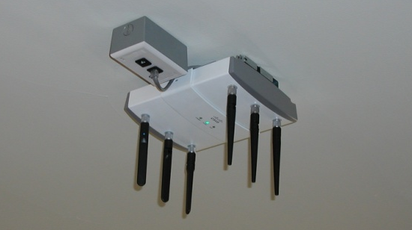
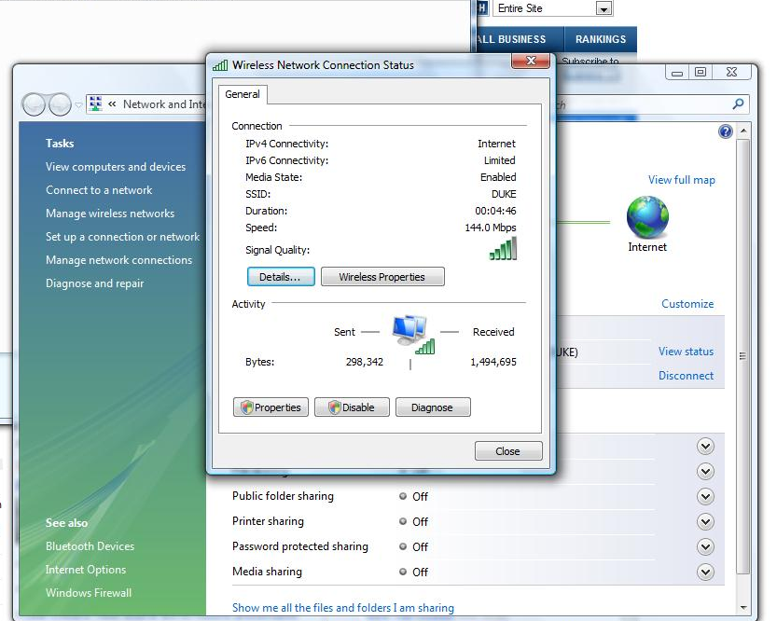
802.11n First look

Slide 9

Pilot Environment
Epworth Residence Hall
  16K S.F.
  ~55 students, faculty-in-residence
  Previously hotspot-only 802.11b/g
Qty. 8 – AP1252 (2.4GHz + 5GHz)
Dedicated 4402 (code eval)
3750G + 802.3at PoE injectors

Slide 10
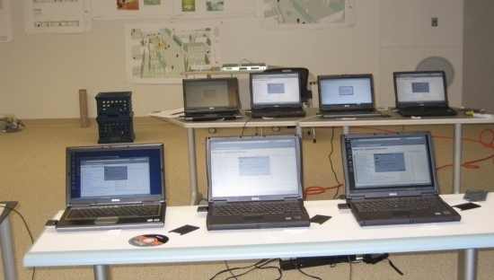
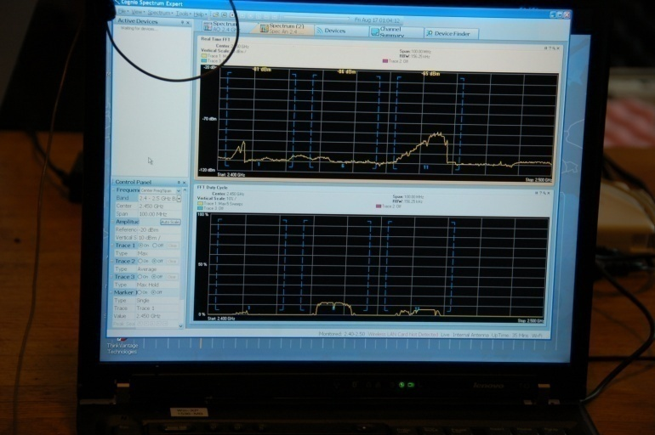
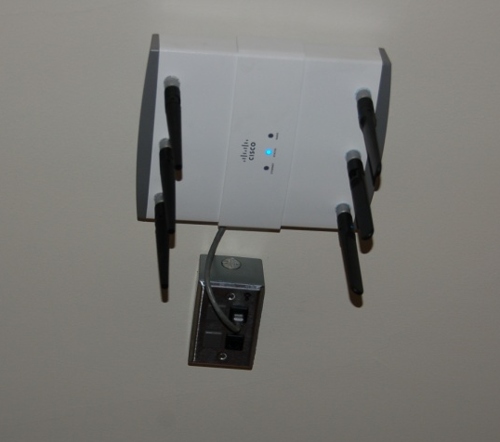
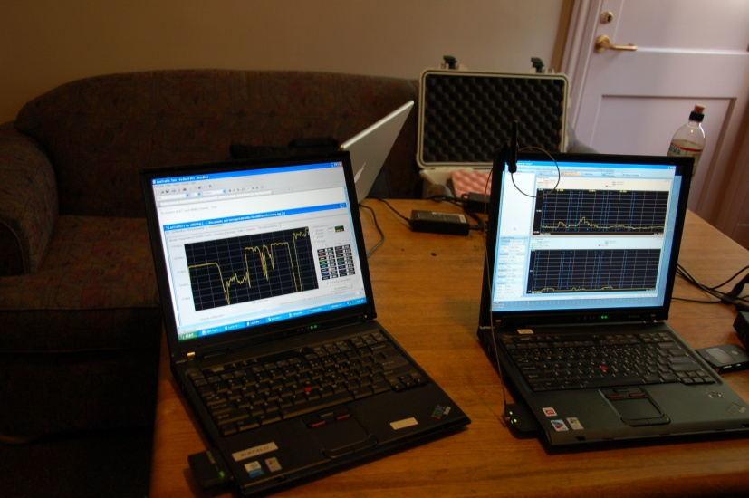
Intensive Testing

Slide 11
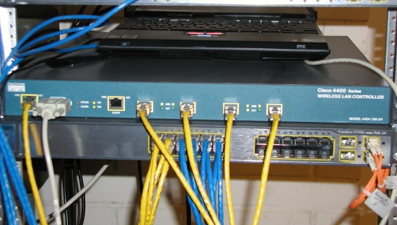
Experiences
40%+ connecting with 802.11n
  MacBook
  Dell, Lenovo, others
129Mbps+ peak throughput (11n clients)
802.11g client: 2x faster on 11n AP compared to 11g AP
  Especially pronounced at greater distances

Slide 12
Next Steps
Campus-wide 802.11n rollout over next 6-9 months
  1:1 swap of existing 802.11a/b/g APs
  Completing wireless deployment in reshalls
All new laptops to have 802.11n radios
Prioritizing locations
  Teaching and learning spaces
  Greenfield opportunities (“New Campus”)
Risk mitigation
  802.11n standard
  PoE, GbE connectivity

Slide 13
Financial Considerations
Evaluation of funding approach for wired and wireless networks
  Wireless installed with one-time funds
  Wired network: ongoing refresh budget
802.11n upgrade: advancing planned 4 year refresh cycle
Observation: wired network size decreases, yet cost per port will increase (GbE, 10GbE)

Slide 14


Future
Experimenting with HDTV-over-WiFi
Preparing for phase-out of 802.11b
  Legacy devices v. leading edge
    Refresh issues with Auxiliaries (inventory, PoS)
VoWiFi
  Location, E911

Slide 15

Questions
Future of wired VoIP phones?
Future of wired ports?
Laptop backup on wireless network?
Gaming – suitable over wireless?
Multicast applications on wireless? (IPTV)
Wireless security & usability

Slide 16
Contact Information
Bob Johnson
  rlj33@duke.edu
  +1 919 668 1762
Kevin Miller
  kevin.miller@duke.edu
  +1 919 668 6484

