Slide 1

IU UniCom Project
OCS/CS2100 Integration
J. Michael Lucas
Jennifer Van Horn
February 10, 2008
UNIVERSITY INFORMATION
TECHNOLOGY SERVICES

Slide 2
Agenda
Why IU chose MS/Nortel platform
  Benefits of Innovative Communications Alliance
Evolution of real-time communications systems
Demonstration / Feature Sets
Lessons Learned
IU UniCom Project

Slide 3

Indiana University Demographics
8 Campuses in IN
    Bloomington, Fort Wayne, Gary, Indianapolis, Kokomo, New Albany, Richmond, & South Bend
Population
    Enrolled Students – 99,122
    Faculty and Staff – 33,789

Slide 4
What is the IU UniCom Project?
Unified Communications – the IU brand name for the integration of MS Office Communications Server 2007 (OCS) and the Nortel CS2100 PBX software
Innovative Communications Alliance – collaboration between Nortel and Microsoft to deliver voice, video, and data communications on a single unified communications platform

Slide 5
Why?
Underlying Factors
Campus saturated with mobile devices
  Faculty, staff and students increasingly mobile
  Students disinterested in campus telephony
Diminishing office & meeting room space
Physically dispersed, “time shifted” work force
Overloaded Email storage (file management)
Cost of supporting multiple vendor solutions:
  Email
  Voicemail
  IM & conferencing
Interest from many directions to move to VoIP
IU UniCom Project

Slide 6
How?
Addressing the Issues
Merged operations under one Director
  Voice, data, video, messaging
  Targeted unified communications, not just VoIP
Assembled a technical working group
  Monthly meetings to discuss vendor options
  Considered proprietary & open source solutions
  Established test environments for various solutions
Still Could not come up with a viable solution
July 2006 Announcement:
Microsoft and Nortel form
“Innovative Communications Alliance”
Then…
IU UniCom Project

Slide 7
Benefits of the Innovative Communications Alliance
Successful history with Nortel & Microsoft
Leverages existing skill sets & institutional knowledge
  Advanced knowledge of Nortel systems
  Experienced group of Windows Server & Exchange engineers
Allows merging of SL-100 switches onto one platform with Geo Redundancy
Supports legacy phone environment
  Handset (TDM) phones will be in place for several years
  Opens up multiple migration paths to VoIP
IU UniCom Project

Slide 8
Benefits of the Innovative Communications Alliance (Continued…)
Merges MS Outlook and phone at the desktop
  35,000+ Phone lines
  34,000+ Exchange mailboxes
  MS Office is widely used, Outlook calendaring is critical
Provides a robust set of communication tools
  Instant Messaging & Presence Awareness
  Full featured “soft phone”
    Audio / Video Calls
    Call control features
  Live Meeting web conferencing
IU UniCom Project

Slide 9
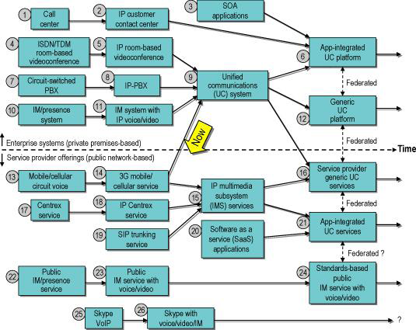
Evolution of Real-Time Communications Systems
Source: Burton Group, December 2006
IU UniCom Project

Slide 10
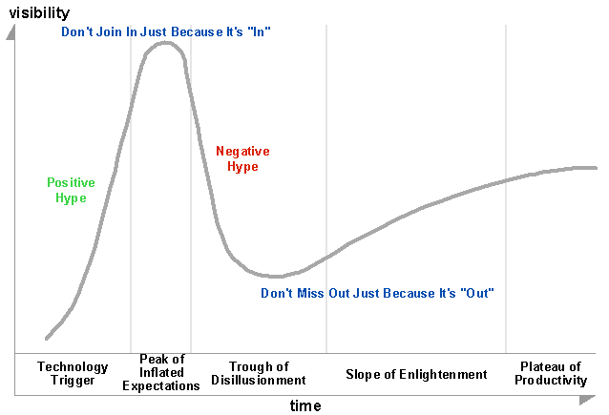
Hype Cycle
Unified Communications
and Collaboration
IP Telephony
Unified Communications
Source: Gartner Group, July 2007
IU UniCom Project

Slide 11
Key Arguments for Unified Communications and Collaboration
Community of users around Active Directory
Enhanced Presence integrated into emails, Office applications, SharePoint documents, etc.
Integrated flow of communication
  Contact information all in one repository
Mobility and portability
Caller ID
IU UniCom Project

Slide 12
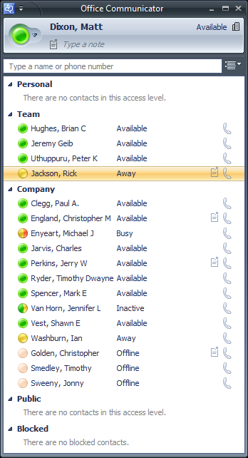
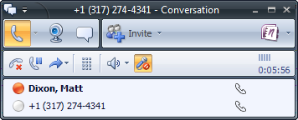
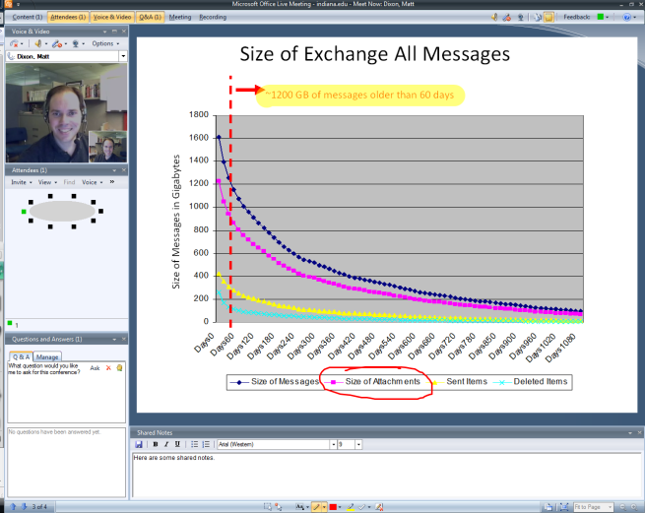
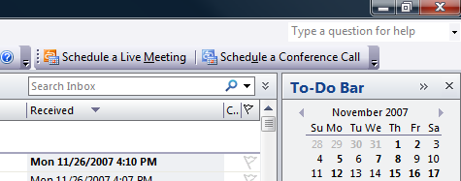

Rich Client
Feature Set
Instant Messaging (including groups)
Enhanced Presence Awareness
Directory (GAL) Integration
File Transfers
Video Calls
Enterprise Voice \ Call Control
  Multiparty Calls
  Call Hold
  Call Transfers
OCS
Office
Communicator
2007
Live
Meeting
2007
Outlook
Conferencing
Add-In
Schedule Conferences
Launch IM within Email
“Call all” Message Recipients
Ad-hoc Web Conferencing
Q&A Panel
Attendee Polling (survey)
Desktop & Application Sharing
Record Meeting Content
IU UniCom Project
Notes:
Group IM
More on presence: Reduces “interrupt driven” communication
Self-assigned contact lists builds natural social-networks, extending beyond departmental or even institutional lines
- Highlight further benefits of Ad-hoc conferencing

Slide 13
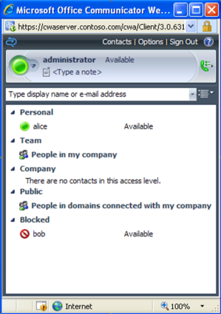
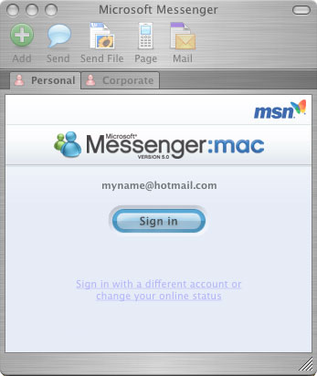
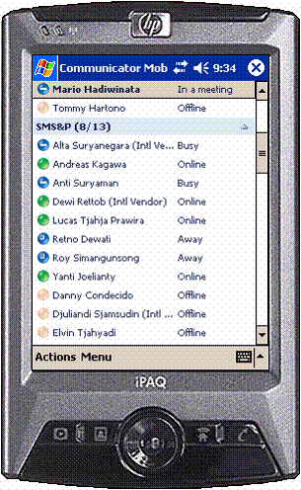
Additional Clients
Instant Messaging
Enhanced Presence
Manage Phone Settings
Option for Forms-based Logon
Supported Browsers:
  IE 6 & 7
  Firefox 2.0 and later
  Safari 2.0.4
Instant Messaging
Manage Contacts
Audio & Video Calls
File Transfers
Uses Global Address List
Bonjour Support
Requires Mac OS X 10.4.10 or above
OCS
Communicator
Web
Access
Communicator
Mobile
Microsoft Messenger for Mac 7.0 (in beta)
Instant Messaging
Enhanced Presence
Manage Contacts
Make Calls
Supported on Windows Mobile 5 & 6
IU UniCom Project
Notes:
Bonjour = Apple’s trade name for a service discovery protocol used in Mac OS X. It uses multicast DNS records to locate devices advertizing themselves on the network. In this context, Bonjour activates the ability to locate and chat with other Messenger for Mac 7.0 users on the local network.

Slide 14
Telephony Lessons Learned
Study your telephony dial plan
  Be prepared to modify the PBX dial plan
  We use 5 digit and 10 digit dialing
No E911 Support from OC Client
  Consider having users sign a “waiver” document
Watch voice mail rollover ring time
  Could affect “Sim Ring” or “Forward to”
IU UniCom Project

Slide 15
Project Lessons Learned
Senior Management support a necessity
Engage deep level PBX vendor support
Target “highly communicative” pilot groups
Use department specific “real world” demos to generate enthusiasm
Develop business case based on new value, not cost savings
IU UniCom Project

Slide 16
Timeline
Install CWA Server
OCS 2007 and CS2100 Integration
Create Support Model
UITS Pilot
Limited Campus Availability
2007 2008
October November December January February March April
Pre-Pilot
Testing
Create IUWare
Client Install
Package
Install External
Access Servers

Slide 17
mlucas@iupui.edu jvh@indiana.edu
Find us in the courtyard
(will answer questions for beer or whisky )
Questions?
IU UniCom Project

Slide 18

Thank You!
IU UniCom Project

Slide 19














Building the OCS Infrastructure
1
Phone Switch Upgrade
(Nortel CS2100 w/SE10 load)
5
Installed Load Balancers
2
Extended Active Directory Schema
6
Configured OCS Pool & Install
Front-end servers
3
Installed SQL 2005 Cluster
7
Installed Web & A/V
Conferencing Servers
4
Installed Archiving Server
(w/File Shares & SQL 2005)
Active
Directory
8
Installed Mediation Server
PBX(s)
Media Gateway
(IW-SPM)
OCS Mediation
Server
PSTN Network
SIP Gateway
(NGSS)
Internal IP Clients
Nortel Equipment
LAN Switch
LB Subnet
IU Private Network
Load Balancers
(Primary & Failover)
OCS Front-end Servers
(with Web Components)
OCS Archiving &
CDR Server
SQL Back-end
Servers
A/V Conferencing
Server
Web Conferencing
Server
OCS Pool
IU UniCom Project
Notes:
Telecom & IP clients - Disparate technologies, isolated silos (Highlight importance of working with Telecom Techs)
IW-SPM = Interworking Spectrum Peripheral Module. The Interworking SPM is required for a hybrid TDM and IP Peripheral Module deployment off a single call server. By creating a new (IW-SPM) resource module that supports an IP packet interface which can be housed in the existing SPM platform, the SPM platform is transformed into an interworking SPM that can interface with elements of a packet network, such as the Passport 7000. The new resource module, called the Gig Ethernet Resource Module (GEM), supports a Gig interface to the network and is used in conjunction with the common equipment resource modules.

Slide 20














Building the OCS Infrastructure (Edge)
Trusted External Communicator & Live Meeting Clients
Internet
Federated
OCS Partner(s)
Public IM Service Providers
IU Public Subnet
LAN Switch
LB Subnet
ISA HTTP
Proxy Server(s)
Load Balancers
(Primary & Failover)
Access
Edge Server(s)
A/V Conferencing
Edge Server(s)
Web Conferencing
Edge Server(s)
Communicator Web
Access Server(s)
Campus
Router
1
Install Load Balancers
5
Install Access Edge Server
2
Build ISA array (HTTP Proxy)
6
Install A/V Conf. Edge Server
3
Install CWA Server
7
Install Web Conf. Edge Server
4
Install OCS Director
8
Configure external access features…
OCS Director(s)

Slide 21
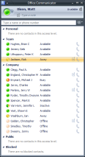
Phone Switch Integration Details
Communicator to Telephone Call
Ring!
Media Gateway
(Nortel IW-SPM)
RTP
OCS
Mediation
Server
RTP
x-msrta
8000Hz
(RTAudio)
G.711 PCMU
8000Hz
SIP Session Progress
SIP Trying
PSTN
Network
SIP INVITE
SIP BYE
SIP OK
SIP Session Progress
SIP INVITE
SIP INVITE
SIP Session Progress
SIP Trying
SIP Trying
SIP BYE
SIP OK
SIP BYE
SIP OK
Phone Switch
(Nortel CS2100)
SIP/CSTA Gateway
(Nortel NGSS)
OCS Front-end Servers
IU UniCom Project

