Slide 1
Copyright Michael White and Sandra Thompson, 2008. This work is the intellectual property of the author. Permission is granted for this material to be shared for non-commercial, educational purposes, provided that this copyright statement appears on the reproduced materials and notice is given that the copying is by permission of the author. To disseminate otherwise or to republish requires written permission from the author.

Slide 2
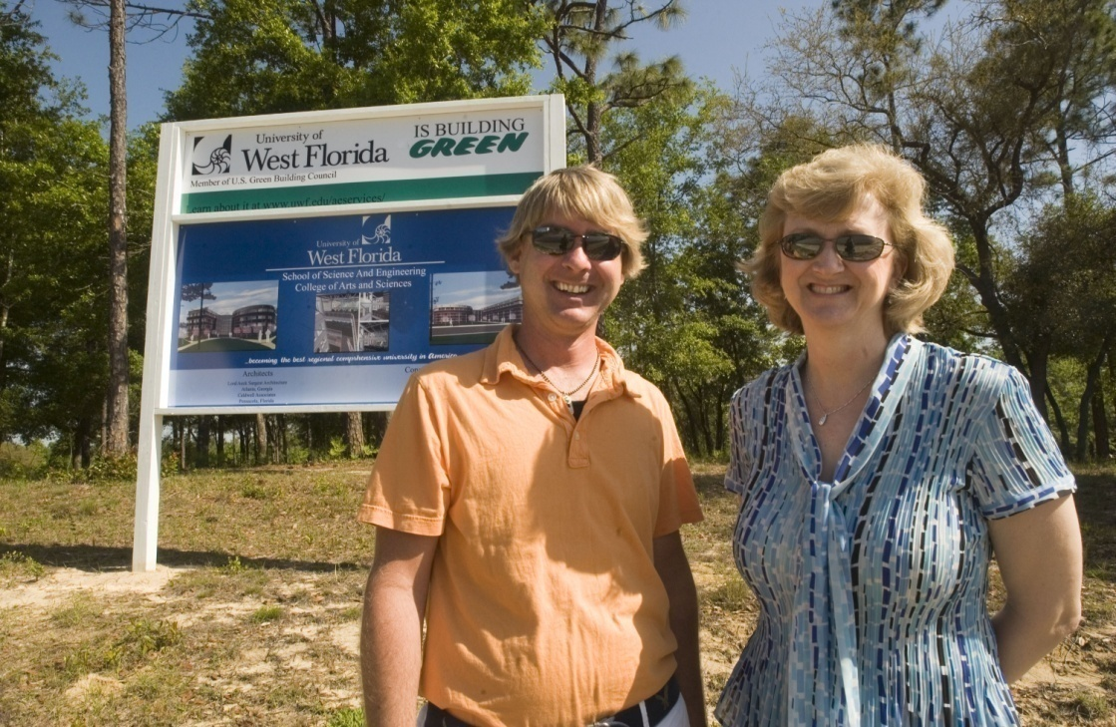
…but I work in IT; why do I need to know about facilities?
Sandra Thompson and Michael White
The University of West Florida
© 2008

Slide 3
Talking Points
The University of West Florida
Classroom Technology Design Considerations
Networking and Telecommunications Design Considerations
Construction and Renovation
Overarching Principles

Slide 4


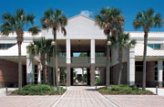

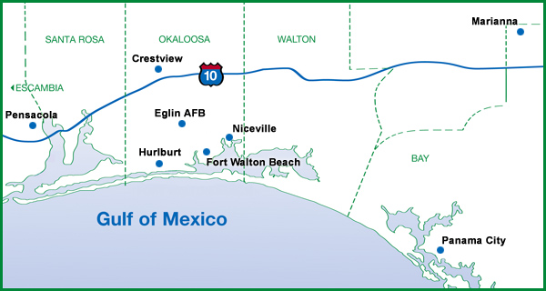
The University of West Florida
Notes:
- State university – 1 of 11
-Main campus in Pensacola (<15 miles from the Florida/Alabama State Line)
-1,600 acre nature preserve (Pensacola Campus) (left)
- Downtown campus (2nd from left)
Seven additional campuses located east of Pensacola(Emerald Coast Campuses) (3rd from left)
Online campus (right) offering full bachelor’s and master’s degrees
~10,000 students
Colleges: Arts & Sciences, Business, and Professional Studies
We are part of the central IT organization, a dept of about 60 staff

Slide 5
Classroom Technology Design Considerations
Ceilings
Lighting
Ventilation ducts
Electrical
Network connectivity
Conduit, floor boxes, and cabling
Notes:
Installing information technology infrastructure in new building construction or existing facilities is a complex undertaking and requires development of specialized skills through long-term experience. The University of West Florida is currently building a $32 million Science and Technology facility, which will be a showcase building for the university highlighting efforts, initiatives, and accomplishments of university computer science, mathematics, physics, and engineering students and faculty. Close working relationships must be developed and fostered between the IT organization and facilities, architects, planners, designers, and academic departments.
Ceilings: minimum 12 feet
Lighting
Placement of light fixtures must be planned so as not to co-exist in the same location as ceiling-mounted projection equipment.
Lighting control is critical. Adequate light is needed for student note-taking. Sufficient light is needed at the podium and on the whiteboards. All light fixtures must be located and controlled to minimize washing out the image on the projection screen.
To eliminate or minimize light spillage on the projection screen;
During projection, switched lighting systems should be designed so that the rear 2/3 of the room has sufficient light for note-taking while the front 1/3 is without light that might spill onto the screen.
To achieve these requirements, switched lighting systems should be zoned in rows positioned parallel to the screen (i.e. side-to-side across the width of the room) rather than perpendicular to the screen (i.e. from the front-to-back of the room).
Light from outside the room needs to be controlled. Vision panels in doors should be narrow to reduce spillage of light from the hallway.
All classrooms must have a minimum of two lighting zones: one zone for the instructor at the podium, and another zone for the student area. Ideally, the student zone should have the capability of multiple light levels. Each zone shall be independently controllable via its own separate switch.
Large classrooms, such as lecture halls, must have a minimum of three zones: the two zones above plus a zone for the presentation/whiteboard area. This zone should be dimmable, with incandescent lighting preferred.
In auditoria, master control units shall be provided. These master control units must include multiple zones and presets plus be provided with an RS-232 AV interface for connection to a control system. The AV Interface must provide appropriate bi-directional RS-232 feedback status back to the control system.
As a safety feature, it is desirable to have a fixture or two at the rear of the room, unswitched, which remains on at all times, so that the room is never totally dark. Such unswitched fixtures must be positioned as required by code, but without spilling light onto the screen or interfering with projected images.
HVAC
Placement of HVAC vents must be planned so as not to co-exist in the same location as ceiling-mounted projection equipment and document cameras. Vents must be located away from projection screens, so as not to create air circulation currents that might move the screen.
HVAC ductwork must be planned so as not to be placed in the same location as ceiling-mounted projection equipment.
Electrical
Audiovisual and multimedia systems require clean, high quality electrical power to operate correctly and reliably. Dedicated electric circuits are required for the ceiling-mounted projector and computer electrical outlets.
A true isolation transformer is recommended, specifically designed for technical system power.
All audio, video and control electrical circuits should be fed from "clean" legs of the transformer free of high inductive loads. There shall be no elevator motors, compressor motors, blower motors, etc. on the side of the power transformer that feeds the media equipment.
Audiovisual and multimedia equipment require standard 110VAC electrical outlets in specific locations:
All eClassrooms must have a floor-mounted duplex outlet in an appropriate location under the instructor podium;
All eClassrooms must have a ceiling-mounted quad outlet near the location of the ceiling-mounted projector;
A duplex electrical outlet should be located on the instructor podium to provide power for the laptop computers.
Network connectivity
All eClassrooms require connectivity to outside resources. Network connections enable accessibility to and real-time interaction with resources such as distant computers, databases, banks of stored information, via local networks and the Internet.
Network connections in all eClassrooms will be run using the current UWF standard for all networking.
Classroom facilities are to be designed with appropriate wired network connections available:
Availability of wireless network connectivity (ArgoAir) provided by the university, is not to be viewed as a substitute for the installation of wired network connections in eClassrooms.
4 data (Ethernet) ports must be provided in the ceiling, near the ceiling-mounted projector, to accommodate network-capable projection devices and the room control system;
1 voice and 3 data ports must be provided for connection to the instructor podium, to accommodate connections for a telephone, resident computer, an instructor laptop, and network access for the ADA-compliant port, located in the podium.
Each eClassroom should have the capability of connecting with the ITS Help Desk, via telephone, voice-over-IP, or other technology, to facilitate providing assistance in a timely manner to those instructors needing it while using the eClassroom.
Conduit, floor boxes, and cabling
All eClassrooms will be designed to accommodate a teaching console (instructor podium) to function as base station for instructors or presenters lecturing and/or using instructional technology. This podium will house equipment and therefore must be provided with connectivity and electrical power. The podium will be located to the side of the screen, without obstructing the view of the screen.
Multi-purpose conduit and connections must be provided under each podium. Each in-floor location must include at minimum:
A duplex 110-VAC electrical outlet;
Communication wiring for network connectivity (4 ports);
Empty continuous conduit running from the podium to the wall, then up inside the wall to an over-the-ceiling stub-out for connections to speakers and the ceiling-mounted projector;
A connection to the campus CATV system.
Such conduit and connections can be provided cost-effectively as stub-ups, or be recessed at the floor level within commercially manufactured floor boxes.
Separate continuous non-metallic conduit must be provided during construction including: one 1.5-inch empty conduit from the podium location to a stub-out above the ceiling. This conduit is to be installed during construction with a pull-tape accessible from both ends. This empty conduit will accommodate various audio, video, signal, and control cables to be installed after construction by the designated audiovisual contractor;
All conduit direction changes must be completed with gradual “sweeps”, not 90-degree bends.
The use of Panduit and wall plate connections can be considered in pre-existing classrooms where it would be impratical or cost-prohibitive to install floorboxes.

Slide 6
Networking and Telecomm Design Considerations
User port counts
Assess needs of each space
Comm. room layout
Special wiring needs
Emergency notification system
Notes:
Assess needs of each space (1 v/d outlet on opposite walls of office spaces; port per seat in computer labs and distance learning classrooms; ceiling ports for projectors, instructional technology, and WAPs; courtesy telephones)
Special wiring needs (Nautilus card system; door swipes; vending; cable TV; POS terminals; copier/printer)
Emergency notification system: loud speakers in classrooms wired via comm. room to central announcement center, e.g., police station

Slide 7
Construction
Construction
Design Documents
Review
Construction Documents
Review
Notes:
Planning for the Science and Technology facility began five years ago with forward-thinking academicians and facilities planners. In Florida‘s State University System,, funding for new facilities construction is a long and arduous process that takes many years. The cycle is typically divided into two components, (1) planning and design, and (2) construction. Beyond securing funding, the planning and design phase lasts for approximately two years, and actual building construction requires approximately 18 months to two years. During the planning and design phase, the lead architect and engineering firm plays the pivotal role in locating the building on campus, integrating the architecture of the new facility into the existing campus architecture, and producing concept drawings, design schematics, and construction documents that will be used by the construction firm in building the facility. The role of IT during this phase is critical, as the requisite information technology infrastructure must be included in the construction documents to ensure that upon building opening the devices used by building occupants and students, computers, instructional technology, telephones, videconferencing systems, etc., are able to be connected to the campus network.
During this phase, many time-consuming but absolutely necessary meetings and reviews of design drawings and construction documents must occur. A critical success factor involves starting with a specific vision, getting the future building occupants to imagine themselves in the spaces with the types of technology they will need, and blending the ideas with available budget reality. Experience has shown that this single event is one of the most difficult to achieve but without it, placing the infrastructure in the correct places in the building would not be achieved, and upon building opening, the technology would not be adequately placed to support the functions and uses originally intended for the facility.

Slide 8
Renovation
Renovation
Project documents
Review
Notes:
Renovations are more difficult to keep track of because drawings frequently do not accurately reflect existing infrastructure. Also, items marked for demo sometimes aren’t clear.

Slide 9
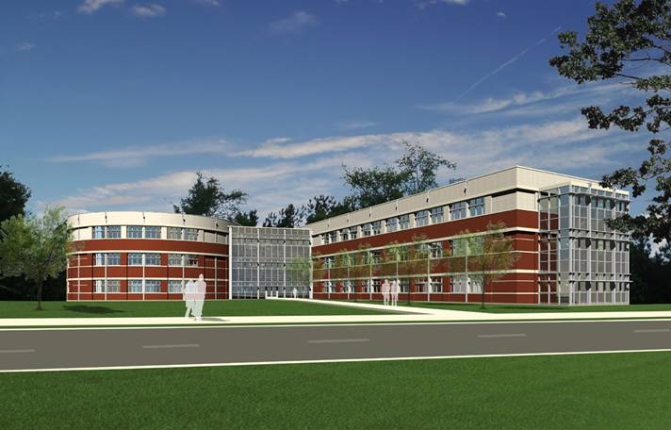
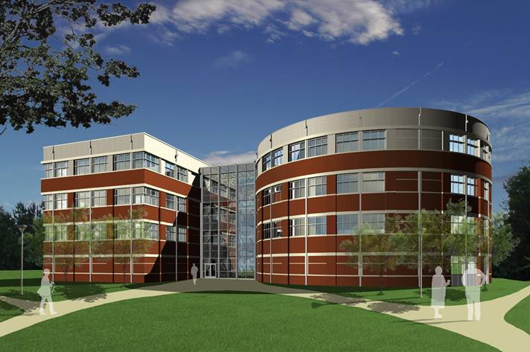
School of Science and Engineering Facility

Slide 10
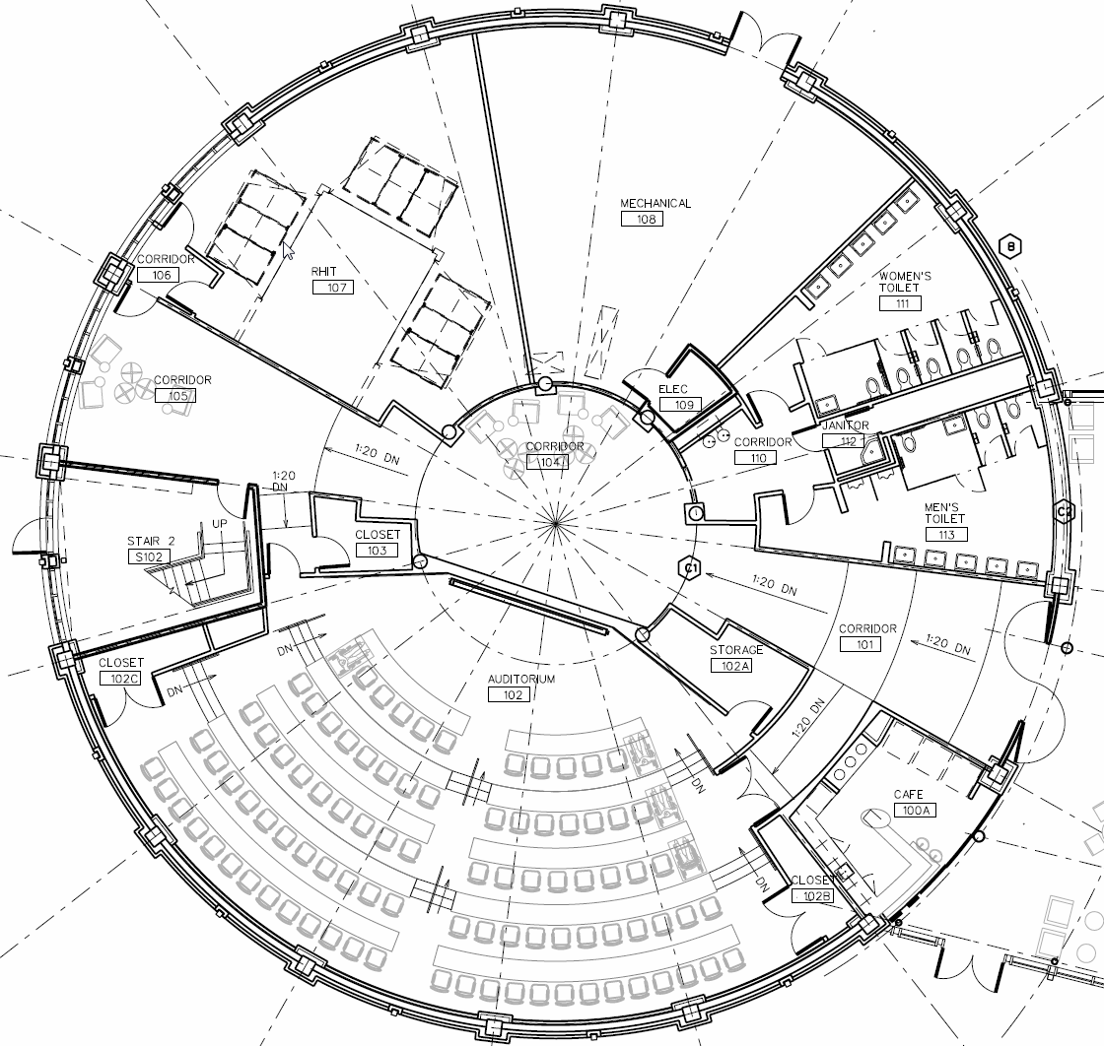
Notes:
Discuss features: location of projector, screen, electrical, data drops, etc.

Slide 11
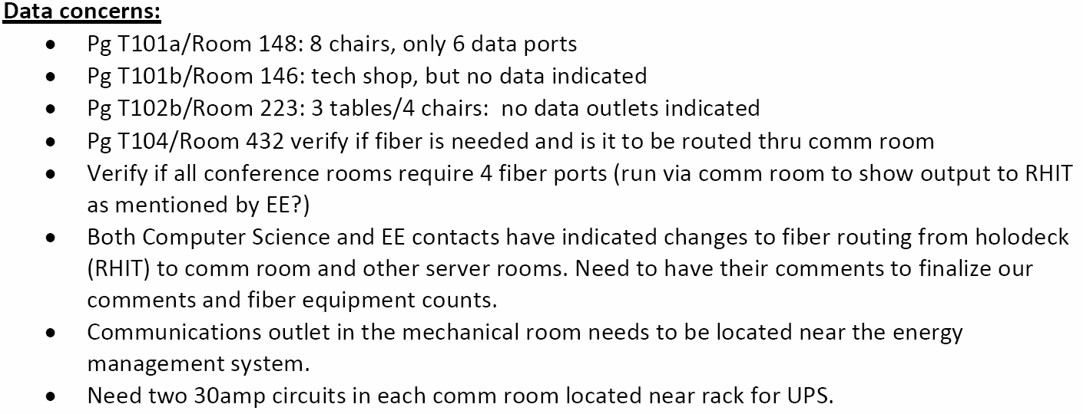
Example of Thorough Review with Comments
Notes:
Note: level of detail required X # of spaces = total chaos
At present, 100% construction documents are expected by 3/31/2007. At presentation time in June 2008, it is expected that ground will have been broken and construction might have started. To get to this point, the Director of Networks and Telecommunications, Director of Academic and Instructional Technology Services, several network engineers, and two instructional technology engineers, all within Information Technology Services, have devoted in excess of 500 hours during the 2007 calendar year reviewing schematics, commenting on design issues, meeting with contractors, and advocating on behalf of building occupants who are not as experienced in working with the facilities organization to construct a new building.
spaces in facility = total chaos

Slide 12
Who else needs to be involved?
Faculty
Registrar
Purchasing/Procurement
Notes:
Depending on the project, cycle of semester, it may be easy or a challenge to work with these groups of people.

Slide 13
Principles
Review plans and document issues
Communication
Correct problems
Standards
Landscape
Contingencies
Project manager
Notes:
Thoroughly reviewing building design drawings and construction documents must become part of the daily work load. Documentation of issues which need to be addressed is absolutely critical.
Frequent communication must occur with the project manager, architectural firm, and technology designers to articulate and address issues related to building design.
Correcting problems in design drawings and construction documents is easier, less expensive, and much-preferred to correcting problems during building construction.
Adhere to standards established by the institution and hold to them when addressing issues. Faculty are accustomed to certain standards in classrooms (touch panels, remote controls, projection systems, audio systems, etc.); while it is permissible to experiment with new ways of doing things, keep in mind the context in which the building is being constructed.
Frequently remind the architect and technology designers that the building must fit into the institution’s technology and network landscape just like it must fit into the university’s physical landscape.
Provide sufficient contingency/change order opportunity to adjust for equipment purchases that may occur during construction.
Ensure that a strong project manager is assigned to oversee details, communicate project status and have the skills to identify and deal with issues.

