Slide 1
Dashboards – Where We’ve Been and Where We’re Going
Janell Bohlmann, Clemson University
Jamie Brown, Clemson University

Slide 2
Copyright Janell Bohlmann and Jamie Brown, 2008.
This work is the intellectual property of the authors. Permission is granted for this material to be shared for non-commercial, educational purposes, provided that this copyright statement appears on the reproduced materials and notice is given that the copying is by permission of the authors. To disseminate otherwise or to republish requires written permission from the authors.

Slide 3
Overview
About Clemson University
What is a dashboard?
Where We’ve Been
  Project Dashboard
  Exchange Implementation Dashboard
Lessons Learned
Where We’re Going
Questions

Slide 4

About Clemson
Clemson University is a science and technology oriented research university ranked among the nation's top 30 public institutions.
Since 2001, Clemson has doubled external research funding, raised the academic profile of the student body, increased retention and graduation rates
Launched high-profile economic development initiatives -- including the Clemson University International Center for Automotive Research in Greenville
Earned national accolades, including being named TIME Magazine's Public College of the Year
www.clemson.edu

Slide 5
Dashboard Benefits
According to Wikipedia… A dashboard is a control panel located under the windshield of an automobile. It contains instrumentation and controls pertaining to operation of the vehicle.
Our Definition:
Easy to read - visual presentation of performance measures
Provides the ability to view less/more detail, through drill down functionality
Communication tool - provides benefit for IT as well as our customers
Measures efficiencies/inefficiencies.
Provides the ability to identify and correct negative trends
Web based - saves time over running multiple reports

Slide 6
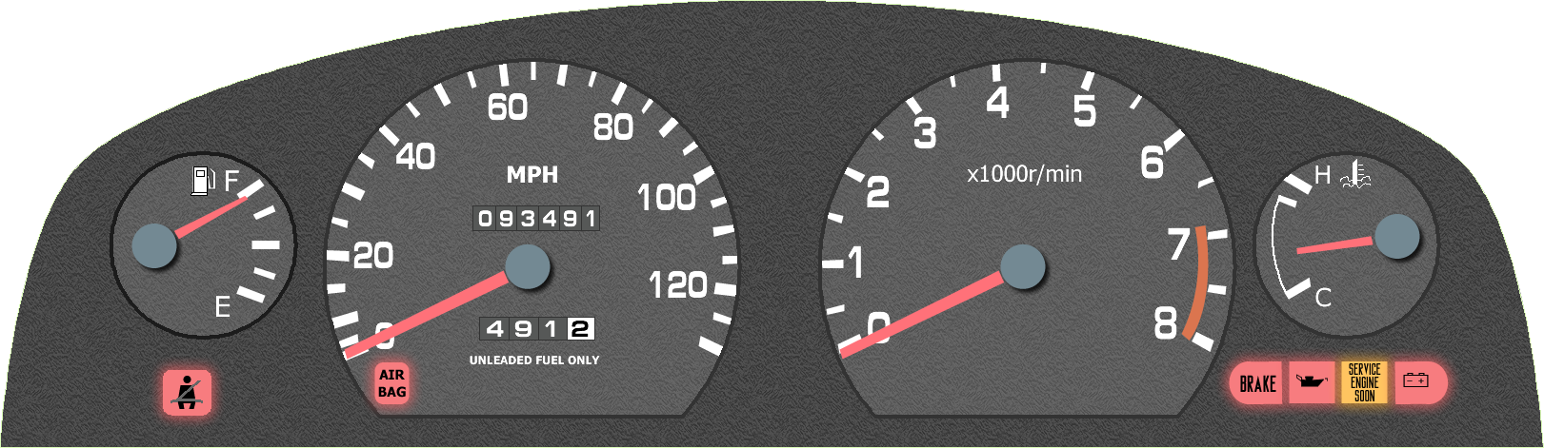
What’s on a Dashboard
Fuel Gauge
- How much gas is left
Speedometer
- How fast you’re going
Odometer
- How far you’ve gone
Trip Odometer
- How far you’ve gone on this trip

Slide 7
What’s on a Dashboard
Tachometer
- RPMs – need a different gear?
Temperature Gauge
- Warm up or cool down?
Alert Lights
Oil problem?
Check engine light
Battery problem?

Slide 8
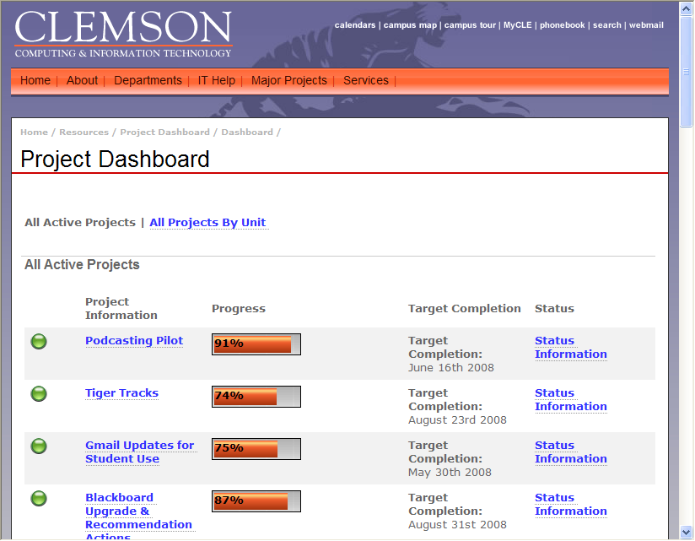
Project Dashboard

Slide 9
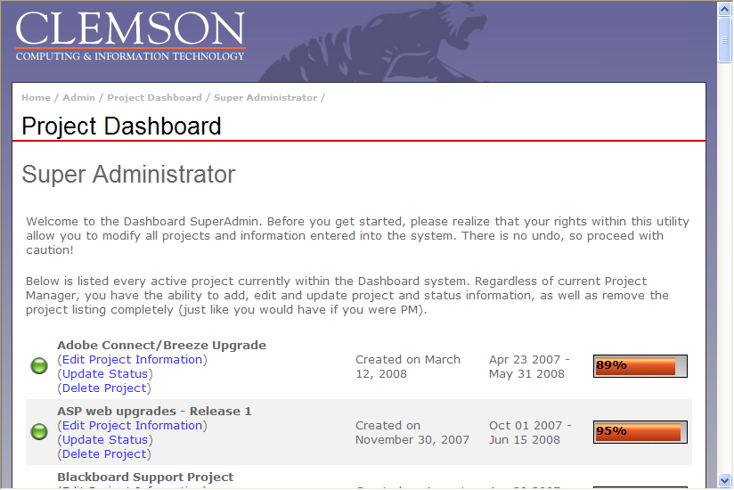
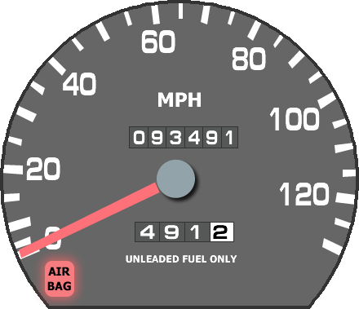
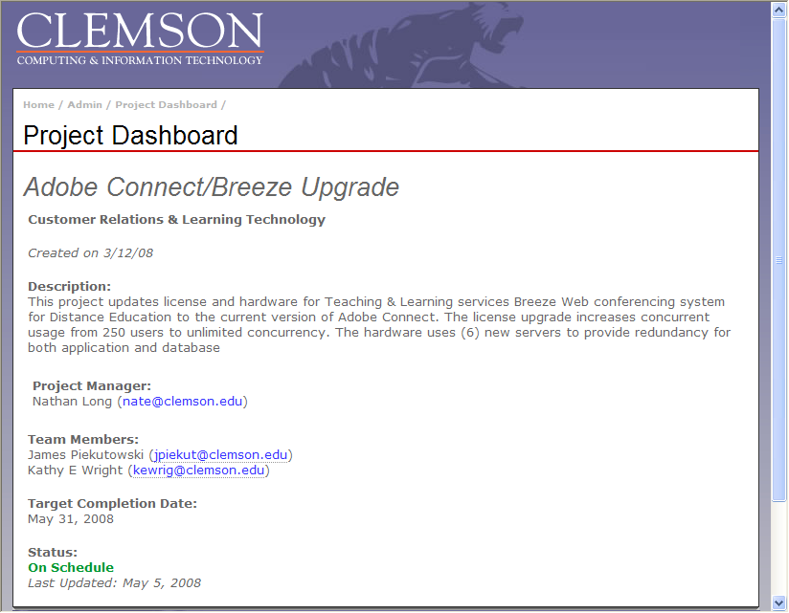

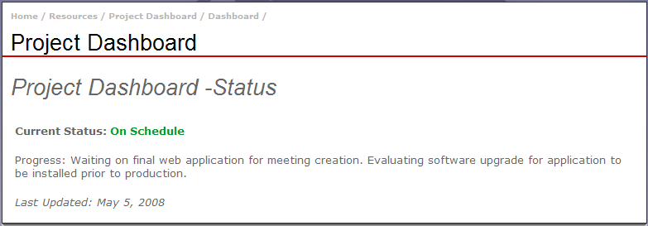
Where We’ve Been
Speedometer – Overview of All Projects
Odometer – Historical Project Info
  Progress over time
  Periodic updates
Trip Odometer – Specific Project’s Info
  Target completion date
  % completion
  Current status
  Staff involved
  Any issues

Slide 10
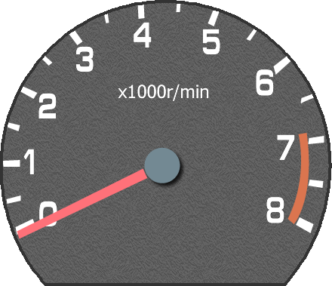
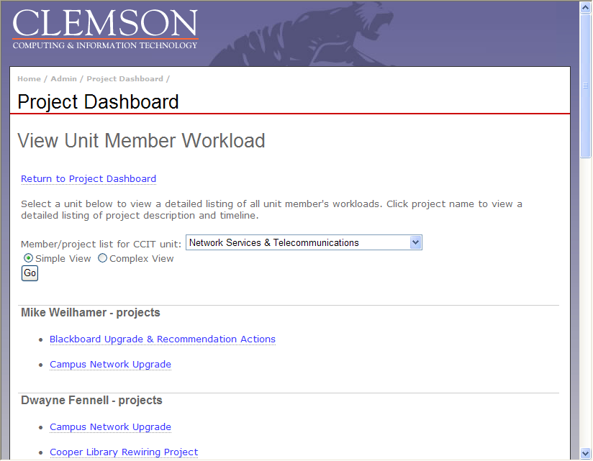
Where We’ve Been
Tachometer – Staff Utilization
  Number of projects per staff
  Make sure you don’t “redline” the staff – running at dangerously high speed

Slide 11
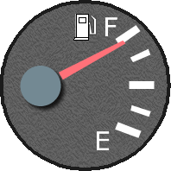
Where We’ve Been
Fuel Gauge – Overall Staff Utilization
  Running at higher RPMs can run your fuel down faster
  Can help identify need for more resources – or less RPMs
    Spare gas can = temps

Slide 12
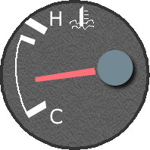
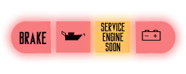
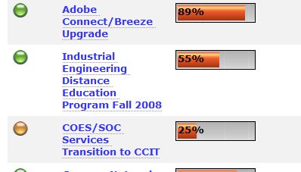
Where We’ve Been
Temperature Gauge – Project Statuses
  Make sure things aren’t overheating
  Make sure things aren’t staying cold
Alert Lights
  Oil Light: Reminders to update project statuses
  Service Engine Soon: Projects behind or on hold may need more inspection

Slide 13
A Slightly Different Dashboard
In early 2007, Microsoft Exchange was selected as replacement for standard messaging and calendaring options
Implementation required extensive coordination among all IT units to ensure smooth transition
Limited time available to transition users

Slide 14
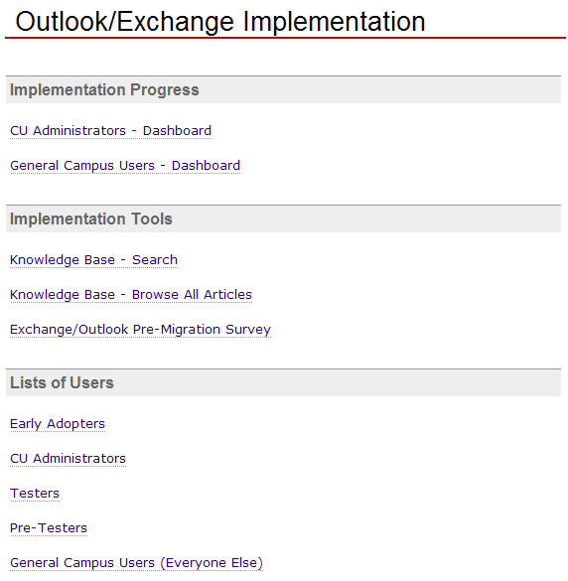
Exchange Dashboard
1,750+ users requiring attention (either a conversion or confirmation of opt-out)
Largest groups for conversion were administrators and general campus users
19 installation teams broken down by college/unit

Slide 15
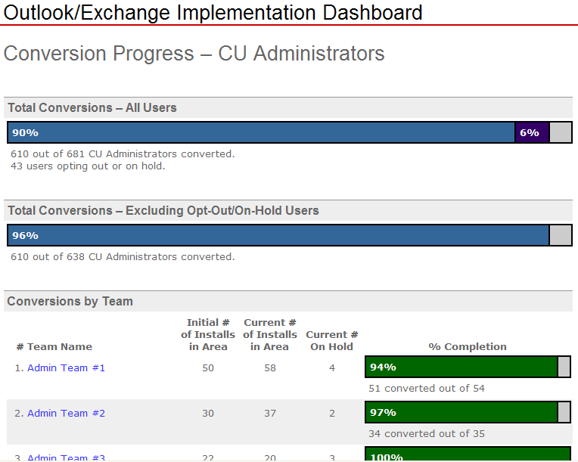
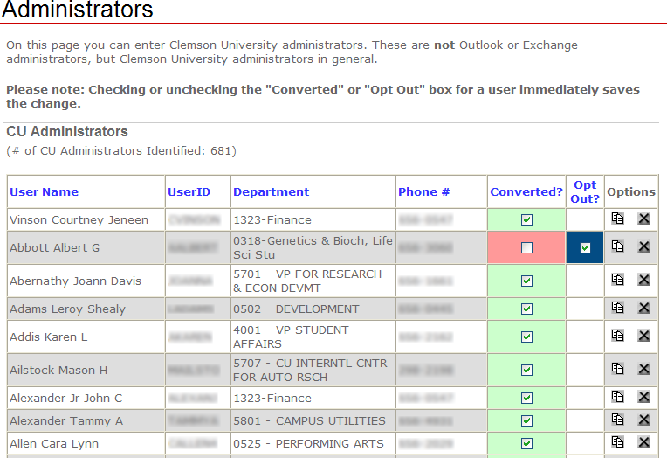
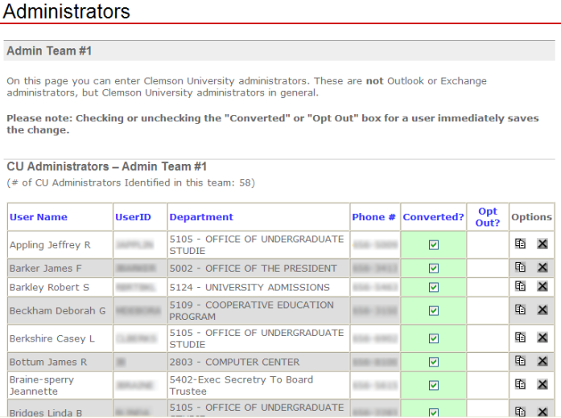
Where We’ve Been
Speedometer – Overview of All Conversions
Odometer – Historical Conversion Info
  Progress over time
  Minute-by-minute updates
Trip Odometer – Specific Team’s Info
  # of users per team
  % conversion
  Any conversion notes (on vacation, etc.)

Slide 16
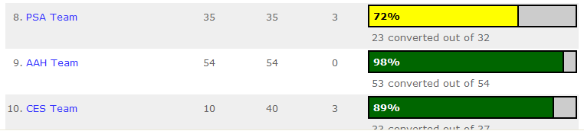
Where We’ve Been
Tachometer – Staff Utilization
  Number of staff per team
  Number of conversions per area
  “Redlining” the staff – if running behind on conversions, could pull from other teams

Slide 17
Where We’ve Been
Fuel Gauge – Overall Staff Utilization
  For Exchange, because of the nature of the project, staff were made available from central and all distributed IT areas
  Training came from temp staff

Slide 18
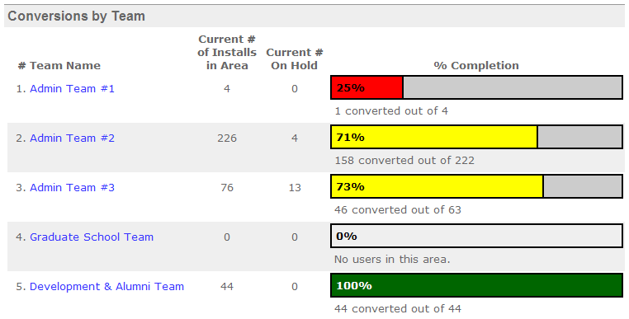
Where We’ve Been
Temperature Gauge – Project Statuses
  Make sure things aren’t overheating
  Make sure things aren’t staying cold
Alert Lights
  Oil Light: Each conversion team member could “add oil” by updating lists
  Service Engine Soon: Areas behind may need more conversion staff

Slide 19
Where We’ve Been
Complete history of projects
Periodic reminders to update project status
Changing colors to represent progress
Layered level of access

Slide 20
Lessons Learned
Dashboards can enhance reporting on the health of your portfolio or specific projects
  Helps keep administration updated with real-time progress status
  Allows functional managers to monitor their staff’s project workload
  Helps keep campus informed about IT initiatives and their progress
  Not just a communication tool – transforming to a portfolio management tool
  Starting small and simple worked well

Slide 21
Lessons Learned
Dashboards can provide greater visual appeal than simple data tables
  Calculations don’t have to be complex – can be simple additions or percentages
  Three- or four-color charts can be a good starting point (red, yellow, green)
Different levels of access can provide different abilities
  View-only
  Update details/status

Slide 22
Lessons Learned
Utilizing modular, re-usable, and abstract programming can help extend dashboard functionality quickly
  “Super administrator” capability added to Project Dashboard
  Additional types of users for Exchange implementation

Slide 23
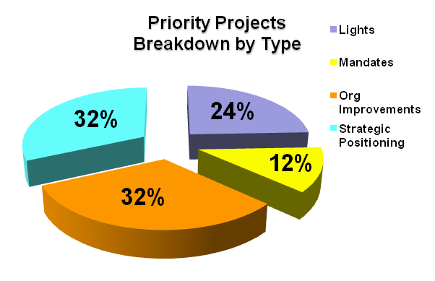
Where We’re Going
Graphs & Charts
Layered viewing & access
Allow for project pipeline capability (in the queue as well as active)
Service-side metrics (usage, costs, # of SLA’s in place, satisfication rating, etc…)

Slide 24
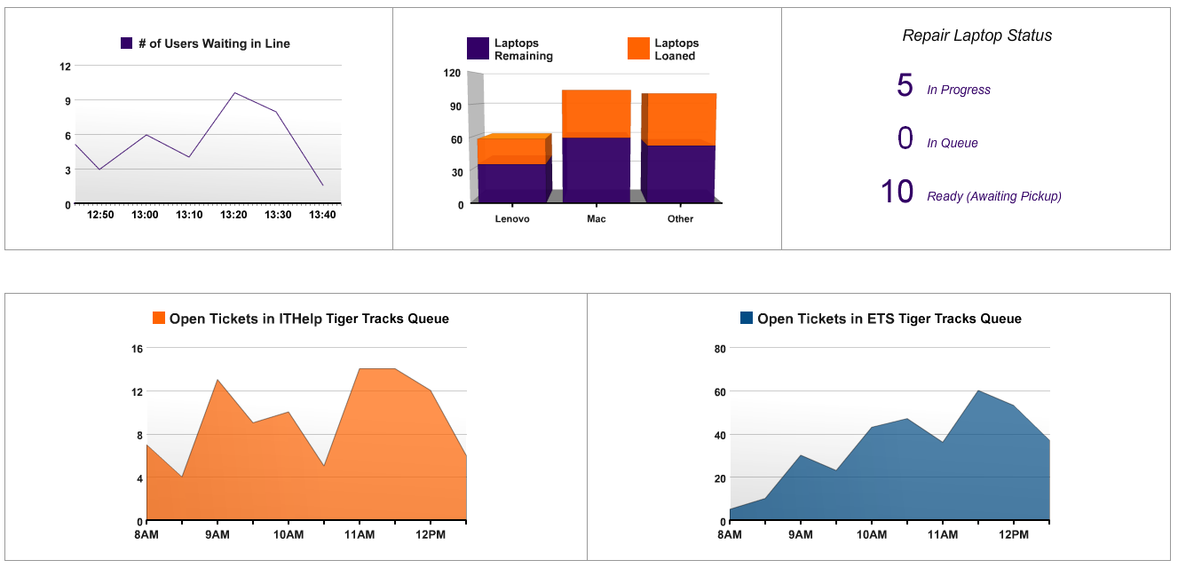
Where We’re Going
Centralize dashboard views – Support Center

Slide 25
Questions ?
valiant@clemson.edu
janell@clemson.edu
Notes:
Questions?
The End

