Slide 1
Copyright Michael White and Sylvia Maxwell, 2008. This work is the intellectual property of the author. Permission is granted for this material to be shared for non-commercial, educational purposes, provided that this copyright statement appears on the reproduced materials and notice is given that the copying is by permission of the author. To disseminate otherwise or to republish requires written permission from the author.

Slide 2
eDesktop Year 2: Getting it Right
Sylvia Maxwell and Michael White
The University of West Florida
© 2008

Slide 3
Talking Points
The University of West Florida
What is eDesktop?
Getting people to use your innovative technologies
eDesktop Year 2

Slide 4

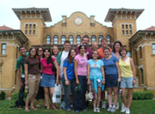


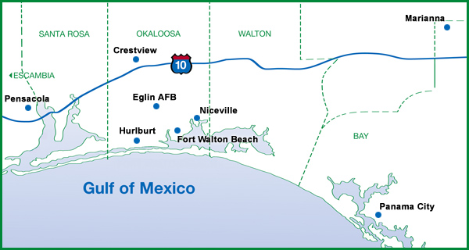
The University of West Florida
Notes:
- State university – 1 of 11
-Main campus in Pensacola (<15 miles from the Florida/Alabama State Line)
-1,600 acre nature preserve (Pensacola Campus) (left)
- Downtown campus (2nd from left)
Seven additional campuses located east of Pensacola(Emerald Coast Campuses) (3rd from left)
Online campus (right) offering full bachelor’s and master’s degrees
10,000 students
Colleges: Arts & Sciences, Business, and Professional Studies
We are part of the central IT organization, a dept of about 60 staff

Slide 5
What is eDesktop?
Virtual Computer Lab
Softricity
Terminal services
Software license servers
Notes:
Sylvia
- Using Windows Remote Connection students log into eDesktop
- What they see is almost exactly what they see if they were to log into a computer in a physical lab on campus
-The student has access to all major software applications that are university licensed such as MS Office, SAS, and SPSS.
-Save work to central storage or your local hard drive
-Ability to print
The back end of eDesktop consists of
If asked: the Reasons we went to eDesktop
-Increased emphasis on online courses for recruitment of new students/ “make summer count”
-Online courses needed to be as robust as on campus courses/online students needed access to the same resources
-Deliver up-to-date software directly to the students that needed it
-Make available a virtual lab environment for students
-Reduce or constrain software costs
-Reduce or constrain the proliferation of computer labs
-Take full advantage of university licensed software

Slide 6
Getting People to Use Your Innovative Technologies
Four elements of diffusion
  Innovation
  Communication Channels
  Time
  Social System
Notes:
Michael
Diffusion is the process by which an innovation is communicated through certain channels over time among the members of a social system. It is a special type of communication, in that the messages are concerned with new ideas.
Communication is a process in which participants create and share information with one another in order to reach a mutual understanding
Social change is the defined process by which alteration occurs in the structure and function of a social system.
Controlling Scurvy in the British Navy: Innovations do not sell themselves
Nondiffusion of the Dvorak Keyboard

Slide 7
Adopter Categories

Slide 8
eDesktop Year 2

Slide 9
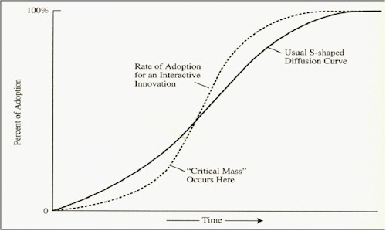

Slide 10
Communication
( pushing the adoption curve)
“Top 10” campaign
Notes:
Remember that Michael listed communication as one of the four elements in the diffusion model. The diffusion model recognizes that communication between similar groups speeds the accept rate so we designed our eDesktop communication around the groups of faculty and students.

Slide 11
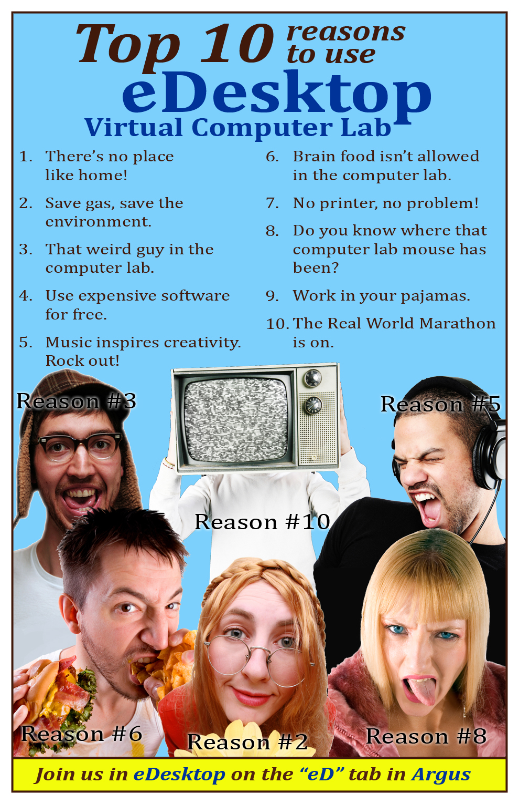
Notes:
Top 10 campaign – posters, flyers (in welcome back bags), table tents in the Student Commons, faculty postcards
Note how we attempted to appeal to the traditional student population. We also hoped this would be catchy enough for our adult working students to notice.

Slide 12
Communication
(pushing the adoption curve)
“Top 10” campaign
Conversations and communication with academic department chairs
“Learn 8 in ’08”
Notes:
Michael

Slide 13

Notes:
When you get to the late early majority (adopting technology), they will adopt new technology when they hear about the experiences of the other.
Held a session about eDesktop.
TA – eDesktop a requirement to use in Mircocomputer Packages class. Share his perspectives: printing, saving files, PDF’s, cheating, using eLearning via eDesktop.
Dr. Platt
No pain of S/W installation – sdnt
No pain of project submission – sdnt & fac
Fast loading of project for grading – fac
Easy to access student project for assistance – sdnt & fac
Work on projects from anywhere – sdnt

Slide 14
Overarching Principles
Communication with faculty and students
Availability of support staff
Awareness of how innovations diffuse

