Slide 1
The Situation Room: A Case Study
Bobby Clark, Manager
Customer Support Services
Kathy Hoellen, Director
Teaching & Learning Services
Notes:
Ask what kind of audience? Teaching / Learning ? Support Personnel?
TL Services: Bb operations and support; faculty, staff, student training; instructional design; technology enhanced classrooms; web and video conferencing

Slide 2
Agenda
Clemson University
Support Structure
Adobe Connect in Teaching & Learning
What is a Situation Room?
Three Case Studies
Path Ahead
Lessons Learned
Alternative Collaboration Tools
Current CallCenter Situation Room
Questions

Slide 3
Clemson University
Students – 17,585
Employees – FT/PT - 5000
Approximately 55-60 sites
Land Grant University

Slide 4
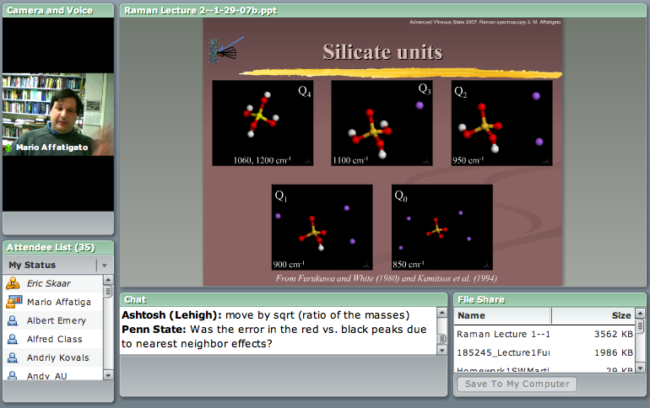
Adobe Connect in
Teaching & Learning
Collaboration tool for Distance Education
Collaboration for Face-to-Face courses
Meeting Environment for Support Personnel and other university personnel

Slide 5
IT Personnel
Data as of Friday, April 11, 2008
145 Technical Support Providers (Part-time)
94 Technical Support Contacts (“go to” college personnel – admin assts.)
59 College Consultants (Full-time)
~298 Total Members
Ratio support personnel
to employees – ~1 to 85
Notes:
TSPs - Departmental support (% of their job) work with Consultants
We provide training; access to higher level support personnel; access to perform IT administrative tasks; tools ; Community
Tech support contact – job has nothing to do with IT – they ID problems AND make connections with the right support staff

Slide 6
The Problem
Large-scale implementation
Previous models didn’t fit
Not enough support personnel
Limited access to experts/top tier support
Notes:
New Course Development
New Course – 1st offering
Course Maintenance

Slide 7
Situation Room
“where latest information on a situation is channeled”
From Physical to Virtual
From War Room to Situation Room
Notes:
First thought was a physical room with several staff and tools assigned to it. Several “men” named it a War room but “Situation Room” was suggested by Katherine Doberenen.

Slide 8
Exchange Implementation –
Case Study #1
Migrate from Legacy Systems to
an institution-wide Exchange Server
  Email systems in place: Eudora, Pegasus Mail, Thunderbird, older versions of outlook, Meeting Maker
Total ~5000 users to convert
  ~1700 critical users
Situation Room idea – physical to virtual
Notes:
Creating a process to support the design and delivery of a new course
AND updates to existing courses
Clarifying that we’re talking about development process/ NOT the instructional process
To ensure consistency of the development process
Melissa is going to take you through an exercise to help you begin to define that process

Slide 9
Our Preparation for Implementation
Started in October 2006
Two Committees: Select Committee (Oct. 2006) and Implementation Committee (Dec 2006)
Phased in implementation – Started with Testers (~50), Early Adopters (~100), Admin Users (~511), finally public adoption
Hire a Trainer for Outlook/Entourage (Support and User)
Evaluated and implement PDA Support (BES/ActiveSync)
Spent a long time Identifying Critical Users
  Formed 18 install Support Teams
Extensive training for Support Staff
  We purchased Conversion tools for Calendar and Email.
    TranSend & Sumatra Development LLC
  Create Install Manuals & Procedures
  Had several Support Briefings (January to June 07)

Slide 10
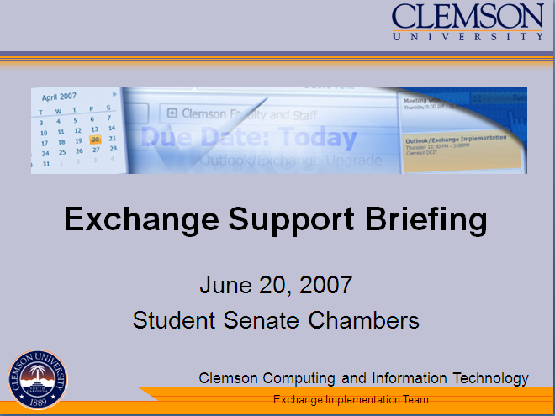
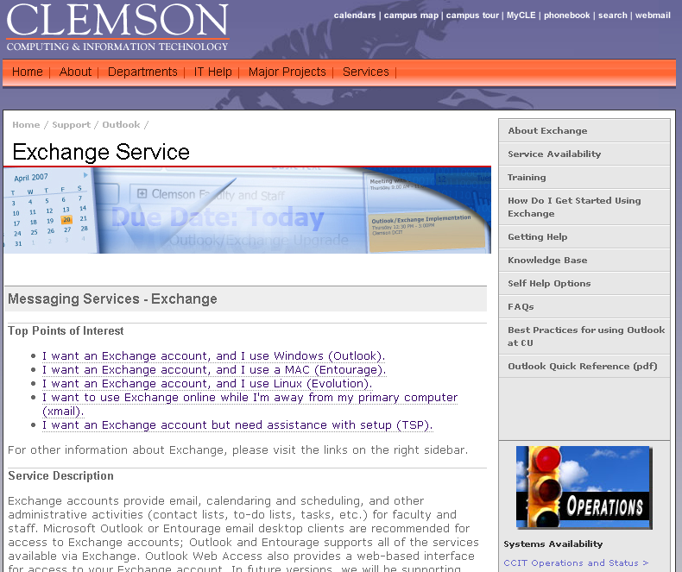
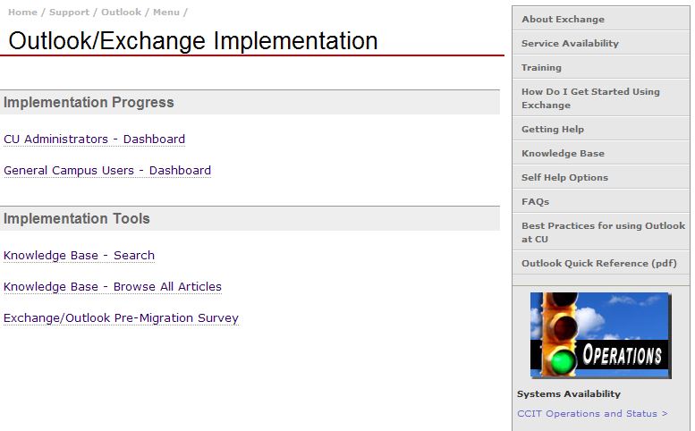
We created several resources for implementation:
  Conducted several Support Briefings for Support Staff
  Created User Resources Page for campus
  Index for Support Resources w/ Dashboards, Exchange KB, Best Practices, & User Survey
Notes:
Dashboard: Carla & Brandon login for status/ track individual progress
New Course – 1st offering
Course Maintenance

Slide 11
The Results
511 administrative users converted in a 4 day blitz (June 25-29, 2007)
Short turnaround to get personnel up to speed
Reporting to management via website
Positive feedback: personnel & users
Notes:
New Course Development
1255 migrations to date (in 11 months, May 30th)
New Course – 1st offering
Course Maintenance

Slide 12
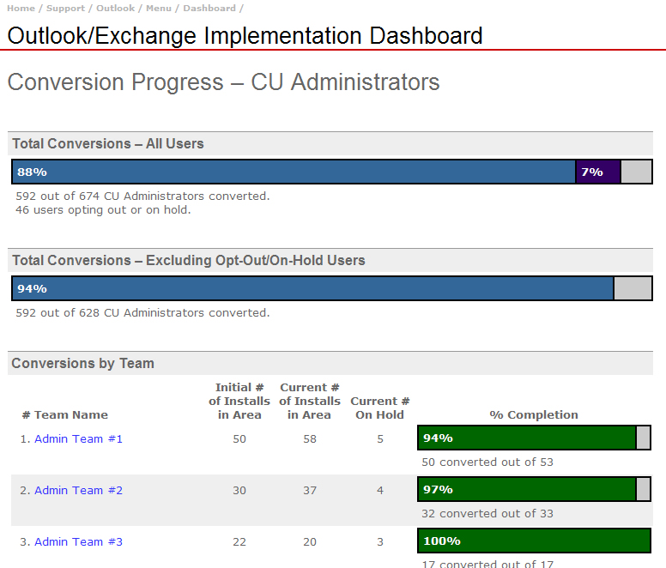
The Results - continued
Dashboard: http://ccit.clemson.edu/support/outlook/menu/
Support personnel experiences/comments
Keep Mgt Updated
Lessons Learned/importance of after action documentation
As of 6/2 we have migrated ~1255 users. We have 4057 users on Exchange Server.
Notes:
Dashboard: Carla & Brandon login for status/ track individual progress
New Course – 1st offering
Course Maintenance

Slide 13
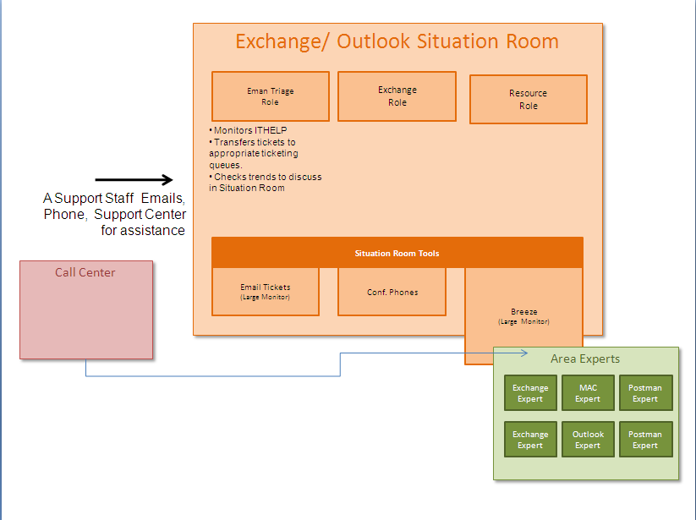
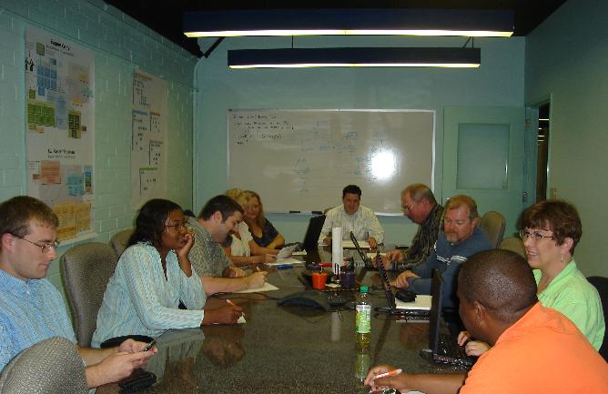
Outlook Implementation
Situation Room
Staffed a Physical Situation Room (6-7 people) for 4 day blitz.
Monitored Breeze, ticketing Systems, dashboards in the room
We used a Breeze session (chat room, attending pods) just one part of the room.
Required an intense effort for Situation Room
Notes:
Fill with food and snacks. Staff really bonded in the process.

Slide 14
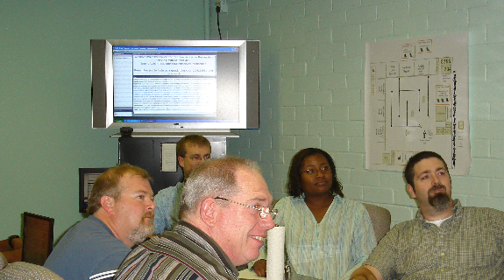
Exchange Implementation’s
Adobe Breeze Session

Slide 15
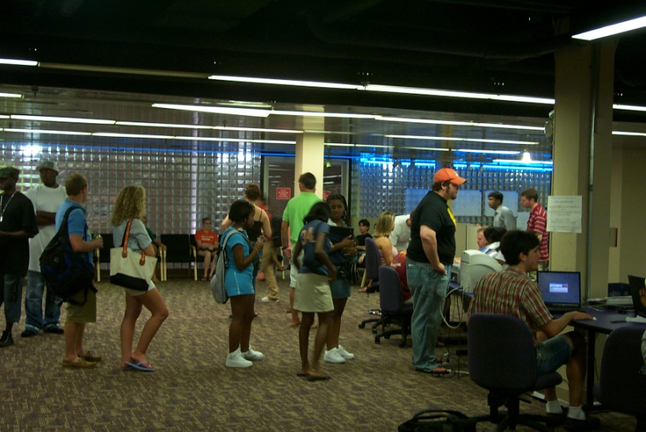
Fall Semester Startup–
Case Study #2
Track # student supported
Track time to resolve issues
Other support areas get involved
  PC Repair
  Blackboard Support
  Consultants and TSPs
  for distance support
Notes:
New Course Development
New Course – 1st offering
Course Maintenance

Slide 16
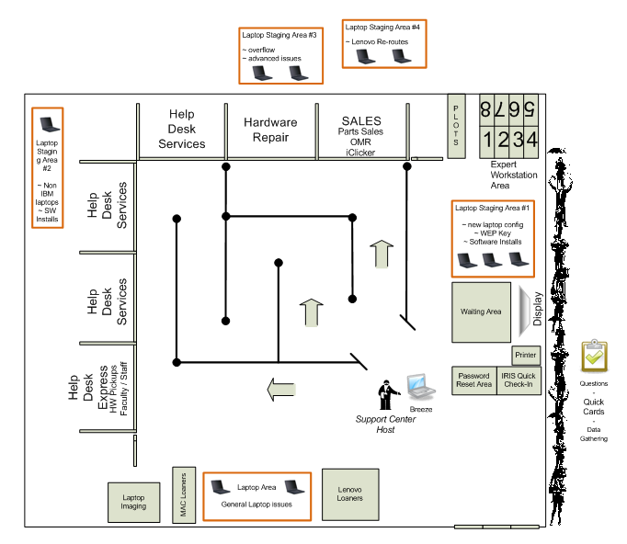
Fall Semester 2007 Startup
Just consolidated several areas in a single Support Center
We have a laptop mandate at Clemson with more than 2500 laptops from new Freshmen.
We didn’t any detailed information about the previous startup numbers
We target the first two week of the fall Semester
Notes:
Also had our previous user base of 8500-10000 students who could need help. We have 1700 Tickets went through our support center.

Slide 20
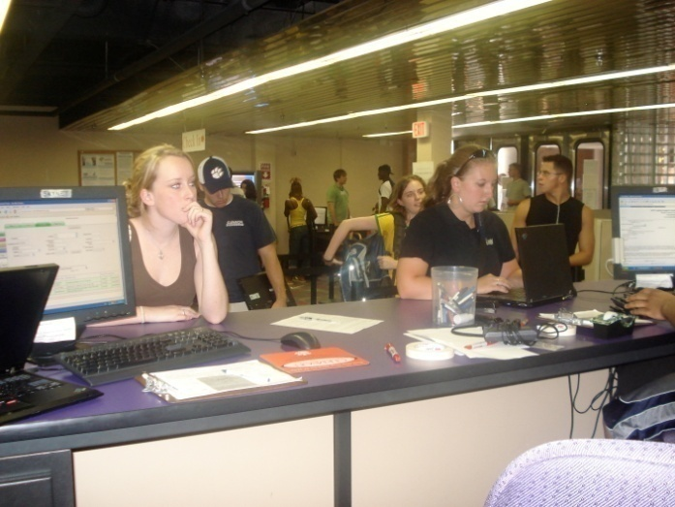
Fall 2007
Support Center snapshots (August 18 - 30, 2007)
Walk-in / Calls Averages
10.081 users in line
(Max 30 – more would overflow outside)
.089 calls average on phone (Max 5)
35.674 laptops being supported (40 Max)
Email inquiry/incidents
1369 opened tickets (~105 per day)
1194 tickets closed ( ~92 per day)
132 dead messages
97% closed during that period

Slide 21
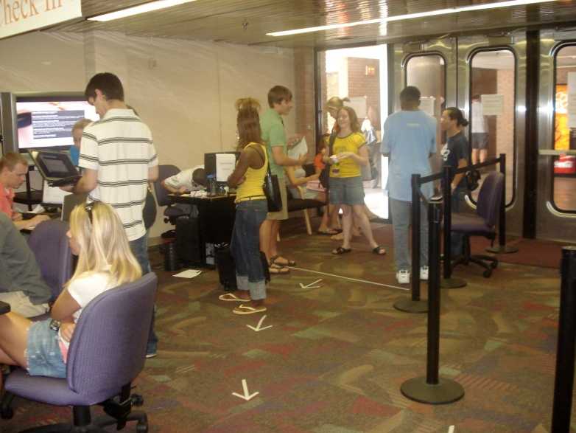
Hardware & Walk-in Tickets
2234 opened in period ( ~171 tickets per day)
1671 tickets closed (~ 128 tickets per day)
0 dead messages
(Maintain 2-3 day backlog)
75% closed during that period
iClicker sales – 1,993 (~153 sold per day)
CD Sales - 263 (~20 per day)
8 Office 2003
115 Office 2007
26 Office 2004 (Mac)
55 Windows XP
59 Windows Vista

Slide 22
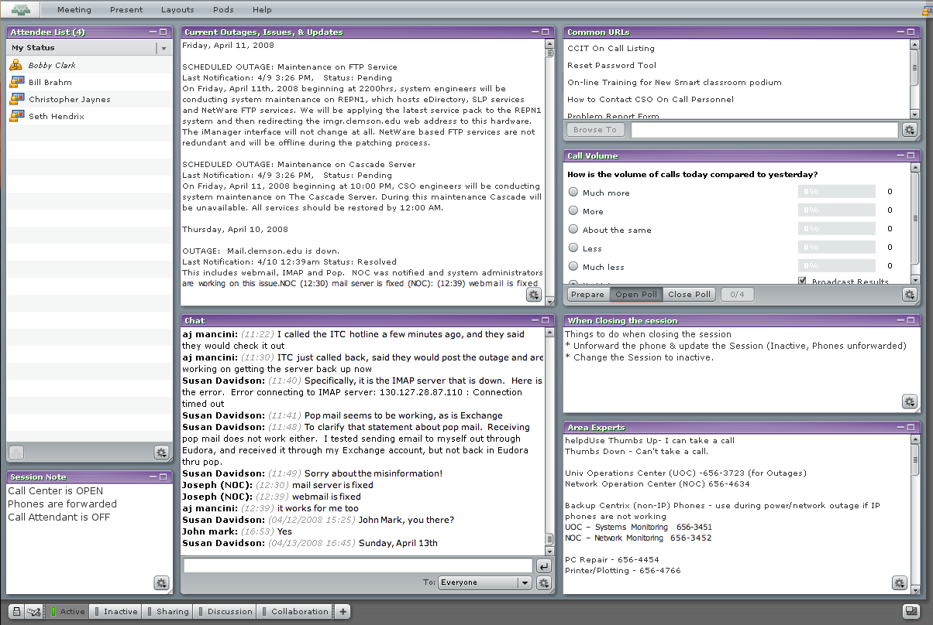
Integration in Daily Service Desk Procedure - Case Study #3
Log conversions, questions, discussion about support incidents
Allow Callcenter to route calls to Area Experts
Store information about changes, updates, issues for the campus IT structure.
Other support areas get involved
  Blackboard Support
  NOC, Systems, Support management
  TSP, Consultants from other support areas
Notes:
New Course Development
New Course – 1st offering
Course Maintenance

Slide 23
Moving the Physical to the Virtual
We handle crisis more efficiently
We communicated more effectively
We seem to create a sense of community to resolve issues.
We continued the Situation Room beyond the initial two week period until present day.

Slide 24
Callcenter Situation Room as of May 20, 2008
Notes:
New Course Development
New Course – 1st offering
Course Maintenance

Slide 25
Minimum Use guidelines
Adobe Connect
Discuss Login Roles
  As a guest
  As a host
How to post an incident
  Use “ISSUE:”, “OUTAGE:”, “UPDATE:”
  Put the Last Notification and Status, before the Description.
Use features for other purposes
  USE Status indicators (Agree and Disagree)
    Make sure to using the Status markers when you cannot / can received a call.

Slide 26
Remote (TSP) Support Rooms
Notes:
What is a TSP?
We used them in the Semester Startup and continued them as part of the Call Center Daily Sessions

Slide 27
Comments
Using Adobe Connect for logging outages and issues has increased the continuity and quality of support at our call center. Our call center is primarily staffed by student employees who sometimes work short shifts between classes.
As we have developed the habit of posting outages and issues into our session, it has become easier for part-time staff to quickly “get up to speed” on the current issue and possible resolutions. The staff log into our session, read the current postings, and are able to answer new support calls from the moment they arrive.
Susan Davidson
Service Desk Manager
Notes:
Using Adobe Connect for logging outages and issues has increased the continuity and quality of support at our call center. Our call center is primarily staffed by student employees who sometimes work short shifts between classes.
As we have developed the habit of posting outages and issues into our session, it has become easier for part-time staff to quickly “get up to speed” on the current issue and possible resolutions. The staff log into our session, read the current postings, and are able to answer new support calls from the moment they arrive.
Susan Davidson
Service Desk Manager

Slide 28
Comments
The call center informs the attendee list of immediate issues and outages and what is being done at this time to resolve those issues. There is also the ability to chat with others to clarify issues. The chart informs us quickly of the volume of the calls and keeps us up to date at a glance. The URLs listed quickly guide support to the correct location for a specific answer. The list of experts and their phone numbers is ideal for contacting the right person for a specific issue. The benefits of having all of this information in one location creates efficiency in our support staff and improves our ability to resolve issues.
Faye Buckley
Blackboard Support Specialist
Notes:
The call center informs the attendee list of immediate issues and outages and what is being done at this time to resolve those issues. There is also the ability to chat with others to clarify issues. The chart informs us quickly of the volume of the calls and keeps us up to date at a glance. The URLs listed quickly guide support to the correct location for a specific answer. The list of experts and their phone numbers is ideal for contacting the right person for a specific issue. The benefits of having all of this information in one location creates efficiency in our support staff and improves our ability to resolve issues.
Faye Buckley
Blackboard Support Specialist

Slide 29
Comments
Dan Morella – “It is great to keep up to date IT Status on campus even can’t view the conversation”
Curt Russell – “The TSP Support Room helps me support distance users and then I can use the callcenter session to report my observations”
James Spangenburg “The Call Volume Graph actually gives some incentive to track call properly”
Barbara Bergman – “I like the get feedback from Help Desk about different issues and problems on Mail Server.”
Trudy Houston –“ I like the live communication between IT Staff from various groups help us better our users. Especially like the Area Expert Listing to help route problems.”

Slide 30
The Path Ahead
Recently Added Features
  Distance Education (remote) support rooms
  URL Pod
  Call Volume Graph from Ticket system
  Improved Authentication
Future Plans
  Breakout Rooms
  Personnel status graphics
  More graphical data from Ticket System
Notes:
New Course Development
New Course – 1st offering
Course Maintenance

Slide 31
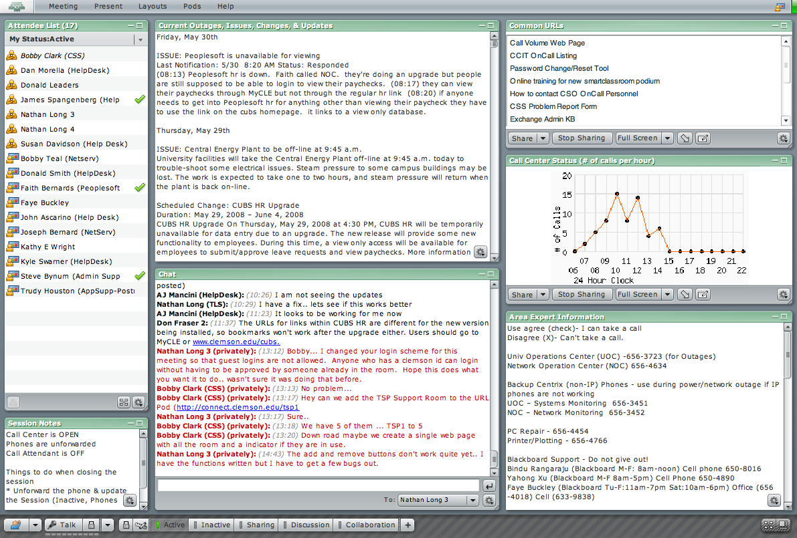
Updated Callcenter Situation Room as of May 30, 2008
Notes:
Live Demo is after the Lessons Learned & Handout

Slide 32
Lesson Learned
We gained many of benefits of the physical situation room, virtually.
Foster a relationship with Support and other groups and Teaching learning tools.
Develop a backup and recovery plan for your archived data.
Setup minimum guidelines for use, as soon as possible
Be ready to adapt tools to work from different viewpoints.
Use “Dashboarding” to provide incentive for data tracking

Slide 33
Can’t Afford Connect?
Alternative
Options for
Collaboration
Notes:
What kinds of collaboration tools does your institution already license? How can you leverage these tools for support communication?

Slide 34
Demo of the Current Situation Room
Notes:
Bring up the live Situation Room - Bobby

Slide 35
Questions
Bobby Clark
carlc@clemson.edu
Kathy Hoellen
hoellen@clemson.edu

