Slide 1
The Library + WebCT =
A Perfect Partnership

Slide 2
The Library + WebCT
Brenda
  Hired to be the Instructional Designer/Director of the Course Design Center. Due to staffing issue, also became WebCT Administrator for one semester.

Slide 3
The Library + WebCT
Jeannie
  Hired to be Distance Education Librarian: provide library resources and services for students in online courses.

Slide 4
The Library + WebCT
Lee College
  Baytown, TX
  Community College
  Student population: 5,361
  Number of students enrolled in online classes
    Fall 07
    Spring 08

Slide 5
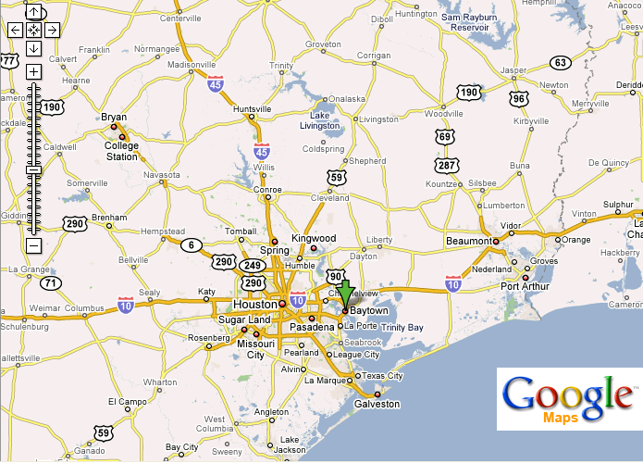

Slide 6
The Library + WebCT
Strengths
  Brenda & Jeannie hired same day with similar missions
  Supervisors who allowed us the freedom to try new things
  Library colleagues with good ideas and flexibility
  Brenda had admin access to WebCT

Slide 7
The Library + WebCT
Weaknesses
  Institutional website….
    No webmaster
    No updating
    No adding
    No editing….

Slide 8
The Library + WebCT
Opportunities
  “Can do” attitudes
  Brenda!
  WebCT (and freedom!)

Slide 9

The Library + WebCT
Threats
  Traditional animosity between IT departments and Libraries
  Access issues (pop-ups, Java)
  Relevance vs. “Cool”
  Assessment
  Time!!!
Challenges

Slide 10
The Library + WebCT
Student perspective
  All students at Lee are “enrolled” in the Library Resources course
  Fall, 2007: 8,245 logins, >131 hours
  Spring, 2008 (through 2/12/08): 2,079 logins, >24 hours

Slide 11
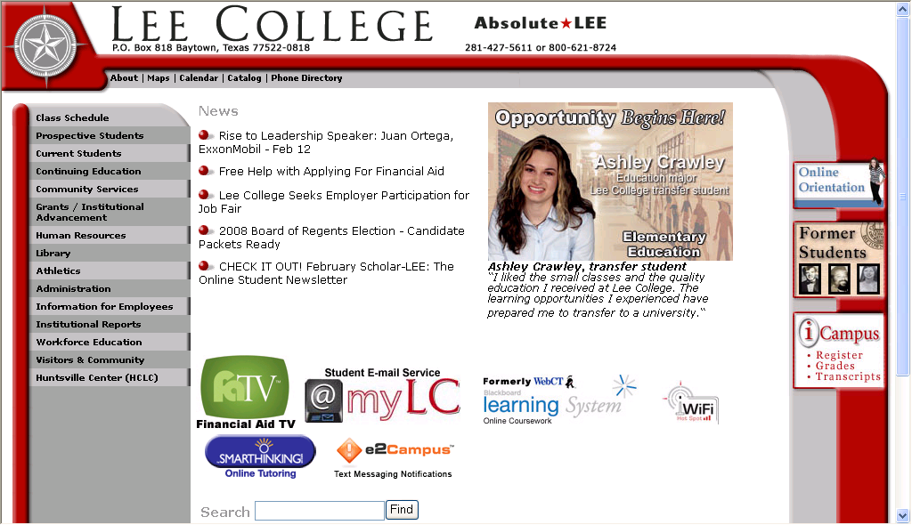

Slide 12
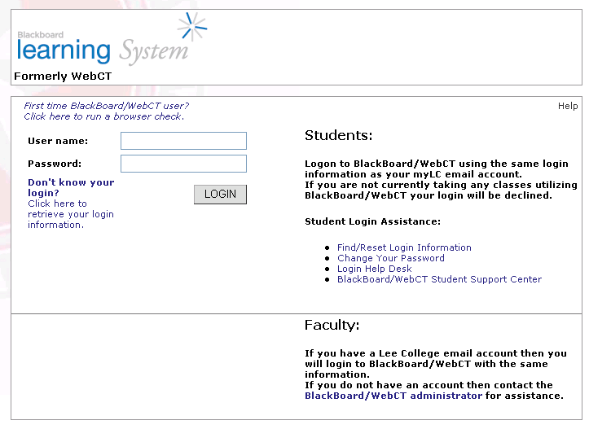

Slide 13
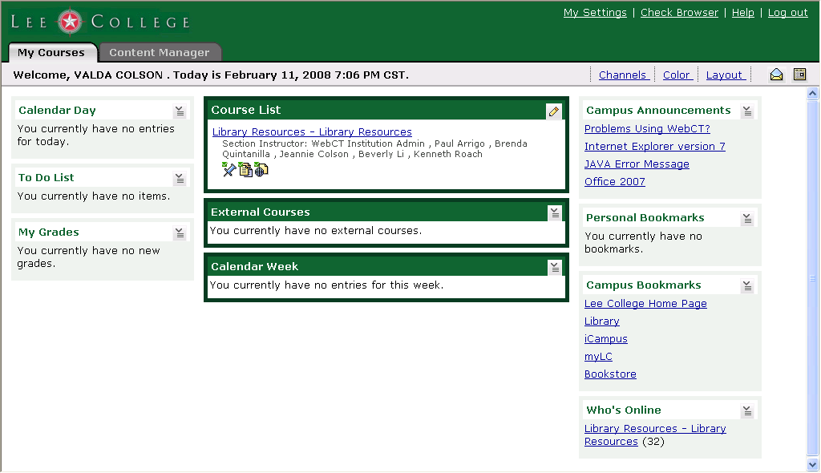
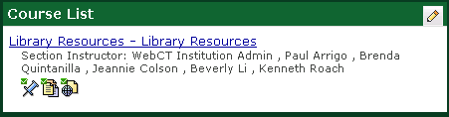

Slide 14
The Library + WebCT
Student’s perspective

Slide 15
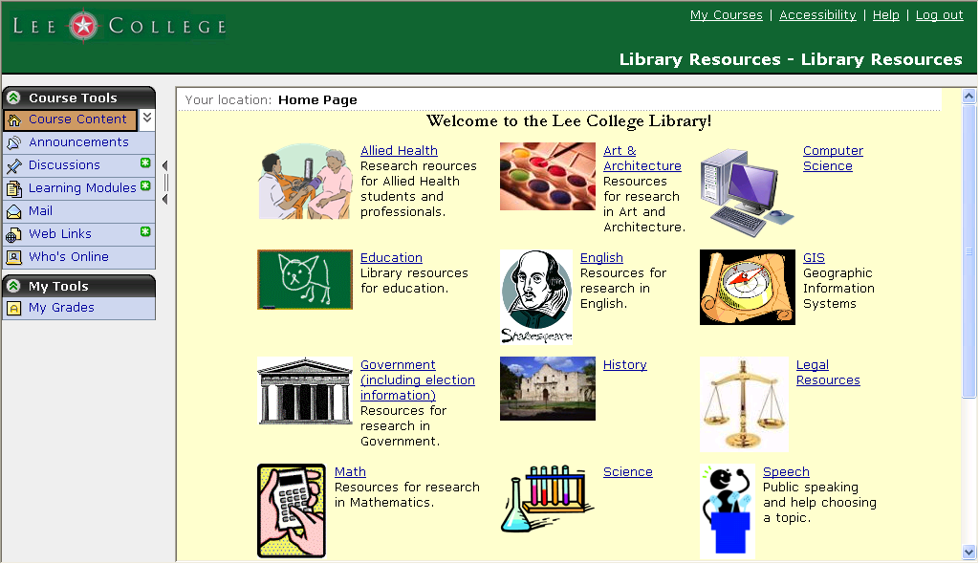

Slide 16
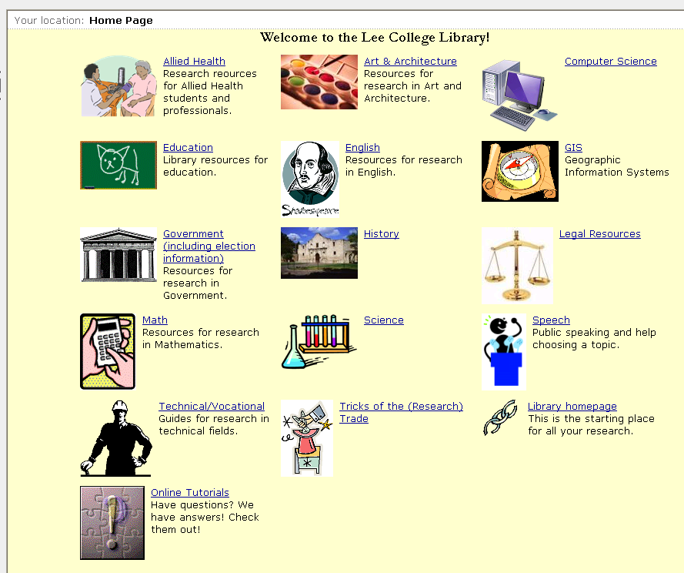

Slide 17
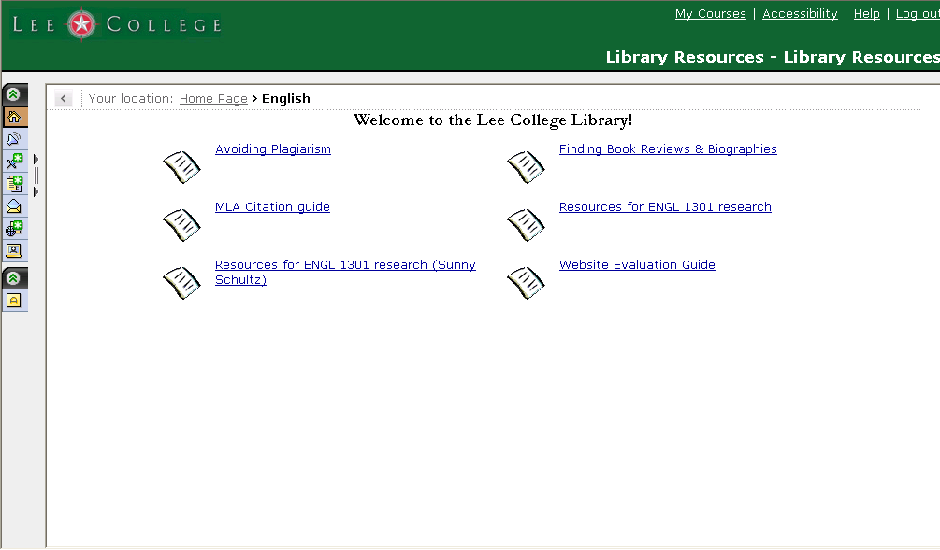

Slide 18
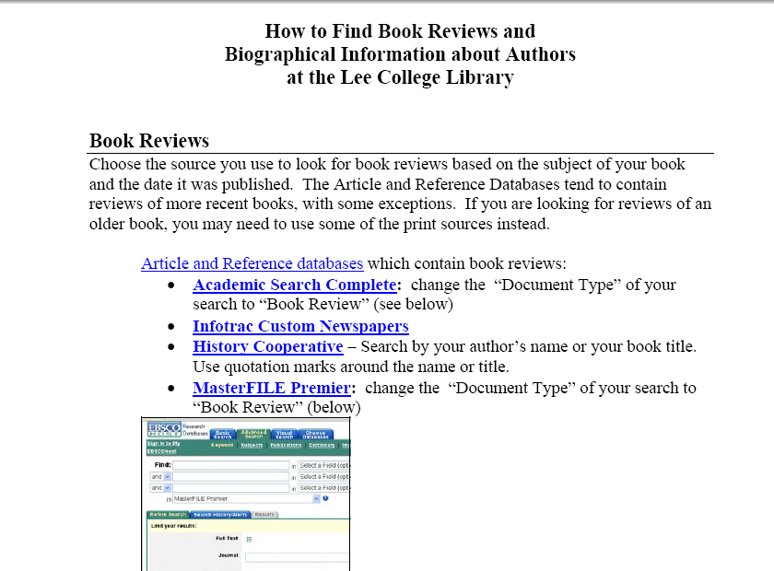

Slide 19
Old fashioned handouts – with live hyperlinks!
Webliographies
Links
Pre- and Post-tests (or not…)
Tutorials

Slide 20
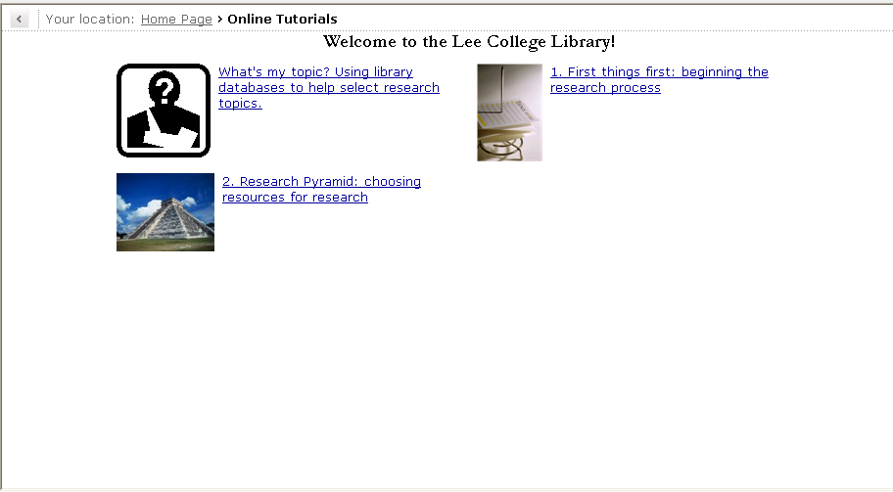

Slide 21
The Library + WebCT
Librarians’ (instructor’s) perspective

Slide 22
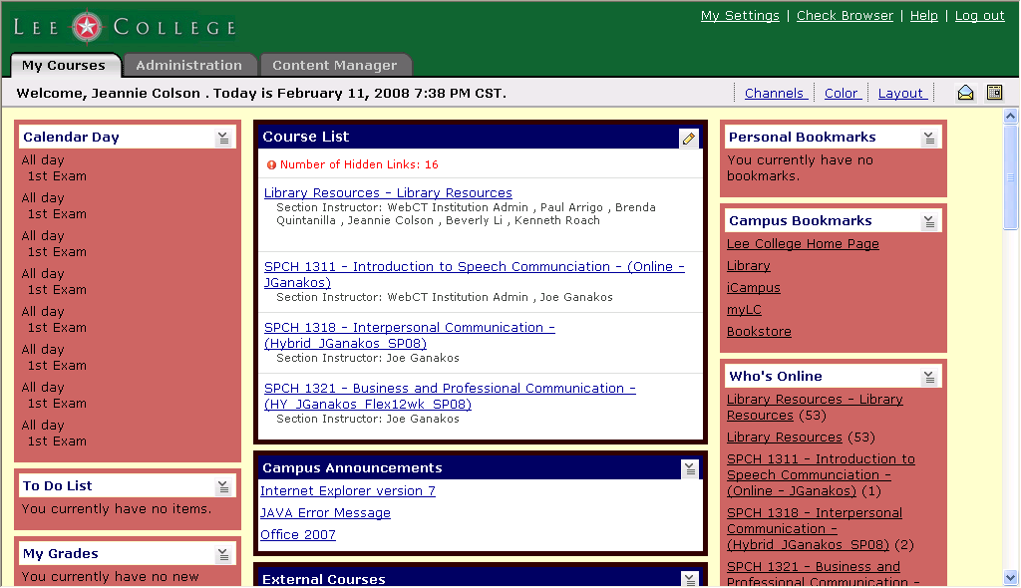

Slide 23
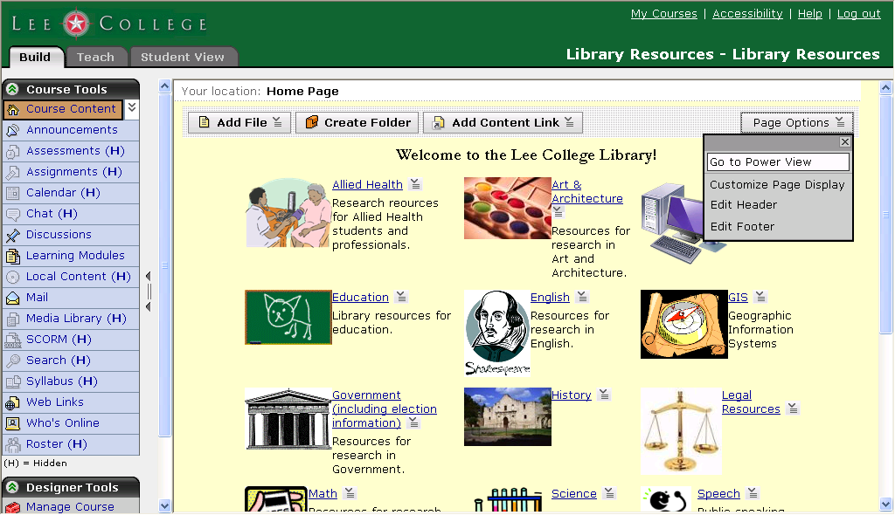

Slide 24
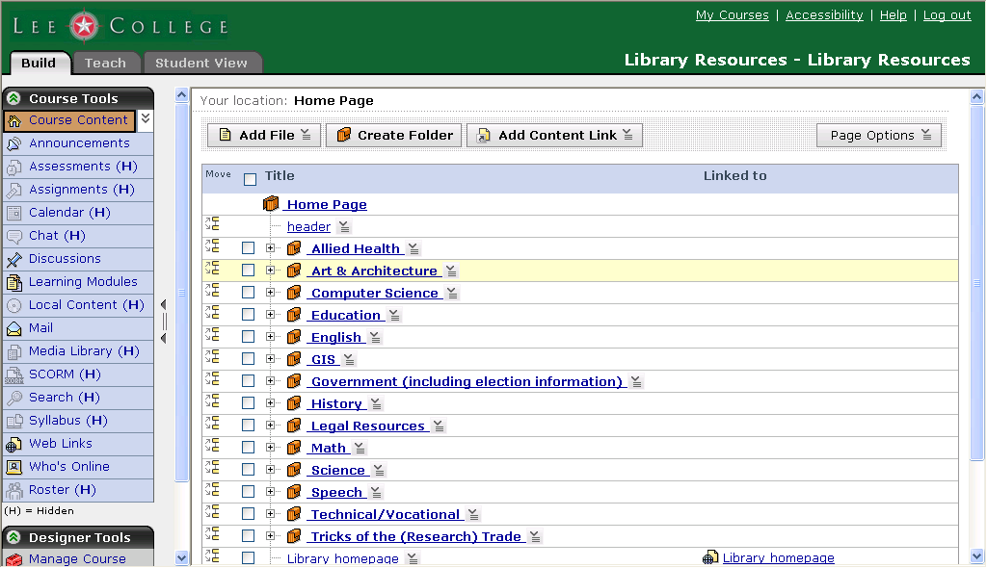

Slide 25
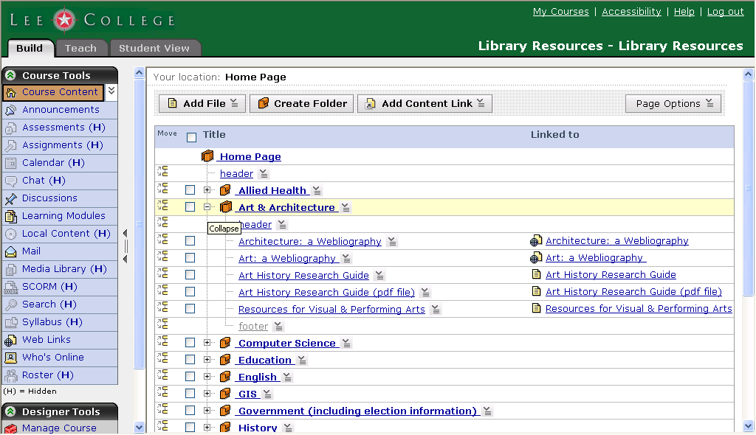

Slide 26
