Slide 1
Technology Projects:
Here, There and Everywhere!
Hilary J. Baker Vice President for IT/CIO
Christopher Xanthos, Senior Director, Project Management Office
March 31, 2008
Copyright Hilary J. Baker and Christopher Xanthos, 2008. This work is the intellectual property of the author. Permission is granted for this material to be shared for non-commercial, educational purposes, provided that this copyright statement appears on the reproduced materials and notice is given that the copying is by permission of the author. To disseminate otherwise or to republish requires written permission from the author(s).

Slide 2
Technology Projects:
Here, There, and Everywhere!
About California State University, Northridge
Projects, Projects, Everywhere!
Transforming IT: Governance & Strategic Planning
Project Management Office
Project Mindset & Process
Critical Success Factors
Q&A

Slide 3
Technology Projects:
Here, There, and Everywhere!
About California State University, Northridge
Projects, Projects, Everywhere!
Transforming IT: Governance & Strategic Planning
Project Management Office
Project Mindset & Process
Critical Success Factors
Q&A

Slide 4
California State University, Northridge
“The intellectual, economic and cultural heart of the San Fernando Valley and beyond”
Regionally focused, nationally recognized
356 acre campus in San Fernando Valley

Slide 5
California State University, Northridge
(CSUN)
~35,000 students
4,000+ faculty and staff
9 schools offering:
      63 baccalaureate degrees
      49 master’s degrees
      53 teaching credential programs

Slide 6
About IT @ CSUN
We deliver effective, secure, reliable technology infrastructure & services to enable, promote, and support students, faculty and staff to achieve their goals
We are committed to offer leadership and support in the advancement of technology, working in a collaborative partnership with our campus colleges, and administrative divisions

Slide 7
About IT @ CSUN
Centralized IT division ~ 100 staff
Decentralized college/division technical support
50+ computer labs
2,500+ lab computers and 4,000 faculty/staff computers

Slide 8
IT @ CSUN: Scope of Services
  Campus portal
  Classroom technology
  Remote connectivity
  Project Management
  Learning Mgmt systems
  Phones & voice mail
  Information Security
  Help Desk support
  Technology training
  Media and Video Services
  Business Continuity
  Wired and wireless network
  Email and calendaring

Slide 9
IT @ CSUN: Assessment
High level IT assessment by consultants identified:
  Lack of focus on service
  Lack of governance structure
  Lack of strategic plan
  Minimal collaboration between central IT and decentralized support

Slide 10
IT @ CSUN: New Focus
Instituted IT governance
Created technology strategic plan
Restructured IT division to focus on service
Paradigm shift to include business process analysis
Develop project management
Notes:
Paradigm shift to include business process analysis as part of IT (how IT can facilitate better business process and not just the technology solution)

Slide 11
Technology Projects:
Here, There, and Everywhere!
About California State University, Northridge
Projects, Projects, Everywhere!
Transforming IT: Governance & Strategic Planning
Project Management Office
Project Mindset & Process
Critical Success Factors
Q&A

Slide 12
The Problem: Technology Projects Everywhere!
Volume
  Technology projects in each division and school
  100s of projects – on different project lists
  Project workload > campus resource bandwidth

Slide 13
The Problem: Technology Projects Everywhere!
Process
  No process to review and approve new projects
  No process to prioritize technology projects
  We don’t know what we don’t know!

Slide 14
The Problem: Technology Projects Everywhere!
Planning
  Lack of definition of a project
  Minimal visibility, collaboration, definition of problem
  Inconsistent planning

Slide 15
The Problem: Technology Projects Everywhere!
Resources
  IT division unaware of projects needing their resources
  Duplicate projects working on solving the same problem
  Want to make most effective use of campus budgets

Slide 16
The Problem: Technology Projects Everywhere!
Element of Surprise!
  Impact of project on others around campus
  Often little communication about project before impact

Slide 17
Technology Projects:
Here, There, and Everywhere!
About California State University, Northridge
Projects, Projects, Everywhere!
Transforming IT: Governance & Strategic Planning
Project Management Office
Project Mindset & Process
Critical Success Factors
Q&A

Slide 18
Transforming IT: IT Governance
Executive Technology Steering Committee
Administrative Systems Committee
Web Communications Committee
Technology Infrastructure
& Services Committee
Advisory Committee on Academic Technology

Slide 19
Transforming IT: Strategic Planning Process
Implement an annual planning process integrated into the existing campus planning and budget process
Engage governance and advisory groups
Define and align IT goals with University planning priorities

Slide 20
University Planning Priorities
Academic Excellence
Student Engagement and Success
User-friendly Business Practices
Campus and Community Collaboration
Resource Enhancement

Slide 21
Information Technology Strategic Goals
Encourage the development and adoption of the use of technology to enhance and support a learning centered environment
Sustain a secure, reliable and stable technology infrastructure
Deliver quality IT support services that are valued by the University community
Notes:
Five strategic goals, here are three

Slide 22
Technology Strategic Planning: Process
IT Governance & Advisory Groups
CSUN College & Division Priorities
inform
IT Goals
CSUN University Planning Priorities
System-wide CSU priorities
create
Higher Education and IT Environmental Scan
IT Projects

Slide 23
Technology Project examples #1:
Smart Classroom enhancements
University Planning Priorities:
  Academic Excellence
  Student Engagement
IT Goal:
  Encourage the development and adoption of the use of technology to enhance and support a learning centered environment

Slide 24
  Technology Project example #2:
  Information Security Awareness Training
University Planning Priorities:
  User friendly business practices
  Academic Excellence
IT Goal:
  Sustain a secure, reliable and stable technology infrastructure

Slide 25
Technology Project example #3:
Unified Technology Support system
University Planning Priority:
  User friendly business practices
IT Goal:
  Deliver quality IT support services that are valued by the University community

Slide 26
Technology Strategic Planning:
Initial Project Inventory
“Collected” an initial inventory of technology projects across campus
Linked each project to a University Planning Priority and an IT Strategic Goal
Associated each project with an IT Governance group

Slide 27
Technology Strategic Planning:
Initial Project Inventory
The initial project inventory allowed us to:
  Began discussion about project prioritization
  View similar or overlapping projects
However, it was a static project inventory
We clearly needed a different ongoing approach to project management, so……..

Slide 28
Technology Strategic Planning:
Initial Project Inventory
The initial project inventory allowed us to:
  Began discussion about project prioritization
  View similar or overlapping projects
However, it was a static project inventory
We clearly needed a different ongoing approach to project management, so……..
I hired Chris Xanthos!

Slide 29
Technology Projects:
Here, There, and Everywhere!
About California State University, Northridge
Projects, Projects, Everywhere!
Transforming IT: Governance & Strategic Planning
Project Management Office
Project Mindset & Process
Critical Success Factors
Q&A

Slide 30
Project Management Office: Scope
  Technology Portfolio project management
  Project management of enterprise-wide projects
  Assistance with planning and oversight of IT division projects
  Assistance with planning and oversight of cross-divisional
  technology projects
  Project management training

Slide 31
Project Management Office: Objectives
Add value and benefit, not burden
Collaborate with the goal of reaching decisions
Provide visibility
  Better decision making
  Economies of scale

Slide 32
Project Management Office: Model
Project Management Institute
  Leading membership association for the project management profession
  Over 260,000 members in 171 countries
Project Management Body of Knowledge (PMBOK)
  Internationally recognized standard that provides the fundamentals of project management
  44 defined processes in 5 high level groups

Slide 33
Project Management Office: Model
CSUN is implementing a “Lite” version of PMBOK
  Project Charters and Schedules
    Scope, Milestones, Tasks and Timelines
  Lifecycle Stages
    Initiate
    Plan
    Execute
    Monitor
    Close

Slide 34
Technology Projects:
Here, There, and Everywhere!
About California State University, Northridge
Projects, Projects, Everywhere!
Transforming IT: Governance & Strategic Planning
Project Management Office
Project Mindset & Process
Critical Success Factors
Q&A

Slide 35
Project Mindset & Process
Identify
Collect
Prioritize
Plan
Cultural Shift

Slide 36
Project Mindset & Process: Identify
Define a project
Establish thresholds
  Impact to campus systems
  Time requirements
  Cost
  Involvement of outside vendors
  Security risks
Is it ready to be a project?

Slide 37
Project Mindset & Process: Collect
Collect information about the project
  Purpose
  Drivers
  Alternatives
  Scope
  Resources
  Alignment to university
  mission and goals

Slide 38
Project Mindset & Process: Prioritize
Change the approach
Shift the responsibility to the stakeholders
  Division portfolio liaisons
  Intra-division engagement and discussion
  Approval by vice presidents
  Collaboration with other divisions facilitated by PMO

Slide 39
Project Mindset & Process: Prioritize
Abandon High, Medium and Low categories
Use sequential numbers
  Make the tough decisions
  Only one “number 1” priority project
PMO facilitates campus-wide visibility

Slide 40
Project Mindset & Process: Prioritize
Establish Prioritization Criteria
Requirements
  Regulatory requirements?
  System or cabinet mandate?
Project Contingencies
  Is it a pre-requisite to other projects?
  Is it dependent on another pre-requisite project?

Slide 41
Project Business Decisions
Increased productivity vs. opportunity cost
If project is not done,
  What is the impact?
  Who is negatively impacted?
  What support resources are required?
  Will project reduce current support requirements?

Slide 42
Project Process: Planning
Enterprise-wide
  Substantial campus or resource impact & complexity
Division only
  No campus system or resource impact
Cross-divisional
  Minor campus or resource
  impact and complexity

Slide 43
Project Process: Planning Tools
Process is key
  If the process isn’t understood, the tool won’t work
Tools
  A wide variety of software tools exist that range from complex to simple
Assess what works for you
  Requirements
  Pilot first

Slide 44
Project Process: So where are we now?
Accomplishments
Challenges
Mitigating Actions

Slide 45
Accomplishments
  IT governance has been in place 2 years
  Each division has a liaison, responsible for technology project coordination for their division
  We’re close to compiling a complete list of technology projects

Slide 46
Accomplishments
  Executive leadership embrace the process
Metrics
    Project demand (queued)
    Project activity (active and completed)
    Working to identify bandwidth (not just IT resources)

Slide 47
Challenges: Skepticism
Same old IT with new structure and approach, but the same people doing the work, so nothing will change
New idea, flash in the pan
It will never work

Slide 48
Challenges: Tough Choices & Priorities
What is really the top technology project priority?
So often, every project is a “high” priority; none are medium or low priority
My own division projects are more important than other projects

Slide 49
Challenges: Overwhelming/Paralysis
Just thinking about the project is overwhelming
Where do I start?
Just best not to start another new project

Slide 50
Challenges: Perceived Workload
I’m too busy for this
It’s just one more thing to do
This is all busy work and I need to get to the real work or it won’t get done

Slide 51
Navigating the challenges
Stay the course and let it play out
Enable the governance process
  Exceptions defeat the purpose
  Communicate the process
  Enforce at all levels – staff, execs
Re-assess and adjust the process
Communicate success

Slide 52
Technology Projects:
Here, There, and Everywhere!
About California State University, Northridge
Projects, Projects, Everywhere!
Transforming IT: Governance & Strategic Planning
Project Management Office
Project Mindset & Process
Critical Success Factors
Q&A

Slide 53
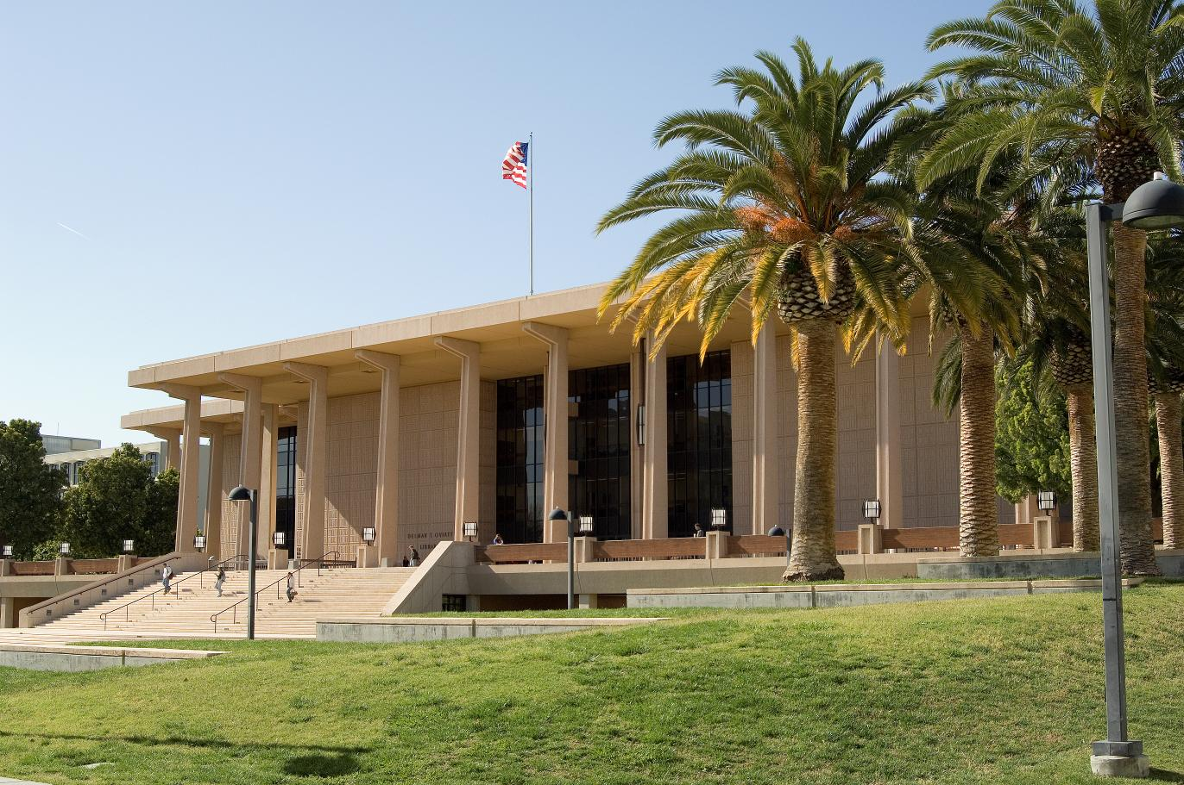
Critical Success Factors
Executive Support
IT Governance
Resources
Culture

Slide 54
Critical Success Factors: Executive Support
Recognition that technology aligns to Univ. priorities
Technology touches every aspect of the university
Engaged dialog about technology projects

Slide 55
Critical Success Factors: IT Governance
Build a framework to balance the technology project portfolio
Focus resources on institutional priorities
Engage in cross-college and cross-division collaboration
Governance structure must enable a timely decision

Slide 56
Critical Success Factors: Resources
Balance finite resources
Align technical and functional resource schedules
Recognition that technology projects don’t only involve IT division resources
Timely project delivery
Economies of scale from joint projects

Slide 57
Critical Success Factors: Culture
University-wide perspective
Transparency
Sharing
Open
Collaborative
No silos
Everything impacts everything else

Slide 58
Looking ahead for CSUN Project Mgmt
  Continue to institute a new technology project mindset
  Include technology discussions within campus-wide planning process
  Increase understanding about resource utilization
  Leverage economies of scale through project visibility and governance
      Implement common platforms and products
      Realize savings on licensing and hardware
Notes:
Next 6 months
ETSC – conversations are different
Proactive instead of reactive
Come back next year!
Gradual shift (large ship; collage about higher ed)

Slide 59
So, our technology projects are no longer...
  Here,
  There,
  and
  Everywhere!

Slide 60
Instead, they are becoming…
  Strategic,
  Planned,
  Managed,
  and
  Completed!

