Slide 1
Carl Johnson
Director, Copyright Licensing Office
Brigham Young University
801 422-3821, copyright@byu.edu
Educause Presentation
April 2008, San Francisco, California
Collaborative Social Networks:
Copyright Dream, Nightmare or Reality

Slide 2
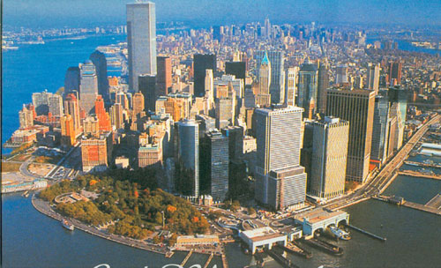



Possibilities….

Slide 3
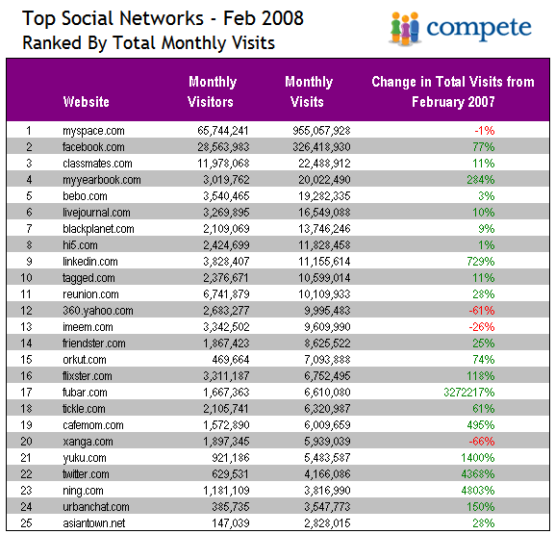
Possibilities….

Slide 4
Reminder…
YouTube Broadcast Yourself™
…. wants to share a video with you
Play YouTube Video: Social Networking
http://www.youtube.com/watch?v=6a_KF7TYKVc

Slide 5

Wizard of ©

Slide 6
Introduction…
Is it OK to post video online?
I think so?
As long as is no one makes any money?
Should be OK as long as peoples’ faces are blurred!

Slide 7
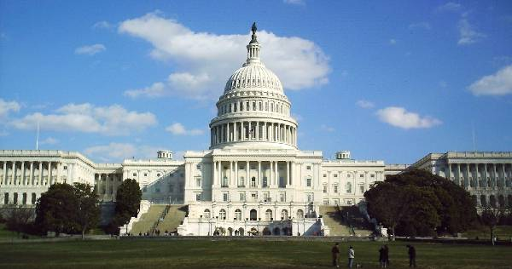
© Overview…
ROOTS OF THE LAW :
“The Congress shall have power…
To promote the progress of science and useful arts, by securing for limited times to authors and inventors the exclusive right to their respective writings and discoveries;“
Article 1 Section 8, Clause 8

Slide 8
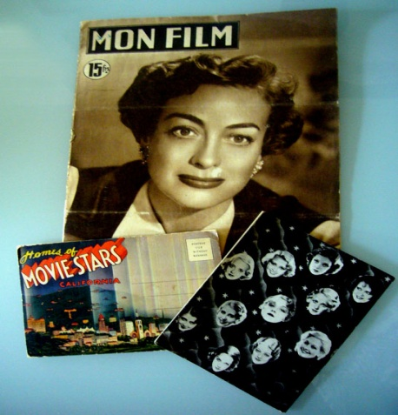
© Overview…
Works Protected by Copyright:
Literary, Musical, Dramatic works
Choreographic works
Pictorial, graphic, and sculptural works
Motion pictures and other audiovisual works
Sound recordings
Architectural works

Slide 9
© Overview…
Copyright owner’s rights:
To do and to authorize the following:
  To reproduce the work
  To prepare derivative works
  To distribute copies
  To perform the work publicly
  To display the work publicly
  To perform publicly a digital sound recording

Slide 10
© Overview…
Copyright Ownership:
Author/creator is usually the © owner
Employer owner when:
  Employee--within scope of employment
  IP ownership policy
By agreement--documented as a “Work for Hire”
    Fits within specific categories

Slide 11
© Overview…
User of © material…
Exemptions--Limitations on Owner’s Rights:
Fair Use, Section 107
Library Copying, Section108
First Sale Doctrine , Section 109
Face-to-Face Teaching , Section 110(1)
Distance Education, Section 110 (2)
7. Computer Software, Section 120
8. Modifications for Blind and Disabled (121)

Slide 12
© Overview…
Section 110 (2) TEACH provision
…institutes policies regarding copyright,
Provides informational materials to faculty,
students, and relevant staff members that
accurately describe, and promote
compliance with, the laws of the
United States relating to copyright...
Notes:
Vicarious copyright infringement
Vicarious liability, a form of indirect copyright infringement, is found where an operator has (1) the right and ability to control users and (2) a direct financial benefit from allowing their acts of piracy. User agreements or Acceptable Use Policies may be evidence of an operator's authority over users. The financial benefit may include a subscription fee, advertising revenues, or even a bartered exchange for other copyrighted. Under the doctrine of vicarious liability, you may be found liable even if you do not have specific knowledge of infringing acts occurring on your site.

Slide 13
Reminder…
YouTube Broadcast Yourself™
…. wants to share a video with you
Play YouTube Video: Fair(y) Use Tale…
http://www.youtube.com/watch?v=CJn_jC4FNDo

Slide 14
Licensing…
Implied license--implications of …vs. actual license to use
Click wrap/through license
User agreement
Patron instructions
Terms of use
Copyright and user information

Slide 15
Terms of Use…
Facebook:
  …you authorize and direct us to make ….you automatically grant and represent you have the right do grant…
  Copyright complaints
    Respect IP rights of others…
    Prohibit user’s from…violating others’ rights
  Notification of alleged infringement

Slide 16
Terms of Use…
MyFamily:
  …you affirm, represent and warrant…you own, or have the necessary licenses, rights, consents and permissions…
  Copyright management
    We do not control content members choose to post…
    You agree not to use…
    Terminate your account – first or repeat
  Notification of alleged infringement

Slide 17
Terms of Use…
MySpace:
  …you affirm, represent and warrant…you own, or have the necessary licenses, rights, consents and permissions…
  Copyright management
    We do not control content members choose to post…
    You agree not to use…
    Terminate your account – first or repeat
  Notification of alleged infringement

Slide 18
Terms of Use…
YouTube:
  …User submissions..you affirm… you own or have the necessary rights, consents and permissions
  …you hereby grant… a worldwide, sublicenseable and transferable license to use, reproduce, distribute, prepare derivative works, display and perform...
  Notification of alleged infringement

Slide 19
Liability…
Individual liability
  Direct copyright infringement
  Individual disregards institutional policy— “on their own”
Institutional Liability
  Vicarious infringement
  Contributory infringement
Notes:
Vicarious copyright infringement
Vicarious liability, a form of indirect copyright infringement, is found where an operator has (1) the right and ability to control users and (2) a direct financial benefit from allowing their acts of piracy. User agreements or Acceptable Use Policies may be evidence of an operator's authority over users. The financial benefit may include a subscription fee, advertising revenues, or even a bartered exchange for other copyrighted. Under the doctrine of vicarious liability, you may be found liable even if you do not have specific knowledge of infringing acts occurring on your site.
Contributory copyright infringement
The other form of indirect infringement, contributory infringement, requires (1) knowledge of the infringing activity and (2) a material contribution -- actual assistance or inducement -- to the alleged piracy.
Posting access codes from authorized copies of software, serial numbers, or other tools to assist in accessing such software may subject you to liability. Providing a forum for uploading and downloading any copyrighted file or cracker utility may also be contributory infringement. Even though you may not actually make software directly available on your site, providing assistance (or supporting a forum in which others may provide assistance) in locating unauthorized copies of software, links to download sites, server space, or support for sites that do the above may contributorily infringe.
To succeed on a contributory infringement claim, the copyright owner must show that the webmaster or service provider actually knew or should have known of the infringing activity.

Slide 20
Institutional Liability
Activities as a Service Provider
…provider's transmitting, routing, or providing connections for, material through a system or network controlled or operated by or for the service provider, or by reason of the intermediate and transient storage of that material in the course of such transmitting, routing, or providing connections, …

Slide 21
Institutional Liability
As a Service Provider…
Transmission…
  Initiated by person other than SP
  …carried out through technical process without selection of the material by SP
  3. SP does not select recipients…
  … stored and accessed only for recipients and no longer than reasonably necessary
  Content is transmitted without modification to its content
Notes:
Vicarious copyright infringement
Vicarious liability, a form of indirect copyright infringement, is found where an operator has (1) the right and ability to control users and (2) a direct financial benefit from allowing their acts of piracy. User agreements or Acceptable Use Policies may be evidence of an operator's authority over users. The financial benefit may include a subscription fee, advertising revenues, or even a bartered exchange for other copyrighted. Under the doctrine of vicarious liability, you may be found liable even if you do not have specific knowledge of infringing acts occurring on your site.

Slide 22
Educational Institution…
As a Service Provider…
Faculty or graduate student performing a research function, if…
Not required nor recommended course materials
Institution has not received more than 2 notices within a 3 year period…
Notes:
Vicarious copyright infringement
Vicarious liability, a form of indirect copyright infringement, is found where an operator has (1) the right and ability to control users and (2) a direct financial benefit from allowing their acts of piracy. User agreements or Acceptable Use Policies may be evidence of an operator's authority over users. The financial benefit may include a subscription fee, advertising revenues, or even a bartered exchange for other copyrighted. Under the doctrine of vicarious liability, you may be found liable even if you do not have specific knowledge of infringing acts occurring on your site.

Slide 23
Educational Institution…
As a Service Provider…
Designated an agent to receive claimed infringement notifications
Provides to all users informational materials that describe and promote compliance with U.S. Copyright laws…
Notes:
Vicarious copyright infringement
Vicarious liability, a form of indirect copyright infringement, is found where an operator has (1) the right and ability to control users and (2) a direct financial benefit from allowing their acts of piracy. User agreements or Acceptable Use Policies may be evidence of an operator's authority over users. The financial benefit may include a subscription fee, advertising revenues, or even a bartered exchange for other copyrighted. Under the doctrine of vicarious liability, you may be found liable even if you do not have specific knowledge of infringing acts occurring on your site.

Slide 24
Reminder…
YouTube Broadcast Yourself™
…. wants to share a video with you
Play YouTube Video: Ron in D.C.
http://www.youtube.com/watch?v=rr9SQ4qkMMk&feature=email

Slide 25
Student Response…
University Student Advisory Council (SAC)
35 Members
I. Understanding of Copyright Law, policy and practice
  No Knowledge—5
  Some Knowledge—29
  Highly knowledgable—1
2. Know University Copyright Office exists
  Yes—12
  No—15

Slide 26
Student Response…
Student Advisory Council cont…
3. How interested in learning copyright ….
  Not interested—12
  Somewhat interested—6
  Very interested—0
4. How to determine what is protected by © ?
  No idea—2
  Vague/some idea—25
  Knowledgable—2

Slide 27
SAC Suggestions…
Make it [©] a buzz around campus
Make copyright education part of freshman English
Large posters-explaining copyright
Make it clear that by downloading illegal music we are breaking the student honor code

Slide 28
© Analysis
Is © work you are about to post protected by copyright?
  Copyright has expired
  Works published by Fed. government
  Explicitly donated to the public domain
  Material clearly licensed for your planned use
2. Does your institution, employees/faculty or students own the material?

Slide 29
© Analysis
3. How will the material protected by copyright be used?
Will your proposed use qualify as an exemption?
Does your institution’s copyright use policy provide useful guidance?

Slide 30
Studies…
London Knowledge Lab, U. of London
…an investigation of students’ educational use of Facebook.
“If anything the data in this paper constitute a case of
‘business as usual’ with students simply being
students—albeit in a more visible and noisy manner
than is apparent in the formal settings of their
university setting.”

Slide 31
Studies…
European Network and Info Security Agency
Security Issues and Recommendations for online Social Networks
“…users should be educated in how to use social media safely via awareness raising efforts….targeted at students, parents and teachers…It requires a culture shift..from there may be dragons scaremongering attitude of banning SNS to a more mature attitude of encouraging sensible, well-informed use.”

Slide 32
Legislation….
SEC. 494. CAMPUS-BASED DIGITAL THEFT
PREVENTION.
…Each eligible institution participating in any program under this title shall to the extent practicable-
(1) make publicly available to their students and employees, the policies and procedures related to the illegal downloading and distribution of copyrighted materials…; and

Slide 33
Legislation…
  Cont….
  (2) develop a plan for offering alternatives to illegal downloading or peer-to-peer distribution of intellectual property as well as a plan to explore technology-based deterrents to prevent such illegal activity.

Slide 34
© Education…
Website, resources materials, newsletters, handouts
Presentations, teaching, university and department meetings
Copyright information displays
Copyright compliance recognition

Slide 35
© Education…
5. Copyright features in campus newspaper
6. Student forums and groups
Student produced © information
Campus emails to students and faculty
New student orientation materials
Online copyright tutorial

Slide 36
Trends…
All Rights Reserve?
Some Rights Reserved—Creative Commons?
Complete Commons—open access?
National laws and policies—NIH and more?
Second Life—collaborative authorship
Faculty ownership initiatives--Harvard

Slide 37
Trends…
Cont…
Viacom's website, states that
"regardless of the law of fair use, we have not generally challenged users of Viacom copyrighted material where the use or copy is occasional and is a creative, newsworthy or transformative use of a limited excerpt for noncommercial purposes."

Slide 38
Points to consider…
Promote Copyright awareness and education
Involve students in copyright awareness strategies
Develop a copyright awareness culture
Copyright law always lags behind the progress of technology
Collaborate with others—begin the discussion

Slide 39
Sources…
1. The University of Texas System, Intellectual Property, Copyright, Developing a Comprehensive Copyright Policy to Facilitate Online Learning, Georgia Harper,
http://www.utsystem.edu/OGC/INTELLECTUALPROPERTY/polcydev.htm
2. Visual Resources Association, Image Collections Guidelines, The Acquisition and Use of Images in Non-Profit Educational Visual Resources Collections, VRA
http://www.vraweb.org/copyright/guidelines.html
AAU, ARL, AAUP, AAP, Campus Copyright Rights and Responsibilities: A Basic Guide to Policy Considerations, http://aaupnet.org/aboutup/issues/Campus_Copyright.pdf
Columbia University Libraries, Copyright Advisory Office, Court Case Summaries, accessed March 28, 2008, http://copyright.columbia.edu/court-case-summaries.html
London Knowledge Lab, University of London, Institute of Education, UK, Screw Blackboard..do it on Facebook!: an investigation of students’ educational use of Facebook, accessed March 28, 2008, http://www.scribd.com/doc/513958/Facebook-seminar-paper-Selwyn
European Network and Information Security Agency, Position Paper No. 1, Security Issues and Recommendations for Online Social Networks, October 2007. http://www.enisa.europa.eu/doc/pdf/deliverables/enisa_pp_social_networks.pdf
U.S. Copyright Office website, Copyright Law of the United States.
http://www.copyright.gov/title17/
8. Electronic Frontier Foundation, Fair Use Principles for User Generated Video Content,
http://www.eff.org/issues/ip-and-free-speech/fair-use-principles-usergen
BYU Copyright Licensing Office website: http://copyright.byu.edu

Slide 40
End…
Copyright © 2008 Carl Johnson
This work is the intellectual property of the author. Permission is granted for this material to be shared for non-commercial, educational purposes, provided that this copyright statement appears on the reproduced materials and notice is given that the copying is by permission of the author. To disseminate otherwise or to republish requires written permission from the author.
Contact:
Carl Johnson
Director, Copyright Licensing Office
Brigham Young University
801 422-3821, copyright@byu.edu

