Slide 1
What We’re Learning from eTexts
Rodney Petersen, Managing Director of Washington Office
Joan Cheverie, Policy Specialist
Jarret Cummings, Policy Specialist
December 10, 2012

Slide 2
Agenda
Overview of eText Pilot
Policy Issues
  Affordability
  Broadband
  Information Policy
  Accessibility
  Privacy and Security
  Identity and Access Management
Discussion

Slide 3
EDUCAUSE & Internet2 eText Pilot

Slide 4


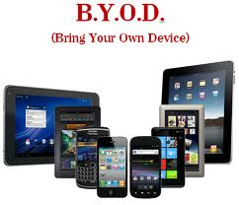

Emerging Technologies and Trends

Slide 5




Spring 2013 eContent Pilot Goals

Slide 6



2013 eContent Pilot Goals

Slide 7
Funding and Distribution
Institutional Agreements
  College or University Pays
  Leverage Institutional Buying Power
  Software Site License Model
Distribution to Students
  Access via Learning Management Systems
  Option to Purchase Print-On-Demand
  Institutional Choice on Cost Recovery

Slide 8
Stakeholders
Faculty
Students
Bookstores
IT/Libraries
Publishers
eReaders
Institution

Slide 9

Additional Functionality
Highlighting passages
Recording comments
Sharing notes with other students
Reading materials while offline
Using different devices (e.g., computers, tablets, etc.)

Slide 10

Evaluation and Research
Methods
  Student Survey
  Faculty Research Protocol
  Usage Data
Spring 2012 Results
  Option to purchase a paper copy (12%)
  Lower cost of eText most important factor
  Portability also ranked high
  Offline access desirable
  Access throughout college, not just class
  Usability of eReader (especially zoom feature)
  Faculty not using enhanced eText features

Slide 11
Affordability

Slide 12
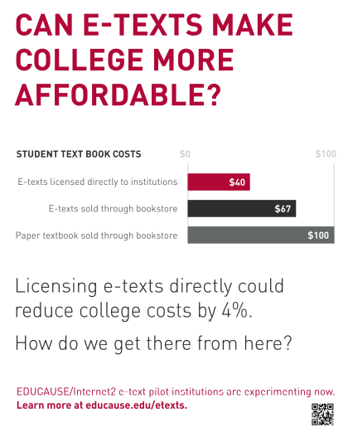
Textbook Costs and Their Impact
Notes:
Notes
Research by The Student Public Interest Research Groups (PIRGs) = textbook prices have increased at 4x the rate of inflation for the last 2 decades. (A Cover-to-Cover Solution, Sept. 2012, p. 6).
College Board’s Trends in College Pricing 2012 indicates that books and supplies account for $1200-1250 in the avg. estimated undergraduate budget for 2012-13.
For students at public 2-year colleges, that’s almost 40% of what they pay on average in tuition and fees. For students at public 4-year institutions, it’s 14%. (The College Board, Trends in College Pricing 2012, Fig. 1)
In a survey conducted earlier this year by the e-textbook publisher bookboon.com, approx. 77% of U.S. students responding indicated that they don’t always buy the required textbooks for their courses, citing cost as a major consideration. (Edward Nawotka, “Are College Students Buying Required Textbooks? 75% in U.S. Say No,” Publishing Perspectives, Sept. 11, 2012: http://publishingperspectives.com/2012/09/are-college-students-buying-required-textbooks-75-in-us-say-no/)
Citations for Graphic
Brad Wheeler, “E-Texts: A Perishable Opportunity for Higher Education?” EDUCAUSE Live! (webinar series), January 24, 2012 (http://www.educause.edu/events/educause-live-etexts-perishable-opportunity-higher-education).
Fresno City College, “Standard Student Budget,” May 16, 2012 (http://www.fresnocitycollege.edu/index.aspx?page=38).

Slide 13
Avg. Textbook Costs By Type Plus Institutionally Licensed E-Text
Institutionally Licensed E-Textbook
Source: Nicole Allen, A Cover-to-Cover Solution, The Student PIRGs, Sept. 2010, p.19; Brad Wheeler, “E-Texts: A Perishable Opportunity for Higher Education,” EDUCAUSE Live!, Jan. 24, 2012 (webinar).
Notes:
Notes
The Student PIRGs looked at the cost of textbooks by type for 10 major subjects; this chart shows the avg. cost across those subjects by type with the estimated average cost of an e-textbook under the institutional licensing model we’re currently piloting with Internet2.
By leveraging the volume of purchasing at the institutional (and really, the inter-institutional) level, e-texts from major publishers (with a student POD option for a modest additional fee) become competitive with even open-source options.
However, as the chart shows, other models offer the opportunity to generate significant savings for students as well, and the savings generated by them may have improved even more since the PIRGs’ 2010 report.
Key may be to continue pushing for a mix of cost-saving options and allow faculty and students to vote with their dollars, knowing that the different options may not each encompass all of the subjects the curricula need to cover.
Regardless, given the overall concern about college costs, the potential progress achievable in this area can’t be overlooked.

Slide 14
Broadband

Slide 15



Internet Access

Slide 16
Information Policy

Slide 17

Information Policy Issues
Ownership
Licensing
Digital Rights Management (DRM)
Preservation
Notes:
Electronic textbooks have been available for awhile – think NetLibrary in 2001 and many libraries have e-book packages available that include textbooks, so there is some existing expertise out there in the community. Yet there are still key information policy issues to be considered.
Concept of ownership:
Owning a title means student can freely take notes and share with a friend
Choose to keep some key work for future use beyond the semester’s course
Might decide to resell the book to recoup some of the expenses incurred
Licensing v. sale
Available for rental/leased during semester v. owning for college career
Commons restrictions – limited access; limited devices; limited printing
Resale and sharing aspects
Annotations and note sharing – who owns?
Reproduction/use and re-use
Printing (including 3rd party print-on-demand) and downloading to another device?
What happens to fair use in a license situation?
Favorable licensing terms should include broad academic use rights, perpetual ownership (watch potential for those annual fees), unlimited concurrent users, DRM-free format, also favorable ILL provisions
With lease not purchase – copyright law is secondary to contract terms
DRM – publishers control over the content and those implications; also affects accessibility and to make accommodation – i.e., use is restricted with DRM
Limitations to what can be done – some systems do not permit printing of any content, with simple cut and paste often disabled
Long-term preservation and retention rights to stable content are not the norm, because many resellers and vendors don’t possess those rights from the publisher or author. Instead of true ownership, most ebook “purchases” are more like leases, and leases with few residual rights at that. The only way to assure continuing access and storage for an ebook is a permanent download to a device with rights not governed by strict DRM.
Revocable rights statements appear in licenses for use by both individuals and institutions. The publisher “reserves the right to change terms of sale at any time” is another common statement in terms of service for ebooks and other electronic content. Similarly, one major publisher’s license “may require immediate withdrawal of its titles from the Reseller’s System” if certain conditions are not met. Who then becomes the guarantor of access to purchased content? Will the book you read yesterday be available tomorrow?
Need to be specific about what rights are being purchased at time of licensing – if that’s important to a campus
Necessary to have – continuity of the text, markers for change, versioning, permanent archiving of variant editions
Many licenses don’t provide for institutional retention

Slide 18
Accessibility

Slide 19





The E-Text Pilots and NFB
Notes:
Notes
As part of 1st E/I2 pilot (Spring 2012), University of MN’ disability services office evaluated the Courseload eReader application through which e-texts from McGraw-Hill were delivered.
At that time, the office found CL to essentially be inaccessible to persons with visual impairments—students and staff testing could not navigate the application or access content effectively using standard assistive applications.
The MN findings were part of the overall evaluation report that E/I2 and the participating institutions released, and it was on reviewing that report in Fall 2012 that NFB became concerned.
As a result, NFB issued a letter to E, I2, MH, CL, and the institutions participating in the then-active Fall 2012 pilot asking that pilot activities involving Courseload be discontinued until the platform was accessible.
Unfortunately, the progress that Courseload had made on accessibility from the time of MN’s findings had not been communicated broadly or effectively, leading NFB to assume that the conditions reported in the spring still held.
EDUCAUSE and I2 engaged directly with NFB and facilitated dialogue between NFB and Courseload to highlight the commitment Courseload had made to have a fully accessible platform in time for the Spring 2013 pilot set to start in January.
We also further emphasized in program communications that companies without clear accessibility plans and commitments to achieve them would not be able to participate in our e-text pilots, and that institutions would need to fully evaluate their ability to meet accessibility compliance obligations as part of considering participation.
However, there’s much more to the accessibility discussion around e-texts than the accessibility of the delivery platforms.

Slide 20
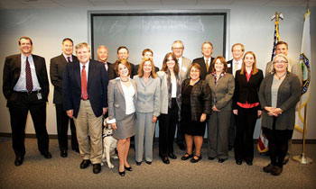
Content Remains Key
Advisory Commission on Accessible Instructional Material in Postsecondary Education for Students with Disabilities
(The AIM Commission)
Notes:
Notes
Content accessibility remains a key issue that has yet to be widely resolved.
This time last year (12/06/111), the ED’s AIM Commission released its report to Congress on the status of the market for accessible digital instructional materials, with recommendations to broadly increase AIM availability.
The Commission found that only a small percentage of the texts sold in the HE market were available in an accessible digital form, but that was changing as e-text providers built their catalogs (AIM Commission Report, p. 49). It also noted that the new ePUB3 standard offers the potential for most publications to be “born accessible” in the future (AIM Commission Report, p. 66).
However, in the near-term, the availability of accessible content remains a concern even if eReader platforms are fully accessible in all other respects. E.g., while Courseload has promised to deliver an accessible platform by Jan., it has to pursue what it calls an “alongside strategy” for content. This means facilitating DSS office access to publisher source files to generate accessible texts that students can use in their preferred adaptive technologies “alongside” CL when publisher-supplied e-texts are not themselves accessible.
The Commission also noted the rapid growth in interactive and multimedia instructional resources that increasingly redefine what we mean by an “e-textbook,” and the difficulty producers and institutions may have in providing either accessible versions of such resources or accommodations that give students with disabilities equally effective and integrated access to the same benefits as the inaccessible resources.

Slide 21
Privacy and Security

Slide 22


Data Analytics
Notes:
Notes
Research by The Student Public Interest Research Groups (PIRGs) = textbook prices have increased at 4x the rate of inflation for the last 2 decades. (A Cover-to-Cover Solution, Sept. 2012, p. 6).
College Board’s Trends in College Pricing 2012 indicates that books and supplies account for $1200-1250 in the avg. estimated undergraduate budget for 2012-13.
For students at public 2-year colleges, that’s almost 40% of what they pay on average in tuition and fees. For students at public 4-year institutions, it’s 14%. (The College Board, Trends in College Pricing 2012, Fig. 1)
In a survey conducted earlier this year by the e-textbook publisher bookboon.com, approx. 77% of U.S. students responding indicated that they don’t always buy the required textbooks for their courses, citing cost as a major consideration. (Edward Nawotka, “Are College Students Buying Required Textbooks? 75% in U.S. Say No,” Publishing Perspectives, Sept. 11, 2012: http://publishingperspectives.com/2012/09/are-college-students-buying-required-textbooks-75-in-us-say-no/)
Citations for Graphic
Brad Wheeler, “E-Texts: A Perishable Opportunity for Higher Education?” EDUCAUSE Live! (webinar series), January 24, 2012 (http://www.educause.edu/events/educause-live-etexts-perishable-opportunity-higher-education).
Fresno City College, “Standard Student Budget,” May 16, 2012 (http://www.fresnocitycollege.edu/index.aspx?page=38).

Slide 23



Device, Applications, and Networks

Slide 24
Identity and Access Management

Slide 25
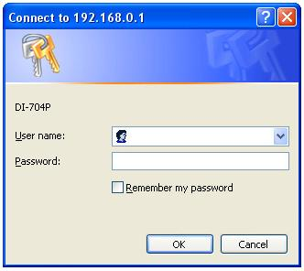


User Credentials and Federations

Slide 26
Discussion

Slide 27
For More Information
EDUCAUSE and Internet2 eText Pilot Series
educause.edu/etexts
Internet2 NET+ Services
internet2.edu/netplus
EDUCAUSE and Internet2 Staff Contacts
  Rodney Petersen, rpetersen@educause.edu
  Joan Cheverie, jcheverie@educause.edu
  Jarret Cummings, jcummings@educause.edu
  Shel Waggener, swaggener@internet2.edu
  Dana Voss, dvoss@internet2.edu
Notes:
Notes
Research by The Student Public Interest Research Groups (PIRGs) = textbook prices have increased at 4x the rate of inflation for the last 2 decades. (A Cover-to-Cover Solution, Sept. 2012, p. 6).
College Board’s Trends in College Pricing 2012 indicates that books and supplies account for $1200-1250 in the avg. estimated undergraduate budget for 2012-13.
For students at public 2-year colleges, that’s almost 40% of what they pay on average in tuition and fees. For students at public 4-year institutions, it’s 14%. (The College Board, Trends in College Pricing 2012, Fig. 1)
In a survey conducted earlier this year by the e-textbook publisher bookboon.com, approx. 77% of U.S. students responding indicated that they don’t always buy the required textbooks for their courses, citing cost as a major consideration. (Edward Nawotka, “Are College Students Buying Required Textbooks? 75% in U.S. Say No,” Publishing Perspectives, Sept. 11, 2012: http://publishingperspectives.com/2012/09/are-college-students-buying-required-textbooks-75-in-us-say-no/)
Citations for Graphic
Brad Wheeler, “E-Texts: A Perishable Opportunity for Higher Education?” EDUCAUSE Live! (webinar series), January 24, 2012 (http://www.educause.edu/events/educause-live-etexts-perishable-opportunity-higher-education).
Fresno City College, “Standard Student Budget,” May 16, 2012 (http://www.fresnocitycollege.edu/index.aspx?page=38).

