Slide 1
Top Issues Facing the NACUBO Community
EDUCAUSE Live!
August 10, 2011
John D. Walda
President and CEO
NACUBO

Slide 2
What Issues Keep Business Officers
Up at Night?
Potential cuts in core state funding/operating support
Rising tuition/affordability
Potential cuts in federal student aid programs
Inadequate enrollment/tuition revenue
Budget shortfalls

Slide 3
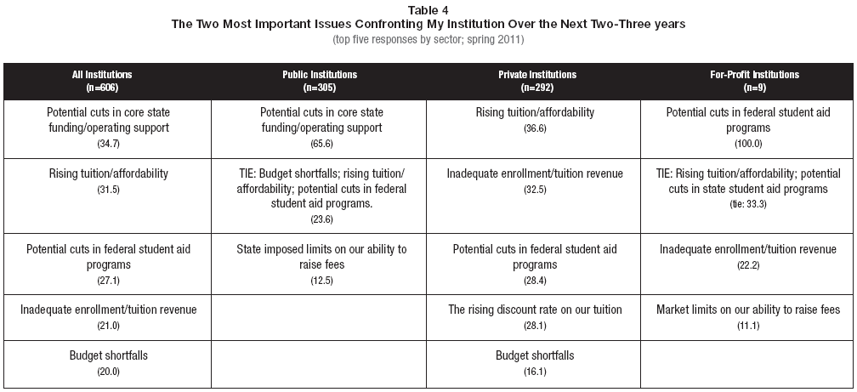
Importance of Issues Varies By Institution Type
Source: The Inside Higher Ed Survey of College and University Business Officers

Slide 4
Polling Question 1
What would you consider your greatest challenges on campus?
  Doing more with less
  Helping IT get a seat the table
  Diverse student needs

Slide 5
Federal Student Aid Programs and the Current Political Environment

Slide 6
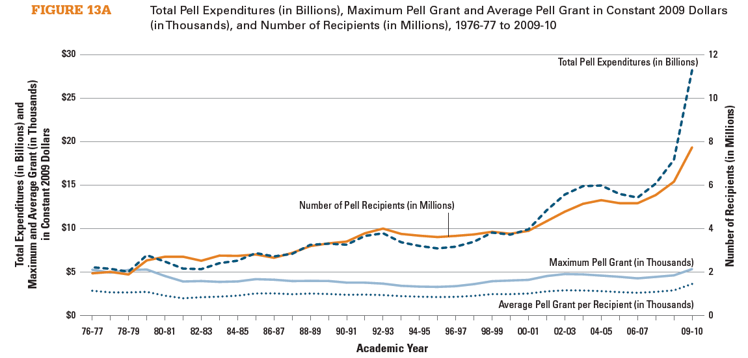
Federal Student Aid: Pell Grant
Source: College Board, based on ED data
Notes:
Total federal Pell Grant expenditures increased from $6.9 billion (in 2009 dollars) in 1979-80 to $8.3 billion in 1989-90, $9.3 billion in 1999–2000, and $28.2 billion in 2009-10.
In 2008-09, 25% of Pell Grant recipients received the maximum Pell Grant of $4,731. The average Pell Grant that year was $2,971. In 2009-10, when the maximum Pell Grant was $5,350, the average grant was $3,646.
The maximum Pell Grant for the 2010-11 academic year is $5,550. This amount covers 34% of the average published tuition, fees, room, and board at a public four-year college or university and 15% of average published charges at a private nonprofit four-year institution
According to Budget analysis: Pell increases from 2008-12 were result of:
40% enrollment growth
14% eligibility formulas (CCRAA and HEOA)
22% year-round Pell
25% increase in the maximum grant

Slide 7
State Operating Support Is at a Per-student 25-Year Low, While Tuition Continues to Climb

Slide 8
Approximate Percentage Change in FY 2012 State Operating Support for Four-Year Public Universities
Alabama +5.2
Alaska +3.1
Arizona -24
Arkansas -0
California -23
Colorado -20.9
Connecticut -1.7
Delaware +.3
Florida -1.2
Georgia -9
Hawaii +.5
Idaho -3.5
Illinois -1.1
Indiana -1.9
Iowa -3.6
Kansas -2
Kentucky -1
Louisiana -0
Maine -0
Maryland -.5
Massachusetts -0
Michigan -15
Minnesota N/A
Mississippi -1
Missouri -7
Montana -2
Nebraska -.7
Nevada -15.3
New Hampshire -48
New Jersey -0
New Mexico N/A
New York -6.5
North Carolina -14.4
North Dakota +6.8
Ohio -11.2
Oklahoma -5.8
Oregon -13.5
Pennsylvania -18
Rhode Island +2
South Carolina -6
South Dakota -10
Tennessee -1.1
Texas -5
Utah -2
Vermont -3
Virginia -7.2
Washington -23
West Virginia +2.8
Wisconsin -11
Wyoming +1.2
Source: AASCU’s July 2011 “Fiscal and State Policy Issues Affecting Postsecondary Education”

Slide 9
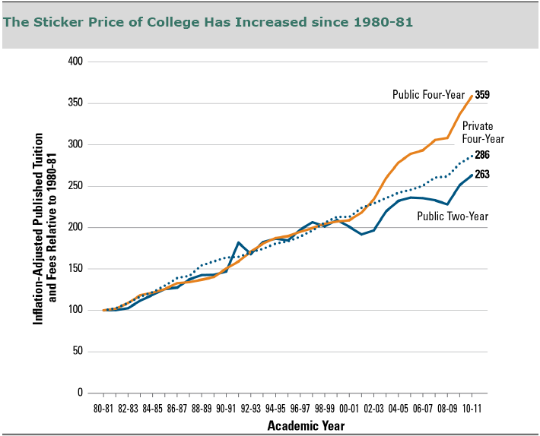
Growth in Tuition in the Past 30 Years
Source: The College Board, Trends in College Pricing 2010, Figure 5.
PEW RESEARCH CENTER

Slide 10
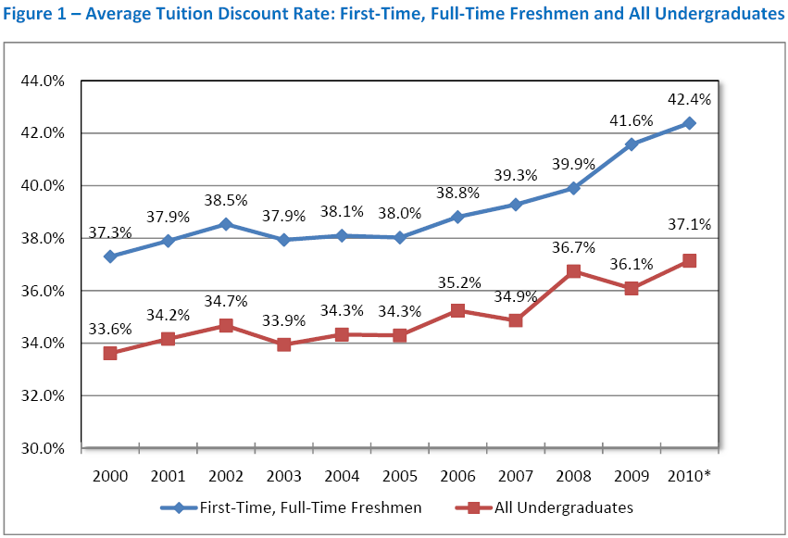
Tuition Discounting Continues to Rise
Source: 2010 NAUCBO Tuition Discounting Survey 2000 to 2010
* Preliminary estimate.

Slide 11
Endowment Support

Slide 12
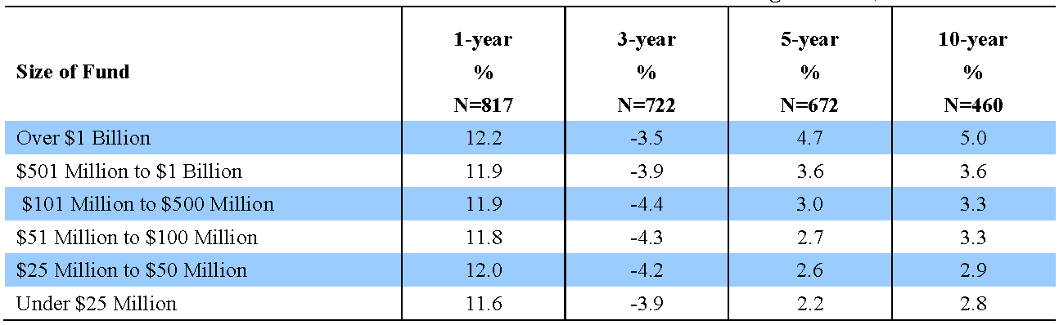
2010 Endowment Returns
NACUBO-Commonfund Study of Endowments
Average Annual One-, Three, Five, and Ten-Year Returns*
for U.S. Higher Education Endowments and Affiliated Foundations
for Periods Ending June 30, 2010
*Net of management fees and expenses.

Slide 13
Average Annual Total Return* for Total Institutions
Fiscal Years 2000 – 2010 ending June 30
Source: Fiscal years 2000 – 2008, NACUBO Endowment Study 2008; Fiscal years 2009 - 2010, NACUBO-Commonfund Study of Endowments 2009 - 2010
* Net of fees
Copyright 2011 The Common Fund for Nonprofit Organizations and the National Association of College and University Business Officers
All rights reserved.

Slide 14
Polling Question 2
How much has your IT budget been trimmed in recent years?
  15 percent
  10 percent
  5 percent
  No trimming

Slide 15
Legislative and Regulatory Issues

Slide 16
Issues of Concern
Program Integrity Rules
  State Authorization
  Gainful Employment
Post-9/11 GI Bill
IRS 3 Percent Withholding Requirement
HEOA
  College Cost Watch Lists
  Net Price Calculator
  Three-Year Cohort Default Rates

Slide 17
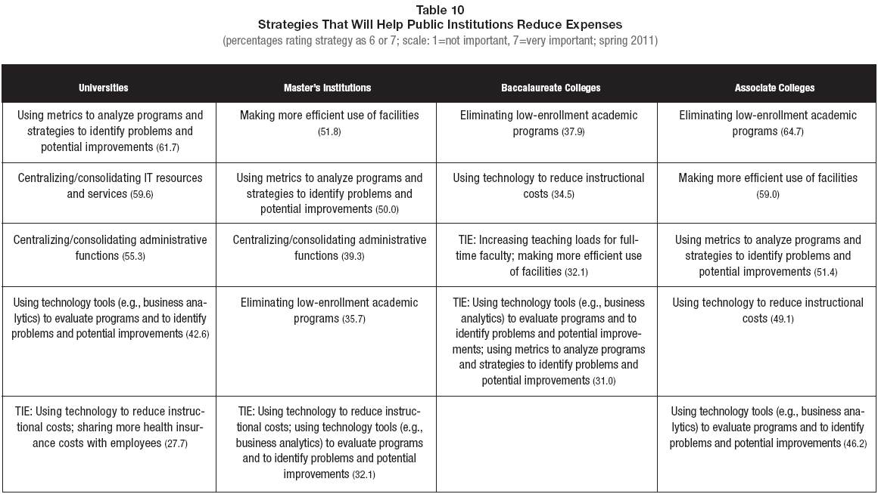
Strategies for Addressing These Issues
Source: The Inside Higher Ed Survey of College and University Business Officers

Slide 18
Polling Question 3
How would you describe your working relationship with the CFO?
We meet at least once a week and share information effectively
We are members of the same leadership team but do not meet 1:1 often
We meet monthly
We do not meet face-to-face often but are in regular email communication
We only communicate when there is an issue to be resolved

Slide 19
CFOs and CIOs Working Together
Cloud Computing – fostering collaboration
  NACUBO Board of Directors’ Ad Hoc Committee work
  White papers
  Webcasts

