Slide 1

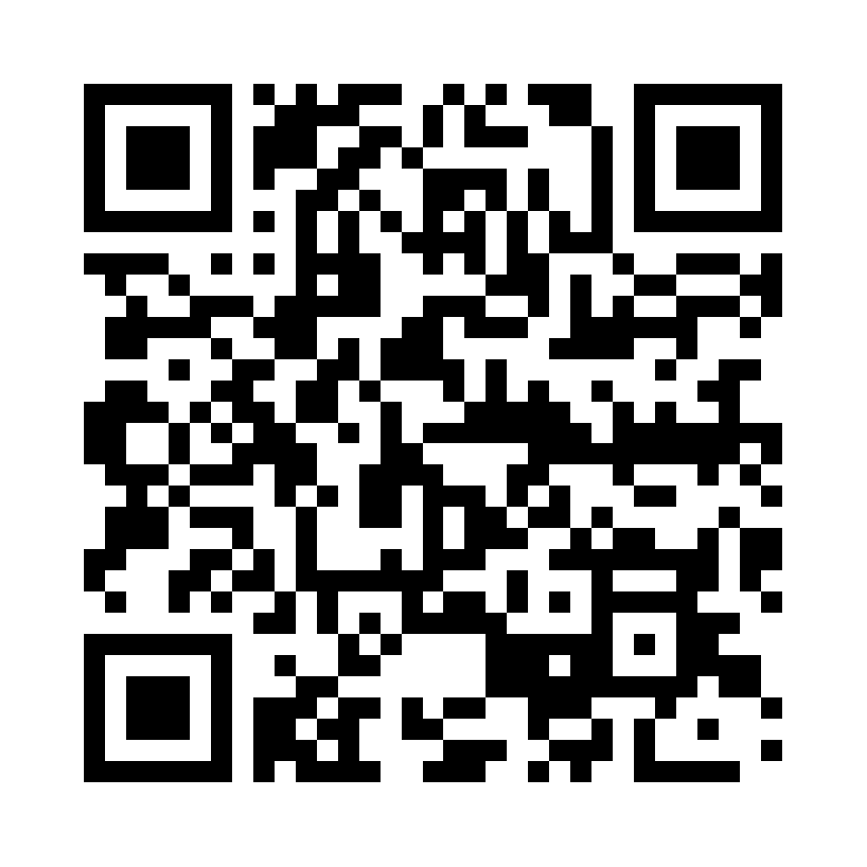
IT Accessibility Constituent Group
The IT Accessibility Group will help the EDUCAUSE community:
Identify resources and initiatives
Develop best practices on IT accessibility, policy, assistive program and service development
Strategize pathways to approach campus-wide universal access to information available via technology
8 Great Questions to Ask About Making Content Accessible
Can you use it without a mouse?
Have you divided up your content with headings?
Can you view a text-only version and understand it?
Do you have transcripts for any audio or video?
Do you use enough color contrast?
Do your pages have a consistent look-and-feel?
Do your images have appropriate text descriptions?
Does each form input have an appropriate label?

