Slide 1
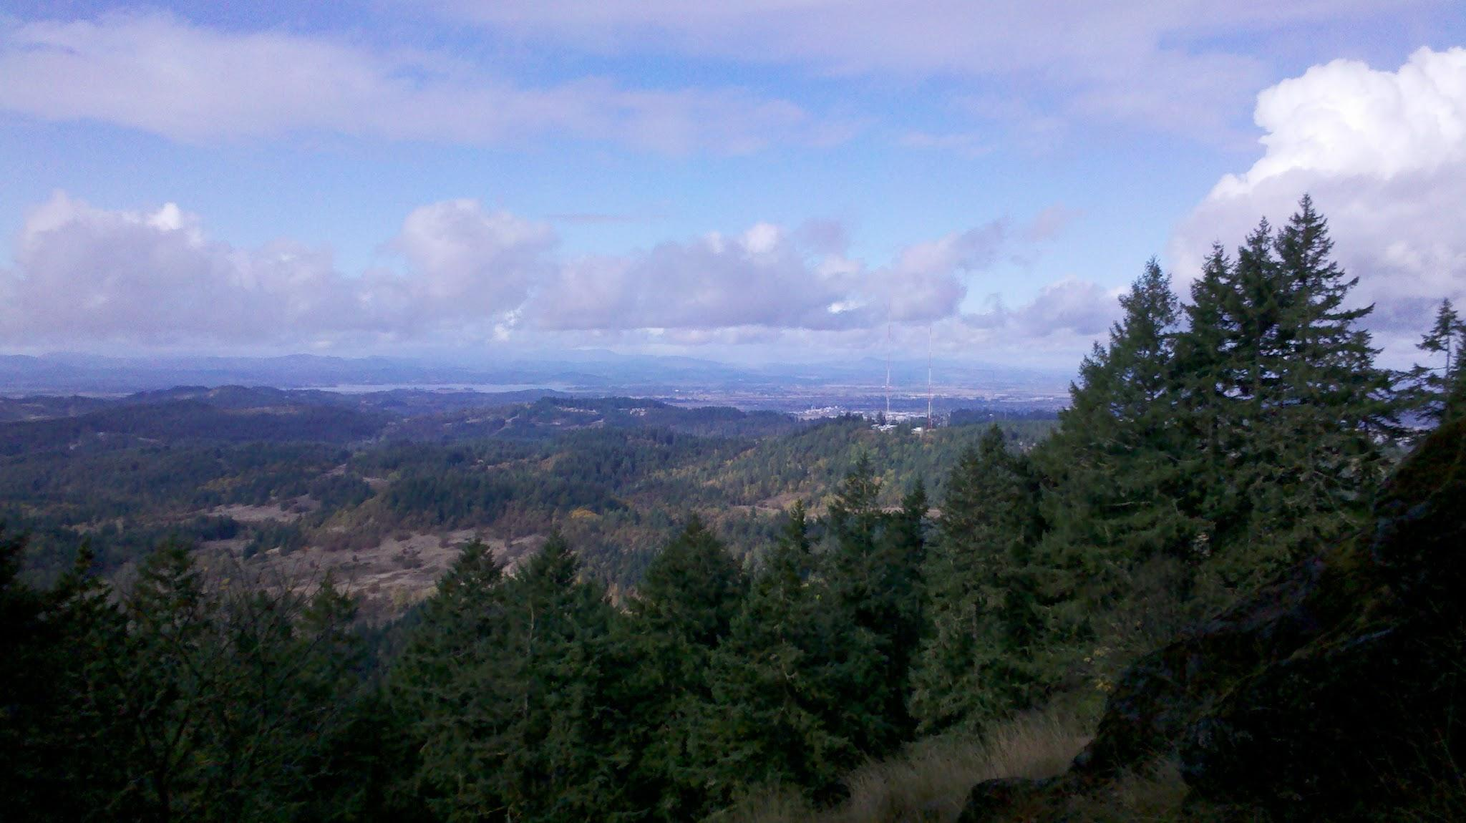
Looking at the Horizon: Supporting Campus Core Technology
Jack Suess
University of Maryland, Baltimore County
Melissa Woo
University of Oregon

Slide 2
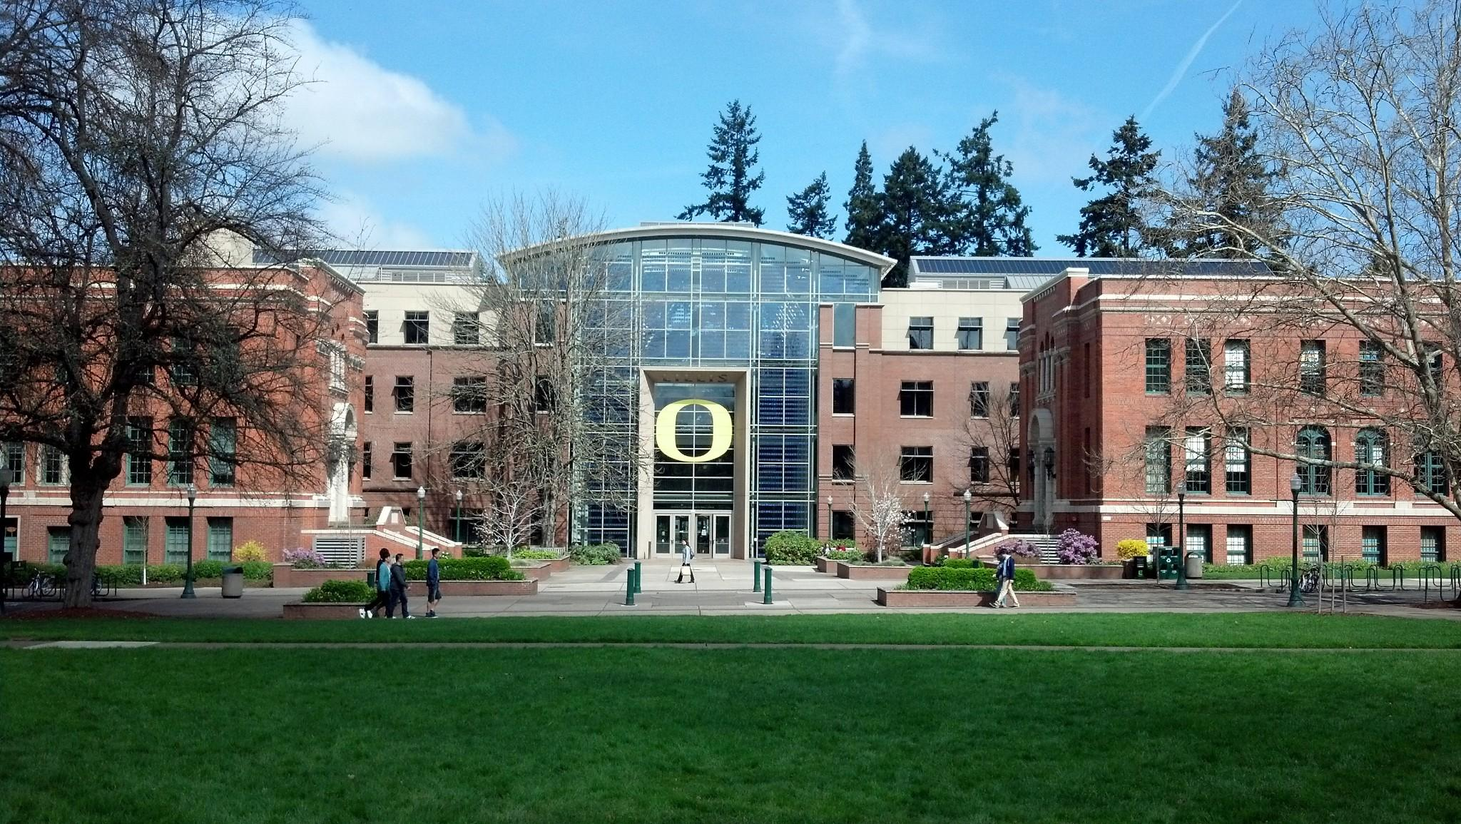

25K students
Public
RU/VH
System flagship

Slide 3
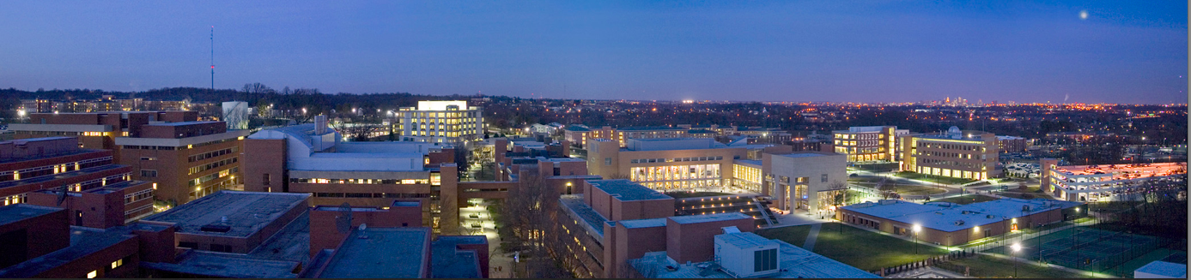
UMBC
Founded in 1966
14,000 Students
Research/High
Public
55% STEM

Slide 4
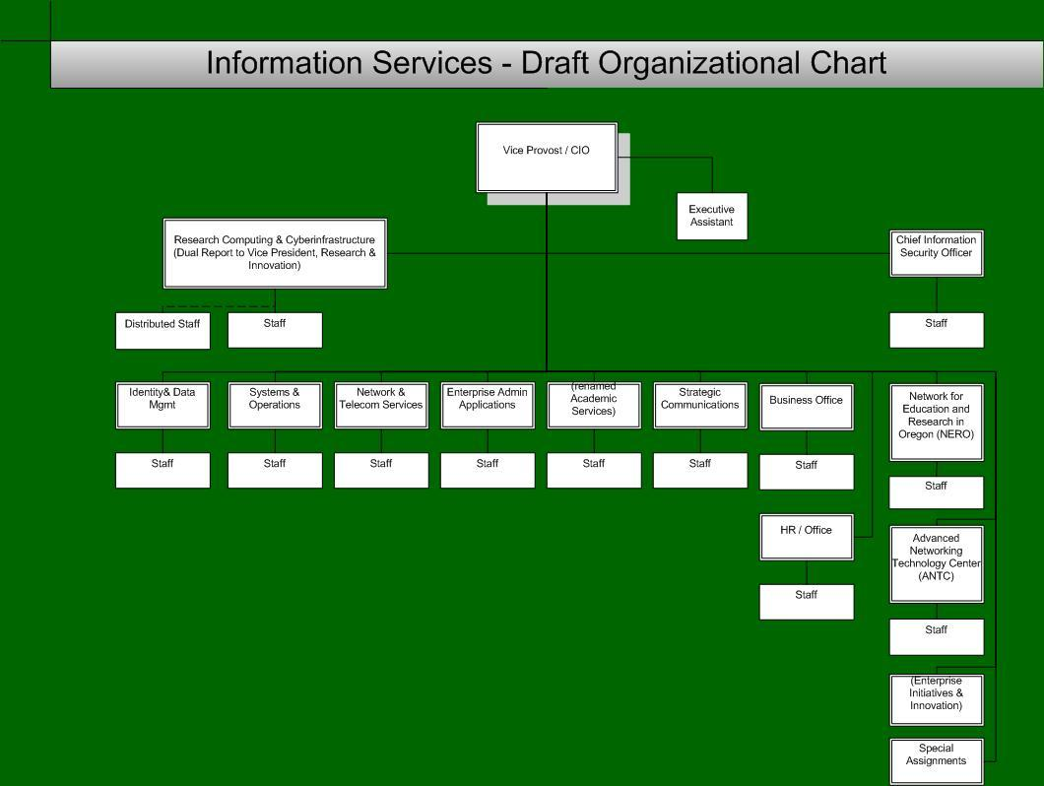

Slide 5
UMBC Organization http://doit.umbc.edu/about-doit/orgchart/
VP of IT/CIO
Audit & Compliance
Adminstrative Support
Business Systems
HR Finance
Student
Analytics
DBA
Identity
Enterprise Infrastructure Network Systems
Desktop
Audio/Visual
HPC
Storage
Instructonal Technology & SupportBlackboard Instruct. tools
Helpdesk New Media
Web design

Slide 6
The 5 "i"s
infrastructure
identity management
information security
information
innovation

Slide 7
UMBC's Approach for IT
Anytime, anywhere, any device
Consumerization of IT
Internet of everything and everywhere
Cloud computing through SaaS, PaaS, and IaaS.
IT focuses on making services
Easy to use,
Reliable,
Robust,
Cost-Effective,
Secure
UMBC's leadership wants to be a model for public higher education and #1 in innovation.

Slide 8
Wireless / Adv. Networking
Wireless
802.1x (UO Secure & eduroam)
Aging (>10 yrs) infrastructure
Need high-density coverage
Advanced Networking
Oregon GigaPoP
NERO
Grant to create research DMZ, investigate SDN

Slide 9
Wireless/ Adv. Networking
Wireless
15 month plan to move campus to 802.11n
Fall 13 migrate to "N", Fall 14 address density
802.1x (eduroam) with open Visitor
Wired/Advanced Networking
Redundant links and 10GB core
All academic buildings link back at 10GB
Mostly 1GB in STEM, 100mb elsewhere.
10GB network to MDREN/MAX
Web interface for faculty/dept IT to manage firewall settings

Slide 10
Identity Management
Sun IdM Aegis TridentHE
LDAP
Active Directory
CAS & Shibboleth
InCommon member
Possible future roadmap items
Multi-factor auth'n
InCommon Bronze, Silver

Slide 11
Identity Management
Internet2 Early Adopter (2000)
Sun IdM --> OpenLDAP
Our own SSO (Webauth) and CAS
InCommon member
Partnered with Fischer on project
Roadmap
Multi-factor, launching Duo in June
Bronze (summer)
Silver (fall)
OpenLDAP - summer 2014

Slide 12
Information Security
UO's 1st CISO - in recruitment
Infosec currently in Networking area
CISO will have plenty to do...
Form Infosec group
Develop University policies
Communicate, communicate, communicate!

Slide 13
Information Security
No CISO, team-based approach.
Lone security engineer is in Network group.
Compliance & Policy report to CIO
IT Security Committee
Networks, Systems, Applications, Support, Legal, Health Research Center, CIO, Deputy CIO
Reviews threats, incidents, and outreach plans.
IT Compliance Committee
CIO, Deputy CIO, AVP for Business, Director of Telecommunications, Policy, and Compliance
Determines & reviews risk level of services, reviews and develops procedures and compliance standards

Slide 14
Virtualization
VMware
660 VMs
Hosting services for campus units
Evaluating vCloud

Slide 15
Virtualization
Run large dual-homed VM cluster (300 VM's)
Units purchase service for a fee but they get business continuity and support for free.
We run all our Windows services, including Blackboard on this.
Looking hard at AWS
Deploying our first service on AWS now, our web-hosting and content solution.
Moving our portal development to AWS now, will move portal to this in January.
Looking at Peoplesoft development

Slide 16
Cloud and NET+
Limited cloud service adoption
Need further work with campus partners

Slide 17
Cloud Service Adoption
NET+
Box deployed to campus
Participated in Duo validation, now launching
Evaluating SDG for IT business services
Seevogh video deployed to campus
Will move to AWS when available
Piloting Aastra/Level3 for VoIP.
Already have many SaaS
Parking, tuition/billing, career services, transcripts, facilities management, housing, and judicial

Slide 18
Data Storage
Central IT's storage is primarily for enterprise services
Xythos provided for end-users
Storage for researchers urgently needed
Significant "unauthorized" use of cloud storage on campus

Slide 19
Data Storage
Enterprise - all dual-homed
Peoplesoft Dev/prod (20TB)
Dual-homed VM storage (20/40 TB)
User storage
Central AD for campus (5 TB)
Box launched for users in fall (60TB)
Plans are for Box to replace most user AD and user AFS (about 10 TB)
Research
280 TB of Infiniband attached.
Purchased Terascala - 200 now, 300 later

Slide 20
BC / DR
3rd data center in-progress
Need BC / DR data center outside of seismic zone

Slide 21
Business Continuity/DR
Started BC/DR efforts in 2006. Focused on higher risk events (fire,flood, sabotage).
3 data centers on campus, each about .5 mile from each other. No important service is tied to one data center.
Mirrored storage. Robotic tape in 4th place.
We have 100TB on a remote storage system 35 miles away used for backup.
June 2012 event - UMBC lost power for 7 days, all services remained operational!

Slide 22
Decision-Making
EVERYTHING is "in-progress"
Forming campus decision-making & prioritization group
Will be informed by advisory groups: teaching, research, services/operations, IT leaders

Slide 23
Decision Making
External
IT Steering - policy & planning
Senate CPC - Faculty & Academic Computing
Campus Systems - Administrative
Data Management
Campus Web
Internal
AVP's Budget & Planning
DoIT Managers - Yearly operational
CTO group - technical architecture
Security Workgroup - IT security
Audit & compliance

Slide 24
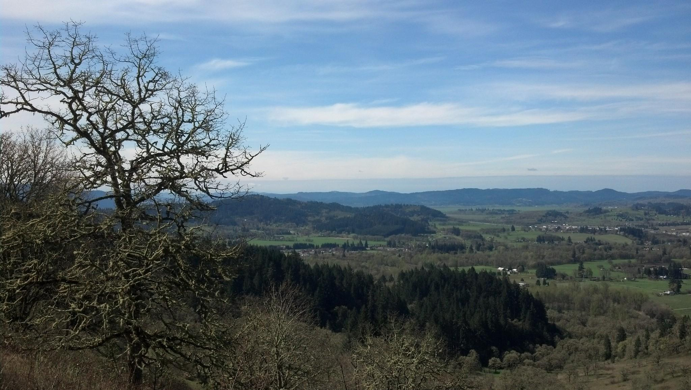
Questions?

