Slide 1
The Importance of Core Infrastructure in R&E
Ron Hutchins, PhD
Associate Vice Provost for Research and Technology and CTO

Slide 2
In a Nutshell
Dear Colleague letter from NSF – current and future demands on researchers, faculty, and others…
The Network as foundational – and then… complexity enters…
Wireless and Telecom as strategic themes
High Performance Computing for Modeling and Simulation… don’t forget analytics
Data sets as strategic resources – data management – “Big Data”
Challenges for infrastructure
Coda – Hosting

Slide 3
NSF Dear Colleague Letter:
Cyberinfrastructure Framework for 21st Century Science and Engineering (CF21)
“Today, every discipline of science and engineering is being revolutionized by the widespread use of comprehensive Cyber-infrastructure (CI). Computing power, data volumes, and network capacities are all on exponential growth paths, collaborations are growing dramatically, and all forms of CI---and multiple communities spanning multiple agencies and international domains---often must be brought to bear to address a single complex grand challenge problem, such as climate change. All of these developments are part of a revolutionary new approach to scientific discovery in which advanced computational facilities (e.g., data systems, computing hardware, high speed networks) and instruments (e.g., telescopes, sensor networks, sequencers) are coupled to the development of quantifiable models, algorithms, software and other tools and services to provide unique insights into complex problems in science and engineering.

Slide 4
Some Observations from Alan Blatecky of NSF
Science and Scholarship are a team sport
  Competitiveness and success will come to those who can put together the best team, and can marshal the best resources and capabilities
Collaboration/partnerships will change significantly
  Growth of dynamic coalitions and virtual organizations
  International collaboration will become even more important
Ownership of data plus low cost - fuels growth and number of data systems
  Growth in both distributed systems and local systems
  More people want to access more data
  Federation and interoperability become more important

Slide 5
More Observations (Alan Blatecky)
More discoveries will arise from search approaches
  Mining vast amounts of new and disparate data
  Collaboration and sharing of information
Mobility and personal control will continue to drive innovation and business
Gaming, virtual worlds, social networks will continue to transform the way we do science, research, education, and business
The Internet has collapsed six degrees of separation and is creating a world with two or three degrees.

Slide 6
The Network…
Networking has been foundational for many years… but…
Private physical or virtual networks are now eroding the lock the Internet had on ubiquitous connectivity – Banks, Insurance Co’s, Hospitals, Stock traders.
VLANs have proliferated creating separation of layers and isolating very complex infrastructures so no one really knows the architecture.
Cloud services undermine our understanding of connectivity even more…

Slide 7
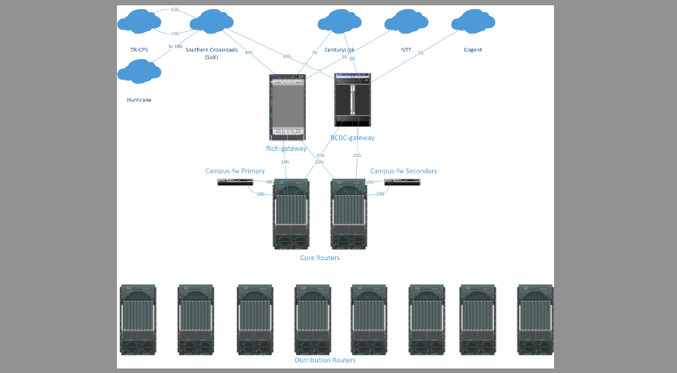
The Network as foundational – and then… complexity enters…
Many outside ISP
And R&E network
connections
120k ports
Several hundred buildings

Slide 8
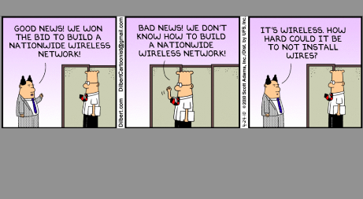
Wireless Networks

Slide 9
Wireless and Telecom as strategic themes
Access is King – everywhere, any time.
Negroponti’s rule – “if it moves it’s wireless, if it doesn’t, it’s wired”
Telecom is moving away from desk phone to handheld for everything
Campus telephony moving to SIP/WebRTC and WiFi with cellular voice/data handoff on campus. Voice is moving to “data” (VoIP) including cellular --LTE
So, wireless is becoming a very important component of research!

Slide 10
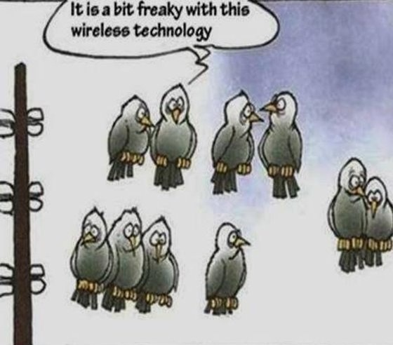
LAWN State Overview - Equipment
Access Points
  Approximately 3700 and growing
  Most are 802.11N 2.4Ghz and 5.8Ghz capable
Controllers
  18 controllers (mostly WISM2)
Networks
  Six /20 networks (ISS Enabled)
  One /22 serving Wired LAWN
  One /24 serving ISS Disabled

Slide 11
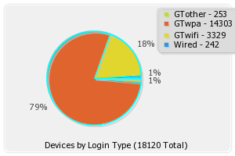
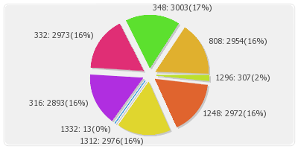
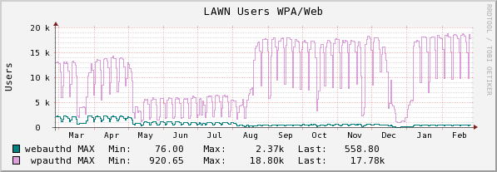
Wireless Usage

Slide 12
Planning for High Density Areas
Areas such as large lecture halls/classrooms with seating of over 100 may need to have special considerations in wireless deployments.
Specialized equipment may need to be purchased and deployed (directional radios).
Wireless configuration parameters in high density areas are outside of the “normal” building areas and are determined on a case by case basis.
Adjacent access points may need to be moved or modified in order to not interfere with high density areas

Slide 13
High Performance Computing
The primary research tool for modeling and simulation… and now analytics on data sets
To Cloud or not to Cloud? HPC today appears to still be about highly customized hardware based on a specific algorithm for cost/performance optimization
How long will that hold?

Slide 14

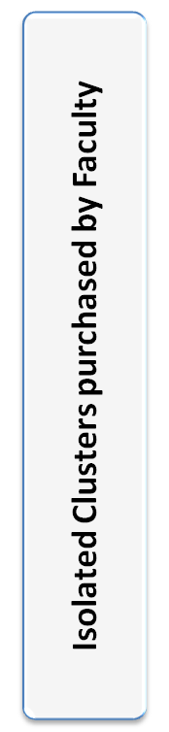
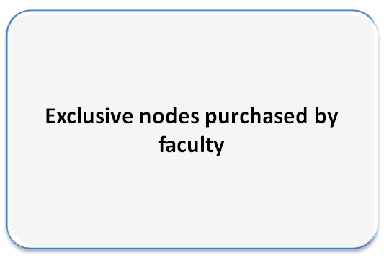
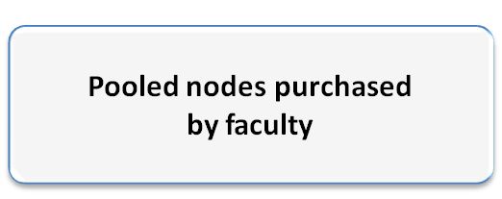




High Performance Computing for Modeling and Simulation…
TECHNICAL SERVICES and SUPPORT
(Hardware & OS Management/Consulting / procurement / purchase )
SOFTWARE LICENSES / TOOLS
Pooled nodes purchased by the Institute
BACKUP / STORAGE / NETWORKING / INTERCONNECT
INFRASTRUCTURE
(Space / Cooling / Power)
Legend:
GT dollars
Faculty dollars

Slide 15
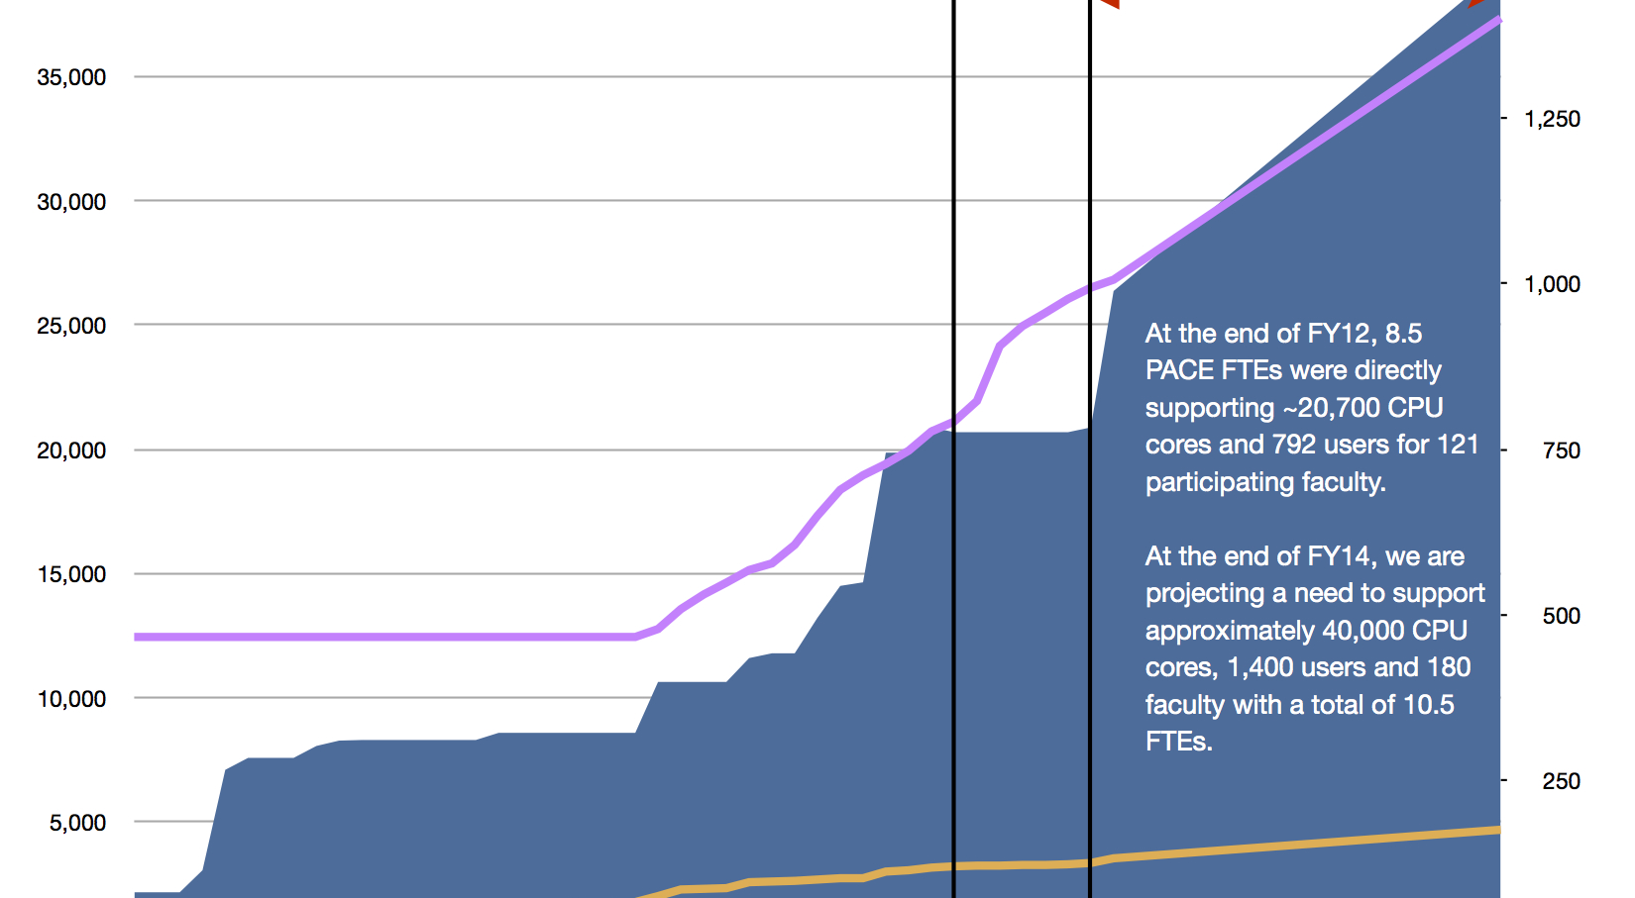
PACE - HPC growth over 5 year period

Slide 16
Big Data? Really?
What is big data? What’s different today than 5 years ago?
Alan’s comments – price of storage has dropped precipitously making larger stores available
Google has “written the book” on hosting and searching large data sets – Hadoop, etc.
Joining of multiple diverse data sets has brought about new discoveries
Health care is one of the largest growing areas of research. Data is becoming king in health related areas – search is replacing investigative diagnosis?
Shared big data sets as a black hole?

Slide 17
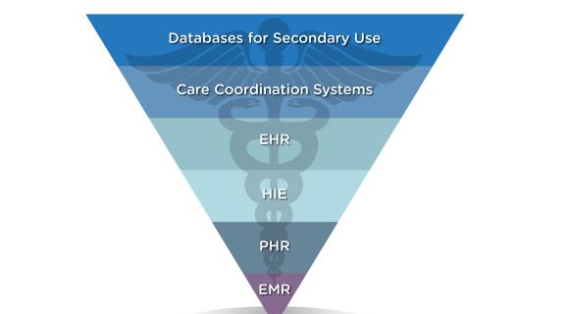
Data sets as strategic resources – data management issues

Slide 18
How do we survive and thrive?
Growth in power consumption
Growth in number of cores needed to do research
Growth in watts per sq. ft. for hosting
Increased need for storage to be colocated with compute and have access to high performance networks
“Put it in the Cloud!” Well…

Slide 19
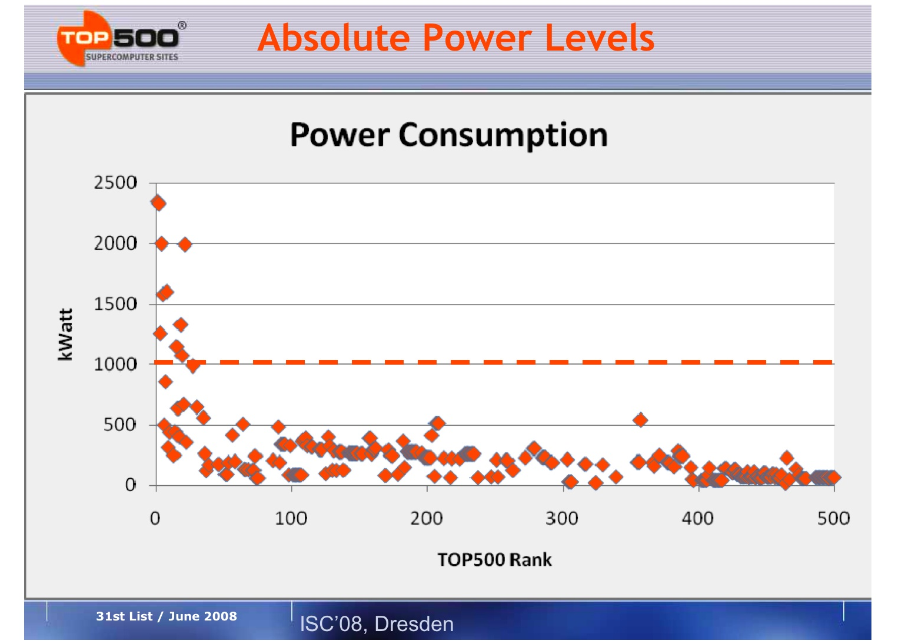
Power as related to Power!
Notes:
From: The Greening of HPC - Will Power Consumption Become the Limiting Factor for Future Growth in HPC?
Horst D. Simon, Associate Laboratory Director, Computing Sciences Lawrence Berkeley National Laboratory and EECS Dept., UC Berkeley

Slide 20
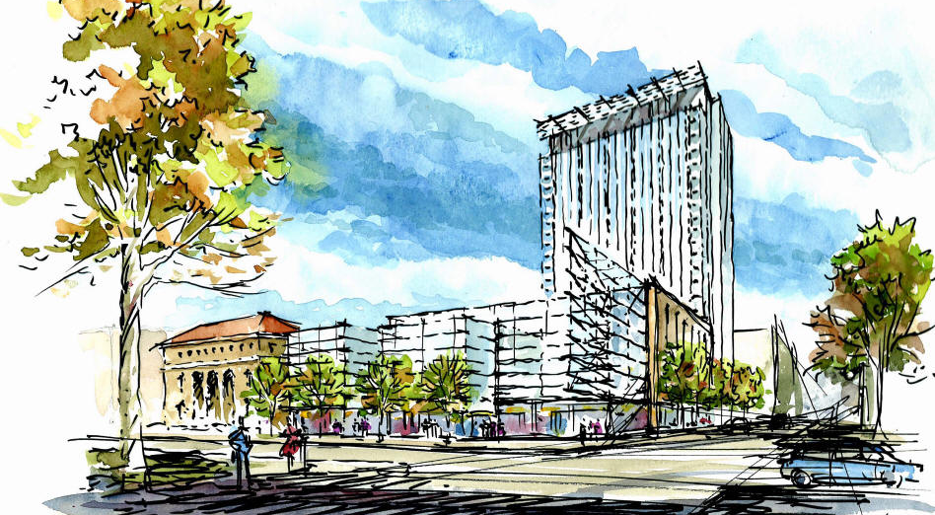
Coda - Hosting

Slide 21
Challenges
Cloud? Where do I invest? If I just wait long enough…
WiFi vs. Cellular??? Is it a choice or a both and…?
Internet of Things? Internet of Everything? Does this make v6 necessary finally?
To host or not to host, may not be the question, but it’s sure confusing…
When is good enough good enough?

