Slide 1
Managing Digital Identity

Slide 2
Agenda
Identity Management: where are we?
Case studies
Mapping digital identities to the student lifecycle
Questions

Slide 3
The Identity Decade:
2000-2009
Portals
Directories
Federations
Etc.

Slide 4
Cradle to Endowment

Slide 5
Lifecycle Identity Management
  Number of identities increases
  Digital identity is the constant (directory)
  As your role changes, so does your access (e.g. portal)
Admit
Enrolled
Applicant
Alumni
Former
Notes:
In the past, digital identities had a relatively short lifespan
Today we have to manage digital identities across a much broader timeframe
Identity for life?

Slide 6
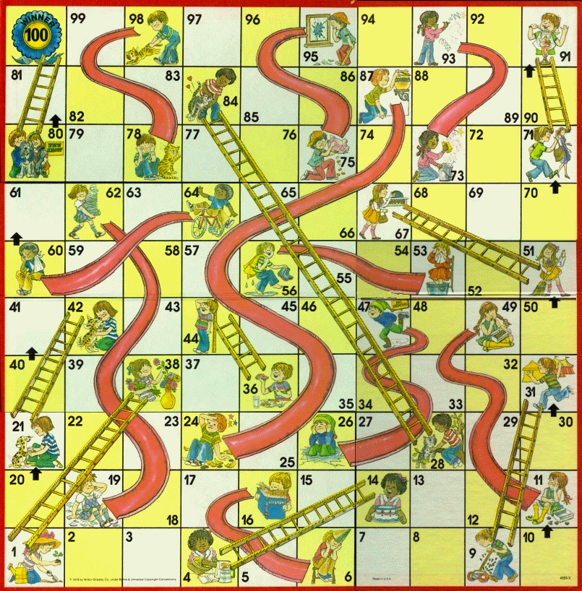
The lifecycle is not always smooth

Slide 7
Challenges
Password reset vs. re-credentialing
System of record?
  Name changes

Slide 8
Identity in the Enterprise
We have a lot of identities to manage and…we have to manage digital IDs across a very long lifecycle
We need infrastructure to manage this lifecycle
  Account provisioning/de-provisioning
  Passphrase maintenance
  Identity aggregation and synchronization

Slide 9
Case Studies

Slide 10
How many identities at IU?
137,448
205,391
450,586
1,003,185

Slide 11
Students at IU
32,201
37,074
214,687
126,357

Slide 12
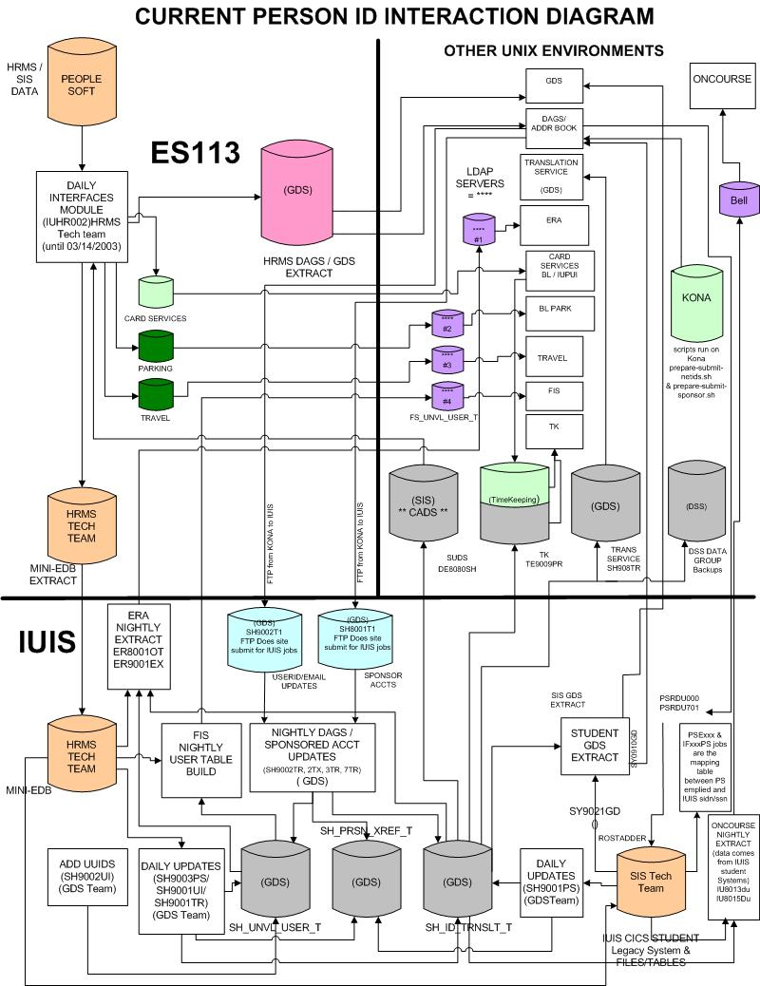
The bad old days…
We need to:
  Simplify
  Consolidate
  Automate

Slide 13

Digital identities @ IU
Identity store
  Active Directory
Credentials
  Passphrases
  SafeWord® tokens
  Security Questions
Notes:
AD is the primary identity store
Your basic account and credential is stored here
Used to access most systems at IU

Slide 14
Authentication @ IU
Central Authentication Server (CAS)
  Trusted login server authenticates users
  Other applications accept CAS tokens for access
  Single sign-on
    CAS server remembers you
    Access multiple applications in a single CAS “session”
Shibboleth/InCommon

Slide 15
Identity Management @ IU
Management systems
  Account Management System (AMS)
    Account provisioning and de-provisioning
    Helpdesk
  passphrase.iu.edu
    Self-service change
    Administrative reset

Slide 16
Identity Management @ IU
Identity Lifecycle Manager (ILM)
Metadirectory
  Central database for all identity data
  Connected to other identity stores
  Aggregates identity data
Sync engine
  When identity data changes anywhere it gets updated everywhere

Slide 17

Identity Lifecycle in action
Applicant
Admit
Enrolled
Former
Alum
Printing
Portal
Alumni
LMS
Identity
Lifecycle
Manager
SIS
E-mail
Active Directory
Notes:
Identity Lifecycle Manager (ILM)
Metadirectory
Central database for all identity data
Connected to other identity stores
Aggregates identity data
Sync engine
When identity data changes anywhere it gets updated everywhere
2/5/2009 8:00 AM
© 2007 Microsoft Corporation. All rights reserved. Microsoft, Windows, Windows Vista and other product names are or may be registered trademarks and/or trademarks in the U.S. and/or other countries.
The information herein is for informational purposes only and represents the current view of Microsoft Corporation as of the date of this presentation. Because Microsoft must respond to changing market conditions, it should not be interpreted to be a commitment on the part of Microsoft, and Microsoft cannot guarantee the accuracy of any information provided after the date of this presentation.
MICROSOFT MAKES NO WARRANTIES, EXPRESS, IMPLIED OR STATUTORY, AS TO THE INFORMATION IN THIS PRESENTATION.
17

Slide 18
Inflection Point?

Slide 19


Identity in the Cloud
More and more services are outside of the enterprise
Will cloud identities make their way into the enterprise???
Notes:
More and more services are being offered in the “cloud”
Examples: hosted e-mail
We still need identity and access, but how to we enable/manage that???

