Slide 1
Implementing an Automated Identity and Access Management System:
Tracking Students on (and away from)Your Campus Through Roles
  Ted Bross, Ed.D.
  Associate Director, Administrative Information Services
  Office of Information Technology
  Princeton University
  tbross@princeton.edu

Slide 2
Who Am I And How Did I Get Here Today (And Why)?
What I learned in Graduate School
  Make sure you have lots of coffee
  Don’t tell adults what they already know
My career at Princeton and before
  My day job (takes up 98% of my time)
  Identity Management (takes up the remaining 22%)
  98%+22%<>100%

Slide 3
Princeton University
4900 Undergraduate Students (all full-time, day)
2300 Graduate Students (almost all full-time, fully funded)
850 Full-time Faculty Members, 6000+ other employees
PeopleSoft ERP (HR, Student, Financials) with many locally developed applications using PL/SQL, Java, PHP and dotNet for other administrative functions; BSR ADVANCE and Blackboard among a set of third party vendor applications
No Medical School, Dental School, Law School, Business School (I died and went to heaven)
Existing “Patchwork” set of incomplete and manually intensive solutions for Identity Management (some of our faculty and staff died, went to heaven and still appeared on our on-line directory)
LDAP enabled Sun Directory used for authentication with PeopleSoft Campus Community as the authoritative source of people
New Identity Management Project kicked off in September 2007; restarted in September 2008; go-live on July 7, 2009 (Phase I-yes it is a project)
Data governance structure fully in place since 2000, primarily due to Campus Community

Slide 4
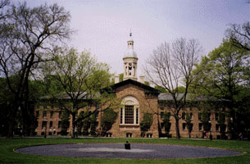

Slide 5
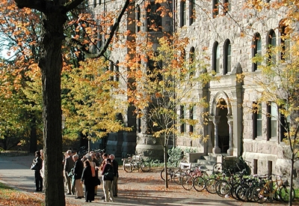

Slide 6
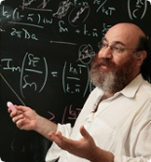

Slide 7


Slide 8


Slide 9
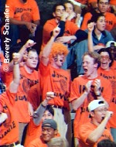

Slide 10


Slide 11

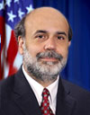


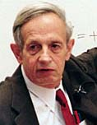
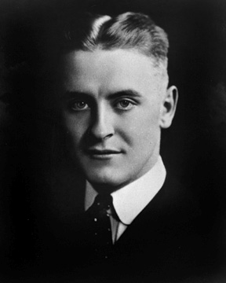


Slide 12
“No grand idea was ever born in a conference, but a lot of foolish ideas have died there.”
F. Scott Fitzgerald

Slide 13


Slide 14


Slide 15
High Level Objectives of the Identity Management Project (Phase I-YES, IT IS A PROJECT)
Automate the creation of the university NetIDs
Automate the provisioning and deprovisioning of user accounts and the services to which those users are entitled (e.g.-Unix, AD, Public Search Directory, OPM etc.). This is for central authentication, not authorization, only
Establish self-service user account claiming and password reset processes
Support Single Sign On (SSO)
Strengthen application security, starting with the 9.0 version of the PeopleSoft HR and Student systems, by using stepped up, “bank-like” functionality
Lay the groundwork for additional phases, such as centralized authorization and federated identities

Slide 16
Source System: Where it all Begins
Princeton uses PeopleSoft for all ERP Systems (Student, HR, Financials)
Combined Student, HR database with Campus Community holding all the “person” records
Only one record may exist per person with a unique number generated in Campus Community
PeopleSoft feeds the Oracle Identity Management Suite(creates records and then reads Sun LDAP enabled directory)
Princeton created the concept of affiliations and statuses in PeopleSoft in 2001 (bolt on)

Slide 17
Key Considerations
Each Step in the Person Life Cycle=New Affiliation/Status (Role)
Affiliation=How You are Related to the University (High Level)
  Student, Employee, Alumnus, Kin, Miscellaneous
Affiliation Group=Further Defines the Affiliation
  Student: Undergraduate, Graduate, Special Student
  Employee: Dean of Faculty, Human Resources, PPPL
  Miscellaneous: Departmental Computer user, Docent, Trustee, Corporate Vendor
Status=Temporal and Relative Relationship
  Active, Inactive, Deceased, Retired (High Level)
    On Leave, Voluntary Withdrawal, Suspended (Granular)
    i.e.-a student on leave is still considered active; a student who is suspended is considered inactive

Slide 18
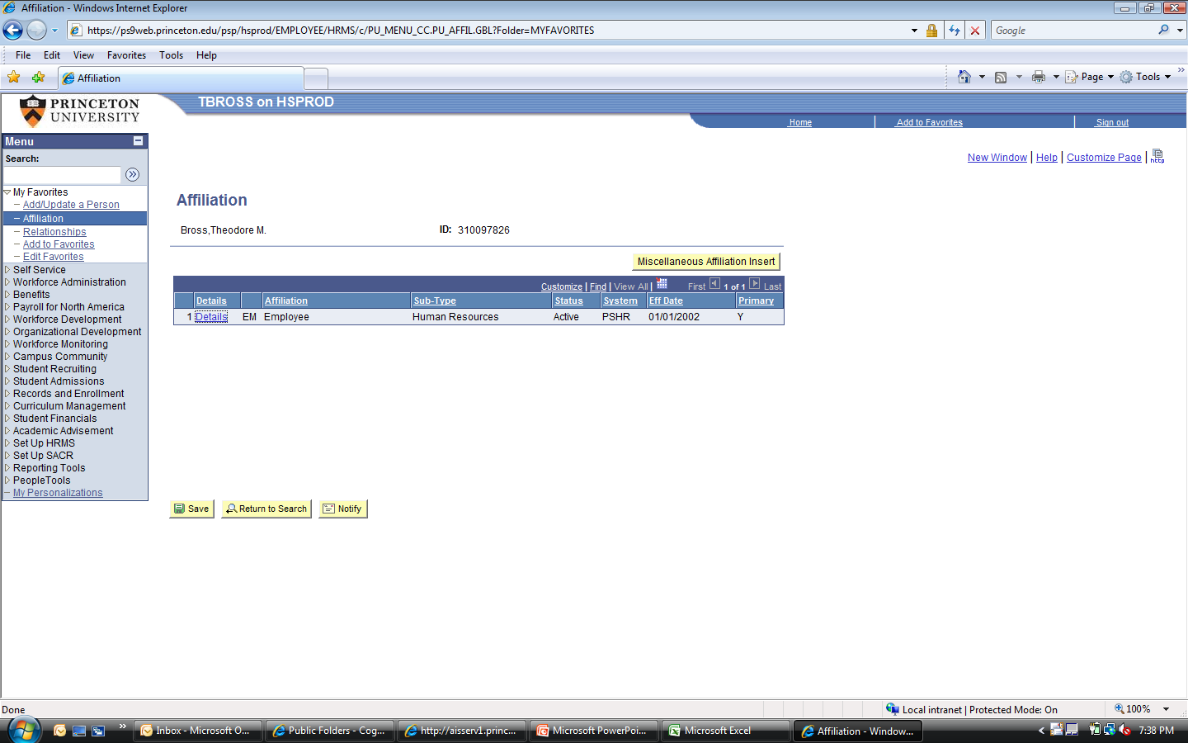
Affiliation Page-Employee Only

Slide 19
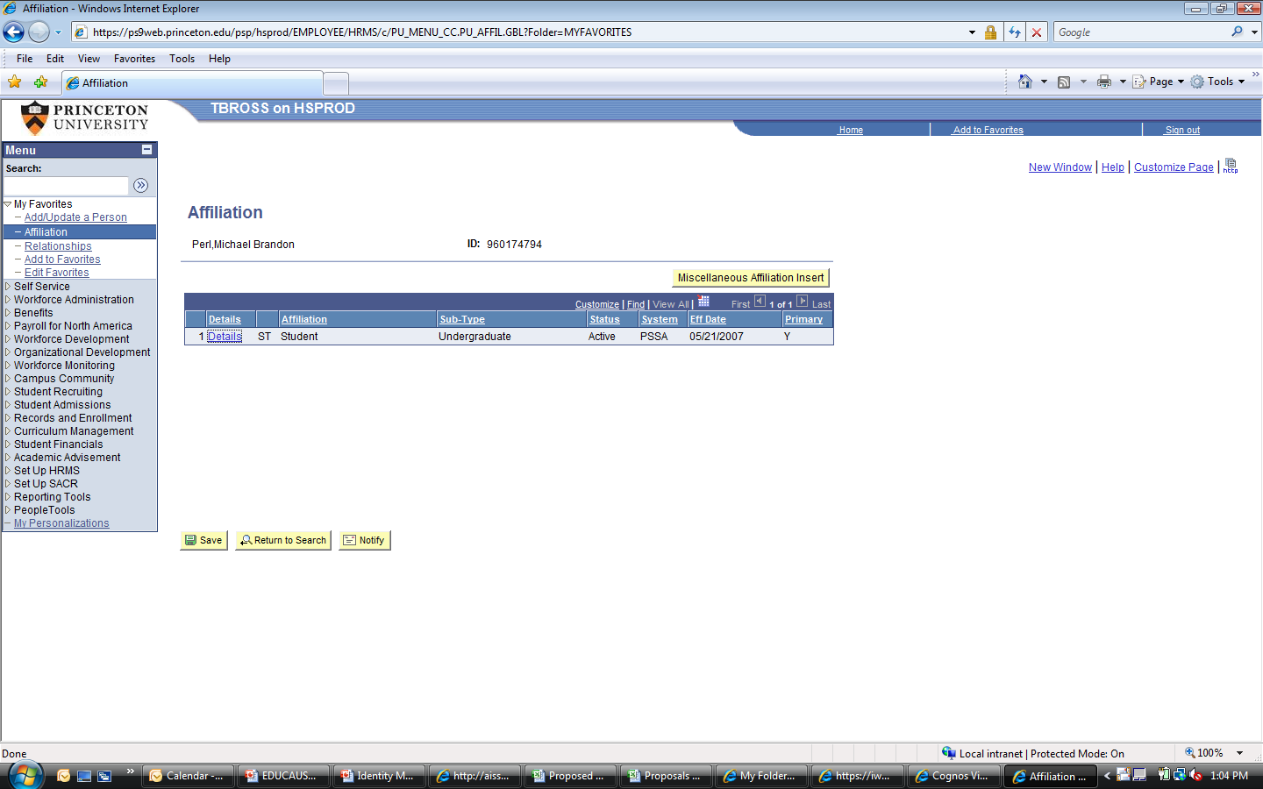
Affiliation Page-Undergraduate Student Only

Slide 20
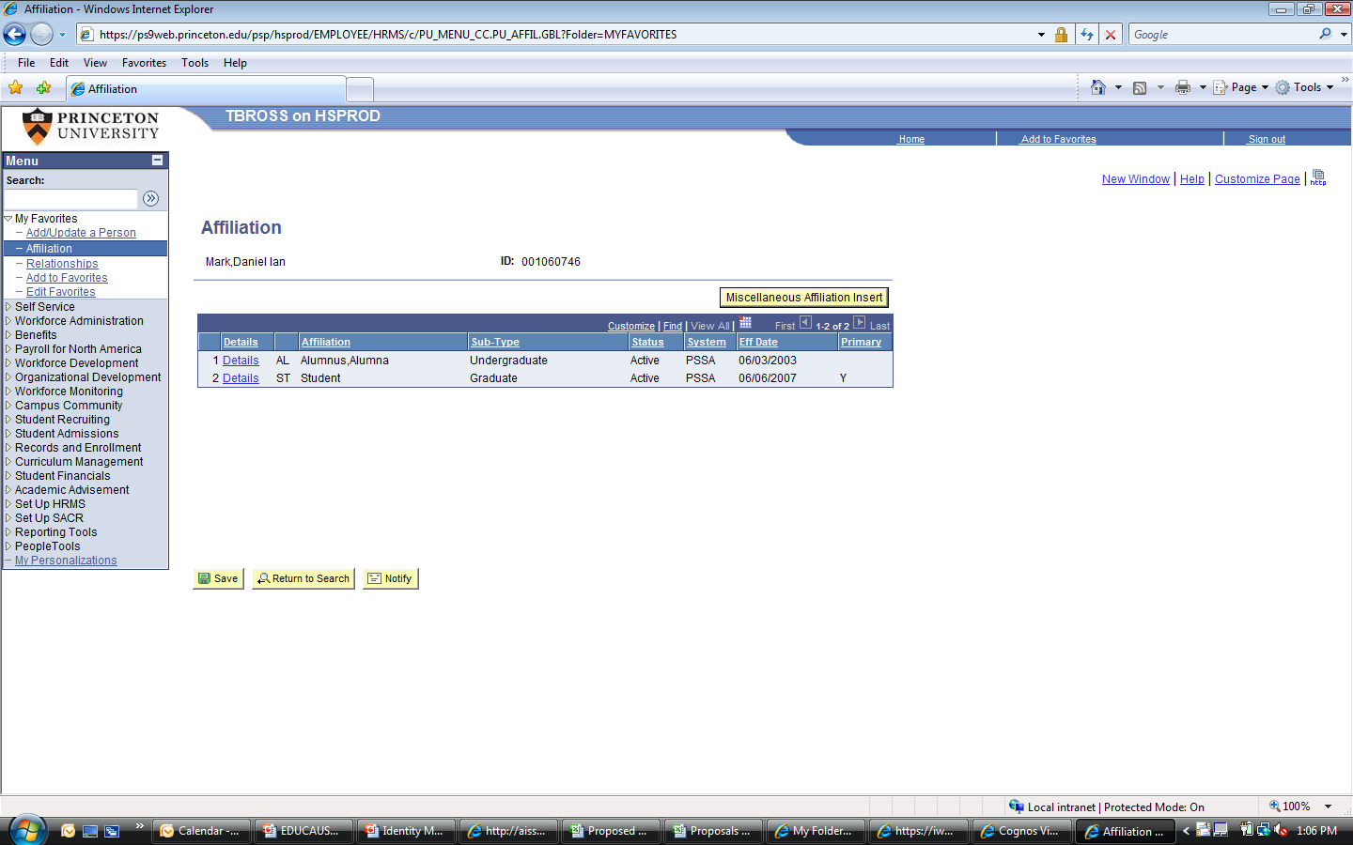
Affiliation Page-Undergraduate Alumnus and Active Graduate Student

Slide 21
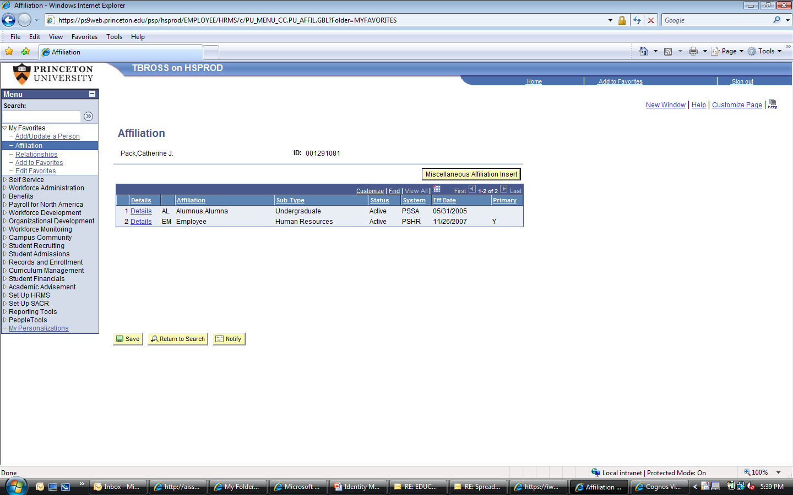
Affiliation Page-Undergraduate Alumnus and Active Employee

Slide 22
The Typical Student Life Cycle
Prospect (creates a skeletal record in PeopleSoft)
Applicant (adds applicant information in PeopleSoft)
Admitted (we admit the student)
Accepted (the student accepts our offer of admission)
Matriculated (creates a student record)
Progress Towards Degree
  Change in Class Year; qualifying events for Graduate students
  Stop In/Stop Out Events (leaves, withdrawals)
  Graduation (Alumnus)
  Post Graduation Relationship(s)-(Second Student Career/Employee/Trustee/Parent/Other)

Slide 23
Electronic Credentials-Services
What is the Princeton NetID?
How is it generated?
When is it awarded?
When is it inactivated?
What services/privileges are tied to the NetID and how do they change over time?
What is the difference between centralized authentication and authorization?

Slide 24
The Typical Student Life Cycle and the Princeton NetID
Prospect (creates a skeletal record in PeopleSoft)
  NO NETID
Applicant
  NO NETID
Admitted (we admit the student)
  NO NETID
Accepted (the student accepts our offer of admission)
  NO NETID
Matriculated (creates a student record)
  NETID Created
Progress Towards Degree
  Change in Class Year; qualifying events for Graduate students
    Might Cause NETID status change
  Stop In/Stop Out Events (leaves, withdrawals)
    Might Cause NETID status change
  Graduation (Alumnus)
    Currently causes NETID inactivation-will not in future when multiple LDAPs are merged
  Post Graduation Relationship(s)-(Second Student Career/Employee/Trustee/Parent/Other)
    Will reactivate the NETID and assign new services and privileges

Slide 25
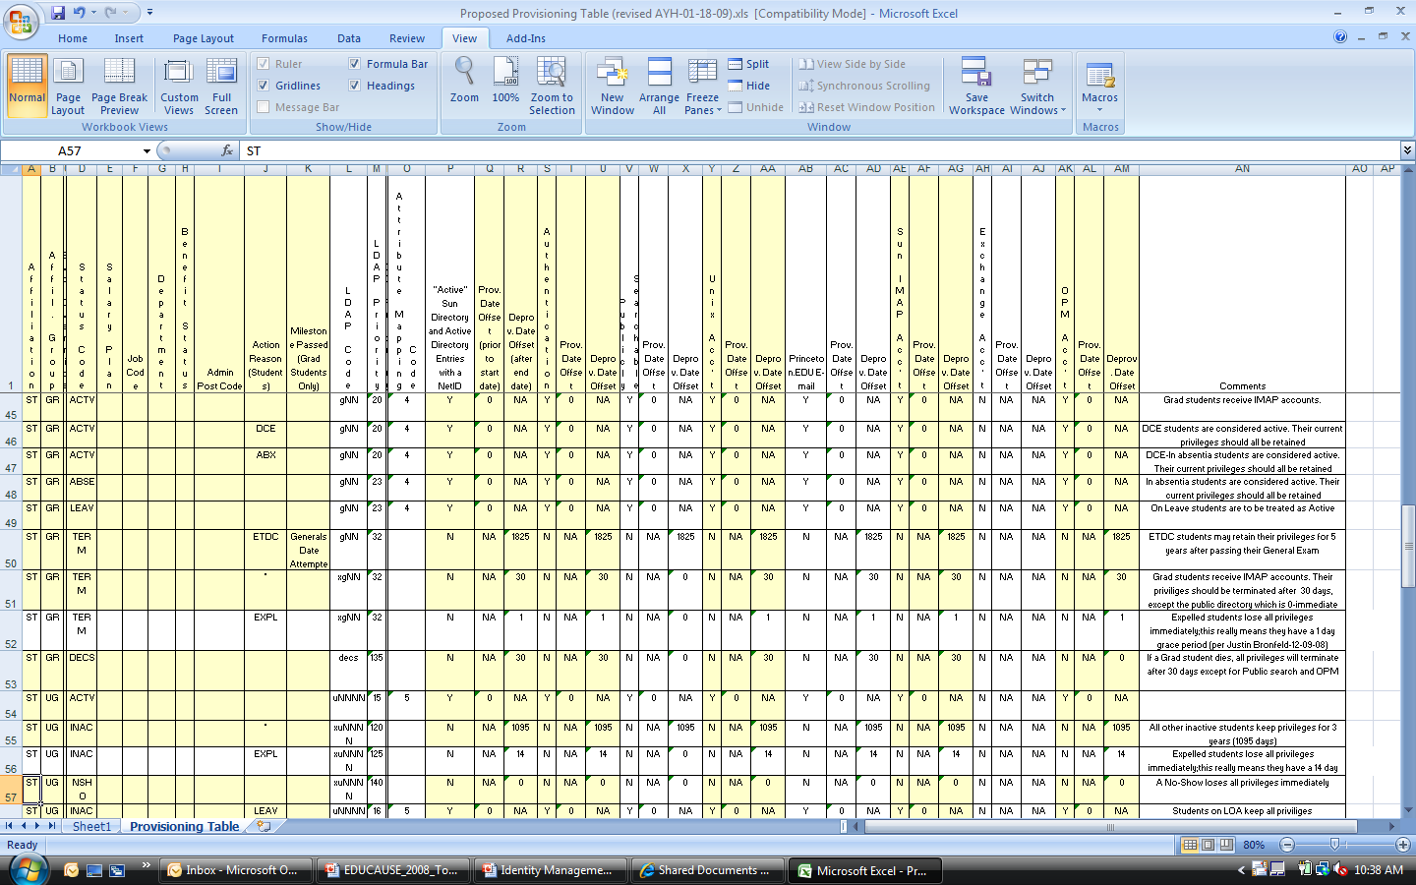
Provisioning Spreadsheet

Slide 26
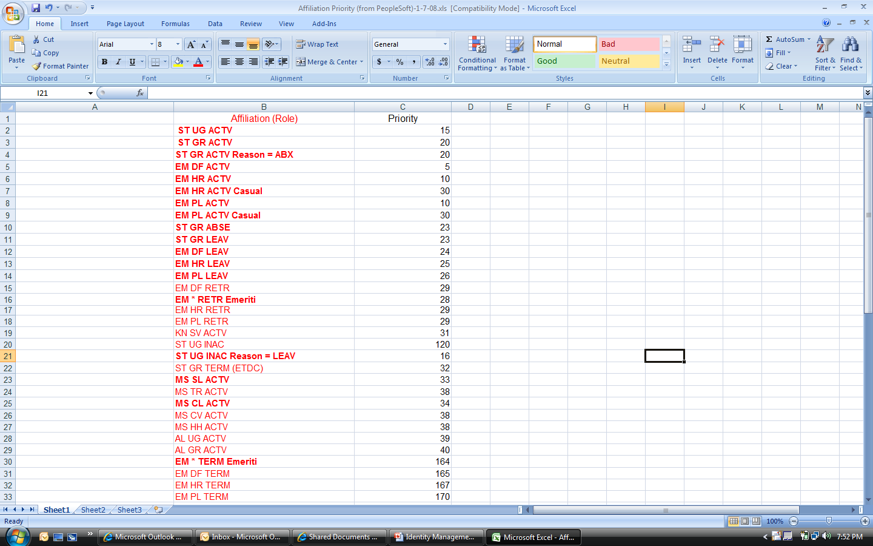

Slide 27


Slide 28


Slide 29
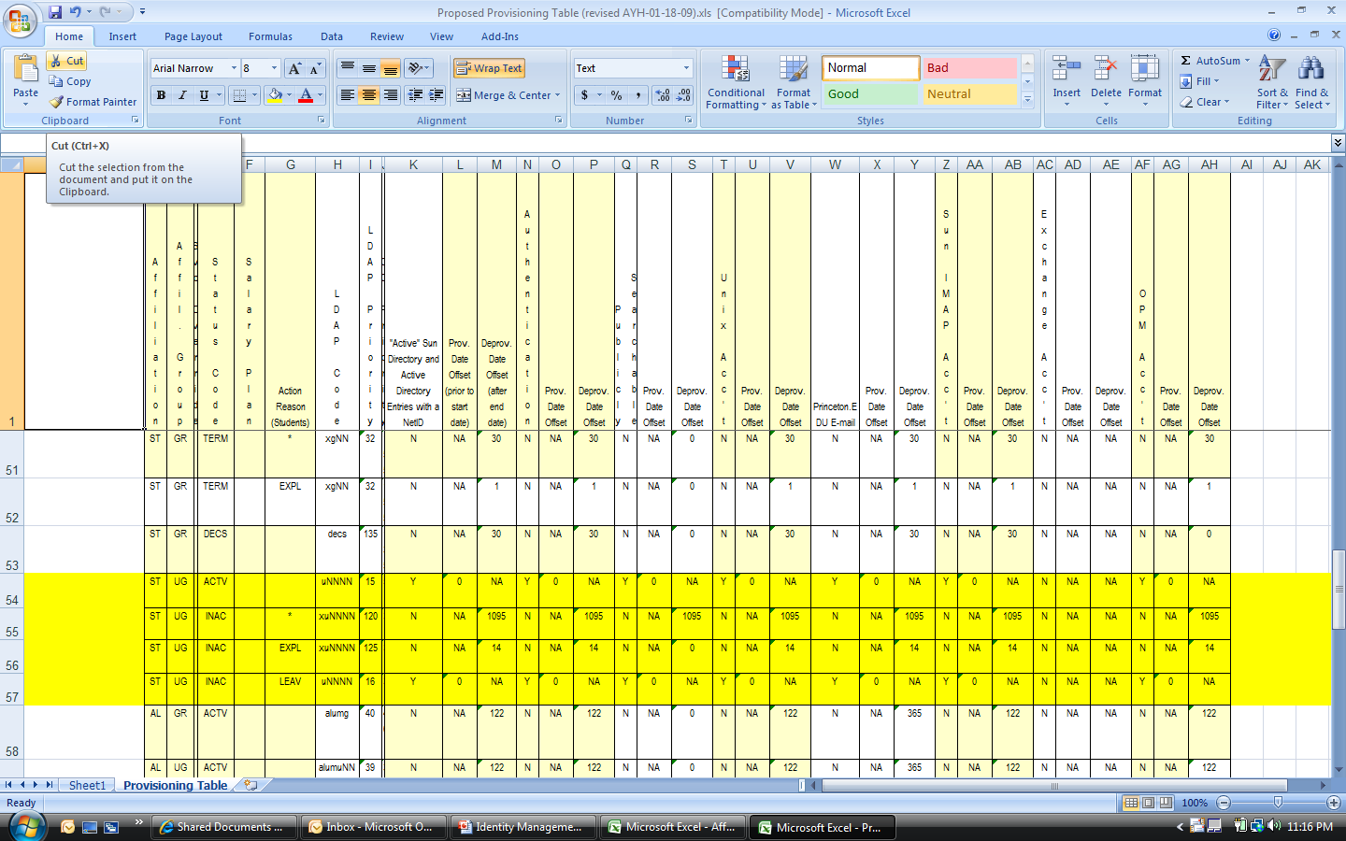

Slide 30
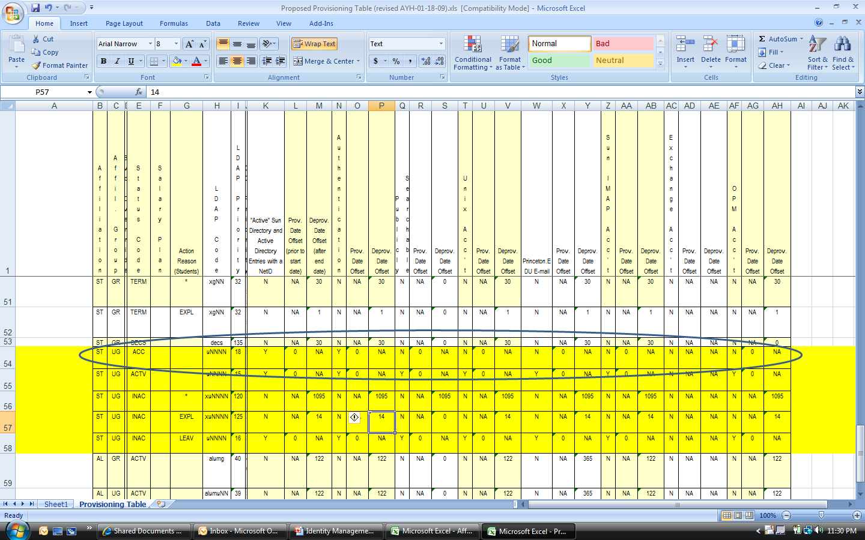

Slide 31


Slide 32
Some Real Life Challenges
Special Students who do not enroll in consecutive terms
Systems that do not have their own authentication mechanisms and equate authorization with authentication
Alumni who need transcripts

Slide 33
Special Students
Most do enroll in consecutive terms
  Extend their “offset” deprovisioning rule to 122 days
  This allows for a smooth transition from fall to spring and spring to fall registrants
  Still causes a problem for fall to fall and spring to spring registrants (the NetID becomes inactive prior to their next term)

Slide 34
Authentication=Authorization
Some of the older systems (few left)
Limited threat (any system that needs more security has that built in already)
The problem will be addressed in Phase II by using Virtual Directories
  The IdManagement system will authenticate against a virtual directory that has only students, faculty and staff and not include others with a valid NetID

Slide 35
Alumni Transcripts
Current mechanism is for alumni to enter a web application that authenticates against the “alumni LDAP” directory
The request returns the PUID (9 digit number that is generated in PeopleSoft and replicated in both directories)
The PUID is then sent, via batch, to PeopleSoft and a transcript is created for the alumnus
Phase II calls for the merging of the directories so that alumni will use the same application as do current students
  The alumnus will keep his NetID and authentication privileges
  All other services will be deprovisioned according to the spreadsheet (122 days after commencement)

Slide 36
Top 10 Things Learned in an Identity Management Project
Identity management is still in its infancy and you will soon become an expert and a leader in the field very quickly.
Make sure you have full campus buy in, both from the top down and bottom up
Treat the project like a full ERP implementation, with a dedicated project team, a full project plan, stakeholders and a proactive communications plan.
Do not underestimate the sheer volume of work/time needed, both from a technical and from a functional perspective.
Make sure you actively manage your consulting partner.

Slide 37
Top 10 Things Learned in an Identity Management Project (cont.)
Make sure your consulting partner and your application vendor are on the same page.
Make sure your consulting partner and your application vendor understand the complexities and idiosyncrasies of a university environment.
Nail down all your business rules early in the project and look for ways to reengineer antiquated university business practices.
Make sure you enlist (and keep) the correct people on the project, both on your own project team and on your consulting partner’s team as well.
If it looks and sounds too easy to be true…it probably is.

Slide 38
Thank you for your interest!
Questions, comments, concerns?

