Slide 1
Identity Management
An Auditor’s Perspective
Influenced By Some Really Talented IT Staff From the University of Minnesota and Others In Higher Ed

Slide 2

Outline
Introduction
One auditors perceptions about Identity Management
Understanding auditors so you can get ahead of them
Concluding Observations/Ideas

Slide 3
Introduction
About me
Quick exercise
What do the results of the exercise say about the relationship of auditors to their clients?

Slide 4

Setting the Stage – Today’s Reality
From FY 2010-11
Biennial Budget Presentation By Governor Tim Pawlenty
Today we are preparing the next budget based on revenues of $31.9 billion
Concluding Observations/IdeasEconomy is expected to shrink by 2.5%
2,720,400 Minnesotans have jobs
Federal budget deficit is $1.2 trillion (8.3% of GDP)

Slide 5
FY08-09 vs. Proposed FY10-11
STATE OF MINNESOTA
Proposed by Governor Tim Pawlenty
.
($ millions) | FY 08-09 | Gov 10-11 | % Chg.
K-12 Education* | 13,797 | 14,059 | 1.9
Higher Education | 3,099 | 2,845 | (8.2)
Local Aids, Prop. Tax Credits | 3,062 | 2,897 | (5.4)
Health & Human Services** | 10,328 | 11,324 | 9.6
Debt Service/Capital Projects*** | 883 | 114 | (87.1)
All Other Omnibus areas | 3,919 | 3,555 | (9.3)

Slide 6

Pawlenty proposes $151 million cut to U
.
University President Bob Bruninks speaks to state senate members at a lunch in Coffman Memorial Union on Tuesday. In reaction to Gov. Pawlenty’s announcement of 151 million dollar budget cut to the University Bruninks states, “You didn’t hear the University whine last time; you won’t hear the university whine this time.” Jules Ameel, DAILY

Slide 7
Total Technology Expenses $92 Million
A Few More Facts and Figures

Slide 8
IT expenses at U of M

Slide 9
Bottom line to IT
Institution would like everything
Funding is shrinking
Reality For U Of M
    Our management is focused on transformational initiatives
    Our management is focused on greatest value

Slide 10
Shifting Gears- One auditors perceptions about Identity Management
Trust and Identity Management
Are Very Closely Linked

Slide 11
The Speed of Trust By Stephen Covey
Nothing is as fast as the speed of trust.
Trust impacts us 24/7, 365 days a year.
Trust lost is hard to regain.

Slide 12
We need to find ways to trust more if we are going to cut costs
Covey suggests
Trust = Cost + Speed

Slide 13
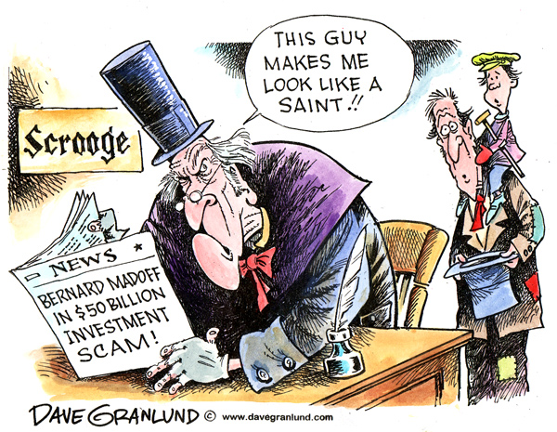
We need to find ways to trust more but that does not mean blind faith

Slide 14
Covey suggests there are
4 cores requirements for establishing credibility
Integrity
Intent
Capabilities
Results
.
See
“Paradigm Shift”
Behave
“Behavior Shift”
Speak
“Language Shift”

Slide 15
5 Parts to Understanding Auditors
So
You can get ahead of them
To
Build or Expand Trust
Trust = Cost + Speed

Slide 16
What do most auditors want in systems and business processes?
Understanding Auditors Part 1
Integrity
Reliability
Consistency
.
Integrity
Intent
Capabilities
Results
.
Covey’s 4 core requirements to establishing credibility

Slide 17
What should folks on Identity Management projects look to demonstrate to their auditors?
.
Integrity
Reliability
Consistency
.
Look to answer questions like:
How do we know that person using our systems is who they claim to be?
How do we know that person can’t switch identity unexpectedly?
How do we know the process works the same for all folks of the same class?
.

Slide 18
An exercise to demonstrate how most auditors think
Understanding Auditors Part 2
Most auditors care about risk minimization
Auditors should be saying they want to
avoid unnecessary risk not avoid all risk
.

Slide 19
What we fear most?
Nothing is more fearful than the unknown

Slide 20


The Blair Witch Project
Shot in a mixture of color and black and white, with shaky handheld camera movements and only natural lighting, the footage includes material that was intended to be used in the documentary, but the bulk of the film shows the experience of the three students as they wander through the woods. Occasionally, the view switches out to a kind of "mood footage" (footage of no characters, just video of the environment) while the audio track continues.

Slide 21
Look for ways to show the auditors that as you are implementing an identity management tool and process ,you are
Starting with small bets
Understanding and managing the risk by:
Identifying important risks
Mitigating the unnecessary risks
Managing the big risks
Keeping senior management aware of the
large risks that you can’t eliminate or manage
.

Slide 22
Understanding Auditors Part 3
What is many auditors favorite maxim on trust?
Trust but verify!
Auditors are in part paid to be the professional skeptic

Slide 23
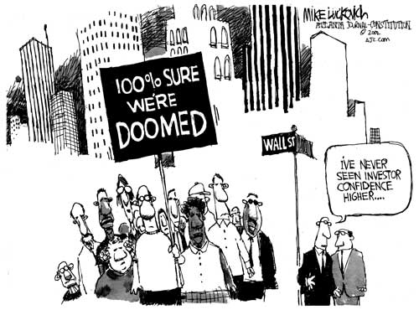
The Speed of Trust By Stephen Covey
Trust lost is hard to regain.

Slide 24
What should folks on Identity Management projects do to help their auditors understand?
Show your auditors why you know/believe your tool and process are working as intended by doing things like
Listing key controls and how you periodically verify they continue to work as intended
Getting SAS 70 reports from outside service providers
Working on contract language such as:
  Right to SAS 70 reports
  Right to audit
  Requirement to be notified in a timely manner of any breach
.

Slide 25
Understanding Auditors Part 4
Do the Identity Management systems and processes help us improve the odds that we will accomplish our mission of :
Most auditors care about the bottom line
Teaching
Research
Outreach
.

Slide 26
What can you do to get the auditor pulling with you?
Look for ways to demonstrate/quantify the benefits of the Indentify Management project such as:
Better alignment of rights with business need
Easier to revoke rights when no longer have a business need
More/better seamless interaction with customer
Less system development effort for security concerns
Removal of need to do much of security audit work in individual applications or business reviews because using a consistent identity management system
.

Slide 27
Understanding Auditors Part 5
Most auditors are interested in emerging issues
Many of us auditors know use of cloud technology and tools like Google apps is not only unavoidable but shouldn’t be avoided.
However, most of us auditors don’t fully understand the potential risks and tools that can be used to manage those risks.
Most of us know identity management tools are likely one of the technologies that can help us manage this new world

Slide 28
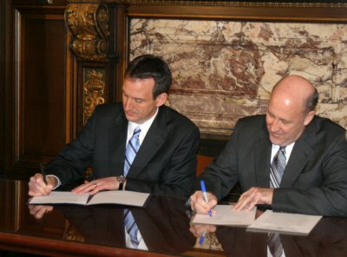
An example where cross organization Identity Management projects will likely help
.
Governor Pawlenty and Wisconsin Governor Jim Doyle hold a press conference announcing
a nation-leading effort to identify
potential shared services between their states

Slide 29
What can you do to build trust with your auditors?
Collaborate with your auditors as they/you try to get answers to questions like:
How do we evaluate the security of cloud technology?
Are there strategies so we can use things like Google mail for students but ensure sensitive data like grades are not being stored in the cloud?
How do we ensure limited roll-outs to cloud technology (e.g., use of Google mail for students) are rational and controlled?

Slide 30
How do we manage access for folks who have multiple roles like those who are both students and employees?
How do we ensure sensitive data which by law can’t leave the US stays in the US, if we use cloud technology?
What are we required to do if our data that is located in the cloud gets compromised? What are the reporting requirements?
What is our backup plan or recovery plan if cloud technology fails/is unavailable?

Slide 31
What do we do if use of cloud technology gets expensive after we convert to cloud technology and discard internal systems?
What is our backup plan or recovery plan if cloud technology fails/is unavailable?
.

Slide 32
Concluding Observations
These are tough economic times and we need to focus on:
Transformational initiatives
Greatest value
Identity Management tools and processes is likely one of the technologies that can help us manage this new world
Nothing is as fast as the speed of trust.
Trust = Cost + Speed

Slide 33
4 cores to credibility for trust and identity management tools and processes include:
Trust and Identity Management are closely linked
Integrity
Intent
Capabilities
Results
.
A catalysis for positive change
A partner in your success.
Most auditors want to be:

Slide 34
Next time your parent’s or kid’s eyes glace over when you try to explain your job, tell them
You have a critical job
You are a steward of trust
Nothing is as fast as the speed of trust.
Trust = Cost + Speed

Slide 35
Questions/Comments
The Speed of Trust By Stephen Covey
Trust = Cost + Speed

Slide 36
Final Advice
Continue your vital work to help build trust in and across our organizations
Give us auditors a second and third chance, most of us auditors really do want and need to be on your side

