Slide 1
Kuali Identity Management
Advanced CAMP: Identity Services Summit for Higher Ed Open / Community-Source Projects

Slide 2
Presenters
Eric Westfall – Indiana University
Kuali Rice Project Manager
IU Workflow Technical Lead
Ailish Byrne – Indiana University
Kuali Financial Systems Development Manager
IU Financial Systems Manager
Leo Fernig – University of British Columbia
Kuali Student Lead Architect
Notes:
What we want to achieve in the 1 hour session today:
<Read from slide>

Slide 3
Rice Terms
KIM: Kuali Identity Management
KEW: Kuali Enterprise Workflow
KNS: Kuali Nervous System (Web Development Framework)
KSB: Kuali Service Bus
KEN: Kuali Enterprise Notification

Slide 4
Overview
The Kuali Identity Management module will be included in version 1.0 of Rice
Provides identity and access management services to Rice and other applications
Includes a service layer as well as a set of maintenance screens
Supported Concepts include:
  Entities and Principals
  Groups
  Roles
  Responsibilities
  Authentication

Slide 5
Motivation
As more projects began to use the Kuali Rice framework, we identified a need for a common API for Identity and Access Management
Wanted to introduce the concept of Roles and Permissions into Kuali, previously groups were used for authz
Ease the implementation overhead for implementers working with multiple Kuali projects
Results in one-time institutional customization of identity services for all Kuali projects

Slide 6
Design Goals
Shared identity and access management services that all Kuali projects can use
Generic enough to be used by non-Kuali projects
Provide a rich and customizable permission-based authorization system
All services available on the service bus with both SOAP and Java serialization endpoints
Provide a set of GUIs that can be used to maintain the data

Slide 7
Design Goals
Provide a reference implementation of the services but allow for customization/replacement to facilitate integration with institutional services or other 3rd party IDM solutions
Allow for the core KIM services to be overridden piecemeal
  For example: override the Identity Service but not the Role Service

Slide 8
Terminology
Entity – a Person or System which exists within KIM
Principal - represents an Entity that can authenticate into the system
Group – consists of one or more principals or other groups
Permissions – ability to perform actions
Permission Details – additional information on a specific permission used to further qualify it (i.e. permissions that are associated with a particular Document Type in KEW)

Slide 9
Terminology
Roles – permissions are granted to roles, principals and groups are assigned to roles
Role Qualifications – additional attributes on a role assignment that help to qualify the role member’s relationship to the role
  i.e. a principal could be assigned the “Account Manager” role with a qualification of “account # 12345”
Responsibilities – granted to a role, gives role members responsibilities to perform certain actions (such as approving documents routed by KEW)

Slide 10
Services
KIM consists of the following services which encompass it’s API
  IdentityService
  GroupService
  PermissionService
  RoleService
  ResponsibilityService
  AuthenticationService
These are read-only, there are also “update” services which allow for write operations

Slide 11
Services
KIM also provides various façade services that sit on top of the other core services and provide features such as caching
  Identity Management Service
  Role Management Service
It is intended that client applications will interface primarily with these services
Role Management Service provides on-the-fly assignment of permissions to roles via the API

Slide 12
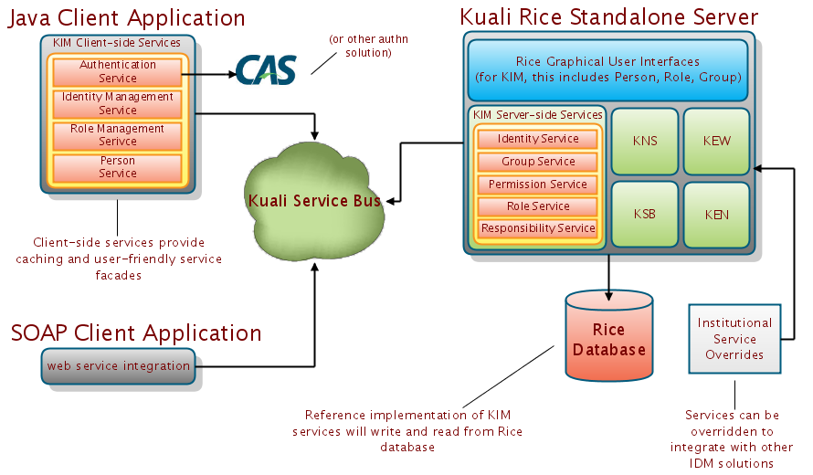
Architecture diagram

Slide 13
Kuali Financial System Perspective

Slide 14
Entity Attribute Requirements
Examples (not a comprehensive list)
Email: Electronic Invoicing Notifications
Tax Identifier: Payments to Research Participants
Campus: Workflow, Check Formatting
Salary: Budget Construction, Labor Distribution
Affiliation: e.g. Faculty, Staff, etc. – Roles

Slide 15
Role Requirements
Collection of primary organization for Affiliates (people without employment records)
Ability to differ primary organization by module in use
Ability to override primary organization derived from department on job record for Faculty / Staff
Recognition of Organization Hierarchy (one of many types of logic)
Derived (application) roles, e.g. functional users and applications not using KIM need Fiscal Officer on the account table in the financial system

Slide 16
Permission Requirements
Smarts!
  Accomplished via templates & the KNS
  Allow functional users to add permissions without code modifications
Hooks for logic
  Recognition of document type hierarchy
  Wildcard matching, e.g. namespace
Both of these lead to overriding capabilities that cut the sheer number of permissions by at least 75%

Slide 17
Responsibility Requirements
Workflow actions need to roll up to the same source as permissions, e.g. approve, resolve exception
Need same recognition of document type hierarchy and override capabilities as with permissions
Functional setup / grants should be similar

Slide 18
Tremendous Improvements
Tying qualifying, application data to assignments rather than the record the permission is associated with
Sharing roles that have permissions and responsibilities across multiple applications
Maintain all user information in one place
  One document for all person setup
  Use role or group document for bulk setup
  Retain ability for applications to validate their data
Significant enhancements to route log
Document Type IDM Hierarchy!

Slide 19
Future Improvements
Replace User document with same hooks as we have for removal (inactivation) now
At IU, we will be looking at tying positions to role for templating during hires and transfers

Slide 20
Kuali Student and KIM
20
December 2007 workshop with Kuali folk
2008 Development of core Kuali Student Services
June 2009 integration of KIM and Kuali Student.
KIM is also viewed by many KS partner Universities as the enterprise solution for authorization:
  A set of re-usable interface defintions that existing implementation
  As the implementation

Slide 21
KIM and the Enterprise
ERP
KIM
Roles
HR
Permissions
Finance
Roles
Student
Attributes

Slide 22
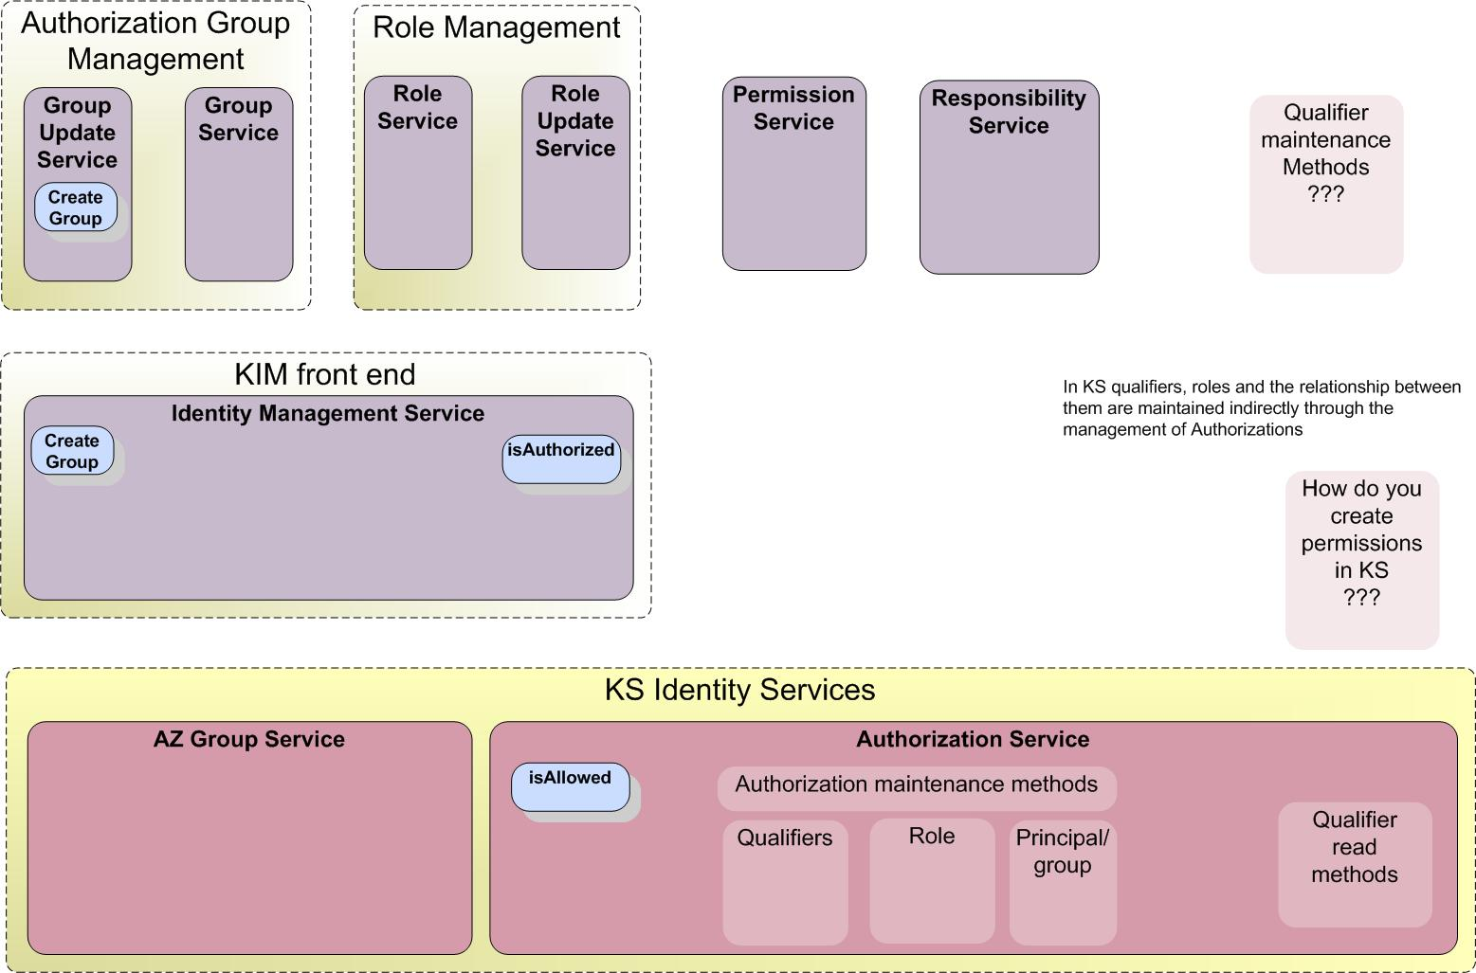
Aligning Boundaries and definitions

Slide 23
Questions?
rice.collab@kuali.org

