Slide 1
Developing an Online Community for the Sharing of Research
Andre Tan
Lead Web Architect, ResearchChannel,
University of Washington

Slide 2
“
”
I need to get my work out there out there…
But How?
Notes:
There are a few obvious answers to that, but the first one that came to mind is…

Slide 3
“
Get published in a journal, of course…
”
Notes:
“… and they’re useful once you’ve completed your research”
What if there was a way to get your work out to the world instantaneously and while you’re in the midst of your research?

Slide 4
“
Get published in a journal, of course…
”
(but first I need to get my work done…)
Notes:
“… and they’re useful once you’ve completed your research”
What if there was a way to get your work out to the world instantaneously and while you’re in the midst of your research?

Slide 5
“
I’ll just put something up on the Web…
”
Notes:
… it’s not always that easy.
You need to know where to host your website, how to build your website. Beyond that, what if you want a blog, a wiki, or streaming video?
You can probably work your way through all of these things and set up a robust web presence, but chances are they will be individual service silos (stuff on YouTube, Flickr, message boards on other hosts, etc.)

Slide 6
HTML?
Blogs?
Content Management Systems?
Streaming Video?
“
I’ll just put something up on the Web…
”
(but that’s not always as easy as it sounds…)
Wikis?
Forums?
Cascading Style Sheets?
Databases?
Notes:
… it’s not always that easy.
You need to know where to host your website, how to build your website. Beyond that, what if you want a blog, a wiki, or streaming video?
You can probably work your way through all of these things and set up a robust web presence, but chances are they will be individual service silos (stuff on YouTube, Flickr, message boards on other hosts, etc.)

Slide 7
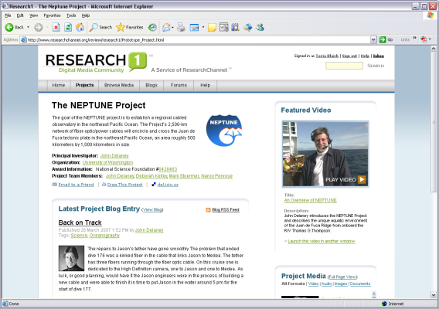
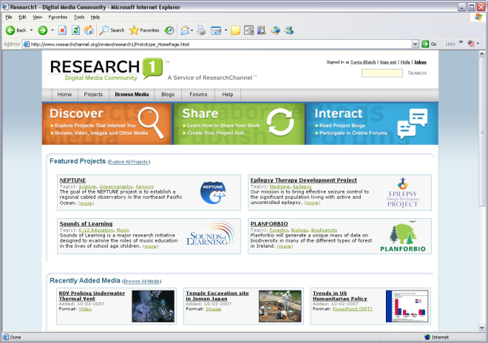
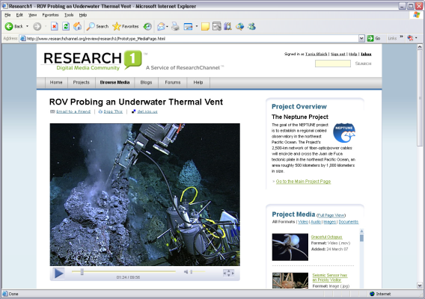
Research1 is an online community that allows researchers and academics to share their work, and interact with peers and the public

Slide 8
Research1 Core Features
Easily create a “Project Hub” that serves as a
public-facing webspace for their work and/or a private collaboration area for team members
Upload, store, and publish digital media in multiple formats including video, audio, images and documents
Publish a blog for the project to discuss ongoing work
Interact with other researchers and the general public through project- and discipline-specific message boards, and private messaging

Slide 9
The Research1 Platform
Digital Well – Digital Asset Management, Storage and Delivery
Community Server – Blogs, Forums, User Management, Authorization Model
Custom Integration – Project Space, Project Management, Authentication

Slide 10
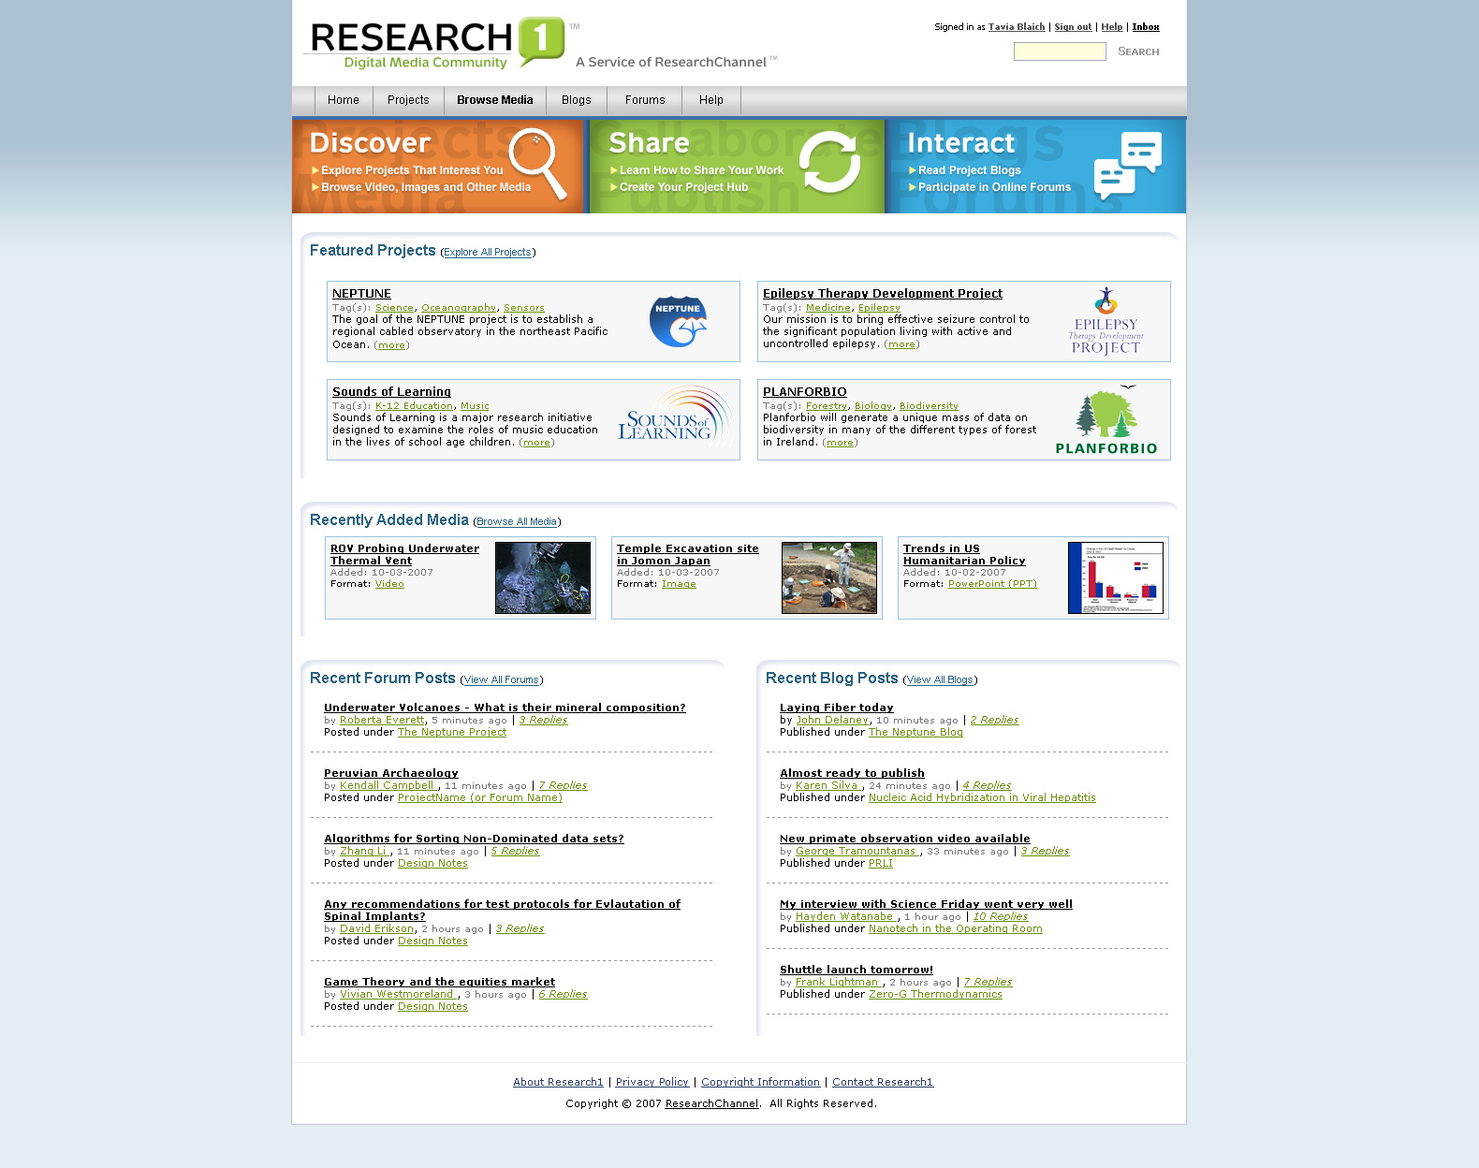

Slide 11
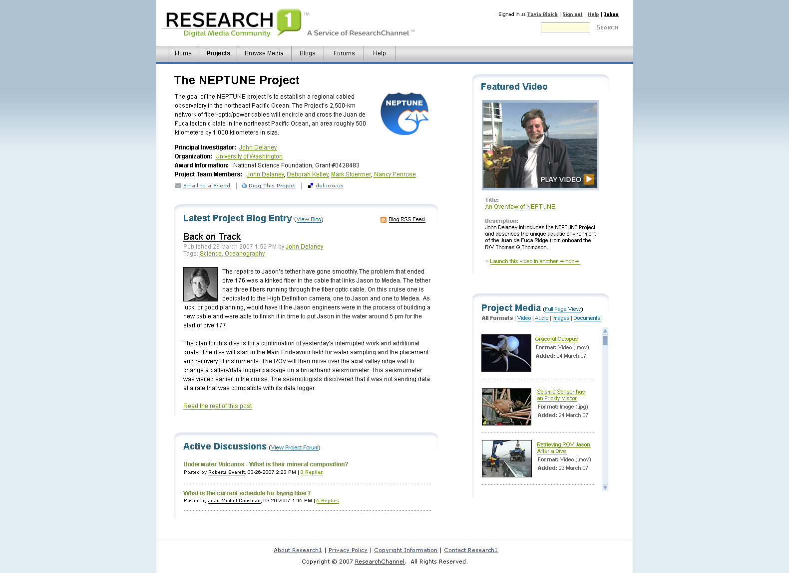
9
9

Slide 12
General Project Information
10
9

Slide 13
Project Blog Entry
12
9

Slide 14
Project Forums
14
9

Slide 15
Project Media Browser
13
9

Slide 16
Featured Media
11
9

Slide 17
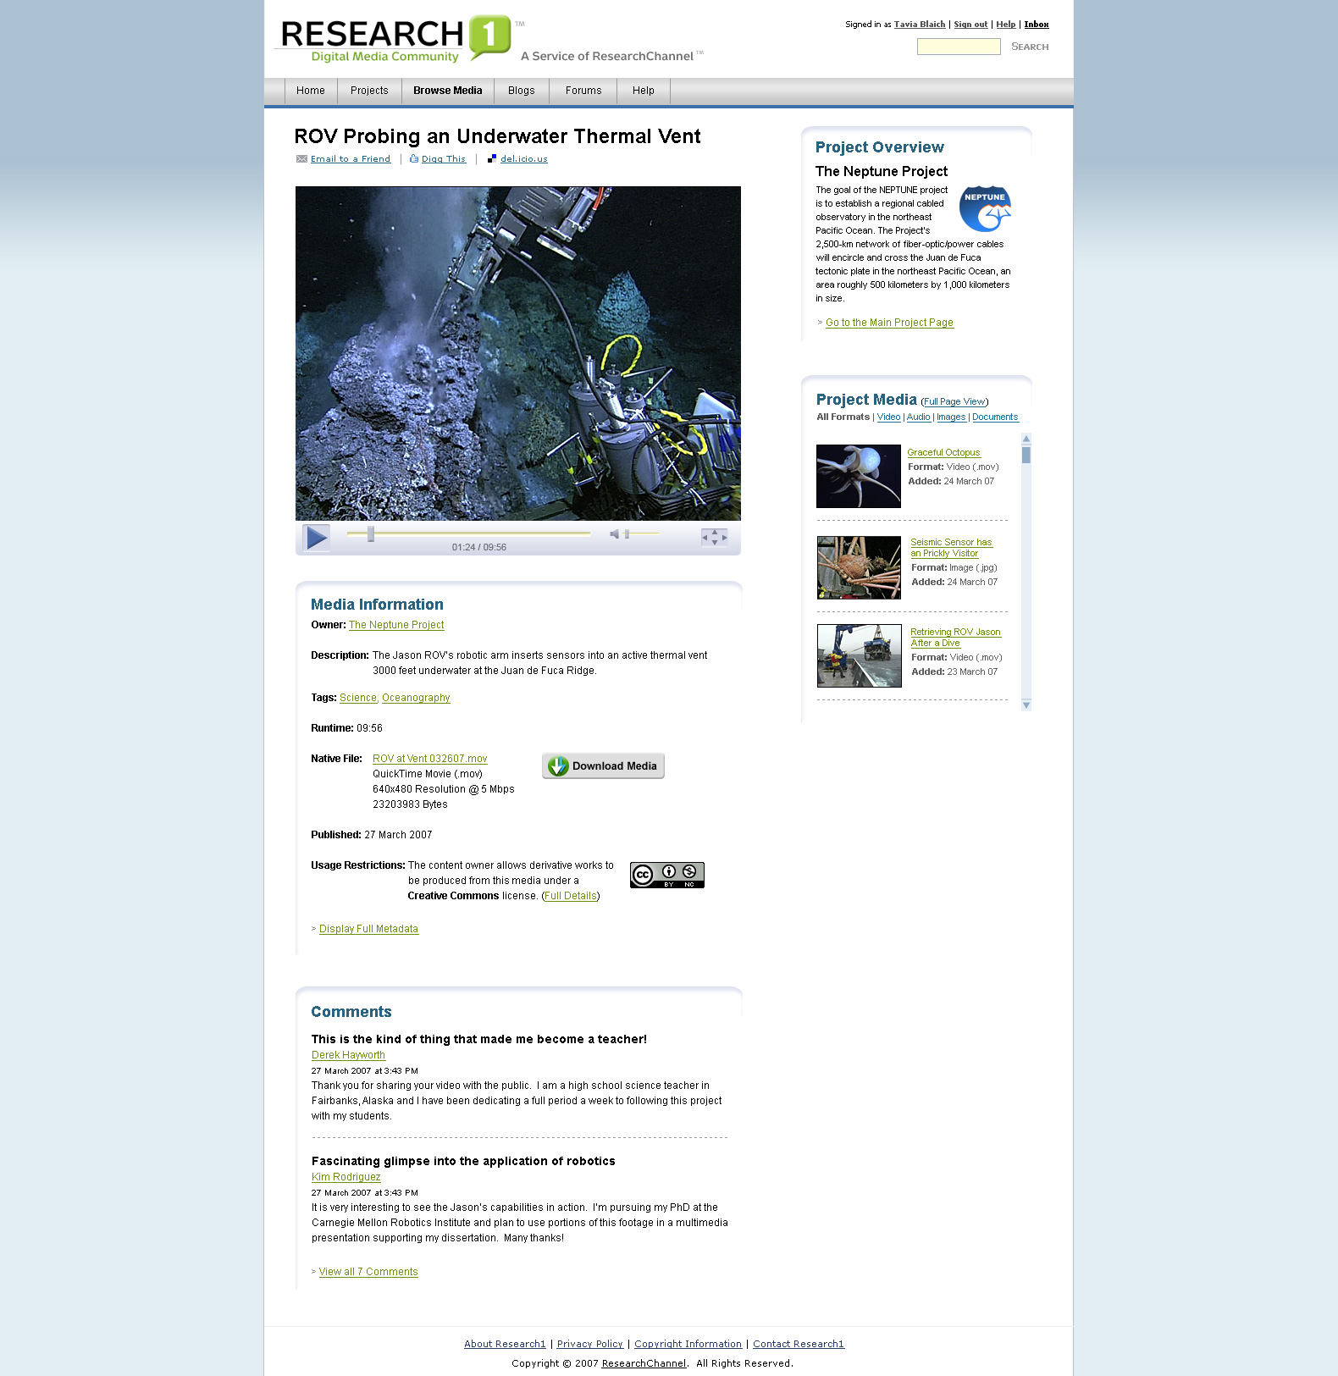
15
15

Slide 18
Media Viewer
16
15

Slide 19
Description/Metadata
17
15

Slide 20
Visitor Comments
18
15

Slide 21
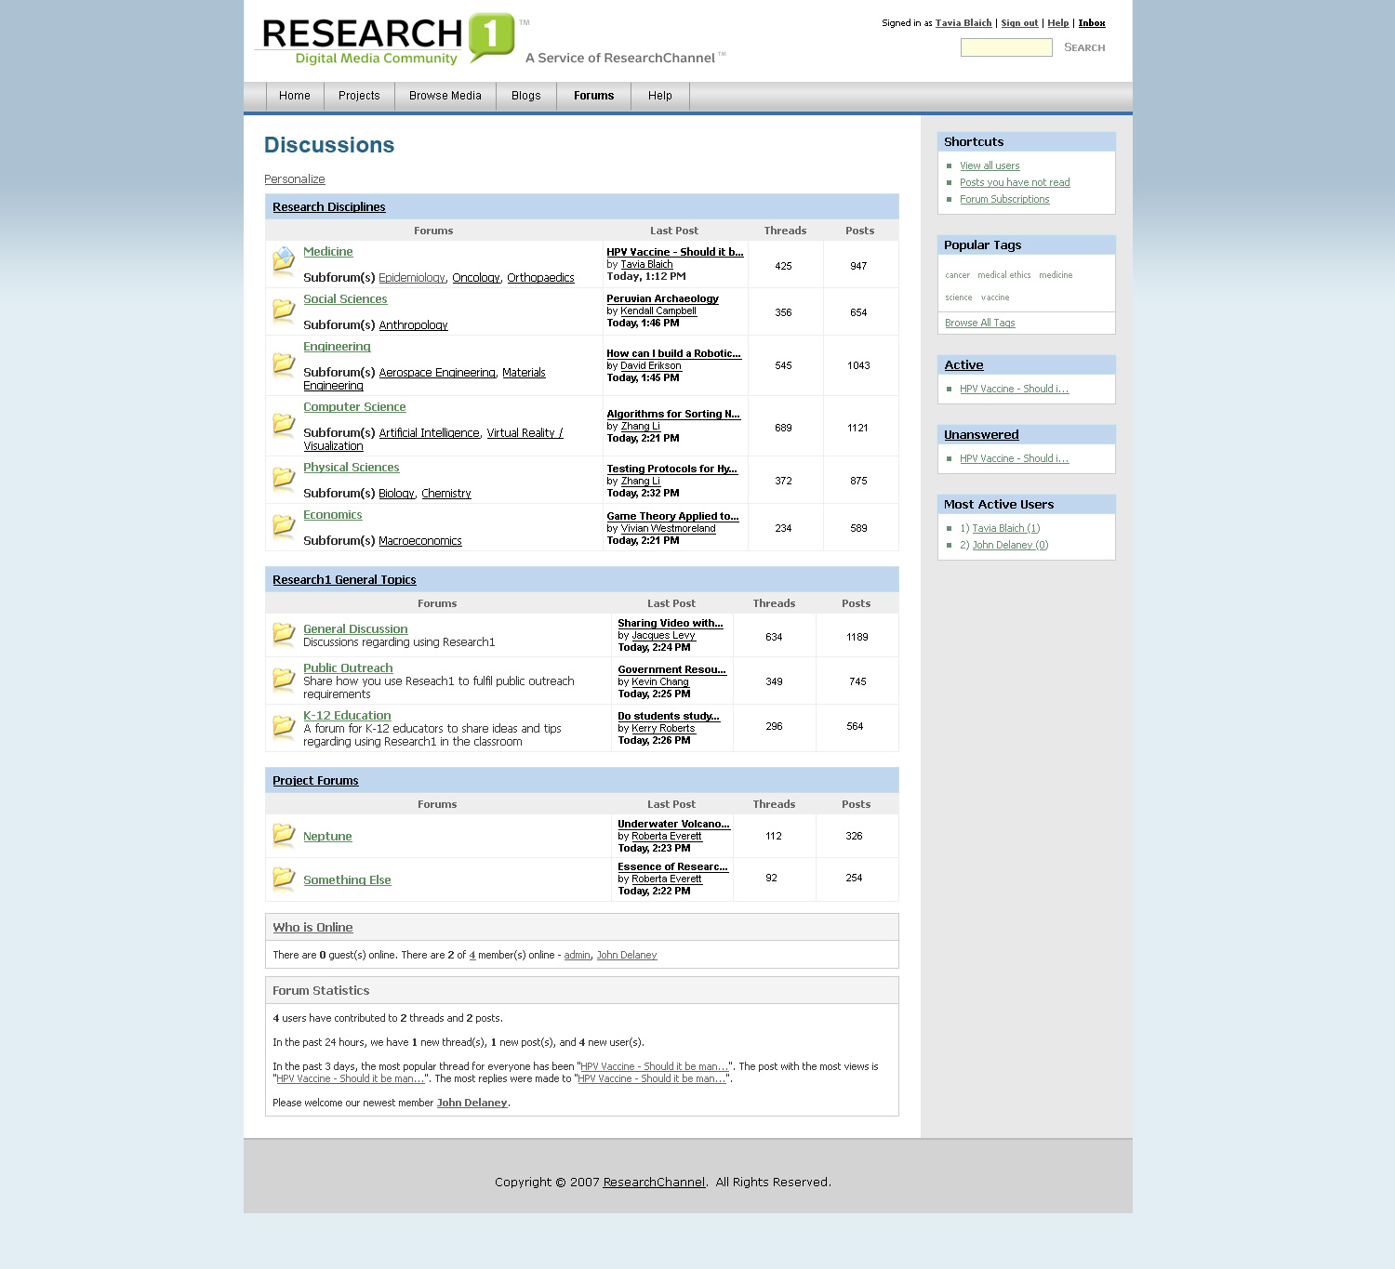
20
20

Slide 22
Subject-specific Forums
21
20

Slide 23
Project-specific Forums
22
20

Slide 24
Interested?
Sign up for the Research1 Beta Test
www.researchchannel.org/research1

