Slide 1
Hardware Lifecycle Management
Educause 2008
Presenter: Ronan Glynn

Slide 2
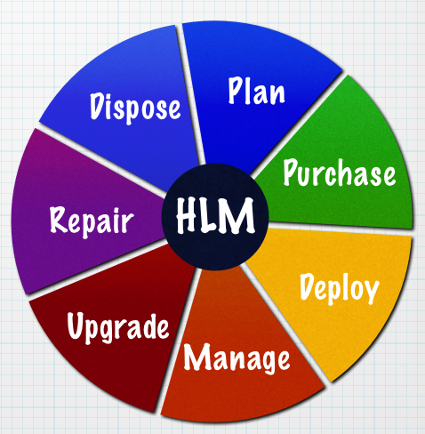
What is Hardware Lifecycle Management?
HLM is a procedural system of handling the life of hardware, from cradle to grave.
The goal of HLM is to maximize benefits while simultaneously reducing costs

Slide 3
HARDWARE ACQUISTION COSTS: JUST THE TIP OF THE ICEBERG!
Hardware Cost
Technical Support
Downtime
Maintenance
Risk
Industry Reputation
Data Loss
Performance issues

Slide 4
Industry Analysis Shows...
A study by leading analysts Gartner Group shows that almost 80% of IT costs occur after purchase!
What is TCO?
Total Cost of Ownership is a financial metric designed to illustrate the true cost of owning an asset, taking into account such intangibles as performance, downtime and risk.

Slide 5
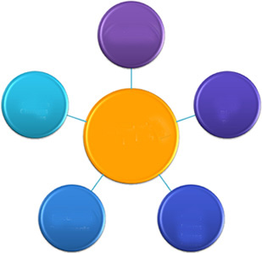
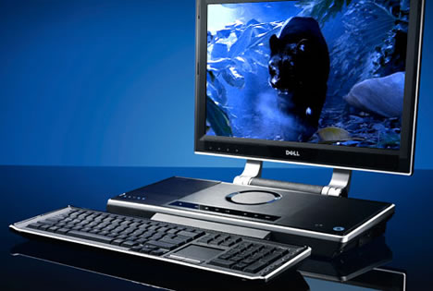
What kind of factors affect TCO?
End Users
Other Business Units
IT Services
New Technology
IT Vendors
External Partners

Slide 6
Recommended Practices to improve HLM
Standardize IT hardware
Implement Hardware Refresh Cycles
Reduce the number of Operating Systems
Manage centrally
Re-image systems on a scheduled basis
Limit the number of IT vendors
Utilize open industry-standard management tools
Eliminate inkjet printers

Slide 7
Real World HLM at MSKCC
Take thorough inventory
Integrate findings into database
Establish desired speed threshold
Talk to vendors & place order
Draw up project plans for rollout
Wipe old data and sell/donate old hardware

Slide 8
Real World HLM Cost Savings
TOTAL New PC Cost Yrs 1-4 $ | TOTAL old PC Cost Yrs 4-8 $
$1750 | $2300

